Slide 1
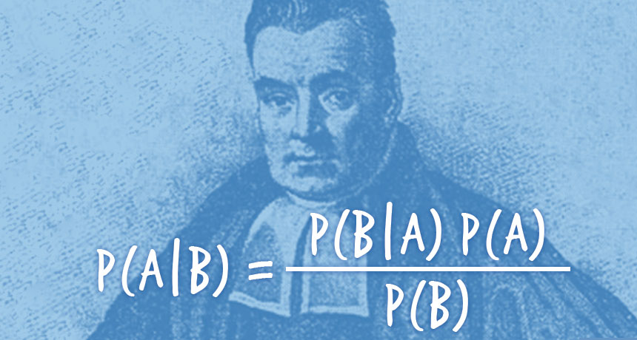
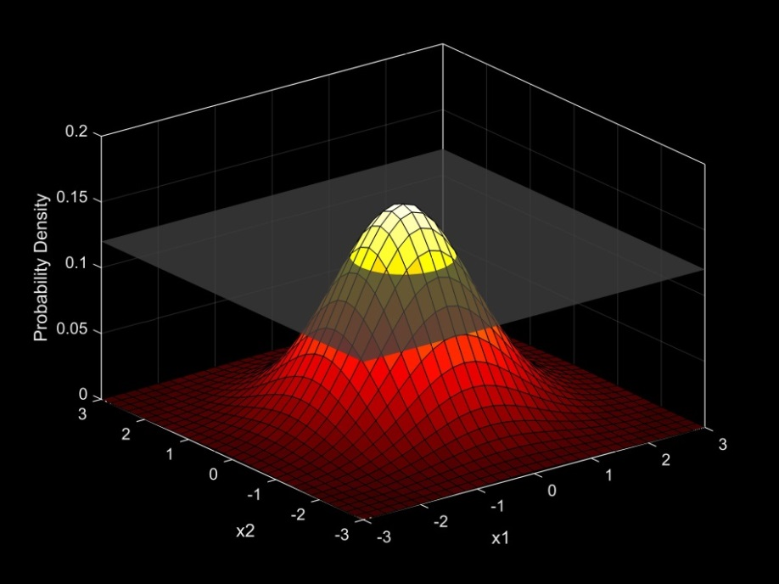
Introduction to Bayesian Analysis Part Deux
Many slides adapted from Matt Falcy ODFW, and SESYNC course by Chris Che-Castaldo, Mary B. Collins, N. Thompson Hobbs (with permission)

Slide 2

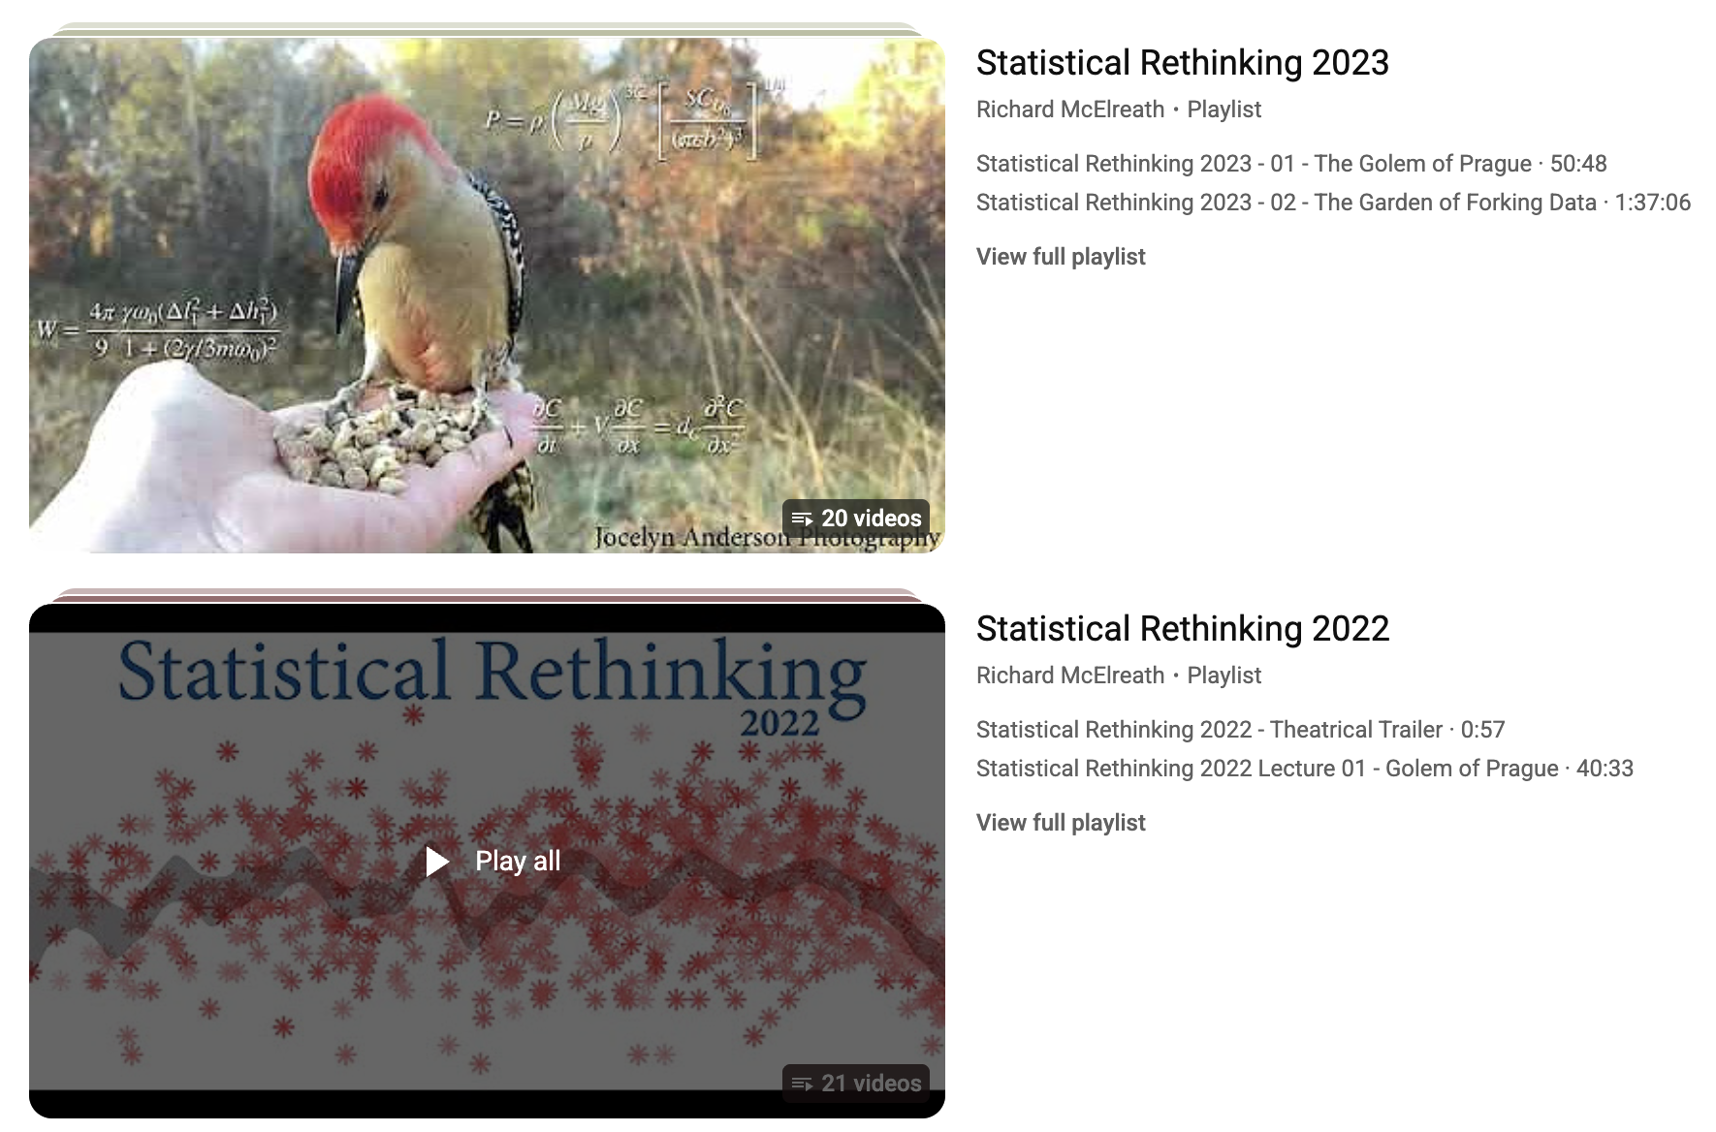
Where to go from here

Slide 3


Where to go from here
If you have strong quantitative skills and want to become a master
Covers a diverse array of topics

Slide 4






This course is just a jumping off point
Train yourself by reading books.
Consider pursuing side project using methods you want to learn
Consider attending weekly math/stats seminars

Slide 6
Unlike with lm() and glm()
this easily extends to nonlinear functional forms
(e.g. Spawner-Recruit Lab)

Slide 7
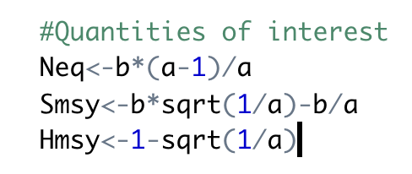
Spawner-Recruit
Another Example with Derived Quantities
Spawner-recruit problem. We want to estimate
  equilibrium number of spawners without harvest, Neq
  Spawners that maximize sustained yield
  The MSY harvest
Beverton-Holt Model
R = (a*S)/(1+a/b*S)
Hmsy
Smsy
Neq
How would you estimate these with uncertainty in frequentist framework?

Slide 8
Ant Species Richness:
Beware of Vague Priors with Link Functions

Slide 9
Lizard Occurrence on Islands

Slide 10
Hierarchical models are very natural in a Bayesian framework

Slide 11
#offspring per pair of owls
Model offspring counts with Poisson, but each individual’s rate parameter drawn from a Gamma distribution.
Not just variance in counts, but variance within owl pair and among owl pairs!
Gamma is the conjugate prior and flexible/non-negative. Good choice here
These are called hyperpriors.

Slide 12
This model is hierarchical.
Individual fecundity comes from data from that individual and is informed by entire population
Every individual has one of these
But they arise from a common distribution
Gamma is the conjugate prior and flexible/non-negative. Good choice here
These are called hyperpriors.

Slide 13
HIERARCHICAL OR MULTILEVEL MODELING
Soil nitrous-oxide emissions are measured at multiple sites across the world. Each site has multiple measurements of (nitrogen input, emission). Different sites have wildly different soil organic carbon, climate, and microbial communities — so we expect site-level structure.
Build complexity incrementally!
We will fit no pooling, complete pooling, andrandom intercept model, before adding more complexity

Slide 14
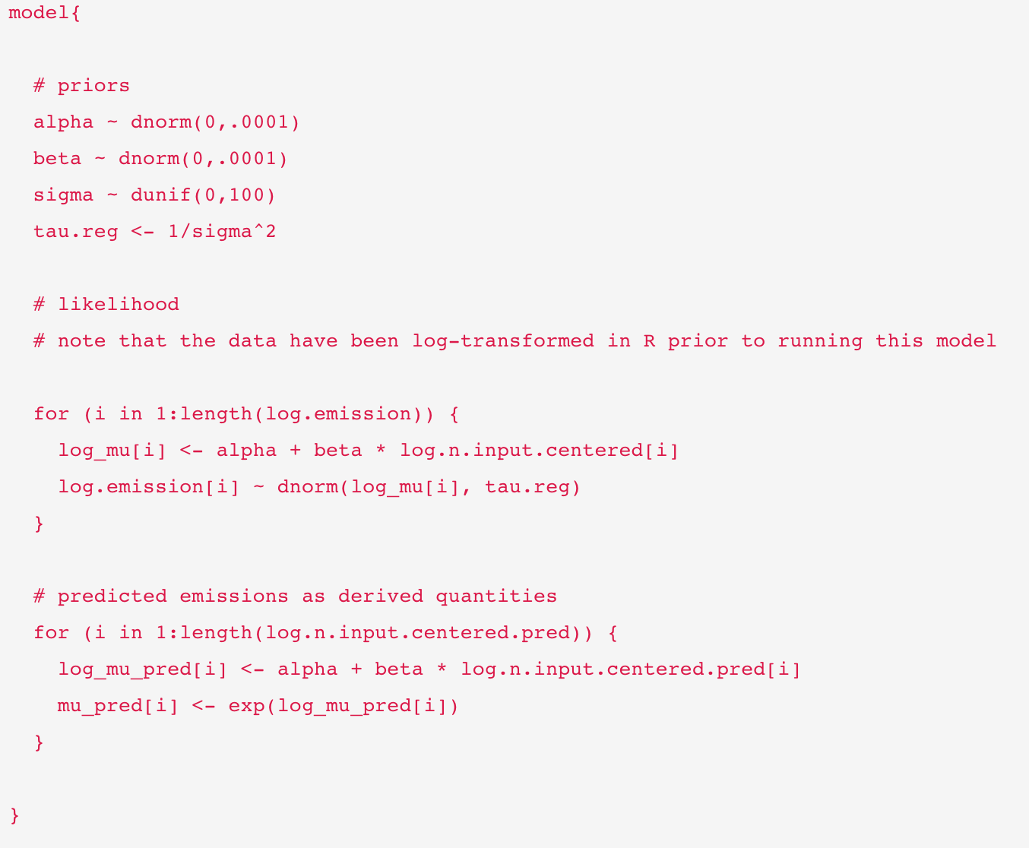
Complete pooling
Only one alpha and beta
Iterate likelihood over the data
Only one alpha and beta

Slide 15
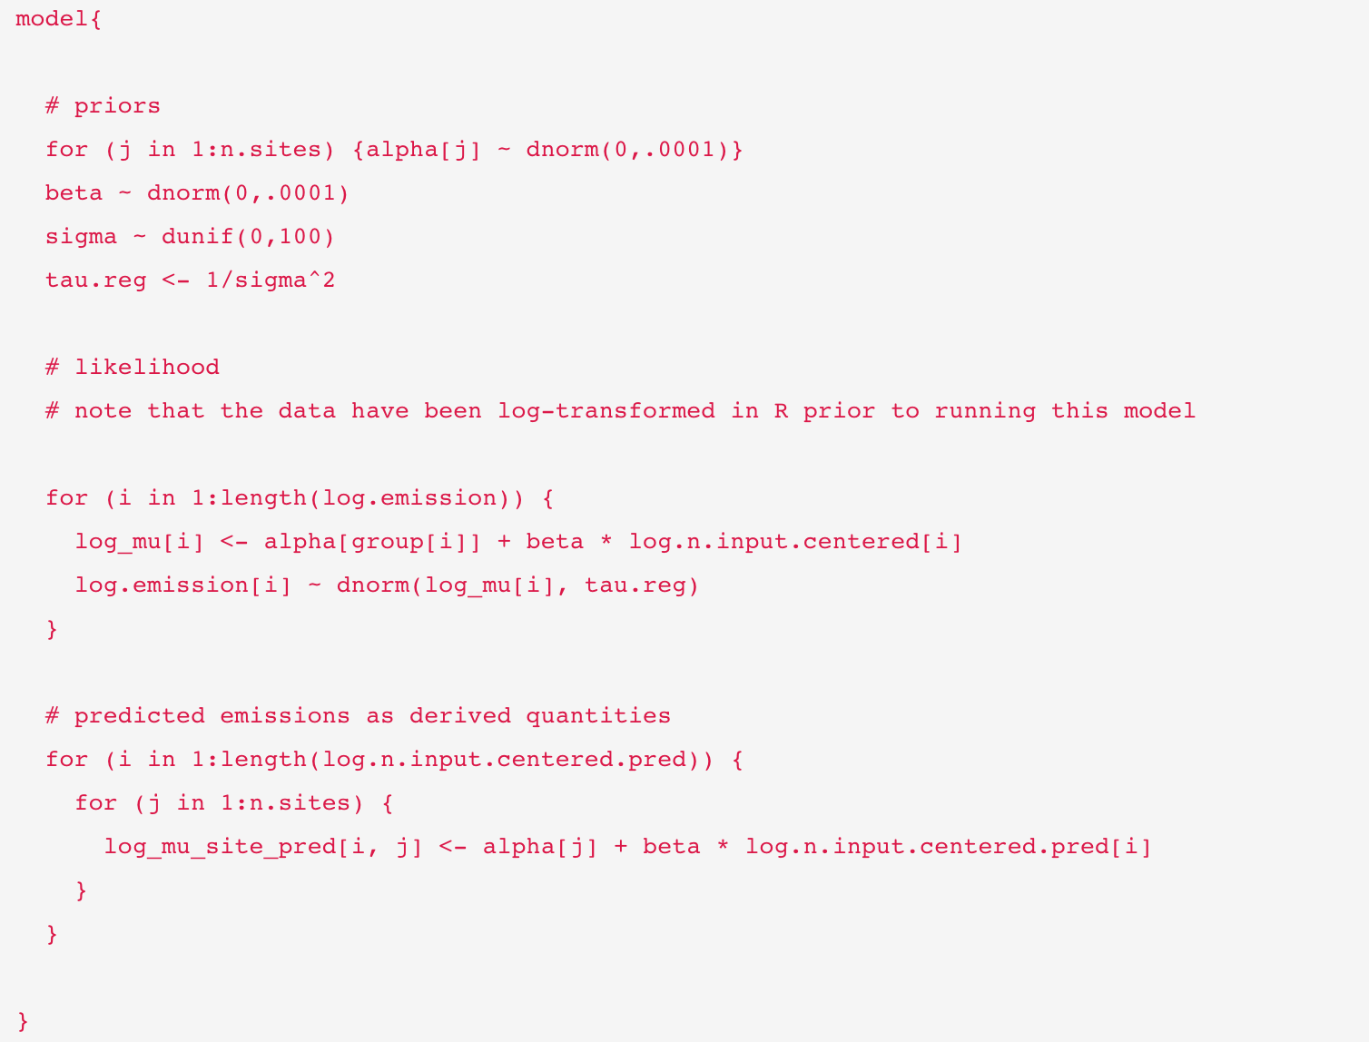
No pooling
Every site gets its own alpha
Every site gets its own alpha
“group” was passed as data

Slide 16
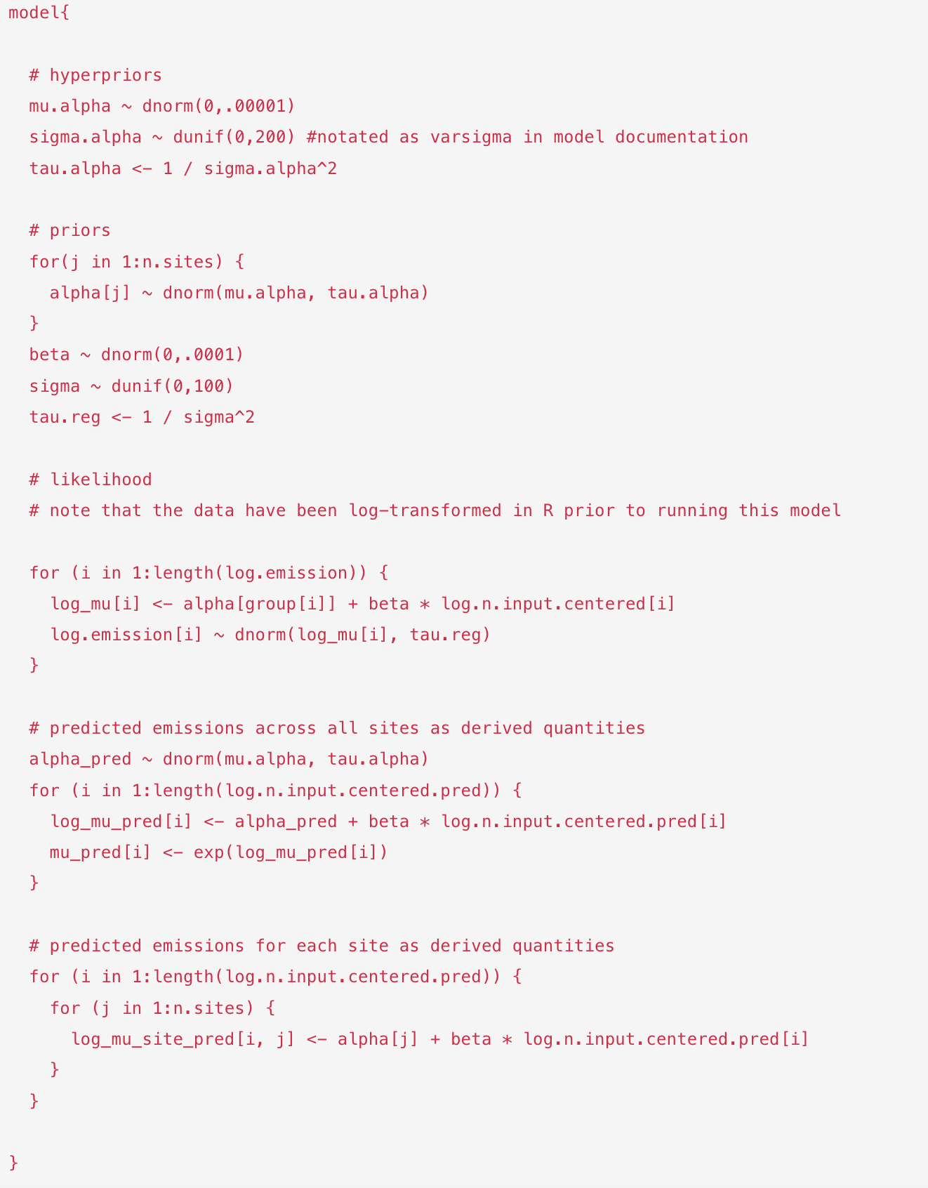
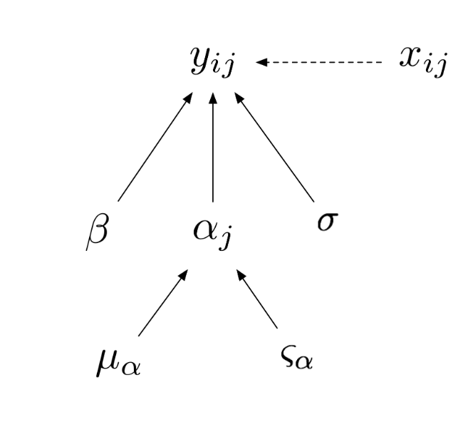
Random intercept
Partial pooling
Alpha varies by site but within shared distribution

Slide 17
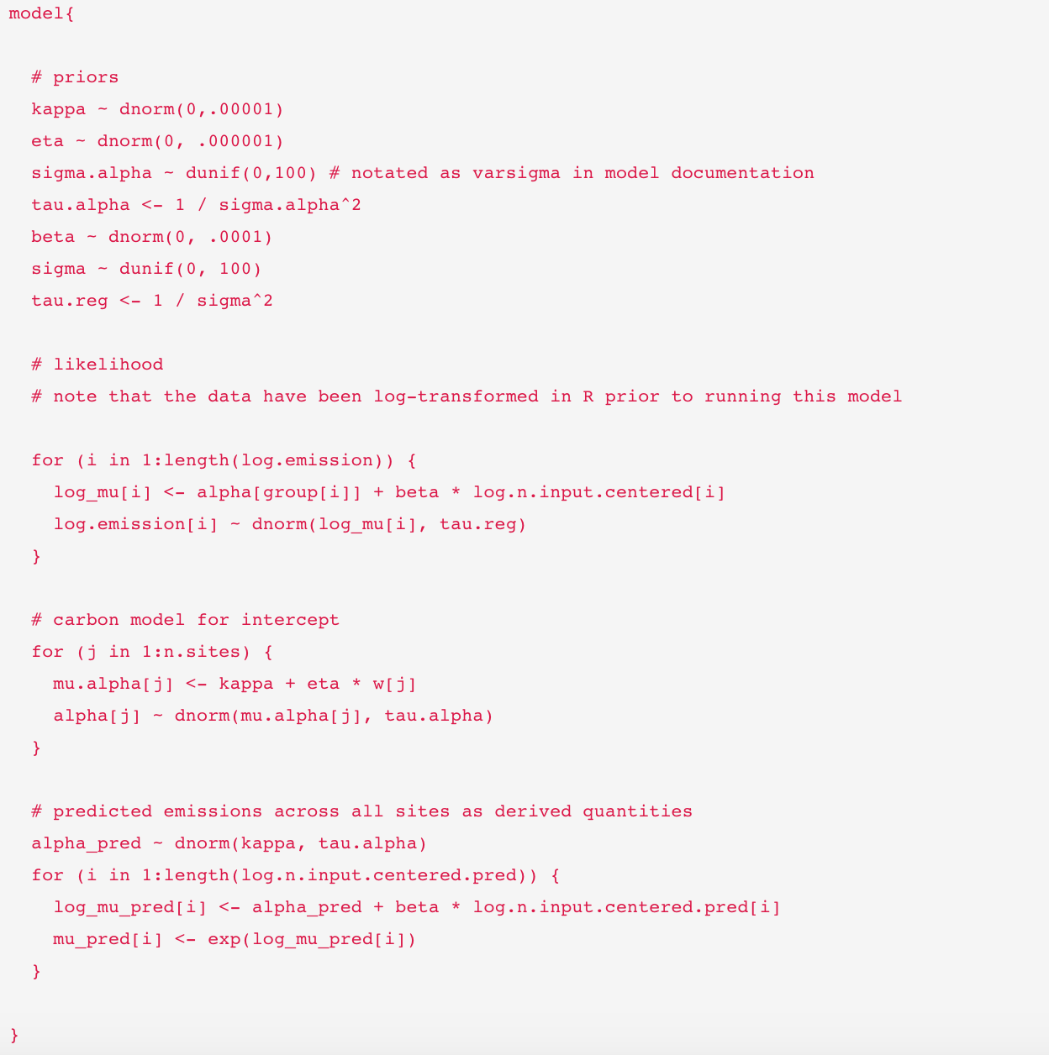
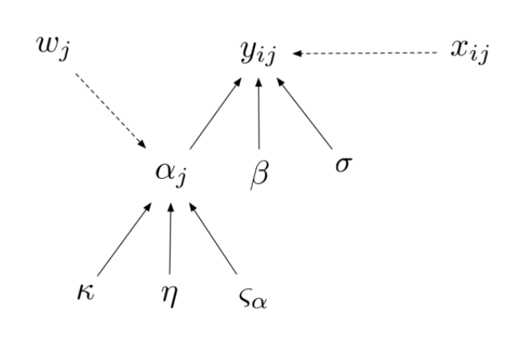
Random intercept
Partial pooling, but also attempt to EXPLAIN site-level differences
In the previous example, we assumed that the variation in the intercept was attributable to spatial variation among sites. We did not try to explain that variation, we simply acknowledged that it exists. Now we are going to “model a parameter” using soil carbon content data at the site-level to explain variation in the intercepts among sites.
Flexibility! Intercepts can depend on soil carbon
Every site gets its own alpha
Alpha varies by site but within shared distribution

Slide 18
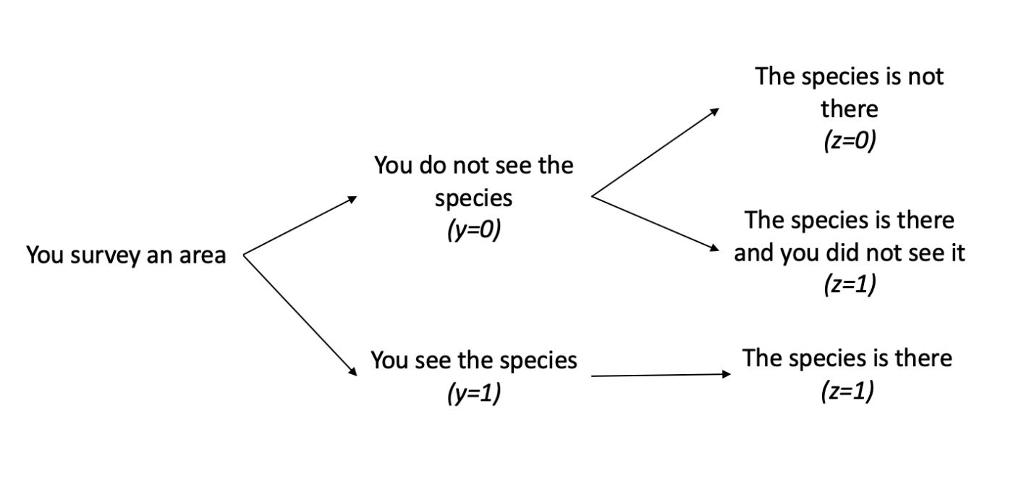
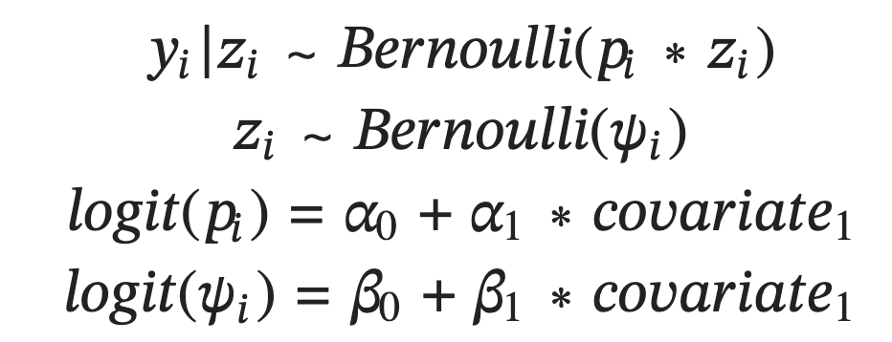
Latent Variable Modeling I - Occupancy
“Latent variable” inferred rather than observed
What should the priors be?

Slide 19
An implied Uniform(0,1) prior for ψ is a Logistic distribution prior for intercept centered at 0 with scale parameter 1
Logistic(μ = 0, σ = 1)

Slide 20
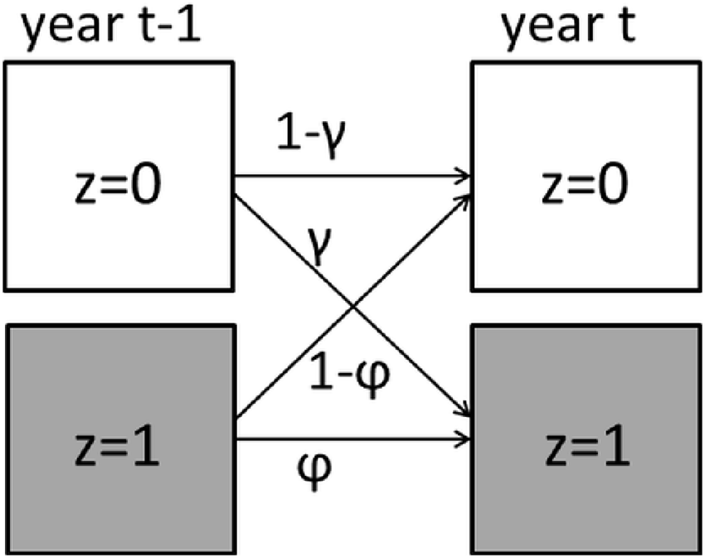
DYNAMIC OCCUPANCY MODELING
Occupancy with a time series. Model colonization and extinction

Slide 21
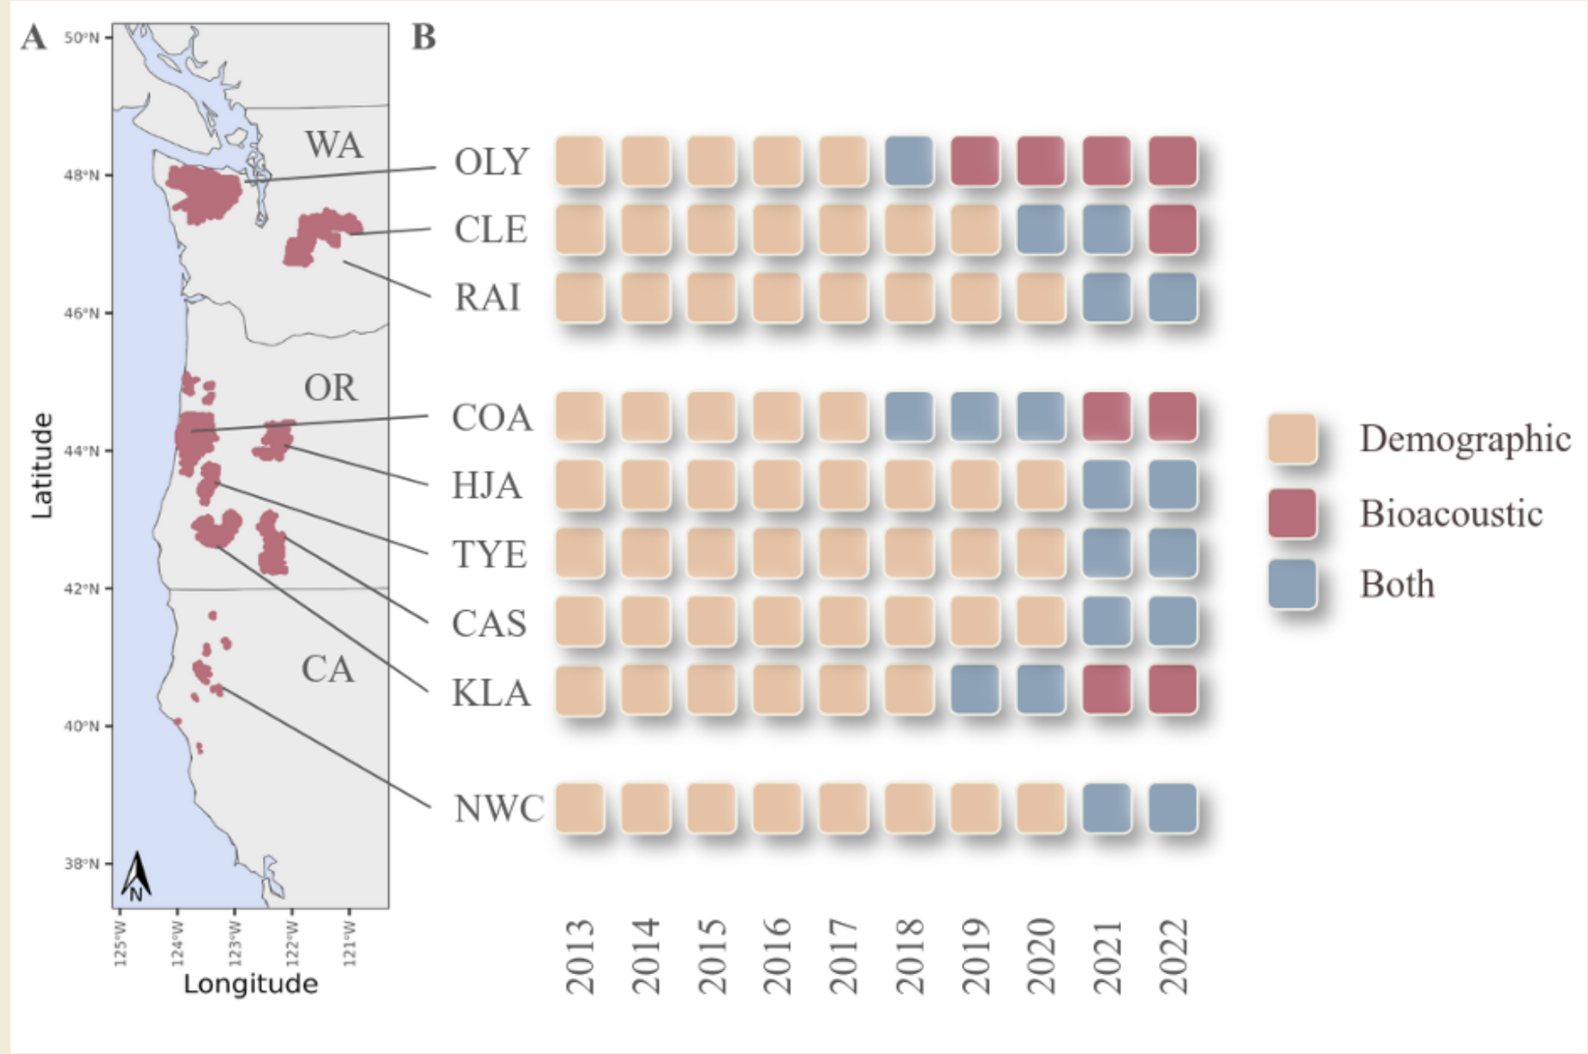
Spotted Owl, Integrated, Multistate, Dynamic Occupancy

Slide 22
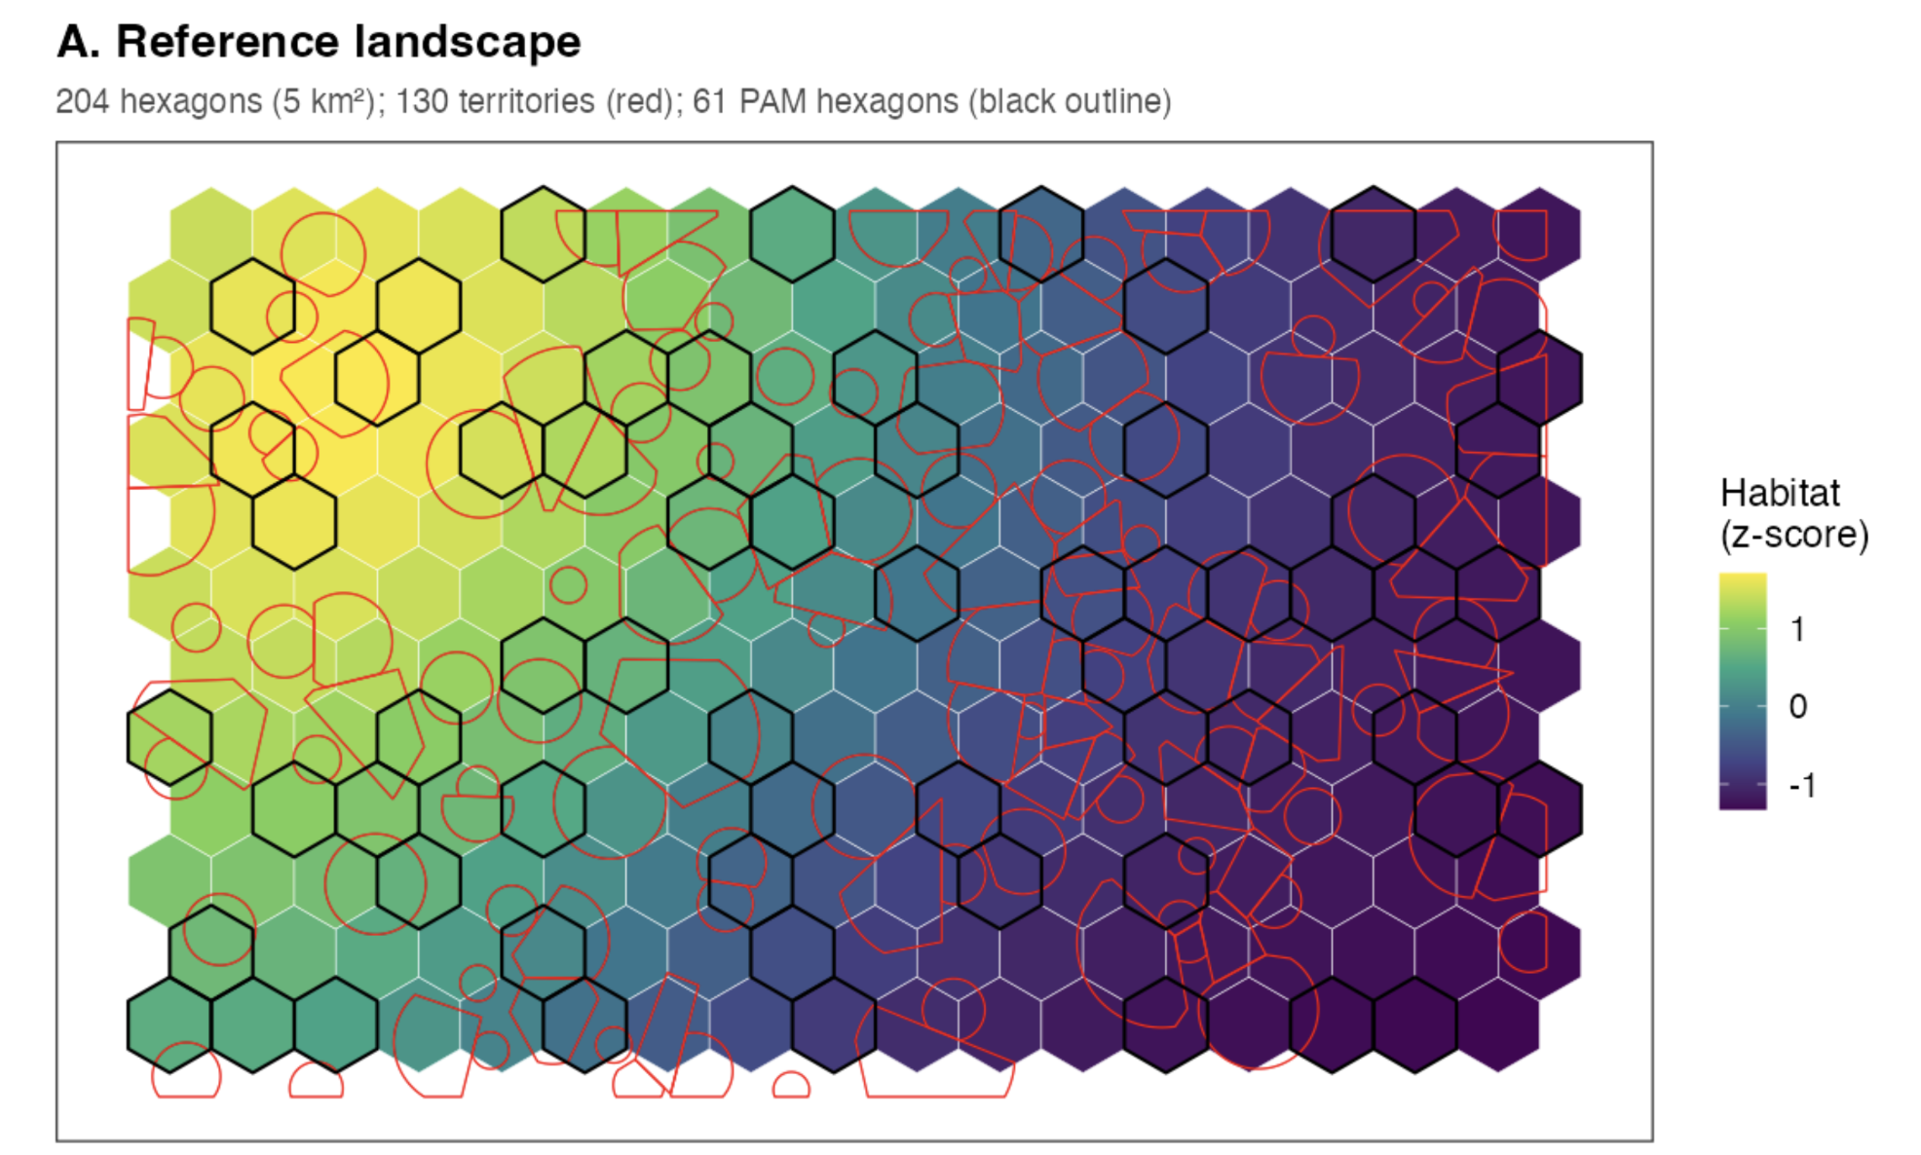

Slide 23
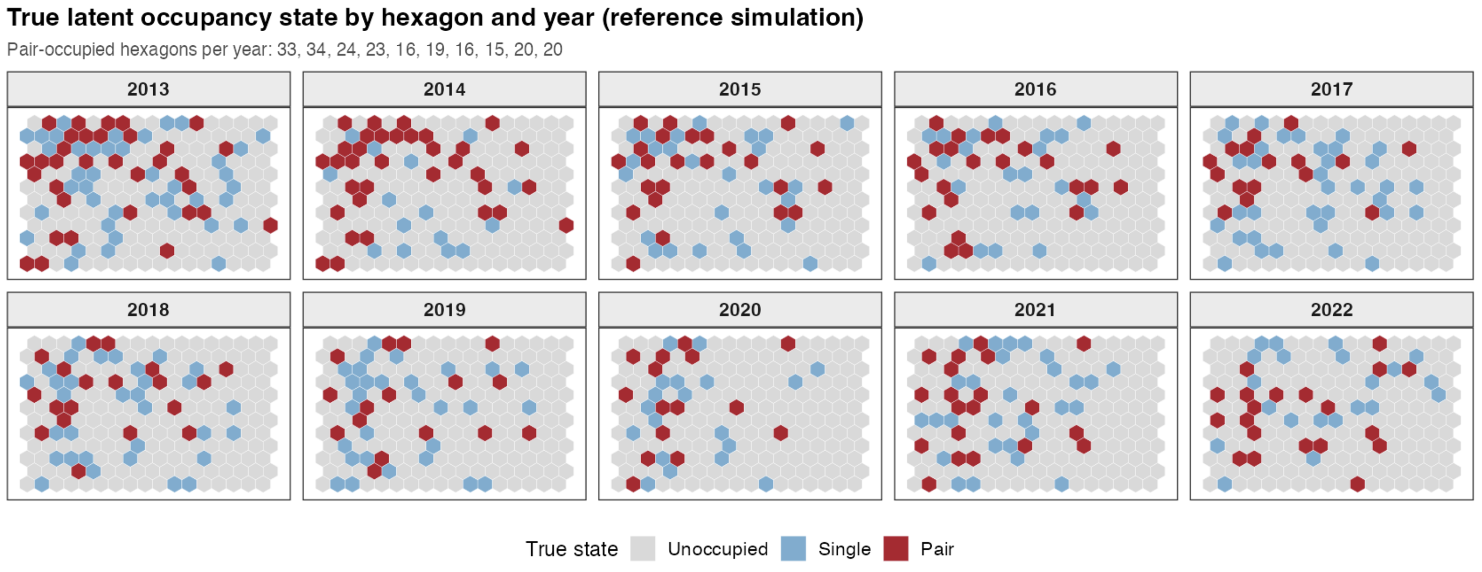

Slide 24
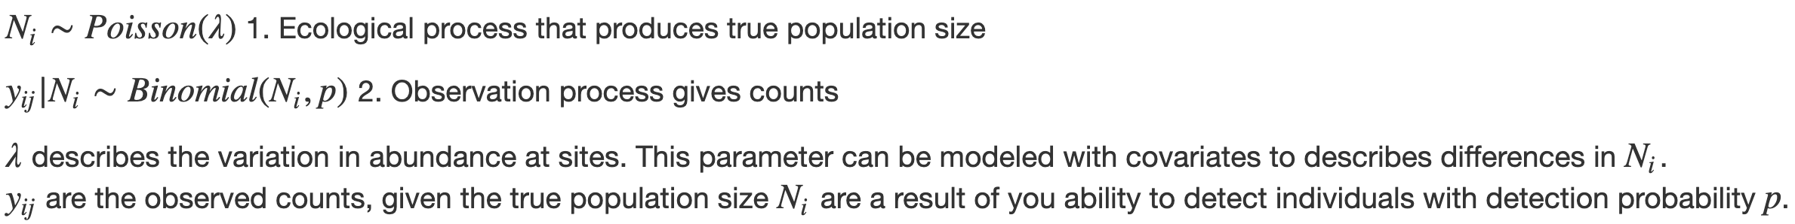
N-mixture Models
Separating Process and Observation Error
Imperfect detection is also a problem when estimating abundance
N-mixture models can account for imperfect detection of individuals within a species

