Slide 1
LearnTrack CLP
Corporate Learning Progress, Intervention & Compliance Tracking System SME Demo & Training Overview
Architecture Proposal for Project Owners
Batch 24 Team#4 · Persistent Systems Limited · 7 June 2026
Production Architecture v2.0 · Validated by Live POC

Slide 2
Purpose of This Presentation
What we are asking project owners to take away
Understand the full production architecture — not just the demo
See how the POC de-risks the hardest technical and compliance paths
Confirm the phased 20-week delivery approach is credible
Align on scope, boundaries, and what 'done' looks like at GA
Architect's recommendation: Proceed to Phase 1. The POC has proven the core domain model, event pipeline, and compliance gates. Remaining work is platform hardening — not unknown R&D.
LearnTrack is an intelligence layer on top of existing LMS/HRIS systems — not a replacement LMS.

Slide 3
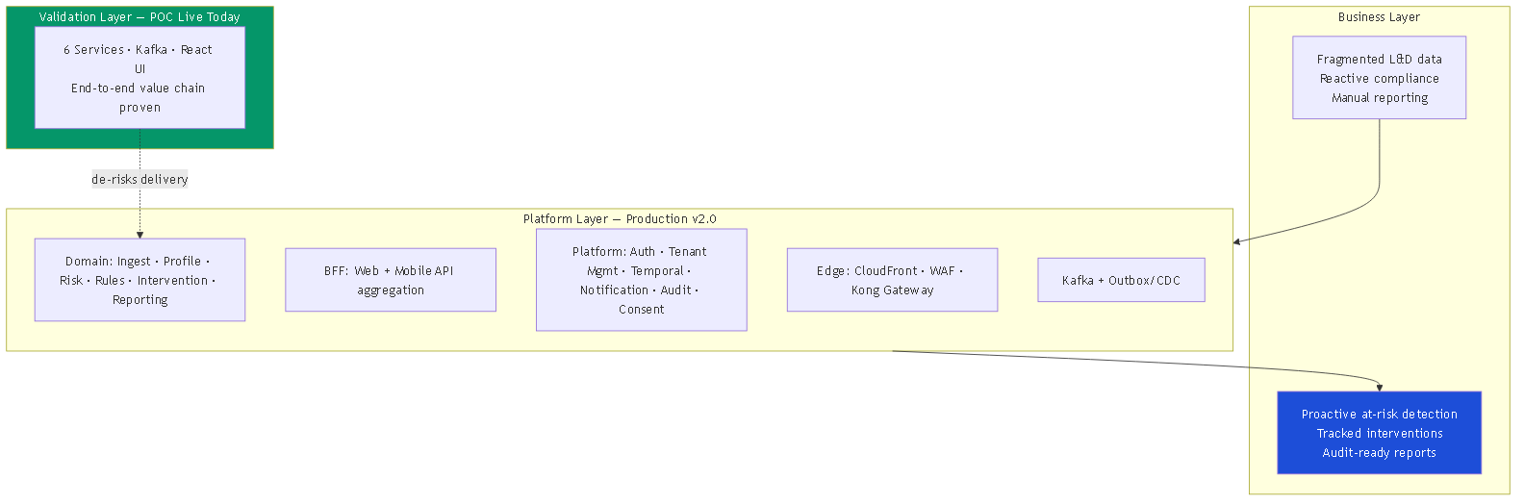
Executive Summary — Problem, Platform, Proof
One view of why we are building this and why we can deliver it
POC validates the domain path; production adds platform services, gateway, Temporal, and regional deployment.

Slide 4
Part I
Business Context & Outcomes

Slide 5
The Business Problem
Why organisations need this platform
Learning data is scattered across LMS, assessments, and spreadsheets
At-risk employees are found only after compliance failure — 4–6 weeks too late
Interventions are ad hoc with no measurable outcomes
Compliance reports are assembled manually with no audit trail
No consent management for automated profiling (GDPR, CCPA, DPDP, PIPEDA)
Right-to-erasure requests handled manually across siloed systems
Regulated industries cannot prove due diligence on training compliance
L&D teams lack a single actionable view of employee learning health
LearnTrack CLP closes this gap with proactive detection, tracked interventions, and audit-ready reporting.

Slide 6
What We Are Building
Clear scope boundary for project owners
LearnTrack IS | LearnTrack IS NOT
Aggregation & analytics layer on LMS/HRIS data | A full corporate LMS or course authoring tool
Configurable at-risk detection & intervention workflow | A generic HRIS or payroll system
Multi-tenant SaaS with compliance controls built in | A one-off reporting dashboard
Event-driven microservices on AWS (cloud-portable) | A monolithic on-premise application

Slide 7
Target Outcomes
Success metrics that drive architectural decisions
Outcome | Target | Architecture driver
Early at-risk detection | 4–6 weeks before failure | Event pipeline + rule engine
Intervention effectiveness | 70% measurable improvement | Temporal workflow + outcome tracking
Tenant onboarding | < 5 minutes | Temporal provisioning saga
Platform availability | 99.5–99.9% by tier | Multi-AZ EKS, Istio, DLQ alerts
Right-to-erasure | < 72 hrs target | Cross-service Temporal erasure saga
Accessibility at GA | WCAG 2.1 AA | Design system + ARIA from day one

Slide 8
Part II
Production Architecture — The Full Picture

Slide 9
Architectural Principles
Non-negotiable decisions locked for v2.0
1
Microservices with strict data ownership
Each service owns one database. No cross-DB reads.
2
Event-driven domain communication
Kafka for domain fan-out; REST only for cache-backed lookups.
3
Transactional outbox + CDC
Exactly-once event delivery via Debezium — no direct Kafka publish.
4
Temporal for multi-step sagas
Provisioning, interventions, erasure — durable with compensation.
5
Compliance by design
Human-review gate, consent, opt-out, erasure — not bolted on later.
6
Multi-tenant isolation by plan tier
RLS → schema-per-tenant → dedicated DB as customers scale.

Slide 10
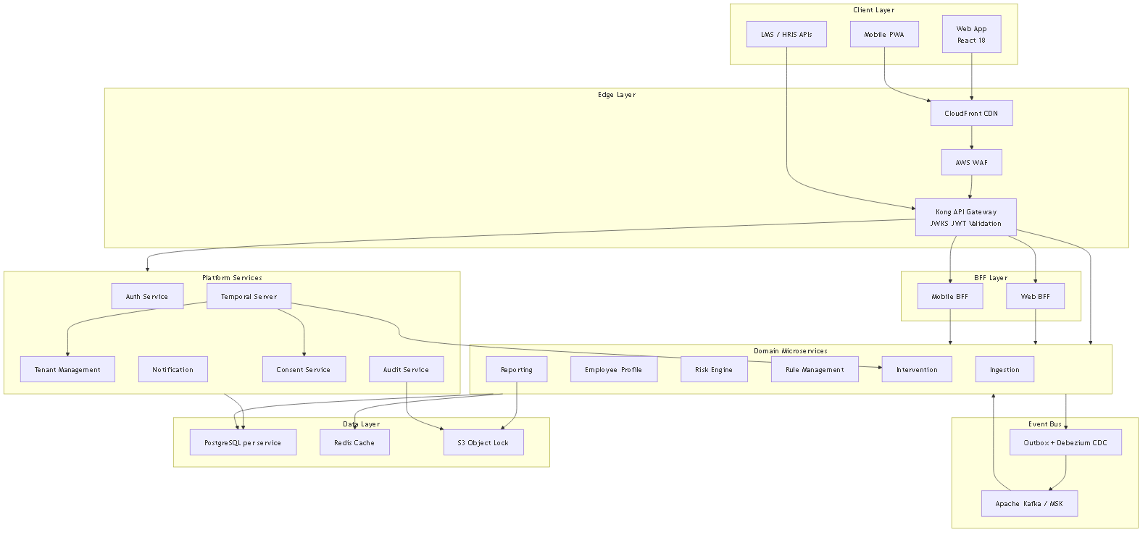
Production Architecture — Layered View
11 microservices organised across edge, platform, domain, messaging, and data layers
Every box maps to an independently deployable service with its own database schema or instance.

Slide 11
Service Landscape
Three tiers — what each service owns
Tier | Services | Purpose
Edge & BFF | CloudFront · WAF · Kong · Web/Mobile BFF | Security, routing, aggregated APIs
Platform | Auth · Tenant Mgmt · Notification · Audit · Consent · Temporal | Shared cross-tenant capabilities
Domain | Ingestion · Profile · Risk · Rules · Intervention · Reporting | Core L&D business logic
Domain tier detail:
Service | Owns | Database
Ingestion | Raw staging only — idempotent REST/CSV ingest | ingestion-db
Employee Profile | Curated learning profiles built from events | profile-db
Risk Engine | At-risk classification + human-review gate | risk-db
Rule Management | Rule CRUD, versioning, test sandbox | rules-db
Intervention | Lifecycle workflow, sessions, outcomes | intervention-db
Reporting | CDC-fed read model, compliance exports | reporting-db
Consent | Per-purpose consent, opt-out, erasure trigger | consent-db

Slide 12
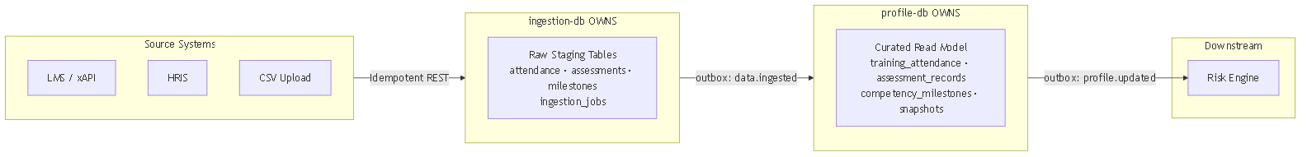
Data Architecture — Ownership Boundary
The most important rule in the system: who owns what data
Ingestion owns RAW staging only
Profile owns CURATED read model
Neither reads the other's database
All cross-service flow via Kafka
Reporting built from CDC — no dual-write

Slide 13
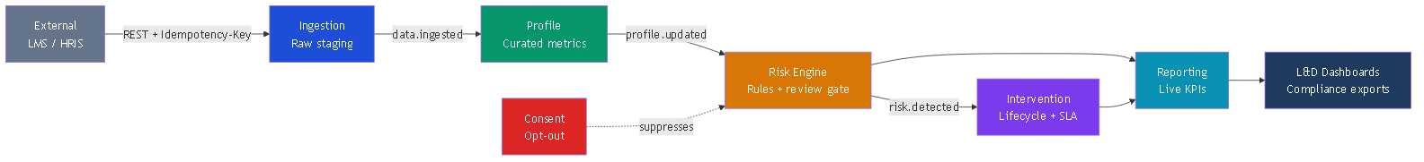
Business Value Chain
How data flows from external systems to actionable L&D insights
Every arrow is a Kafka event with tenant_id — the same chain the POC runs end-to-end today.

Slide 14
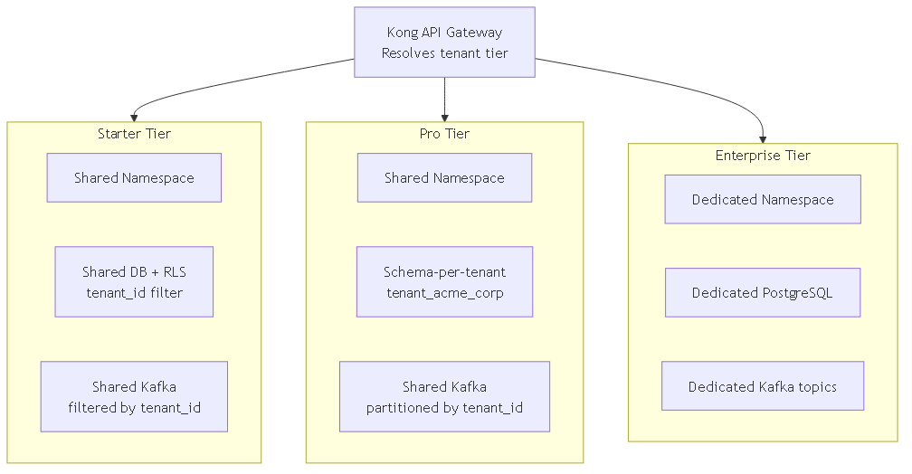
Multi-Tenant Isolation
Isolation depth scales with subscription tier — Starter, Pro, Enterprise

Slide 15
Event-Driven Communication
When we use async events vs synchronous REST
Interaction | Mechanism | Why
Ingestion → Profile → Risk → Intervention | Kafka events | Loose coupling, fan-out, auditability
Risk Engine → Rule Management | REST (Redis-cached) | Low-latency rule lookup
All services → Tenant context | Redis / TMS REST | Plan limits, feature flags, schema routing
Client → Platform | HTTPS via Kong Gateway | JWT validation, rate limiting
Service-to-service | mTLS via Istio mesh | Zero-trust internal network

Slide 16
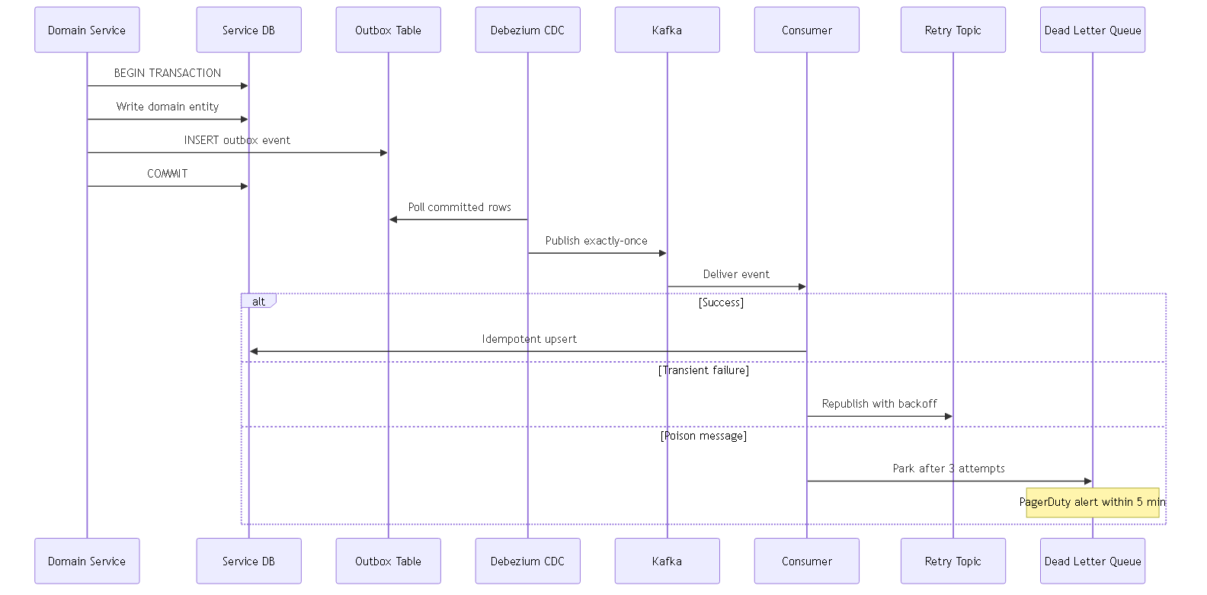
Reliable Event Delivery
Transactional outbox + Debezium CDC + dead-letter queues
DLQ depth > 0 triggers PagerDuty within 5 minutes — no silent message loss.

Slide 17
Workflow Orchestration — Temporal Sagas
Durable multi-step processes with automatic compensation
Workflow | Steps | POC today
Tenant provisioning | Validate → DB → migrations → seed rules → admin user → welcome | Designed — not in POC
Intervention lifecycle | Recommend → approve → sessions → complete → evaluate → SLA timer | In-service state machine (proven)
Right-to-erasure | Anonymise across 6 services → audit → signed certificate | Designed — not in POC
Plan upgrade | Dedicated DB → migrate → validate → switch → billing | Designed — not in POC

Slide 18
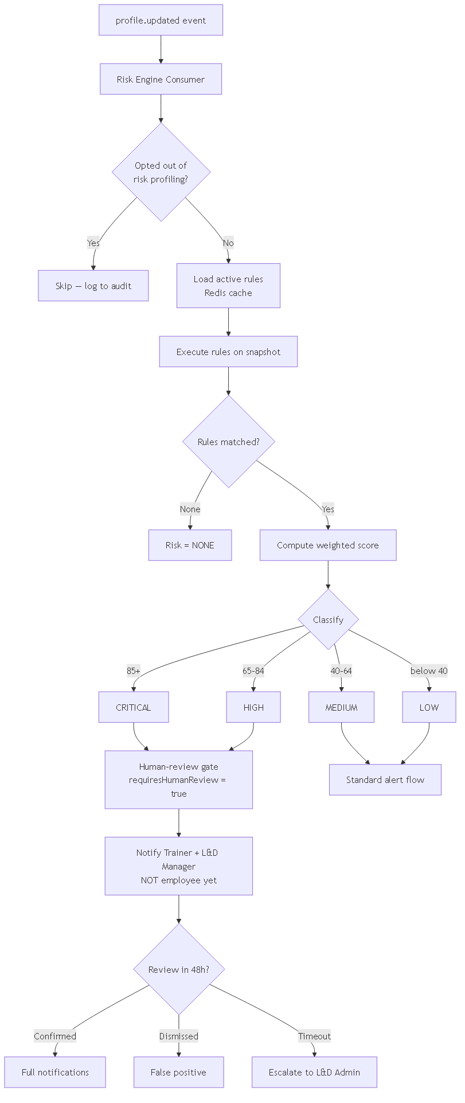
Risk Detection & Human-Review Gate
Automated profiling with mandatory human oversight — GDPR Art. 22
CRITICAL/HIGH assessments require Trainer or L&D Manager review before employee notification.

Slide 19
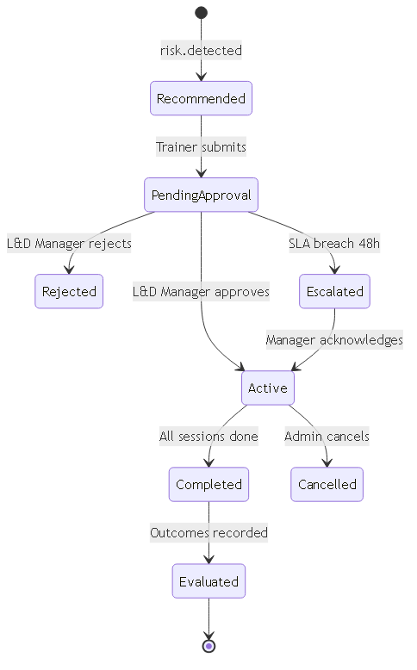
Intervention Lifecycle
From auto-recommendation to measured outcome
48-hour approval SLA enforced by Temporal timer in production; @Scheduled timer in POC.

Slide 20
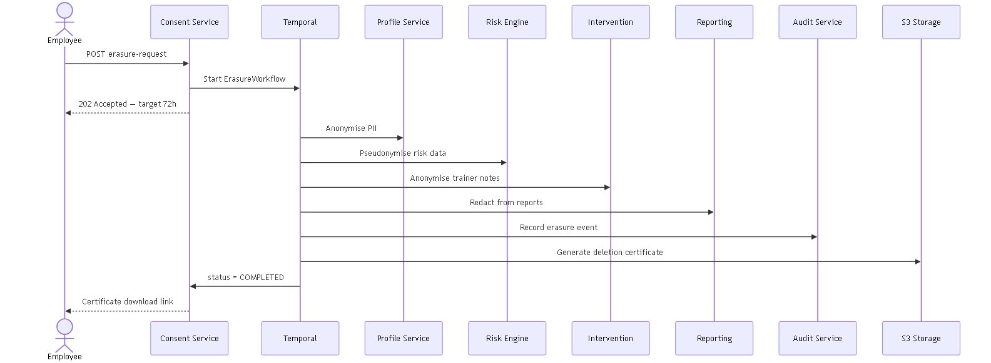
Right-to-Erasure Saga
Cross-service PII anonymisation — target completion 72 hours
Audit log retained but de-linked. Signed deletion certificate issued to employee.

Slide 21
Security & Compliance Architecture
Defence in depth across four target regions
Security layer | Control
Edge | WAF · CloudFront · TLS 1.3
Gateway | JWKS-local JWT · rate limits
Mesh | Istio mTLS · circuit breakers
Data | Vault DEK + AWS KMS envelope encryption
Audit | Hash-chained log · S3 Object Lock
Region | Regulation | Data residency
EU/UK | GDPR · EAA | eu-west-1 only
India | DPDP Act 2023 | ap-south-1 only
United States | SOC 2 · CCPA | us-east-1
Canada | PIPEDA · Law 25 | ca-central-1

Slide 22
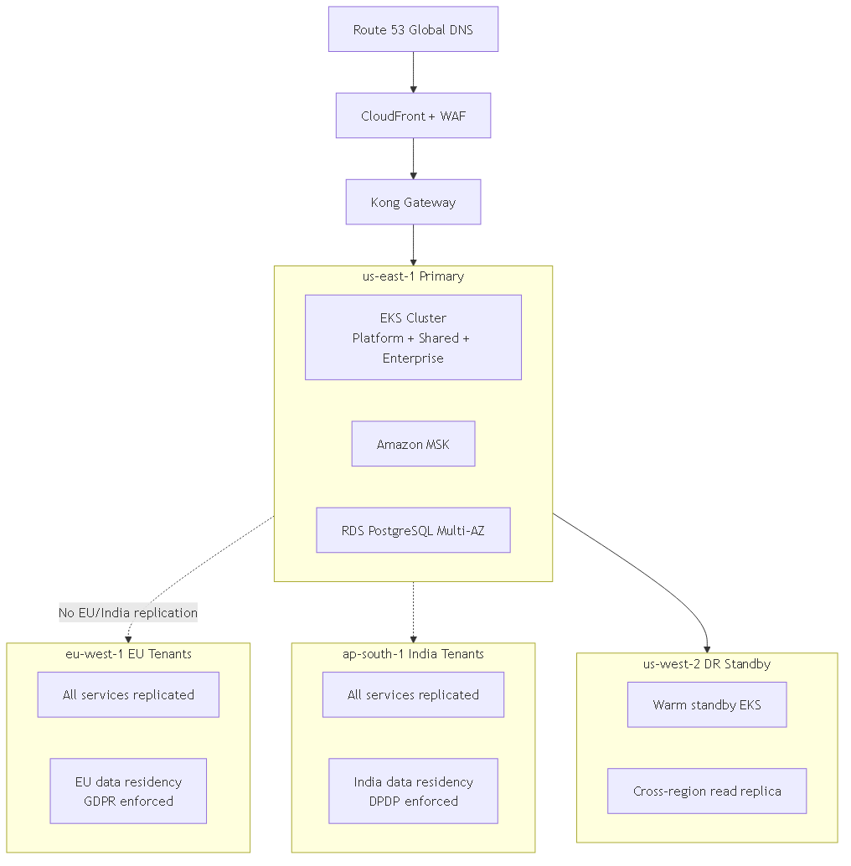
Deployment & Multi-Region
AWS primary — EKS, MSK, RDS, ElastiCache — with DR warm standby
EU and India tenants: cross-region Kafka replication disabled.

Slide 23
Part III
POC Validation — Evidence We Can Execute

Slide 24
POC Objective
What we deliberately set out to prove — and what we excluded
In scope (proven) | Out of scope (production Phase 1–2)
End-to-end event-driven value chain | Kong API Gateway + JWKS auth
Multi-tenant data isolation (tenant_id) | Tenant Management + Temporal provisioning
Transactional outbox pattern | Debezium CDC (uses scheduled poller)
Rule engine + human-review gate | Notification + Audit services
Consent opt-out + report pseudonymisation | Right-to-erasure saga
Intervention state machine + SLA escalation | Multi-region deployment
React dashboard wired to live APIs | OpenTelemetry observability stack

Slide 25
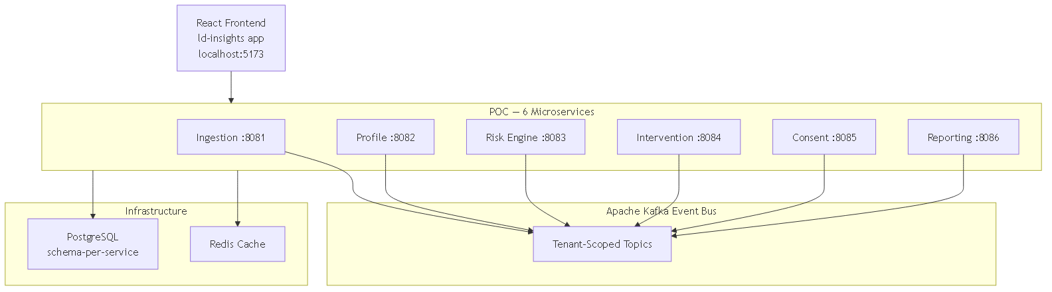
POC Architecture — What Is Running Today
6 Spring Boot services + React frontend + Kafka — docker compose up
Ports 8081–8086 · PostgreSQL schema-per-service · Redpanda Kafka · seed.mjs demo data

Slide 26
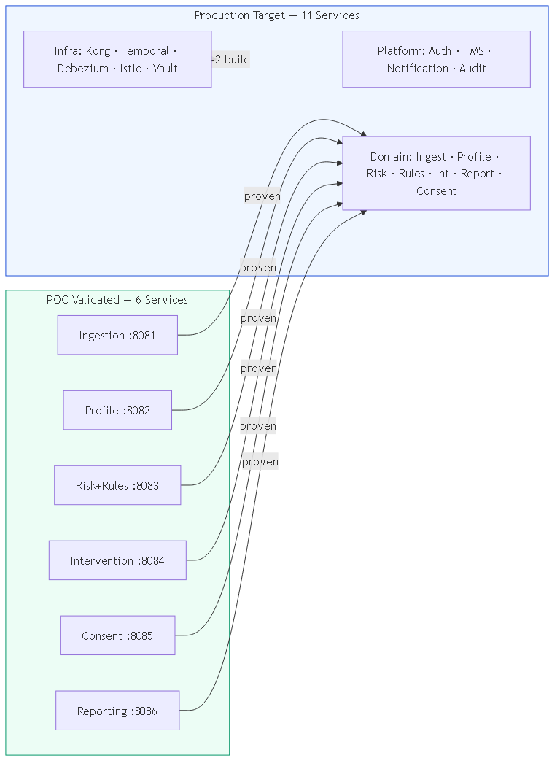
POC → Production Mapping
Every POC service validates a production domain boundary
Platform services (Auth, TMS, Notification, Audit) are net-new in Phase 1 — not R&D unknowns.

Slide 27
POC Proof Points — Evidence from Code
Eight concrete validations backed by running implementation
✓
End-to-end event chain works
Ingestion → Profile → Risk → Intervention → Reporting via Kafka
✓
Transactional outbox pattern
OutboxPublisher + OutboxPoller in common-lib — same TX as domain write
✓
Multi-tenant isolation enforced
JwtAuthFilter → TenantContext; every query scoped by tenant_id
✓
Idempotent ingestion
Idempotency-Key header; duplicate batches return 200 Already Processed
✓
Rule engine + severity classification
JSON rules evaluated against profile snapshots; CRITICAL/HIGH gate
✓
GDPR Art.22 human-review gate
requiresHumanReview=true; employee notification withheld until review
✓
Consent opt-out suppresses profiling
consent.withdrawn → Risk skips assessment; reports pseudonymised
✓
Intervention lifecycle + SLA
Auto-create on risk.detected; approve → active → complete; SLA → ESCALATED

Slide 28
POC Demo Flow
What project owners can see live in 15 minutes
1. Login as Acme Corp LD_ADMIN — switch to Globex to prove tenant isolation
2. Dashboard KPIs — compliance %, at-risk count, awaiting review (Kafka-fed, not mocked)
3. At-Risk Monitor — Critical/High/Medium learners with full profile drill-down
4. Human-review gate — Confirm / Override / Dismiss a Critical assessment
5. Intervention — approve Recommended → Active → log sessions → Complete with scores
6. Live ingest — failing assessment creates new at-risk learner through the pipeline
7. Consent opt-out — employee drops off at-risk list; report shows REDACTED in CSV
Quick start: docker compose up → node seed.mjs → npm run dev | Frontend: localhost:5173

Slide 29
Honest Gap Analysis
What the POC does NOT yet prove — and our mitigation
Gap | Risk if unaddressed | Mitigation in production plan
No API Gateway / SSO | Security, tenant routing | Phase 1: Kong + JWKS; Enterprise SSO in Phase 3
Outbox poller vs Debezium | Event reliability at scale | Phase 1: Debezium CDC — proven OSS pattern
No Temporal | Workflow durability | Phase 1 foundation; intervention saga in Phase 3
Single Postgres instance | Blast radius at scale | Tier-based isolation already designed; Enterprise = dedicated DB
No erasure saga | GDPR compliance gap | Phase 5 go-live blocker — designed in architecture/03
No observability stack | Operational blindness | Phase 1: OpenTelemetry + Grafana from day one of prod

Slide 30
Part IV
Delivery Plan & Recommendation

Slide 31
Technology Stack — Locked Decisions
No framework churn — Spring Boot 3 + React 18 + Kafka + Temporal
Layer | Technology | Status
Backend | Spring Boot 3 / Java 21 | ✓ POC running
Frontend | React 18 + TypeScript + Vite + shadcn/ui | ✓ POC running (JSX today)
Event bus | Kafka (MSK) + Protobuf + Schema Registry | ✓ Kafka proven; Protobuf Phase 1
Workflow | Temporal OSS | Designed; Phase 1 deploy
Database | PostgreSQL 16+ per service | ✓ Schema-per-service proven
Gateway | Kong OSS + Istio mesh | Phase 1
Observability | OpenTelemetry → Grafana stack | Phase 1

Slide 32
Commercial Model — Subscription Tiers
Isolation and features scale with organisation size
 | Starter | Pro | Enterprise
Employees | 500 | 5,000 | Unlimited
DB isolation | Row-level RLS | Schema-per-tenant | Dedicated DB
Custom rules | 5 | 50 | Unlimited
SSO / SAML | — | — | ✓
SLA | 99.5% | 99.5% | 99.9%
All tiers include: consent management · erasure API · human-review gate · WCAG 2.1 AA · immutable audit trail

Slide 33
20-Week Delivery Roadmap
Five phases — POC work counts toward Phase 2 domain services
Weeks 1–4
Temporal · Auth/JWKS · Kong · Kafka+Debezium · DB isolation
Foundation
Weeks 5–8
Ingestion adapters · Profile · Risk · Rule Management ← POC accelerates this
Core domain
Weeks 9–12
Intervention (Temporal) · Consent · Notification · human-review gate
Workflows
Weeks 13–16
CDC Reporting · Audit (hash-chained) · role-based dashboards
Compliance
Weeks 17–20
Erasure saga · regional compliance · WCAG · load/pen test
Go-live
POC status: Phase 2 domain services are ~80% complete as working code. Phase 1 platform work is the critical path.

Slide 34
Risks & Mitigations
Architect's view of top delivery risks
Risk | Likelihood | Mitigation
Temporal/Kong ops complexity | Medium | Helm charts + runbooks in Phase 1; POC team owns domain, platform team owns infra
Compliance scope creep | Medium | Locked GA regions (US/EU/CA/IN); erasure saga is Phase 5 gate, not optional
Event schema evolution | Low | Schema Registry + Protobuf FULL compatibility from Phase 1
Multi-tenant data leak | Low | POC proven tenant_id scoping; RLS + schema isolation + pen test in Phase 5
Team ramp-up on Kafka/Temporal | Medium | POC codebase is living reference; CONTRACTS.md is source of truth

Slide 35
Architect's Recommendation
Proceed to Phase 1 — platform foundation
The hardest unknowns — domain model, event pipeline, compliance gates — are proven in the POC
Production architecture is fully documented in architecture/ (11 documents, v2.0)
Remaining work is platform hardening and scaling — known patterns, not research
Phase 2 domain services can reuse POC service code as the starting point
20-week timeline is achievable with the POC as an 8-week head start on domain logic
Ask of project owners: 1. Approve Phase 1 kickoff (platform foundation) 2. Confirm GA compliance regions: US, EU, Canada, India 3. Assign platform infra team for Kong/Temporal/EKS 4. Schedule live POC walkthrough with stakeholders

Slide 36
Questions & Discussion
LearnTrack CLP — From proven POC to production-grade multi-tenant L&D intelligence platform
Team
Organisation
Date
Batch 24 Team#4
Persistent Systems Limited
7 June 2026
Architecture
POC
This deck
architecture/ — 11 docs
CLP/backend — docker compose up
LearnTrack_CLP_Project_Owner_Proposal.pptx

