Slide 1
LearnTrack CLP
Corporate Learning Progress, Intervention & Compliance Tracking System — SME Demo & Training Overview
Multi-Tenant SaaS
Event-Driven
GDPR / CCPA / DPDP / PIPEDA
AWS · Kubernetes
POC Live
Prepared for SME Team · Demo & Training Session · v2.0 Architecture
Batch 24 Team#4 · Persistent Systems Limited · 7 June 2026
Merged Architecture Review Deck — Production v2.0 + POC Demo

Slide 2
Agenda
Production architecture, compliance, deployment, and live POC demonstration
1
Executive Summary & Business Objectives
2
Problem Statement & Solution Overview
3
Production Architecture — 11 Services + Diagrams
4
POC Architecture — 6 Services & Validation
5
Data Ownership, Multi-Tenancy & Event Flows
6
Risk Engine, Interventions & Erasure Saga
7
Compliance, Security & Multi-Region Deployment
8
Tech Stack, Plans, SLAs & Delivery Roadmap
9
POC Demo Walkthrough & Quick-Start Guide
10
Key Capabilities, Future Scope & Next Steps

Slide 3
Executive Summary
Multi-tenant SaaS aggregation, analytics and workflow layer — not a full LMS
Consolidates attendance, scores and competency milestones from LMS/HRIS
Configurable rule-based risk engine — Critical / High / Medium / Low
Intervention lifecycle with Temporal SLA enforcement
Compliance-ready reports with immutable hash-chained audit trail
Consent management and right-to-erasure across all target regions
AWS primary with cloud-agnostic abstractions (Azure/GCP portable)
Customers: Corporates, Regulated Industries, Training Providers
Tiers: Starter (500) · Pro (5,000) · Enterprise (unlimited)
Automated tenant onboarding in under 5 minutes (Temporal saga)
Human-review gate for automated profiling (GDPR Art.22)
WCAG 2.1 AA accessibility at GA
POC validates core patterns — production v2.0 ready for phased delivery

Slide 4
Business Objectives & Success Metrics
Measurable outcomes driving platform design
Objective | Target
Early at-risk detection | 4–6 weeks before compliance failure
Intervention effectiveness | 70% show measurable competency improvement
Training completion improvement | +25% year-over-year
Compliance reporting | 100% on-time, accurate regulatory submissions
Tenant onboarding speed | New organisation live in < 5 minutes
Platform availability | 99.9% (Enterprise) · 99.5% (Pro/Starter)
User adoption per tenant | 90% of target users active in first month
Right-to-erasure SLA | Target < 72 hours (regulated max: 30 days)
Accessibility | WCAG 2.1 AA on all user-facing portals at GA

Slide 5
The Problem We Are Solving
Why fragmented L&D data is a compliance and business risk
Fragmented data: LMS, assessments, milestones in separate systems
No single view of employee learning health
Reactive identification — 4–6 weeks too late for remediation
Ad hoc interventions without systematic outcome tracking
Manual compliance report assembly (GDPR, CCPA, DPDP, PIPEDA)
No audit trail for automated profiling decisions
No consent management — legal exposure
Right-to-erasure handled manually across siloed systems
Cost: Organisations lose remediation time, face regulatory fines, and cannot prove due diligence when employees fail certification.

Slide 6
Solution — What LearnTrack CLP Is
Lightweight intelligence layer on top of existing systems
NOT a full LMS — aggregation, analytics and workflow SaaS
Unified curated learning profile per employee
Configurable JSON rule engine for at-risk detection
Full intervention lifecycle with SLA tracking
Compliance-ready reports with full audit trail
Consent, opt-out and erasure built in from day one
Earlier at-risk detection
4–6wk
Intervention improvement target
70%
Training completion YoY
+25%

Slide 7
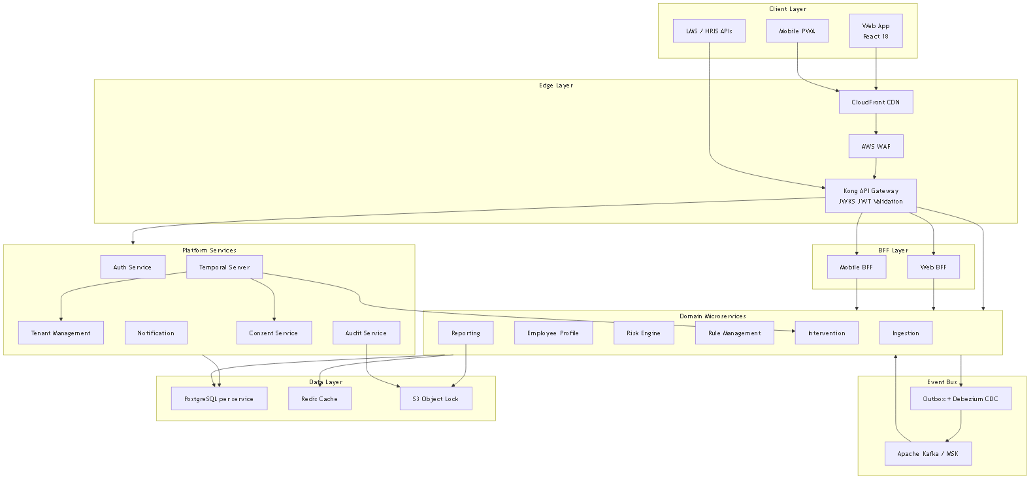
Production System Architecture
11 microservices — edge, BFF, platform, domain, messaging and data layers
Source: architecture/01-architecture.md — each service owns its database; cross-service via Kafka or REST

Slide 8
Microservices Catalog
Service responsibilities and database ownership
Service | Responsibility | Database
Tenant Management | Onboarding, billing, feature flags, Temporal provisioning | tenant-db
Auth / Identity | OAuth2, JWT/JWKS, SSO/SAML, RBAC | auth-db
Ingestion | Raw staging only — idempotent REST/CSV ingest | ingestion-db
Employee Profile | Curated profiles from data.ingested events | profile-db
Risk Engine | Rule execution, classification, human-review gate | risk-db
Rule Management | Rule CRUD, versioning, test sandbox | rules-db
Intervention | Temporal workflow — sessions, outcomes, SLA | intervention-db
Reporting | CDC-fed CQRS read model, compliance exports | reporting-db
Consent | Per-purpose consent, opt-out, erasure orchestration | consent-db
Notification | Email, SMS, in-app, WebSocket — stateless | None
Audit | Hash-chained immutable log, S3 WORM archive | audit-db

Slide 9
POC vs Production Architecture
Prototype validates patterns; production extends scope
Aspect | POC (Live Today) | Production Target
Services | 6 domain services (8081–8086) | 11 services + BFF + platform layer
Event delivery | Outbox + poller | Debezium CDC (exactly-once)
Workflows | In-service state machine | Temporal OSS sagas
Authentication | Dev HS256 JWT | Kong + JWKS + SSO/SAML (Enterprise)
Database | Single PostgreSQL, schema-per-service | DB-per-service; tier-based isolation
Gateway / Edge | Direct service ports | Kong + CloudFront + WAF
Observability | Actuator health endpoints | Full OTel stack (Prometheus, Tempo, Loki)

Slide 10
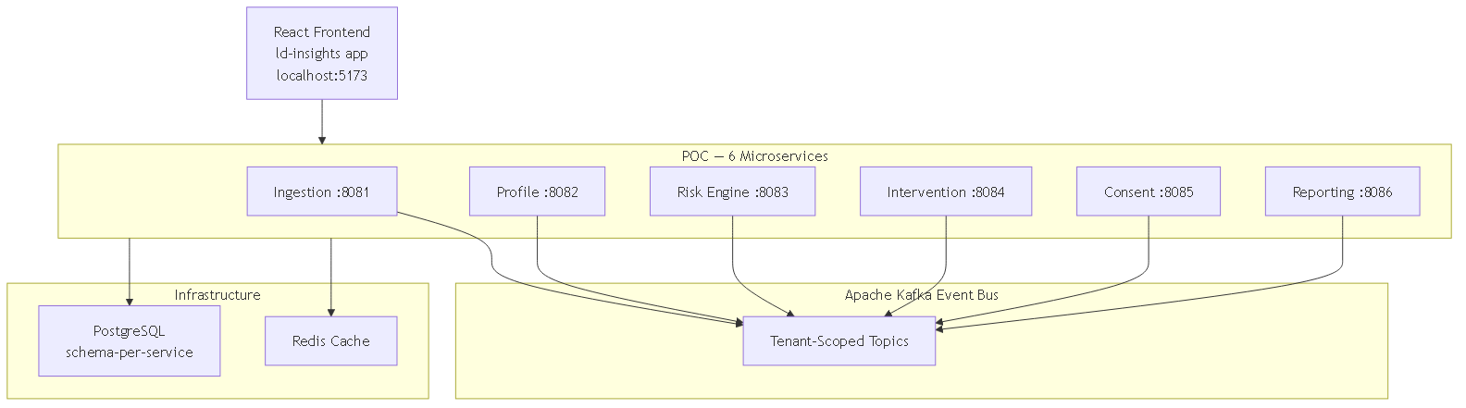
POC Architecture — 6 Microservices (Live)
Spring Boot + React + Kafka — running via docker compose up
Ingestion :8081 — validate & stage raw data
Profile :8082 — aggregate learning metrics
Risk Engine :8083 — rule execution + human-review gate
Intervention :8084 — state machine lifecycle
Consent :8085 — opt-out & erasure triggers
Reporting :8086 — CDC read model from Kafka events
React frontend: ld-insights (8 pages)
Multi-tenant: Acme Corp (seeded) vs Globex (empty)
POC simplifications: outbox poller (not Debezium), in-service state machine (not Temporal), dev JWT (not Kong/JWKS)

Slide 11
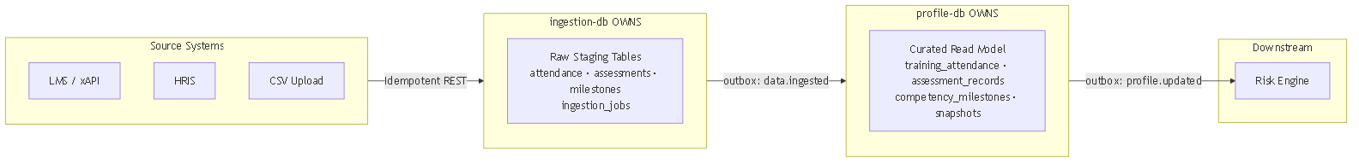
Data Ownership Boundary
Critical rule — no cross-service database reads
ingestion-db: raw staging ONLY
profile-db: curated read model ONLY
Built exclusively from data.ingested events
Reporting consumes via CDC — no dual-write
PII classification drives encryption & erasure scope
Rule: Neither Ingestion nor Profile reads the other's DB. Data flows only via Kafka events.

Slide 12
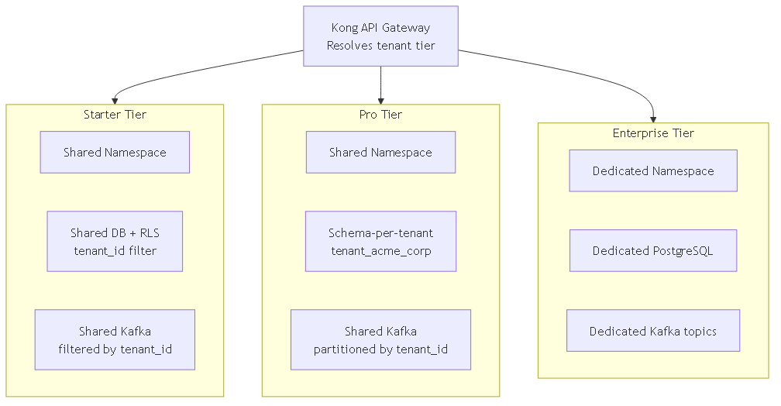
Multi-Tenant Isolation Models
Isolation depth scales with subscription tier
Starter: PostgreSQL RLS + shared everything
Pro: schema-per-tenant + shared Kafka partitioned
Enterprise: dedicated DB + namespace + Kafka topics
Redis keyspace always prefixed: {entity}:{tenant_id}:…
KMS: shared DEK (Starter) → dedicated DEK + alias (Enterprise)

Slide 13
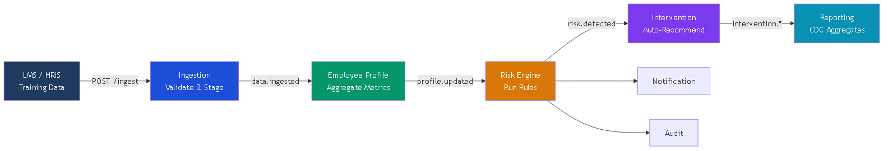
Core Value Chain — End-to-End Event Flow
Raw training data flows automatically to insights and action
All events carry tenant_id; consumers MUST filter before processing

Slide 14
Microservice Communication
Hybrid model — async for domain fan-out, sync for cache-backed lookups
Path | Mechanism | Pattern
Client → Gateway → Services | HTTPS REST | Synchronous
Ingestion → Profile | Kafka: data.ingested | Asynchronous
Profile → Risk Engine | Kafka: profile.updated | Asynchronous
Risk → Intervention/Notification/Reporting/Audit | Kafka: risk.* | Asynchronous
Risk Engine → Rule Management | REST GET (Redis cache 5 min) | Synchronous
Any Service → Tenant Context | Redis cache / TMS REST | Synchronous
Service-to-service | mTLS via Istio mesh | Synchronous

Slide 15
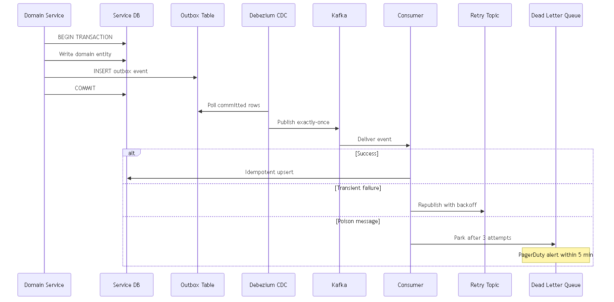
Reliable Event Delivery — Outbox + DLQ
Transactional outbox + Debezium CDC for exactly-once delivery
Domain write + outbox INSERT in same DB transaction
Debezium polls committed outbox rows → Kafka
Retry topics with exponential backoff (3 attempts)
Confluent Schema Registry — Protobuf, FULL compatibility
Standard envelope: event_id, event_type, tenant_id, payload
DLQ naming: dlq.{service}.{event-type} — PagerDuty alert if depth > 0 within 5 minutes

Slide 16
Tenant Provisioning — Temporal Saga
8-step durable workflow with compensation on failure
Validate → Create tenant → Provision DB → Migrations → Seed rules → Seed templates → Create admin → Publish → Welcome email
Estimated completion: < 5 minutes
Partial failure triggers compensation rollback
DPA acceptance required before data ingestion
data_region pinned at onboarding
Plan upgrade also runs as Temporal saga (~30 min)
Enterprise upgrade: dedicated DB + K8s namespace
Stripe billing integration on completion
All services refresh tenant context cache
Regions: EU (eu-west-1), India (ap-south-1), US, Canada
SSO/SAML flow for Enterprise tenants (Azure AD, Okta)

Slide 17
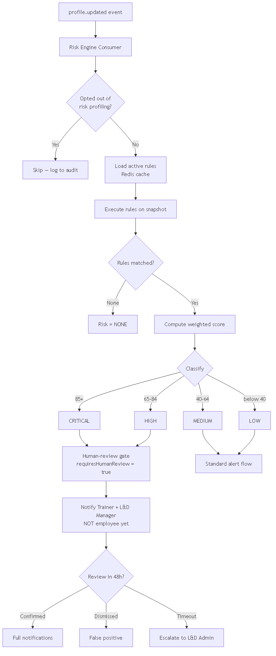
Employee Risk Detection Flow
Configurable rules with human-review gate for CRITICAL and HIGH (GDPR Art.22)
risk_profiling_opt_out = true → skip assessment entirely; log suppression to audit

Slide 18
Risk Engine & Human-Review Gate
Rule-based classification with mandatory human oversight
Level | Score
CRITICAL | 85+
HIGH | 65–84
MEDIUM | 40–64
LOW | < 40
CRITICAL/HIGH → requiresHumanReview = true
Employee NOT notified until Trainer/L&D Manager reviews
Actions: Confirm · Override · Dismiss
48-hour SLA — Temporal escalates to L&D Admin
L&D Admins: create rules via UI → test → activate
Redis cache invalidated on rule activation
Sample rule: { "operator": "AND", "criteria": [ { "metric": "training_attendance_percentage", "operator": "less_than", "value": 80 }, { "metric": "competency_average_score", "operator": "less_than", "value": 65 } ] }

Slide 19
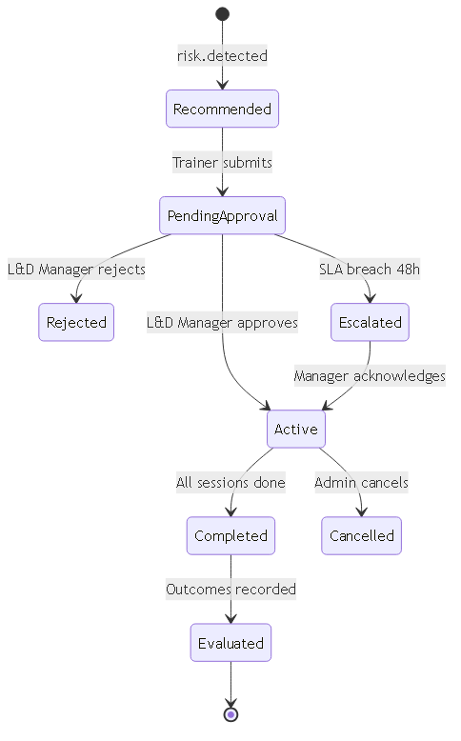
Intervention Lifecycle — State Machine
Temporal-backed workflow with 48-hour SLA enforcement
Trainer: create, log sessions, mark complete
L&D Manager: approve/reject, review escalations
Pre/post scores → automatic improvement %
intervention.completed → Risk Engine re-evaluates
intervention.escalated → L&D Admin alert on SLA breach
Types: Remedial Training · 1:1 Coaching · Group Mentoring · Self-paced Module

Slide 20
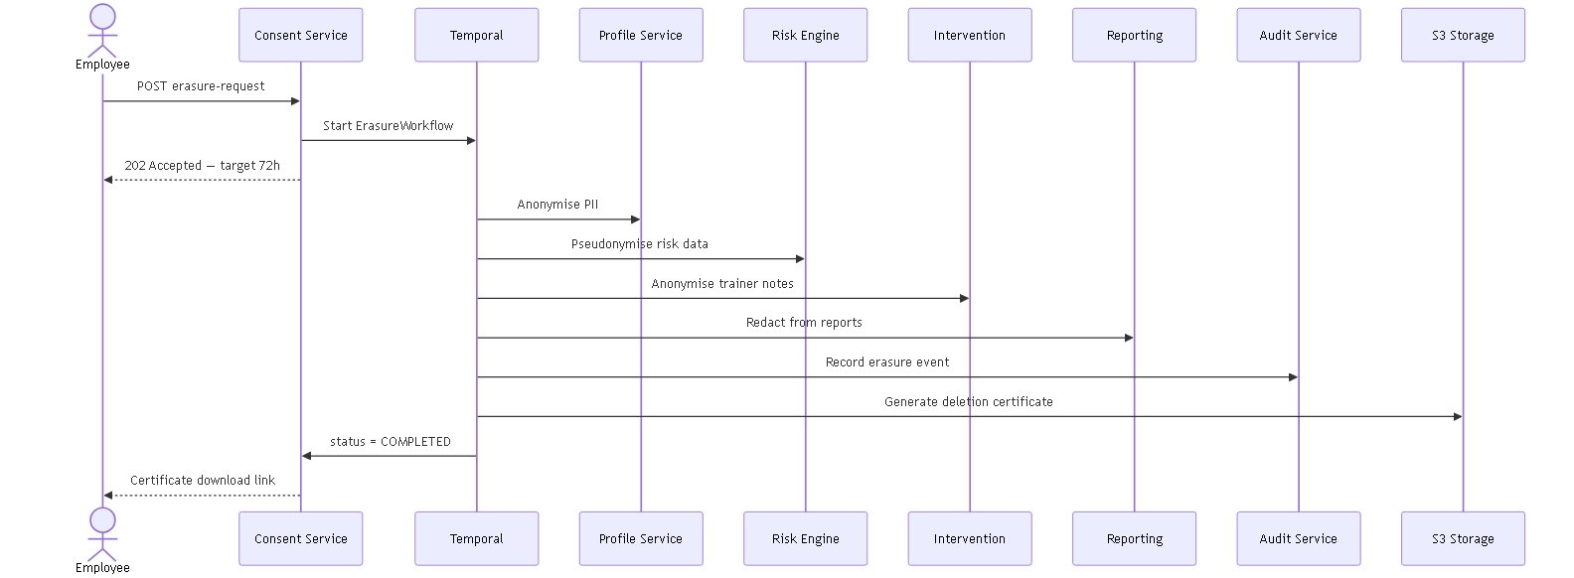
Right-to-Erasure Saga — Temporal Workflow
GDPR Art.17 · CCPA right-to-delete · DPDP erasure — target completion 72 hours
Audit log entries retained but de-linked; signed deletion certificate emailed to employee

Slide 21
Consent Management & Compliance
Built-in privacy compliance across GDPR, CCPA, DPDP and PIPEDA
EU/UK
GDPR, UK GDPR, EAA (WCAG 2.1 AA)
Consent purposes: risk_profiling, benchmarking, ml_scoring, trainer_notes
Employee withdraws consent → consent.withdrawn event → Risk Engine skips
Reports pseudonymise opted-out employees (REDACTED-…)
Immutable hash-chained audit log — S3 Object Lock (WORM)
DPA required before employee data ingestion
Per-employee erasure and portability API (all regions)
United States
SOC 2 Type II, CCPA/CPRA
Canada
PIPEDA, Québec Law 25
India
DPDP Act 2023 — residency ap-south-1

Slide 22
Security Architecture
Defence in depth — edge to data at rest
Layer | Control
Edge | AWS WAF (OWASP), Shield Standard, CloudFront, TLS 1.3
API Gateway | JWKS-local JWT validation, per-tenant rate limiting, Unleash feature flags
Service mesh | Istio mTLS STRICT, circuit breakers (5 errors), 3 retries, 10s timeout
Database | RLS/schema isolation, pgaudit SQL audit extension
Data at rest | AES-256; envelope encryption for PII (Vault DEK + AWS KMS)
Secrets | HashiCorp Vault per-tenant namespace — no secrets in ConfigMaps

Slide 23
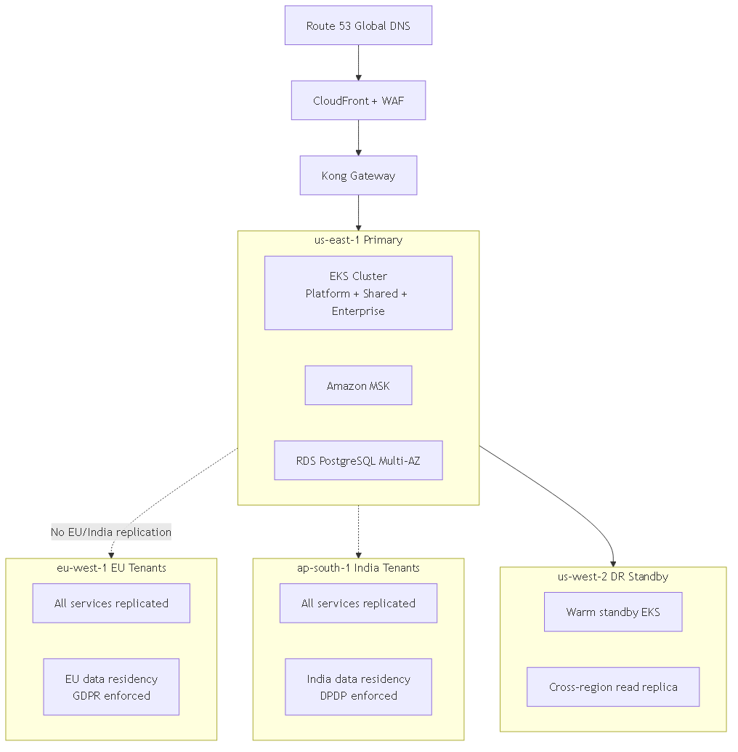
Deployment & Multi-Region Architecture
AWS primary — compliance-driven data residency pinning
Namespaces: learntrack-platform · learntrack-shared · tenant-{id}
Self-hosted K8s: Kong, Temporal, Unleash, Vault, Grafana stack
Managed AWS: EKS, MSK, ElastiCache, RDS, SES, S3, WAF, KMS
GitOps: GitHub Actions + ArgoCD (dev → prod)
DR: us-west-2 warm standby + cross-region read replica
EU and India tenants: cross-region Kafka replication DISABLED — data stays in home region

Slide 24
Observability & Operational Resilience
Unified OpenTelemetry — per-tenant tagged metrics, traces and logs
Metrics: OTel Collector → Prometheus → Grafana
Traces: OTel → Grafana Tempo (distributed tracing)
Logs: OTel → Grafana Loki (tenant-tagged structured)
Errors: Sentry — code-level errors and performance
DLQ depth > 0 → PagerDuty alert within 5 minutes
Backups: pgBackRest (PostgreSQL WAL) + Velero (K8s)
Istio: 5 consecutive errors → circuit open; 30s half-open
FinOps: cost-per-tenant monitoring

Slide 25
User Roles & Dashboards
Role-based access — Platform Admin through Employee self-service
Role | Key Capabilities
Platform Admin | All organisations, platform health (OTel), Stripe billing
L&D Administrator | Org KPIs, rules, reports, consent disclosures, user management
Trainer | Team at-risk, human-review queue, interventions, session logging
L&D Manager | Intervention approval, escalation queue, effectiveness summary
Employee | Own profile, consent preferences, erasure request, interventions

Slide 26
Accessibility Standards
WCAG 2.1 AA baseline for all user-facing portals at GA
Standard | Requirement
WCAG 2.1 Level AA | All web content — EU, UK, US, Canada, India
European Accessibility Act (EAA) | EU market access — EN 301 549
Section 508 / ADA | US federal and case-law SaaS obligations
Keyboard navigation | Tab / Shift+Tab / Enter / Space / Arrow keys on all controls
Risk indicators | Colour + icon + text — never colour alone
Screen readers | aria-live regions for at-risk alerts; aria-describedby on form errors
Contrast ratio | Minimum 4.5:1 normal text · 3:1 large text

Slide 27
Technology Stack
Cloud-agnostic design — AWS primary, portable to Azure/GCP
• Backend: Spring Boot 3 / Java 21 | Frontend: React 18 + TypeScript + Vite + shadcn/ui + Tailwind
• Workflow: Temporal OSS | Event Bus: Kafka (MSK) + Protobuf + Confluent Schema Registry
• CDC: Debezium + Outbox | Cache: Redis 7 | DB: PostgreSQL 16+ (JSONB rules)
• Gateway: Kong OSS | Mesh: Istio | Secrets: Vault + AWS KMS envelope encryption
• Observability: OpenTelemetry → Prometheus/Grafana/Tempo/Loki | CI/CD: GitHub Actions + ArgoCD
• Billing: Stripe | Email: SES | Storage: S3 Object Lock | Flags: Unleash | Errors: Sentry
AWS EKS · S3 Object Lock · Amazon SES · Schema Registry · Unleash · Sentry · Stripe · pgBackRest · Velero

Slide 28
Subscription Plans
Three tiers — isolation depth and features scale with organisation size
Feature | Starter | Pro | Enterprise
Max employees | 500 | 5,000 | Unlimited
DB isolation | Row-level (RLS) | Schema-per-tenant | Dedicated DB
K8s isolation | Shared namespace | Shared namespace | Dedicated namespace
Custom rules | 5 | 50 | Unlimited
Notifications | Email | Email+SMS+In-app | All + WebSocket
Employee portal | No | Yes | Yes
SSO / SAML | No | No | Yes
API access | No | Rate-limited | Dedicated quota
SLA | 99.5% | 99.5% | 99.9%
All plans include: consent management · right-to-erasure API · WCAG 2.1 AA · immutable audit trail · human-review gate

Slide 29
Performance & SLA Targets
Production-grade targets for enterprise-scale regulated workloads
Metric | Target
API P95 | < 200 ms
Dashboard load | < 2 s
Profile generation | < 500 ms
Risk batch (1K emp) | < 2 min
Report generation | < 30 s
Tenant provisioning | < 5 min
Training sync latency | < 1 hour
Erasure target: 72 hours (regulated max: 30 days)
Availability: 99.9% Enterprise · 99.5% Pro/Starter
DLQ alert: PagerDuty within 5 minutes if depth > 0
Tenant context resolution (cached): < 5 ms
Report generation endpoint timeout: 60 s (Istio)

Slide 30
Delivery Roadmap — 20 Weeks to Production
Five phases from foundation to compliance go-live
Phase 1 · Weeks 1–4
Foundation: Temporal provisioning, Auth/JWKS, DB isolation, Kafka+outbox
Phase 2 · Weeks 5–8
Core: Ingestion adapters, Profile Service, Risk Engine, Rule Management
Phase 3 · Weeks 9–12
Workflows: Intervention (Temporal), Consent, Notification, human-review gate
Phase 4 · Weeks 13–16
Compliance: CDC Reporting, Audit (hash-chained), role-based dashboards
Phase 5 · Weeks 17–20
Go-live: Erasure saga, regional compliance, WCAG 2.1 AA, load/pen test

Slide 31
POC Validation Status
Live prototype proves core architecture patterns are feasible
POC Component | Status | What It Proves
6 Spring Boot microservices | ✅ Live | Multi-service decomposition works
React frontend (8 pages) | ✅ Live | Role-based dashboards feasible
Full Kafka event pipeline | ✅ Live | Event-driven value chain end-to-end
Human-review gate | ✅ Live | GDPR Art.22 workflow implementable
Consent opt-out + pseudonymisation | ✅ Live | Privacy controls enforceable
Multi-tenant isolation (Acme/Globex) | ✅ Live | tenant_id scoping works
docker compose up | ✅ Live | Single-command local demo stack

Slide 32
POC Demo — Live Stack Walkthrough
6 Spring Boot microservices + React frontend wired over Kafka
Multi-Tenant Login (RBAC)
Intervention Lifecycle
1
Dev-login → Acme Corp + LD_ADMIN. JWT scoped to tenant_acme_corp. Switch to Globex to show isolation.
5
Approve Recommended → Active → log sessions → Complete with pre/post scores.
Dashboard — CDC Read Model
Live Ingestion Demo
2
Org compliance 92%, 6 awaiting review, 15 active interventions — Reporting Service consuming Kafka events.
6
Re-run ingest with failing assessment. NEW at-risk learner appears after event propagation.
At-Risk Monitor
Consent Opt-Out + Pseudonymisation
3
6 learners flagged: 1 Critical, 3 High, 2 Medium. Click learner → full learning profile.
7
Withdraw risk_profiling consent → drops off at-risk list. Report shows REDACTED-… in CSV.
✅ What the POC Proves: multi-tenant isolation, event-driven pipeline, human-review gate, consent opt-out, CDC read model, idempotent ingestion — all on one docker compose up.
Human-Review Gate
4
Confirm / Override / Dismiss Critical assessment. Watch awaiting-review KPI drop in real time.

Slide 33
Running the POC Demo — Quick Start
Everything you need to run the full stack locally in 3 steps
Step 1 — Start Backend
Page | URL
Dashboard | /dashboard
At-Risk Monitor | /at-risk
Employee Profile | /employees/:id
Interventions | /interventions
Session Planner | /sessions
Reporting | /reporting
Rules Management | /rules
Settings / Consent | /settings
cd CLP/backend/infra docker compose up -d --build # Health: localhost:808{1..6}/actuator/health
Step 2 — Seed Demo Data
cd CLP/backend node infra/seed.mjs # Creates employees for tenant_acme_corp
Step 3 — Start Frontend
💡 Demo Tip: Use tenant switcher to show Acme Corp (seeded) vs Globex Ltd (empty) — proves multi-tenancy in 10 seconds.
cd CLP/ld-insights npm install && npm run dev # Open http://localhost:5173 · Login: Acme Corp + LD_ADMIN

Slide 34
Key Capabilities at a Glance
Production platform deliverables
Multi-source ingestion (REST + CSV) from any LMS/HRIS
Curated profiles: attendance %, scores, trends, milestones
Configurable JSON rule engine (5 to unlimited by plan)
CDC-fed reporting — always fresh, zero polling
Temporal sagas: provisioning, intervention, erasure, plan upgrade
Real-time notifications: WebSocket/SSE for at-risk alerts
GDPR Art.22 human-review gate on automated profiling
Per-purpose consent with full audit history
Right-to-erasure — 72hr target, signed certificate
Row/schema/dedicated DB isolation by plan tier
Data residency pinning (EU, India, US, Canada)
White-label branding + SSO/SAML (Enterprise)

Slide 35
Future Scope (Post GA)
Prioritised enhancements beyond MVP
Priority | Capability | When
P1 | E-signature (21 CFR Part 11) — DocuSign/Adobe Sign | Pharma tenants
P1 | Developer Portal (Stoplight) — public API docs | Pro/Enterprise API
P2 | ClickHouse OLAP — cross-tenant analytics | Benchmarking feature
P2 | ML Risk Scoring (MLflow + Feast feature store) | Enterprise tier
P2 | Amazon OpenSearch — advanced employee search | Scale threshold
P2 | Cross-tenant anonymised benchmarks | Requires benchmarking consent

Slide 36
Thank You & Questions?
LearnTrack CLP — Turning fragmented L&D data into proactive, compliant, measurable action. POC is live. Production architecture v2.0 is ready for phased delivery.
Team
Organisation
Architecture Docs
Batch 24 Team#4
Persistent Systems Limited
architecture/ — 11 documents
POC Demo Deck
Diagram Assets
Next Step
7 June 2026
LearnTrack_CLP_Presentation.html
presentation_assets/diagrams/
Review → feedback → Phase 1 kickoff

