Slide 1
AIDA-project Group 5
London Smart Meter – Phases 4-6
Olli Korvala Taavi Kuuluvainen Janne Arkko Suvi Kenttälä

Slide 2
Recap to phases 1-3
London Smart Meter dataset with Acorn categorization, weather data and holiday categories for corresponding energy measurements.
Roughly 3.5+ million rows in 4 datasets total.
Time-series data.
High number of dimensions in raw, grouped data.
These phases were revisiting according to the CRISP-DM –method multiple times to make the data suitable for each model.

Slide 3
Phase 4
Modeling Techniques
Decided to proceed with several different Machine Learning algorithms: - LSTM - Gradient Boosting - Random Forest Regression - Support Vector Machine - Linear Regression - K-Nearest Neighbors

Slide 4
Building the models
Workflow consisted of hard-coded universal variables that were mostly compatible across different models. Making workflow more maintainable and to provide easier hyperparameter tuning, when applicable.
According to CRISP-DM, previous phases were revisited and data was reorganized and reprocessed to fit models better and to provide more robust models.
Each model was evaluated with error metrics like MAE, MSE and R2 during the workflow after each training session.
Some models were trained using sklearn train_test_split() –splitting method, and some were trained using sliced data to predict a full month.

Slide 5
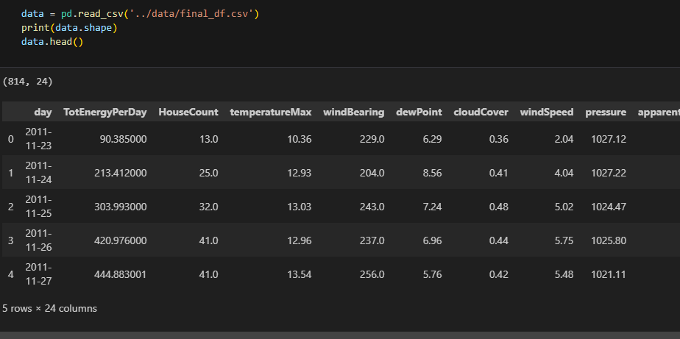
Workflow
Reading the data ---->
Notes:
After try and error, the original data of over 3,5 million rows was squeezed down to roughly 800+ rows by calculating average energy consumptions and grouping the data by households. This lead to lightning fast training and reduced the dimensionality of the data making it easier for the model to learn patterns.

Slide 6
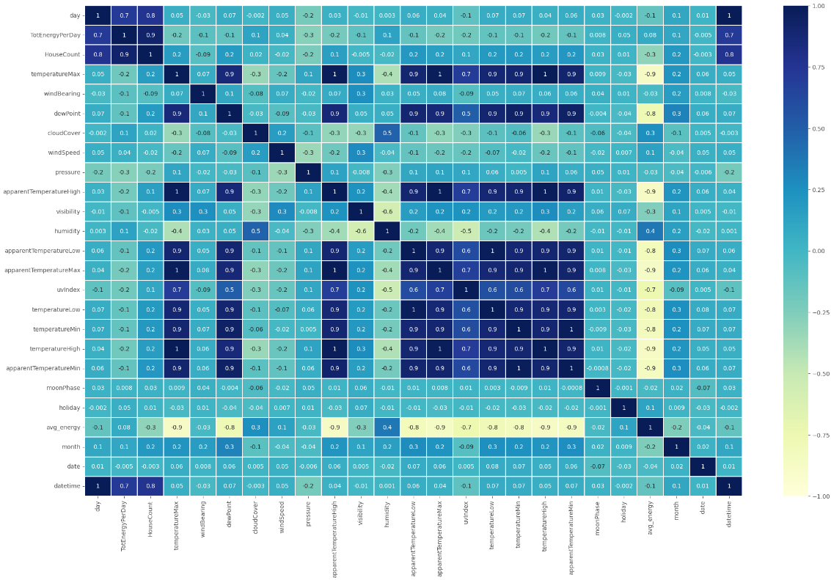
Workflow
Calculating and visualizing correlations ->
Notes:
At first, the features selected for training were chosen by correlation of over 0.3, but eventually, probably all features were atleast tried in training to find the most suitable combination.

Slide 7
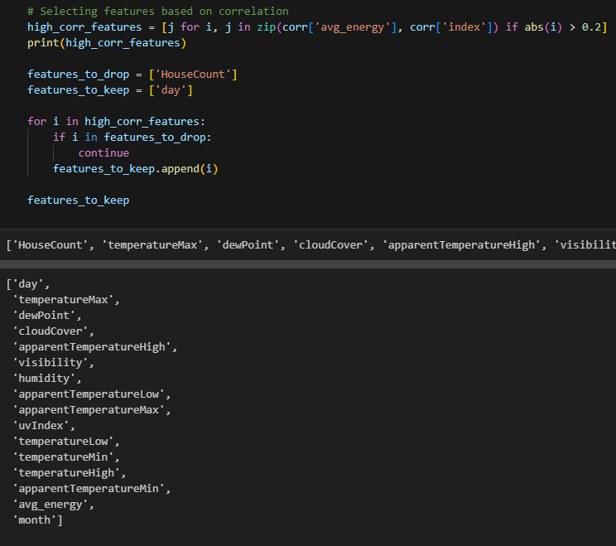
Workflow
Choosing features for modeling ->
Notes:
Features shown in the picture present the > 0.2 correlation with ’day’ column kept as index. ’features_to_drop’ and ’features_to_keep’ were used to try out different combinations by forcing different features to the data or out of the data.

Slide 8
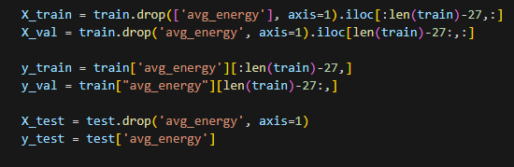
Workflow
Splitting the data (slicing) ->
Notes:
Some models were trained with sklearn’s ’train_test_split()’, but most of the models were trained by slicing the data to hold one full month as test data to observe the capabilities to predict actual time-series data.

Slide 9
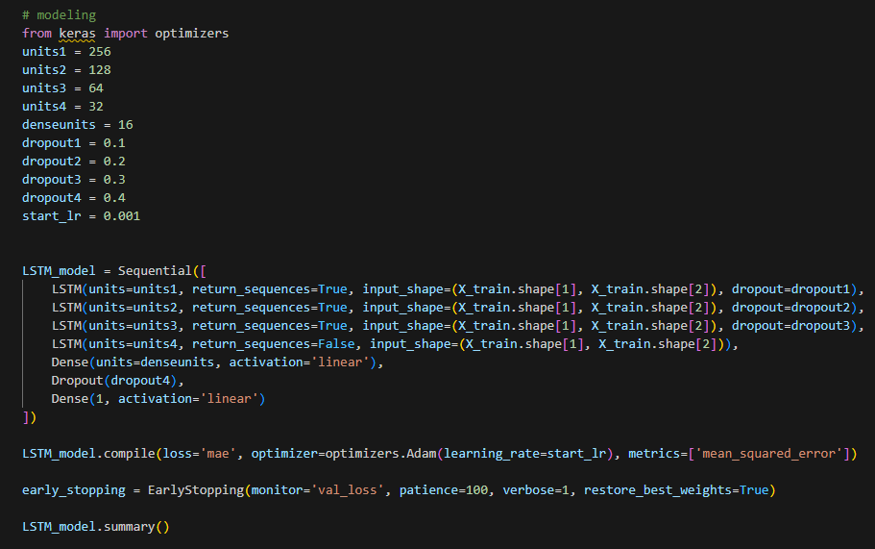
Workflow
Model architecture(s) ->
Notes:
Architecture of LSTM. Assigning hyperparameters to variables allowed easier tuning but also the ability to store each architecture parameters to a file to maintain replicability.
In this part of the workflow we had to think about the data preprocessing all over again to make it suitable for deep learning models like this LSTM.

Slide 10
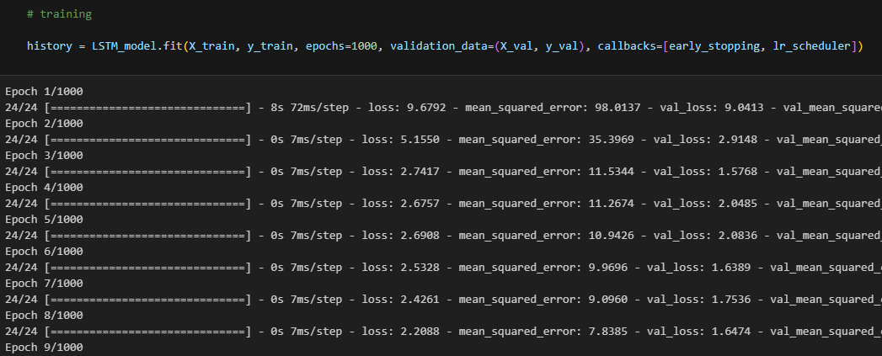
Workflow
Training ->
Notes:
Not much to say here, but we used different callbacks like early stopping and learning rate scheduler and used some proportion of the data as validation data.

Slide 11
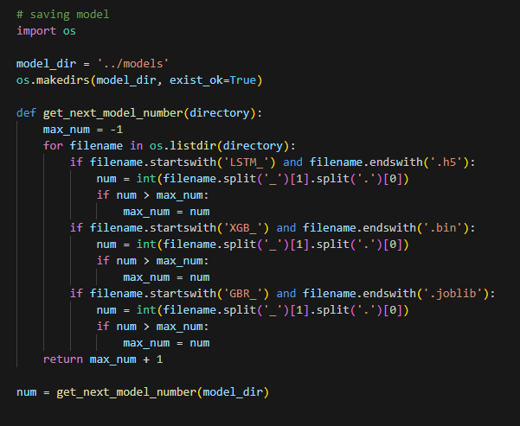
Workflow
Saving model(s) ->
Notes:
Best models were saved with universal naming so that evaluation and testing can be done with the actual best models.

Slide 12
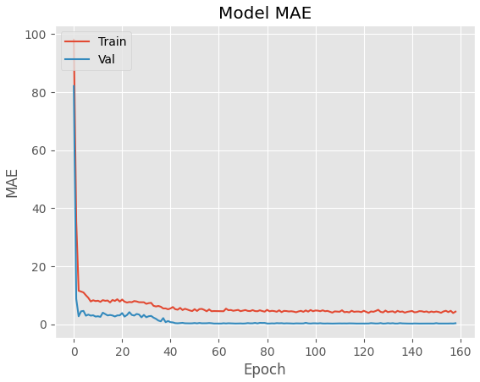
Workflow
Plotting training curves ->
Notes:
The MSE and MAE training curves were the primary source of evaluation during training phases. Basically just by looking at the curve, you can tell if it’s worthwhile to continue with these hyperparameters or not.

Slide 13
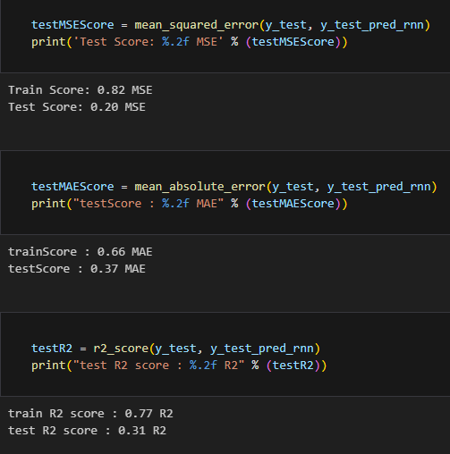
Workflow
Printing and evaluating metrics ->
Notes:
Primary metrics used during training were MSE, MAE and R2.
These metrics were used as numerical evaluation tool for each training session and hyperparameter setup.

Slide 14
Workflow
In between each run, hyperparameters were tuned and best models were saved. Results were saved to a csv file for thorough evaluation and comparison of different models across certain test data.
Initialization of different models for ensemble-like predictions in implementation phase would’ve been easier with universal naming policy and documentation of model architectures.

Slide 15
Phase 5
Analysis and evaluation of models
Cornerstone of evaluation were different metrics and calculations against the actual values.
Visualizing predictions against actual values.
Choosing top performing models and deepening evaluation on those.
Analysing performance.

Slide 16
Results
’Target mean’: Mean of the ’target’ values ’Pred mean’: Mean of the prediction values with each model ’Difference’: Difference of the ’Target mean’ against ’Pred mean’ ’Abs-mean’: Absolute mean of predictions against target values ’Sq-mean’: Squared mean of predictions against target values ’STD’: Standard deviation of predicted values ’Range’: The range of predicted values (max – min)
Model | Target mean | Pred mean | Difference | Abs-mean | Sq-mean | STD | Range
LSTM | 11.16 | 11.19 | 0.03 | 0.37 | 0.2 | 0.36 | 1.39
XGB | 11.16 | 11.42 | 0.26 | 0.45 | 0.31 | 0.15 | 0.76
GBR | 11.16 | 12.36 | 1.2 | 1.2 | 1.82 | 0.43 | 1.63
RFR | 11.16 | 12.31 | 1.15 | 1.15 | 1.63 | 0.34 | 1.92
LR | 11.16 | 12.11 | 0.95 | 0.95 | 1.08 | 0.45 | 1.43
SVM | 11.16 | 12.38 | 1.22 | 1.21 | 1.67 | 0.45 | 1.56
KNN | 11.16 | 12.23 | 1.07 | 1.12 | 1.58 | 0.49 | 2.51

Slide 17
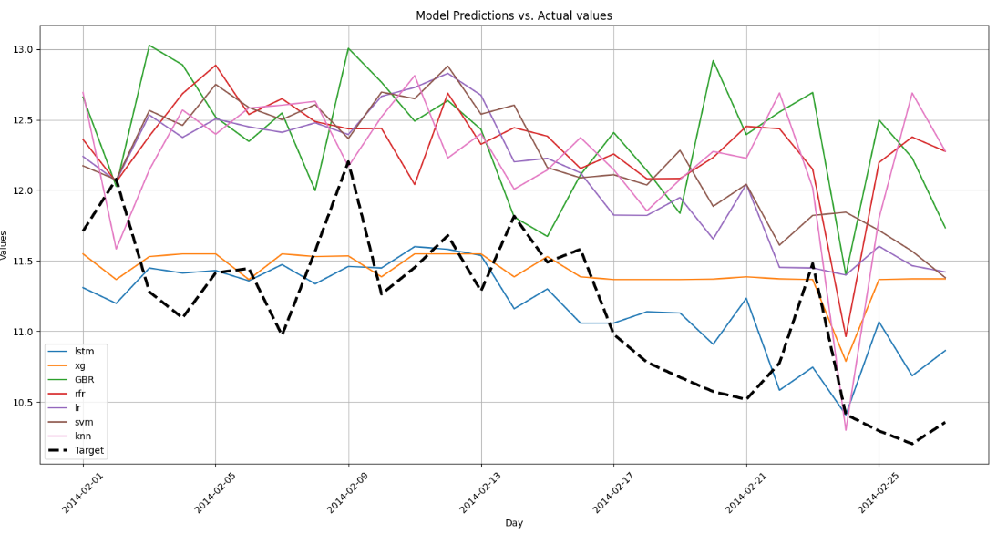
Visualizing results

Slide 18
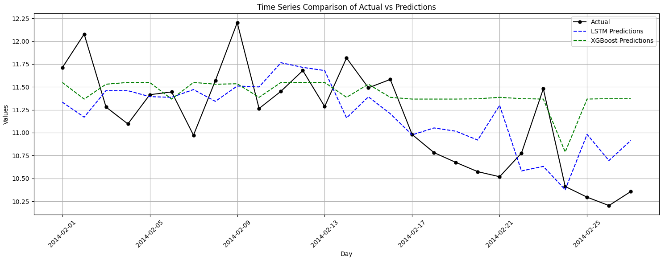
Visualizing top models

Slide 19
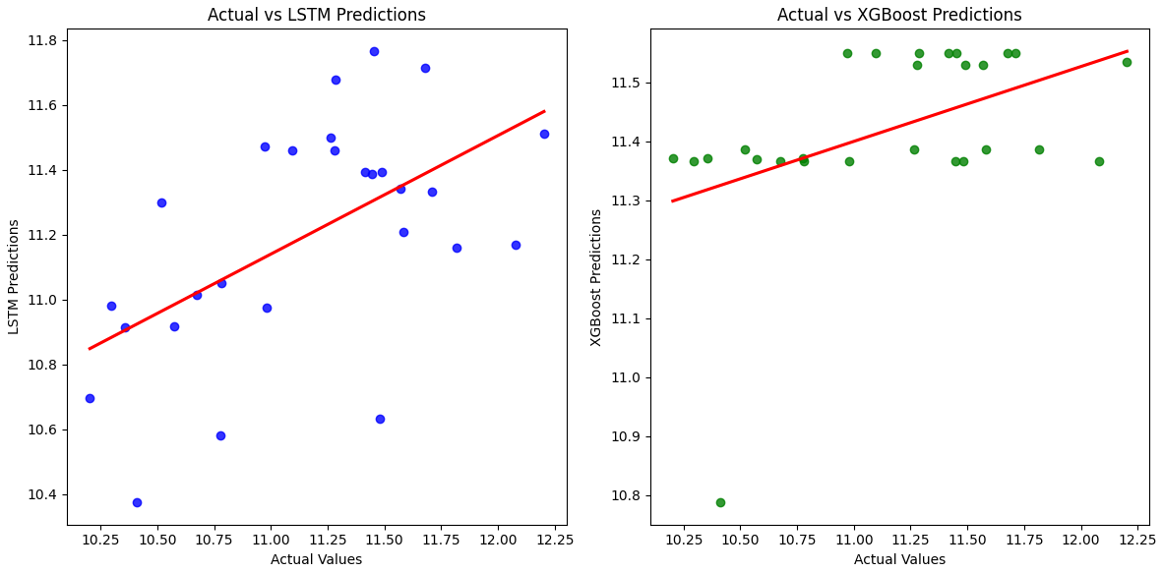
Scattering LSTM and XGB predictions vs. Actual values
Notes:
This presents the range of of predicted values agains tthe actual values.
XGBoost shows nice tight pack, but as we saw earlier, the predictions line against target values were quite in small range.

Slide 20
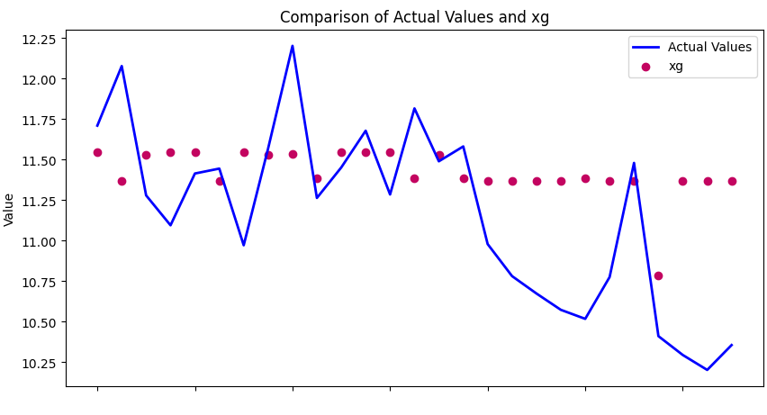
XGBoost vs. Actual

Slide 21
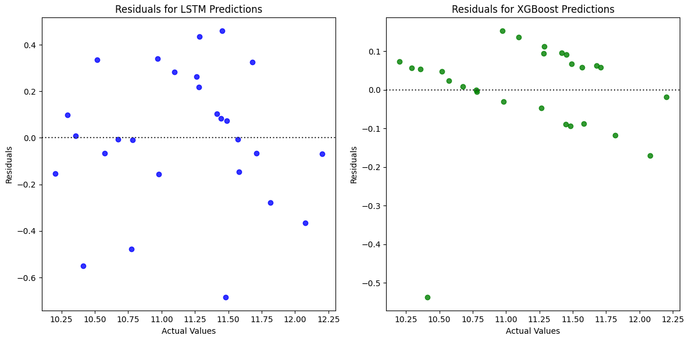
Residuals
Notes:
Here are the residuals of these two models.
Residuals generally refer to the difference between actual values and predicted values.
And as we can see the range of residuals is much higher with the LSTM, but as we saw before,
The range of predicted values with XGBoost is much shorter, therefore the residuals are not scattered as much.
The range of LSTM looks quite promising here as well as we are talking about minus point 6 to point 4 residuals ranges.

Slide 22
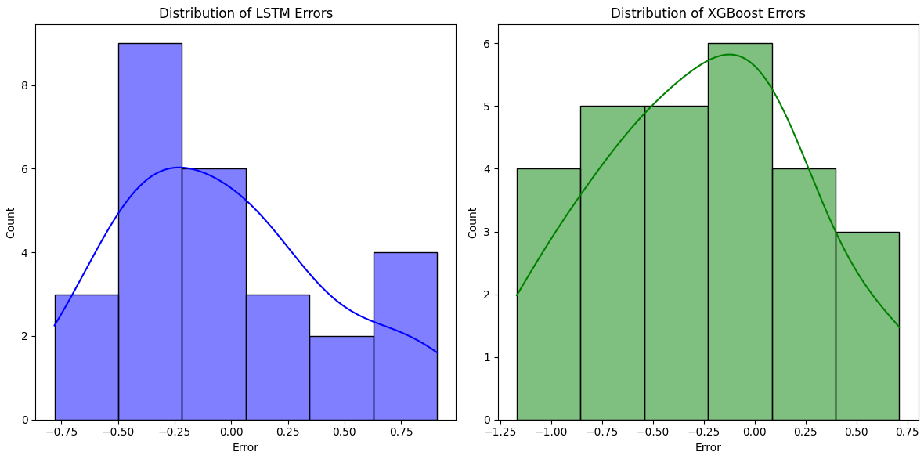
Distribution of errors

Slide 23
Analysis and comparison
LSTM:
Shows great promise for future predictions.
Needs more research and practice to narrow down the range of errors.
Overall performance was quite good and possibly the most robust model out of all.
Slower to train compared to the others.
Received the most attention and training out of all models.
XGBoost
Solid foundation of performance.
Range of predicted values needs attention.
Did not see as much attention and tuning as LSTM.
Fast to train and potential to surpass LSTM with proper tuning.

Slide 24
Phase 6
Implementation
This project did not involve implementation due to time running out.
Plan was to create a web server to host an API with access to the model.
UI would’ve had roughly a calendar for the user to mark days for which energy consumption would’ve been predicted as well as all other expected inputs by the user.
Due to model architecture and expected input of the model(s), the API would’ve automatically fetched weather data from open APIs to fill in input slots for dates selected by the user.
Predictions made through the API would’ve been stored to a database for further training and polishing of the model(s).

Slide 25
Conclusion
Regression tasks with time-series data are difficult, especially with this dataset as the data is multi-dimensional and reducing the dimensionality is crucial in getting good results.
More data transformation and feature engineering would definitely be needed in further evaluation, training and optimization of models.
Some models performed better in some range of target values and some in other ranges, therefore creating an ensemble-like model, or atleast predicting same input with multiple models, and combining the results would be necessary for more robust predictions.
Overall a very comprehensive project that taught us that only hard labor and good research can yield adequate results.

Slide 26
THE END

