Slide 1
eDocent
a museum guide for your Android device
Notes:
Casey: Hi, my name is Casey and I’m the group leader of group 5 and our project is called eDocent. We are creating an open source framework for museums to take advantage of mobile technologies to engage with their visitors.

Slide 2
Group
Casey
Ashley
Kritika
Sukaynah
Nisreen
Chethan
Notes:
Casey: In our group, we have...

Slide 3
Overview
Museums are enthusiastic about using mobile technology
Lack the technical and financial resources to do so on their own
Providing museums with an open source solution to engage visitors through mobile applications
Notes:
Casey: A quick overview. Museums are very enthusiastic about using mobile technologies to engage with their visitors, but they often lack the the technical and/or financial resources to do so on their own. What we are hoping to accomplish is to help museums overcome these hurdles by providing an open source framework and mobile application that museums can use to host and disseminate materials.

Slide 4
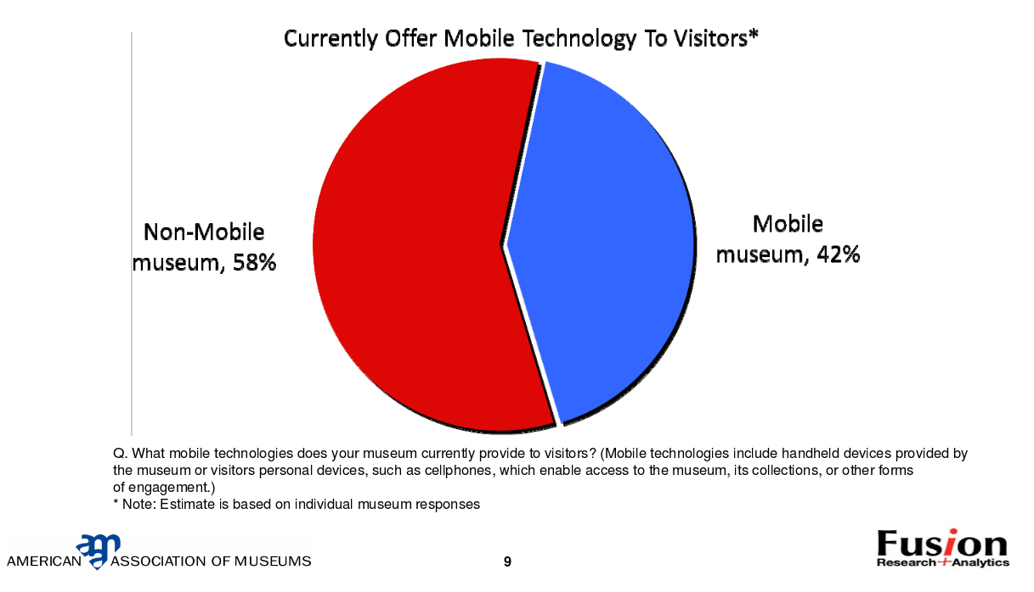
Motivation
Notes:
Casey: Our motivation was that we wanted to find something that would be both interesting to us, but potentially serve a public need. As you can see many museums do not offer any sort of mobile technology to visitor. To see what that actually means, we can take a look at the next slide.

Slide 5
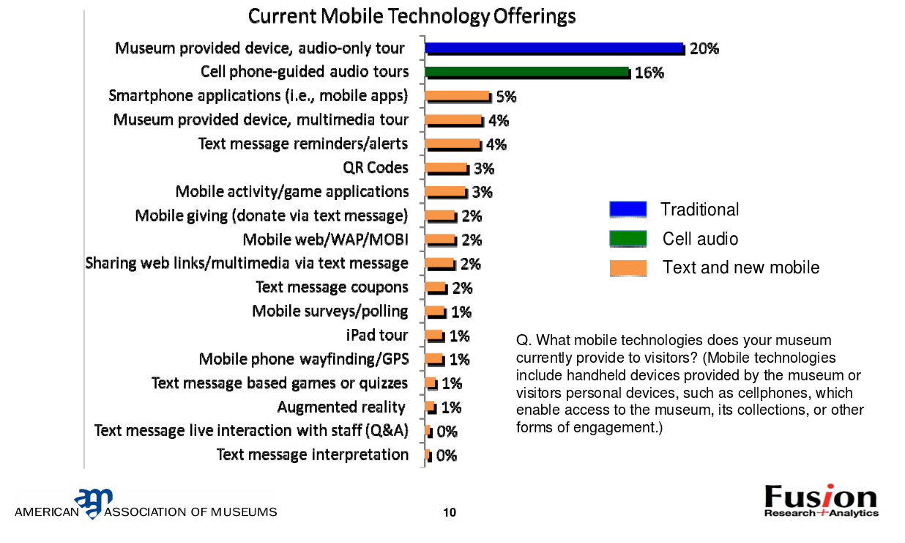
Motivation
Notes:
For many museums, mobile means a museum-provided device. Only 5% have a mobile app.

Slide 6
Two Components
Web application and service for hosting and pushing material
Android application for viewing material
Notes:
Casey

Slide 7
Management Plan
Two teams
Web Application and Service
Android application
Process Model
Agile Approach
Two development teams
Scrum approach
Notes:
Casey

Slide 8
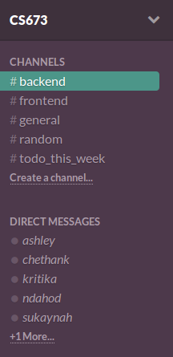
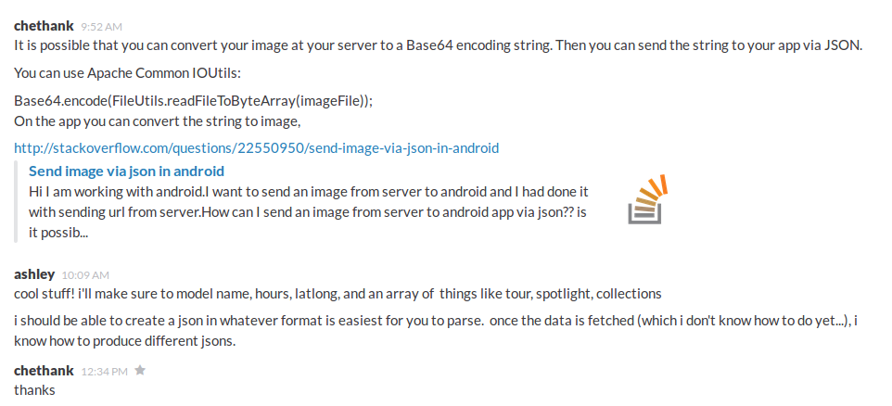
Communication
Notes:
Casey: Joke about email and miscommunication. Mention that other groups use it

Slide 9
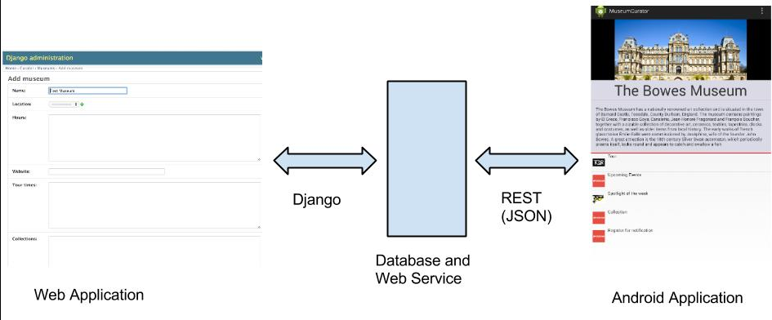
Architecture
Notes:
Casey

Slide 10
Interface for museum curators
Django admin interface
museums can logon
ability to add information about museum
ability to add information about art
Notes:
Ashley museums that want to make their information available on the app will be able to interact with a user friendly interface to upload their content into our database, this will be possible through a Django admin interface

Slide 11
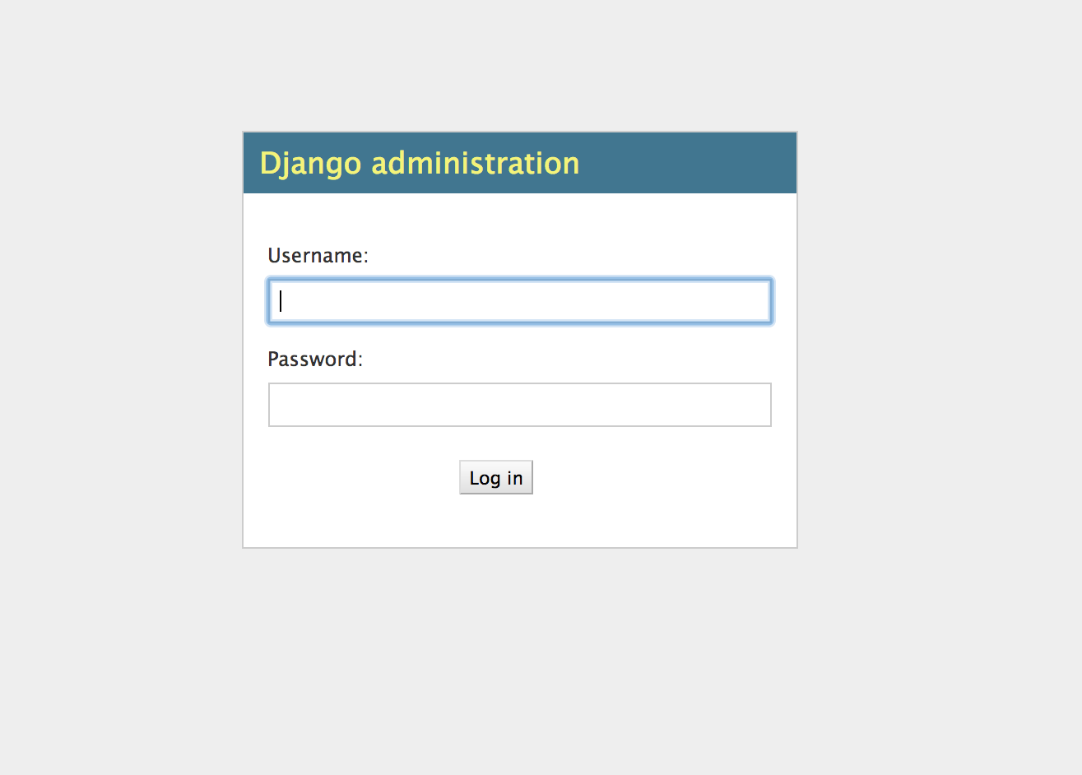
Login page
Notes:
Ashley we will set them up with a username and password so they can login and add new information anytime they like

Slide 12
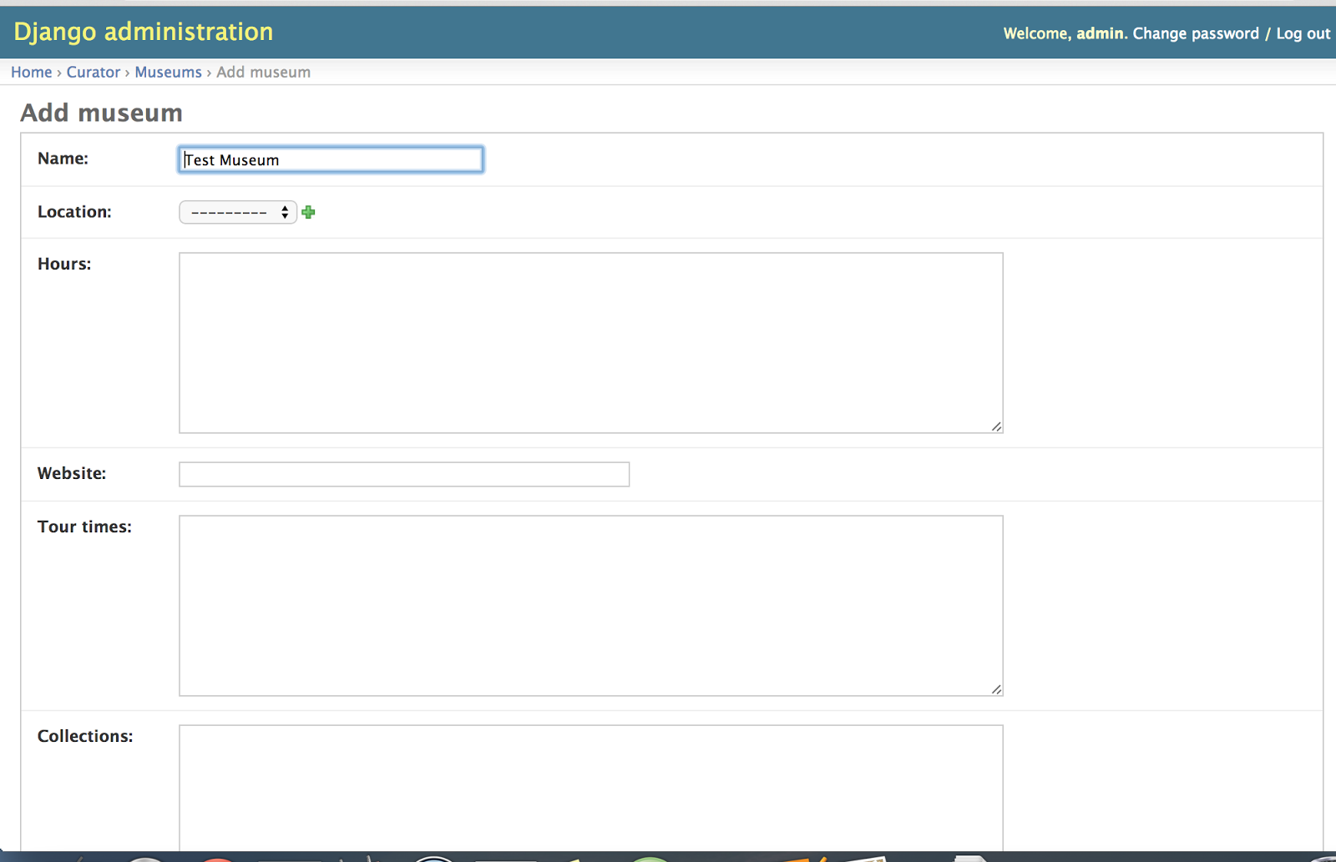
Add and edit museum information
Notes:
Ashey museums can add the display name of the museum, the location, the hours they are open, their website url, tour times, and information about current collections

Slide 13
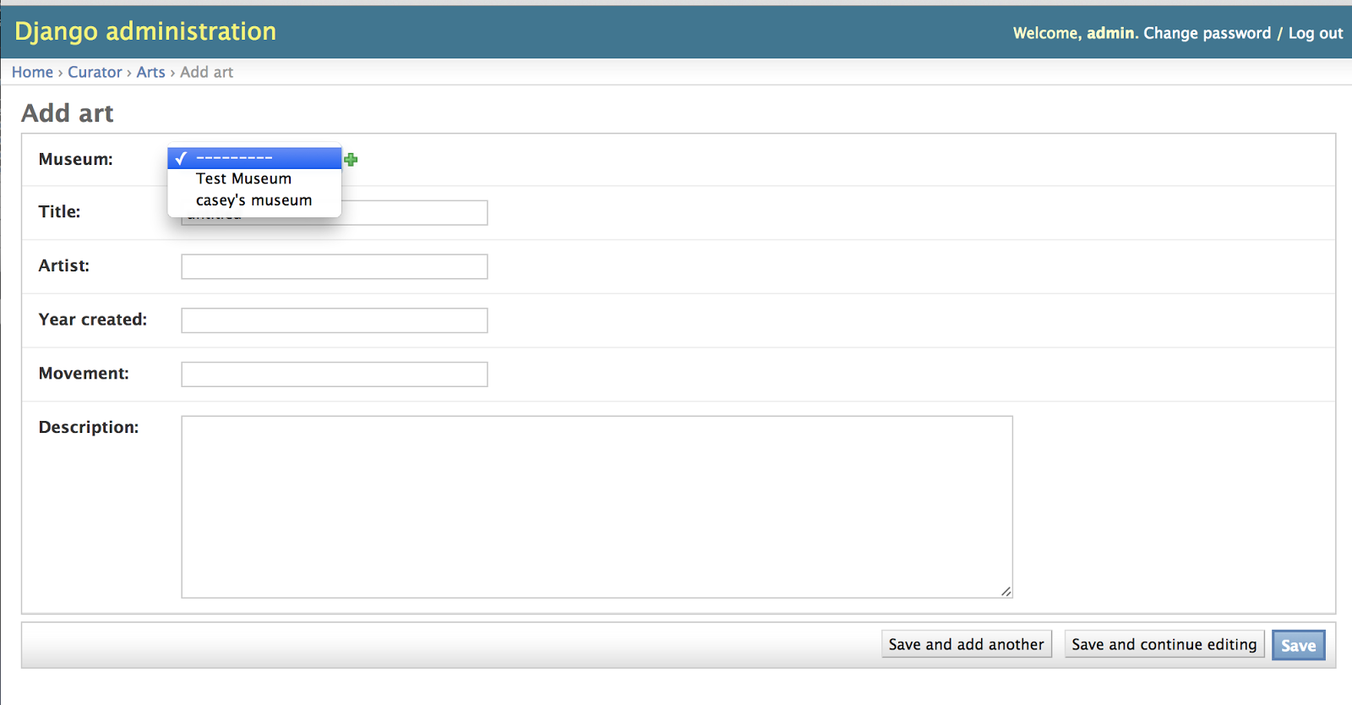
Add and edit art associated with museum
Notes:
Ashley they can then associate art with their museum. museum curators can fill this form with the art’s title, artist, year created, artistic movement, and a description

Slide 14
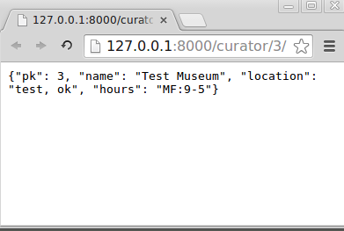
Web Service
Notes:
the mobile android application will be able to send a GET request to our web application to get museum information in the form of a JSON file

Slide 15
Interface for museum patrons
The front end will have a QR code scanner to look up information.
Will also have list of Collections, Events, Tours, Spotlight.
Notes:
Chethan

Slide 16
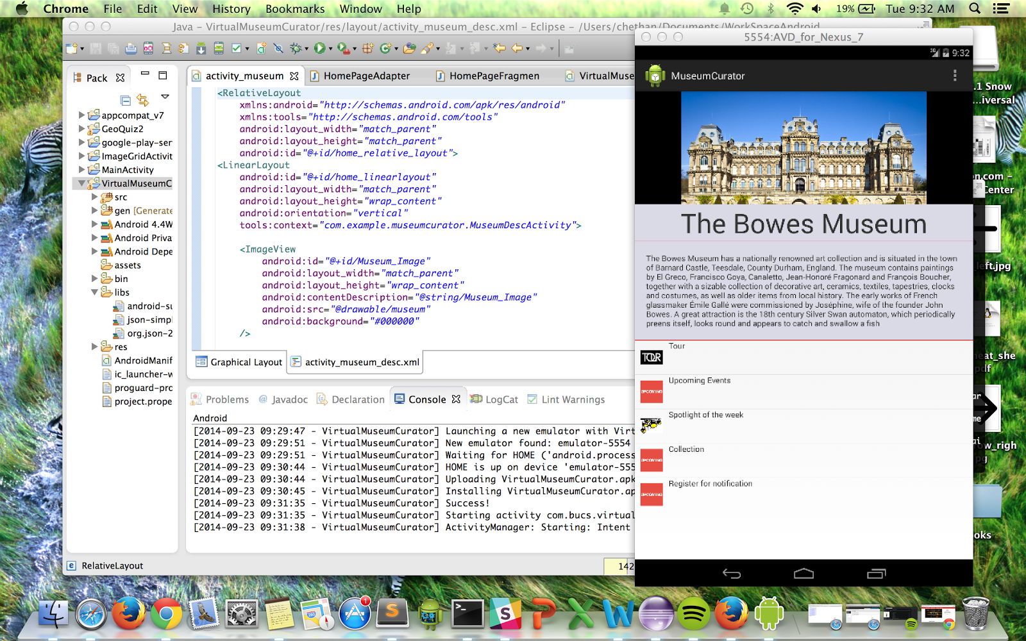
Prototype of the Front page Activity
Notes:
Chethan

Slide 17
Timeline
Iteration 1
Models for database
Museums can add all their information
REST protocol for communicating with Android application
Android visual of museum information and ability to select museum on the app and see the museum info

Slide 18
Timeline
Iteration 2
Museum can upload art objects
Mobile application has access to these objects through search or browse.
Notes:
Each museum has several art objects, which includes a picture and a description (which may go beyond what is displayed in the museum paragraph).

Slide 19
Timeline
Iteration 3
Add QR/bar code to directly look up objects in mobile application.
The mobile application will be able to play audio files about each art objects.

Slide 20
Quality Assurance
Metrics
Fault Profile
Breadth Testing
Standards
Documentation
Coding
Comments
Inspection
Testing
Unit Testing
System Testing
Integration Testing
Defect Management

Slide 21
Configuration Management
GitHub repository
Main branches: front end and back end
New features will be tested in branches off of the two main branches

Slide 22
Questions?

