Slide 1
eDocent
Group5 - Iteration 1

Slide 2
Outline
Recap of first iteration goals
Web portion
Database design
Admin and Web API
Android Frontend
Current Progress
Architecture
Future Work
Demo
Notes:
Nisreen

Slide 3
First Iteration
Goal:
Museums will be able to add all their information including address, hours, tour times, and special exhibits. A REST protocol will communicating with Android application, and the Android interface will provide a visual of museum information.
Notes:
Nisreen

Slide 4
First Iteration
What we have done:
Web Application:
basic database structure (museum and art models and their properties)
museum users can create museum and art objects
A web API that queries the database
Android Application:
Call the API, get JSON responses, parse them and display the museum information to the Android application users.
Notes:
Nisreen

Slide 5
Modeling and Database
Five Main Tables (Museums Data):
Museum Table (one entry for each museum)
Art Table (one entry for each piece)
Artist Table (one entry for each artist)
Exhibitions Table
Tours Table
Notes:
Sukaynah

Slide 6
Modeling and Database
Other Tables for Controlling Users Accounts:
User
Log Entry
Permission
Content Type
Abstract User

Slide 7
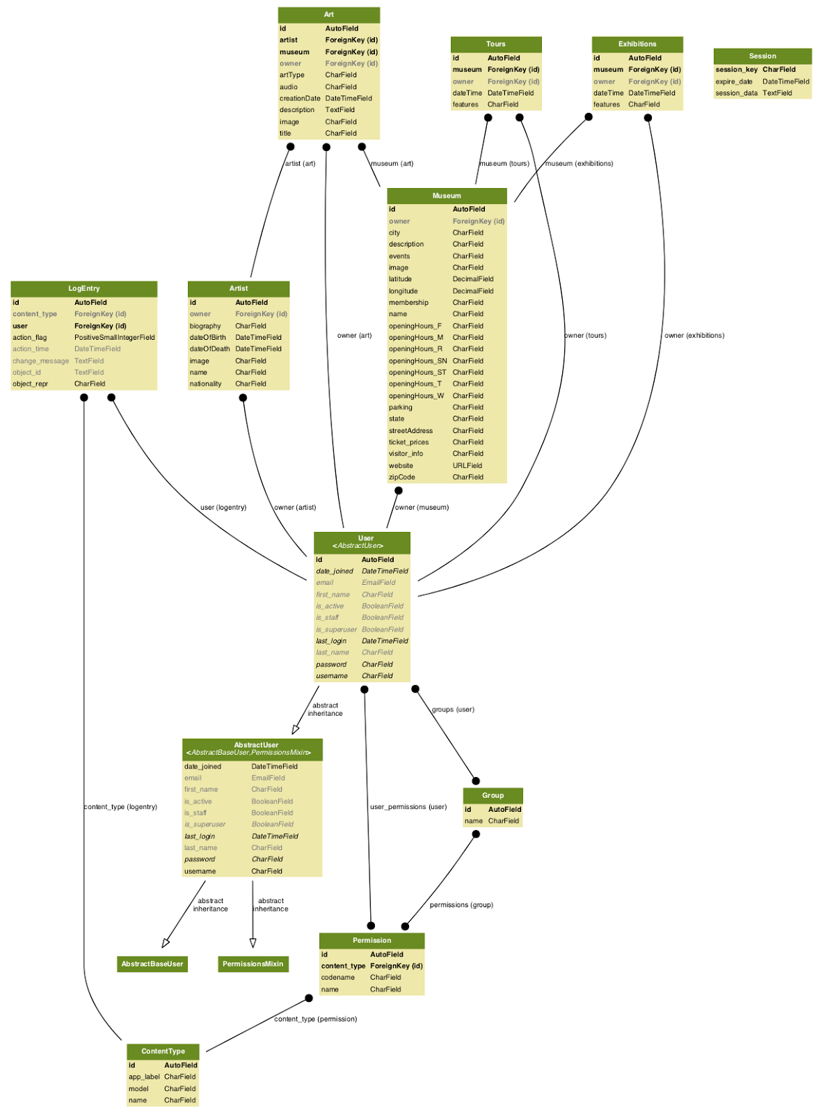
Notes:
ER-Diagram (Database Modeling):
Museum: all fields are “CharField” except Latitude (decimal), Longitude (decimal), and website (URL)
Tours, Exhibitions, and Arts: have a special field that maps to which museum they “belong” → The Foreign Key!
Each artwork has an artist (Art Table contains a foreign key to the Artist Table
As a first step, all these five tables (museum, art, artist, tours, and exhibitions) have foreign key that maps to the user table

Slide 8
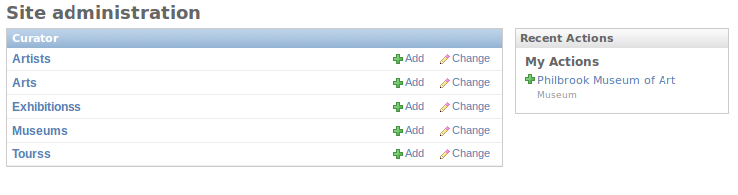
Admin and Object Creation
Notes:
Casey

Slide 9
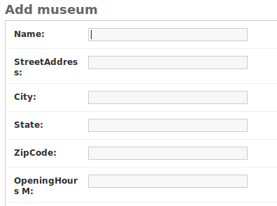

Slide 10

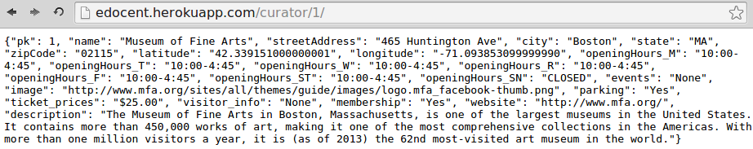
Web API

Slide 11
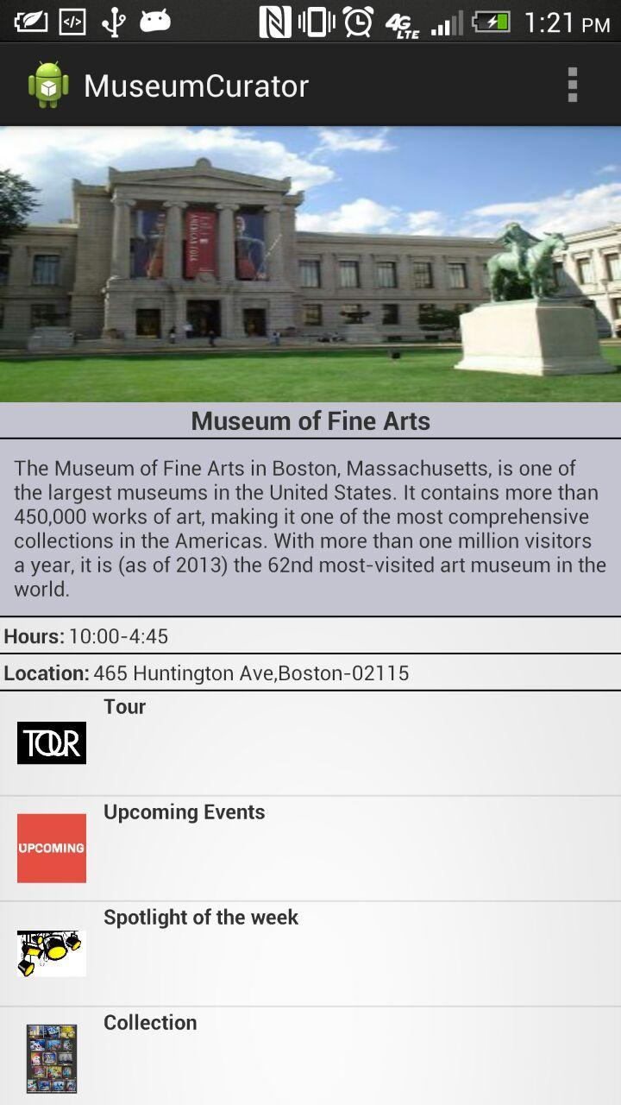
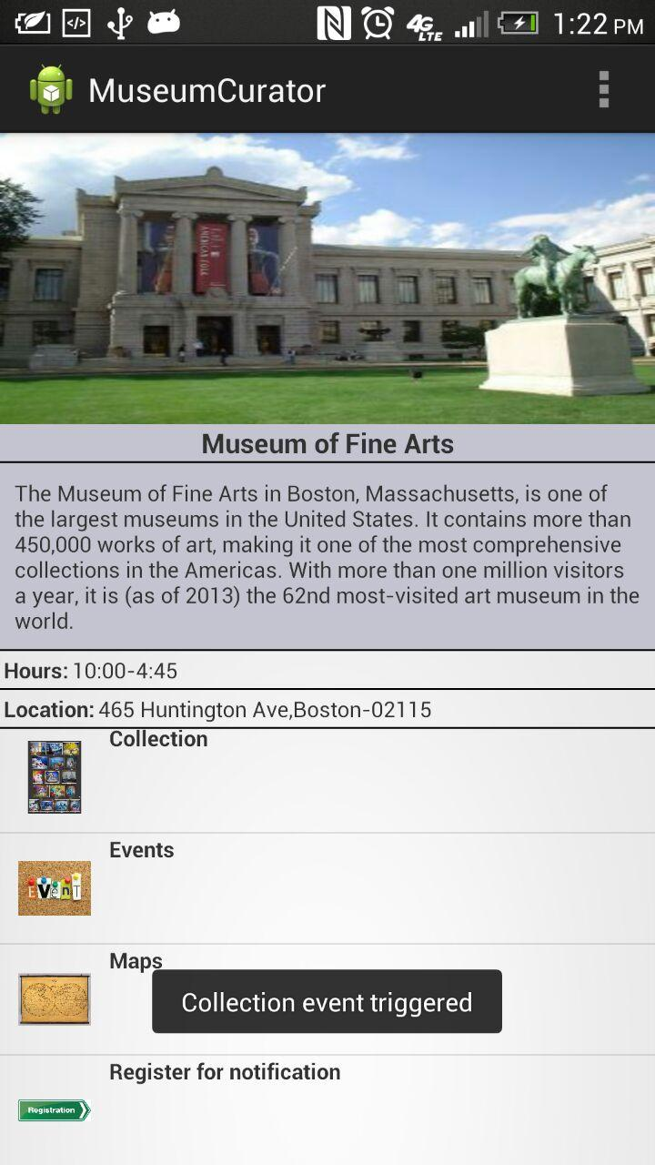
Android Frontend
Current
Progress
Click on Collections

Slide 12
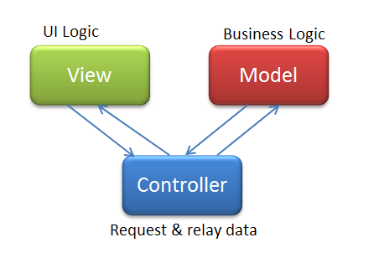
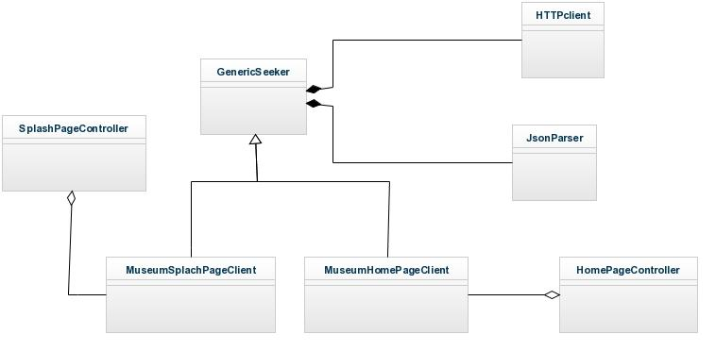
MVC Architecture

Slide 13
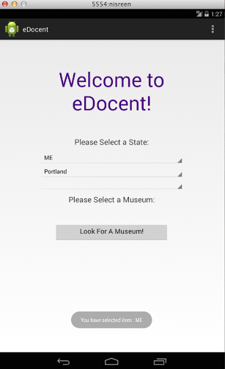
Future Work
Splash Page
Art Works Page
Trigger events from the
homepage

Slide 14
Demo

Slide 15
Questions?

