Slide 1
Agile Software Development CRN-14532-201801 Northern Lights Walk in Clinic Management System Sprint II
Team members:
David Wieczorek 101148080
Allissa Dela Cruz 101019054
Hristo Tsvetkov 100719969
Viacheslav Nepomniashchyi 101184699

Slide 2
Northern Lights Walk in Clinic
Vision: For a busy clinic in a small city who needs to switch to a software system that stores all information electronically. The Clinical Management System is a Web-based service that aides with booking appointments, charging fees, and keeps patients' files up to date. Unlike other services, our clinical management software system provides very capable services that will meet your needs at a reasonable cost.
Mission: Create a clinical management system that enables booking appointments, creating the work schedule, calculating payrolls and deposits, and managing patient files.
Identification of parts completed.
Allissa Dela Cruz: Vision, Mission, User Stories, Registration Forms.
David Wieczorek: Agile Chart, Personas, Doctor’s and Nurse’s Forms.
Hristo Tsvetkov: Additional User Stories, Clinic Manager’s Forms.
Viacheslav Nepomniashchyi: MsProject , Booking forms, integration .

Slide 3
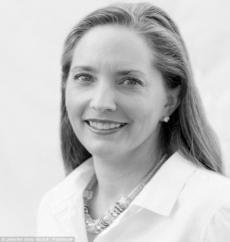
Northern Lights Walk in Clinic
User Stories.
Clinic Manager.
Has a personal goal to be able to make the work schedule according to the staff’s availability so that everyone knows what days and shifts they will be working.
***
I need to be able to calculate the total fee payable to each doctor (based on sick notes, etc.) and give it to the concerned doctor, so that they can sign a receipt and I can keep it in the clinic records.
***
I would like to be able to fill a form that adds the amounts of fee money at the end of every month and deposit the total amount in the clinic’s bank account so that I will no longer have to manually add the numbers myself.
***
I would like to be able to calculate the number of hours worked for each person so that I can provide this information to our accountant and they can take care of the payroll and salaries.

Slide 4
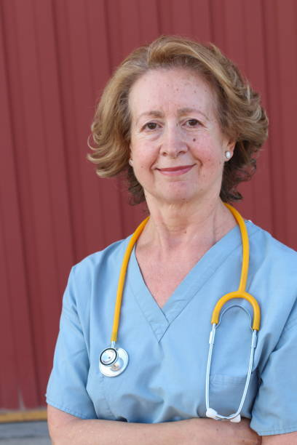
Northern Lights Walk in Clinic
User Stories.
Doctor.
I need to be able to record the patient’s symptoms, diagnosis, medications, and lab tests prescribed to the patient so that I can keep track of their medical history. Especially now since I have been mandated by law to do this electronically.
***
My personal goal is to be able to refer patients to a specialist doctor and enter this information in the file so that I can keep track of other doctors the patient sees.
***
I would like to be able to keep the letter written by specialist doctors in the patient’s file so that I am aware of the specialist’s assessment of the patient.

Slide 5

Northern Lights Walk in Clinic
User Stories.
Nurse.
I need to be able to note the patient’s vitals and brief history of problems/symptoms in their file so that we have a written record of their current state.

Slide 6

Northern Lights Walk in Clinic
User Stories.
Receptionist.
I would like to be able to book appointments for patients who have a permanent family doctor so that they are able to see their doctor at their preferred time.
***
I would like to be able to cancel or reschedule booked appointments so that I can make adjustments if a patient is unable to come at their scheduled time.
***
I would like to be able to charge $30 to patients that missed their appointment so that they will know to cancel their appointment in the future if they are unable to make it.
***
I would like to be able to check in walk in patients so that they can be placed in a queue and be seen by the next available doctor.
***
I would like to be able to set a default time slot for a patient appointment with a doctor for 15 minutes, or 30 minutes for patients with special circumstances, so that I can see where other patients can be scheduled in for the day.
***
I would like to be able to verify the patient’s health card, address, and contact details upon arrival, so that the clinic is up to date with the patient’s information.
***
I would like to be able to mark “check in” status for a patient upon arrival and mark “check out” status at the end of the appointment so that I can make sure that the patient has completed their appointment.
***
I would like to be able to charge fees for services such as sick notes and keep information about the fees and payment status in the patient’s file, so that I can collect the money needed and note what the service was.

Slide 7

Northern Lights Walk in Clinic
User Stories.
Patient.
I would like to be able to fill out a registration form that contains my basic information so that the clinic can keep a personal file that will include my information and medical history.
***
I would prefer to be able to book an appointment with my family doctor on-line so that I do not need to call to the clinic and wait.
***
I would like to be able to skip a queue in some cases, so I do not need to wait for a doctor when I have an emergency case.

Slide 8
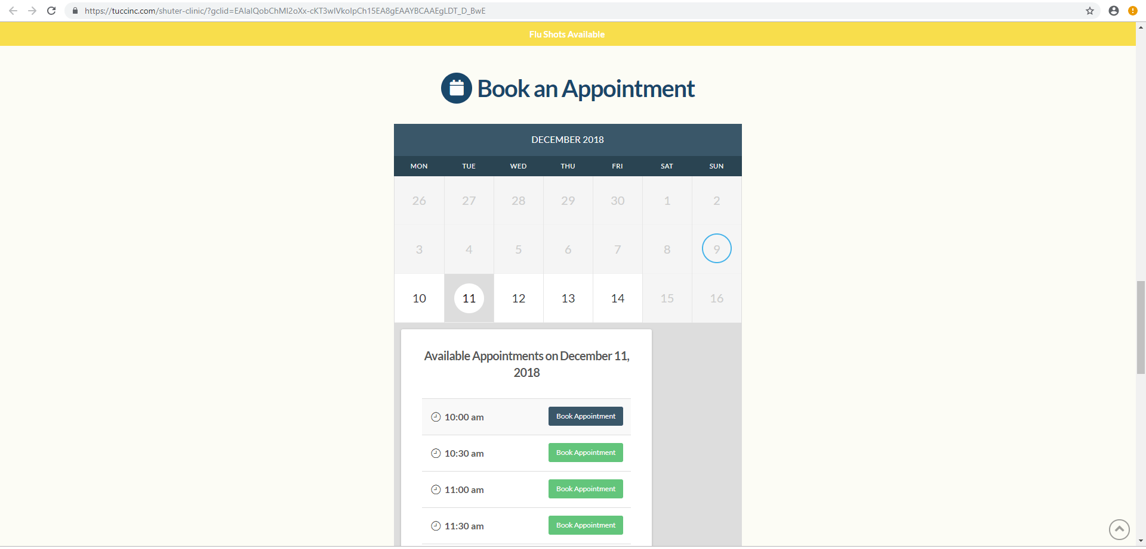
Northern Lights Walk in Clinic
Business Case 1.
Patient comes to the clinic.
a) Patient fills in Health Card#, DOB and code on-line
b) New patient fills out additional form with contact info.
c) Patient may choose preferred date and time for the visit:

Slide 9
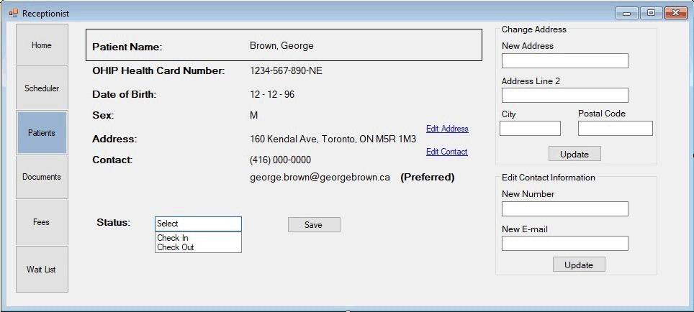
Northern Lights Walk in Clinic
Business Case 1.
Patient comes to the clinic.
d) Registration form filled out by Receptionist for every new patient. Receptionist can Check Patient In and verify contact information of a returning Patient.

Slide 10
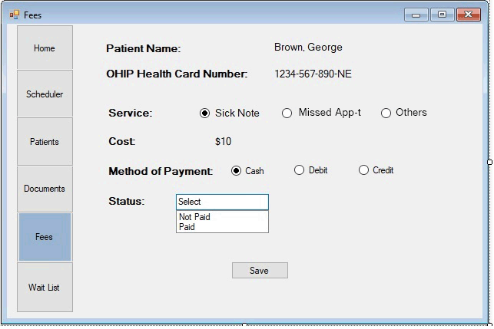
Northern Lights Walk in Clinic
Business Case 1.
Patient comes to the clinic.
e) Fees for a Sick Note ($10) or for a Missed Appointment ($30) charged by Receptionist at this time if it is a case.

Slide 11
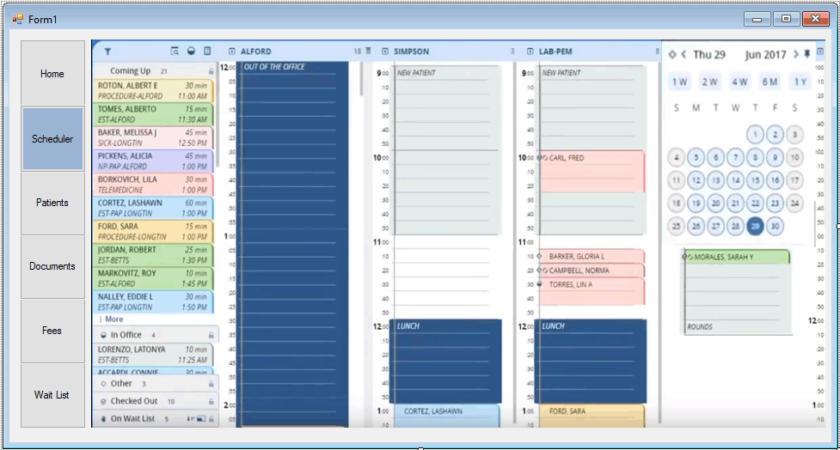
Northern Lights Walk in Clinic
Business Case 1.
Patient comes to the clinic.
f) Patient placed in a queue by Receptionist depends on:
* family doctor room or walk in case;
* one or two 15-minute slots are needed;
* general case or an emergency.

Slide 12
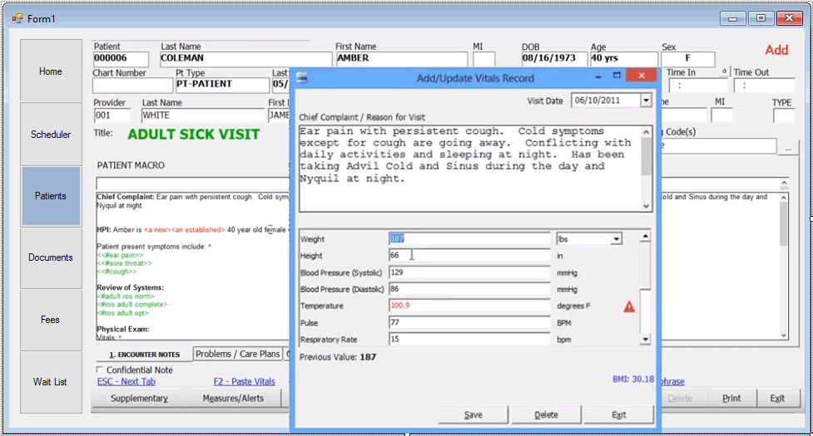
Northern Lights Walk in Clinic
Business Case 1. Patient comes to the clinic.
g) Receptionist assigns a room for Patient, so Nurse sees pop up forms to take Patient’s vitals, complaints etc.
h) Doctor switches to the diagnosis Form and picks standardized phrases from the template or may add own. Doctor chooses Tabs below to review passed tests and letters from other doctors specialists or assigns new tests, referrals and types a prescription:

Slide 13
Northern Lights Walk in Clinic
Business Case 1. Patient comes to the clinic.
i) Receptionist checks Patient out. Follow up visit can be booked at this time if needed.

Slide 14
Northern Lights Walk in Clinic Reflections
We did many types of research:
Personal experience when visiting a clinic.
Interview with a nurse.
Healthcare section
We enjoyed designing this application due to the immense amount of skills required to complete it.
We should have communicated more effectively using real time messaging instead of email only.

Slide 15

Northern Lights Walk in Clinic & Agile Software Developers Team HOPE YOU HAVING WONDEFUL DAY
(C) Copyright George Brown College, A. Rana & Agile Team I, 2018.

