Slide 1



Modules
METIS
MPI
OpenMP
Dynamic SSSP
00
Parallelizing updates to the Single Source Shortest Path Tree
01
Start Slide
02
i190479 Tabarak Sikander, i220862 Musayyab, i22235 Fasih Shahid
Notes:
Graph is mapped into a SSSP tree, solution is not unique. (Multiple trees can be formed). Dynamic means an edge can be added or removed at real time. Tree solution can be recomputed or only affected parts can be updated.
Using Data Portioning in METIS, internode communication using MPI and intranode optimizations using OpenMP

Slide 2
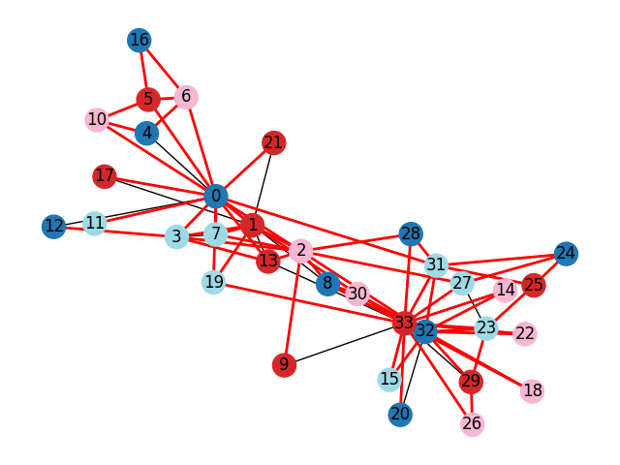
Modules
METIS
MPI
OpenMP
How HPC solves this?
01
METIS Partitioning:
Divides graph into balanced subgraphs (minimizing edge cuts).
Each MPI rank processes a partition locally.
Boundary Synchronization:
Only adjacent partitions communicate (red edges in visualization).
Asynchronous updates reduce wait times (Sec 4.2).
Shared-Memory (OpenMP):
Dynamic Scheduling:
Processes batches of edge changes (Sec 5.1).
#pragma omp parallel for schedule(dynamic) handles load imbalance.
Key HPC Benefit:
"Achieves 5x speedup over Galois by focusing updates on affected subgraphs (Sec 6)."
02
03

Slide 3
Modules
METIS
MPI
OpenMP
METIS in Parallel SSSP
Divides large graphs into balanced subgraphs for distributed (MPI) or shared-memory (OpenMP) processing.
02
Graph G(V, E) is input.
Output:
Balanced partitions (each with ~equal nodes).
Minimized edge cuts (edges between partitions).
Paper’s Use Case:
Partitions dynamic graphs before MPI/OpenMP updates (Sec 4).
03
04
Graph → METIS → Partitions → MPI Ranks → Parallel SSSP Updates
Notes:
Algorithm:
Multilevel Partitioning:
Coarsening: Shrinks the graph iteratively.
Partitioning: Splits the coarsest graph.
Refinement: Improves partitions while uncoarsening.

Slide 4

Modules
METIS
MPI
OpenMP
MPI for Distributed SSSP Updates
Core MPI Strategy
Partition-Centric Processing:
Each MPI rank owns a subgraph (from METIS).
Local computation → boundary sync (no global barriers).
Communication Patterns in Paper:
Non-Blocking Point-to-Point (Isend/Irecv), to synchronize boundary node distances between partitions. Sec 4.2 (Algorithm 2).
Overlaps computation + communication.
Avoids deadlocks in dynamic updates.
MPI_Bcast for Initialization, Distribute graph metadata (e.g., partitions, source node).
Section 4.1: Problem Setup
MPI_Allreduce, Sync global distance for critical nodes.
4.3 (Algorithm 3 convergence).
Ensures correctness when partitions diverge.

Slide 5

Modules
MPI
OpenMP
Introduction to OpenMP for Intra-Node
Parallelism
Updating shortest paths in dynamic networks requires high
performance—not just cross nodes (like GPUs), but within them.
OpenMP enables full utilization of multi-core CPUs for intra-node
parallelism,reducing update times without heavy
synchronization overhead.
04
Performance
05
All edge changes (insertions & deletions) are independent. Processed in parallel.
OpenMP eliminates the need for synchronization because:
Each thread updates non-overlapping parts of the graph.
Shared-flags (Affected, Affected_Del) are set with one-directional
logic.
Step1
06
Notes:
Shared Memory Parallelism:
1. Edge Change Handling:
- Edge insertions and deletions processed in parallel.
- Uses OpenMP’s parallel for to accelerate Step 1.
2. SSSP Tree Update:
- Only affected subgraphs are updated.
- Uses dynamic scheduling to manage irregular workloads.
Benefit: Reduced recomputation and better scalability.

Slide 6
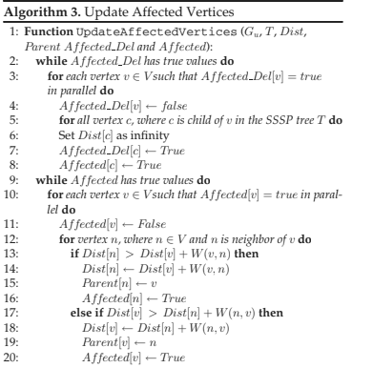
Modules
MPI
OpenMP
Introduction to OpenMP for Intra-Node
Parallelism
Parallel Update of Affected Subgraphs:
Challenge:
Descendant nodes of affected vertices need to be disconnected
and re-evaluated.
Solution with OpenMP:
OpenMP threads dynamically traverse affected subtrees.
Redundant updates are tolerated to avoid locking.
Iterative convergence ensures correctness:
- Vertices update their distance if a better path is discovered.
- Threads continue until no further improvements are made.
04
Step2
05
06
Notes:
Shared Memory Parallelism:
1. Edge Change Handling:
- Edge insertions and deletions processed in parallel.
- Uses OpenMP’s parallel for to accelerate Step 1.
2. SSSP Tree Update:
- Only affected subgraphs are updated.
- Uses dynamic scheduling to manage irregular workloads.
Benefit: Reduced recomputation and better scalability.

Slide 7
Asynchronus Updates
Concept:
Relax synchronization even further by allowing updates across
multiple levels before syncing.
Implementation:
Set an asynchrony level (e.g., update distance for neighbors up to
d levels deep).
Reduces the frequency of thread barriers.
Trades off a bit of redundant computation for speed.
Result:
Improved performance in practice, especially on large,
sparse graphs.
06
07
08

Slide 8
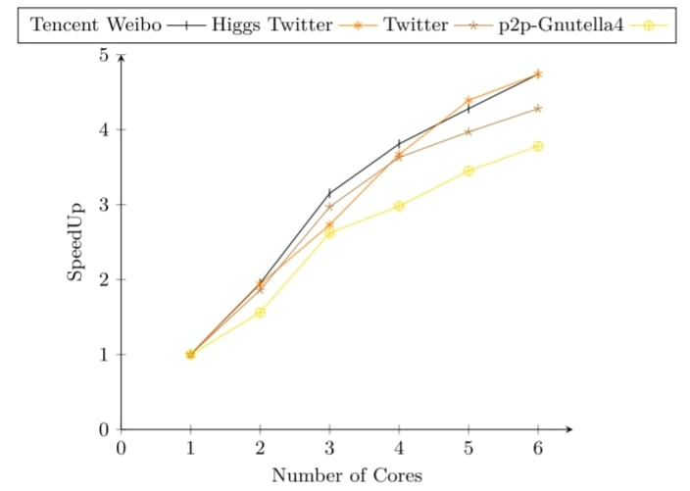

Conclusion
07
Experimental Results:
- Up to 5x speedup vs. Galois (state-of-the-art recompute framework).
- Works well up to 72 threads.
- Batching changes improves cache usage and thread distribution.
Scalability Tactics:
- Dynamic scheduling in OpenMP to handle imbalance.
- No locks — relies on convergence instead.
- Only the affected subgraphs are updated, not the entire graph.
08
09

