Slide 1
Comparatii privind algoritmi de invatare pentru cifre scrise de mana
Realizat de:
Surdu Cosmin
Zaharia Raul

Slide 2
Motivatia
Am ales sa monitorizam doar cifrele multimita echivalentei dintre tot alfabetul si doar cifrele
Exista foarte multe modele de test pentru cifre si putem vedea cum reactioneaza algoritmul ales pentru foarte multe “modele” avand, de asemenea, si teste
Ce urmarim

Slide 3
Baza de date
Baza de date de la MNIST => 30 de mii de imagini
Poze normalizate => 784 pixeli
Poze centrate in mijloc

Slide 4
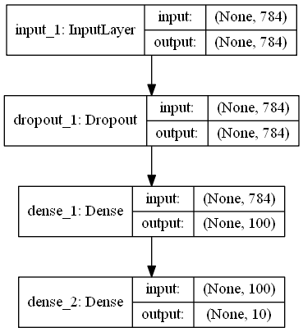
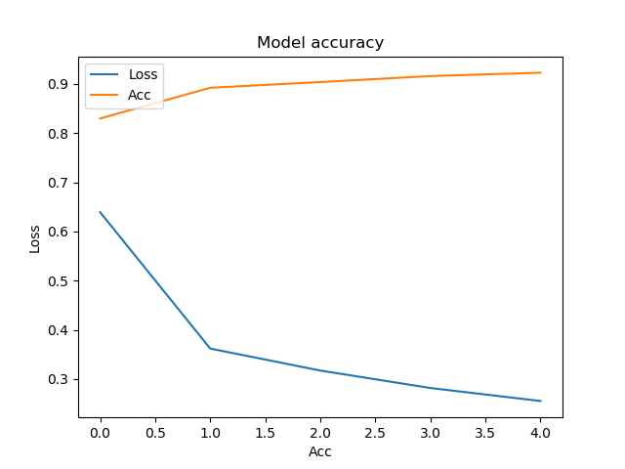
igmoid,,softmax
Loss: 0.1943387132793665; Acc: 0.9435

Slide 5
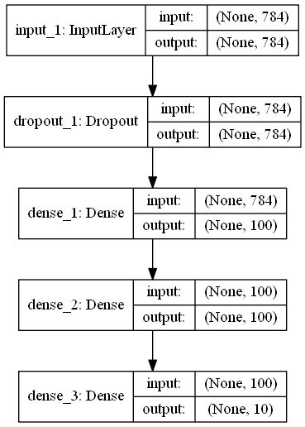
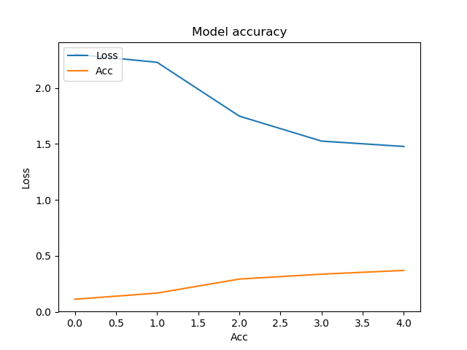
sigmoid,softmax,softmax
Loss: 1.420113613128662; Acc: 0.4004

Slide 6
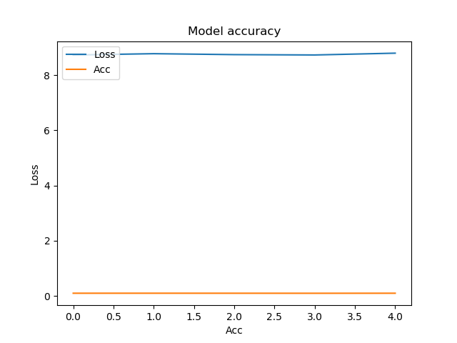
sigmoid,tanh,tanh
Loss: 8.060659577941895; Acc: 0.1009

Slide 7
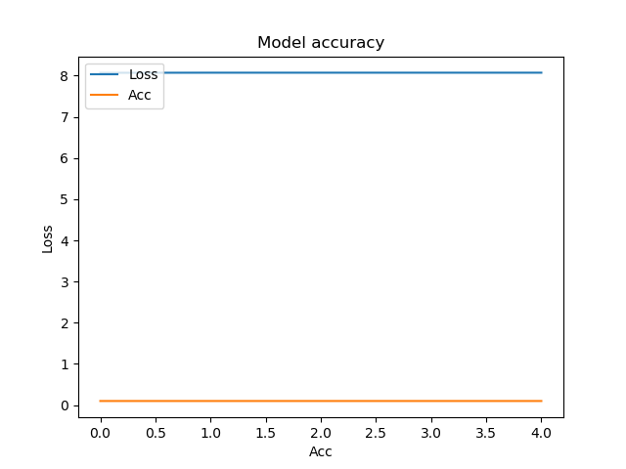
relu,,softmax
Loss: 0.09182416197778658; Acc: 0.9709

Slide 8
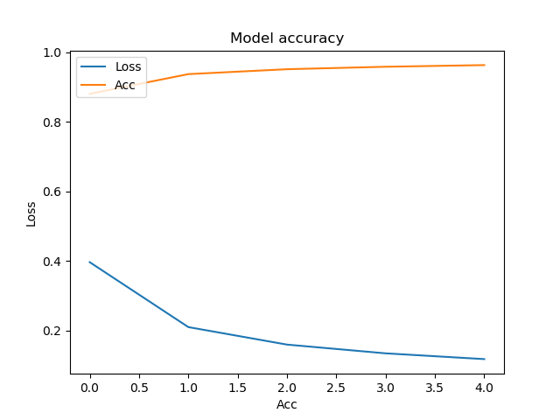
relu,,softmax
Loss: 0.08989390182644129; Acc: 0.9724

Slide 9

sigmoid,,elu
Loss: 12.770374227905274; Acc: 0.273

Slide 10
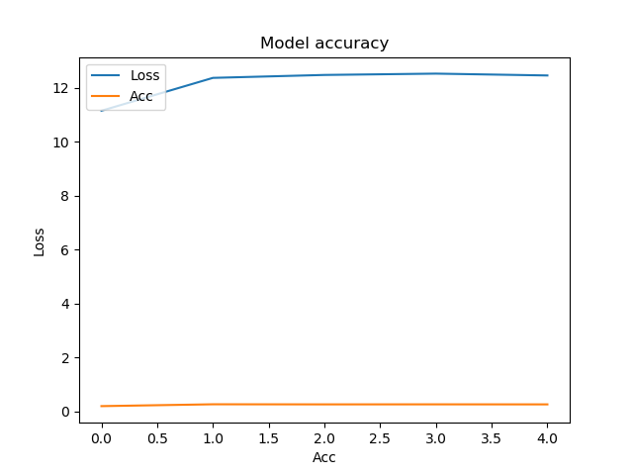
sigmoid,softmax,elu
Loss: 14.573981651306152; Acc: 0.0958

Slide 11
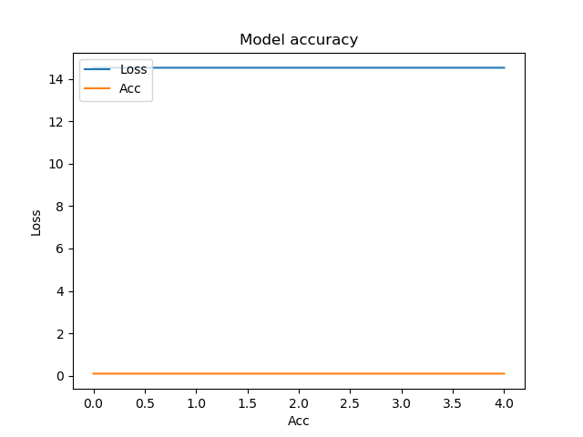
sigmoid,,selu
Loss: 7.8382354179382325; Acc: 0.2422

Slide 12
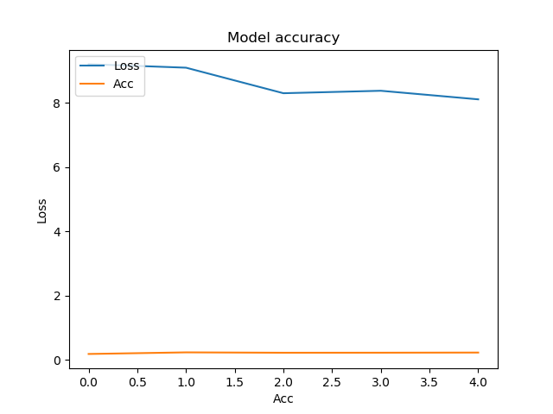
sigmoid,softmax,selu
Loss: 4.693589418792724; Acc: 0.1028

Slide 13
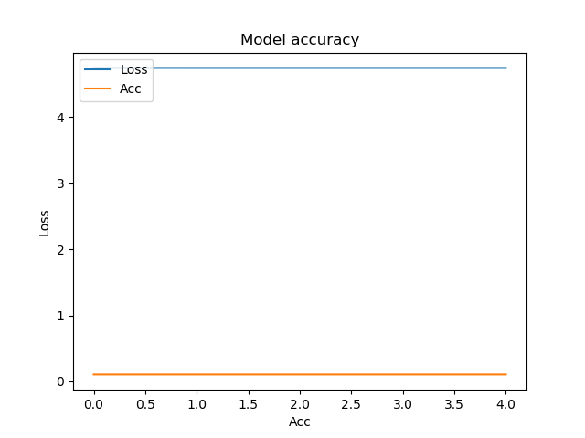
sigmoid,,softplus
Loss: 0.2019722980722785; Acc: 0.9427

Slide 14
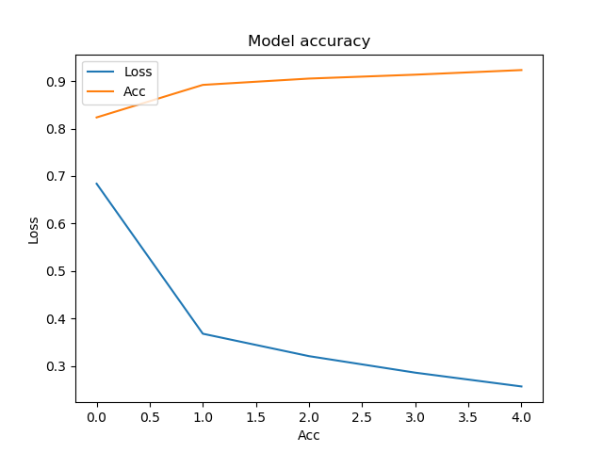
sigmoid,softmax,softplus sigmoid,softmax,softmax
Loss: 1.420113613128662; Acc: 0.4004

Slide 15
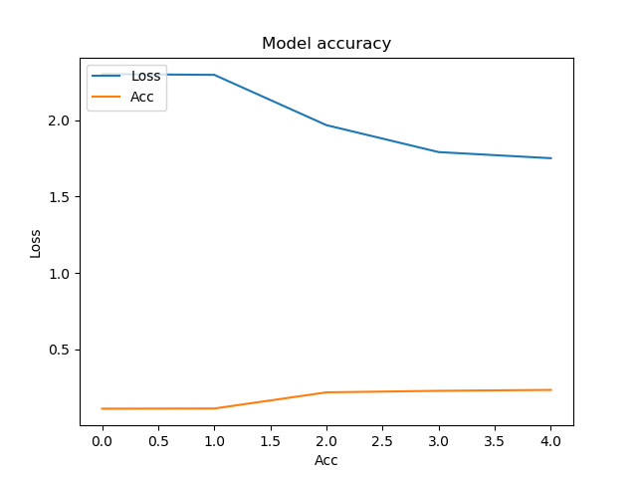
sigmoid,,softsign
Loss: 8.01391713256836; Acc: 0.0982

Slide 16

sigmoid,softmax,softsign
Loss: 2.3011634201049804; Acc: 0.1135

Slide 17
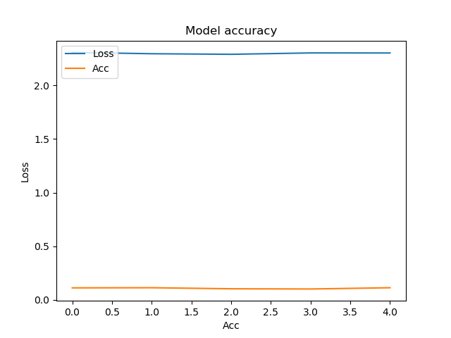
sigmoid,,relu
Loss: nan; Acc: 0.098

Slide 18
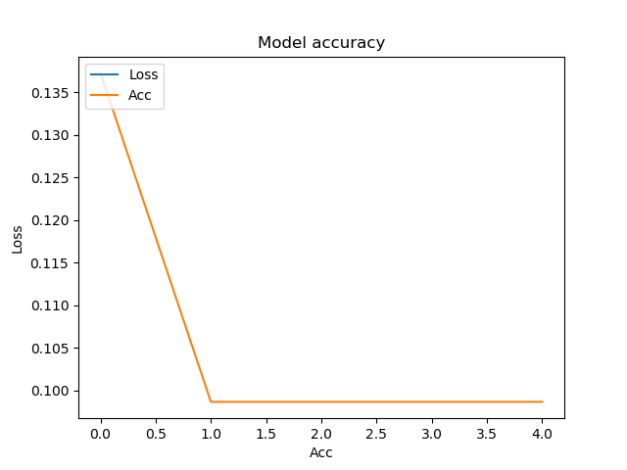
sigmoid,softmax,relu
Loss: 5.941976052093506; Acc: 0.1964

Slide 19
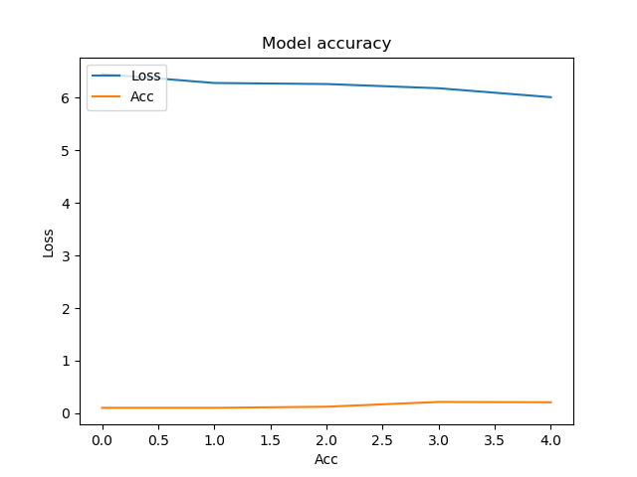
sigmoid,,softsign
Loss: 8.67475904083252; Acc: 0.1009

Slide 20
Concluzie
Cel mai bun model:
  RELU
  SOFTMAX
  ACC => 0.97

