Slide 1

converse
converse is an open-source headstart project to build a chat application.
It is built with React, Redux & Firebase.
It is currently supported by web browsers but it is constructed to work on all major platforms as a PWA in near future.

Slide 2



React
React is an open-source, front end, JavaScript library for building user interfaces or UI components.
It is maintained by Facebook and a community of individual developers and companies.

Slide 3




Redux
Redux is a predictable state container for JavaScript applications.
It proves to be one of the best state management options to go with.

Slide 4



Firebase
Firebase is a platform developed by Google for creating mobile and web applications.

Slide 5
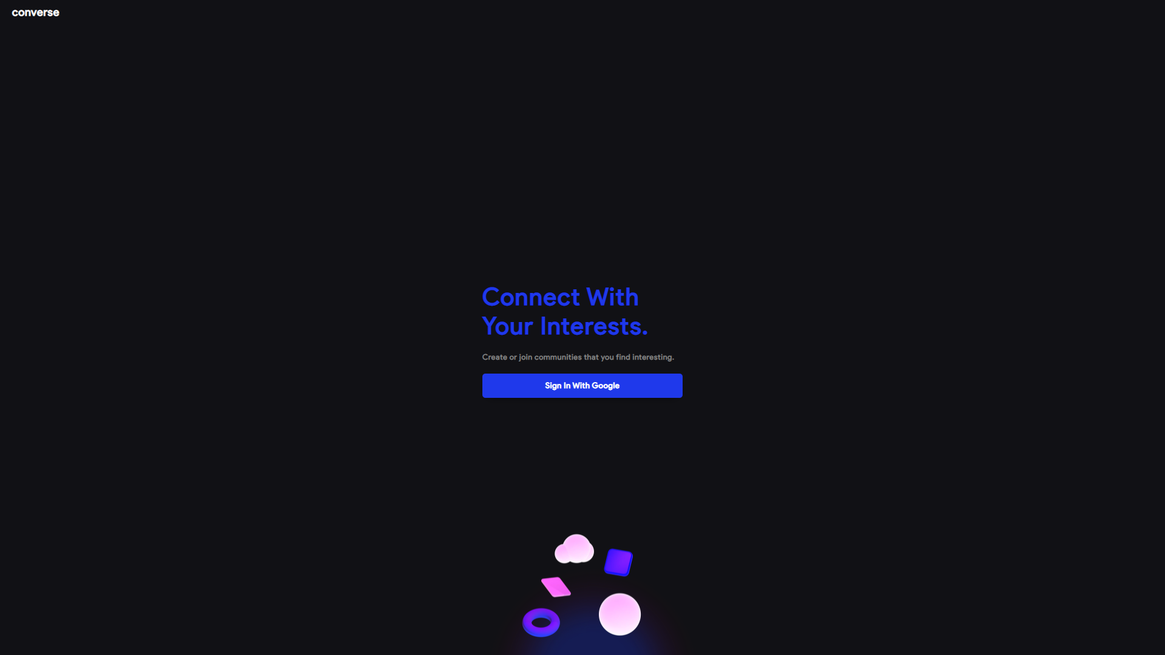
Hassle-free Sign up / Sign in
Users do not have to manually enter their details.
We make it convenient for the users to just click a button and done.

Slide 6

New to converse ?
Don’t worry. There are very simple instructions in the application that would guide you to your goal.

Slide 7
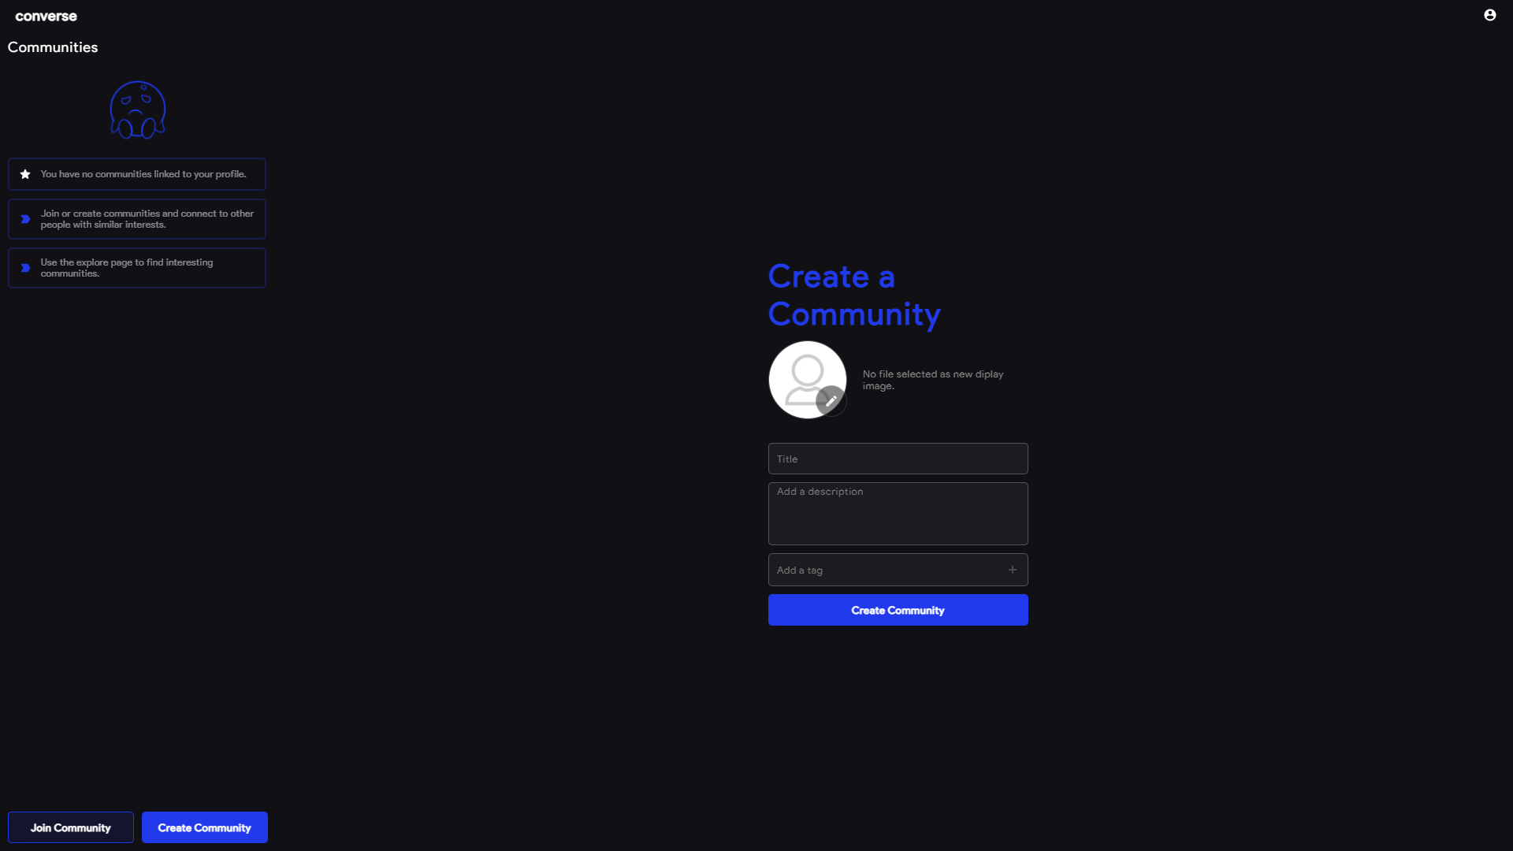
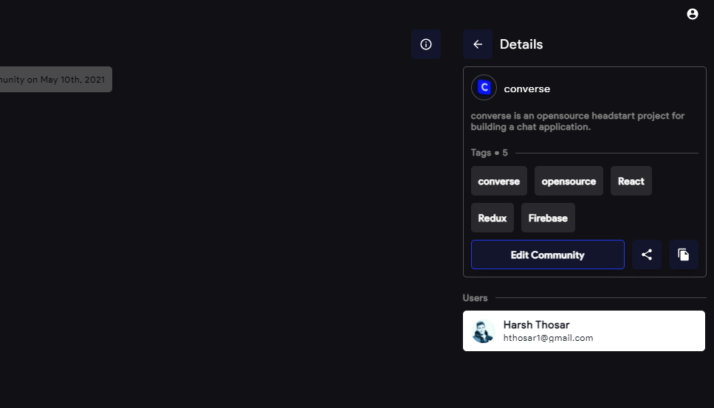
Create new Communities
Create your own community to host discussion on any topic.
Use the Share URL or Copy Code option found in the details section of your community for others to easily discover your community and join along.

Slide 8
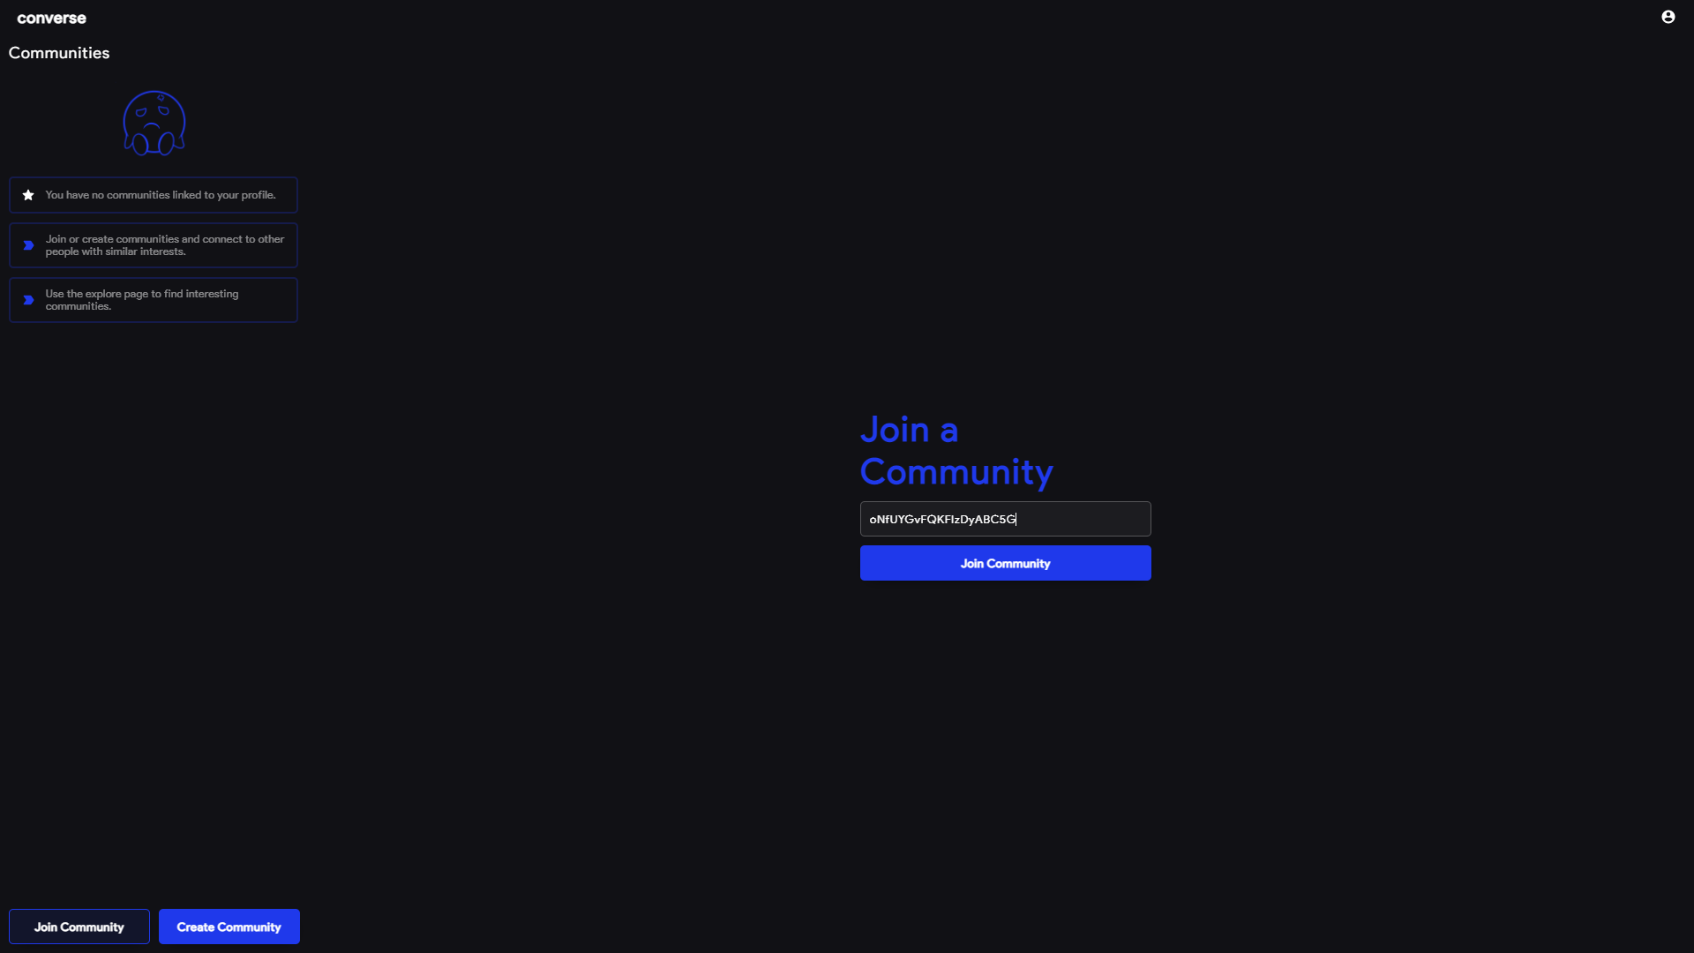
Join Communities
Join a community using the share code.

Slide 9
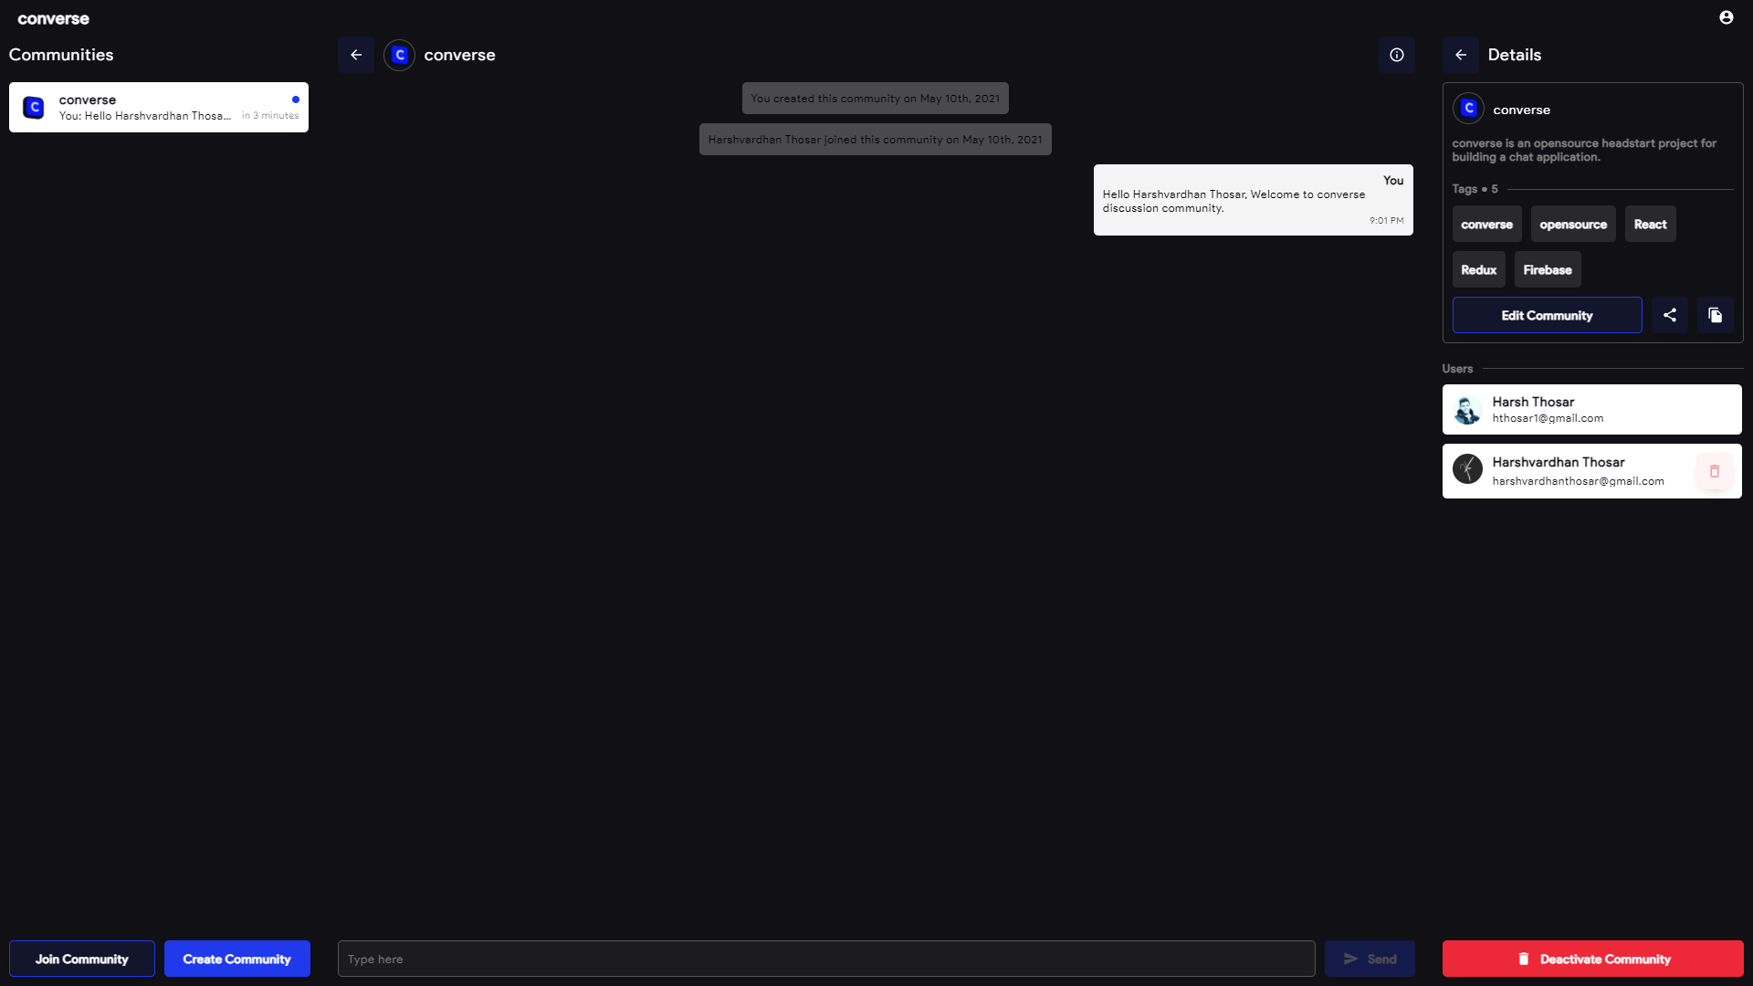
Manage users & Update the Community Details
The creator of a community can update the details of the community & remove any particiant

Slide 10
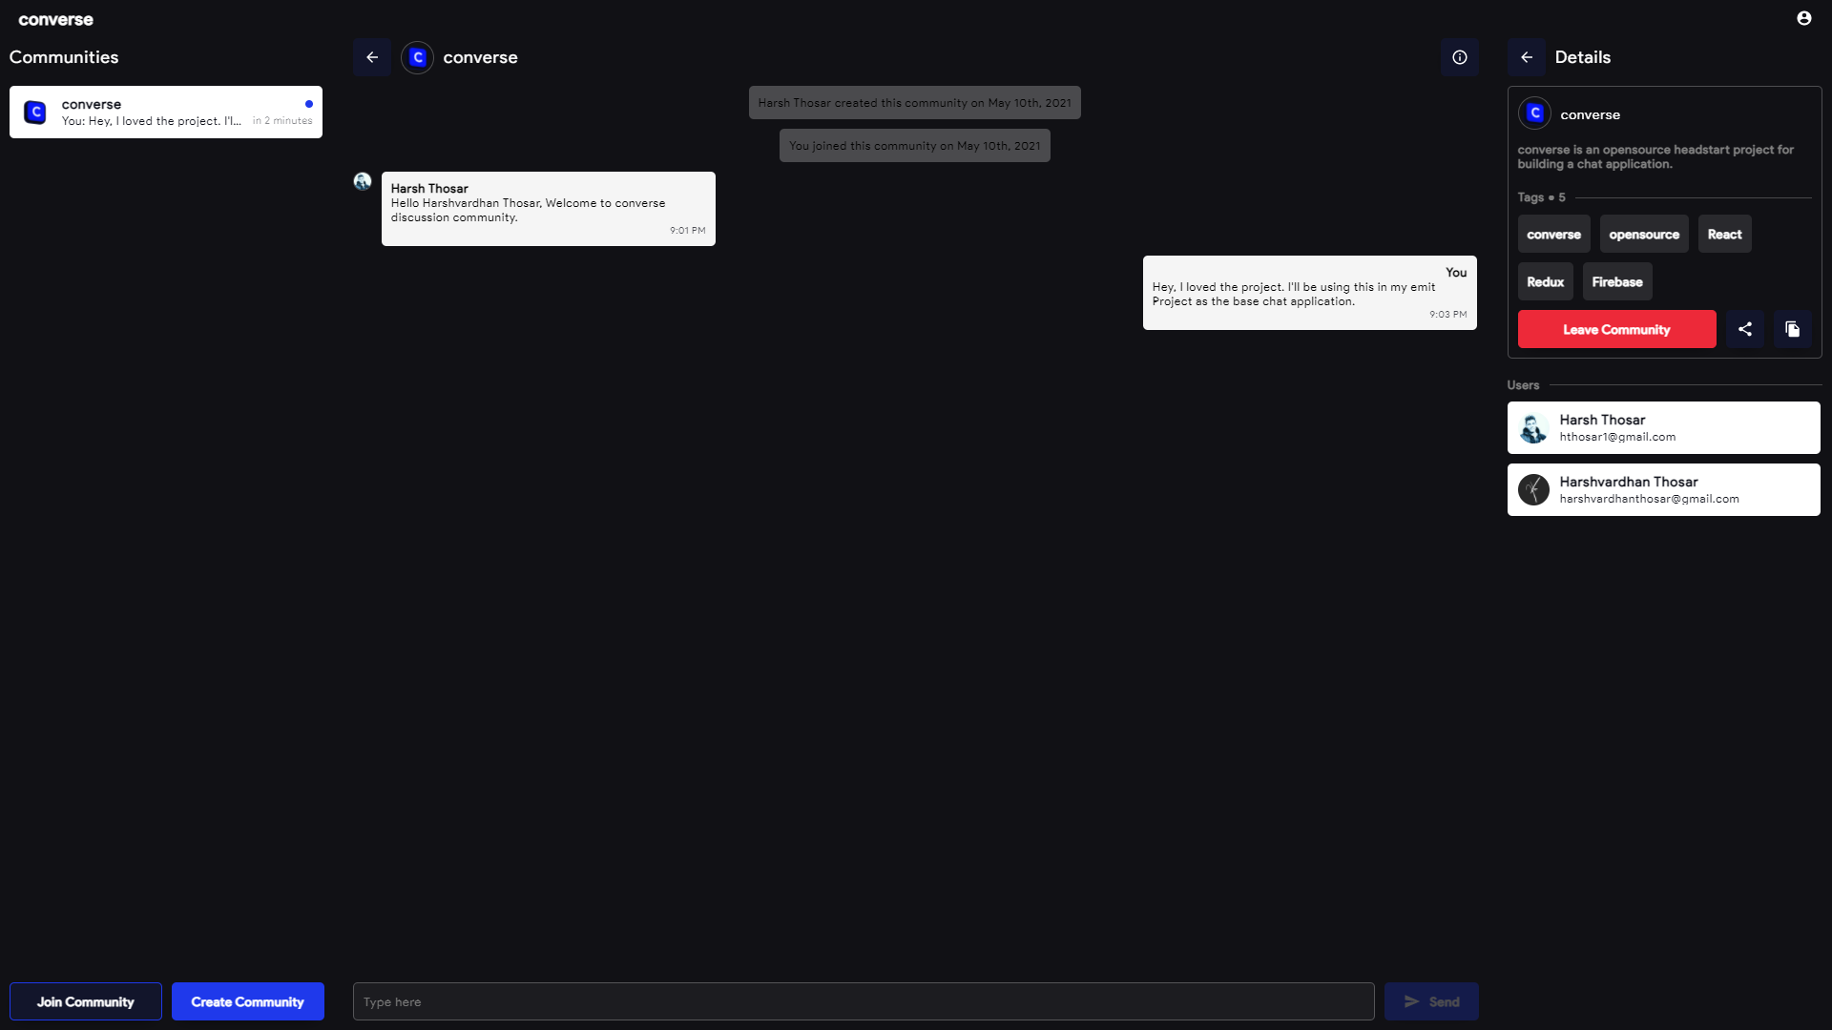
Have a great conversation
Participants of a community can chat with each other.

Slide 11


Thank You
converse
https://github.com/tabassum-siddiqui/converse

