Slide 1
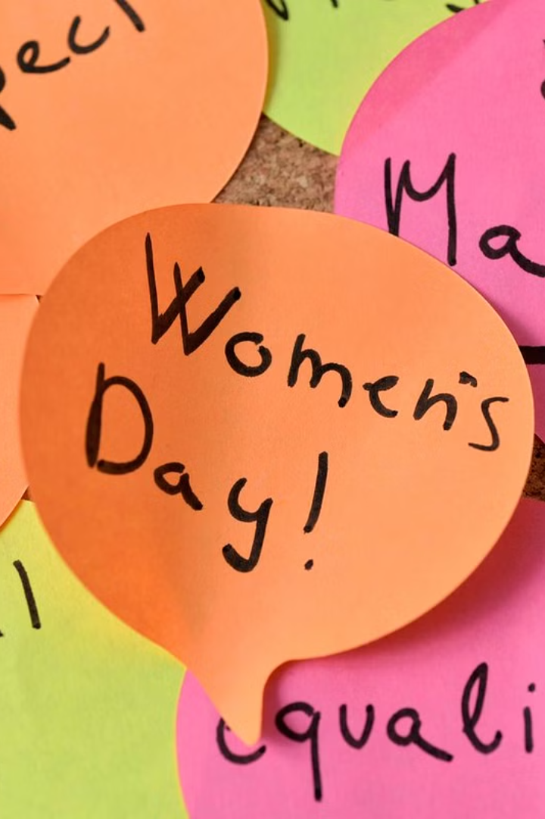
Introduction to International Women's Day
International Women's Day is a global day celebrating the social, economic, cultural, and political achievements of women. It's also a call to action for accelerating gender parity.

Slide 2
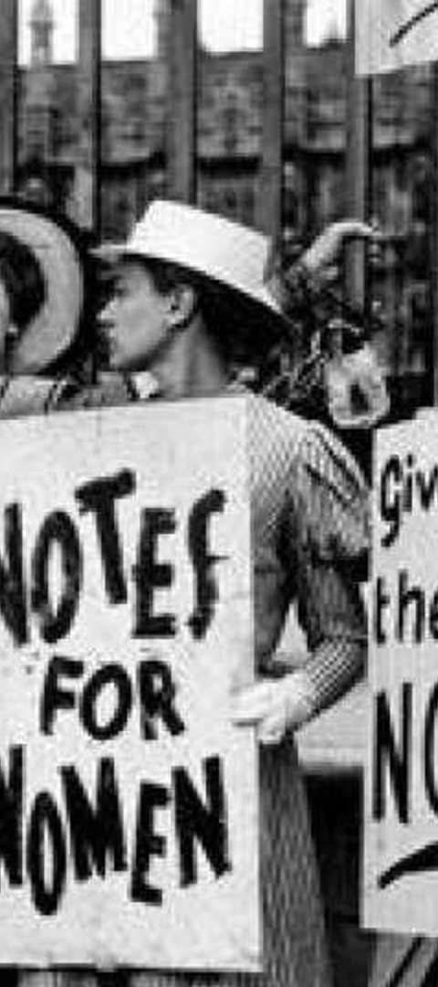
History and Significance of International Women's Day
1
Origins
First observed in 1911, inspired by movements for women's rights and suffrage.
2
Significance
It commemorates the tireless efforts of women to gain equality and justice.
3
Global Celebration
Now celebrated worldwide, advocating for women's rights and gender equality.

Slide 3



Achievements and Progress Made by Women Globally
Leadership
Education Equality
Empowerment
Women leading in politics, business, and social change.
Significant progress in girls' access to education and higher education.
Initiatives empowering women economically and socially.

Slide 4

Challenges and Barriers Still Faced by Women
Gender Pay Gap
Violence Against Women
Unequal pay for the same work remains a prevalent issue.
Physical and emotional abuse continues to impact women globally.
Underrepresentation
Women are underrepresented in leadership and decision-making roles.

Slide 5




Promoting Gender Equality and Women's Rights
Legislation
Advocating for laws promoting gender equality and women's rights.
Education
Raising awareness and educating society on gender equality issues.
Empowerment
Programs and initiatives empowering women in all aspects of life.

Slide 6
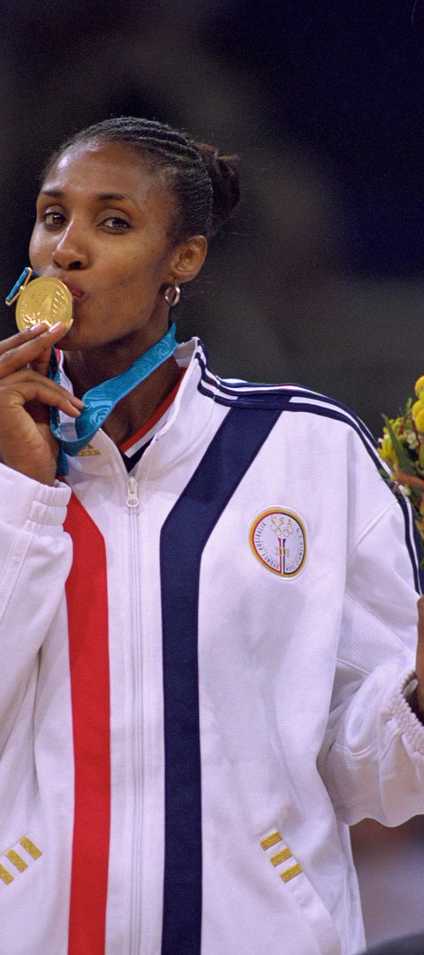
Celebrating Women's Achievements and Contributions
1
Science & Innovation
2
Arts & Culture
Women contributing significantly to advancements in science and technology.
Recognizing and celebrating women's contributions to arts and culture.
3
Activism & Social Impact
Women leading impactful movements for social change and equality.

Slide 7
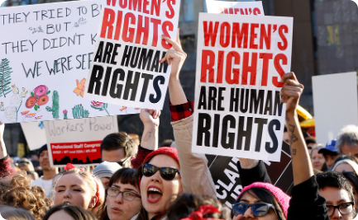

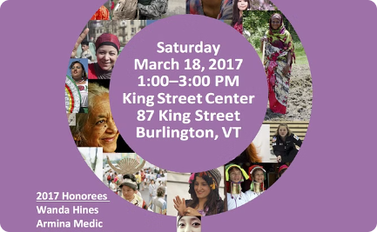
Events and Activities on International Women's Day
Marches & Rallies
Workshops & Seminars
Cultural Celebrations
Women and allies gather globally to advocate for women's rights.
Educational events focused on gender equality and women's empowerment.
Artistic and cultural events celebrating women's achievements and heritage.

Slide 8
Conclusion and Call to Action
100M
2030
Challenges Remain
2030 Agenda
Over 100 million girls are missing due to gender discrimination.
UN's Sustainable Development Goal 5 aims to achieve gender equality by 2030.

