Slide 1
Unveiling Gender Disparities in STEM: A Comprehensive Analysis of Encouragement and Interest among Women
Veronica Mata and Homayra Tabassum
Department of Data Science

Slide 2
Outline
Introduction
Motivation
Stats Gender Gap in STEM
Data Collection
Data Cleaning
Frequent Patterns
Clustering
GPT 3.5 - Classifier
Inference
Conclusion

Slide 3
Introduction: Motivation for Project Topic
Gender Imbalance in STEM
U.S. Workforce (US NSF, 2021): Nearly balanced gender representation, with Men at 52% and Women at 48%.
U.S. STEM Workforce Trend (US NSF, 2021): A significant gap, with 56% Men and only 35% Women in STEM occupations.
Global Perspective (Global Gender Gap Report, 2023): Women constitute just 29.2% of the STEM workforce in 146 countries, despite a 1.58% increase from 2015 to 2023.
Contrast with Non-STEM Fields (Global Gender Gap Report, 2023) : Women make up nearly 50% of non-STEM occupations globally.

Slide 4
Introduction: Investigation the Gender Gap in STEM
Global Concern: The underrepresentation of women in STEM sparks debate on encouragement vs. inherent interest.
Project Focus: Analyzing social media data (Reddit) to understand this gender gap.
Objective: Identify patterns to determine if women are discouraged from STEM or lack genuine interest.

Slide 5
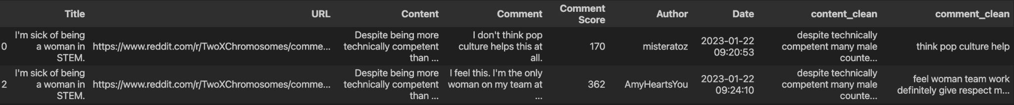
Data Collection Overview
Source: Reddit
Time Range: October 14, 2009, to December 7, 2023
Collected Data:
Posts: 450
Comments: 22,076 (including comment scores)
Author : 11560

Slide 6

Data Cleaning and Preparation
Initial Steps:
Removed deleted and too-short comments
Eliminated duplicate comments
Cleared stop words and unusual characters
Data Processing:
Performed Lemmatization
Tokenized comments for analysis
Cleaned Dataset:
Posts: 450
Comments: 14,268 (with scores)
Author : 6538

Slide 7
Frequent Patterns : LDA - Latent Dirichlet Allocation
Topic 0: Socio-Political Identities and Perspectives
Keywords: gay, asian, feminist, white, conservative, people, feminism, black, vote, country
Topic 1: Gender Dynamics and Perceptions
Keywords: woman, men, people, gender, female, male, think, say, would, see
Topic 2: Professional Environment and Education
Keywords: work, get, job, engineer, go, school, would, make, company, field
Topic 3: General Opinions and Experiences
Keywords: like, would, say, get, think, know, people, make, woman, thing
Topic 4: Personal and Recreational Aspects
Keywords: year, get, go, old, home, house, game, day, time
Notes:
LDA is for topic modeling in text data, while Apriori and FP-Growth are for association rule mining in transaction data.

Slide 8

Embeddings and Dimension reduction
UMAP vs t-SNE
We use BERT for this purpose as it extracts different embeddings based on the context of the word. Not only that, there are many pretrained models available ready to be used.
Library: sentences transformers model: all-MiniLM-L6-v2
UMAP is often better at preserving global structure in the final projection

Slide 9
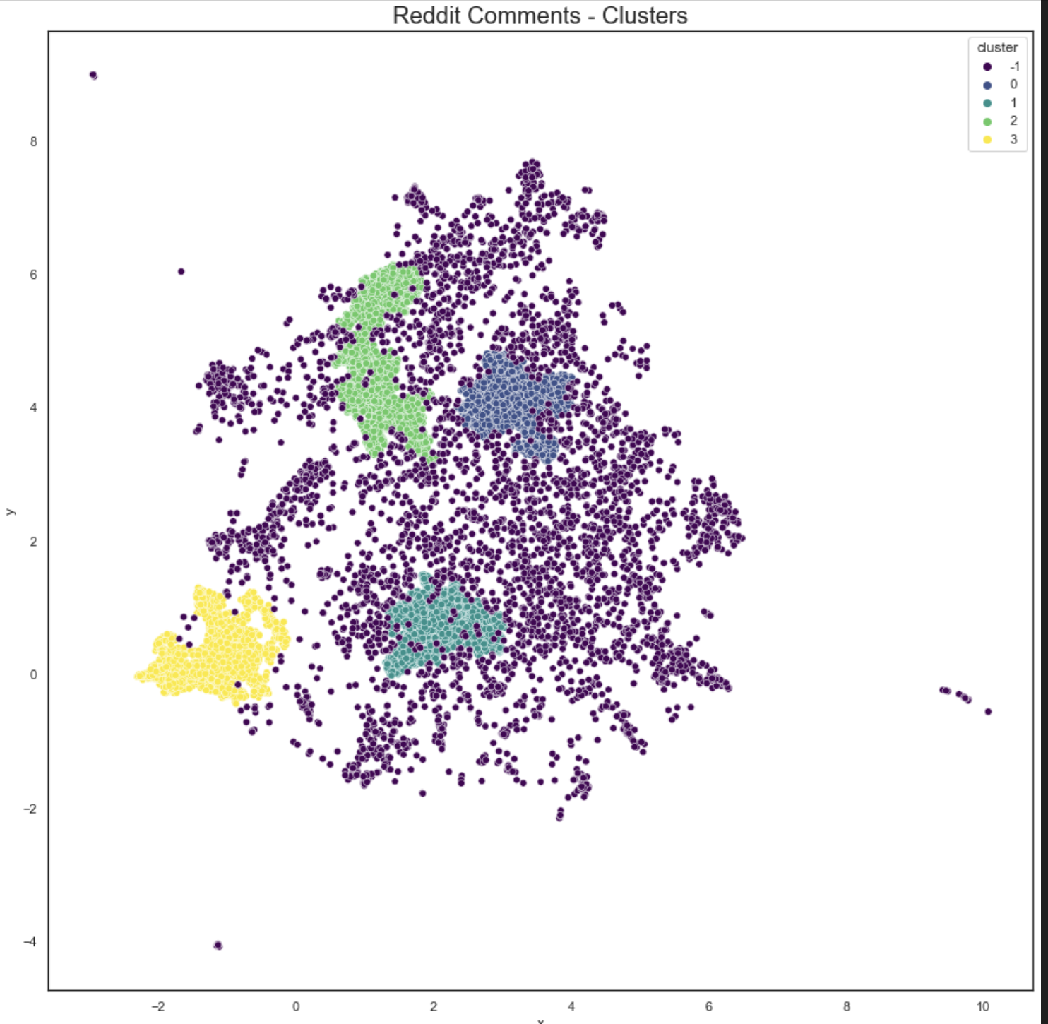
Clustering
OPTICS - (Density based)
Parameters:
xi=0.05,
min_pts=15
Results
Cluster 0: # comments: 2372
Cluster 2: # comments: 2990
Cluster 1: # comments: 2532
Cluster 3: # comments: 2374
Cluster -1:# comments: 4000

Slide 10
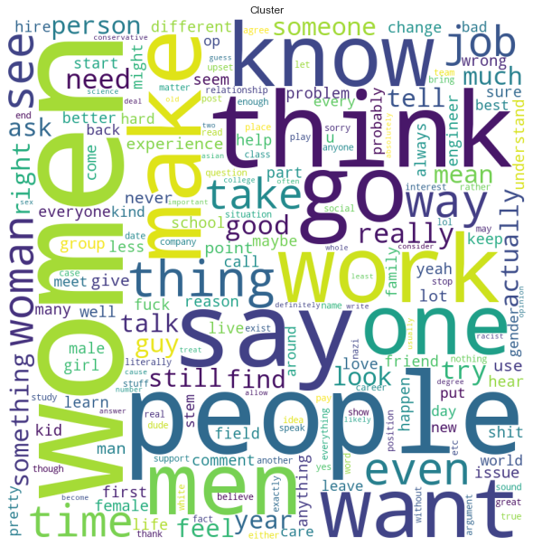
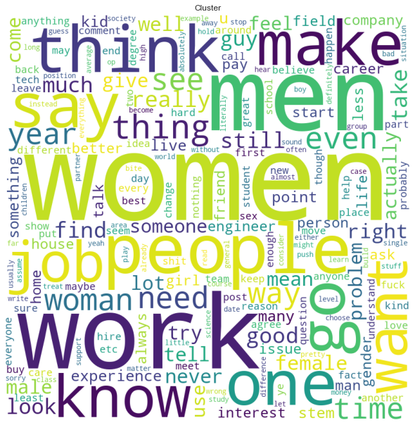
World Cloud
Cluster 0
Cluster 2

Slide 11
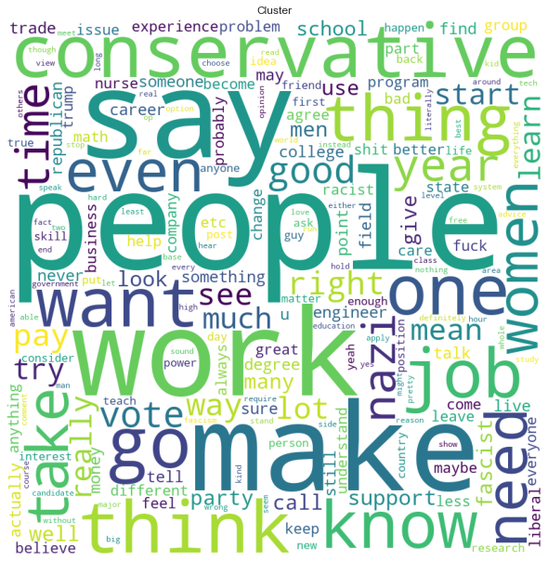
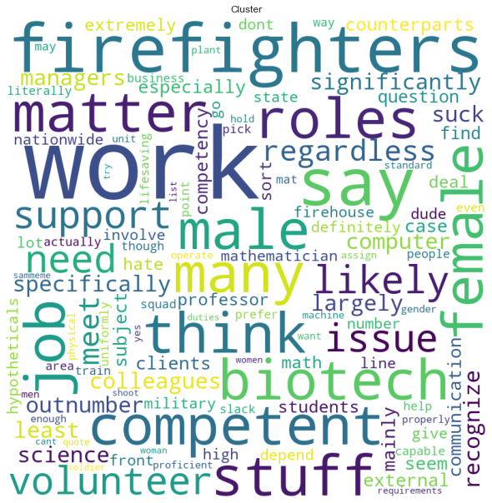
World Cloud
Cluster 3
Cluster 1

Slide 12

GPT 3.5 Turbo - Classifier
Category | #Comments | Mean score
discouraging_women | 5022 | 16.051
encouraging_women | 2152 | 19.79
women_lack_interest | 1057 | 13.66
women_interest_in_stem | 556 | 4.99
Unclassified | 1057 | 7.65
We employ the GPT-3 API as a classifier tool to analyze the sentiment in Reddit comments pertaining to women in the STEM fields.
Classification Categories:
Encouraging Women in STEM
Discouraging Women in STEM
Lack of Interest in Women in STEM
Interest in Women in STEM
Preliminary Results:
A manual review of 100 sample comments was conducted to test the accuracy of the GPT-3 classifier.
This initial check showed promising results with an accuracy rate of approximately 80%.
Future plan:
Fine tune de model, we already have the training set, we plan to use gpt4 to train gpt3.5.

Slide 13
Inference
Since both groups (Discouraging Women and Women Lack Interest ) have a distribution not normal, we decide to use a non-parametric test to check if there is statistical difference significance between the mean score of the groups: discouraging_women, women_lack_interest.
HO: There is no significant difference between the mean scores of the two groups: 'discouraging_women' and 'women_lack_interest'.
H1: There is a significant difference between the mean scores of the two groups: 'discouraging_women' and 'women_lack_interest'.
alpha = 0.05
Test: Mann-Whitney U Test
P-value: 0.00136
Since the p-value (0.00136) is less than the alpha level (0.05), we reject the null hypothesis. This means there is statistically significant evidence to suggest a difference in the mean scores between the two groups 'discouraging_women' and 'women_lack_interest'.

Slide 14
Conclusion
Key Finding:
Higher number of comments and mean scores in the category 'Discouraging Women' compared to 'Women Lack Interest'.
This difference is statistically significant.
Implication:
Majority of discussion points towards women being discouraged in STEM, rather than lacking interest.
Indicates discouragement as a significant factor contributing to the gender gap in STEM fields.
Future Work:
Fine tune GPT 3.5 turbo

Slide 15
THANK YOU!!!!

