Slide 1
AI PRODUCTIVITY · ALKEMY
2026
DOES AI HELP OR
HURT THE BUSINESS?
PRESENTED BY
Alexandra Tabarani · Gabriele Loreti · Edoardo Cocciò
ALKEMY

Slide 2
THE QUESTION WE ANSWERED
UNDER WHAT CONDITIONS DOES AI CAPTURE - OR DESTROY - MARGIN?
01
Does AI help and at what usage level does the profit effect cross zero?
02
What is the mechanism: hours saved, or quality improvement?
03
Which contract structures capture the productivity dividend?
04
Which task types and seniority levels respond best to AI augmentation?
DOES AI HELP OR HURT THE BUSINESS?
ALKEMY · 2026

Slide 3
THE DATASET
3,248 DELIVERED TASKS
WITH REVENUE, COST, HOURS, AI USAGE & OUTCOME RECORDED
3,016
4
3
0 - 100
TASKS ANALYZED
TEAMS
SENIORITY LEVELS
AI USAGE RANGE (%)
from 3,248 raw after cleaning
Content · Design · SEO · Media
Junior · Mid · Senior
Full distribution tracked
ai_usage_pct · profit = revenue − cost · hours_spent · rework_hours · pricing_model · seniority · sla_breach · outcome_score

Slide 4
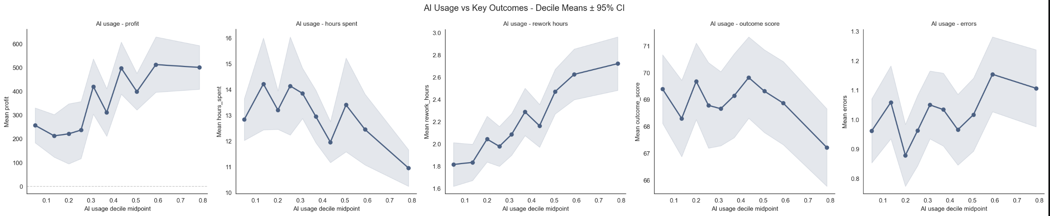
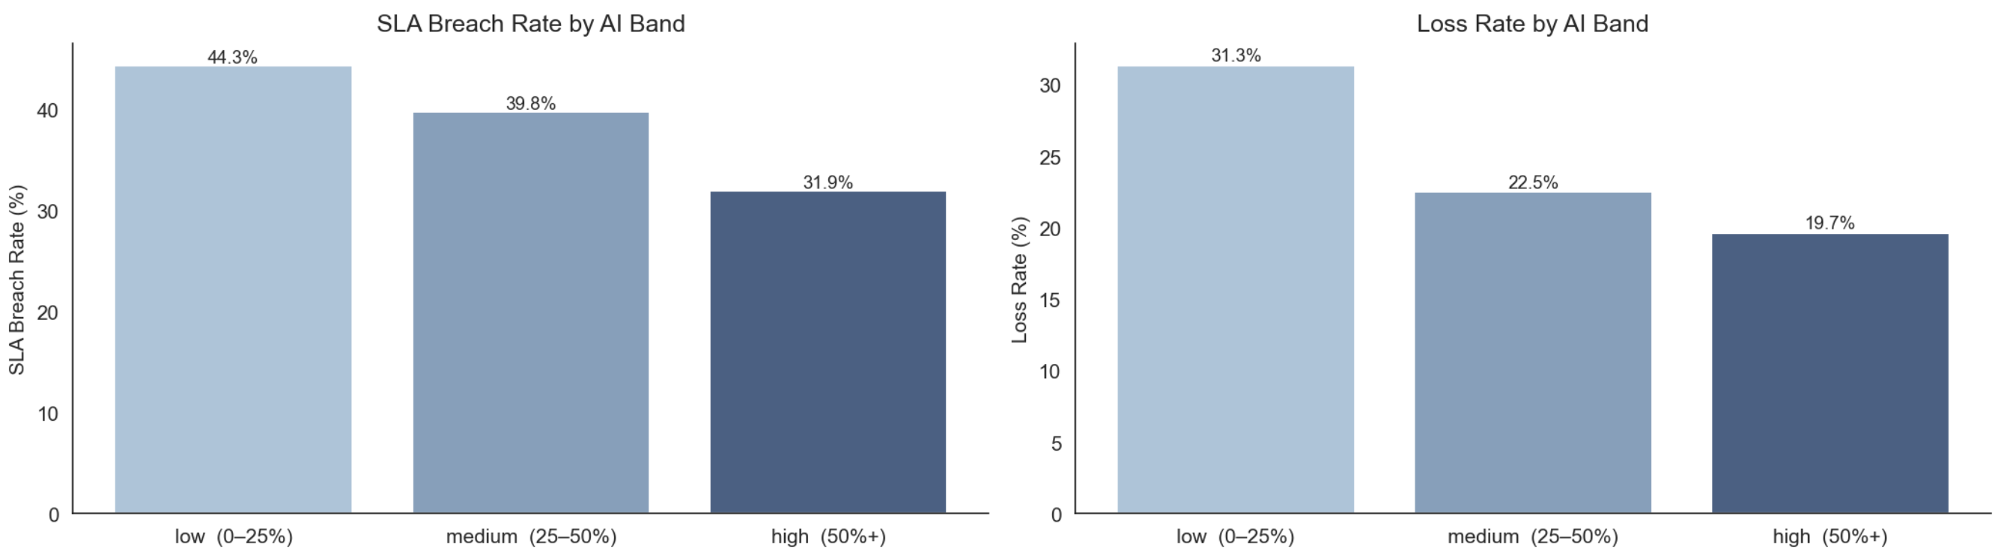
FINDING 01
AI WORKS BUT ONLY ABOVE A THRESHOLD
PROFIT NEARLY DOUBLES
THE 50% PHASE CHANGE
LOSS RATE COLLAPSES
€233 in the low band rises to €468 in the high band.
Below 50%, gains blend with noise. Above 50%, profit improvement accelerates sharply.
SLA breaches 44% → 32%. Loss rate 31.3% → 19.7%
Medium AI barely moves the needle, the jump happens above 50%.
AI de-risks delivery, not just speeds it up.
ALKEMY · 2026

Slide 5
FINDING 02
THE MECHANISM IS HOURS, NOT QUALITY
THE CONTRACT DECIDES WHERE THOSE HOURS GO
NET EFFICIENCY PER TASK
1.3 hrs
FIXED / VALUE-BASED
Hours saved = margin captured ↑
Agency profit rises with every task
−2.0 hrs saved + 0.7 hrs rework
Once hours_spent enters the OLS model, all quality metrics (errors, revisions, rework, outcome_score) lose statistical significance entirely (p > 0.05).
AI's mechanism is time compression, not quality improvement.
HOURLY BILLING
Hours saved = revenue lost ↓
Efficiency is passed to the client
Same 1.3 hrs net gain, entirely different P&L impact.
ALKEMY · 2026

Slide 6
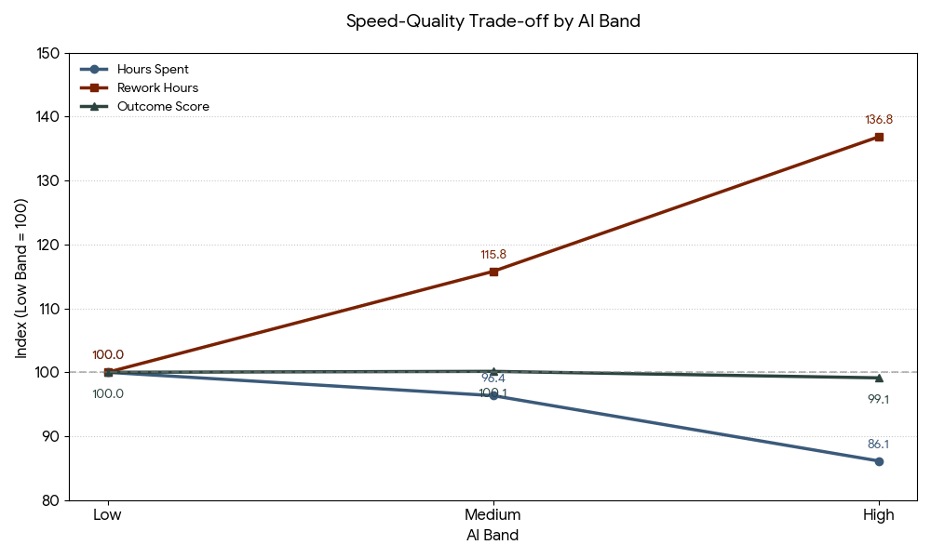
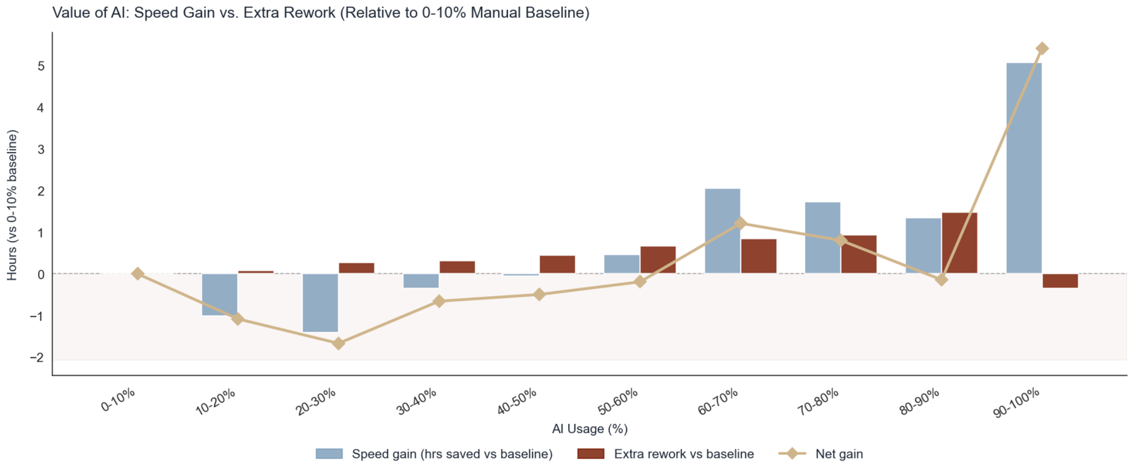
THE EFFICIENCY DIVIDEND
TRADING REWORK FOR SPEED
THE NET GAIN PIVOT
AI is a net time loss until crossing the 60–70% threshold. Below it, rework cancels gains.
THE PRODUCTION SWAP
Labor model shifts from creation to iteration. High AI raises rework while cutting hours spent.
QUALITY STABILITY
Average outcome score stays stable, but the worst decile worsens at high AI usage.
ALKEMY · 2026

Slide 7
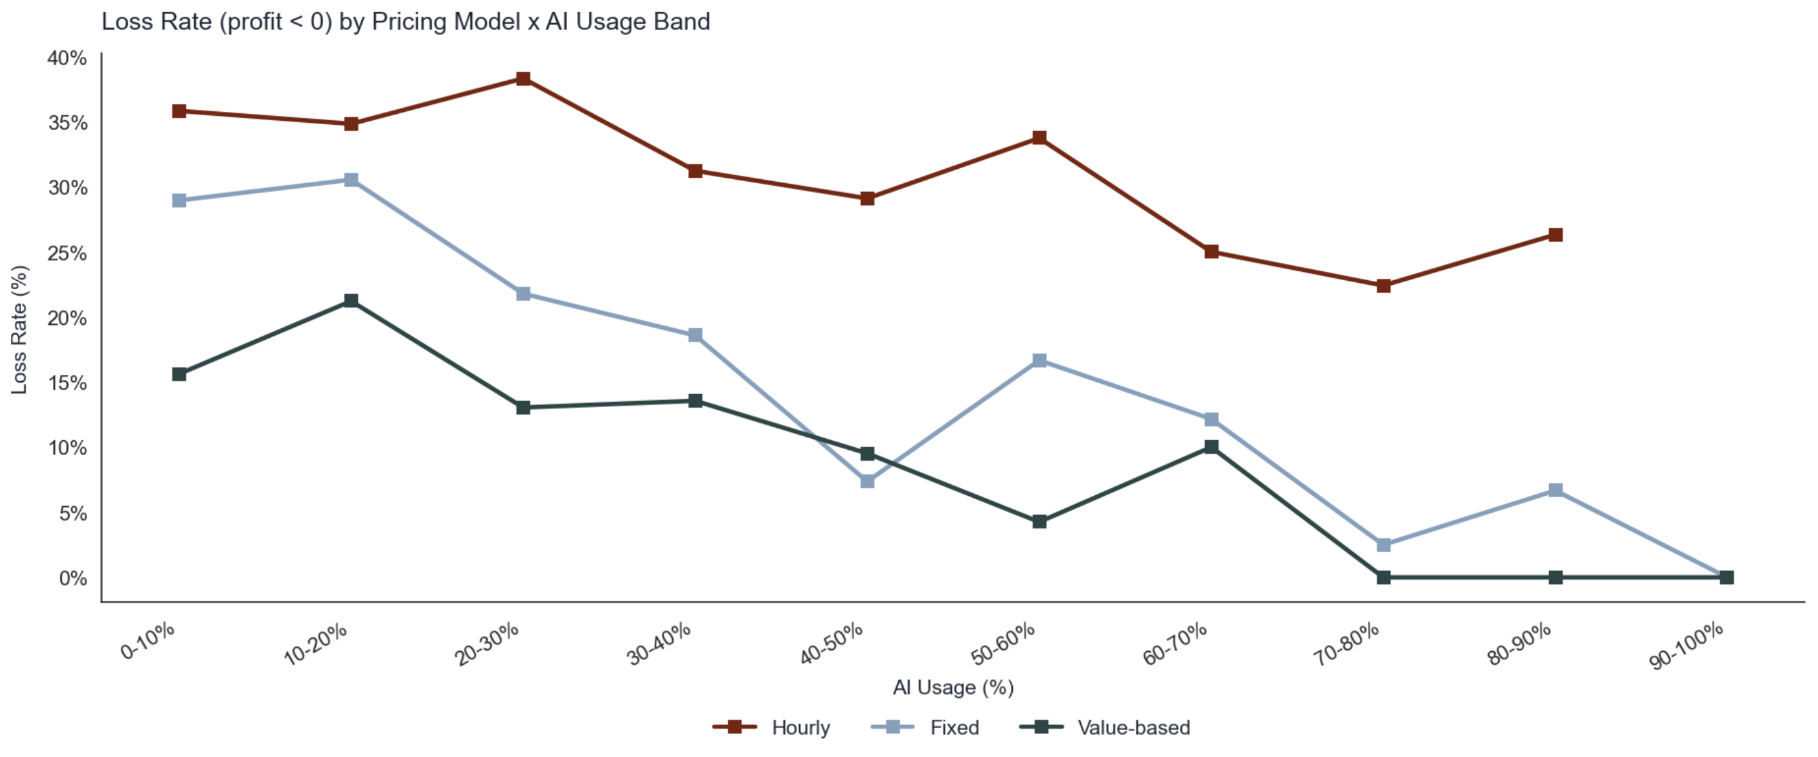
FINDING 03
THE PRICING MODEL IS THE BOTTLENECK, NOT THE TECHNOLOGY
€872 PER-TASK GAP
Between Hourly (€202) and Value-based (€1,073) at high AI usage.
OLS CONTRACT EFFECTS
HOURLY
VALUE
AI × HOURLY
−€254
+€286
−€701
LOSS RATE
Hourly 34% vs fixed/value 16%, a structural 18pp gap AI amplifies, not closes.
ALKEMY · 2026

Slide 8
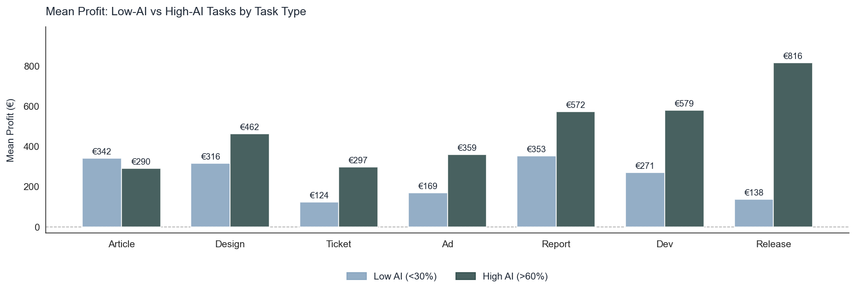
FINDING 04
NOT ALL WORK RESPONDS EQUALLY TO AI
TASK TYPE
LOW AI
HIGH AI
MULT.
Release
€138
€816
5.9×
Ticket
€124
€297
2.4×
Ad
€169
€359
2.1×
Dev
€271
€579
2.0×
Report
€353
€572
1.6×
Design
€316
€462
1.5×
Article
€342
€290
0.8×
Push AI hard on Release, Dev, Report. For Article, cap at 25–50%.
ALKEMY · 2026

Slide 9
FINDING 05
SENIORITY IS YOUR BIGGEST RISK VARIABLE
SENIORS · LOW AI
SENIORS · HIGH AI + RIGHT CONTRACT
51%
€3,935
LOSS RATE — WORST IN THE WORKFORCE
MEAN PROFIT PER TASK — ~15× DATASET MEDIAN
Senior billing rates can't justify manual execution. Each level costs −€173/task at baseline: every unassisted hour compresses margin.
AI × seniority interaction: +€718 gain vs −€346 cost drag, net reversal. Observed in 80-100% AI band.
AI isn't optional for seniors — it's the only viable configuration.
Condition: fixed or value-based contract + AI usage ≥ 80%.
ALKEMY · 2026

Slide 10
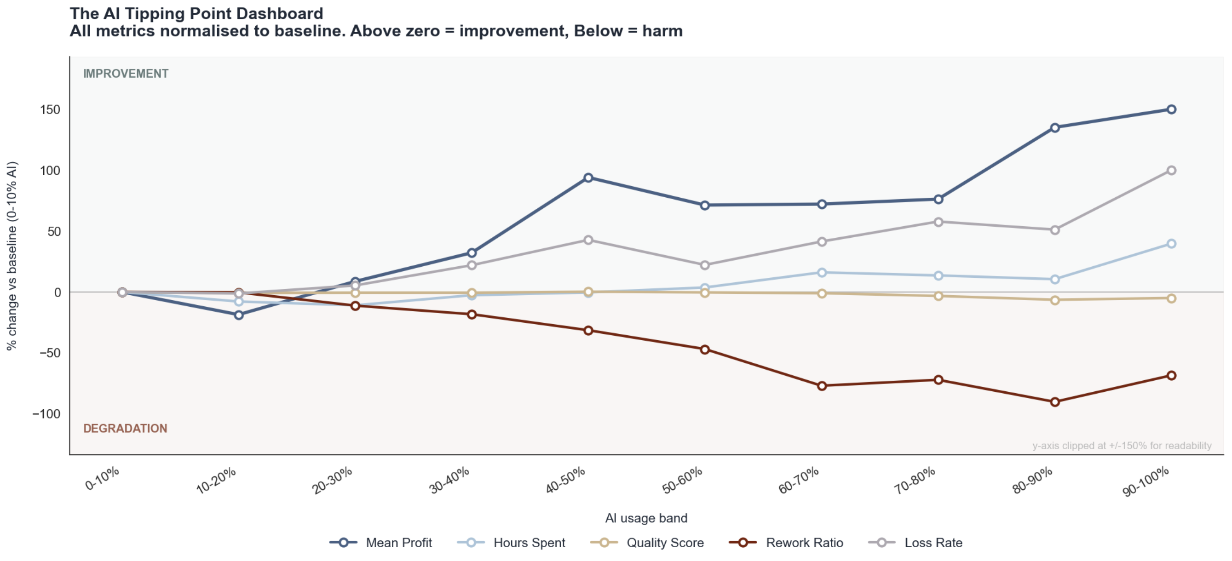
DEEP DIVE
THE REWORK PARADOX
The business gets financially safer by getting operationally messier.
THE PROFITABILITY PARADOX
Loss rate falls 31.3% → 19.7% while rework rises to 32%. Speed creates an efficiency cushion that absorbs correction cost.
THE CRITICAL PIVOT: 60–70%
Between 60–70% AI usage the business crosses from high-loss to high-rework, low-risk.
REWORK IS NOT FAILURE
OLS: rework quadratic p=0.605. No tipping point. Fast generation + heavy iteration is the profitable model.
ALKEMY · 2026

Slide 11
SHAP SIGN-CHANGE ANALYSIS
THE 30.6% THRESHOLD
Below it, AI costs money. Above it, AI makes money.
BELOW 30.6%
SIGN-CHANGE THRESHOLD
ABOVE 30.6%
−€52.5
30.6%
+€51.1
per-task avg. SHAP
AI usage
per-task avg. SHAP
234 of 553 test-set tasks
≈ €103 gap between above vs below
319 of 553 test-set tasks
AI costs more than it produces
Entirely from AI contribution shift
AI makes money:
capture with right contract
DOES AI HELP OR HURT THE BUSINESS?
ALKEMY · 2026

Slide 12
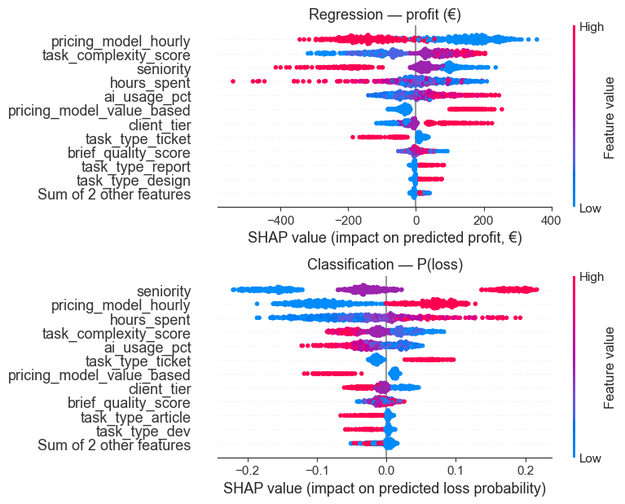
SHAP VARIABLE IMPORTANCE
WHAT DRIVES PROFIT
#1
PRICING MODEL
pricing_model_hourly has the highest mean |SHAP| larger than AI usage itself.
#2
SENIORITY
Top SHAP driver in loss classifier: senior + low AI = highest loss probability.
#3
AI USAGE
Flips sign at 30.6%: −€52.5 below, +€51.1 above.
ALKEMY · 2026

Slide 13
PRE-TASK RISK SCORE
SIX VARIABLES, ONE LOOKUP
RISK FACTORS · LOSS RATE RISES
PROTECTIVE FACTORS · LOSS RATE FALLS
VARIABLE
SAFE
RISKY
GAP
VARIABLE
WITHOUT
WITH
GAP
Hourly pricing
16%
34%
+18pp
High-tier client
27%
16%
−10pp
Senior contributor
21%
33%
+12pp
High complexity
26%
18%
−8pp
Hours spent (top 25%)
21%
31%
+9pp
AI usage ≥ 30%
28%
21%
−8pp
2+ risk factors → pre-kickoff review of contract, staffing, and scope.
Best case: high client tier + high complexity + fixed/value + AI ≥ 30% → loss rate below 18%.
ROC-AUC
PRECISION
BASE RATE
0.754
43/100
24%
ALKEMY · 2026

Slide 14
LIMITATIONS
WHAT THE DATASET STILL CANNOT EXPLAIN
The model explains margin mechanics well, but is missing signals for client value and revision causality.
01 · HIGHEST PRIORITY
WHAT WE'D ASK ALKEMY NEXT
CLIENT RETENTION & SATISFACTION
01
Which revisions were AI-caused vs client-driven?
We measure task profit but not whether AI-heavy delivery hurts long-term trust, renewals, or NPS.
02 · PROCUREMENT
02
Which tools, prompts & iterations were used per task?
TOOL & PROMPT TELEMETRY
The same ai_usage_pct can mean one precise draft or thirty failed iterations, blocking tool ROI decisions.
03
Retention, upsell & NPS after delivery?
03 · ROOT CAUSE
REVISION REASON CODES
Rework hours tell us cost, not cause. Distinguish AI mistakes, scope creep, and client preference changes.
04
Which tasks were under-scoped or repriced?
ALKEMY · 2026

Slide 15
RECOMMENDATIONS
THREE DECISIONS
1
RESTRUCTURE THE PRICING BOOK BEFORE SCALING AI FURTHER
€540
Treat AI adoption as binary per workflow. <30% costs more than it produces; >60% profit + time dividends consolidate.
/ TASK RECOVERY
2
SET AI FLOORS: 30% MINIMUM, 60% EFFICIENCY THRESHOLD
€235
Migrate AI-eligible work off hourly contracts. Priority: senior engagements (hourly = −€78/task vs value-based = +€511).
/ TASK ON MIGRATION
REPOSITION SENIORS AS AI FORCE MULTIPLIERS
Senior
3
Senior tasks must pass two conditions: AI usage ≥ 60% AND fixed/value-based contract. Redirect to 80–100% AI workflows.
MARGIN REVERSAL
DOES AI HELP OR HURT THE BUSINESS?
ALKEMY · 2026

Slide 16
THE BOTTOM LINE
THE TECHNOLOGY IS DOING ITS JOB.
The business model is the bottleneck.
ALEXANDRA TABARANI · GABRIELE LORETI · EDOARDO COCCIÒ
ALKEMY · 2026

