Slide 1
AI PRODUCTIVITY
Does AI Help or
Hurt the Business?
Alexandra Tabarani · Gabriele Loreti · Edoardo Cocciò
Presented to Alkemy
Notes:
1.7.2013
1
‹#›

Slide 2




THE QUESTION WE ANSWERED
Does AI help?
Under what conditions does AI capture margin and under what conditions does it destroy it?
At what AI usage level does the profit effect cross zero?
What is the mechanism: hours or quality?
Which contract structures capture the productivity dividend?
Notes:
1.7.2013
2
‹#›

Slide 3



THE DATA
3,248 RAW TASKS. 3,016 ANALYZED AFTER CLEANING.
Every row is a delivered task with revenue, cost, hours, AI usage, and outcome recorded.
3,016
4 Teams
3 Levels
0 TO 100%
Tasks Analyzed
Content · Design · SEO · Media
Junior · Mid · Senior
AI Usage Range
KEY VARIABLES TRACKED
ai_usage_pct (0 to 100%)
profit = revenue − cost
hours_spent
rework_hours
pricing_model
seniority
sla_breach
outcome_score
Notes:
1.7.2013
3
‹#›

Slide 4
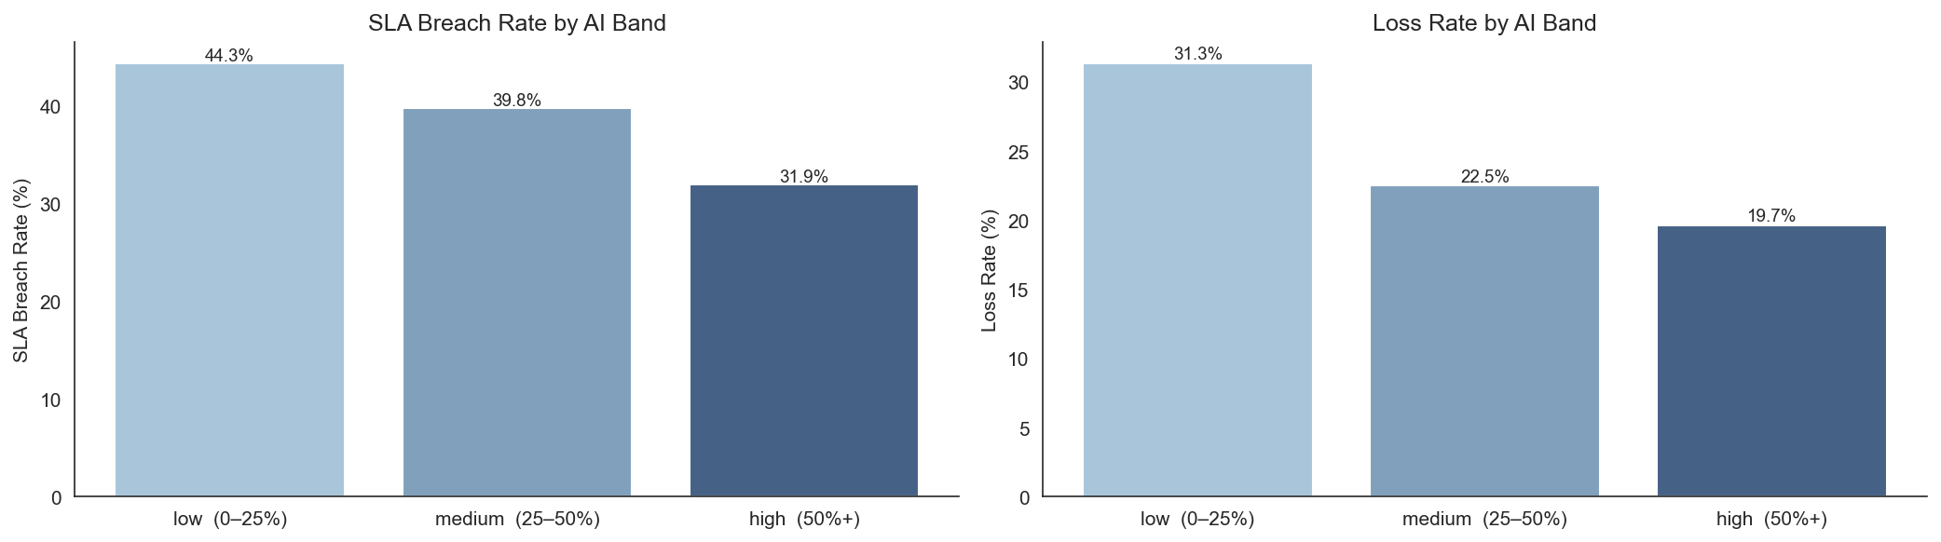



FINDING #1
AI works: but only above a threshold
PROFIT NEARLY DOUBLES
THE 50% PHASE CHANGE
LOSS RATE COLLAPSES
€232 in low band rises to €474 in high band. Medium AI barely moves the needle, the jump happens above 50%.
Below 50%, gains are modest and barely separable from noise. Above 50%, profit improvement accelerates sharply.
SLA breaches fall 44% → 32%. Loss rate drops 31% → 19%. AI de-risks delivery, not just speeds it up.
Notes:
1.7.2013
4
‹#›

Slide 5


FINDING #2
The mechanism is hours, not quality
Once hours_spent enters the OLS model, errors, revisions, rework and outcome_score all become statistically insignificant (p > 0.4).
HOW AI ACTS ON PROFIT
CONTRACT TYPE DECIDES OUTCOME
AI COMPRESSES HOURS.
Same 1.1 hrs saved, different P&L impact.
The contract decides where those hours go:
↑ Fixed / Value-based
Hours saved = margin captured
Agency profit ↑
↑ Agency margin (fixed / value-based)
↓ Client discount (hourly)
↓ Hourly billing
Hours saved = revenue lost
Client discount ↓
Net efficiency: −2.0 hrs saved + 0.9 hrs rework = 1.1 hrs net gain per task.
Notes:
1.7.2013
5
‹#›

Slide 6
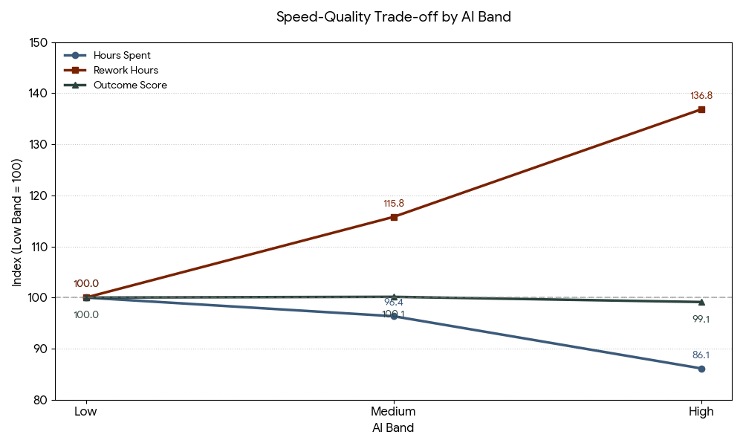

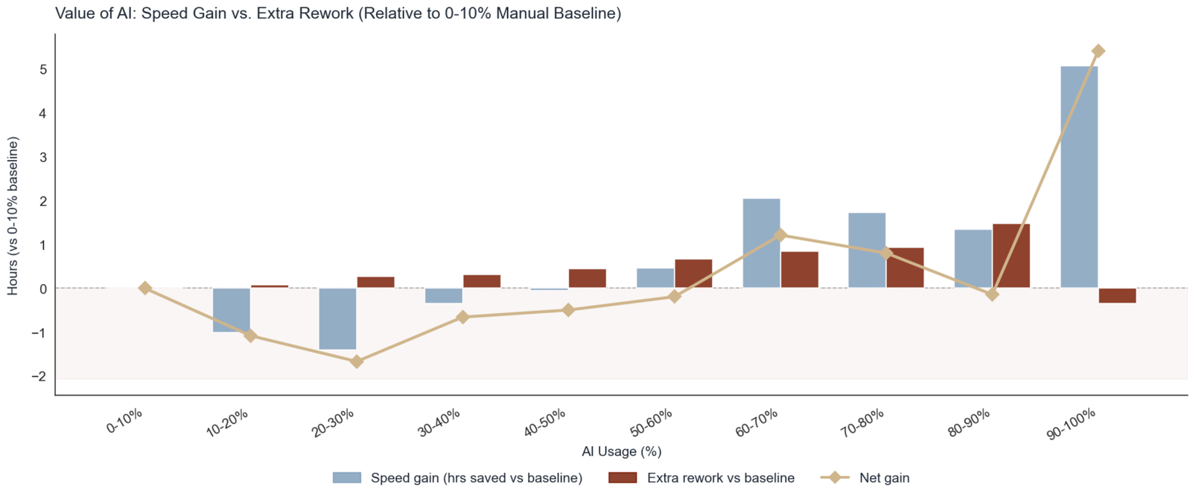
The Efficiency Dividend
TRADING REWORK FOR SPEED
THE NET GAIN PIVOT
AI is a net time loss until crossing the 50–60% usage threshold. Below it, rework cancels out gains; above it, speed wins.
THE PRODUCTION SWAP
High AI cuts hours spent but raises rework hours. The labor model shifts from creation to iteration.
QUALITY STABILITY
Average outcome score stays stable, but the worst decile worsens at high AI usage.

Slide 7
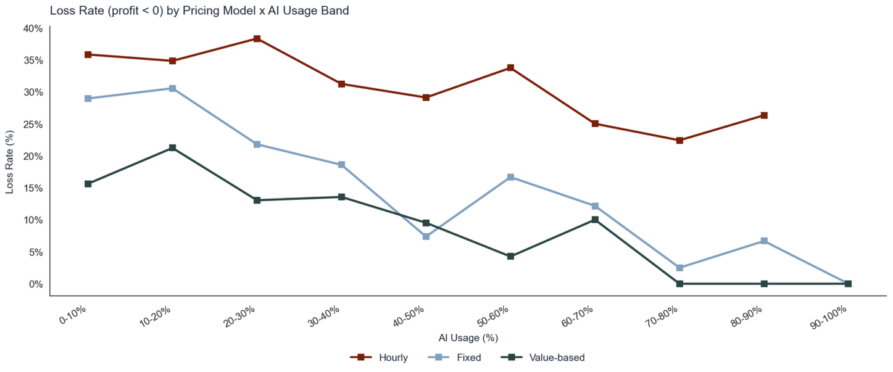

FINDING #3
The pricing model is the bottleneck, not the technology
€870
Per-task gap between
HOURLY (€202) AND VALUE-BASED (€1,073)
at high AI usage.
OLS: Hourly vs Fixed
OLS: Value vs Fixed
AI × Hourly interaction
Hourly loss rate
-€254 / TASK
+€286 / TASK
-€701 (P<0.001)
34% VS 16%
Notes:
1.7.2013
7
‹#›

Slide 8
FINDING #4
Not all work responds equally to AI
TASK TYPE | PROFIT, LOW AI | PROFIT, HIGH AI | MULTIPLIER
Release | €138 | €816 | 5.9×
Dev | €271 | €579 | 2.0×
Report | €353 | €572 | 1.6×
Design | €316 | €462 | 1.5×
Article | €342 | €290 | 0.8×
Ad | €169 | €359 | 2.1×
Push AI hard on Release, Dev, Report. For Article and Ad, performance peaks in the medium band, cap at 25–50%.
Notes:
1.7.2013
8
‹#›

Slide 9

FINDING #5
Seniority is your biggest risk variable
SENIORS AT LOW AI
SENIORS AT HIGH AI + RIGHT CONTRACT
50%
€3,935
LOSS RATEWORST IN THE WORKFORCE
MEAN PROFIT PER TASK (~8× DATASET MEDIAN)
Senior billing rates can't justify manual execution. Each seniority level costs −€173/task at baseline; every unassisted senior hour compresses margin.
AI × seniority interaction: +€359/level (p=0.002). At senior: +€718 interaction gain vs −€346 cost drag — net reversal.
AI ISN'T OPTIONAL FOR SENIORS: IT'S THE ONLY VIABLE CONFIG.
Condition: fixed or value based contract, with the €3,935 ceiling observed specifically in the 80 to 100% AI band.
SENIORS BECOME THE HIGHEST-VALUE ASSET
Notes:
1.7.2013
9
‹#›

Slide 10


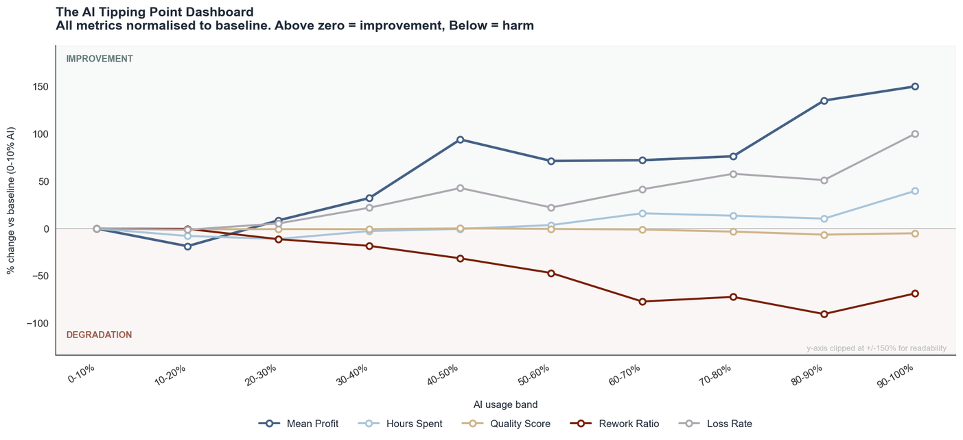
THE REWORK PARADOX
The business gets financially safer by getting operationally messier
THE PROFITABILITY PARADOX
Loss rate falls 31% → 19% while rework rises to 32%. Speed creates an efficiency cushion that absorbs correction cost.
THE CRITICAL PIVOT: 50–60%
Between 50–60% AI usage the business crosses from high-loss to high-rework, low-risk. This is operational break-even.
REWORK IS NOT FAILURE
OLS: rework quadratic p=0.605. No tipping point. Fast generation + heavy iteration is the profitable model.
Notes:
1.7.2013
10
‹#›

Slide 11

THE THRESHOLD
30.6%
The SHAP sign-change threshold. Below it, AI costs money. Above it, AI makes money.
BELOW 30.6%
THE SIGN CHANGE
ABOVE 30.6%
−€52.5
≈ €103
+€51.1
per-task avg. SHAP contribution
gap between above vs below
per-task avg. SHAP contribution
234 of 553 test-set tasks.
entirely from AI contribution shift.
319 of 553 test-set tasks.
Notes:
1.7.2013
11
‹#›

Slide 12
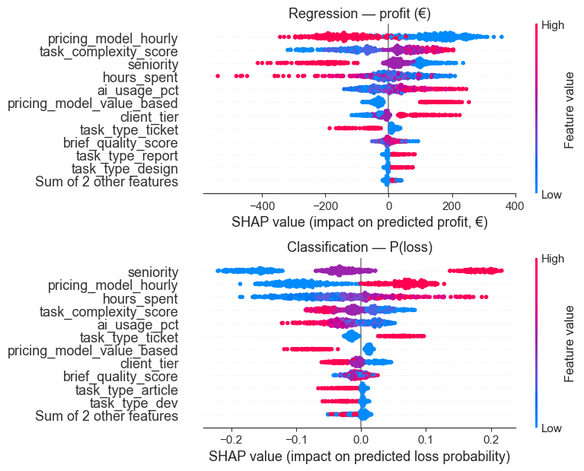



SHAP ANALYSIS
What drives profit: variable importance by SHAP
KEY TAKEAWAYS
#1 PRICING MODEL IS THE DOMINANT DRIVER.
pricing_model_hourly has the highest mean |SHAP| in regression: larger impact on profit than AI usage itself.
#2 SENIORITY DOMINATES LOSS RISK.
In the loss classifier, seniority is the top SHAP driver: senior + low AI = highest loss probability in the dataset.
#3 AI USAGE IS A THRESHOLD EFFECT.
ai_usage_pct flips sign at 30.6%: below it avg. SHAP €52.5/task, above it +€51.1/task. Contract type captures the gain.

Slide 13
RISK SCORE
The pre-task risk score: six variables, one lookup.
Random Forest · ROC-AUC 0.754 · Recall 55% · Flags 43 genuine losses per 100 risk-flagged tasks (base rate: 24%).
RISK FACTORS: LOSS RATE RISES
PROTECTIVE FACTORS, LOSS RATE FALLS
VARIABLE | Safe | Risky | Gap | Share
HOURLY PRICING | 16% | 34% | +18pp | 46% of tasks
SENIOR CONTRIBUTOR | 21% | 33% | +12pp | 22% of tasks
HOURS SPENT (TOP 25%) | 21% | 31% | +9pp | 25% of tasks
VARIABLE | Without | With | Gap | Share
HIGH-TIER CLIENT | 27% | 16% | -10pp | 26% of tasks
HIGH TASK COMPLEXITY (TOP 25%) | 26% | 18% | -8pp | 30% of tasks
AI USAGE >= 30% | 28% | 21% | -8pp | 58% of tasks
HOW TO USE THIS
Any task combining 2+ risk factors triggers a pre-kickoff review of contract structure, staffing, and scope.
Best case: high client tier + high complexity + fixed/value-based contract + AI ≥ 30% → loss rate below 18%.
Notes:
1.7.2013
13
‹#›

Slide 14




BLIND SPOTS
What the dataset still cannot explain
The model explains margin mechanics well, but is missing the signals required to explain client value and revision causality.
01
02
03
CLIENT RETENTION & SATISFACTION
TOOL & PROMPT TELEMETRY
REVISION REASON CODES
We measure task profit but not whether AI-heavy delivery hurts long-term trust, renewals, or NPS.
The same ai_usage_pct can mean one precise draft or thirty failed iterations, blocking tool ROI decisions.
Rework hours tell us cost, not cause. Distinguish AI mistakes, scope creep, and client preference changes.
HIGHEST PRIORITY
PROCUREMENT + TRAINING
OPERATIONAL ROOT CAUSE
WHAT WE'D ASK ALKEMY NEXT:
Which revisions were AI-caused vs client-driven?
Which tools, prompts & iterations were used per task?
Retention, upsell & NPS after delivery?
Which tasks were under-scoped or repriced?
Notes:
1.7.2013
14
‹#›

Slide 15


DECISIONS
Three decisions
1
Restructure the pricing book before scaling AI further
€540/task structural recovery
Treat AI adoption as binary per workflow. <30% costs more than it produces; 30–60% positive but not efficient; >60% profit + time dividends consolidate. The 10–50% band is worse than either extreme.
2
Set AI floors: 30% minimum floor, 60% efficiency threshold
€242/task lift on migrated volume
Migrate AI-eligible work off hourly contracts. Priority: senior engagements (hourly senior = −€78/task vs value-based = +€511). The data justifies the pitch.
3
Reposition seniors as AI force multipliers : remove from low-AI execution
Senior margin reversal
Senior-led tasks must pass two conditions: AI usage ≥60% AND fixed/value-based contract. Redirect seniors to 80–100% AI workflows where the €3,935 ceiling is observed.
Notes:
1.7.2013
15
‹#›

Slide 16
THE BOTTOM LINE
The technology is doing its job.
THE BUSINESS MODEL IS THE BOTTLENECK.
Notes:
1.7.2013
16
‹#›

