Slide 1
AI Productivity: Does AI Help or Hurt the Business?
Alexandra Tabarani · Gabriele Loreti · Edoardo Cocciò Machine Learning 810161 — 2026
Dataset: 3,016 professional service tasks · Agency: Alkemy

Slide 2
The Research Question
Primary question: At what level of AI usage does AI assistance start compressing profit margins — and what moderating factors explain when AI helps versus hurts? Secondary questions: • Does AI reduce SLA breach rates or introduce new delivery risk? • Does higher AI usage reduce perceived quality? • How does the pricing model mediate the AI–profit relationship? • Do seniors extract more or less value from AI than juniors? • Do scope changes compound or dampen the AI effect on rework?

Slide 3
Dataset & Data Cleaning
Dataset
Cleaning → 3,016 rows
3,248 professional service tasks from a real agency (Content, Design, SEO, Media teams) Key variables: ai_usage_pct · profit pricing_model · seniority task_type · client_tier hours_spent · rework_hours brief_quality · outcome_score
Removed: • 67 rows: rework_hours > hours_spent • 11 rows: delivery before creation • 45 duplicate task_ids (kept latest) Kept: • 817 negative-profit rows (losses are signal) • 505 future-dated scheduled tasks Normalised: • team: 15 variants → 4 teams • task_type: 29 variants → 7 types • ai_assisted flag dropped in favour of ai_usage_pct

Slide 4
Modelling Pipeline
Stage 1 — OLS Inference (baseline + interactions) Interpretable coefficients with HC3 robust SEs. Tests which variables matter and which mechanism drives profit. Stage 2 — Regularised Models (LASSO + Ridge) LASSO: variable-selection cross-check. Ridge: stability / collinearity check. Stage 3 — Random Forest (regression + classification) Captures non-linearities (50% phase change, seniority × AI). Classification target: is_loss — intercept losses before delivery. Stage 4 — XGBoost Robustness check: RF vs XGB agreement on R² and SHAP drivers. Stage 5 — SHAP Global importance · AI zero-crossing threshold · decision-view table.

Slide 5
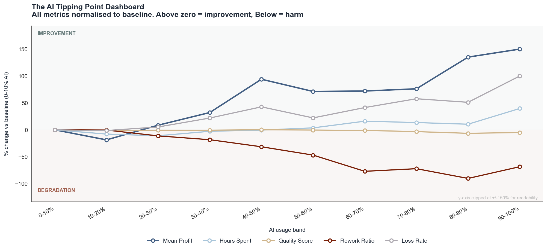
EDA
Profitability Paradox
AI makes the business safer by making it operationally messier
Mean profit per task: Low AI → €232 High AI → €474 (+€242) Loss rate: Low AI → 31% High AI → 19% (−12pp) The driver is not faster billing — it is the suppression of worst-case outcomes. AI creates enough speed margin to absorb rework without tipping into loss. The relationship is non-linear: Below 50% AI → gains are modest and noisy Above 50% → profit improvement accelerates sharply The 50% mark is not a milestone. It is a phase change.

Slide 6
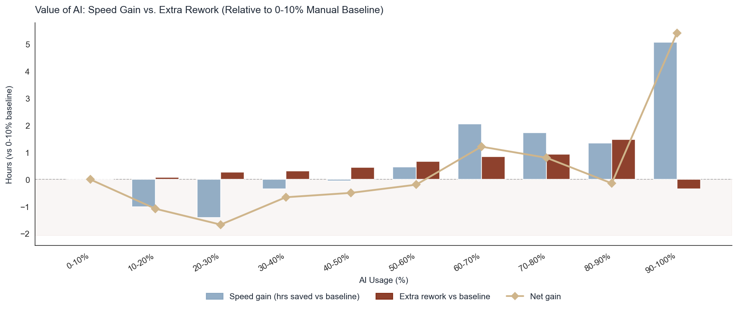
EDA
The Rework Tax
AI saves 2 hours per task — but only if you get past 60%
Net efficiency across the dataset: Hours saved: −2.0 h/task Rework added: +0.9 h/task Net gain: +1.1 h/task (~3,300 h reclaimed at scale) But the rework profile is non-linear: 10–50% AI → AI costs more time than it saves ('incompetence zone') Break-even → 60–70% AI usage Sweet spot → 60–80% AI (stable, high-volume efficiency gains) Quality stays flat on average (outcome_score ~69 across all bands). The tail erodes: 10th percentile drops 11 pts at high AI usage. At 90–100% band: rework falls while errors spike — 'Safety Net Failure'.

Slide 7
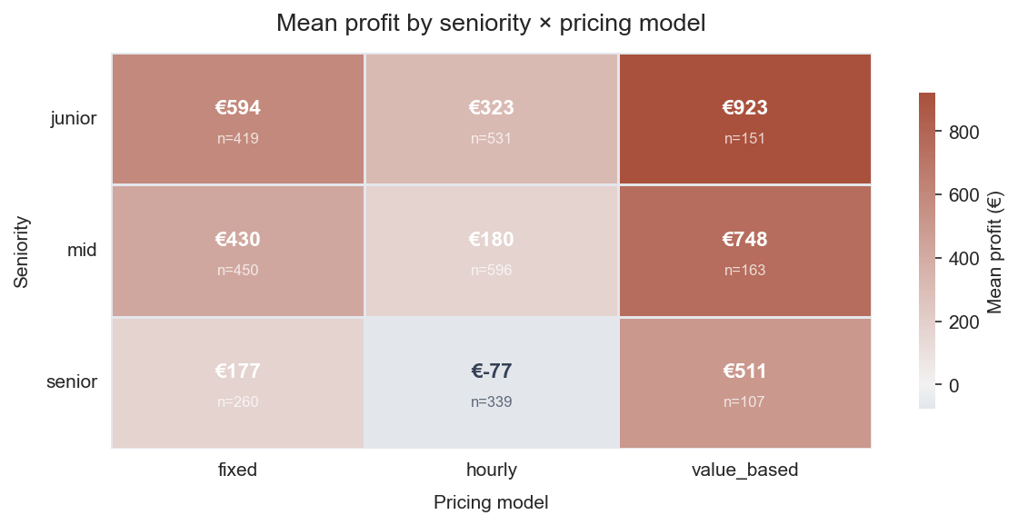
EDA
Pricing × Seniority Heatmap
The pricing model decides who captures the AI dividend
Mean profit by seniority × pricing model: Seniors + hourly → −€77 (worst segment) Seniors + fixed → +€329 Seniors + value-based → +€511 Juniors + value-based → +€923 (best segment) On hourly contracts: every hour AI saves is an hour not billed. The productivity gain transfers to the client, not the agency. On fixed/value-based: saved hours become pure margin.

Slide 8
OLS Inference — Key Coefficients (R² = 0.116)
Structural variables
What this means
Variable Coeff p ───────────────────────────────── pricing_hourly −€254 <0.001 pricing_value_based +€286 <0.001 ai_usage_pct +€222 0.015 seniority −€173 <0.001 task_complexity +€111 <0.001 client_tier +€114 <0.001 hours_spent −€5 0.034 Quality variables (errors, revisions, rework, outcome_score) → ALL lose significance once hours_spent is in the model. → AI acts on profit through hours only, not through quality.
Same task, same hours, same team — the pricing model alone creates a €540 profit spread: Hourly → baseline − €254 Fixed → baseline Value-based → baseline + €286 Seniority costs €173/step by default because senior billing rates compress margin unless recovered by AI or premium contract. Complexity and client tier each add ~€112/step — premium work on premium clients is the highest-margin quadrant.

Slide 9
Interaction Model — The Causal Mechanism
AI × Pricing Model
AI × Seniority
AI × hourly: −€701 p<0.001 AI × value_based: +€247 p=0.398 At full AI adoption under hourly billing, the net effect of AI is: +€222 (main) − €701 (interaction) = −€479 per task There is no usage level that makes hourly safe under AI. Mechanism tests (non-significant): Rework quadratic p = 0.605 AI × rework p = 0.801 → Quality is not the channel. Hours are the channel.
AI × seniority: +€359/level p=0.002 At senior level (2 steps above junior): Cost drag: −€173 × 2 = −€346 AI gain: +€359 × 2 = +€718 Net: +€372 vs junior baseline Seniors at low AI: 51% loss rate Seniors at high AI: €3,935 mean profit AI is not optional for seniors. It is the only configuration in which their cost base is commercially viable.

Slide 10
Random Forest + SHAP — Predictive Performance
Model metrics (test set, n=553)
SHAP Decision View (6 variables)
Regression (predict profit): RF R² = 0.223 MAE = €375 XGB R² = 0.208 (top-5 SHAP identical) Classification (predict is_loss): ROC-AUC = 0.754 Recall = 0.55 (loss class) Precision = 0.43 Flagging 100 'risky' tasks: → 43 genuine losses intercepted vs 24% base rate without model LASSO cross-check: 12 / 25 features zeroed All match OLS non-significant vars → no spurious OLS significance
Variable Safe Risky Gap ──────────────────────────────────────── pricing_hourly 16% 34% +18pp seniority (senior) 21% 33% +12pp hours_spent (long) 21% 30% +9pp client_tier (high) 28% 18% −10pp complexity (high) 29% 21% −8pp ai_usage ≥ 30% 28% 19% −9pp Risk factors compound upward. Protective factors compound downward. No ML infrastructure needed: a lookup table suffices.

Slide 11
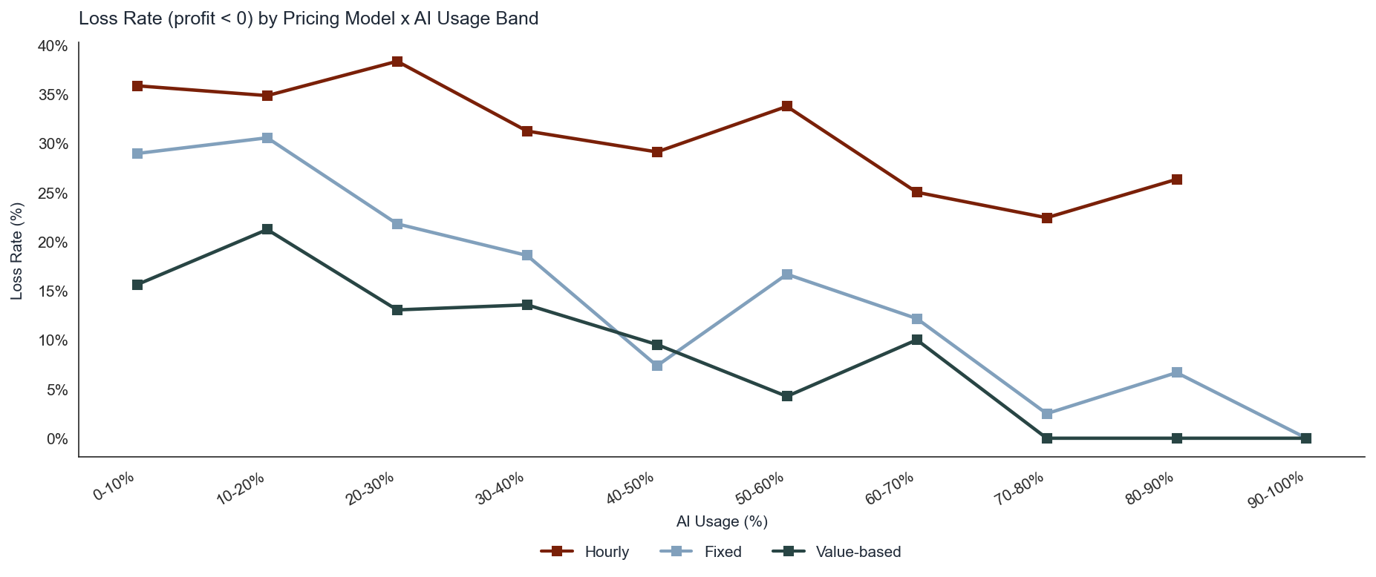
1
KEY INSIGHT
The pricing model is not a backdrop — it is the entire game
OLS baseline (all else equal): Hourly vs fixed: −€254/task Value-based vs fixed: +€286/task Total spread: €540 for identical work With AI interaction: Hourly penalty compounds to −€701/task (p < 0.001) AI alone adds +€222 → net under hourly = −€479/task EDA damage: Hourly loss rate: 34% Fixed/VB loss rate: 16% Hourly share of tasks: 46% The highest-risk contract type is also the most prevalent. Recommendation: Migrate senior-led hourly engagements to fixed or value-based first. At −€77 vs +€511 mean profit, the swing is €588/task on the most expensive talent.

Slide 12
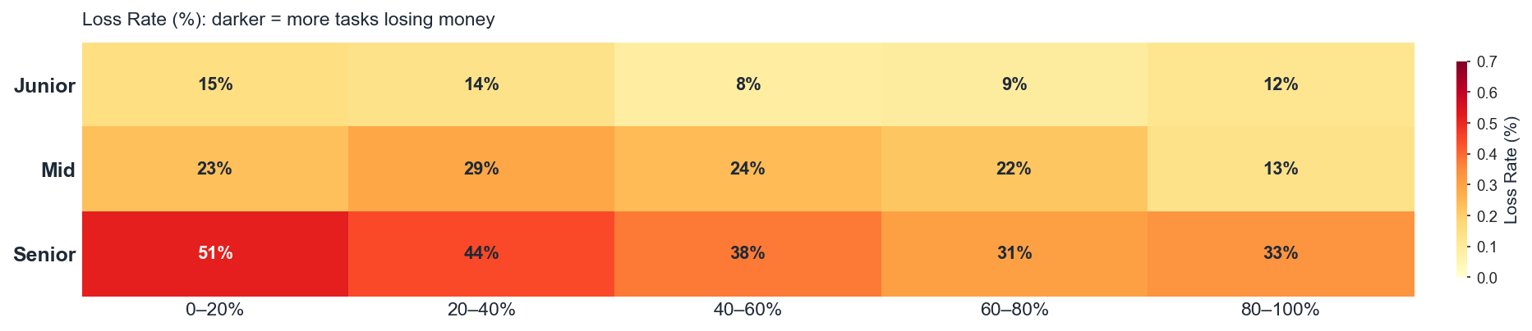
2
KEY INSIGHT
Senior contributors are only viable in one configuration
Low AI usage: 51% loss rate for seniors High AI usage: €3,935 mean profit — best in the entire dataset OLS mechanism: Baseline cost drag: −€173 per seniority level AI interaction gain: +€359 per seniority level (p=0.002) At senior level: +€718 gain vs −€346 drag → net +€372 SHAP worst-loss signature: senior + many hours + low complexity + moderate AI + non-value-based contract → resource allocation failure, not a bad task Recommendation: Pre-check every senior assignment against: 1. AI usage target ≥ 60% 2. Contract type: fixed or value-based If either fails, reassign or renegotiate before kickoff.

Slide 13
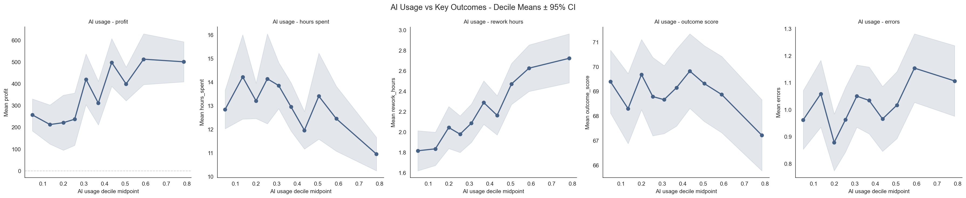
3
KEY INSIGHT
There are two thresholds — they operate through different mechanisms
Threshold 1 — SHAP zero-crossing at 30.6% AI usage: Below 30.6%: avg AI contribution = −€52.5/task Above 30.6%: avg AI contribution = +€51.1/task Gap: ~€103/task → AI's profit contribution switches sign at this point Threshold 2 — Efficiency break-even at 60–70%: Below 60%: net hours peak at 14.2 h (above manual baseline) Above 60%: speed gains finally outpace the rework tax → Real ROI in both time and money only above this level Three zones: 1–30%: AI used but costs more than it produces 30–60%: AI profit-positive but not yet time-positive 60%+: Full ROI — profit and time compound together Recommendation: Treat AI adoption as binary at workflow level. Re-architect for 60%+ or leave fully manual. The 10–50% range is measurably worse than either extreme.

Slide 14
Top Recommendations
1. Restructure pricing before scaling AI
Migrate hourly contracts to fixed/value-based. Senior+hourly = −€77 avg. Value-based senior = +€511. Target: recover €540 structural gap per task migrated.
2. Establish the 30.6% floor and 60% efficiency target as two distinct goals
Below 30%: AI costs more than it produces. Below 60%: no net hours saved. Push 70%+ of eligible tasks into the 60–80% band within two quarters.
3. Differentiate AI strategy by task type
Release: 5.9× profit multiplier — push to 70–80%. Articles: only category where high AI reduces profit — cap at 25–50%.
The technology is doing its job. The business model is the bottleneck. Restructure the system around AI — instead of bolting AI onto the system that existed before it.

