Slide 1
AI PRODUCTIVITY
Does AI Help or
Hurt the Business?
A data analysis of 3,186 professional service tasks
across Content, Design, SEO, and Media teams
Alexandra Tabarani · Gabriele Loreti · Edoardo Cocciò
Presented to Alkemy

Slide 2
THE QUESTION WE ANSWERED
Does AI help?
Under what conditions does AI capture margin and under what conditions does it destroy it?
At what AI usage level does the profit effect cross zero?
What is the mechanism: hours or quality?
Which contract structures capture the productivity dividend?

Slide 3
THE DATA
3,186 tasks. One agency. Real P&L.
Every row is a delivered task with revenue, cost, hours, AI usage, and outcome recorded.
3,186
4 Teams
3 Levels
0 - 100%
Tasks Analyzed
Content · Design · SEO · Media
Junior · Mid · Senior
AI Usage Range
KEY VARIABLES TRACKED
ai_usage_pct (0–100%)
profit = revenue − cost
hours_spent
rework_hours
pricing_model
seniority
sla_breach
outcome_score

Slide 4
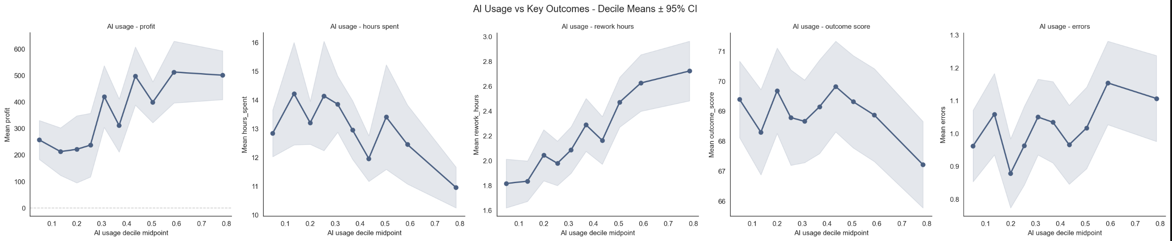
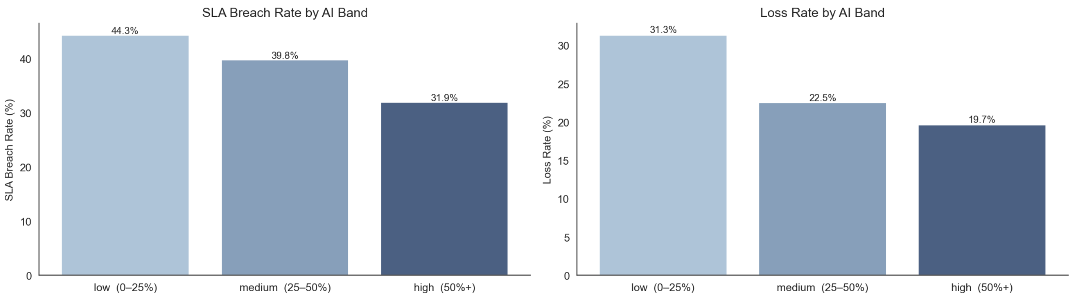
AI works: but only above a threshold
FINDING 1
Profit nearly doubles
The 50% phase change
Loss rate collapses
€232 in low band rises to €474 in high band. Medium AI barely moves the needle — the jump happens above 50%.
Below 50%, gains are modest and barely separable from noise. Above 50%, profit improvement accelerates sharply.
SLA breaches fall 44% → 32%. Loss rate drops 31% → 19%. AI de-risks delivery, not just speeds it up.

Slide 5
FINDING 2
The mechanism is hours, not quality
Once hours_spent enters the OLS model: errors, revisions, rework, outcome_score all become statistically insignificant (p > 0.4)
OLS COEFFICIENTS
HOW AI ACTS ON PROFIT
ai_usage_pct coefficient (OLS)
+€222 at full adoption (p=0.015)
AI compresses hours.
The contract decides where those hours go:
hours_spent coefficient
−€5/hr (p=0.034)
Agency margin (fixed / value-based)
Quality vars once hours enter
All insignificant p>0.4
Client discount (hourly)
Rework quadratic term
p=0.605 — no tipping point
Net efficiency: −2.0 hrs saved / +0.9 hrs rework = 1.1 hrs net gain per task
AI × rework interaction
p=0.80 — not a quality channel

Slide 6
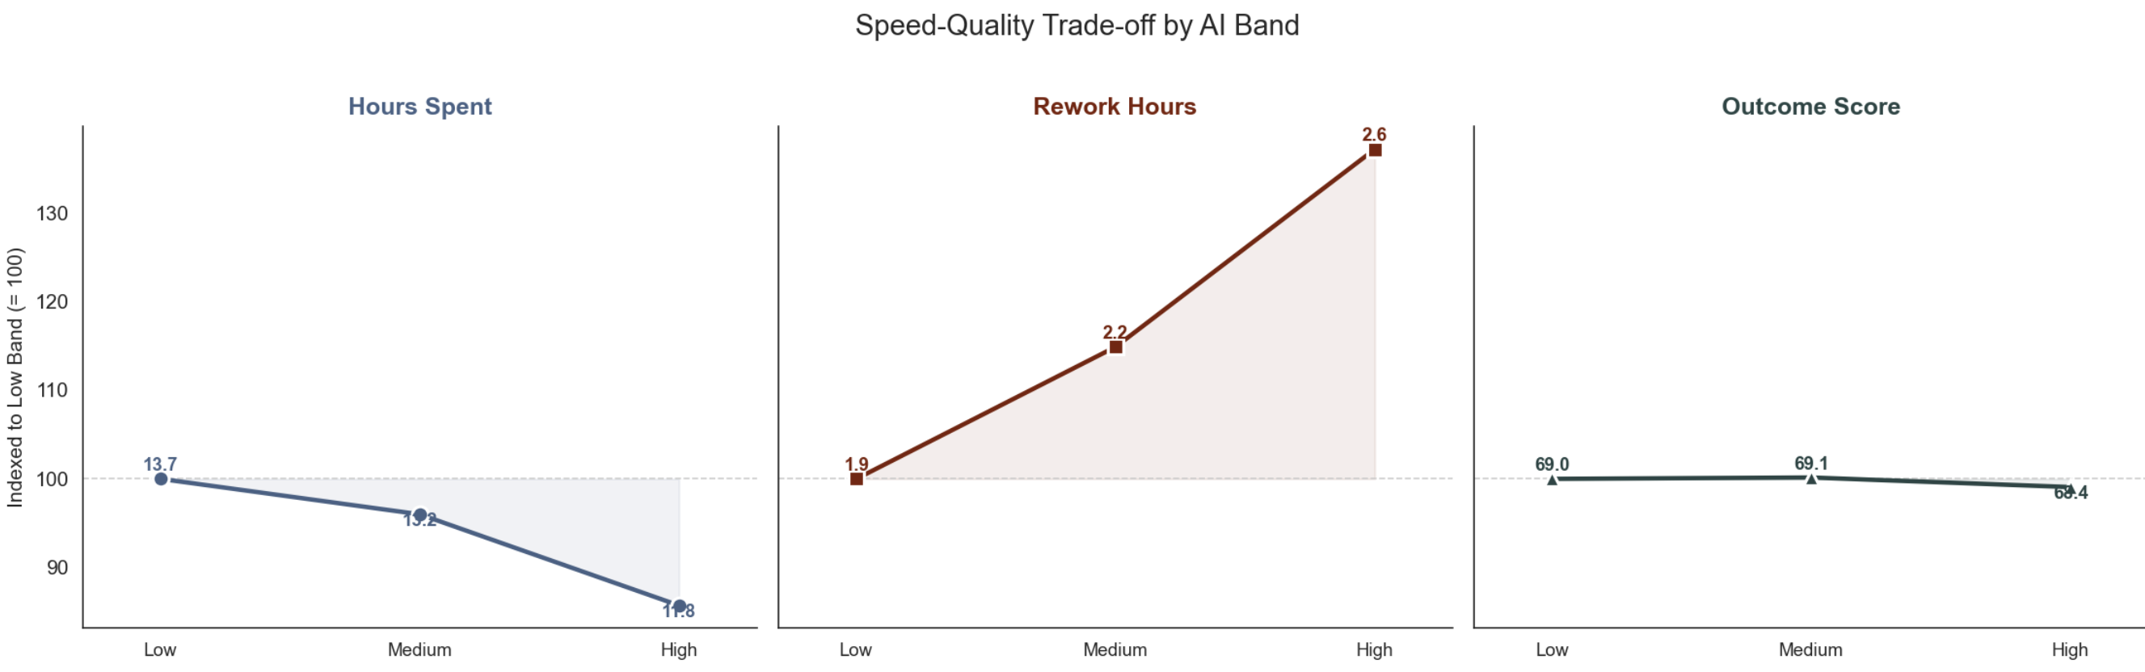
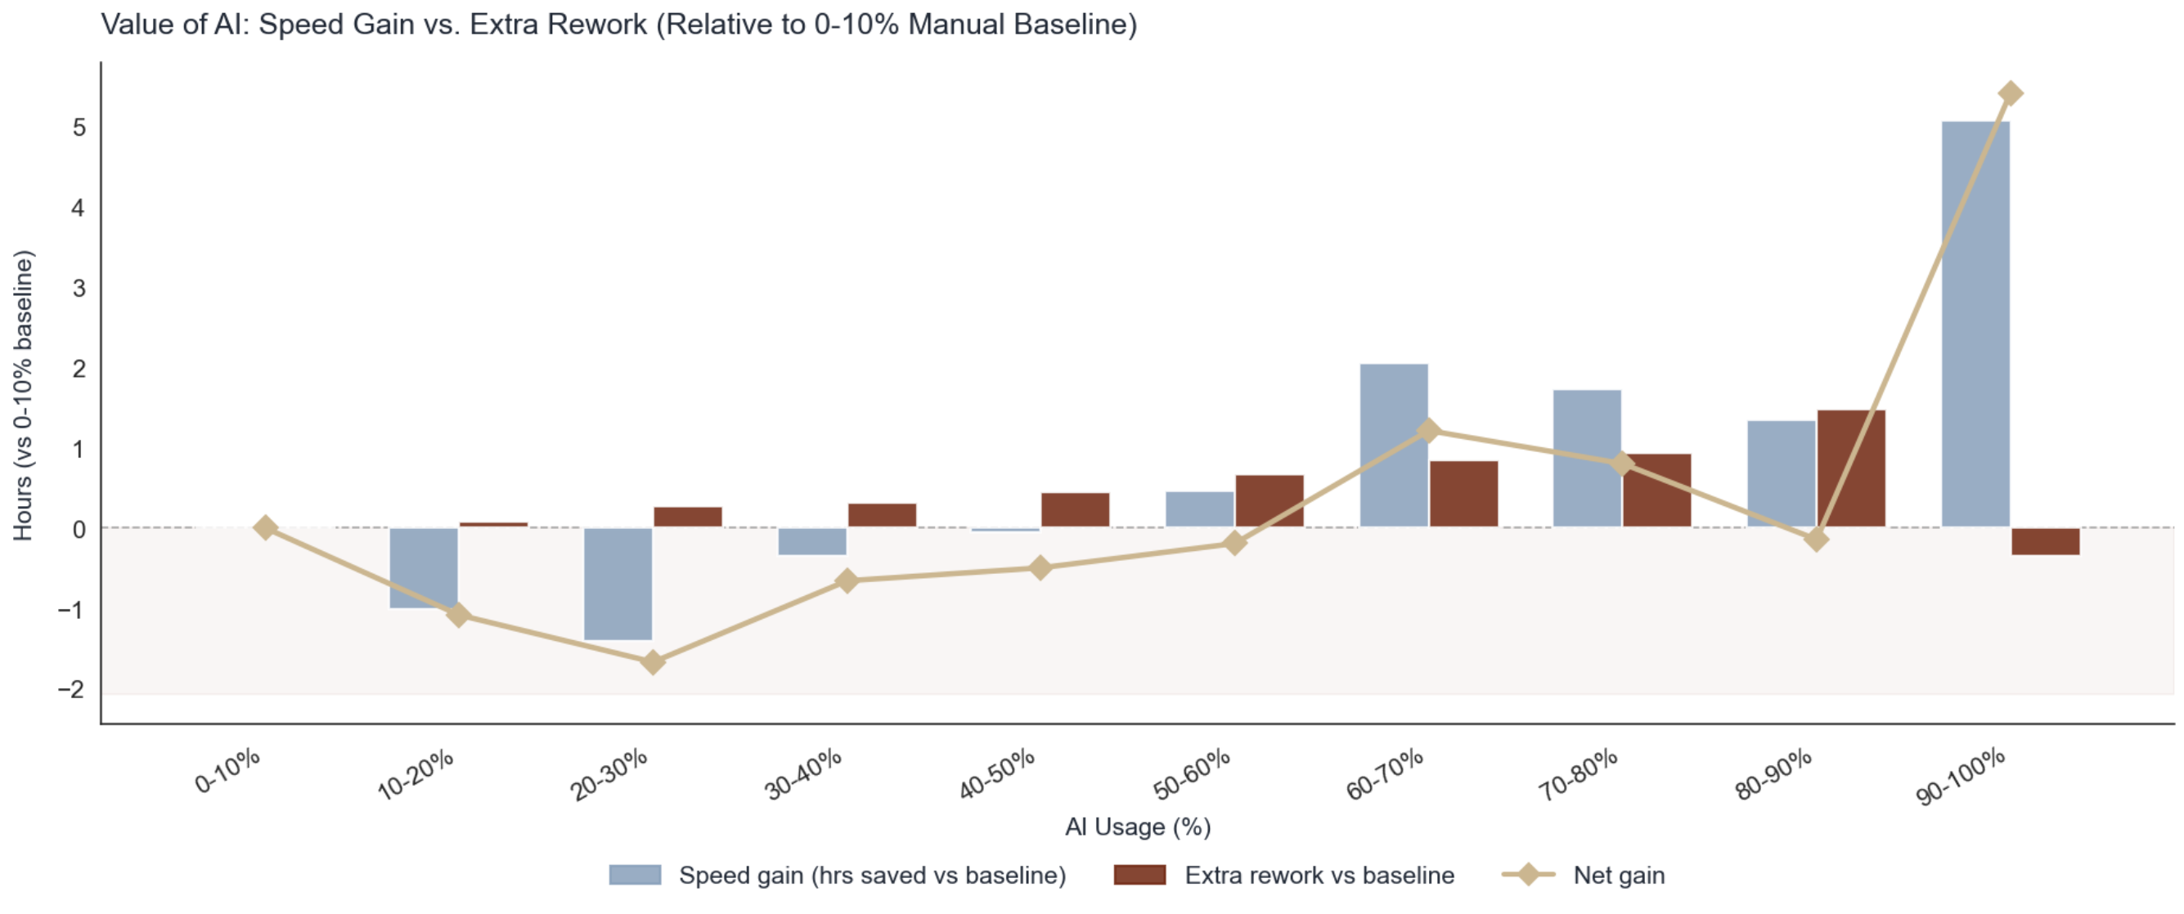
The Efficiency Dividend: Trading Rework for Speed
The Net Gain Pivot
AI is a net time loss until crossing the 50–60% usage threshold. Below this point, extra rework cancels out any advantages; above it, speed gains finally overwhelm the cost of correction, leading to a massive productivity spike.
The Production Swap
High-intensity AI usage radically reduces initial Hours Spent while driving up Rework Hours. This shift fundamentally redefines the labor model, moving the primary human workload from "original creation" to "downstream iteration and correction."
Quality Neutrality
Despite the "messier" operational workflow and higher rework, the Outcome Score remains virtually identical across all bands. This proves that high-speed AI iteration maintains professional standards while significantly shortening the total production cycle.

Slide 7
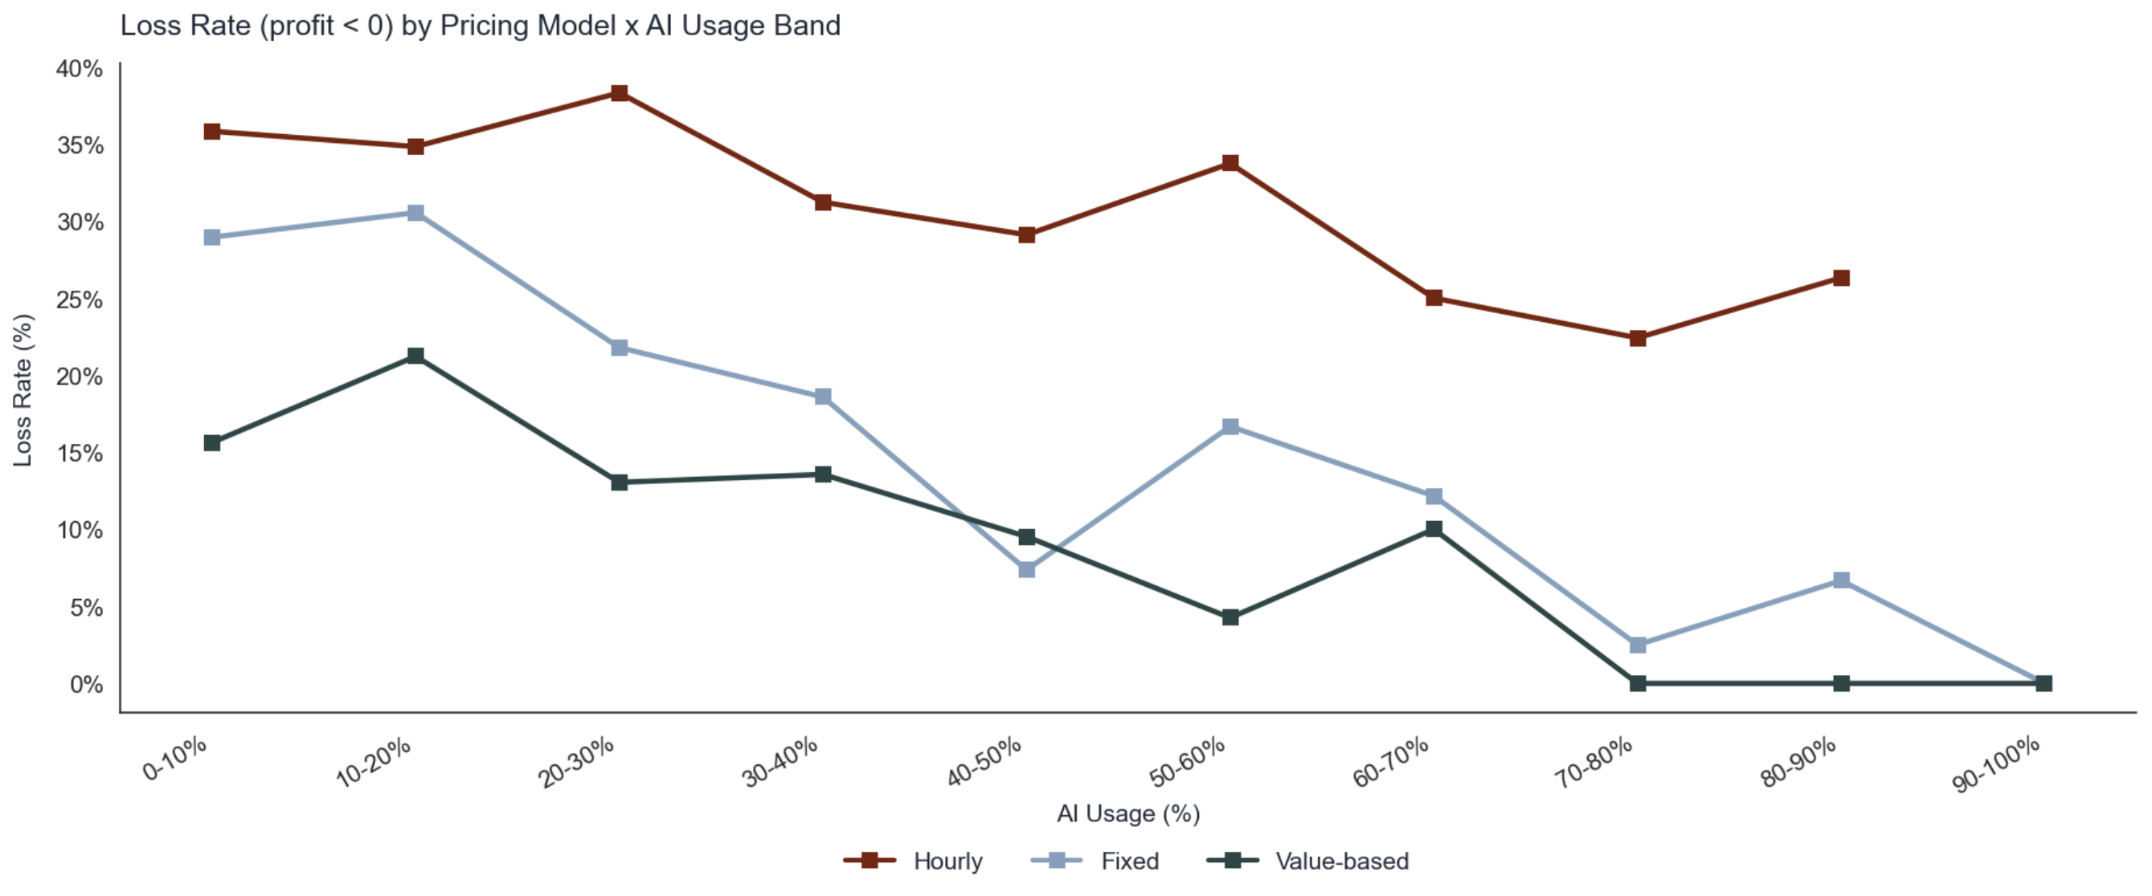
FINDING 3
The pricing model is the bottleneck, not the technology
€870
per-task gap between
hourly (€202) and
value-based (€1,073)
at high AI usage
OLS: Hourly vs Fixed
OLS: Value vs Fixed
AI × Hourly interaction
Hourly loss rate
-€254/task
+€286/task
-€701 (p<0.001)
34% vs 16%

Slide 8
FINDING 4
Not all work responds equally to AI
Task Type | Profit — Low AI | Profit — High AI | Multiplier | Recommendation
Release | €146 | €701 | 4.8× | Push to 70–80%
Dev | €297 | €587 | 2.0× | Push to 70–80%
Report | €311 | €559 | 1.8× | Push to 70–80%
Design | €280 | €490 | 1.7× | Push to 60–70%
Article | €318 | €368 | ~1.1× | Cap at 50% — inverted-U
Ad | €205 | €310 | ~1.5× | Cap at 50% — inverted-U
Release, Dev, Report: push AI usage hard. Article, Ad: performance peaks at medium AI then reverses — cap at 50%.

Slide 9
FINDING 5
Seniority is your biggest risk variable
SENIORS AT LOW AI
SENIORS AT HIGH AI + RIGHT CONTRACT
50%
€3,935
loss rate — worst in the workforce
mean profit per task (~8x dataset median)
Expensive billing rates cannot justify manual execution.
OLS: each seniority level costs -€173/task at baseline.
Every unassisted senior hour compresses margin.
AI interaction: +€359 per seniority level (p=0.002).
At senior: +€718 interaction gain vs. -€346 cost drag.
Net reversal: seniors become the highest-value asset.
AI isn't optional for seniors — it's the only viable configuration.
Condition: AI usage >= 60% AND fixed or value-based contract.

Slide 10
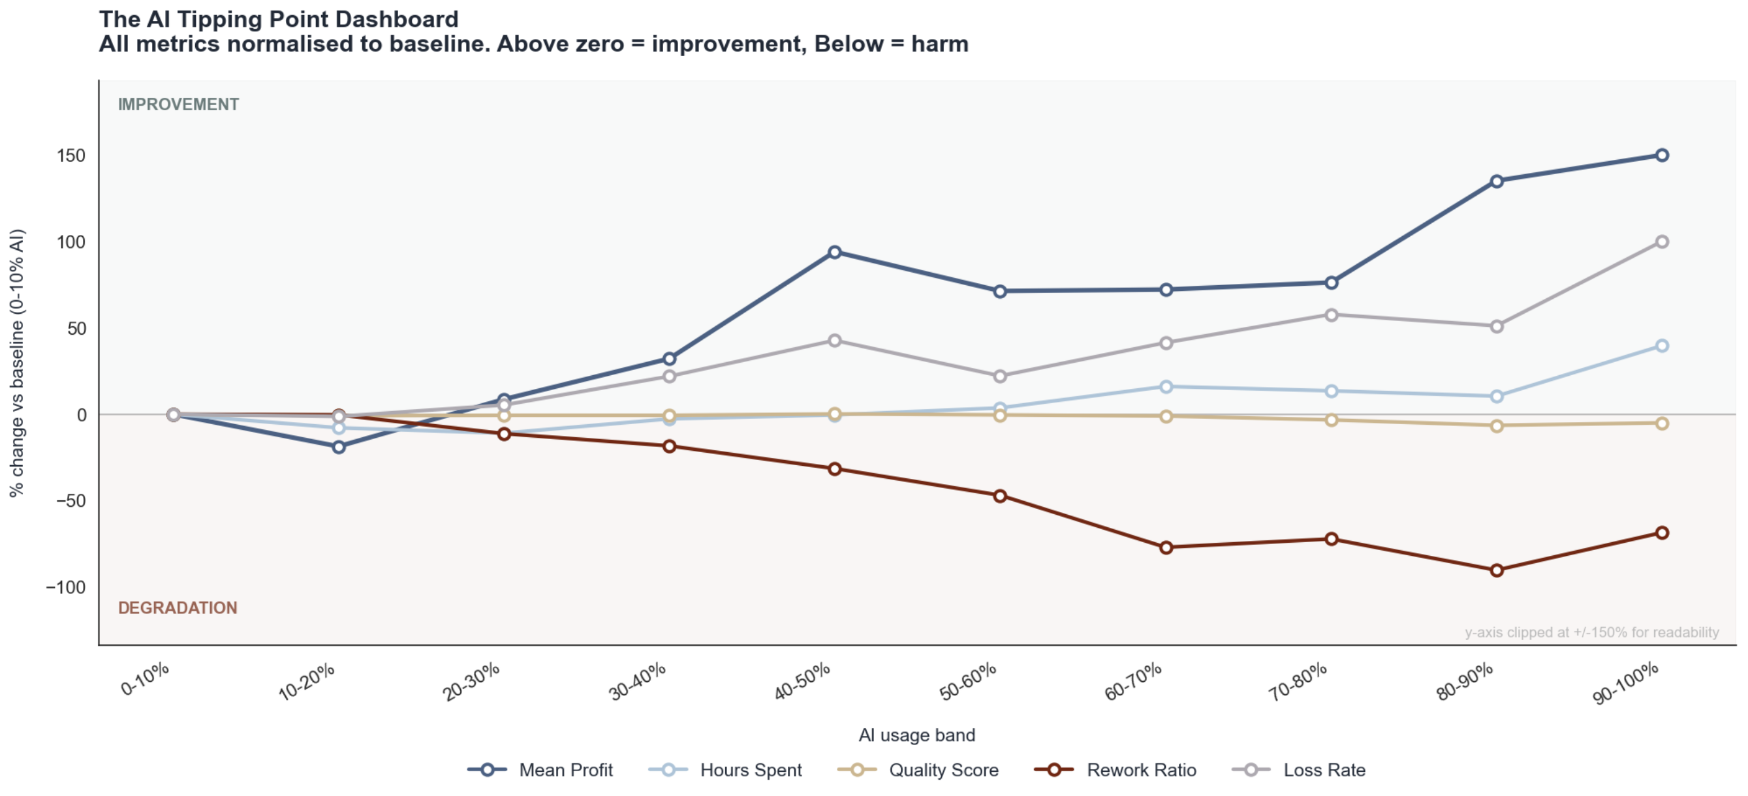
THE REWORK PARADOX
The business gets financially safer by getting operationally messier
The Profitability Paradox
Loss rate falls 31% → 19% while rework rises to 32%. Speed creates an efficiency cushion that absorbs correction cost.
The critical pivot: 50–60%
Between 50-60% AI usage the business crosses from high-loss to high-rework, low-risk. This is the operational break-even.
Rework is not failure
OLS: rework quadratic p=0.605. No tipping point. Fast generation + heavy iteration is the profitable model.

Slide 11
THE THRESHOLD
30.6%
The SHAP sign-change threshold. Below it, AI costs money. Above it, AI makes money.
Below 30.6%
The sign change
Above 30.6%
-€52.5
≈ €103
+€51.1
per task avg.
SHAP contribution
gap between being
above vs. below
per task avg.
SHAP contribution
234 of 553 test-set tasks
entirely from AI
contribution shift
319 of 553 test-set tasks

Slide 12
RISK SCORE
The pre-task risk score: six variables, one lookup
Random Forest: ROC-AUC 0.754 · Recall 55% · Flags 43 genuine losses per 100 risk-flagged tasks (base rate: 24%)
RISK FACTORS — loss rate rises
PROTECTIVE FACTORS — loss rate falls
Variable | Safe | Risky | Gap | Share
Hourly pricing | 16% | 34% | +18pp | 46% of tasks
Senior contributor | 21% | 33% | +12pp | 22% of tasks
Hours spent (top 25%) | 21% | 31% | +9pp | 25% of tasks
Variable | Without | With | Gap | Share
High-tier client | 27% | 16% | -10pp | 26% of tasks
High task complexity (top 25%) | 26% | 18% | -8pp | 30% of tasks
AI usage >= 30% | 28% | 21% | -8pp | 58% of tasks
HOW TO USE THIS
Any task combining 2+ risk factors triggers a pre-kickoff review of contract structure, staffing, and scope estimate.
Best-case combination: high client tier + high complexity + fixed or value-based contract + AI >= 30% → loss rate below 18%.

Slide 13
BLIND SPOTS
What the data can't tell you
This analysis proves operational cost efficiency. It cannot prove customer value.
01
Client retention at 12 months
Most consequential
A profitable task that damages a multi-year relationship is a net loss the current data cannot detect. This is the single biggest missing signal — it transforms cost efficiency into strategic intelligence.
02
AI tool identity and prompt iteration count
Tool procurement
Two precise prompts and thirty rejected iterations look identical in ai_usage_pct. GPT-4 for code vs. image generator for design are structurally incomparable. Required for rational tool procurement and training investment.
03
Revision reason codes
Quality remediation
rework_hours exists but not why rework happened. AI-induced quality failure vs. client preference change are two completely different remediation paths that cannot be prioritised without the distinction.
Recommended data investment: commission 30-50 tasks in the 90-100% AI band (currently only 3 in the dataset) — either validates or invalidates the extrapolated trend.

Slide 14
DECISIONS
Three decisions
1
Restructure the pricing book before scaling AI further
€540/task structural recovery
Migrate AI-eligible work off hourly contracts. Priority: senior engagements (hourly senior = -€78/task vs. value-based = +€511). Reposition as fixed-fee or value-based delivery, the data justifies the pitch.
2
Set AI floors: 30% minimum floor, 60% efficiency threshold
€242/task lift on migrated volume
Treat AI adoption as binary per workflow. Below 30%: AI costs more than it produces. Below 60%: positive but not yet efficient. Above 60%: both profit and time dividends consolidate. The 10-50% range is worse than either extreme.
3
Reposition seniors as AI force multipliers: remove from low-AI execution
50% loss rate → €3,935 ceiling
Any senior-led task must pass two conditions: AI usage >= 60% AND fixed or value-based contract. If either fails: reassign or renegotiate before kickoff. Redirect seniors to 80-100% AI workflows, complex work, and prompt engineering for the team.

Slide 15
THE BOTTOM LINE
The technology
is doing its job.
The business model is the bottleneck.

