Slide 1
Air Hockey Robot Mechanical Design
Version 1
February 2, 2018
Thomas Abdallah

Slide 2
Version 1 Design Goals
Prove out feasibility of belt-driven mechanism on an 1.8m x 0.9m Air Hockey Table
Enable a functional development platform early in the project
Gain knowledge to inform future design decisions
Mass of the moving X-Axis assembly
Robustness of 3D printed components
Encoder based position tracking accuracy
Etc.

Slide 3
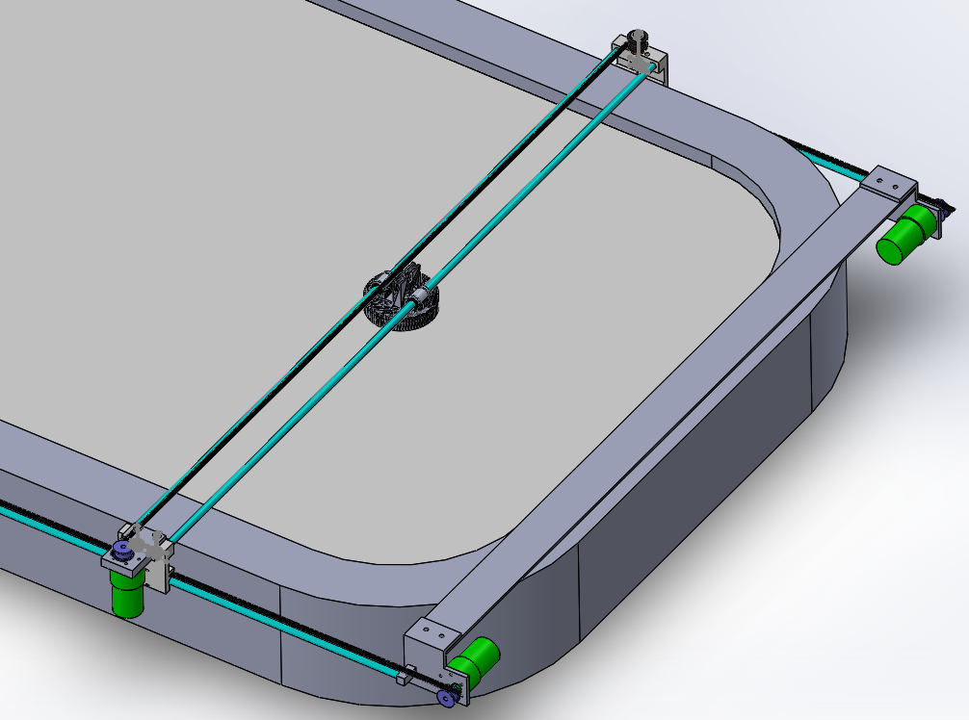
Design Overview
Belt driven mechanism inspired by open-source project
https://www.jjrobots.com/air-hockey-robot-a-3d-printer-hack/
Redesigned to accommodate larger table, implemented numerous improvements to improve robustness & ease of manufacturing
3 motors (2 Y-Axis, 1 X-Axis)
Easy to swap different motors later in the project
Utilizes off the shelf bearings, pulleys and belts
Mounting brackets 3D printed (own design)
Paddle 3D printed (open-source design)
X
Y

Slide 4
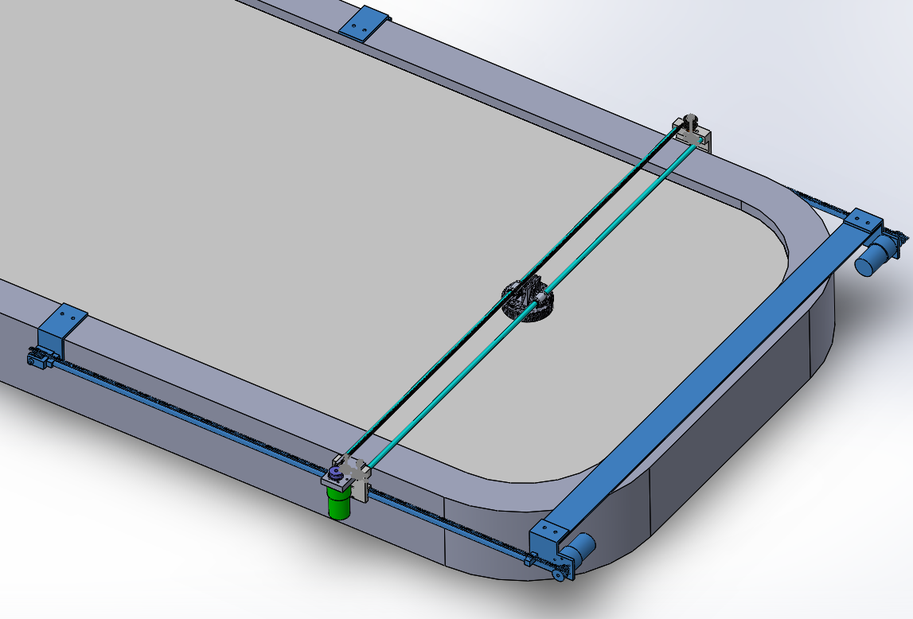
Design Overview
Carriage + Linear Bearing
Idler Pulley
Guide Rod + Belt
Motor + GT2 Timing Pulley

Slide 5
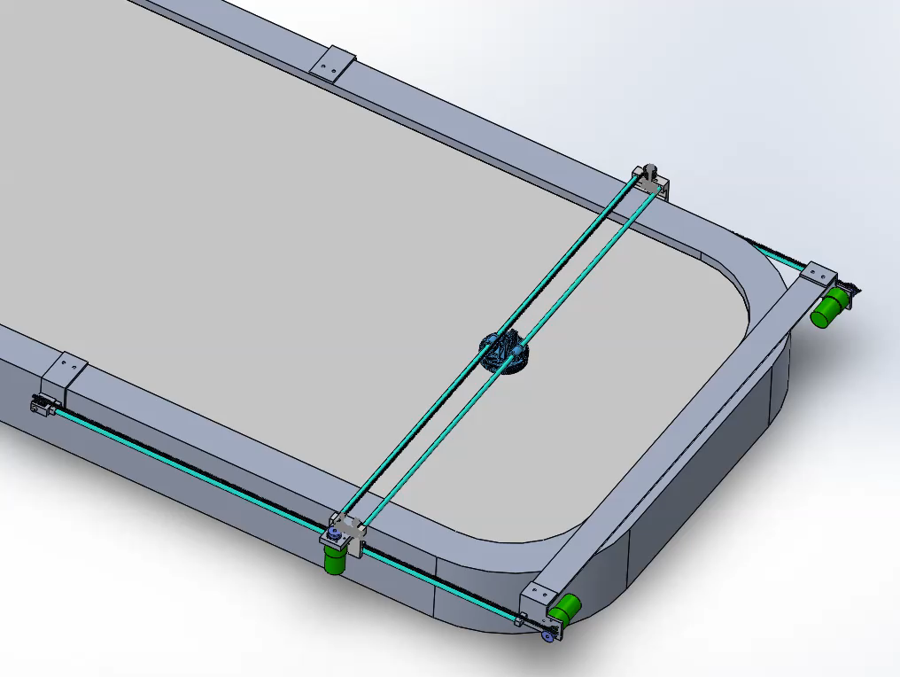
Design Overview

Slide 6
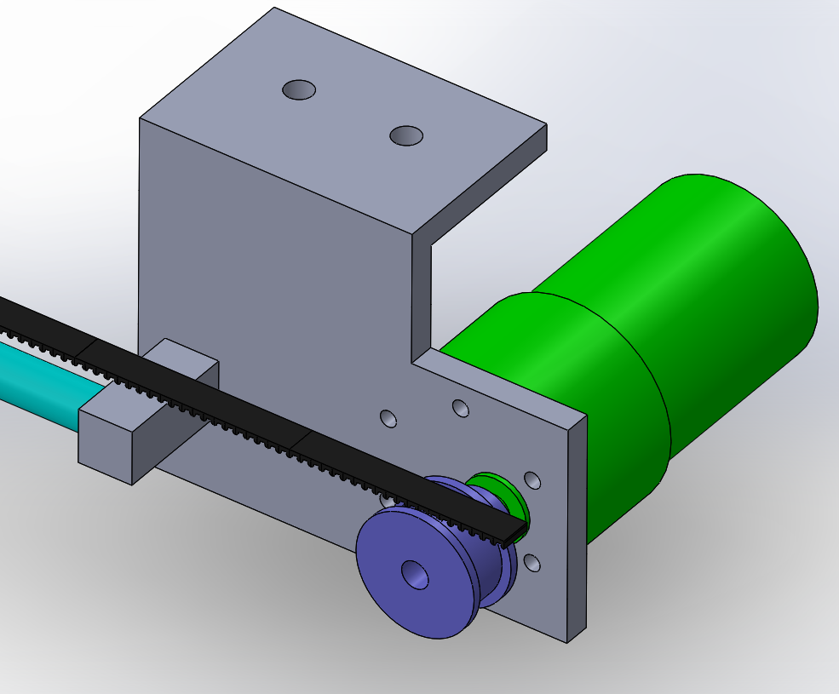
Y-Axis Motor Assembly
Mount design controls position in 3 dimensions
Bolt hole placement controls Y-Dimension
Motor selected for prototyping purposes
May change later once system level design complete
Includes integrated encoder
GT2 30-Tooth timing pulley drives belt
May change later once system level design complete

Slide 7
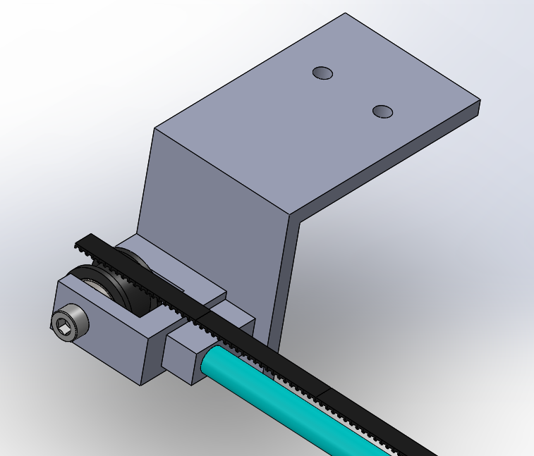
Y-Axis Idler Pulley Assembly
Mount design controls position in 3 dimensions
Bolt hole placement controls Y-Dimension
Idler pulley mounted on 5x16 ball bearings allowing it to rotate freely

Slide 8
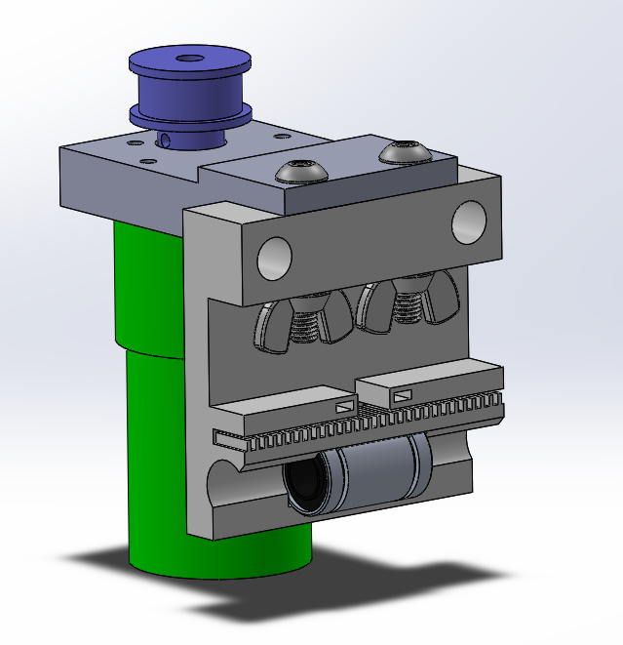
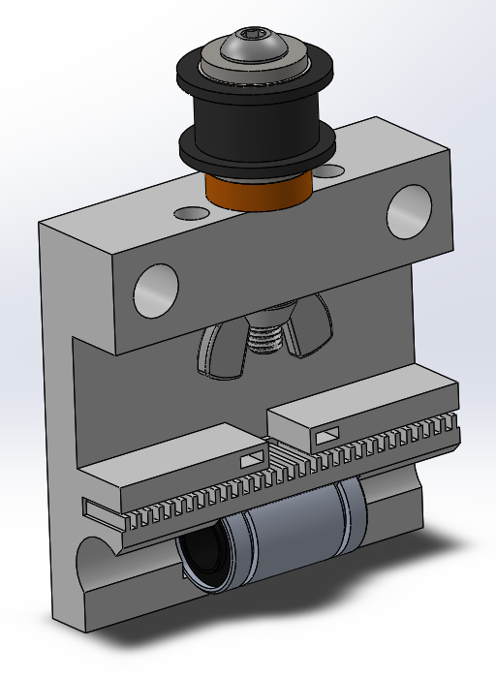
X-Axis Motor + Idler Pulley Assemblies
Common carriage design
Linear bearing allows smooth translation on y-axis guide rod
Opening above belt track to allow for easy tensioning
Motor Assembly
Idler Pulley Assembly

Slide 9
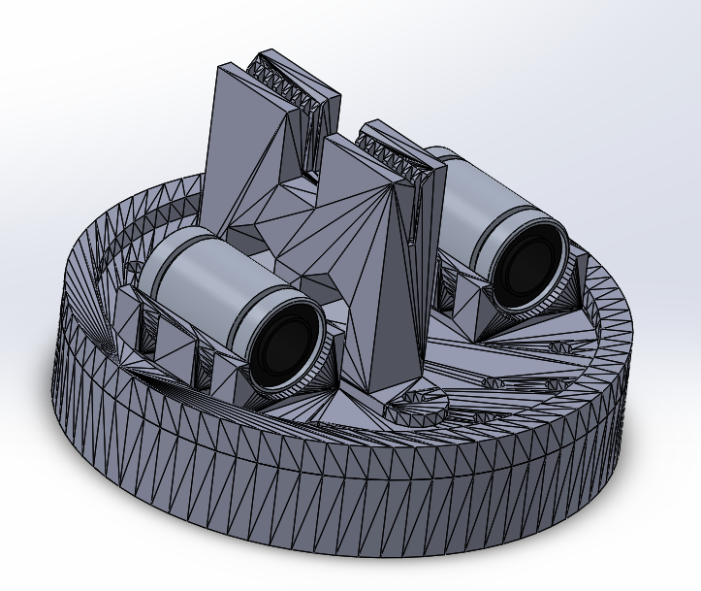
Paddle Assembly
Open-source design
Uses linear bearings to allow for smooth translation on x-axis guide rods
Opening in belt track to allow for easy belt tensioning

