Slide 1
Customer’s Order Manager Application

Slide 2

Customer’s Order Manager
BE 1
BE 2
Create Customer :
Name
Address
Profile photo
Create Order :
Customer Id
Product
Quantity
FE (Angular)
Upload profile photo to object storage
Get image url
App 1 send request to App 2 using http client
Save customer data to customer DB
Save order data to order DB

Slide 3





Application schema
Tools :
Angular (Frontend)
Spring Boot (Backend)
Minio (Object Storage)
Postgresql (Database)
Micro services
customer
Object storage
REST API
REST API
read
customer
order
order
write
database
Database table
database

Slide 4




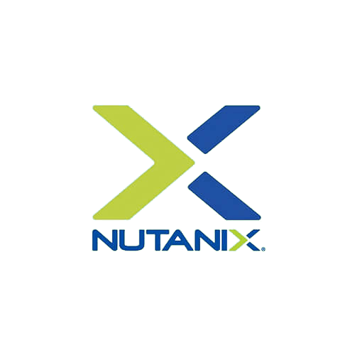
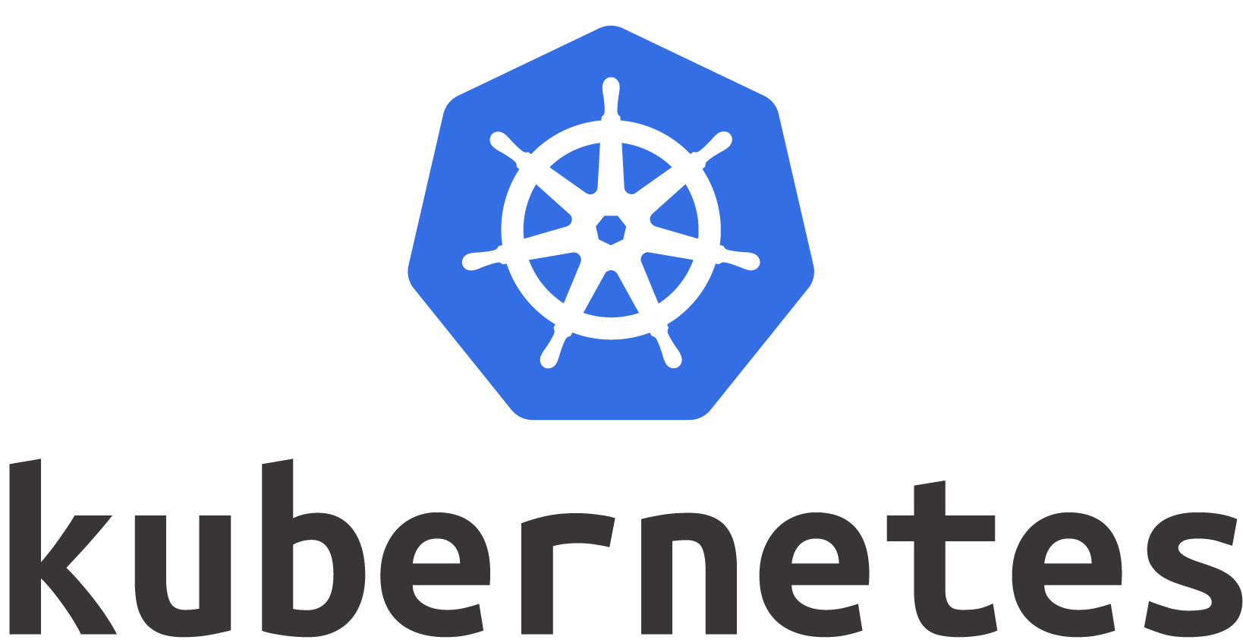
Development Workflow

Slide 5





Application schema on Kubernetes cluster
Config map & Secret
Object storage
webapp
customer
Database
order
Node 2
Node 1

Slide 6
Environment Setup
Angular
Node js (16.13.2)
Angular cli (14)
Spring
Maven (3.6.3)
Java 11
Database
Postgresql
Object Storage
Minio

Slide 7
Docker Setup
Postgresql
docker run --name some-postgres -p 5432:5432 -e POSTGRES_PASSWORD=mysecretpassword -d postgres
Minio
docker run -p 9000:9000 -d -p 9001:9001 -e "MINIO_ROOT_USER=user" -e "MINIO_ROOT_PASSWORD=password" quay.io/minio/minio server /data --console-address ":9001"

Slide 8
Things to note! (Angular)
Environment variable
Angular proxy config(sesuaikan dengan ingress prefix)
{
"/api": {
"target": "http://localhost:8081",
"secure": false,
"pathRewrite": {
"^/api": ""
},
"changeOrigin": true
}
}

Slide 9
Things to note!
(Ingress config)
apiVersion: networking.k8s.io/v1
kind: Ingress
metadata:
name: ingress-apps
annotations:
nginx.ingress.kubernetes.io/rewrite-target: /$2
nginx.ingress.kubernetes.io/app-root: /app/
nginx.ingress.kubernetes.io/proxy-body-size: 100M
spec:
ingressClassName: nginx
rules:
- host: "tabeldata-nutanix.com"
http:
paths:
- pathType: Prefix
path: "/api(/|$)(.*)"
backend:
service:
name: spring-minio-service
port:
number: 8081
- pathType: Prefix
path: "/app(/|$)(.*)"
backend:
service:
name: webapp-service
port:
number: 4200
Backend
Frontend

Slide 10
Things to note!
(Spring Boot)
Environment Variable on application.yml file
Database Connection
Minio object storage Connection
Microservices Connection
SPRING_DATASOURCE_URL: jdbc:postgresql://localhost:5432/postgres SPRING_DATASOURCE_USERNAME: postgres SPRING_DATASOURCE_PASSWORD: password
SPRING_MINIO_URL: http://minio:9000 SPRING_MINIO_ACCESS_KEY: user SPRING_MINIO_STORAGE_ACCOUNT_KEY: password
ORDER_HOST: http://localhost:8082

Slide 11
Connect to Kubernetes cluster (karbon)
Login ke Nutanix prism central
Masuk Service (kubernetes)
Download kubeconfig
Copy ke .kube/config

Slide 12
Provision ndb postgres HA

Slide 13
Provision Object Storage

Slide 14
Ingress Controller Setup
Ingress YAML Manifest
https://raw.githubusercontent.com/kubernetes/ingress-nginx/controller-v0.44.0/deploy/static/provider/cloud/deploy.yaml
Check pod
kubectl get pods --namespace=ingress-nginx
Check service
kubectl get service ingress-nginx-controller --namespace=ingress-nginx

