Slide 1


CAPSTONE PROJECT
MGMT-6134-(31)-25S
MILESTONE 1
BHN Project - Birth Healthcare Number
A Secure Digital Healthcare Platform
1
Notes:
1

Slide 2
Meet The Team
Aniket Mishra
Application Manager
Abu Taber Shareef
Security and Solution Architect
Krishang Mankad
Database Development
Aman Patel
QA
Project Manager.
Geetanjali Sharma
2
Notes:
2

Slide 3
AGENDA
INTRODUCTION
PROBLEM AND ITS SOLUTION
SYSTEM ARCHITECTURE
FEATURES AND BENEFITS
DEVELOPMENT
SWOT ANALYSIS
CHALLENGES
3
Notes:
2

Slide 4





Introduction to BHN
Secure Platform
Unique ID
Digital health on a domain.
BHN for every Canadian citizen.
Cloud Portfolio
Encrypted records: prescriptions, labs, diagnoses.
4
Notes:
3

Slide 5





The Problem
Fragmented Records
Across institutions.
Emergency Delays
Inaccessible patient history.
Duplication
Repeated tests, paperwork.
Privacy Concerns
Manual storage risks.
5
Notes:
4

Slide 6
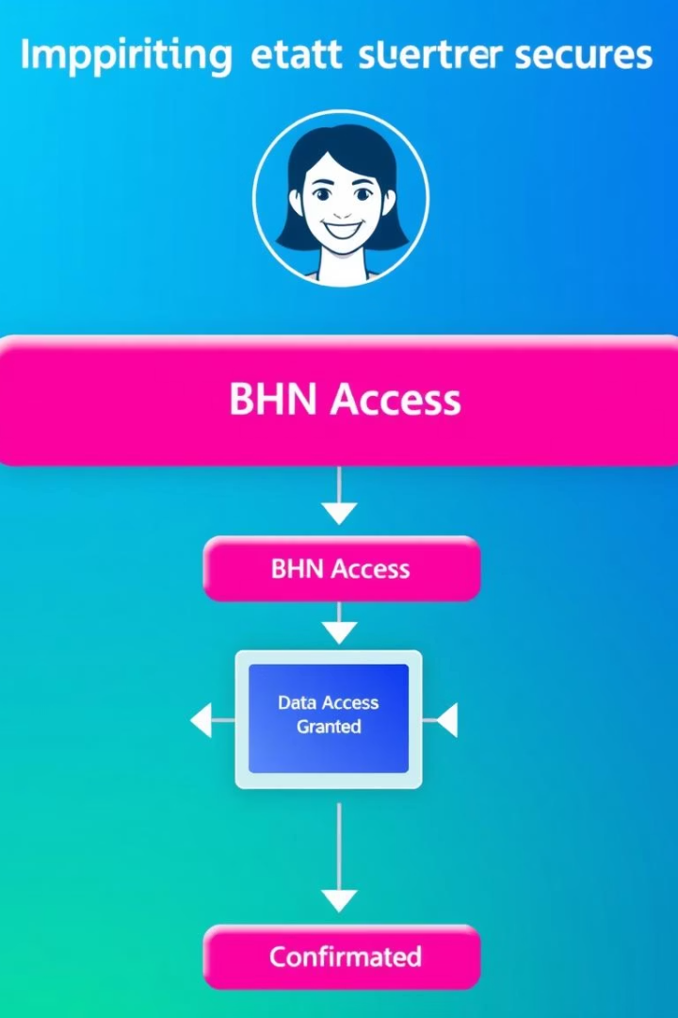
Our Solution - BHN
Unified Digital ID
Health data from birth to death.
Authorized Access
Only via AWS Cognito.
Real-time Access
Critical for emergencies.
Eliminates Duplication
No more paper systems.
6
Notes:
5

Slide 7
System Architecture
Frontend
Authentication
Storage
Backend
AWS Amplify, React
AWS Cognito
AWS S3 (Encrypted folders)
AWS Lambda (Node.js API)
Hospital Portal
CDN & Routing
EC2 hosted
CloudFront + Route 53
7
Notes:
6

Slide 8
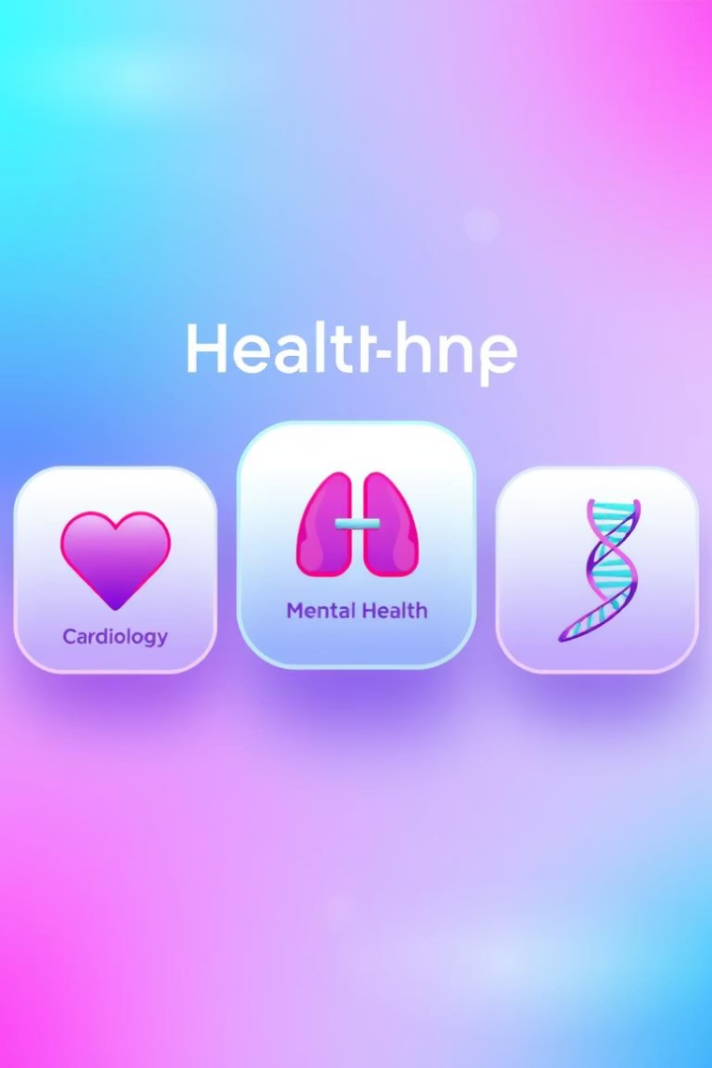




Key Features & Benefits
Centralized Records
Faster Emergency
Prevents Duplication
HIPAA Compliant
PIPEDA Compliance
8
Notes:
7

Slide 9



Development Milestones
SAAS Infra.
On AWS Amplify.
2
BHN Record Portal
doctors/patients to access records.
Encrypted S3
3
Bucket setup complete.
Cognito Auth
In progress.
Lambda API
Next phase.
9
Notes:
8

Slide 10
SWOT Analysis
Strengths
Weaknesses
Opportunities
Threats
Innovative AWS use
Initial AWS complexity
Expand to federal systems
Regulatory hurdles
Real-time health data
High learning curve
Cybersecurity risks
Strong security focus
Integrate wearables
10
Notes:
9

Slide 11
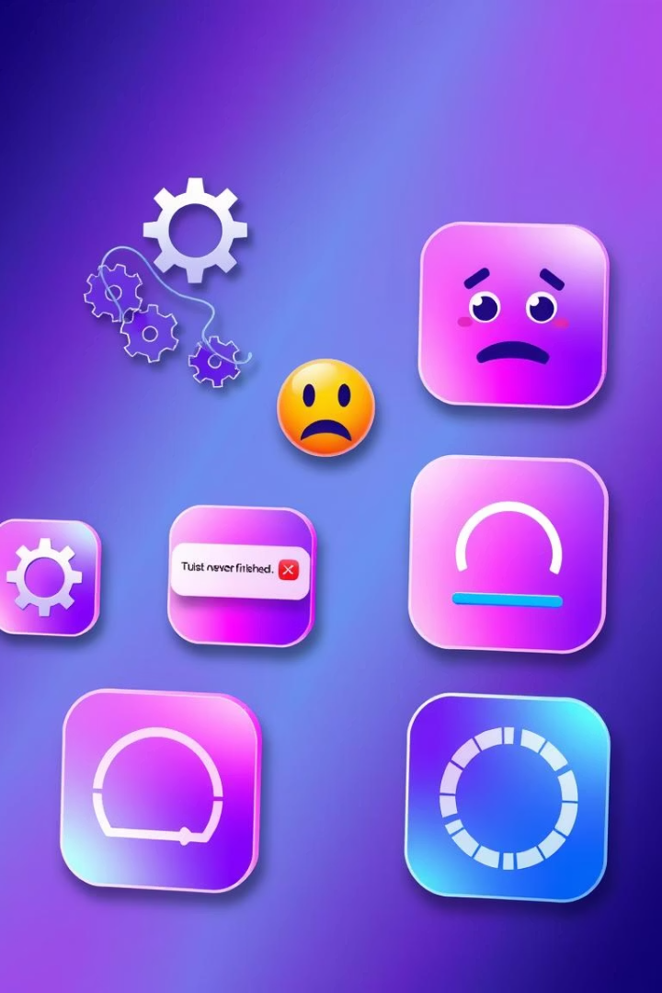
Challenges Faced
Cognito Permissions
Identity Verification
Mapping complexities.
Duplicate BHN handling.
Design Consistency
Web & mobile.
11
Notes:
10

Slide 12

THANK YOU

