Slide 1
MATLAB AND SIMULINK
MIT TECH TEAM
MAHARASHTRA INSTITUTE OF TECHNOLOGY , PUNE

Slide 2
Ring Detection and Real Time Correction of Auto Robot for Shuttlecock throwing.
Image Acquisition Toolbox
Use of Image acquisition toolbox to acquire data from depth sensor of Microsoft Kinect v2.
Image Processing Toolbox
Use of pre-defined image processing functions for : -
Noise elimination and filtering.
Morphological operations.
Intensity adjustment .
Circle detection.

Slide 3
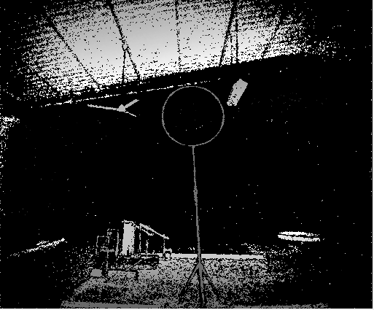
Algorithm for Ring and Shuttlecock detection : -
Acquiring depth image by using image acquisition toolbox for Microsoft Kinect v2. (Fig 1)
Intensity adjustment
2-D Median filtering for noise elimination
Elimination of depth pixels other than the pixels
surrounding ring.
Morphological closing for ring completion.
Detection of centre and radius for ring and
shuttlecock using imfindcircle().
Fig 1

Slide 4
Algorithm for Real time correction : -
If the distance between the centre of the ring and the shuttlecock is less than the radius of the ring then the throw was successful.
2. If the distance is greater than the radius this implies the throw was unsuccessful and the yaw of the robot should be corrected by taking the tan inverse of the distance between ring and shuttlecock and the distance between ring plane and kinect sensor .

Slide 5
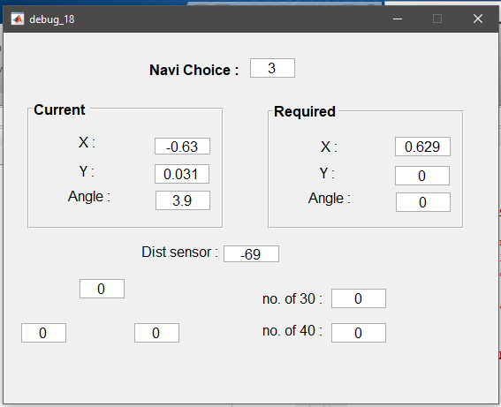
GUIDE for designing GUI based wireless debugging system : -
We developed a wireless debugger with an interactive GUI which gave us the real time values of important variables in the code along with sensor values.
The debugger proved to be a great tool for identifying the errors in our code which surfaced only when the robot was running.
The manual operator used this to his benefit to adjust the various parameters of the throwing mechanism such as: distance sensor data.
It also helped us monitor the working of the autonomous robot.

Slide 6
PLANT MODEL
MODEL
SIMSCAPE BLOCKS
MOTOR
ENCODER
MATLAB FUNCTION
PISTON CONTROL BLOCK
SOLIDWORKS IMPORTED BLOCKS
BODY BLOCKS
JOINT BLOCK

Slide 7
GRAPHICAL REPRESENTATION
READILY AVAILABLE BLOCKS
FEATURES
USER FRIENDLY
HARDWARE INTERFACE
SOLVERS
AUTOMATICALLY GENERATE CODE

