Slide 1
GAMECUBE
Digital Game Keys Marketplace
Dalmady Máté
Németh Barna Kristóf
Tabi Kevin
Frontend Developer
Backend Developer
Database / PM

Slide 2
Dalmady Máté
Frontend Developer
Németh Barna Kristóf
Backend Developer
Tabi Kevin
Database / PM
Homepage & product listing
Cart & checkout UI
Profile, register, login HTML/CSS/JavaScript
Top slider, category filter component
Figma desing
PHP API endpoints
JWT authentication & session handling
Database queries and transactions
Admin order management system
Database schema design
Jira task management & time tracking
GitHub repository management
Team coordination & documentation

Slide 3
Why GameCube?
"One platform. Multiple sellers. Unbeatable prices."
Lower Prices
Instant Delivery
Competitive pricing from multiple sellers, always below MSRP.
Keys delivered immediately to your profile — no waiting.
One Platform, Many Sellers
Easy Access
Aggregated marketplace with verified vendors and multiple offers.
Simple browsing, filtering and checkout experience.
Secure System
JWT authentication, encrypted data, secure payment processing.

Slide 4
Project Overview
What is GameCube?
Digital Marketplace
Instant Delivery
Game keys · DLCs · Gift cards
Keys available immediately in profile
Online marketplace for video game keys, DLCs, and gift cards. Aggregator platform with multi-seller offers — one checkout, many vendors.
Steam, PlayStation, Xbox keys at discounted prices. Fast transactions with instant code redemption on respective platforms.
Multiple Payment Methods
Secure System
Card · PayPal · Bank transfer · Cash
JWT auth · Encrypted data
All major payment methods supported with secure transaction processing.
JWT-based authentication, encrypted storage, and secure payment processing throughout.

Slide 5
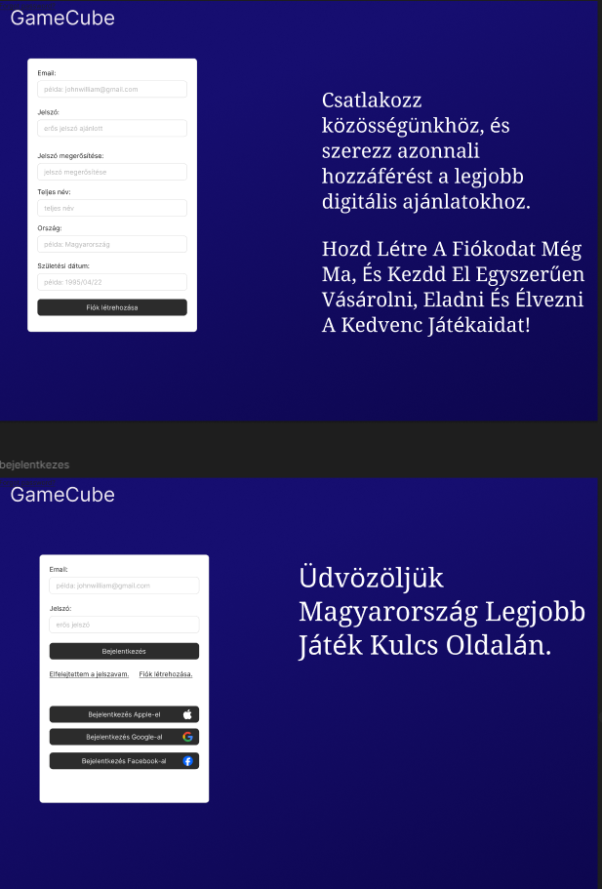
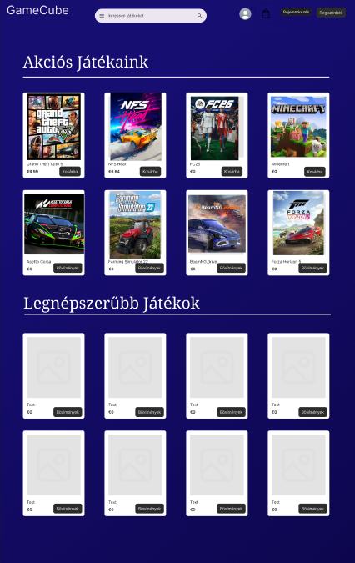
Design Plan
Figma mockups
Register & Login
Product listing

Slide 6
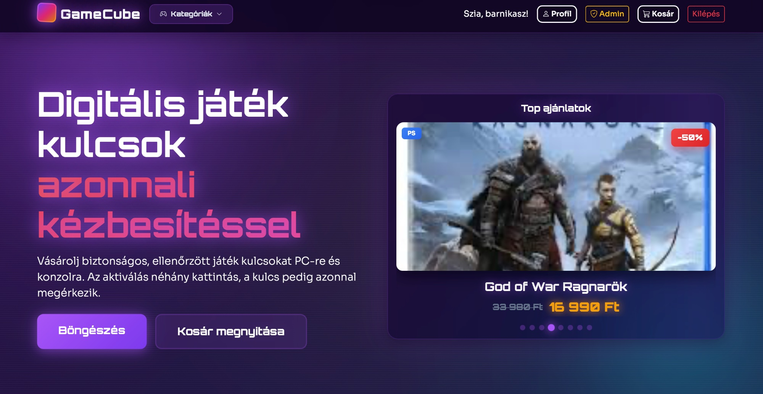
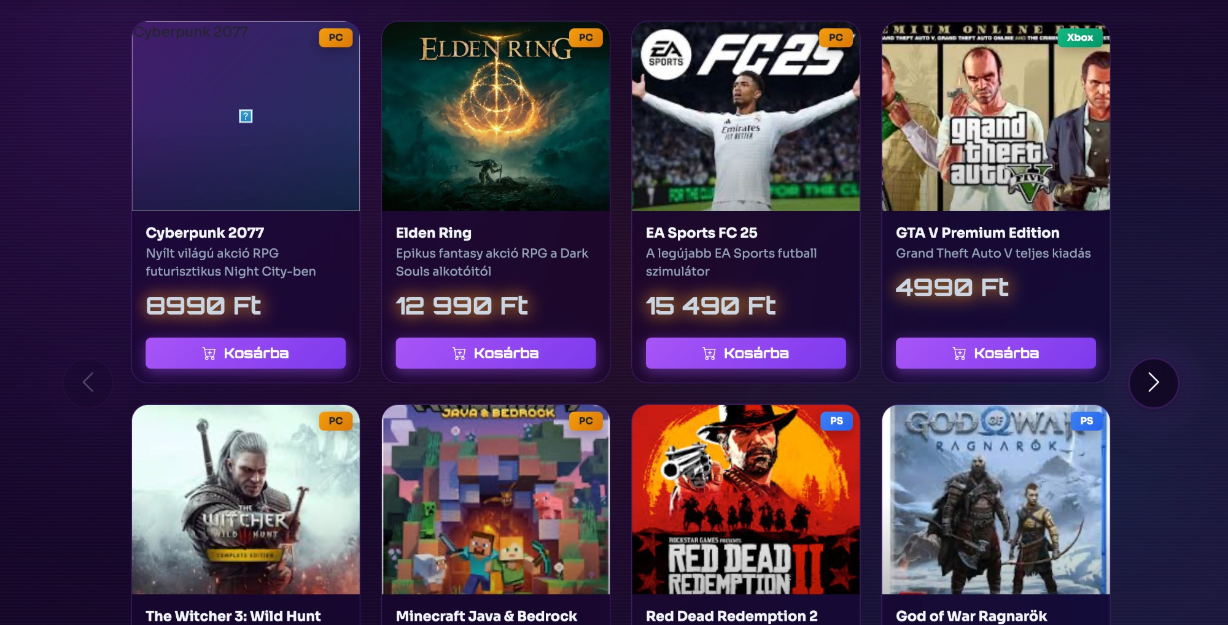
Figma Design vs. Live Website
Side-by-side comparison
Figma
Live website

Slide 7
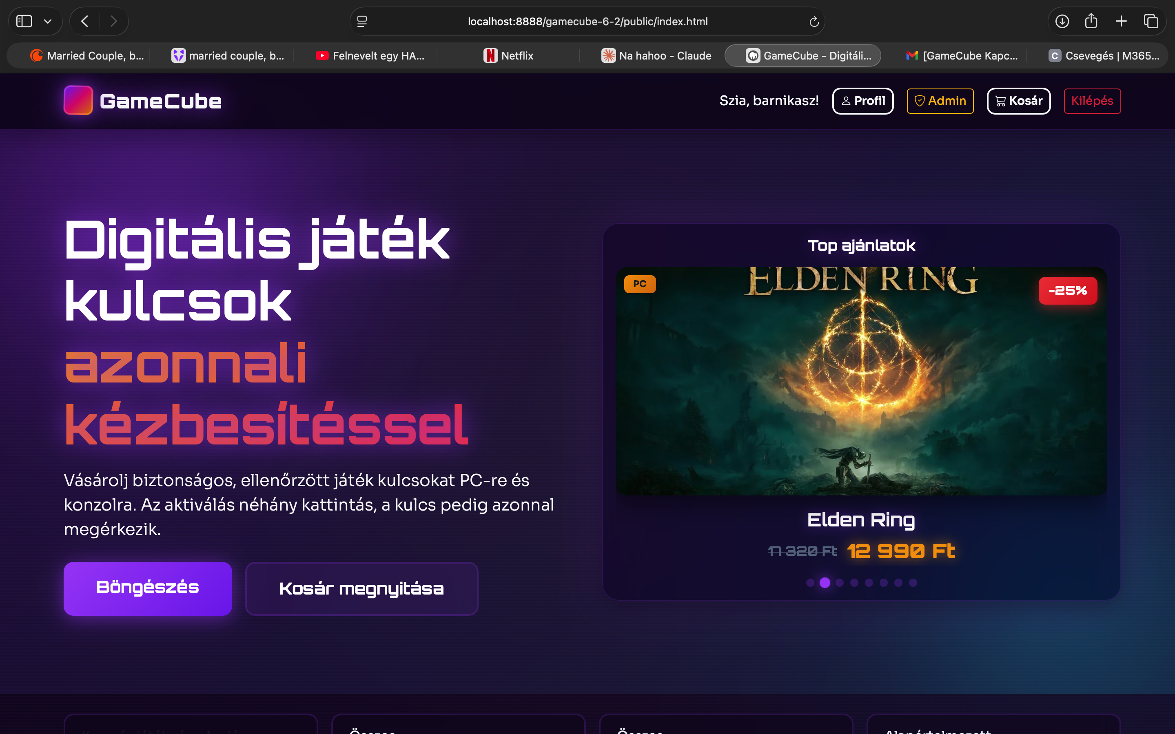
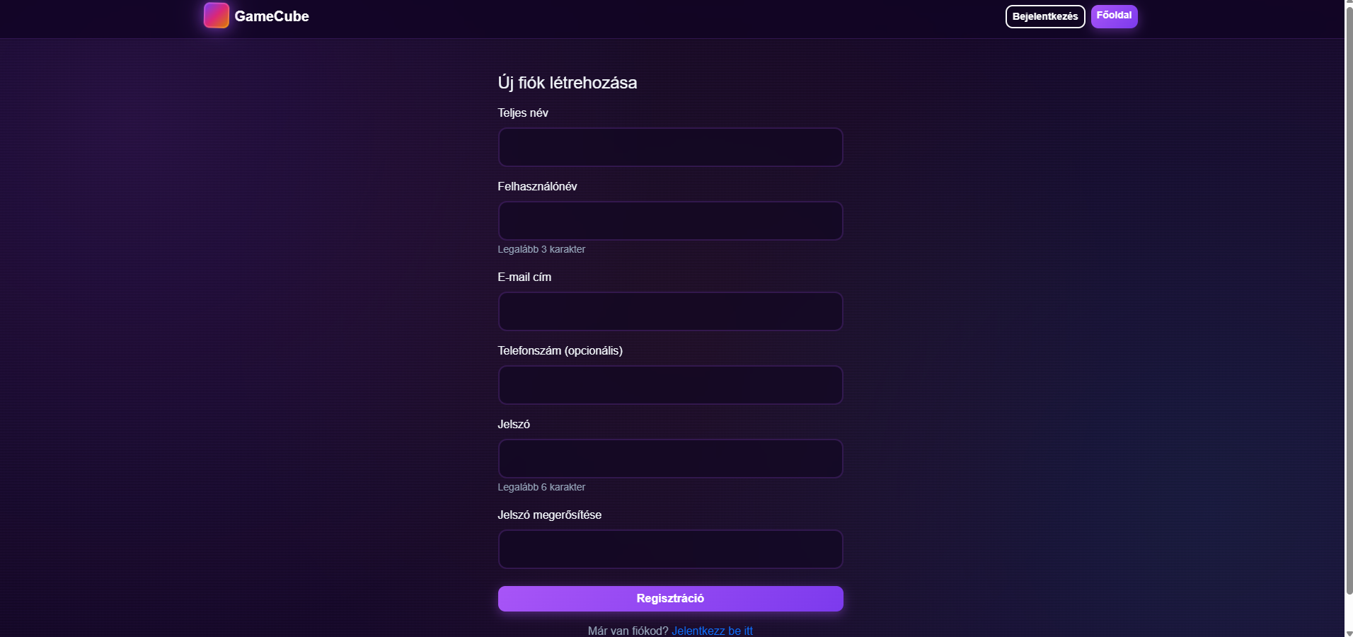
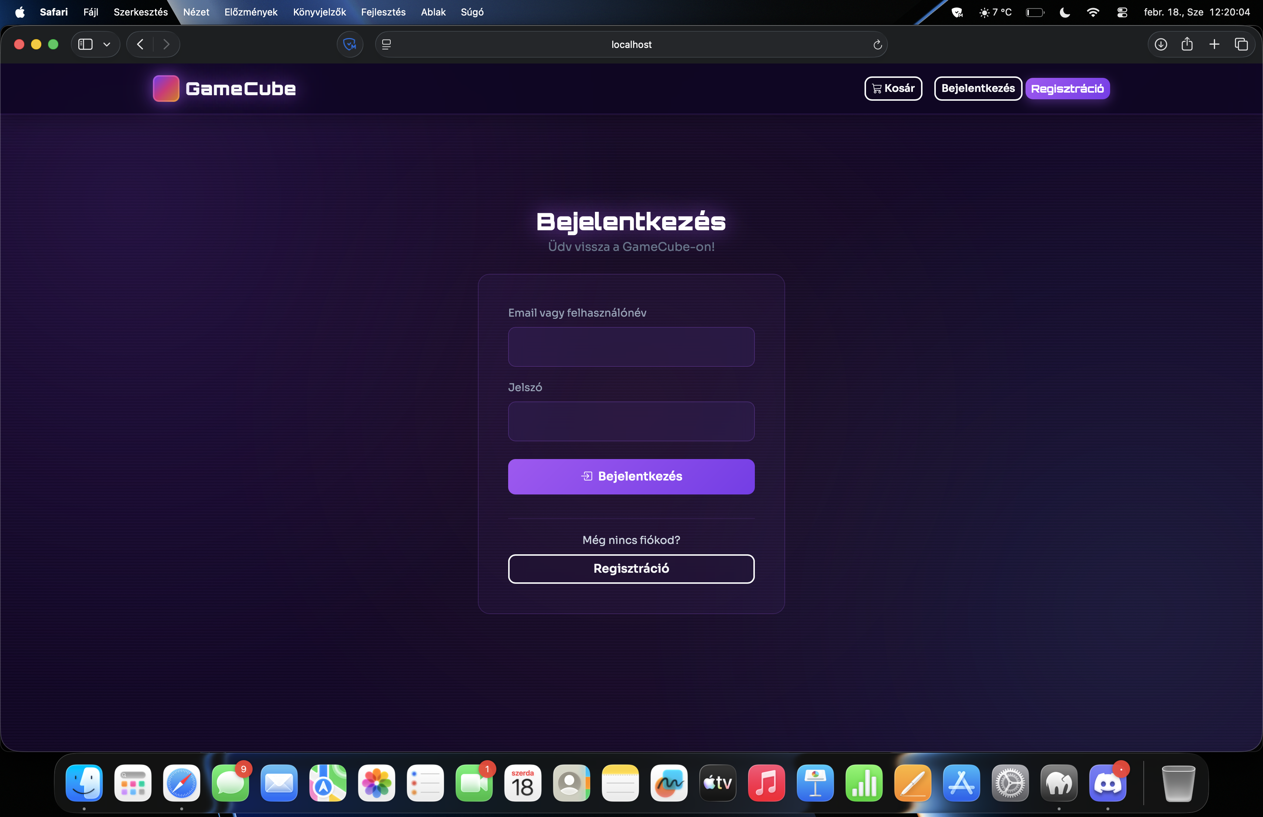
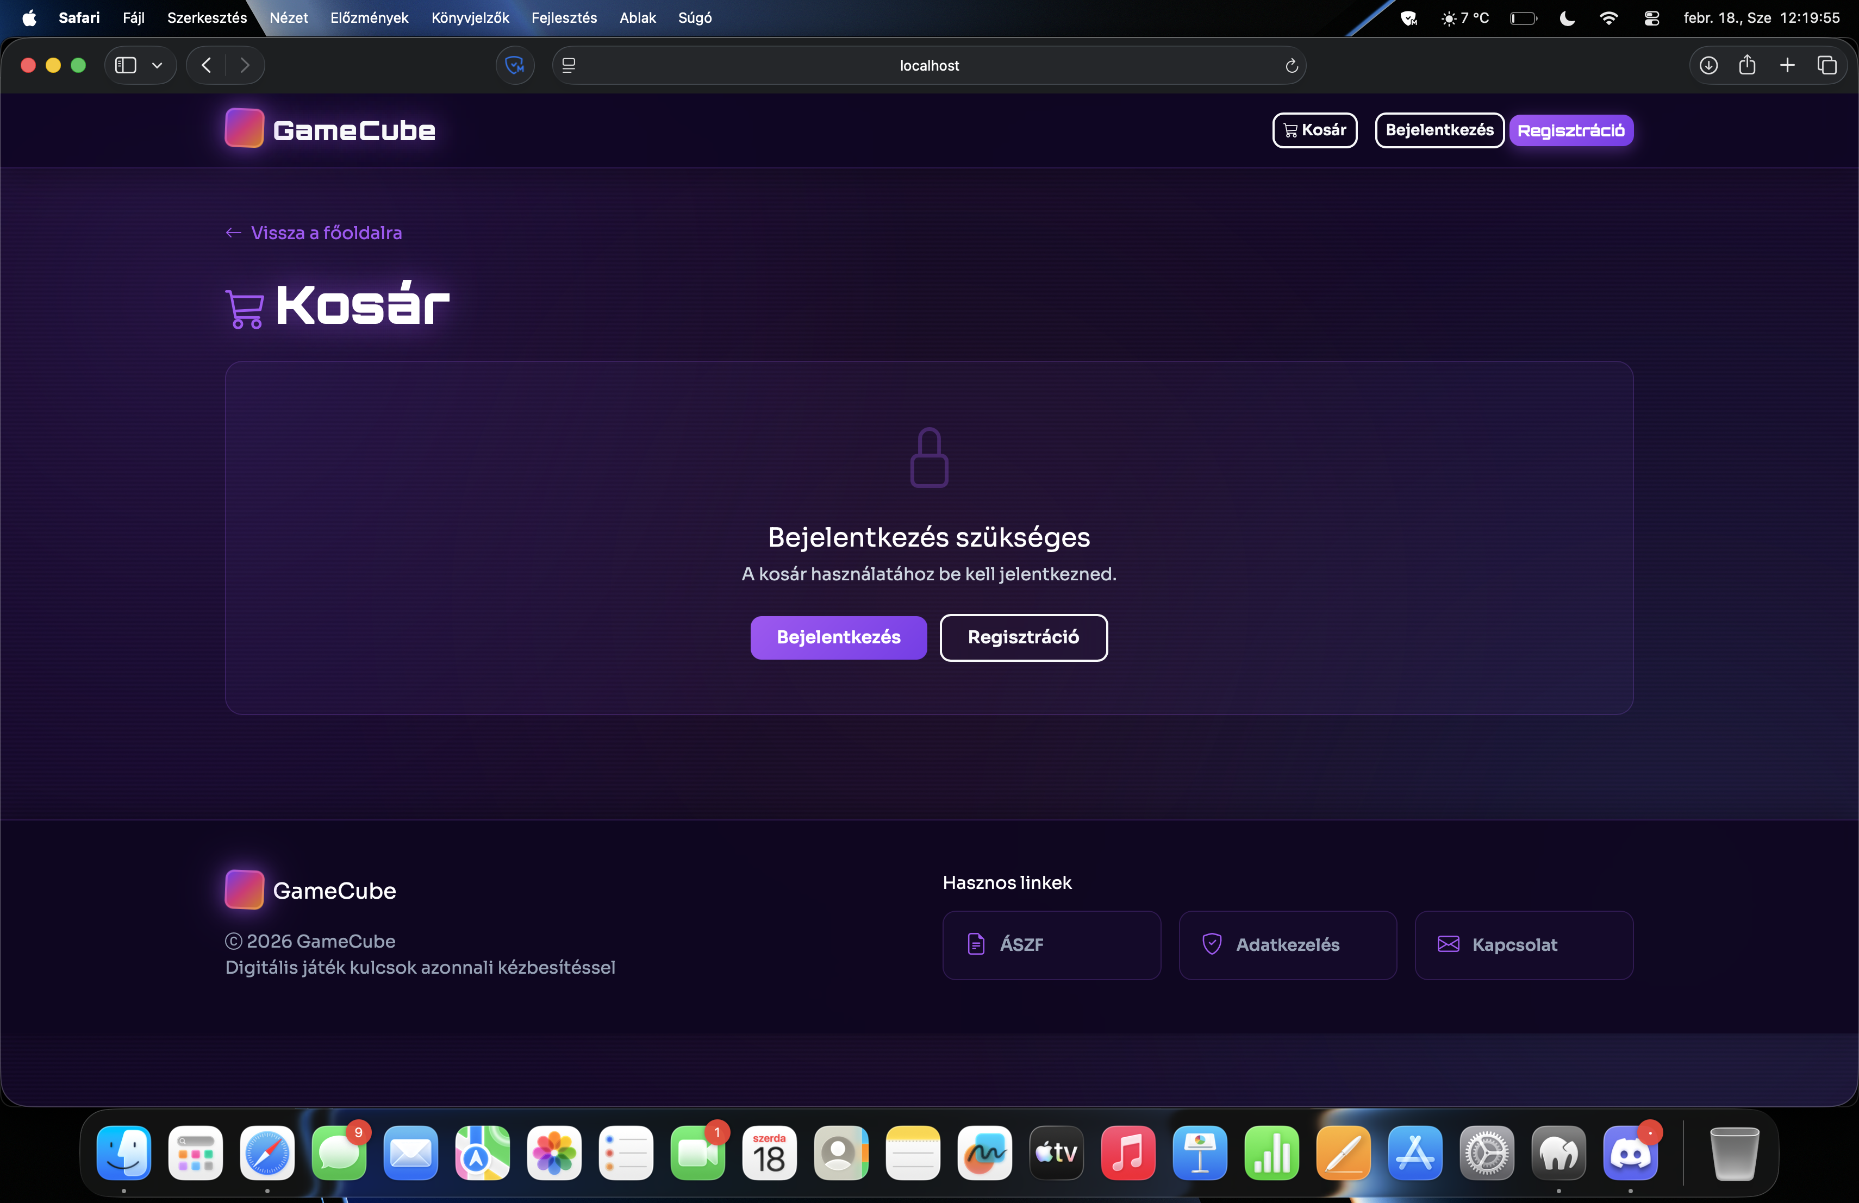
Live Website
Current state of the application
Homepage
Register
Login
Cart

Slide 8
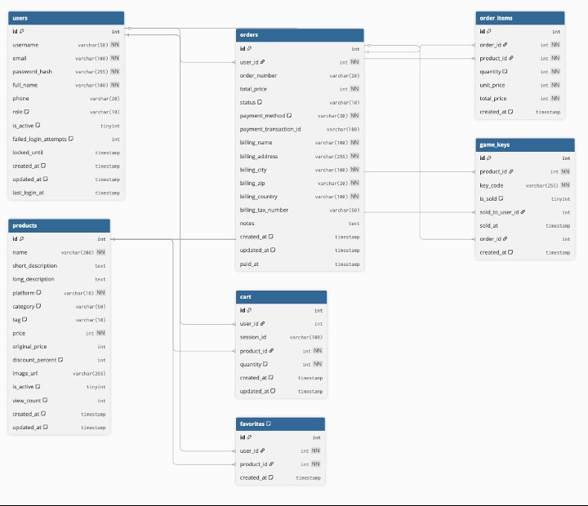
Database Plan
MySQL schema

Slide 9
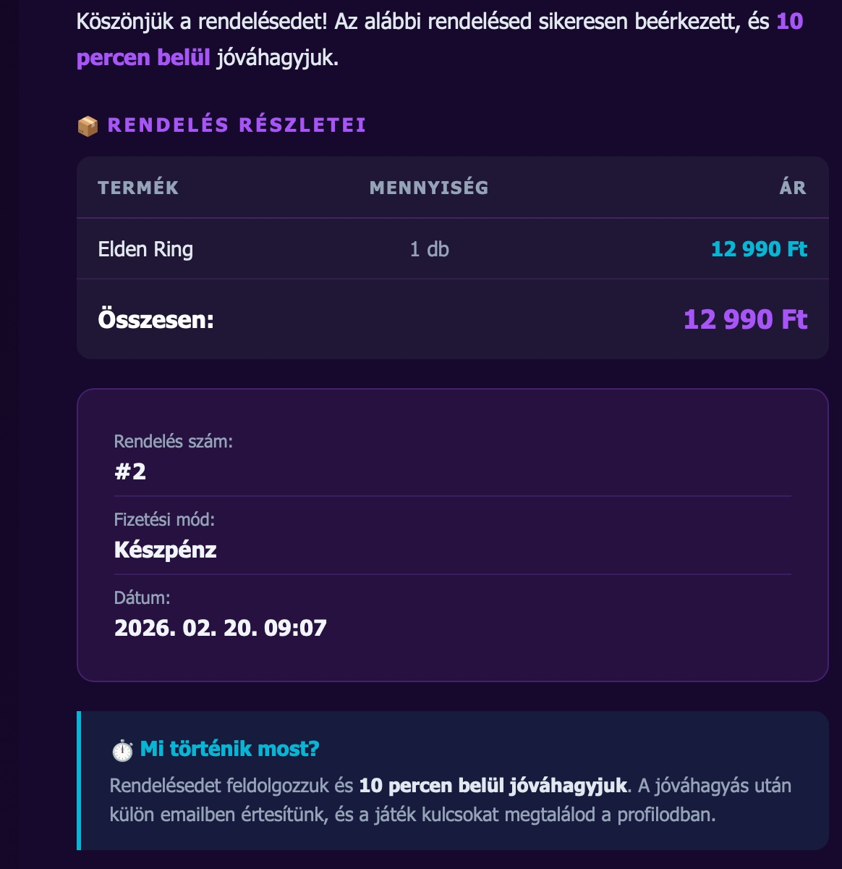
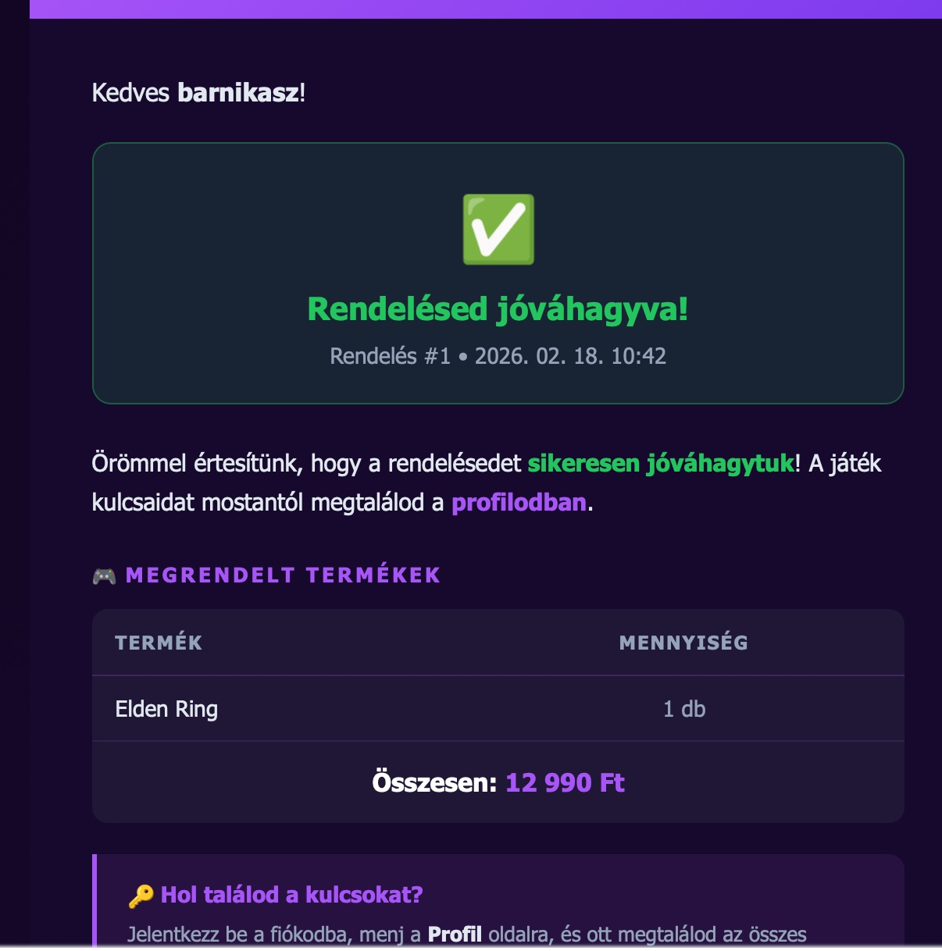
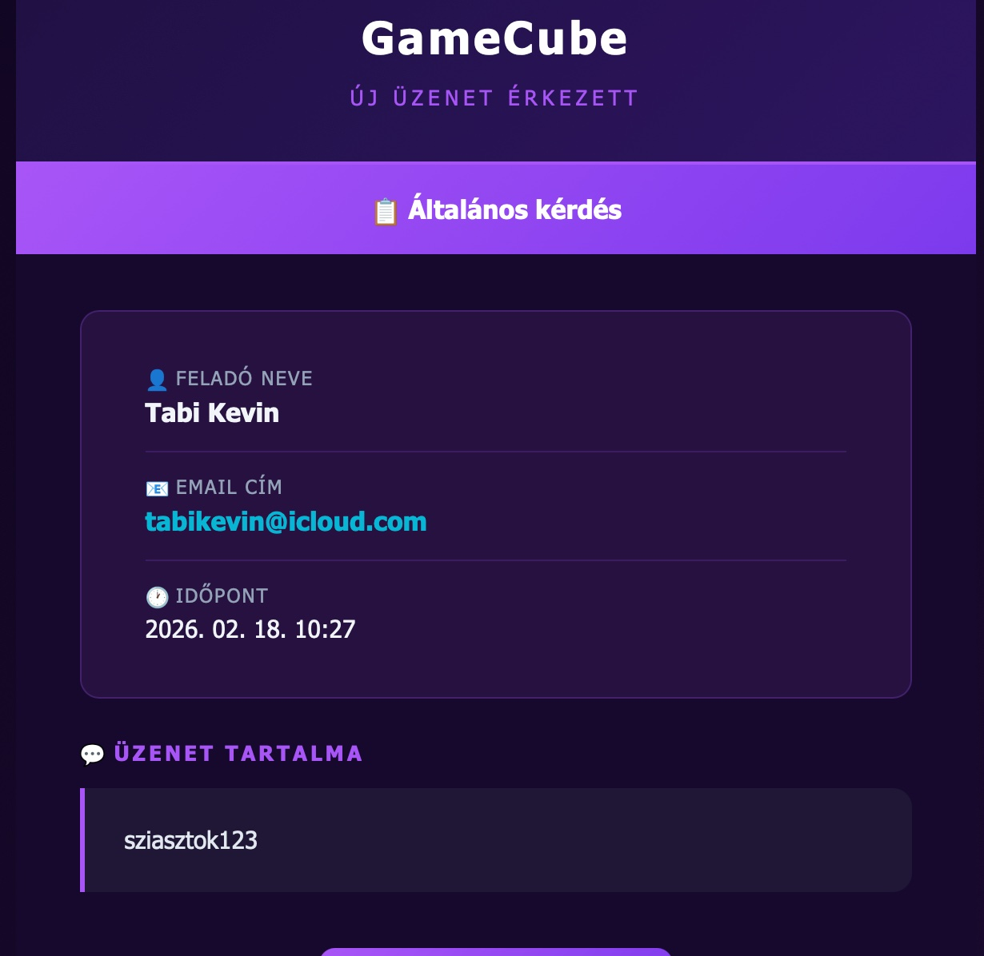
Email System
Automated transactional emails
Order confirmation
Order approved
Contact message

Slide 10
Technologies Used
Our tech stack
Frontend
Backend & Database
Other
HTML
PHP
GitHub
Semantic structure, accessibility
REST API, JWT, session handling, SMTP email sending
Version control, team collaboration, code sharing
CSS
MySQL
Jira
Responsive design, animations, Bootstrap 5
Users, products, orders, and game keys storage
Task, time management & sprint planning
JavaScript
API calls, dynamic UI, cart and filter logic

Slide 11
Project Management
Jira & GitHub
Jira
GitHub
Creating and assigning tasks to team members
44 completed tickets (GAM-1 → GAM-38+)
Status tracking: To Do → In Progress → Done
Priority and deadline management
Sprint planning and retrospectives
Shared repository for the entire team
Everyone has access to the latest code
Progress visible through commit history
Parallel development using branches
Conflict resolution and code review

Slide 12
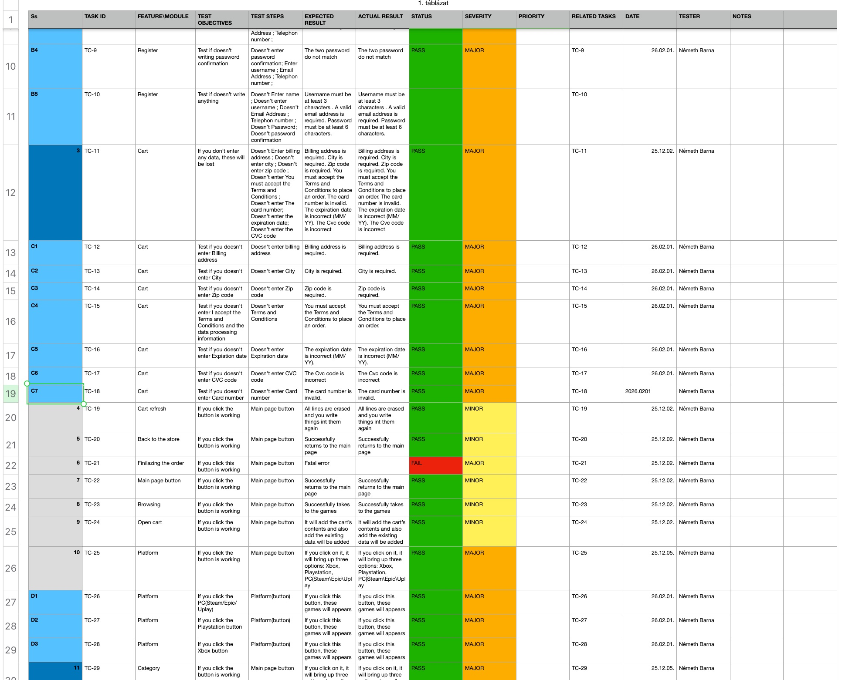
Testing
Test cases & results

Slide 13
Time Management
Jira time tracking — 198 hours total
Németh Barna Kristóf
Backend Developer
85h — 43%
Tabi Kevin
Database / PM
55h — 28%
Dalmady Máté
Frontend Developer
58h — 29%

Slide 14
Thank you.
GameCube — Digital Game Keys Marketplace
Dalmady Máté
Németh Barna Kristóf
Tabi Kevin
Frontend Developer
Backend Developer
Database / PM

