Slide 1
Devflix
Tabish Ilyas

Slide 2
Who Am I?
Tabish Ilyas
23
Little Rock, Arkansas
Graduated from the University of Arkansas at Little Rock
Bachelor’s Degree in Electrical and Computer Systems Engineering

Slide 3
Why Programming?
The few programming courses I took in college piqued my interest in developing my programming skills
I wanted to expand my options for work in the tech industry
I’m always looking to learn something new

Slide 4
Why This Project?
Good place to find the next movie to watch
Good way to display the applications of web-scraping
I like movies

Slide 5
Technologies Used
Database
MySQL
Web Scraper
Java
JSoup Library
Server
Java
Spring Boot
Maven
Client
React JS

Slide 6
Demo

Slide 7
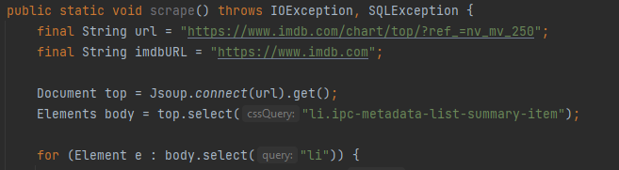
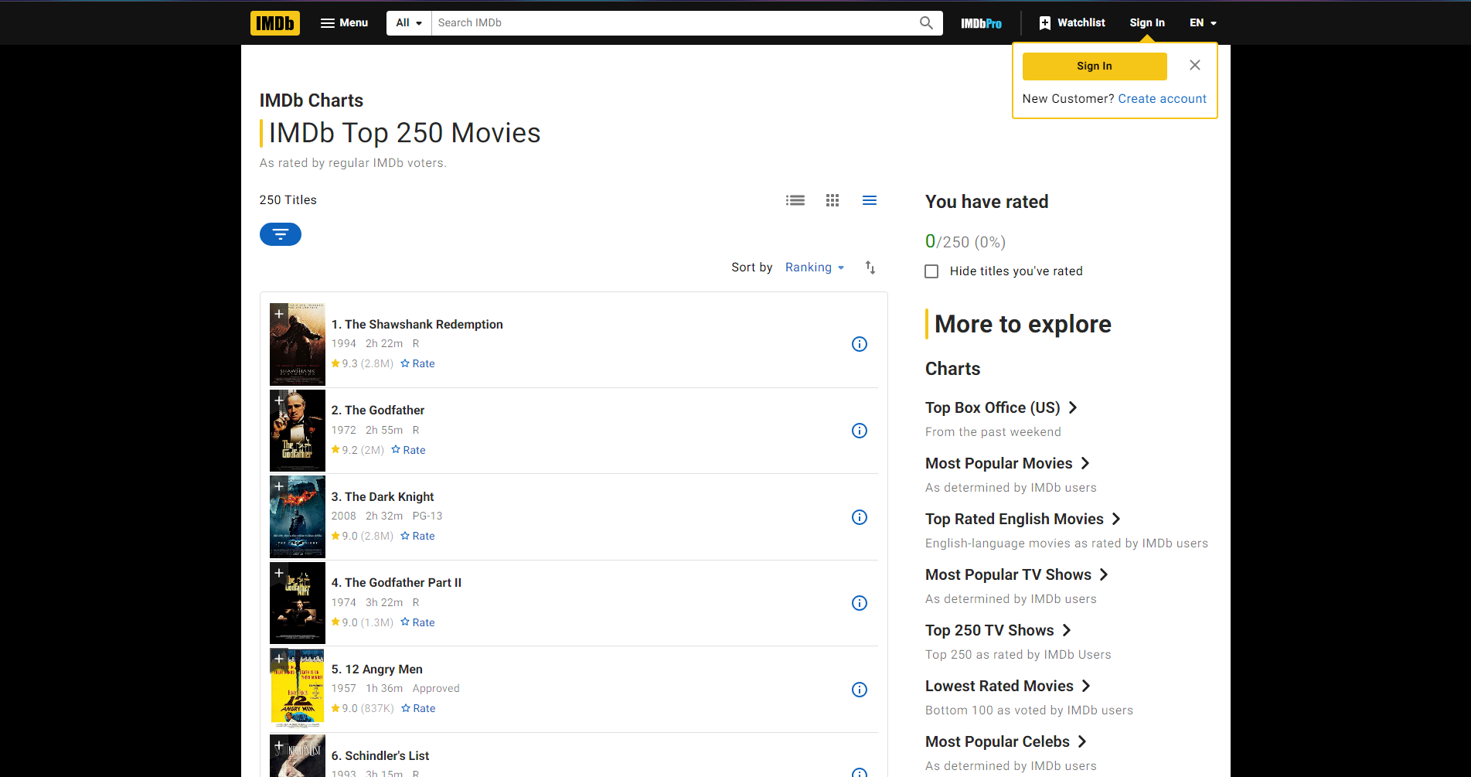

Slide 8
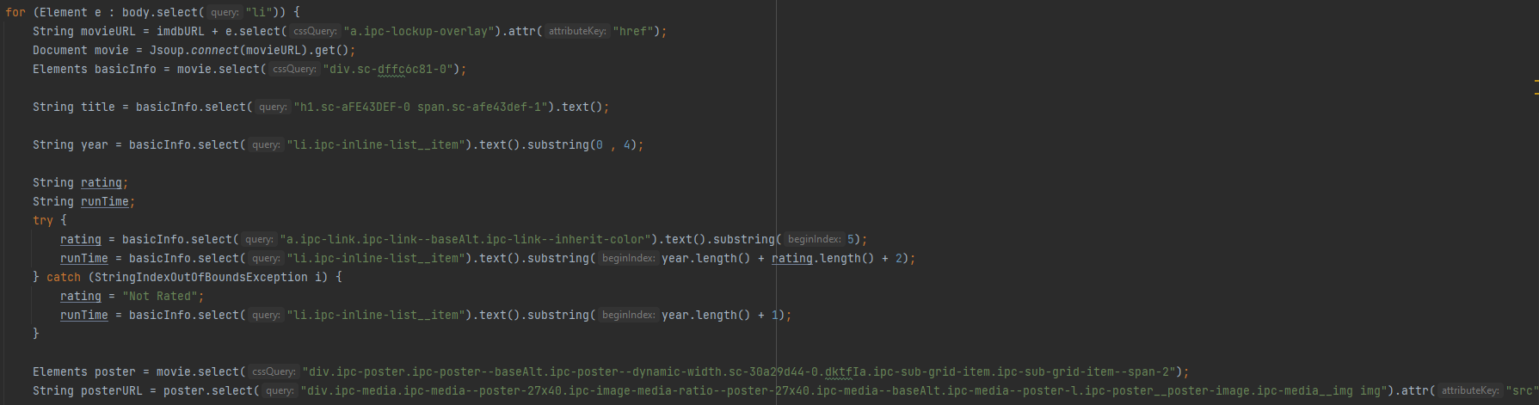
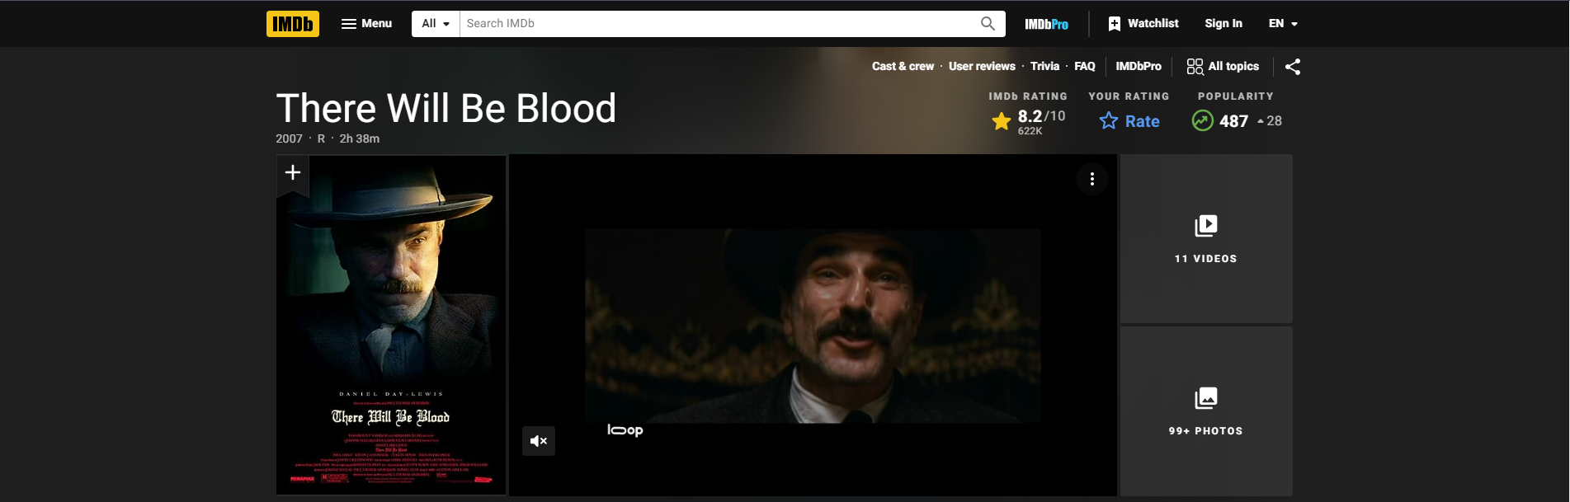

Slide 9
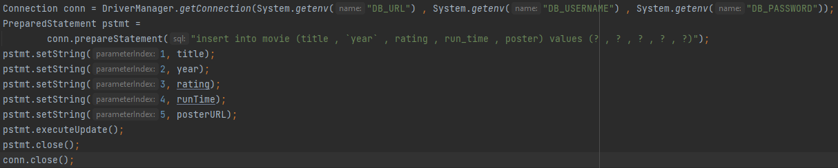
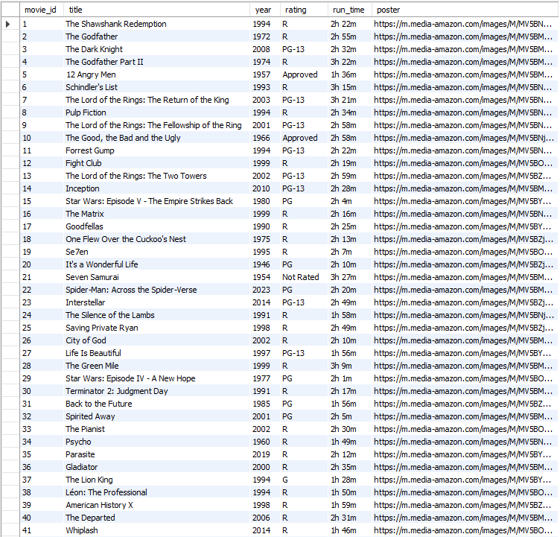

Slide 10
Challenges
The web scraper was tricky to learn, but after some practice with it the process was ultimately simple
The Person-scrape took very long to populate the Person table and I frequently ran into timeout errors. This forced me to find ways to shorten the time it took to populate the table
I still had to run the scraper for a full hour but it eventually worked

Slide 11
Q&A

