Slide 1
JavaScript
By
Tabish Nadeem

Slide 2
Mixins
Definition:
A Mixin is a class that contains methods that can be used by other classes without the need of inheriting from it.
In other words, a mixin provides methods that implement a certain behavior, but we do not use it alone, we use it to add the behavior to other classes.
The main purpose of Mixins is that to achieve multiple inheritance in JavaScript.

Slide 3
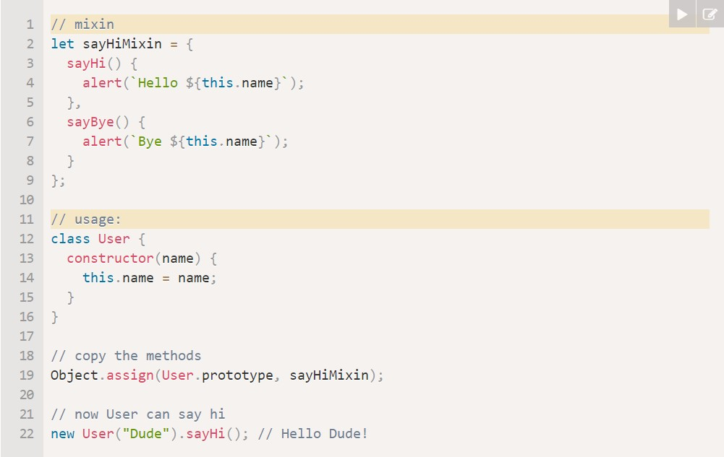
Example:

Slide 4
EventMixin
Events :
Events in JavaScript are special actions that broadcast some information based on the type of action we want.
EventMixin:
EventMixin provides a special mixin object that have certain function and is added to the class which can now access these functions.
Following are the 3 functions:
.trigger(name, […data]) : This function generates an event
.on(name, handler) : This function adds an handler on the event
.off(name, handler) : This function removes the handler attached to the event

Slide 5
Error handling, "try...catch"
What is Error?
Error or bug refer to the unhandled situation in the code which caused it stop compilation or dies after execution. They may occur because of our mistakes, an unexpected user input, an erroneous server response, and for a thousand other reasons.
What is Error Handling?
Error handling refers to the practice of avoiding the death of script.
To be more precise, error handling refers to those ways that can be done so as to make our code error free and to catch bug as fast as possible.

Slide 6
try-catch block
try-catch block is used to handle errors . This block tests a part of code in try block and then if any error occurs then catch block is executed.
This process ensures smooth running of the script and the prevention of any unexpected crash.
We can customize the error block as per our need and if needed can insert our custom message which is optional and can directly print the error object.

Slide 7
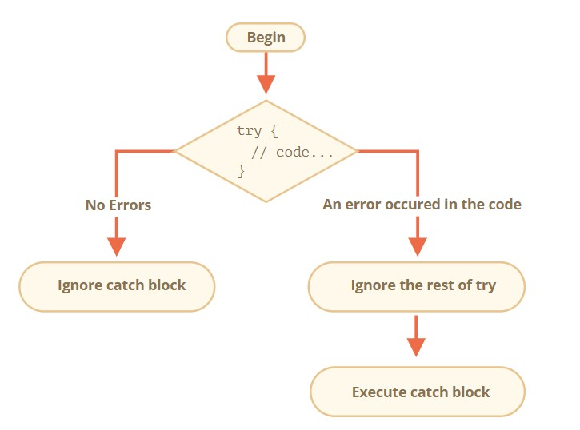
How does it work?
First, the code in try {...} is executed.
If there were no errors, then catch (err) is ignored: the execution reaches the end of try and goes on, skipping catch.
If an error occurs, then the try execution is stopped, and control flows to the beginning of catch (err). The err variable (we can use any name for it) will contain an error object with details about what happened.

Slide 8
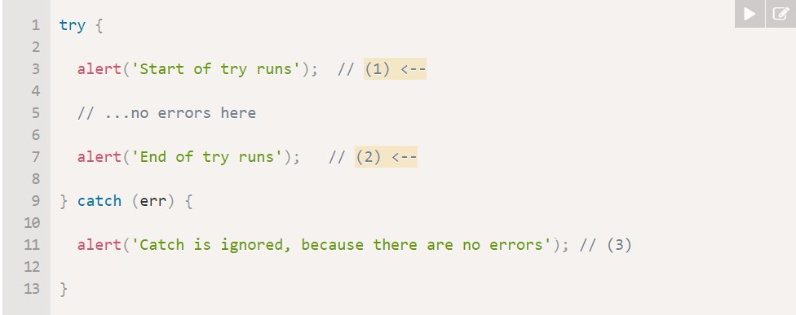
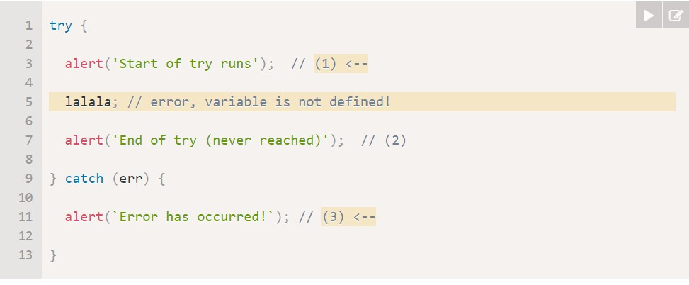
Examples
An errorless example: shows alert (1) and (2):
An example with an error: shows (1) and (3):

Slide 9
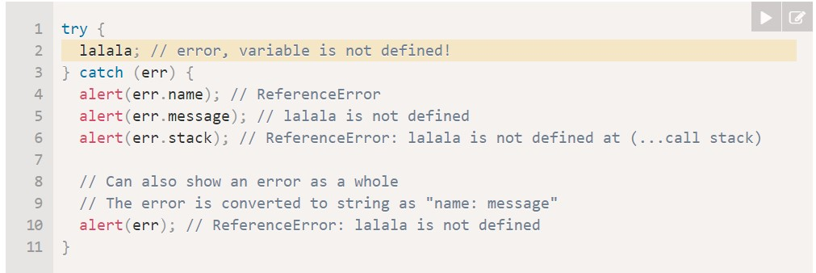
Error Object
When an error occurs, JavaScript generates an object containing the details about it. The object is then passed as an argument to catch:
For all built-in errors, the error object has two main properties:
name:
Error name. For instance, for an undefined variable that’s "ReferenceError".
message
Textual message about error details.
stack
Current call stack: a string with information about the sequence of nested calls that led to the error. Used for debugging purposes.

Slide 10
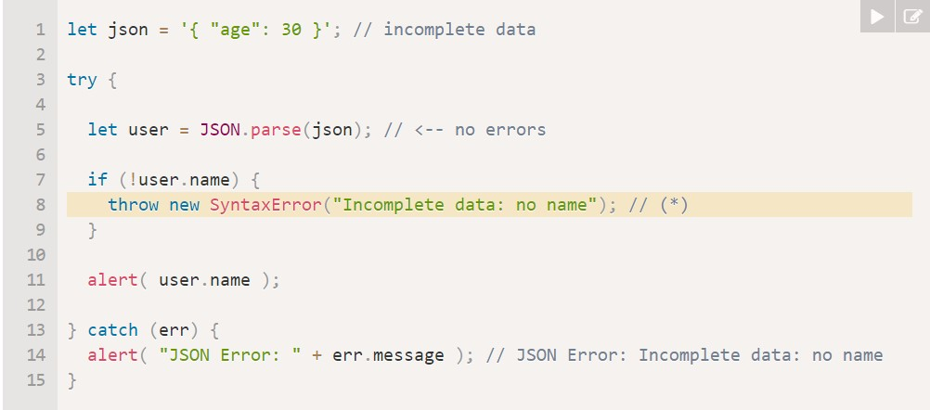
Throw Operator
The throw operator generates an error.
the throw operator generates a Error(SyntaxError, ReferenceError, etc. ) with the given message, the same way as JavaScript would generate it itself. The execution of try immediately stops and the control flow jumps into catch.

Slide 11
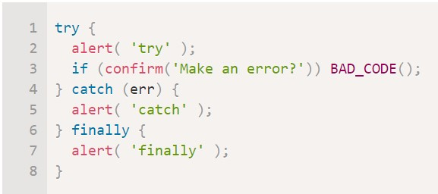
try…catch…finally
The try...catch construct have one more code clause: finally.
If it exists, it runs in all cases:
after try, if there were no errors,
after catch, if there were errors.
The finally clause is often used when we start doing something and want to finalize it in any case of outcome.

Slide 12
Custom errors, extending Error
When we develop something, we often need our own error classes to reflect specific things that may go wrong in our tasks. For errors in network operations we may need HttpError, for database operations DbError, for searching operations NotFoundError and so on.
Our errors should support basic error properties like message, name and, preferably, stack. But they also may have other properties of their own, e.g. HttpError objects may have a statusCode property with a value like 404 or 403 or 500.
The main purpose of creating a custom error is the use case where we want to throw an error that provides information in a different way and be more flexible as compared to built-in classes.

Slide 13
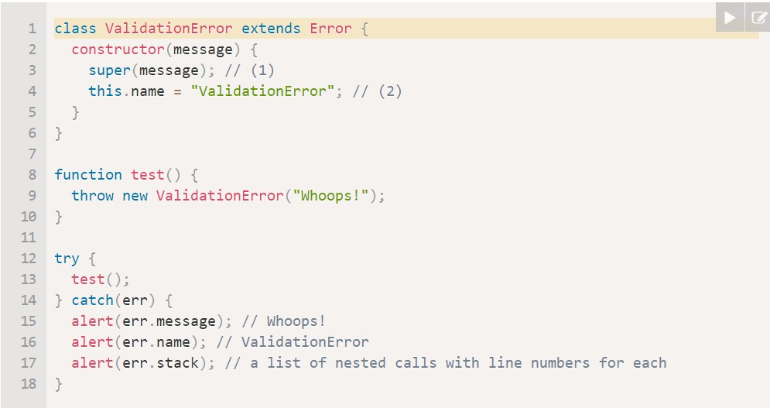
Example
Our function readUser(json) will not only read JSON, but check (“validate”) the data. If there are no required fields, or the format is wrong, then that’s an error. And that’s not a SyntaxError, because the data is syntactically correct, but another kind of error. We’ll call it ValidationError and create a class for it. An error of that kind should also carry the information about the offending field.
Our ValidationError class should inherit from the Error class.

Slide 14
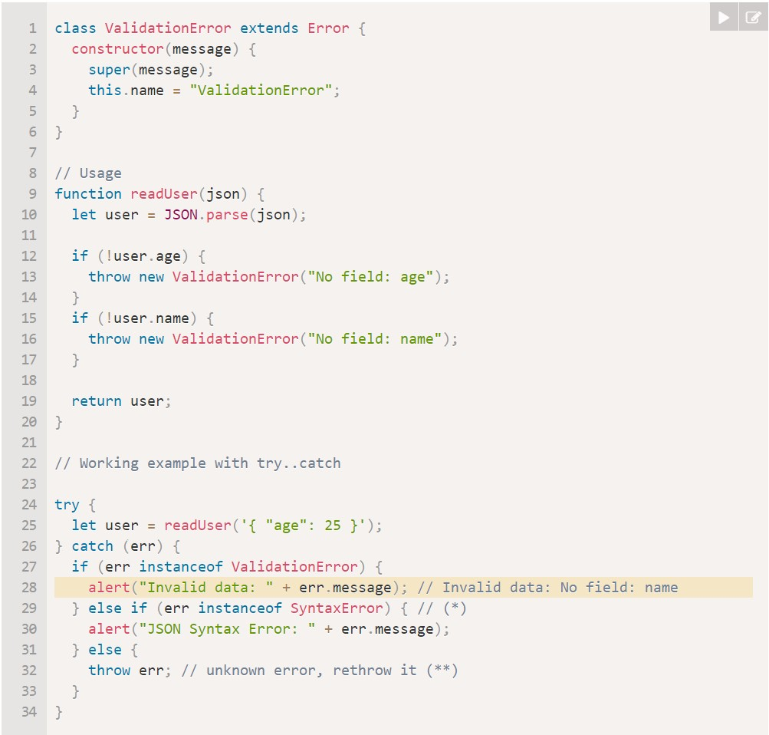
Usage:

Slide 15
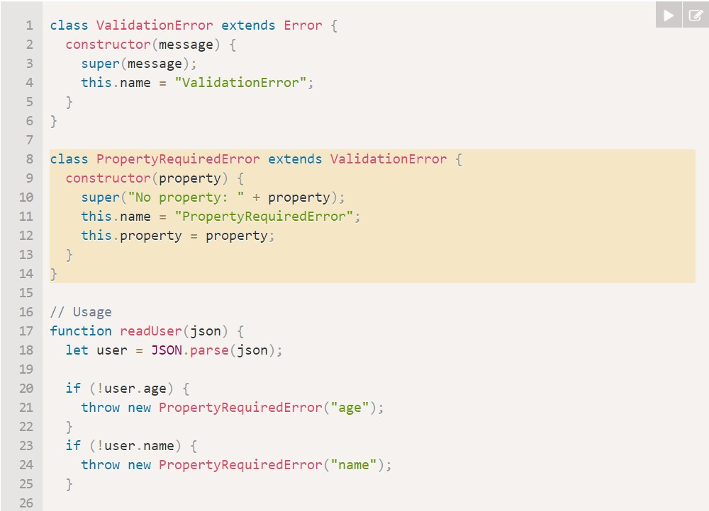
Further Inheritance
The ValidationError class is very generic. Many things may go wrong. The property may be absent or it may be in a wrong format (like a string value for age instead of a number). Let’s make a more concrete class PropertyRequiredError, exactly for absent properties. It will carry additional information about the property that’s missing.

Slide 16
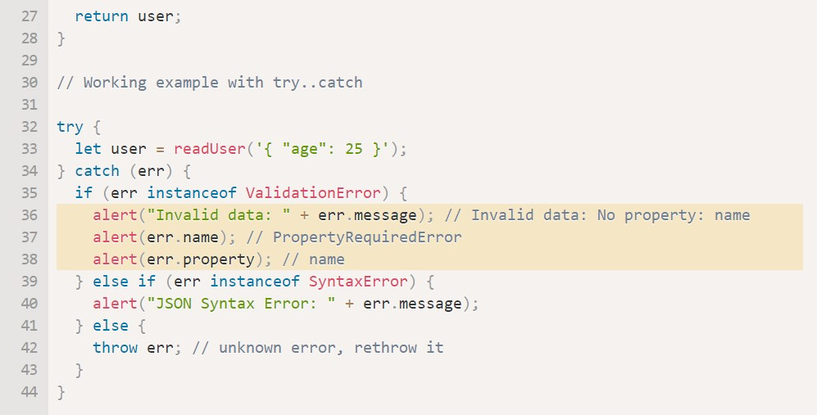

Slide 17
Callbacks : Introduction
A callback function is a function passed into another function as an argument, which is then invoked inside the outer function to complete some kind of routine or action.
Callbacks are often used to continue code execution after an asynchronous operation has completed — these are called asynchronous callbacks.
A function that does something asynchronously should provide a callback argument where we put the function to run after it’s complete.

Slide 18
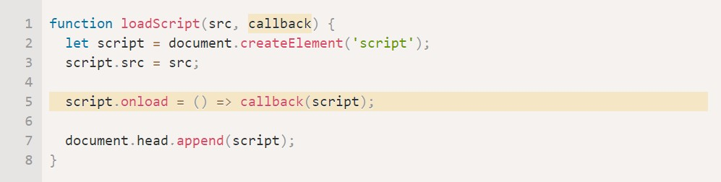
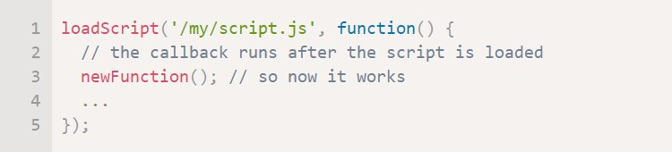
Example
Let’s add a callback function as a second argument to loadScript that should execute when the script loads:
Now if we want to call new functions from the script, we should write that in the callback:

Slide 19
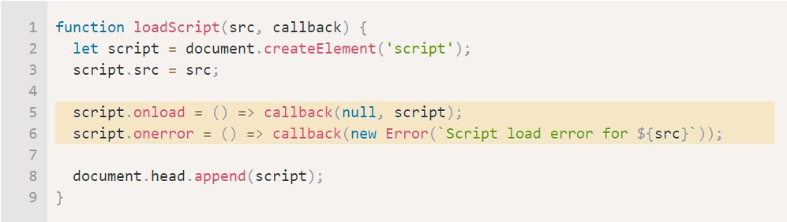
Handling Errors
In the previous example we didn’t consider errors. What if the script loading fails? Our callback should be able to react on that.
Here, It calls callback(null, script) for successful load and callback(error) otherwise.

Slide 20
Promise
"Producing code" is code that can take some time.
"Consuming code" is code that must wait for the result
A promise is a special JavaScript object that links the “producing code” and the “consuming code” together. The “producing code” takes whatever time it needs to produce the promised result, and the “promise” makes that result available to all of the subscribed code when it’s ready.

Slide 21
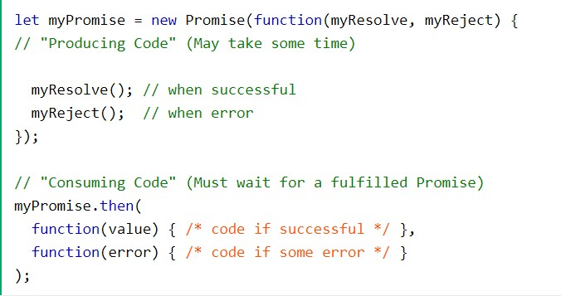
Example(Syntax)

Slide 22
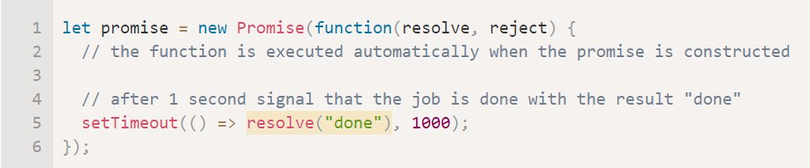
Example(Code)

Slide 23
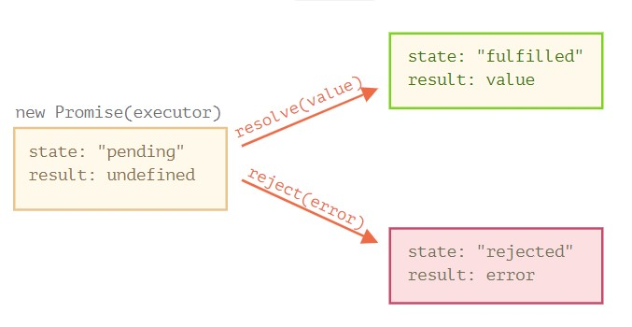
Promise : Executor and callbacks
The function passed to new Promise is called the executor. When new Promise is created, the executor runs automatically. It contains the producing code which should eventually produce the result
Its arguments resolve and reject are callbacks provided by JavaScript itself. Our code is only inside the executor.
When the executor obtains the result, be it soon or late, doesn’t matter, it should call one of these callbacks:
resolve(value) — if the job is finished successfully, with result value.
reject(error) — if an error has occurred, error is the error object.
So to summarize: the executor runs automatically and attempts to perform a job. When it is finished with the attempt, it calls resolve if it was successful or reject if there was an error.
The promise object returned by the new Promise constructor has these internal properties:
state — initially "pending", then changes to either "fulfilled" when resolve is called or "rejected" when reject is called.
result — initially undefined, then changes to value when resolve(value) called or error when reject(error) is called.

Slide 24
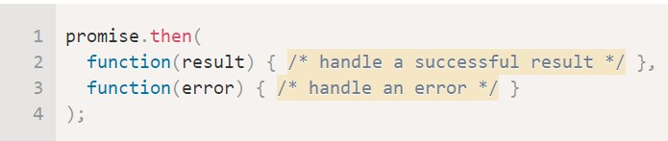
Consumers: then, catch, finally
then: syntax:
The first argument of .then is a function that runs when the promise is resolved, and receives the result.
The second argument of .then is a function that runs when the promise is rejected, and receives the error.

Slide 25
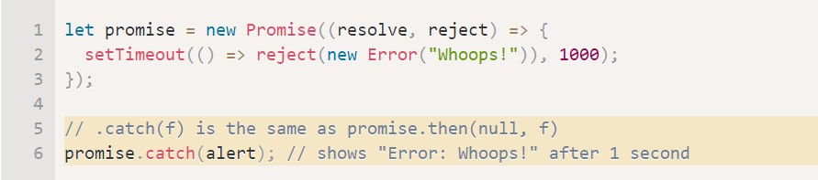
Consumers: then, catch, finally
2. catch: syntax:
If we’re interested only in errors, then we can use null as the first argument: .then(null, errorHandlingFunction). Or we can use .catch(errorHandlingFunction), which is exactly the same.
The call .catch(f) is a complete analog of .then(null, f), it’s just a shorthand.

Slide 26
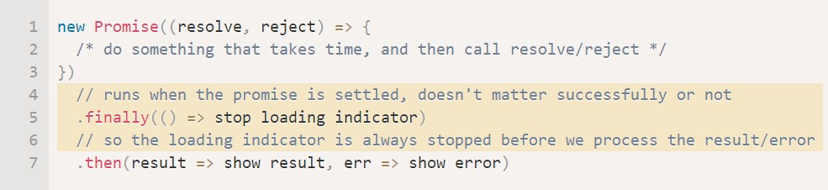
Consumers: then, catch, finally
3. finally: syntax:
Just like there’s a finally clause in a regular try {...} catch {...}, there’s finally in promises.
The call .finally(f) is similar to .then(f, f) in the sense that f always runs when the promise is settled: be it resolve or reject.
finally is a good handler for performing cleanup, e.g. stopping our loading indicators, as they are not needed anymore, no matter what the outcome is.

Slide 27
Promises chaining
To Overcome the challenged faced when dealing with sequence of asynchronous tasks, chaining of promises found to be a better solution.
Promise chaining simply refers to the chaining of different promise handler to get a desired results.

Slide 28
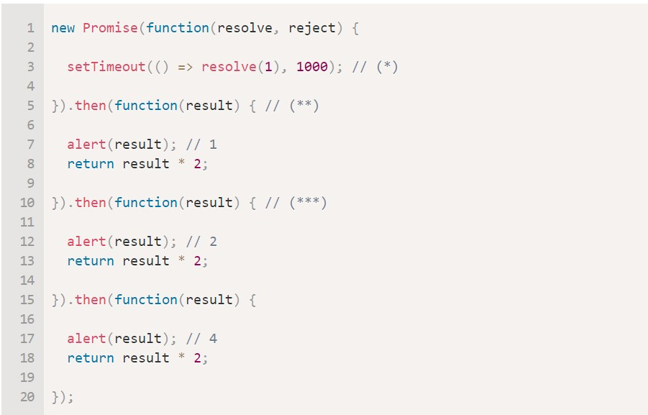
Example
The idea is that the result is passed through the chain of .then handlers.
Here the flow is:
The initial promise resolves in 1 second (*),
Then the .then handler is called (**), which in turn creates a new promise (resolved with 2 value).
The next then (***) gets the result of the previous one, processes it (doubles) and passes it to the next handler.
…and so on.

Slide 29
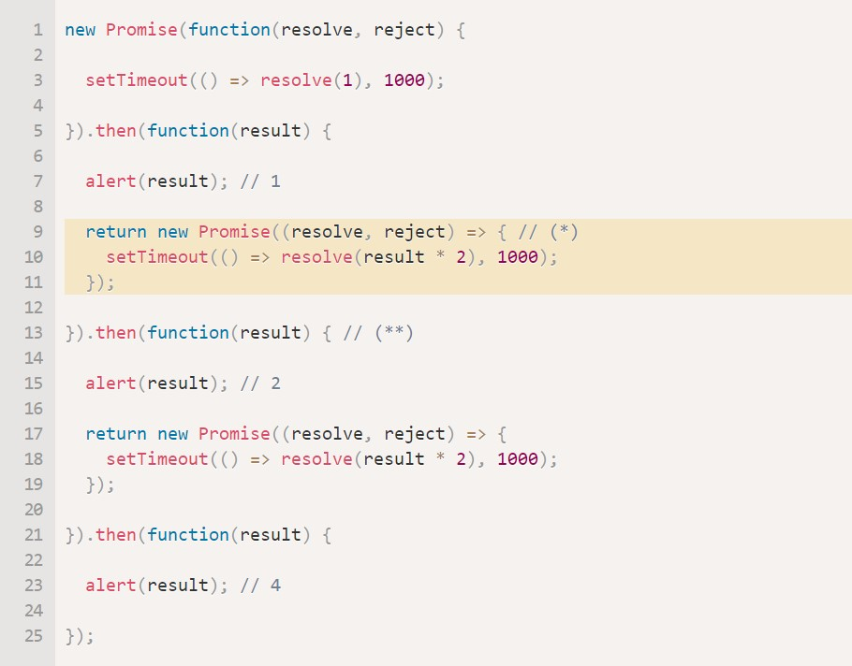
Returning Promises
Here the first .then shows 1 and returns new Promise(…) in the line (*).
After one second it resolves, and the result (the argument of resolve, here it’s result * 2) is passed on to handler of the second .then. That handler is in the line (**), it shows 2 and does the same thing.
So the output is the same as in the previous example: 1 → 2 → 4, but now with 1 second delay between alert calls.
Returning promises allows us to build chains of asynchronous actions.

Slide 30
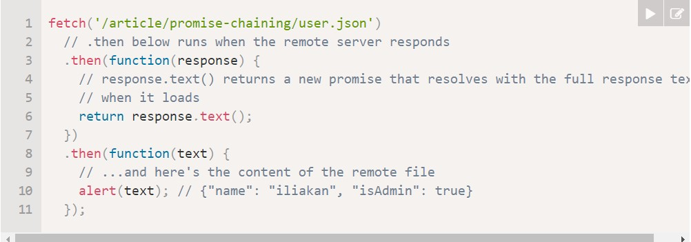
Bigger Example : fetch
In frontend programming promises are often used for network requests
let promise = fetch(url);
This makes a network request to the url and returns a promise. The promise resolves with a response object when the remote server responds with headers, but before the full response is downloaded.
To read the full response, we should call the method response.text(): it returns a promise that resolves when the full text is downloaded from the remote server, with that text as a result.

Slide 31
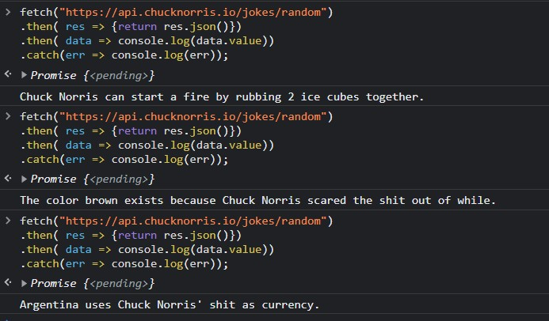
Example
fetch("https://api.chucknorris.io/jokes/random")
.then( res => {return res.json()})
.then( data => console.log(data.value))
.catch(err => console.log(err));

Slide 32
Thank You.

