Slide 1

C.M.M
MOHD MAAZ
MOHD USAMA
M.C.A

Slide 2
What is CMM?
CMM: Capability Maturity Model
Developed by the Software Engineering Institute of the Carnegie Mellon University
Framework that describes the key elements of an effective software process.

Slide 3
Process Maturity Concepts
Software Process
Software Process Capability
Software Process Performance
Software Process Maturity

Slide 4
What are the CMM Levels?
Maturity level indicates level of process capability:
Initial
Managed
Defined
Quantitatively Managed
Optimizing

Slide 5
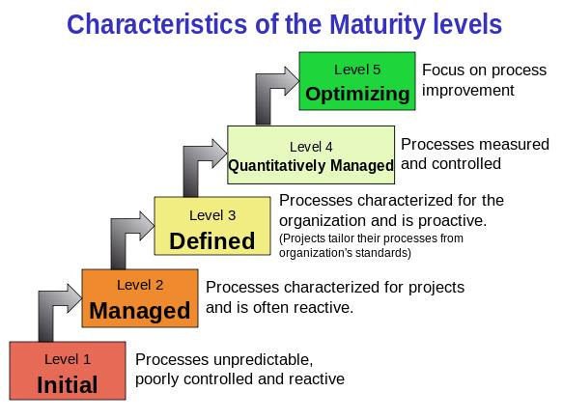

Slide 6
Internal Structure to Maturity Levels

Slide 7
Level 2 KPAs
Requirements Management
Software Project Planning
Software Project Tracking and Oversight
Software Subcontract Management
Software Quality Assurance
Software Configuration Management

Slide 8
Level 3 KPAs
Training Program
Integrated Software Management
Software Product Engineering
Intergroup Coordination
Peer Reviews

Slide 9
Level 4 KPAs
Quantitative Process Management
Software Quality Management

Slide 10
Level 5 KPAs
Process Change Management
Technology Change Management
identify and transfer beneficial new technologies
tools
methods
processes
Defect Prevention

Slide 11
Benefits Of Adopting CMM
Consistency
Cost Saving
Self Improvement
Market demand
Performance demand
Process improvement

Slide 12
Problems with CMM
It is a goal, not a method
Being used just as stamp of approval
Doesn’t say anything about software!
Doesn’t help in a crisis
Only for repetitive tasks

Slide 13
THANK UOU…!

