Slide 1
Sinteza unitatilor de control microprogramate
- O compilatie eclectica pentru a avea un suport de discutie ☺ -

Slide 2
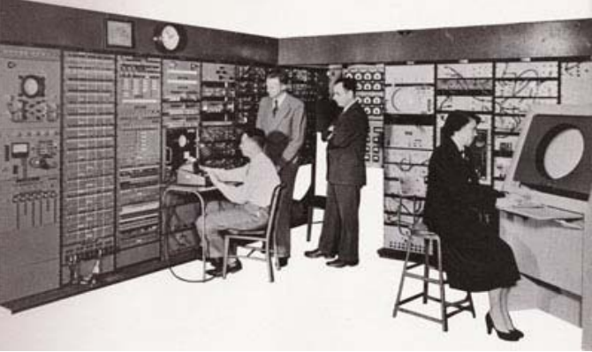
1940’s – Stored program computers
Program instructions can be stored in memory along with data and can be manipulated like data
1947 – MIT Whirlwind: real-time flight simulator control store
two-dimensional lattice
rows – time sequence
columns – control signals

Slide 3
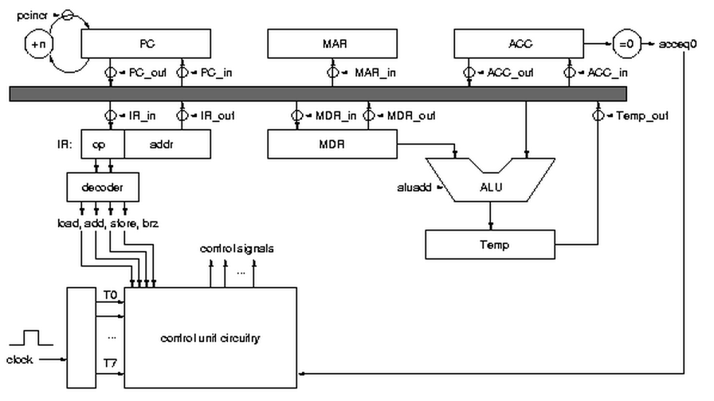

Slide 4
1951 – Maurice Wilkes
Sequencing of control signals within the computer was similar to the sequencing actions required in a regular program.
A stored program to represent the sequences of control signals. Called it microprogramming
Divide machine instructions into subinstructions (microinstructions) that implement the instruction set of the machine
Full set of microinstructions made up the microprogram
1970’s
Complex instruction sets
Trend towards instruction sets very similar to high-level languages

Slide 5
Control logic design
Complex and error-prone
Need a simpler method of developing the control logic for a computer
Writing a program
Simpler than designing the logic
Easier to change
Benefits microprogramming offers
More complex instructions can be implemented
Less primitive than assembly
Reduces field changes to defects

Slide 6
Is Microprogramming Still Used Today?
ROM’s used to be faster than RAM, but not any longer
Control stores were implemented on ROM
Instruction sets have become much simpler (than the 1970s)
Less complexity
Computer-aided design tools have improved
Yes, but benefits need to be weighed against costs:
Complex ISAs such as IA-32 sometimes have more complex instructions implemented as microprograms.
Pentium, Pentium 4, special-purpose processors, etc

Slide 7
Control unit job is to generate the sequence of control signals How about building a computer to do this?
Develop microinstruction set
Write microprogram
Microassemble microprogram
Place the microassembled program (microcode) onto PLA or ROM

Slide 8
Microcode “engine”
A computer to generate control signals is much simpler than an ordinary computer
At the simplest, it just reads the control signals in order from a read only memory
The memory is called the control store
Separate from program memory
A control store word, or microinstruction, contains a bit pattern telling which control signals are true in a specific step
The major issue is sequencing
In what order to read instructions?
How will sequencing (next microinstruction to execute) be determined?

Slide 9
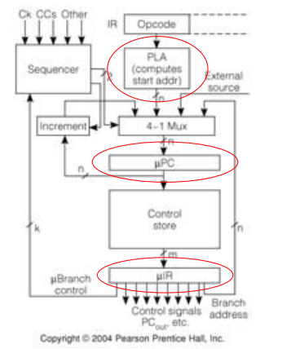
Microinstruction has branch control, branch address, and control signal fields
Micro-program counter can be set from several sources to do the required sequencing
1. Next sequential
2. Start address of next macro inst.
3. Microinst specified address

Slide 10
uP organization
Control signals are just read from memory, the main function is sequencing
This is reflected in the several ways the µPC can be loaded
1. Output of incrementer—µPC+1
2. PLA output—start address for a macroinstruction
3. Branch address from µinstruction
4. External source—say for exception or reset
Micro conditional branches can depend on condition codes, data path state, external signals, etc.

Slide 11
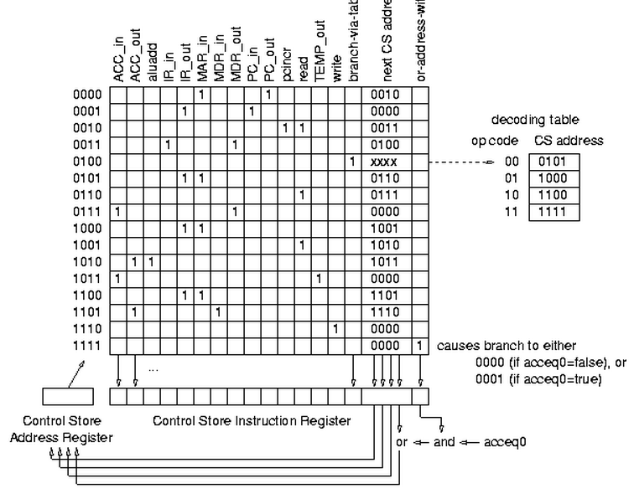

Slide 12
Referinte suplimentare
http://people.cs.clemson.edu/~mark/uprog.html
http://www.cs.virginia.edu/~cs333/notes/microprogramming.pdf
http://research.microsoft.com/en-us/um/people/gbell/Computer_Structures__Readings_and_Examples/contents.html

