Slide 1
QA Project Milestone1
Team 14: Qichen Pan, Jiacong He, Haodong Liu, Qihui Li

Slide 2
Pipeline/Component Structure

Slide 3
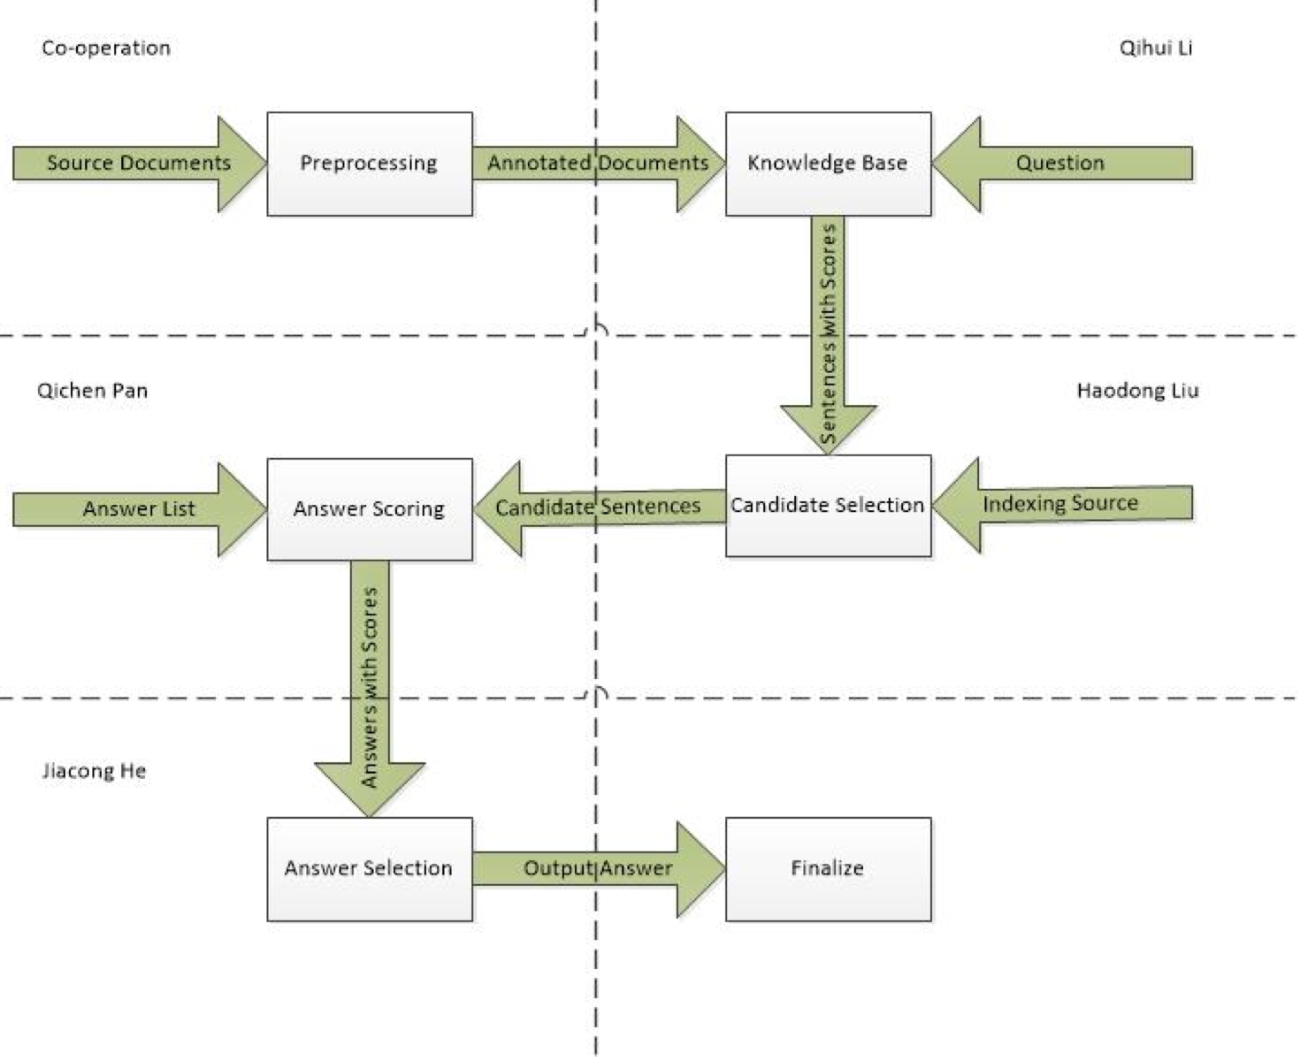

Slide 4
Working Space
Qichen Pan:
    NEAnnotator.xml
    PhraseAnnotator.xml
    SearchCandidates.xml
    TextSegmenter.xml
    StanfordNLPAnnotator.xml
    StanfordQuestionNLPAnnotator.xml
    StanfordSentenceAnnotator.xml
Jiacong He:
    AnswerExtractor.xml
    AnswerSelectionByKCandAggregation.xml
    AnswerSelectionByKCandVoting.xml
Haodong Liu
    AnswerChoiceCandAnsPMIScorer.xml
    AnswerChoiceCandAnsSimilarityScorer.xml
Qihui Li
    QuestionCandSentDependencyMatcher.xml
    QuestionCandSentSimilarityMatcher.xml
    QuestionNEAnnotator.xml
    QuestionPhraseAnnotator.xml

Slide 5
Type System
Document Level:
€SourceDocument: represents source documents.
€TestDocument: represents test documents that have questions and answers in them.
Sentence Level:
€Sentence: represents a single sentence.
€Question: represents a question sentence.
€Answer: represents an answer sentence.
€ QuestionAnswerSet: stores all given answers of a question.
€CandidateSentence: represents sentence that may have relation with the question.
€CandidateAnswer: represents answer that may be the true answer (with PMI as parameter).
Analysis Element Level:
€Token: represents a single token in a sentence.
€Synonym: represents words that may have same meaning as the given phrase.
€NounPhrase: represents a phrase that has a noun as its head word.
€NER: represent a token that is a named entity.
€Dependency: represent a relationship of dependency.

Slide 6
Baseline Methods
● Candidate Sentence Search Strategies
– Search K most relevant sentences w.r.t. question keyword
– Search K most relevant sentences w.r.t. question keywords & its synonyms
– Search K sentences that match with dependency
● Answer Choice Scoring Strategies
– Number of noun phrases/named entities matched in candidate sentence and
answer choice
– Number of synonyms of noun phrases/named entities matched in candidate sentence
and answer choice
– Point-wise Mutual Information(PMI) between noun phrases/named entities in
candidate sentence and answer choice w.r.t. background corpus
● Answer Choice Selection Strategies
– Aggregate the scores of each answer choice across the candidate sentences and
pick the highest scoring answer choice
– Take voting of winner answer choice in each candidate sentence and use majority
voting scheme to pick the answer choice

Slide 7
Our Ideas for Improvement
Tuning Solr Algorithm For Candidate Sentence Search — Qihui
- Lucene Scoring Model/ tf.idf model
        scoring factors:
        tf - Term Frequency. The frequency with which a term appears in a document. Given a search query, the higher the term frequency, the higher the document score.
        idf - Inverse Document Frequency. The rarer a term is across all documents in the index, the higher it's contribution to the score.
        coord - Coordination Factor. The more query terms that are found in a document, the higher it's score.
        fieldNorm - Field length. The more words that a field contains, the lower it's score. This factor penalizes documents with longer field values.
        class for scoring:
        org.apache.lucene.search.Similarity
        -Others
        Boost/Negative Boost/Function Queries

Slide 8
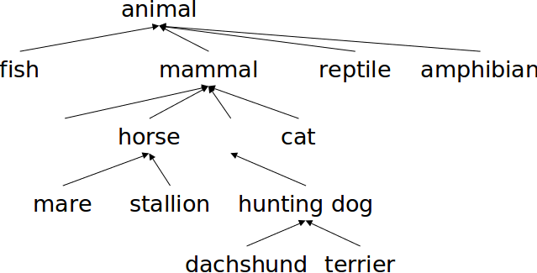
Our Ideas for Improvement
Idea to improve candidate answer scoring method—Haodong
    -Use different algorithms to measure the correlation between question and candidate sentences, and then pick one with the best performance.
    Eg: distance correlation, tetrachoric correlation coefficient, Goodman and Kruskal's lambda, Tschuprow's T and Cramér's V.
    -Finding similarity between words (like synonyms) is helpful to calculate text similarity. and we can use lexical hierarchies database like WordNet to implement this.
WordNet-like Hierarchy

Slide 9
Our Ideas for Improvement
Idea for improving Answer Selection-Jiacong
Because both the two methods have their flaw. The first method may count too little information of the whole candidate sentences. Thus, it is very possible that all candidate answers get one vote or lots of candidate answers have the same vote which is the highest. The second method may count too much information of the whole candidate sentences. Most of the candidate answers may only appears in once in candidate sentences which means we need not count them in our scoring method.
So our improvement method is to count top 5 or top 10 candidate answers in one candidate sentence. We sum those candidate answer’s total score and compare them at the end, which help us decrease the amount of useless information and is less possible to meet problem that find two or more candidate answers with the same score.
Also, the simScore, synonymScore and the PMI may be not same important when selecting candidate answers. So we may have a weight for each of them.
Thus, totalSocre = w1* simScore + w2*synonymScore + w3*PMI.

Slide 10
Our Ideas for Improvement
Idea for Answer Scoring — Qichen

Slide 11
Performance

Slide 12
Thank you!

