Slide 1
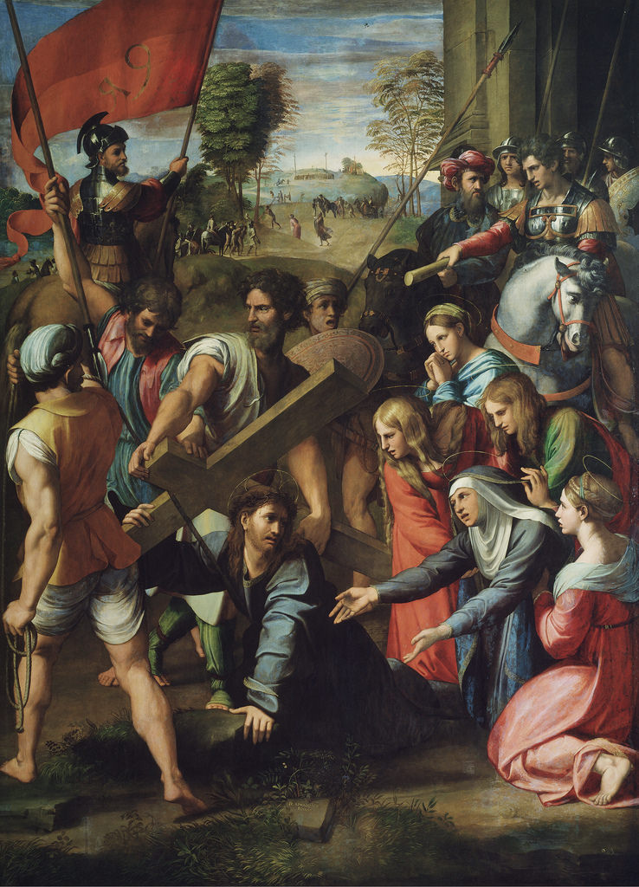
Painting Restoration using Deep Neural Networks
Ren You Adrian Orenstein

Slide 2
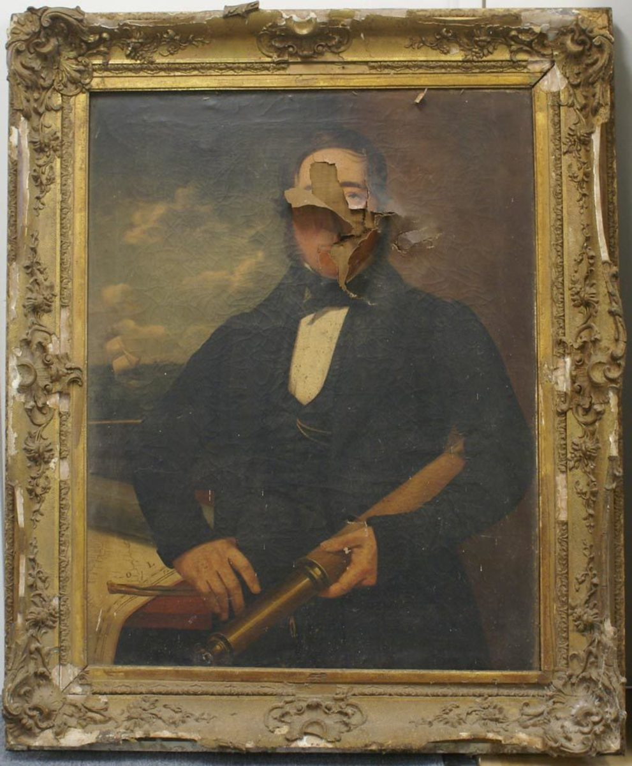
Art Restoration
Artworks degrade over time
Variety of reasons such as smears, smudges, rips
Traditional restoration techniques are done by hand
Laborious, time consuming, and error prone
Technique is often called inpainting

Slide 3
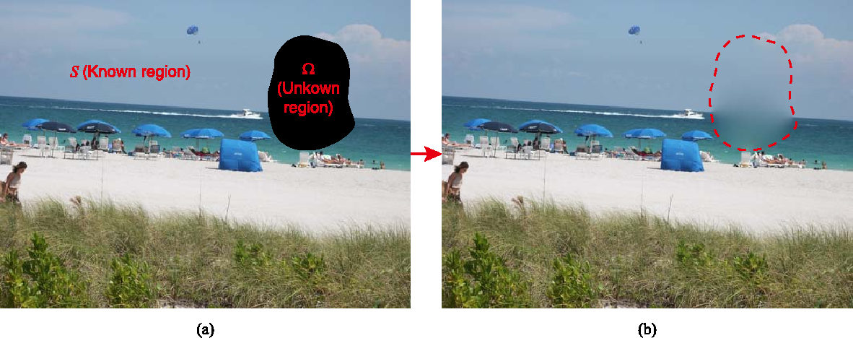
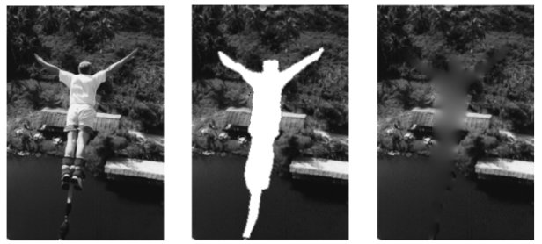
Digital Inpainting
Digital image inpainting began in the mid 1990s
Significant interest from machine vision researchers
Early attempts used propagation and sampling-based approaches
These techniques fail to restore larger areas
Results are often blurs and lack distinctive features

Slide 4
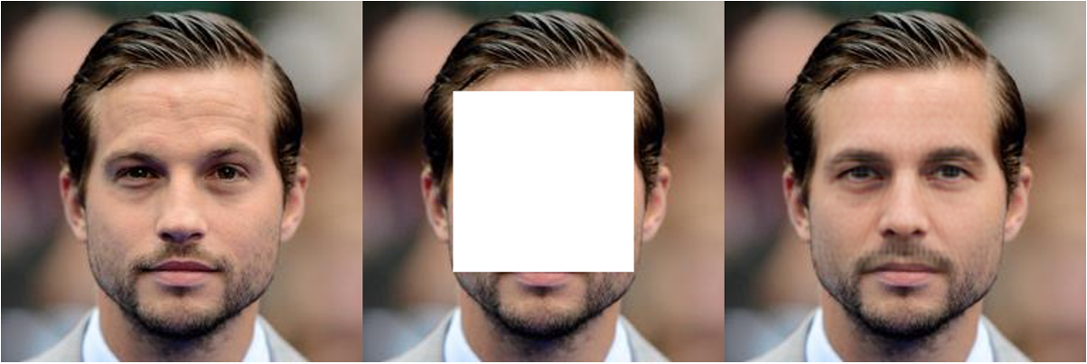
Learning Based Methods
Recent breakthroughs utilize deep neural networks
One of the architectures used is called the encoder-decoder model
An image is gradually mapped to lower feature spaces, before being expanded back to the size of the original
Results can contain more features than diffusion models

Slide 5
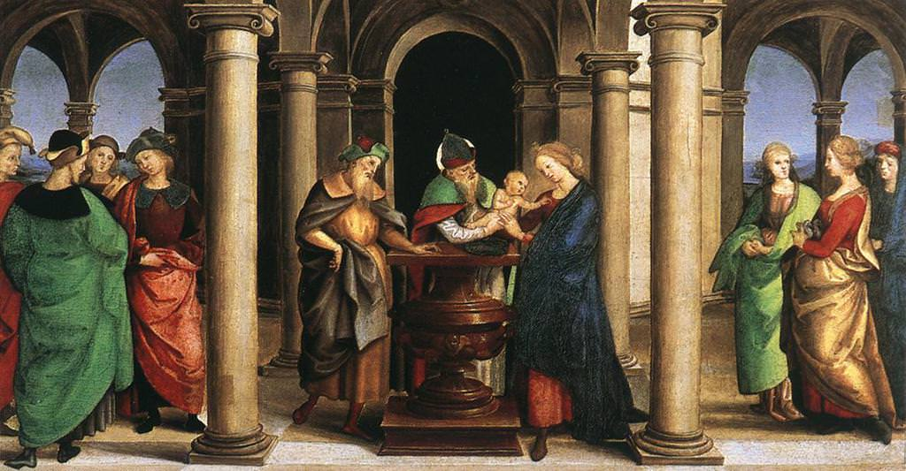
Goals
Develop model that can be used for artwork inpainting and restoration
Focus on artworks from the period of the Italian Renaissance

Slide 6

Challenges
Lack of understanding for PyTorch and AI
Setting up Docker and training loop
Gathering dataset

Slide 7
Results
Haven’t produced any so far, but will have some ready by next week

Slide 8
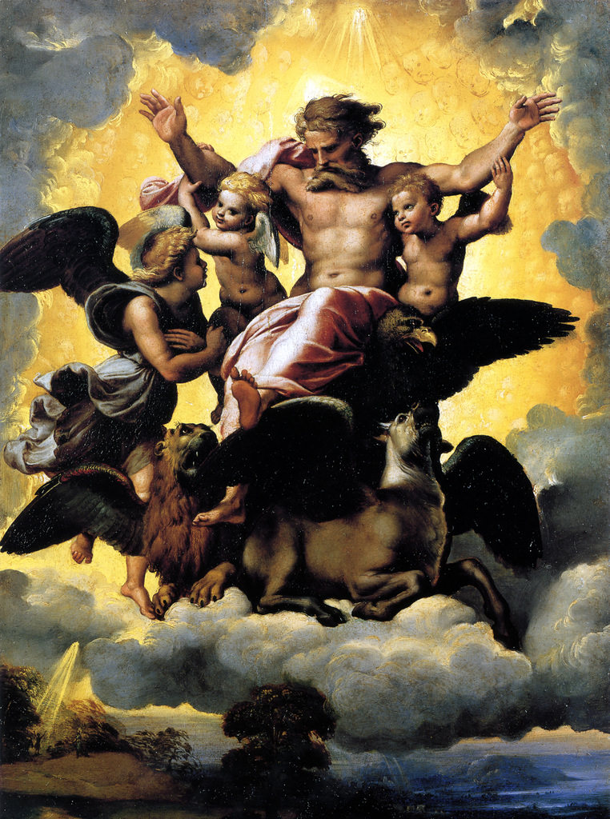
Thanks for listening! Any Questions?

