Slide 1
Object-Oriented Programming
Section 1
Chapter 7
© 2016 Pearson Education, Inc., Hoboken, NJ. All rights reserved.

Slide 2
Classes and Objects
Programs grow in size, become more complex,
  Number of programmers working on same project increases
Dependencies and interrelationships throughout code increases
© 2016 Pearson Education, Inc., Hoboken, NJ. All rights reserved.

Slide 3
Classes and Objects
Partial solution to this problem is data hiding
  Within a unit, as much implementation detail as possible is hidden
Programmer using an object is concerned only with
  Tasks that the object can perform
  Parameters used by these tasks
© 2016 Pearson Education, Inc., Hoboken, NJ. All rights reserved.

Slide 4
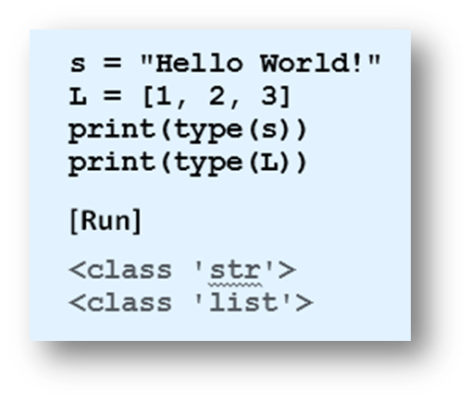
Built-in Classes
Example 1: Program identifies types of objects
  Note use of word “class” instead of “type”
  We refer to a specific literal from one of these classes as an instance of the class
© 2016 Pearson Education, Inc., Hoboken, NJ. All rights reserved.

Slide 5

User-defined Classes
Each class we define will
  Have a specified set of methods
Each object (instance) of the class
  Will have its own value(s)
Class definitions have the general form
© 2016 Pearson Education, Inc., Hoboken, NJ. All rights reserved.

Slide 6
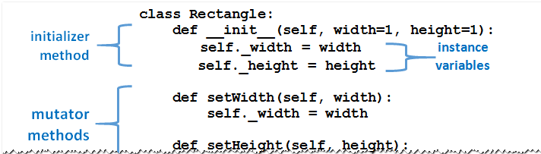
User-defined Classes
Methods defined much like ordinary functions
  Methods have self as their first parameter.
  Each method's self parameter references the object
FIGURE 7.1 A typical class definition.
© 2016 Pearson Education, Inc., Hoboken, NJ. All rights reserved.

Slide 7
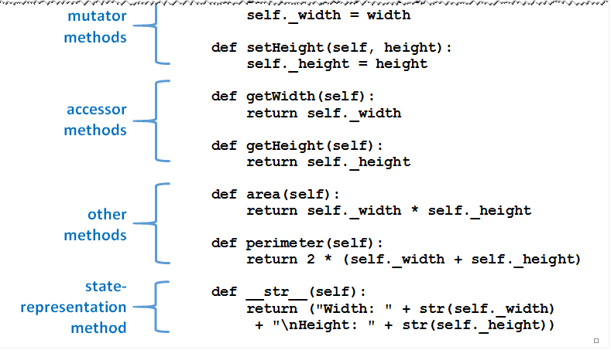
User-defined Classes
FIGURE 7.1 A typical class definition.
© 2016 Pearson Education, Inc., Hoboken, NJ. All rights reserved.

Slide 8
User-defined Classes
Classes are templates from which objects are created
  Specifies properties, methods that will be common to all objects, instances of that class
Classes can be
  Typed directly into programs
  Stored in modules and brought into programs with an import statement
© 2016 Pearson Education, Inc., Hoboken, NJ. All rights reserved.

Slide 9
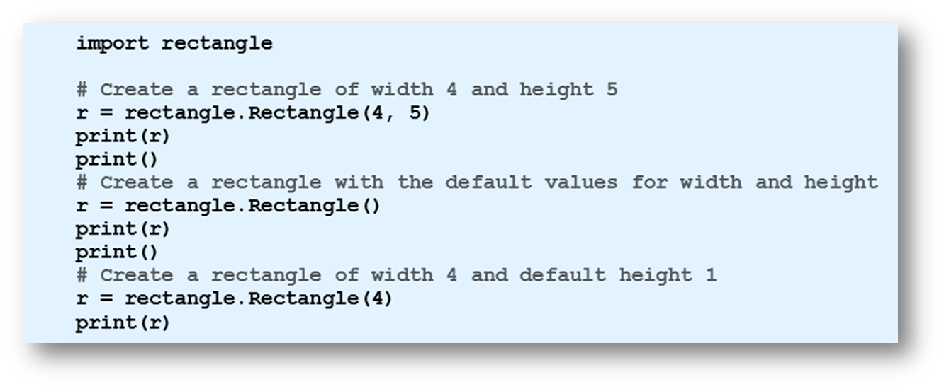
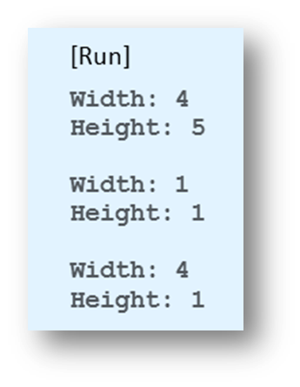
User-defined Classes
Example 2: Program shows effect of three different statements that create an instance of a Rectangle object
© 2016 Pearson Education, Inc., Hoboken, NJ. All rights reserved.

Slide 10
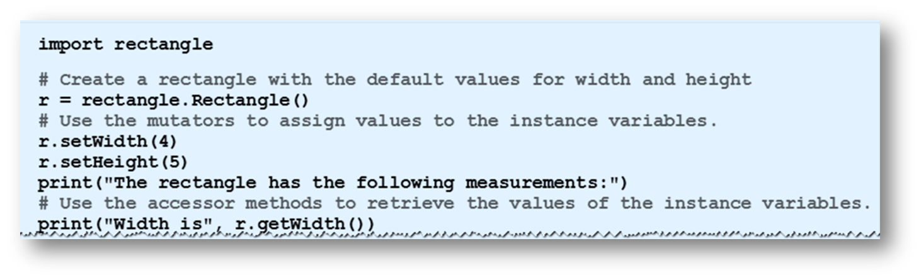
User-defined Classes
Example 3: Program uses Rectangle class methods to set, get measurements of rectangle
© 2016 Pearson Education, Inc., Hoboken, NJ. All rights reserved.

Slide 11
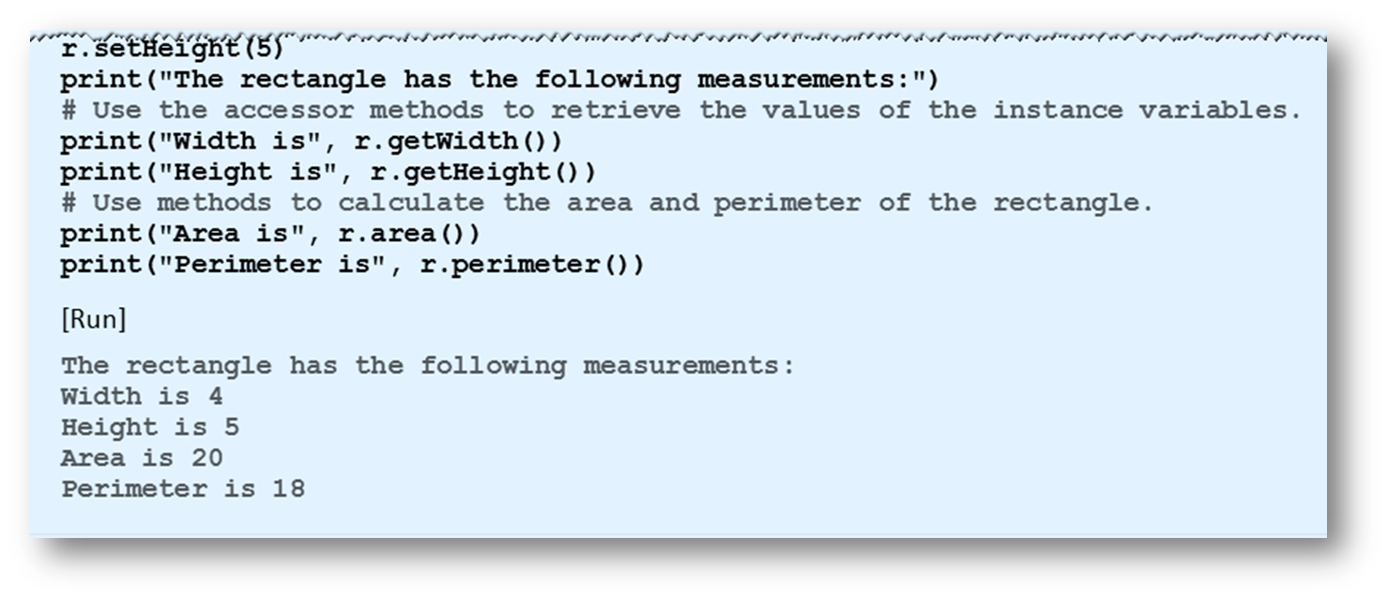
User-defined Classes
Example 3
© 2016 Pearson Education, Inc., Hoboken, NJ. All rights reserved.

Slide 12
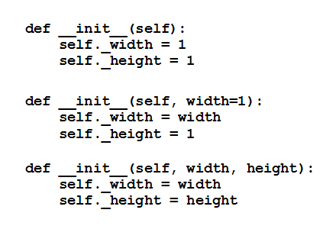
Other Forms of Initializer Method
Three other ways the initializer could have been defined
  Third form,
  statement
  creating an
  instance
  must provide
  two arguments
© 2016 Pearson Education, Inc., Hoboken, NJ. All rights reserved.

Slide 13
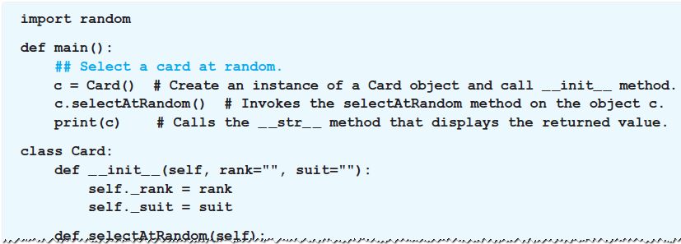
Number of Methods in a Class Definition
Class definitions can contain as many methods as desired
Example 4: Program uses a class containing no mutator or accessor methods
© 2016 Pearson Education, Inc., Hoboken, NJ. All rights reserved.

Slide 14
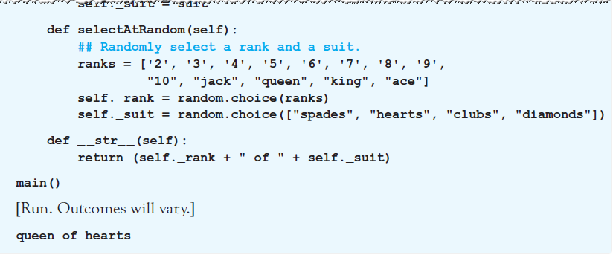
Number of Methods in a Class Definition
Example 4
© 2016 Pearson Education, Inc., Hoboken, NJ. All rights reserved.

Slide 15
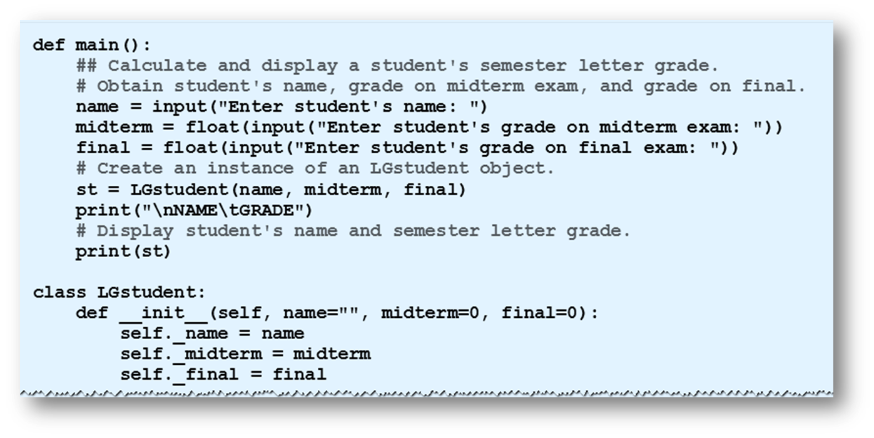
Number of Methods in a Class Definition
Example 5: Program uses a class containing no accessor methods
© 2016 Pearson Education, Inc., Hoboken, NJ. All rights reserved.

Slide 16
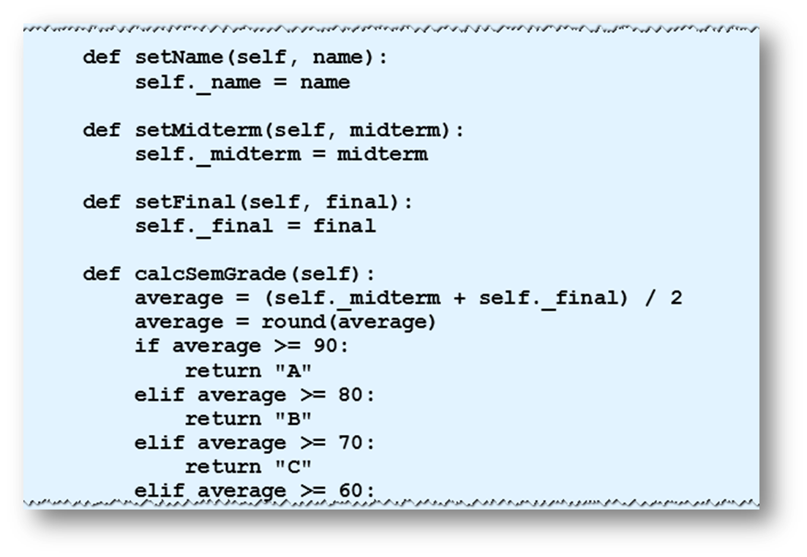
Number of Methods in a Class Definition
Example 5
© 2016 Pearson Education, Inc., Hoboken, NJ. All rights reserved.

Slide 17
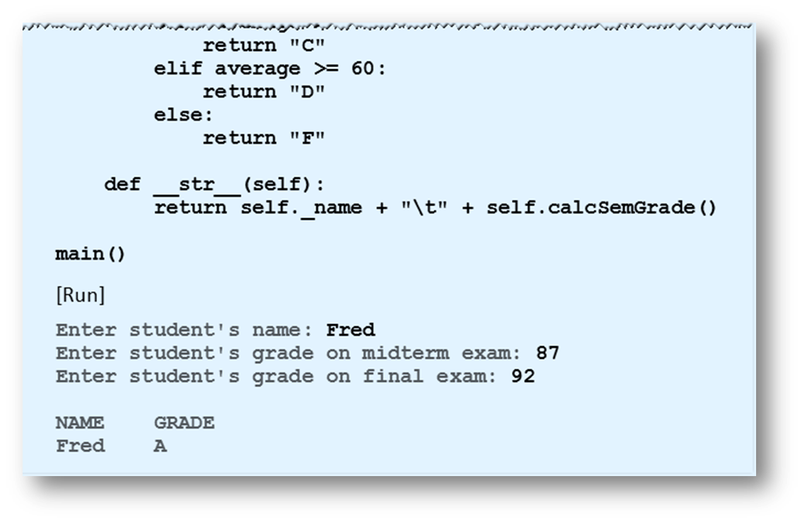
Number of Methods in a Class Definition
Example 5
© 2016 Pearson Education, Inc., Hoboken, NJ. All rights reserved.

Slide 18
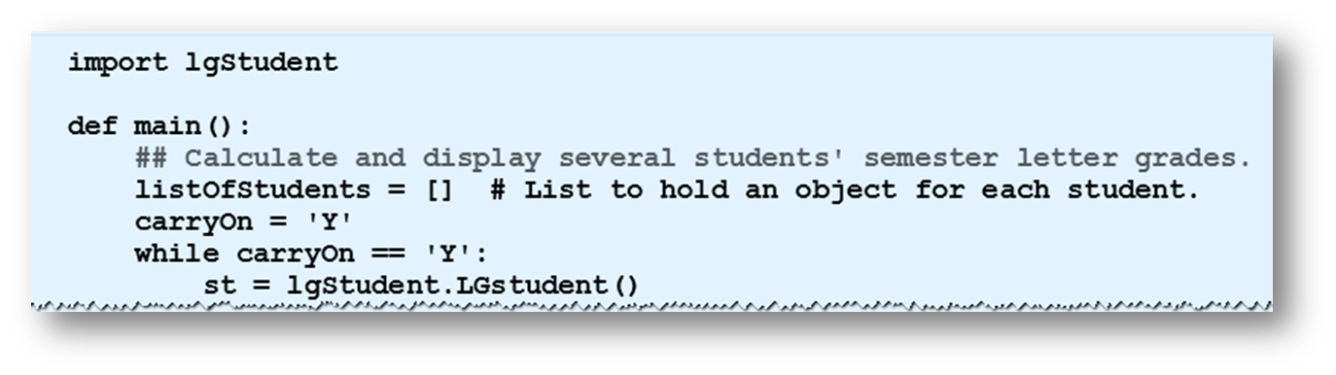
Lists of Objects
Items of a list can have any data type
  Including a user-defined class
Example 6: In program, assume that the class LGstudent has been been stored in the module lgStudent.py.
© 2016 Pearson Education, Inc., Hoboken, NJ. All rights reserved.

Slide 19
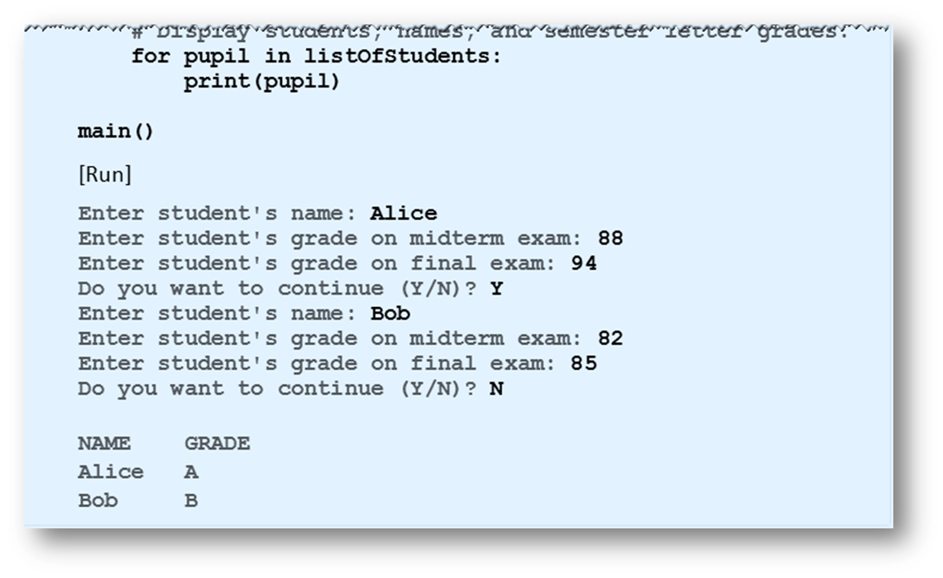
Lists of Objects
Example 6
© 2016 Pearson Education, Inc., Hoboken, NJ. All rights reserved.

Slide 20
End
Section 1
Chapter 7
© 2016 Pearson Education, Inc., Hoboken, NJ. All rights reserved.

