Slide 1
Lists, Tuples, and Files an Introduction
Section 4
Chapter 2
© 2016 Pearson Education, Inc., Hoboken, NJ. All rights reserved.

Slide 2
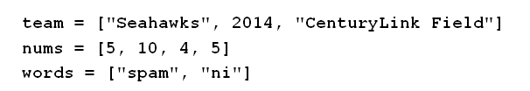
The list Object
A list is an ordered sequence of Python objects
  Objects can be of any type
  Objects do not have to all be the same type.
  Constructed by writing items enclosed in square brackets … items separated by commas.
© 2016 Pearson Education, Inc., Hoboken, NJ. All rights reserved.

Slide 3
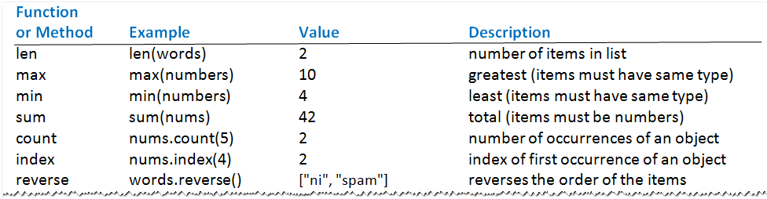
The list Object
Table 2.5 List operations (The lists team, num, and words given in previous slide)
© 2016 Pearson Education, Inc., Hoboken, NJ. All rights reserved.

Slide 4
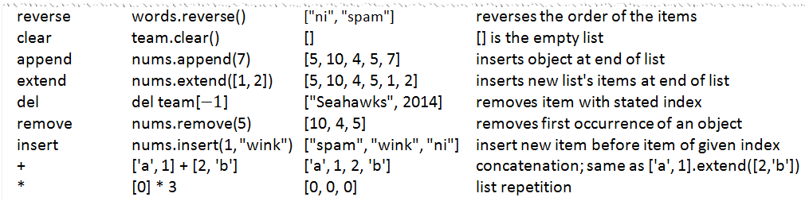
The list Object
Table 2.5 List operations (The lists team, num, and words given in previous slide)
© 2016 Pearson Education, Inc., Hoboken, NJ. All rights reserved.

Slide 5
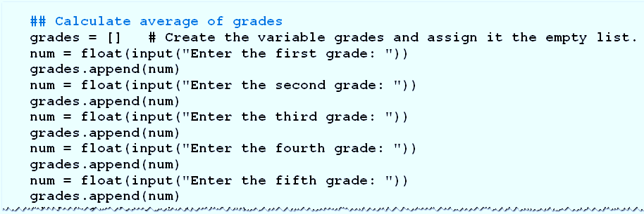
The list Object
Example 1: Program requests five grades as input, displays average after dropping two lowest grades
© 2016 Pearson Education, Inc., Hoboken, NJ. All rights reserved.

Slide 6
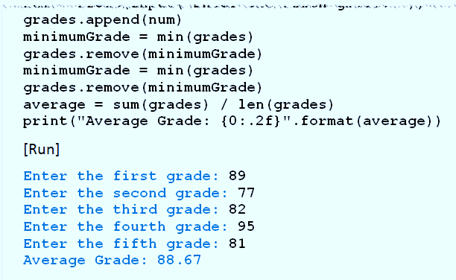
The list Object
Program requests five grades as input, displays average after dropping two lowest grades
© 2016 Pearson Education, Inc., Hoboken, NJ. All rights reserved.

Slide 7
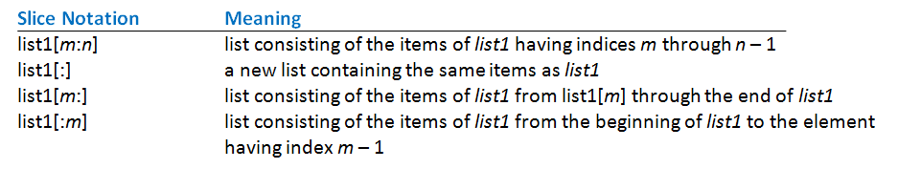
Slices
A slice of a list is a sublist specified with colon notation
  Analogous to a slice of a string
Table 2.6 Meanings of slice notations
© 2016 Pearson Education, Inc., Hoboken, NJ. All rights reserved.

Slide 8
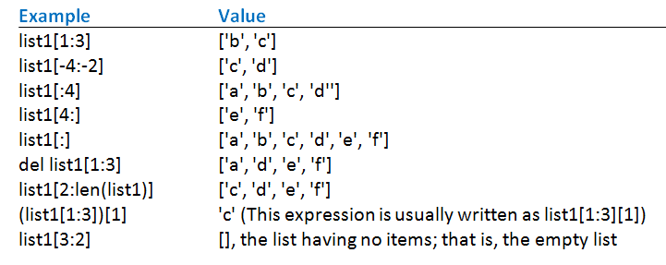
Slices
Table 2.7 Examples of slices where
list1 = ['a', 'b', 'c', 'd', 'e', 'f'].
© 2016 Pearson Education, Inc., Hoboken, NJ. All rights reserved.

Slide 9
The split and join Methods
Split method turns single string into list of substrings
Join method turns a list of strings into a single string.
Notice that these methods are inverses of each other
© 2016 Pearson Education, Inc., Hoboken, NJ. All rights reserved.

Slide 10
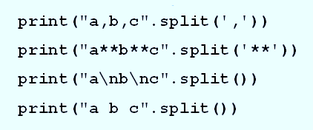
The split and join Methods
Example 2: These statements each display list ['a', 'b', 'c'].
© 2016 Pearson Education, Inc., Hoboken, NJ. All rights reserved.

Slide 11
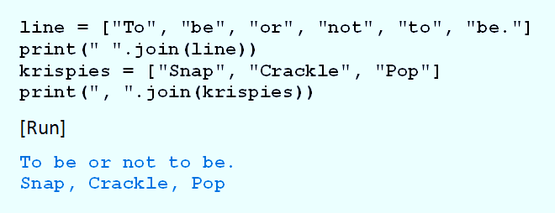
The split and join Methods
Example 3: Program shows how join method used to display items from list of strings.
© 2016 Pearson Education, Inc., Hoboken, NJ. All rights reserved.

Slide 12
Text Files
Text file is a simple file consisting of lines of text with no formatting
  Text file can be created with any word processor
  Python program can access the values
© 2016 Pearson Education, Inc., Hoboken, NJ. All rights reserved.

Slide 13
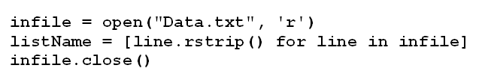
Text Files
Given
  Program opens for reading a file of text
  Strips newline characters
  Characters placed into a list
© 2016 Pearson Education, Inc., Hoboken, NJ. All rights reserved.

Slide 14
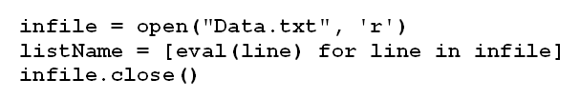
Text Files
Furthermore
  Suppose data is all numbers,
  Previous code produces list of strings, each a number
  Place the numbers into a list with this code
© 2016 Pearson Education, Inc., Hoboken, NJ. All rights reserved.

Slide 15
The tuple Object
Tuples, like lists, are ordered sequences of items
Difference – tuples cannot be modified in place
  Have no append, extend, or insert method
Items of tuple cannot be directly deleted, sorted, or altered
© 2016 Pearson Education, Inc., Hoboken, NJ. All rights reserved.

Slide 16
The tuple Object
All other list functions and methods apply
  Items can be accessed by indices
  Tuples can be sliced, concatenated, and repeated
Tuples written as comma-separated sequences enclosed in parentheses
  Can also be written without the parentheses.
© 2016 Pearson Education, Inc., Hoboken, NJ. All rights reserved.

Slide 17
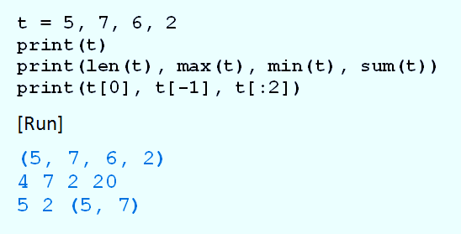
The tuple Object
Example 4: Program shows tuples have several of same functions as lists.
© 2016 Pearson Education, Inc., Hoboken, NJ. All rights reserved.

Slide 18
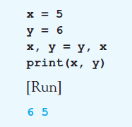
The tuple Object
Example 5: Program swaps values of two variables
© 2016 Pearson Education, Inc., Hoboken, NJ. All rights reserved.

Slide 19
Nested Lists
Beside numbers or strings, items can be lists or tuples.
Consider a list of tuples named L
L[0] is the first tuple
L[0][0] is the first item in the first tuple
And L[-1] is the last tuple
L[-1][-1] is the last item in the last tuple
© 2016 Pearson Education, Inc., Hoboken, NJ. All rights reserved.

Slide 20
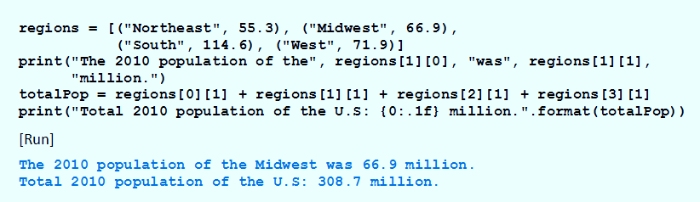
Nested Lists
Example 6: Program manipulates
regions contains four tuples, each tuple gives name and 2010 population (in millions) of a region
© 2016 Pearson Education, Inc., Hoboken, NJ. All rights reserved.

Slide 21
Immutable and Mutable Objects
An object is an entity
  Holds data.
  Has operations and/or methods that can manipulate the data.
When variable created with assignment statement
  Value on the right side becomes an object in memory
  Variable references (points to) object
© 2016 Pearson Education, Inc., Hoboken, NJ. All rights reserved.

Slide 22
Immutable and Mutable Objects
When list altered
  Changes made to the object in list's memory location
Contrast when value of variable is number, string, or tuple … when value changed,
  Python designates a new memory location to hold the new value
  And the variable references that new object
© 2016 Pearson Education, Inc., Hoboken, NJ. All rights reserved.

Slide 23
Immutable and Mutable Objects
Another way to say this
  Lists can be changed in place
  Numbers, strings, and tuples cannot
Objects changed in place are mutable
Objects that cannot be changed in place are immutable
© 2016 Pearson Education, Inc., Hoboken, NJ. All rights reserved.

Slide 24
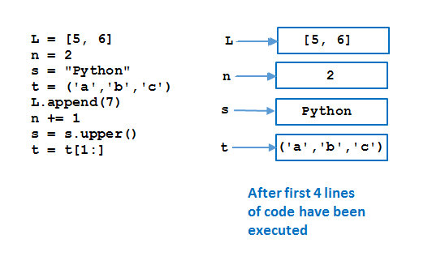
Immutable and Mutable Objects
FIGURE 2.29 Memory allocation corresponding to a program.
© 2016 Pearson Education, Inc., Hoboken, NJ. All rights reserved.

Slide 25
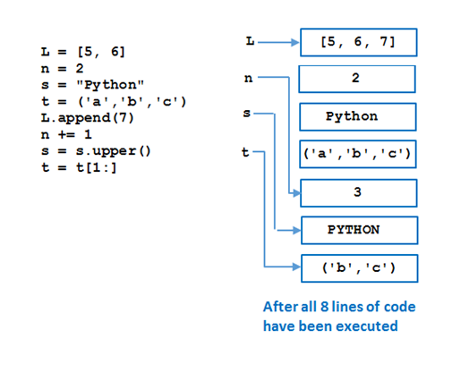
Immutable and Mutable Objects
FIGURE 2.29 Memory allocation corresponding to a program.
© 2016 Pearson Education, Inc., Hoboken, NJ. All rights reserved.

Slide 26
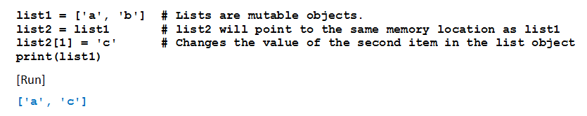
Copying Lists
Consider results of this program
All because lists are mutable
© 2016 Pearson Education, Inc., Hoboken, NJ. All rights reserved.

Slide 27
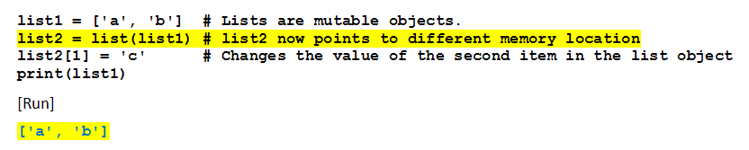
Copying Lists
Now note change in line 2
Third line of code will not affect memory location pointed to by list1
© 2016 Pearson Education, Inc., Hoboken, NJ. All rights reserved.

Slide 28
Indexing, Deleting, and
Slicing Out of Bounds
Python does not allow out of bounds indexing for individual items in lists and tuples
  But does allow it for slices
Given list1 = [1, 2, 3, 4, 5]
  Then print(list1[7])
  print(list1[-7])
  del list1[7]
© 2016 Pearson Education, Inc., Hoboken, NJ. All rights reserved.

Slide 29
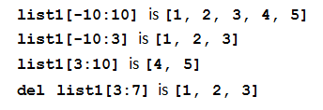
Indexing, Deleting, and
Slicing Out of Bounds
If left index in slice too far negative
  Slice will start at the beginning of the list
If right index is too large,
  Slice will go to the end of the list.
© 2016 Pearson Education, Inc., Hoboken, NJ. All rights reserved.

Slide 30
End
Section 4
Chapter 2
© 2016 Pearson Education, Inc., Hoboken, NJ. All rights reserved.

