Slide 1
The for Loop
Section 4
Chapter 3
© 2016 Pearson Education, Inc., Hoboken, NJ. All rights reserved.

Slide 2
Relational and Logical Operators
A condition is an expression
  Involving relational operators (such as < and >=)
  Logical operators (such as and, or, and not)
  Evaluates to either True or False
Conditions used to make decisions
  Control loops
  Choose between options
© 2016 Pearson Education, Inc., Hoboken, NJ. All rights reserved.

Slide 3

The for Loop
Used to iterate through a sequence of values
General form
of a for loop
Sequence can be
  Arithmetic progression of numbers
  String
  List
  File object
© 2016 Pearson Education, Inc., Hoboken, NJ. All rights reserved.

Slide 4
The for Loop
Variable is successively assigned each value in the sequence
Indented block of statements executed after each assignment
Physical indentation tells interpreter where block starts and stops
© 2016 Pearson Education, Inc., Hoboken, NJ. All rights reserved.

Slide 5
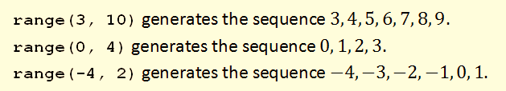
Looping Through Arithmetic Progression of Numbers
Range function is used to generate an arithmetic progression
© 2016 Pearson Education, Inc., Hoboken, NJ. All rights reserved.

Slide 6
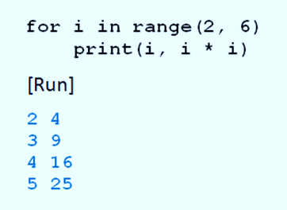
Looping Through Arithmetic Progression of Numbers
Example 1: Code displays four integers and their squares
:
© 2016 Pearson Education, Inc., Hoboken, NJ. All rights reserved.

Slide 7
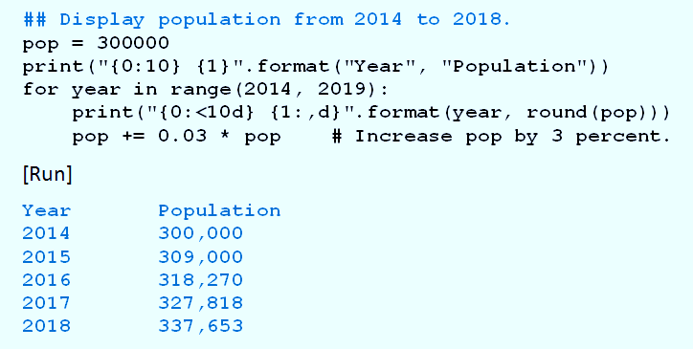
Looping Through Arithmetic Progression of Numbers
Example 2: Program displays a table showing the population each year until 2018.
© 2016 Pearson Education, Inc., Hoboken, NJ. All rights reserved.

Slide 8
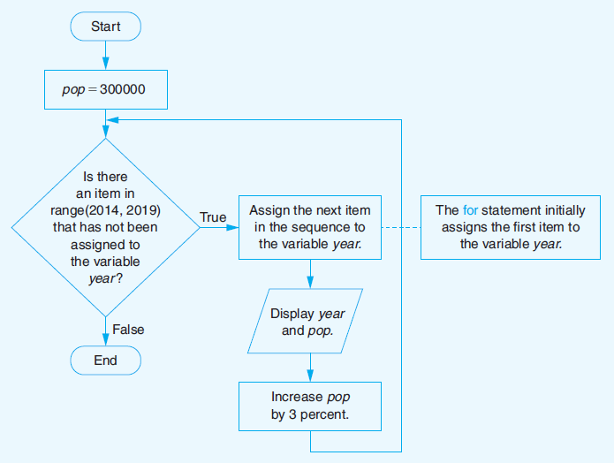
Looping Through Arithmetic Progression of Numbers
FIGURE 3.44 Flowchart for Example 2.
© 2016 Pearson Education, Inc., Hoboken, NJ. All rights reserved.

Slide 9
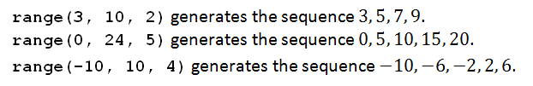
Step Values for the range Function
Variation of the range function generates a sequence of integers
  Successive integers differ by a value other than 1
Examples
© 2016 Pearson Education, Inc., Hoboken, NJ. All rights reserved.

Slide 10
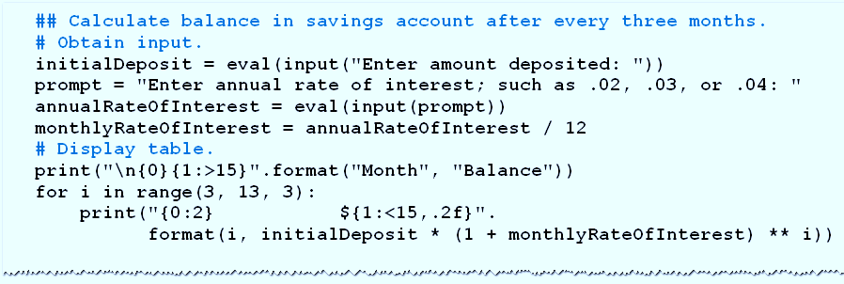
Step Values for the range Function
Example 3: Program requests
  amount deposited
  annual rate of interest
  then calculates balance after each quarter-year for four quarters.
© 2016 Pearson Education, Inc., Hoboken, NJ. All rights reserved.

Slide 11
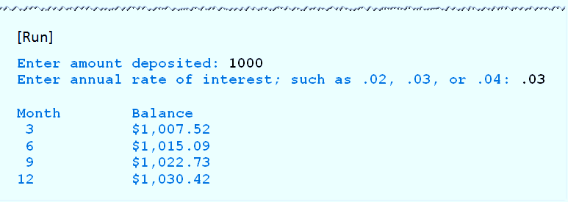
Step Values for the range Function
Example 3, cont.
© 2016 Pearson Education, Inc., Hoboken, NJ. All rights reserved.

Slide 12
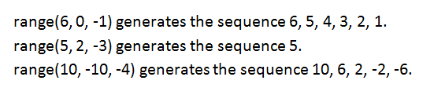
Step Values for the range Function
If negative step value is used and initial value is greater than terminating value,
  Range function generates a decreasing sequence
Examples:
© 2016 Pearson Education, Inc., Hoboken, NJ. All rights reserved.

Slide 13
Nested for Loops
Body of for loop can contain any type of Python statement
  Can contain another for loop.
Second loop must be completely contained inside the first loop
  Must have a different loop variable
© 2016 Pearson Education, Inc., Hoboken, NJ. All rights reserved.

Slide 14
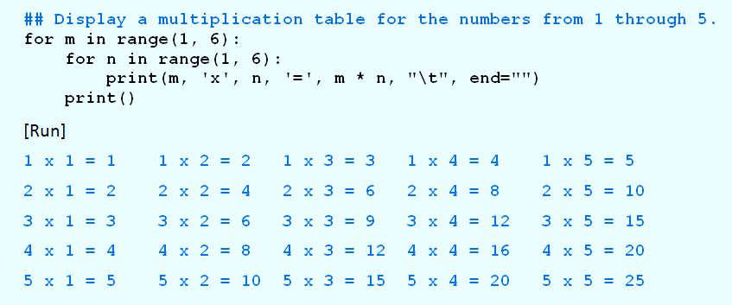
Nested for Loops
Example 4: Program displays a multiplication table for the integers from 1 to 5
© 2016 Pearson Education, Inc., Hoboken, NJ. All rights reserved.

Slide 15
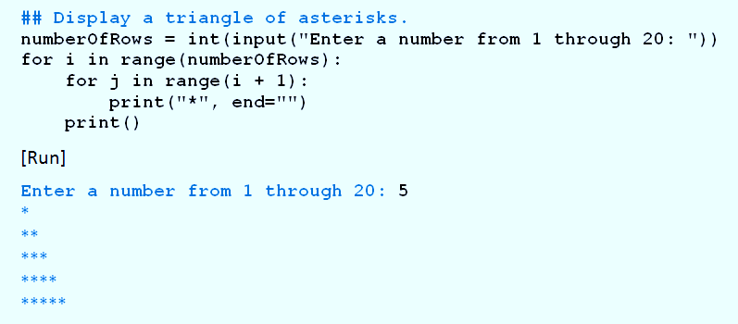
Nested for Loops
Example 5: Program uses nested for loops to display a triangle of asterisks.
© 2016 Pearson Education, Inc., Hoboken, NJ. All rights reserved.

Slide 16
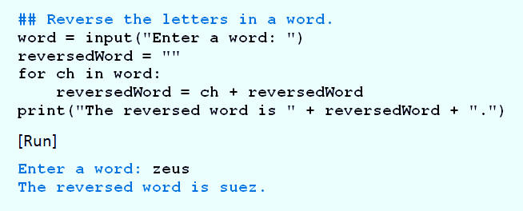
Looping Through
Characters of a String
Example 6: Program requests a word as input and displays it backwards.
© 2016 Pearson Education, Inc., Hoboken, NJ. All rights reserved.

Slide 17
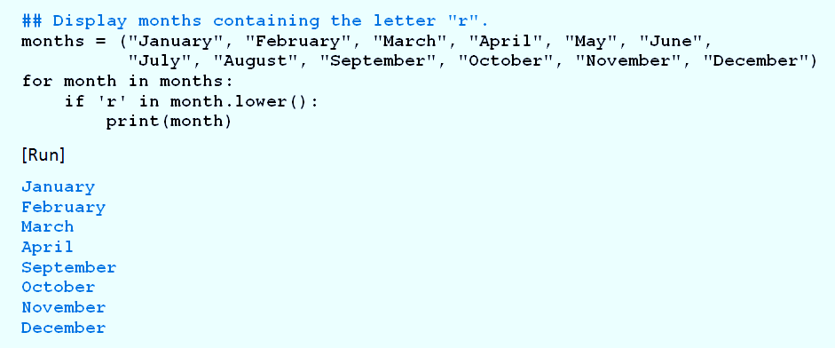
Looping Through Items of a List or Tuple
Example 7: Program displays the months whose names contains the letter r.
© 2016 Pearson Education, Inc., Hoboken, NJ. All rights reserved.

Slide 18
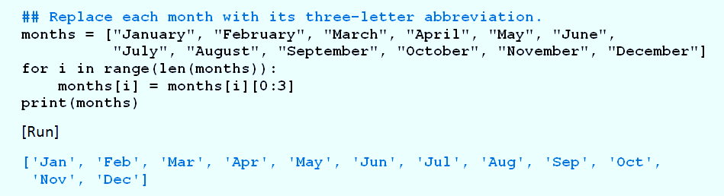
Looping Through Items of a List or Tuple
Example 8: Program replaces the name of each month with its three-letter abbreviation.
© 2016 Pearson Education, Inc., Hoboken, NJ. All rights reserved.

Slide 19
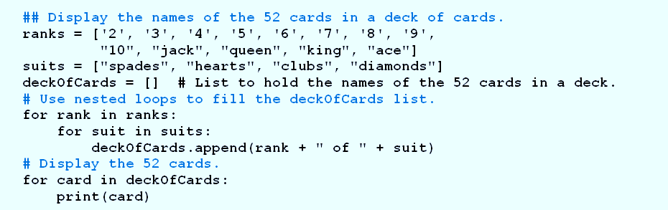
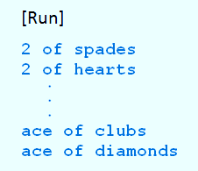
Looping Through Items of a List or Tuple
Example 9: Program uses nested for loops with list of ranks, list of suits
  Creates list consisting of 52 cards in deck of cards
© 2016 Pearson Education, Inc., Hoboken, NJ. All rights reserved.

Slide 20
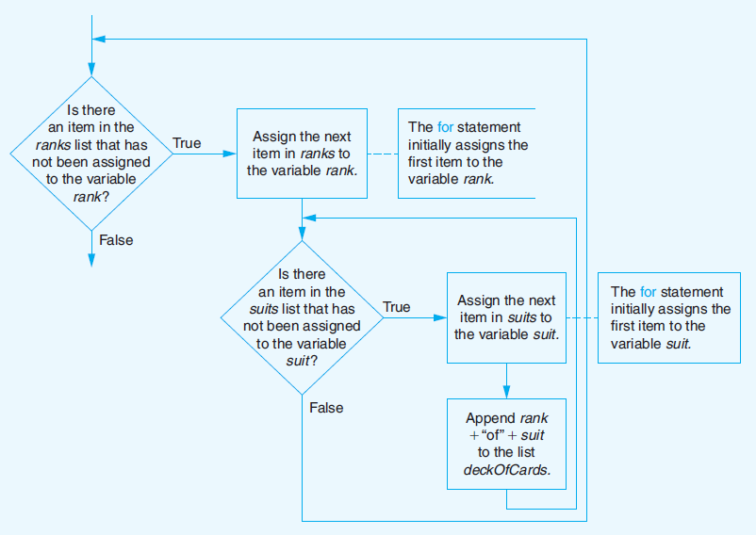
Looping Through Items of a List or Tuple
FIGURE 3.45 Flowchart of nested for loops from Example 9.
© 2016 Pearson Education, Inc., Hoboken, NJ. All rights reserved.

Slide 21
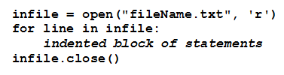
Looping Through Lines of Text File
Reads each line of the file in succession
  Executes indented block of statement(s) for each line
First line establishes connection between program and file
© 2016 Pearson Education, Inc., Hoboken, NJ. All rights reserved.

Slide 22
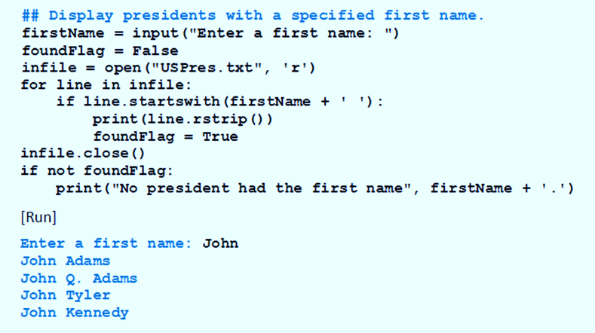
Looping Through Lines of Text File
Example 10: Program requests a first name and then displays names of U.S. presidents having that first name
© 2016 Pearson Education, Inc., Hoboken, NJ. All rights reserved.

Slide 23
The pass Statement
There are times when you want loop to cycle through a sequence and not do anything
  The pass statement should be used.
The pass statement is a do-nothing placeholder statement
© 2016 Pearson Education, Inc., Hoboken, NJ. All rights reserved.

Slide 24
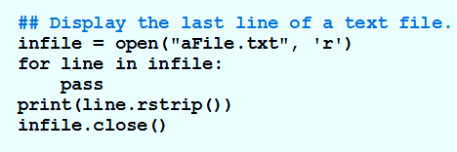
The pass Statement
Example 11: Program displays the last line of a file
© 2016 Pearson Education, Inc., Hoboken, NJ. All rights reserved.

Slide 25
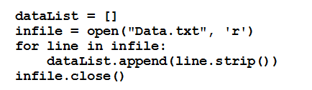
Populating a List with
Contents of a Text File
One way of placing the contents of a text file into a list.
© 2016 Pearson Education, Inc., Hoboken, NJ. All rights reserved.

Slide 26

Populating a List with
Contents of a Text File
A more efficient way (to be explained in next two chapters)
© 2016 Pearson Education, Inc., Hoboken, NJ. All rights reserved.

Slide 27
End
Section 4
Chapter 3
© 2016 Pearson Education, Inc., Hoboken, NJ. All rights reserved.

