Slide 1
Processing Data, Part 2
Section 2
Chapter 5
© 2016 Pearson Education, Inc., Hoboken, NJ. All rights reserved.

Slide 2
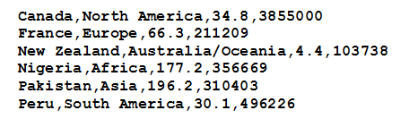
CSV Files
Text files considered so far had a single piece of data per line
Consider CSV formatted file
  Several items of data on each line
  Items separated by commas.
© 2016 Pearson Education, Inc., Hoboken, NJ. All rights reserved.

Slide 3
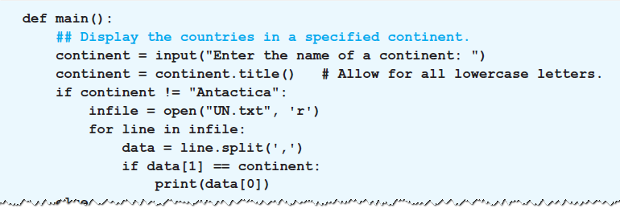

Accessing the Data in a CSV File
The split method is used to access the fields
Example 1 : Program requests name of a continent
  then displays names of UN member countries
© 2016 Pearson Education, Inc., Hoboken, NJ. All rights reserved.

Slide 4
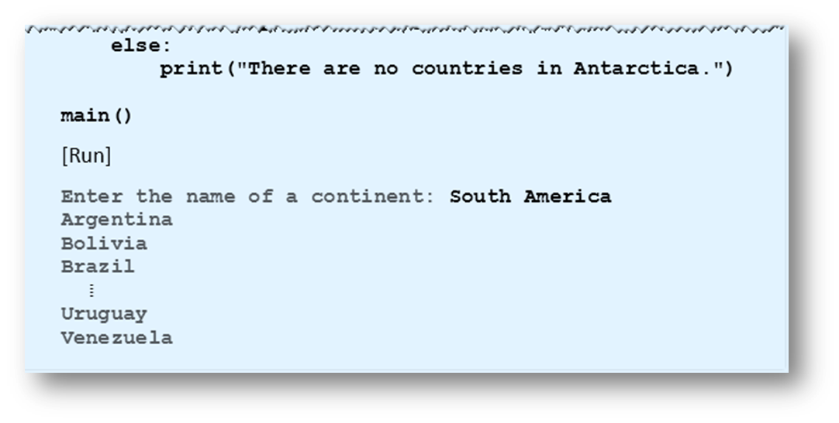
Accessing the Data in a CSV File
Example 1 : Program requests name of a continent
  then displays names of UN member countries
© 2016 Pearson Education, Inc., Hoboken, NJ. All rights reserved.

Slide 5
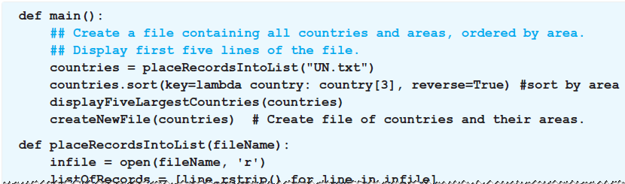
Analyzing the Data in a CSV File with a List
Data can be analyzed by placing data into a list
  Items of the list are other lists
  Holding the contents of a single line of the file
Example 2: Program places contents of file into a list of 193 items
© 2016 Pearson Education, Inc., Hoboken, NJ. All rights reserved.

Slide 6
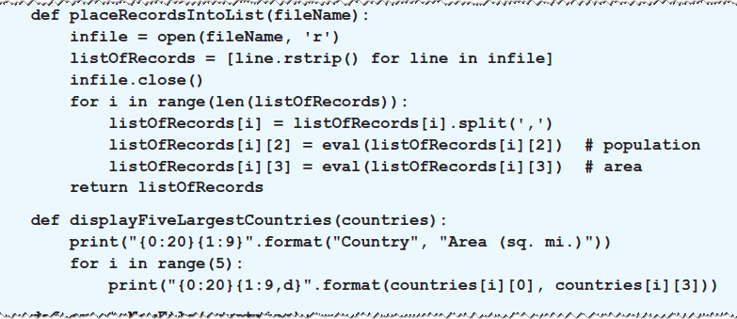
Analyzing the Data in a CSV File with a List
Example 2: Program places contents of file into a list of 193 items
© 2016 Pearson Education, Inc., Hoboken, NJ. All rights reserved.

Slide 7
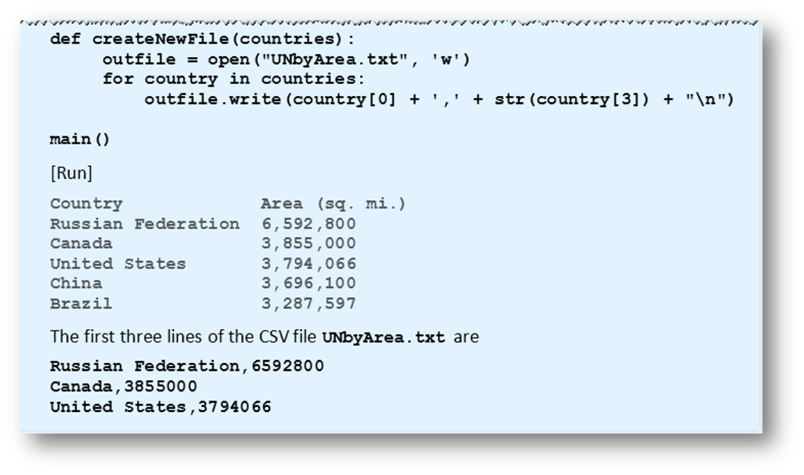
Analyzing the Data in a CSV File with a List
Example 2:
© 2016 Pearson Education, Inc., Hoboken, NJ. All rights reserved.

Slide 8
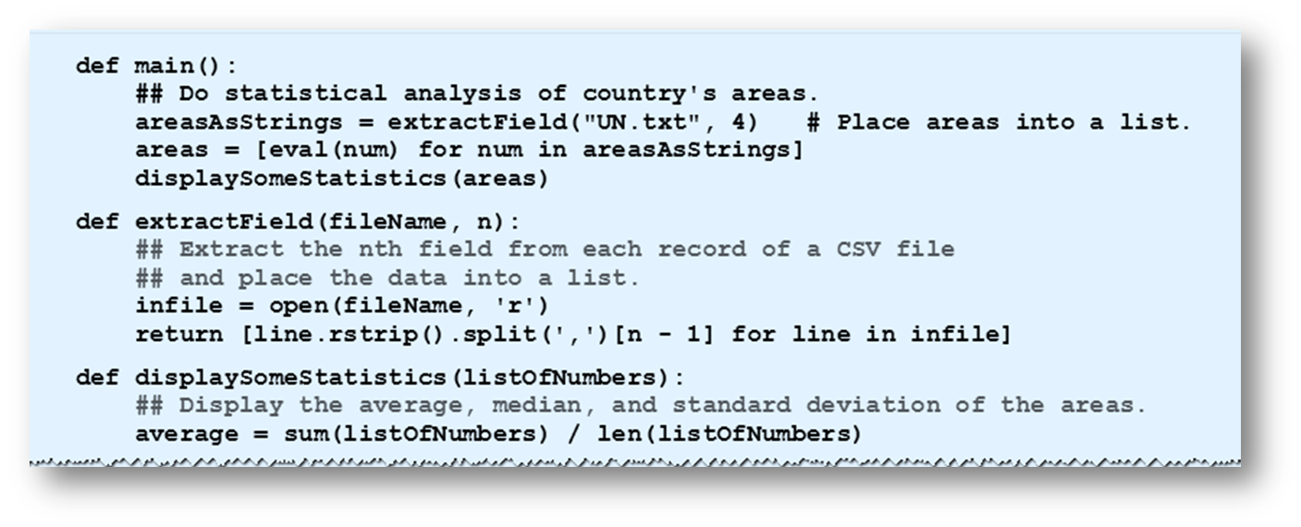
Analyzing Numeric Data
Example 3: Program does statistical analysis of areas of countries in United Nations.
© 2016 Pearson Education, Inc., Hoboken, NJ. All rights reserved.

Slide 9
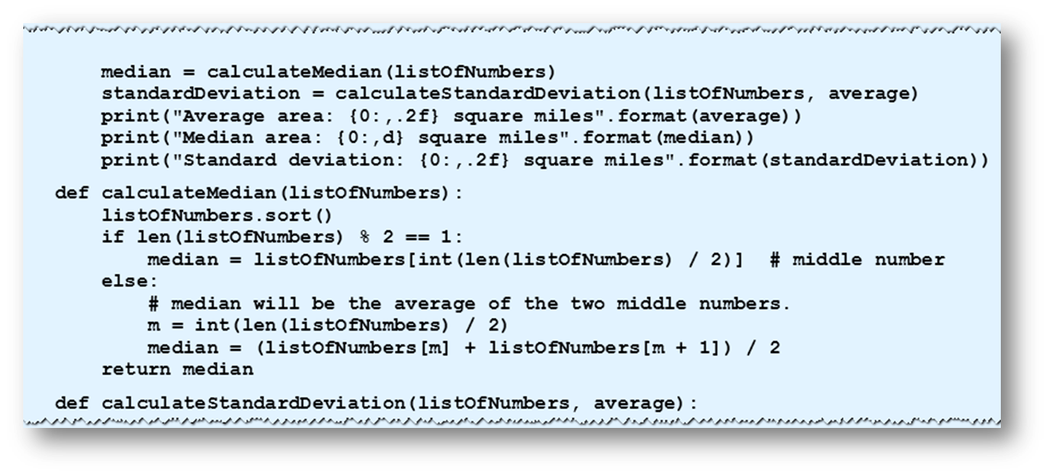
Analyzing Numeric Data
Example 3: Program does statistical analysis of areas of countries in United Nations.
© 2016 Pearson Education, Inc., Hoboken, NJ. All rights reserved.

Slide 10
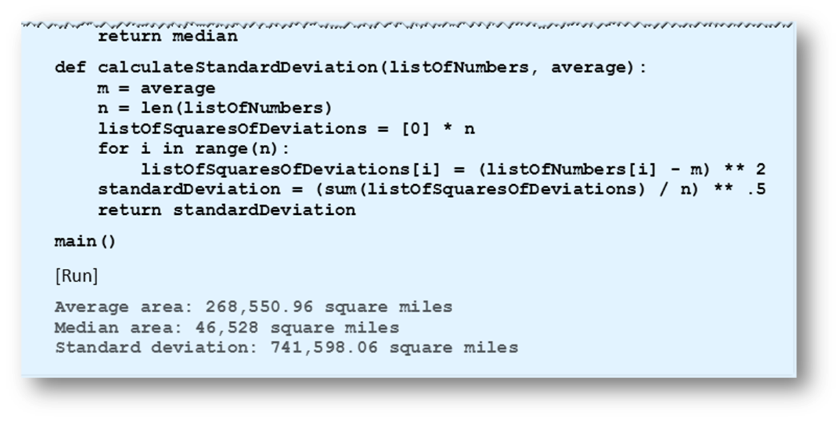
Analyzing Numeric Data
Example 3: Program does statistical analysis of areas of countries in United Nations.
© 2016 Pearson Education, Inc., Hoboken, NJ. All rights reserved.

Slide 11
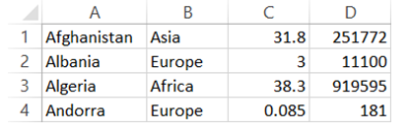
Excel and CSV Files
CSV files can be converted to Excel spreadsheets and vice versa
  Open UN.txt file in Excel, select comma when asked for delimiter
FIGURE 5.12 Spreadsheet Created from UN.txt.
© 2016 Pearson Education, Inc., Hoboken, NJ. All rights reserved.

Slide 12
End
Section 2
Chapter 5
© 2016 Pearson Education, Inc., Hoboken, NJ. All rights reserved.

