Slide 1
Miscellaneous Topics
Section 1
Chapter 6
© 2016 Pearson Education, Inc., Hoboken, NJ. All rights reserved.

Slide 2
Exceptions
Exceptions occur due to circumstances beyond programmer's control
  Invalid data are input
  File cannot be accessed
Even though might be user’s fault
  Programmer must anticipate
  Include code to work around the occurrence
© 2016 Pearson Education, Inc., Hoboken, NJ. All rights reserved.

Slide 3
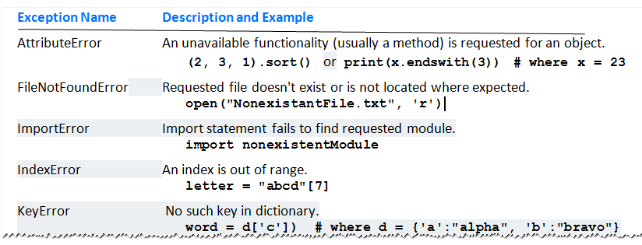
Exceptions
Table 6.1 Some Common Exceptions
© 2016 Pearson Education, Inc., Hoboken, NJ. All rights reserved.

Slide 4
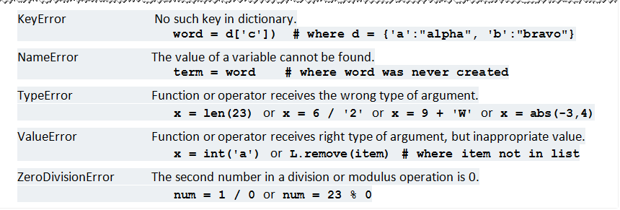
Exceptions
Table 6.1 Some Common Exceptions
© 2016 Pearson Education, Inc., Hoboken, NJ. All rights reserved.

Slide 5

Exceptions
Sample problem:
  Entry may be non numeric or just <Enter> key
  Python gives following error message
© 2016 Pearson Education, Inc., Hoboken, NJ. All rights reserved.

Slide 6
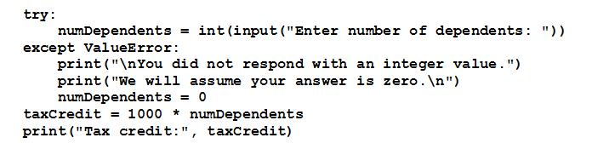
The try Statement
Robust program explicitly handles previous exception
  Protecting the code with a try statement.
© 2016 Pearson Education, Inc., Hoboken, NJ. All rights reserved.

Slide 7
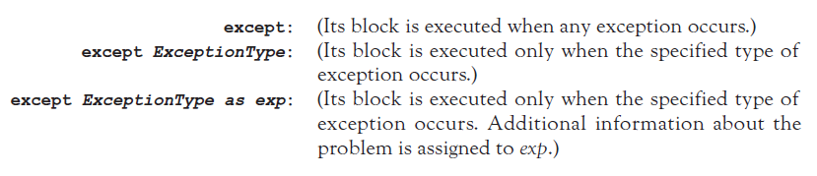
The try Statement
Three types of except clauses:
© 2016 Pearson Education, Inc., Hoboken, NJ. All rights reserved.

Slide 8
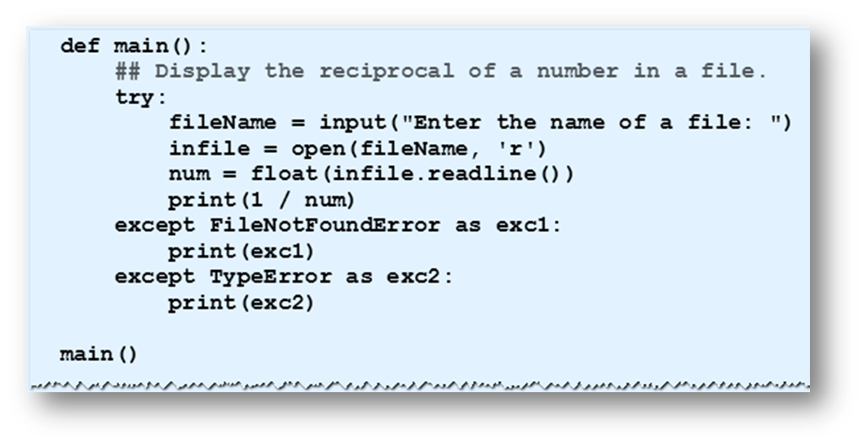
The try Statement
Example 1: Program with different assumptions
© 2016 Pearson Education, Inc., Hoboken, NJ. All rights reserved.

Slide 9
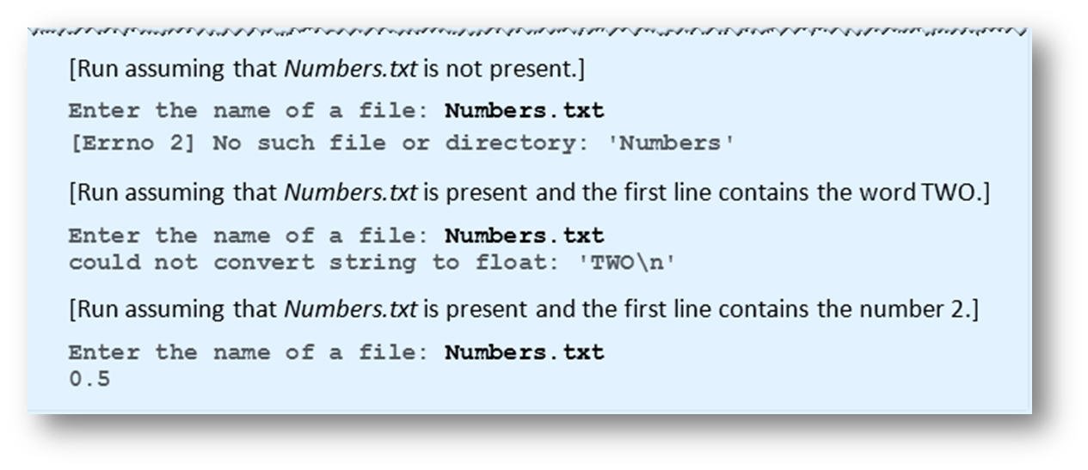
The try Statement
Example 1:
© 2016 Pearson Education, Inc., Hoboken, NJ. All rights reserved.

Slide 10
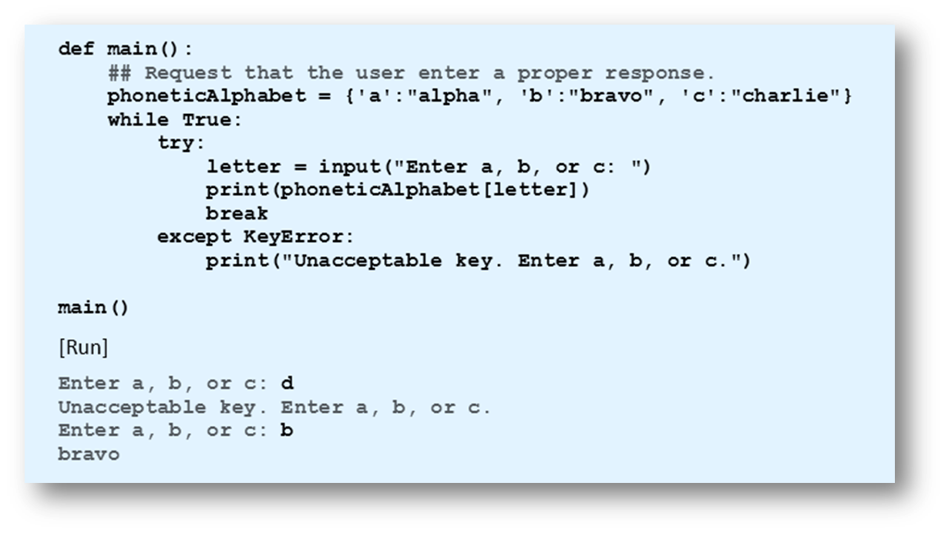
The try Statement
Example 2: Program uses exception handling to guarantee proper response from user.
© 2016 Pearson Education, Inc., Hoboken, NJ. All rights reserved.

Slide 11
The else and finally Clauses
try statement also can include a single else clause
  Follows the except clauses
  Executed when no exceptions occur
try statement can end with a finally clause
  Usually used to clean up resources such as files that were left open
try statement must contain either an except clause or a finally clause.
© 2016 Pearson Education, Inc., Hoboken, NJ. All rights reserved.

Slide 12
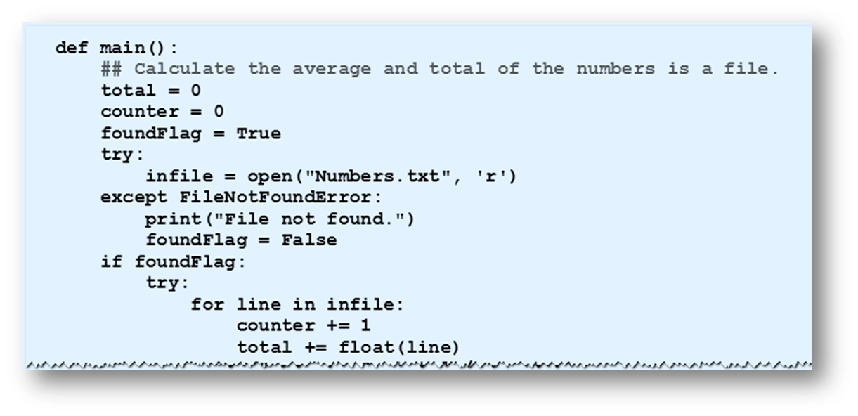
The else and finally Clauses
Example 3: Program attempts to find the average and total of the numbers in a file.
© 2016 Pearson Education, Inc., Hoboken, NJ. All rights reserved.

Slide 13
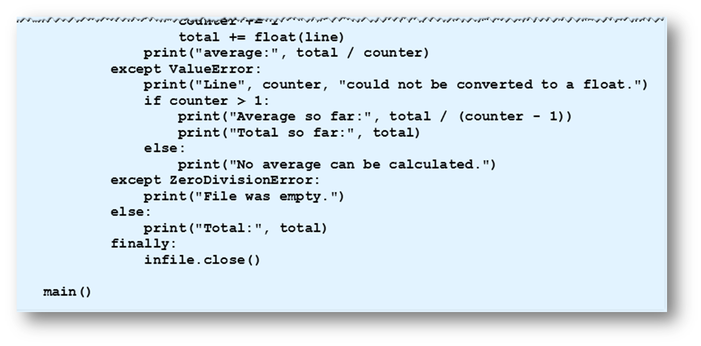
The else and finally Clauses
Example 3:
© 2016 Pearson Education, Inc., Hoboken, NJ. All rights reserved.

Slide 14
End
Section 1
Chapter 6
© 2016 Pearson Education, Inc., Hoboken, NJ. All rights reserved.

