Slide 1
Selecting Random Values
Section 2
Chapter 6
© 2016 Pearson Education, Inc., Hoboken, NJ. All rights reserved.

Slide 2
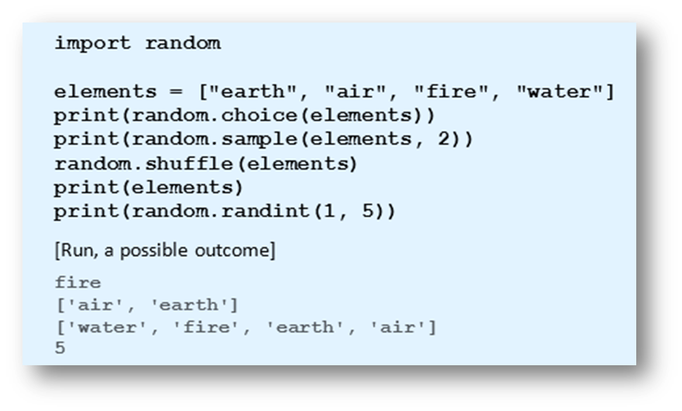
Functions from the random Module
Functions that randomly select items from a list and randomly reorder the items in a list.
Example 1:
Program
demonstrates
functions from
the random
module.
© 2016 Pearson Education, Inc., Hoboken, NJ. All rights reserved.

Slide 3
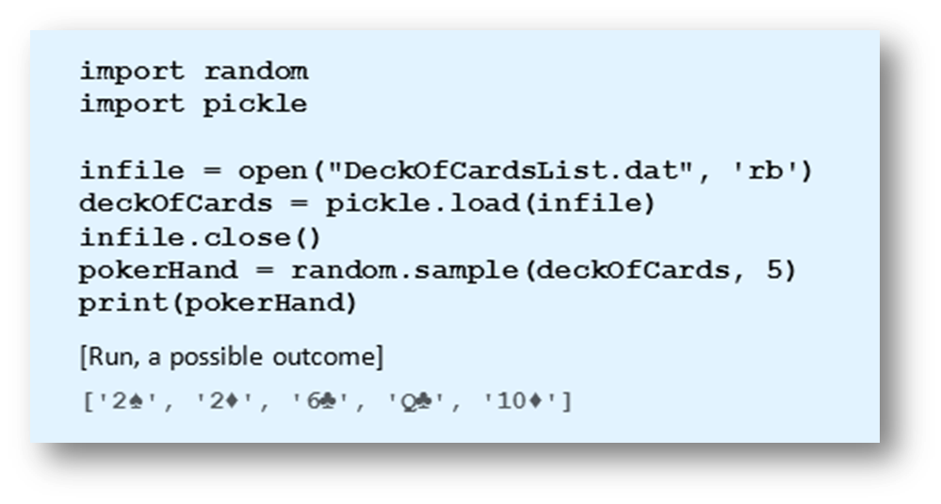
Games of Chance
Example 2: Program randomly selects five cards from the deck.
© 2016 Pearson Education, Inc., Hoboken, NJ. All rights reserved.

Slide 4
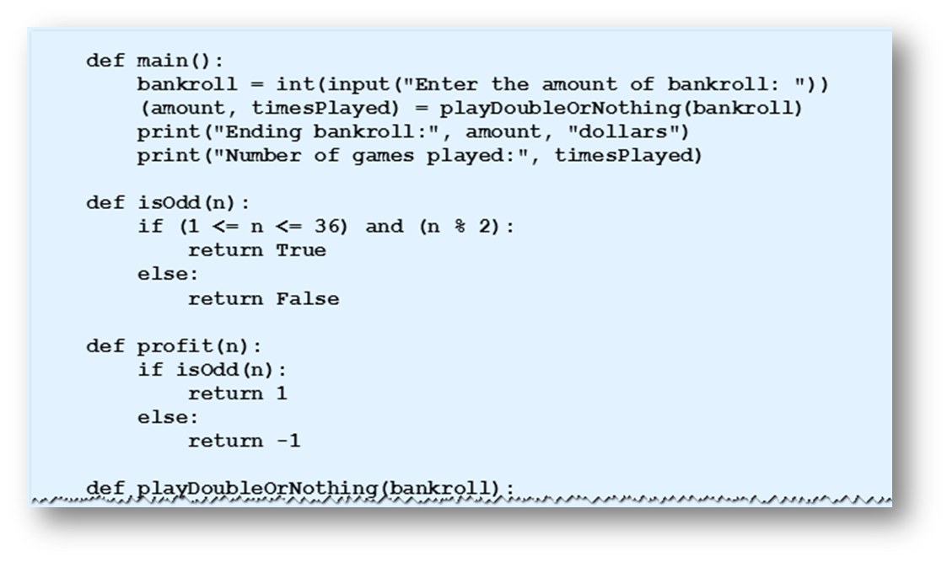
Games of Chance
Example 3: Program simulates a better’s series of wagers placed on roulette
© 2016 Pearson Education, Inc., Hoboken, NJ. All rights reserved.

Slide 5
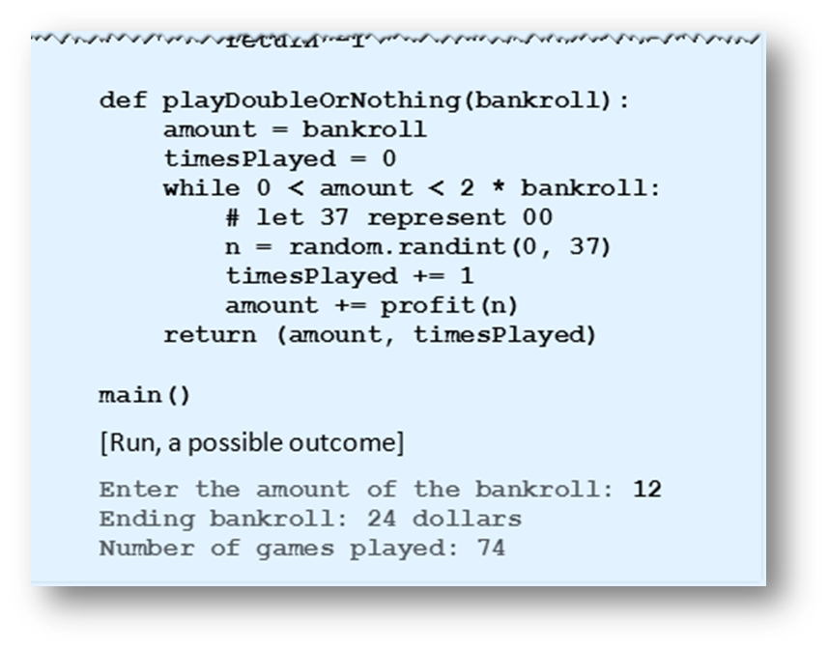
Games of Chance
Example 3:
© 2016 Pearson Education, Inc., Hoboken, NJ. All rights reserved.

Slide 6
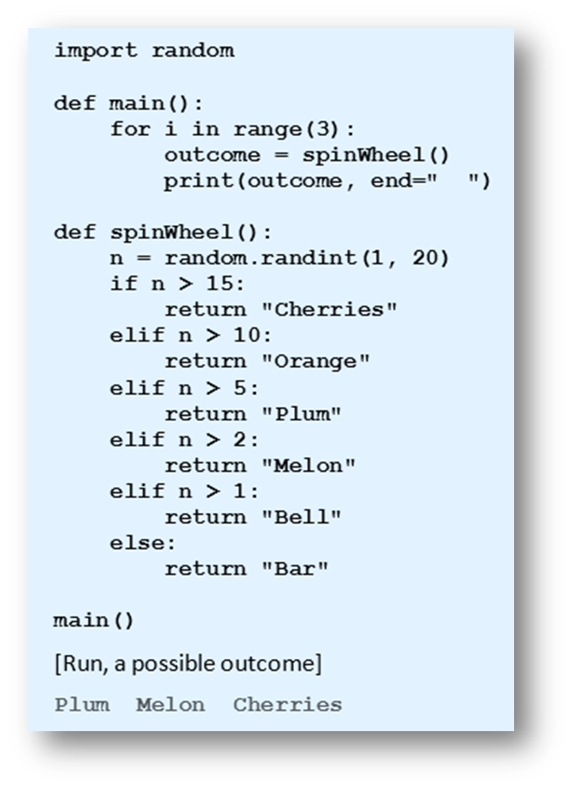
Games of Chance
Example 4:
Program
simulates
outcome
from pulling
slot machine
lever.
© 2016 Pearson Education, Inc., Hoboken, NJ. All rights reserved.

Slide 7
End
Section 2
Chapter 6
© 2016 Pearson Education, Inc., Hoboken, NJ. All rights reserved.

