Slide 1
Recursion
Section 4
Chapter 6
© 2016 Pearson Education, Inc., Hoboken, NJ. All rights reserved.

Slide 2


A Recursive Power Function
Recursive function invokes/calls itself
  Successive calls reduce to simpler task
  Until base case with trivial solution reached
The n^{th} power of a number
  Iteratively
  Recursively
© 2016 Pearson Education, Inc., Hoboken, NJ. All rights reserved.

Slide 3
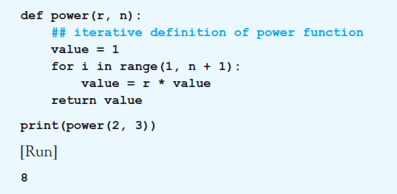
A Recursive Power Function
Example 1: Definition uses the iterative definition of a power.
© 2016 Pearson Education, Inc., Hoboken, NJ. All rights reserved.

Slide 4
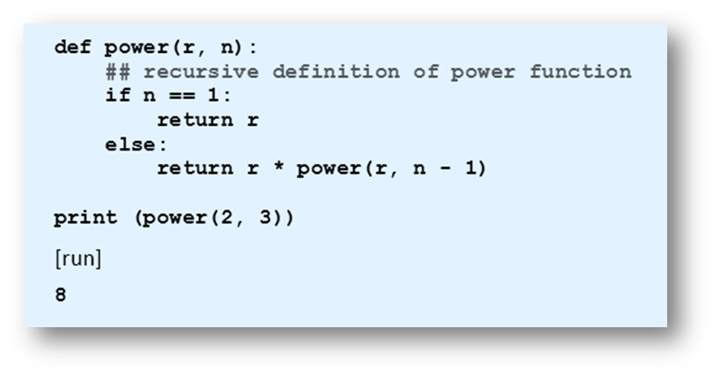
A Recursive Power Function
Example 2: Definition uses the recursive definition of a power.
© 2016 Pearson Education, Inc., Hoboken, NJ. All rights reserved.

Slide 5
A Recursive Power Function
Traits of recursive algorithms
One or more base cases with direct solutions.
An "inductive step"
  Reducing the problem to one or more smaller versions of the same problem
  Reduction eventually culminating in a base case.
  Called the reducing step.
© 2016 Pearson Education, Inc., Hoboken, NJ. All rights reserved.

Slide 6
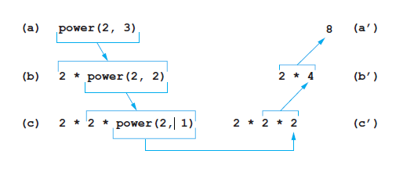
A Recursive Power Function
FIGURE 6.20 The recursive computation of power(2, 3).
© 2016 Pearson Education, Inc., Hoboken, NJ. All rights reserved.

Slide 7
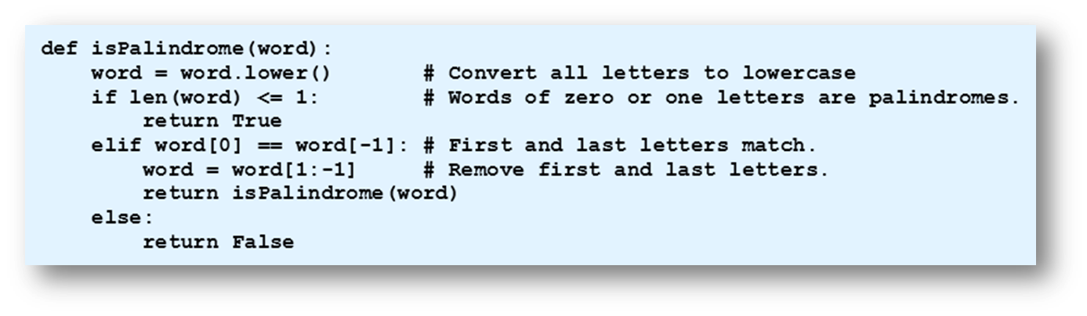
Recursive Palindrome Function
Sometimes a recursive solution is easier to understand and code than iterative routine.
Example 3: Function uses recursion to determine whether or not word is a palindrome.
© 2016 Pearson Education, Inc., Hoboken, NJ. All rights reserved.

Slide 8
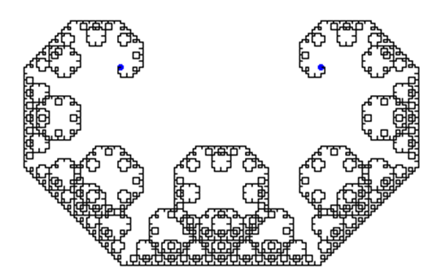
A Recursive Fractal Function
Figure 6.21 A fractal
© 2016 Pearson Education, Inc., Hoboken, NJ. All rights reserved.

Slide 9
A Recursive Fractal Function
Four-step algorithm:
Specify an intricacy level, a non-negative integer
Start with a straight line, level 0
Replace each line in drawing with sides of isosceles right triangle having line as hypotenuse
Repeat step (c) until desired level reached
© 2016 Pearson Education, Inc., Hoboken, NJ. All rights reserved.

Slide 10
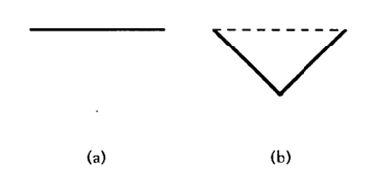
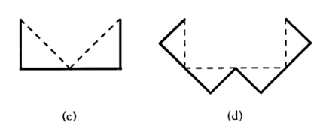
A Recursive Fractal Function
Figure 6.22 Fractals of Levels 0, 1, 2, and 3.
© 2016 Pearson Education, Inc., Hoboken, NJ. All rights reserved.

Slide 11
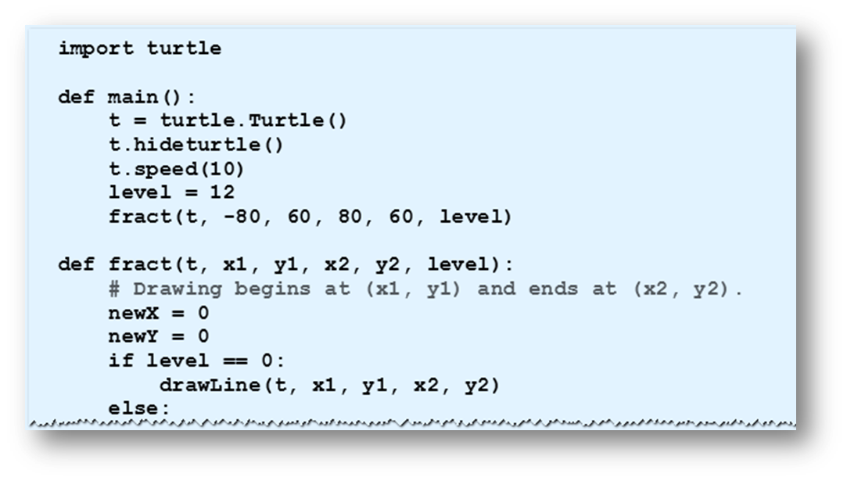
A Recursive Fractal Function
Example 4: Program uses recursion to create level 12 fractal of Fig. 6.21
© 2016 Pearson Education, Inc., Hoboken, NJ. All rights reserved.

Slide 12
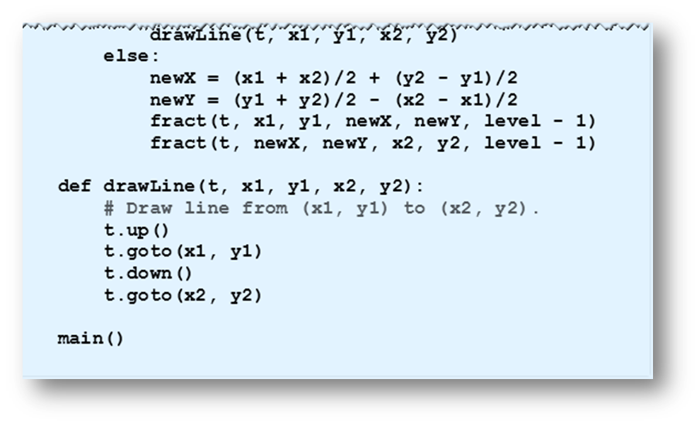
A Recursive Fractal Function
Example 4: Program uses recursion to create level 12 fractal of Fig. 6.21
© 2016 Pearson Education, Inc., Hoboken, NJ. All rights reserved.

Slide 13
End
Section 4
Chapter 6
© 2016 Pearson Education, Inc., Hoboken, NJ. All rights reserved.

