Slide 1
./techweek_2022
pen-plotting weaving-inspired designs with python
//techweek 2022

Slide 2
./outline_&_resources
outline & resources

Slide 3
./outline_&_resources/outline
first: this short slide presentation (on plotters and what we'll do)
task 1: some basic py5 drawing concepts
task 2: introduction to the template file for plotting
then: make code art and plot

Slide 4
./outline_&_resources/web
https://github.com/tabreturn/cc-fest-plotter
* session slides
* task files
* resources for py5
* useful plotter utilities
* plotter-art inspiration
* other useful resources

Slide 5
./plotters
plotters

Slide 6
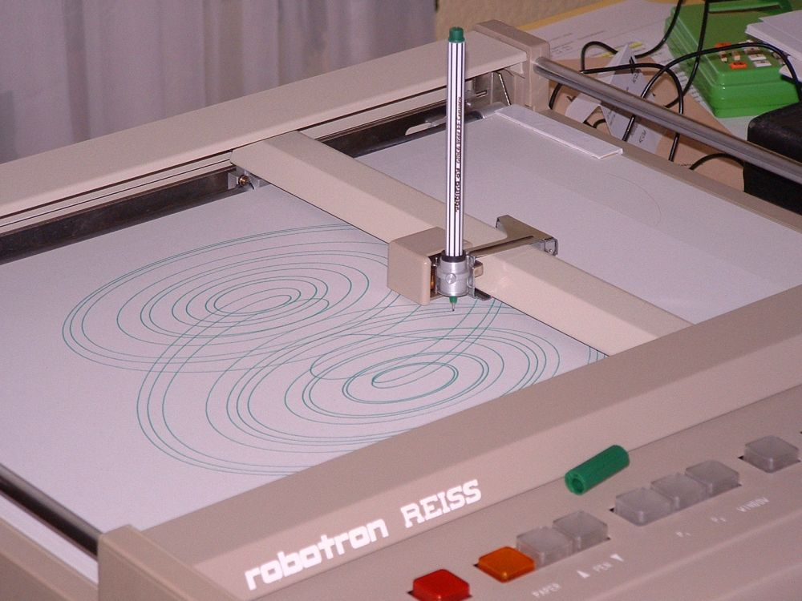
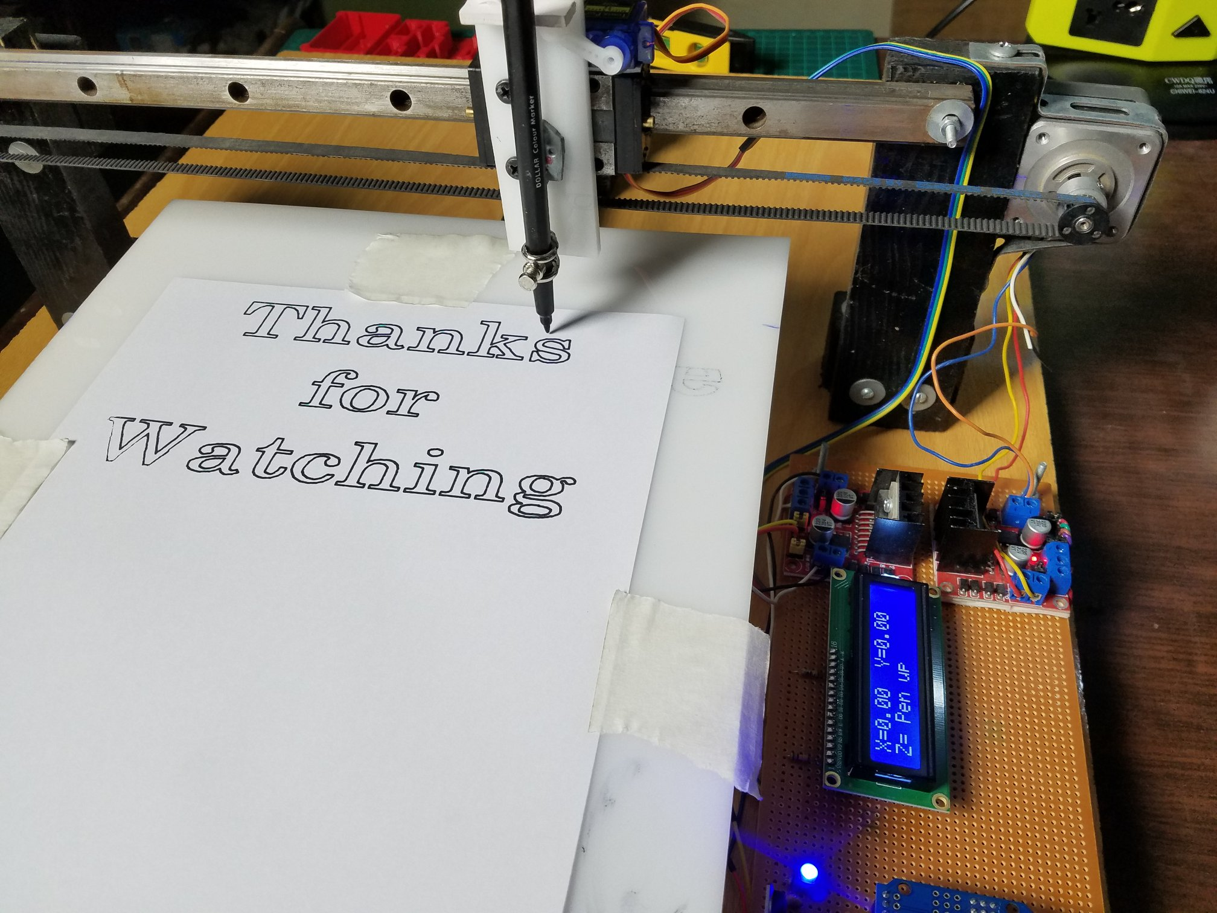
./plotters
https://create.arduino.cc/projecthub/

Slide 7
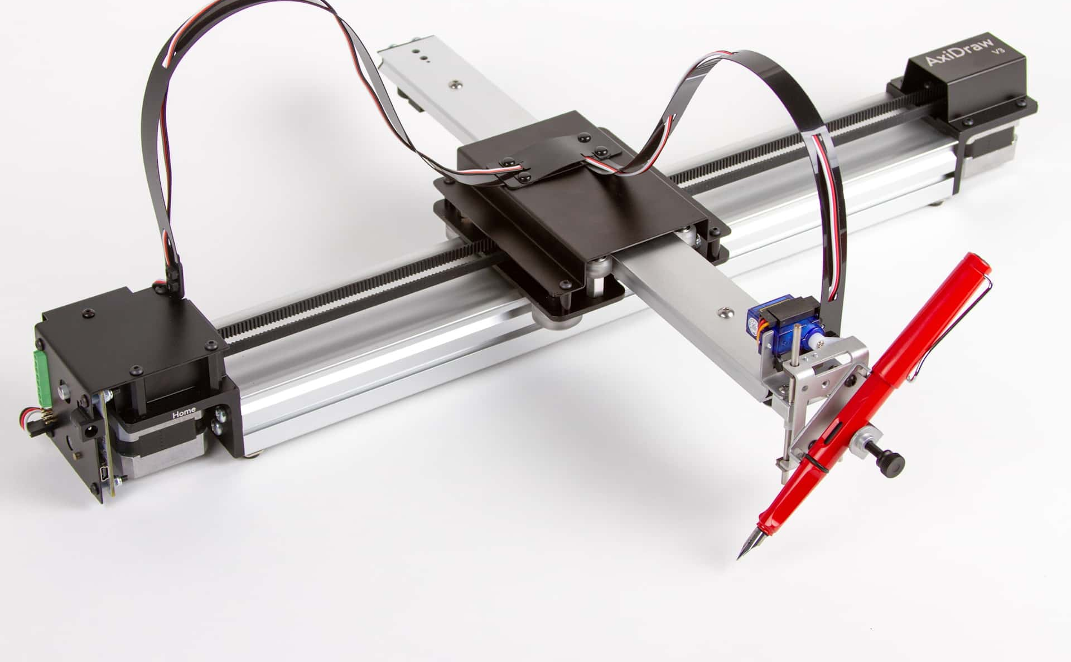
./plotters/axidraw
https://evilmadscientist.com

Slide 8
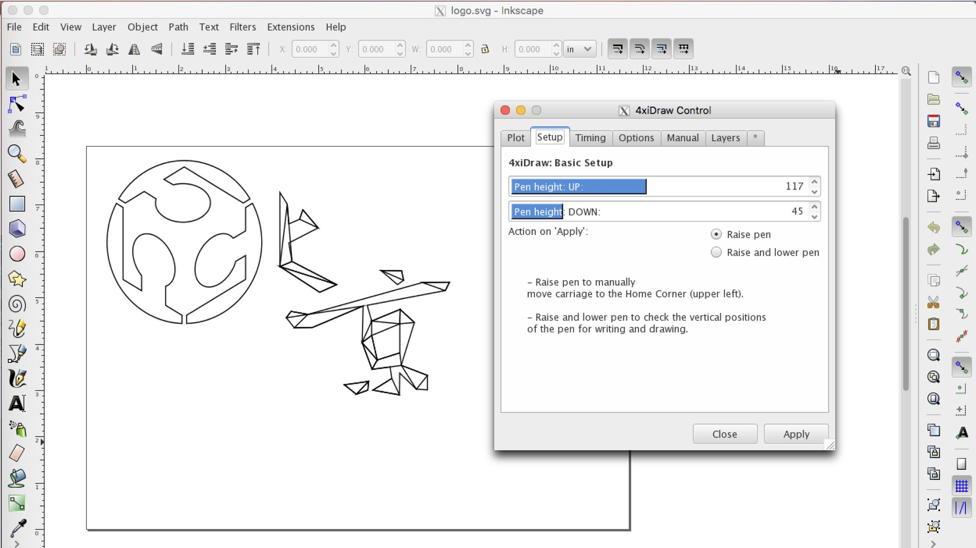
./plotters/axidraw
http://fabacademy.org

Slide 9
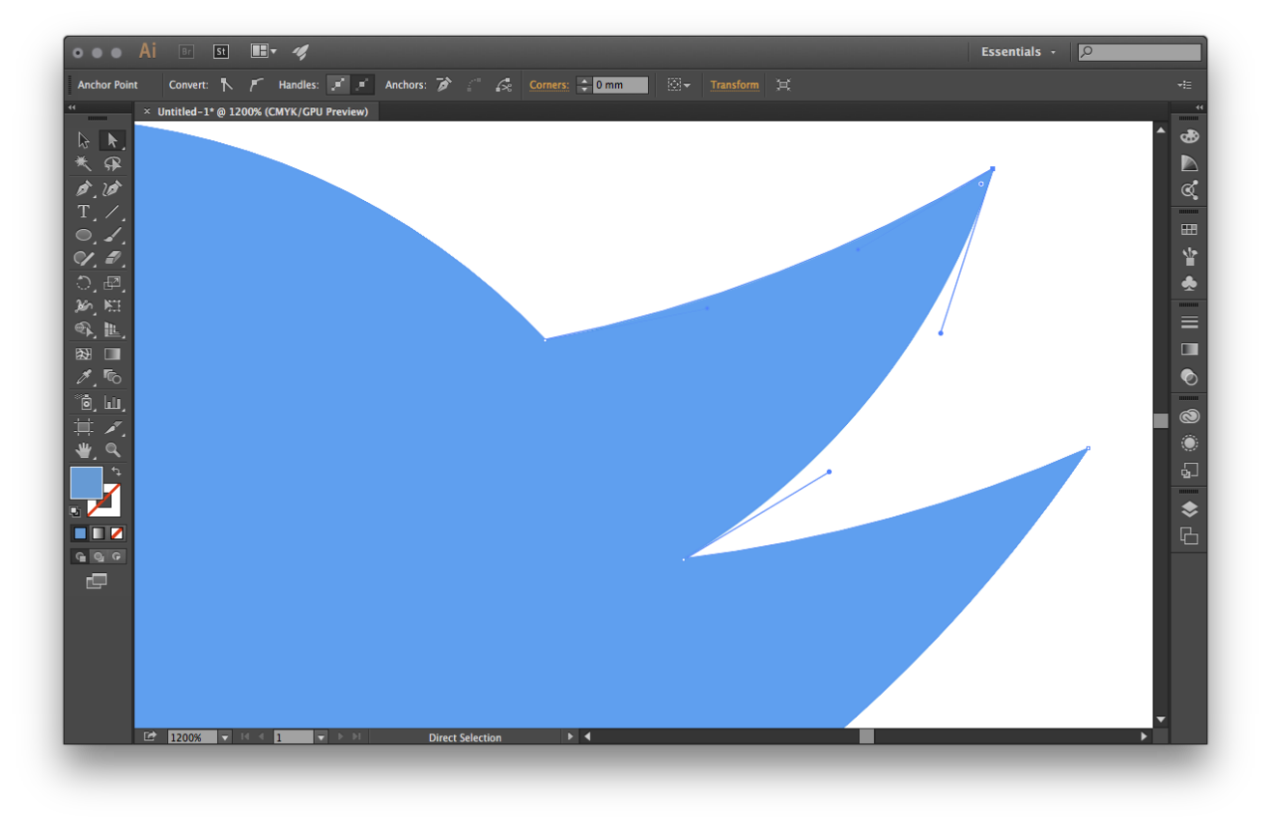
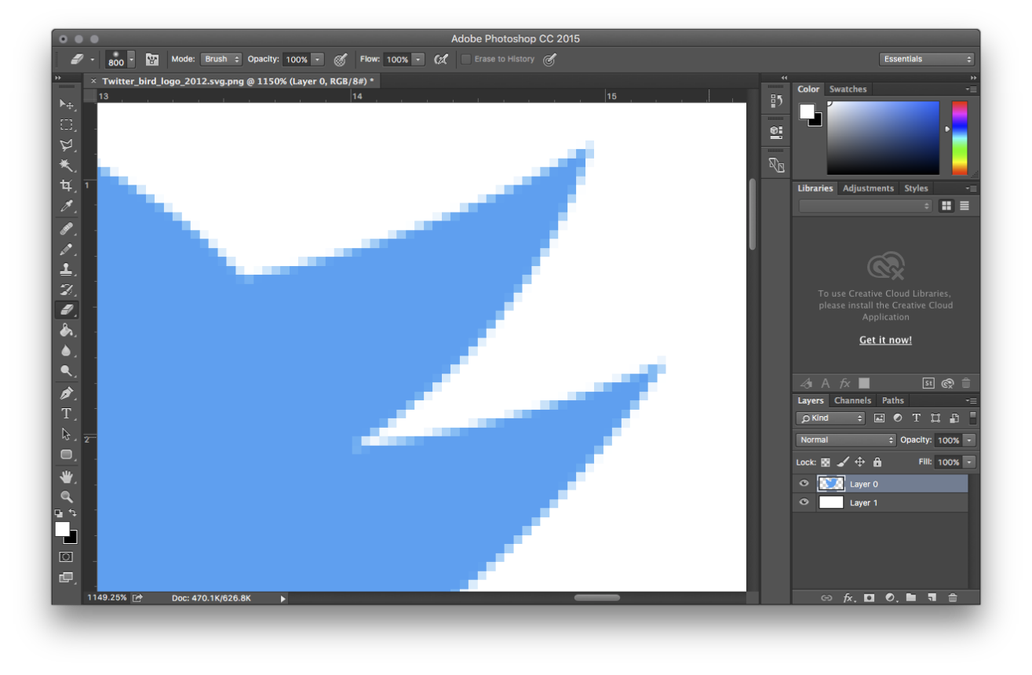
./plotters/vector_graphics
https://twitter.oom

Slide 10
./plotters/vector_graphics/svg
<circle
cx="64"
cy="64"
r="61"
style="fill:red; stroke:black; stroke-width:6px"
/>
<polygon
points="78 240 209 240 144 109 78 240"
style="fill:blue"
/>
https://en.wikipedia.org/wiki/Scalable_Vector_Graphics

Slide 11
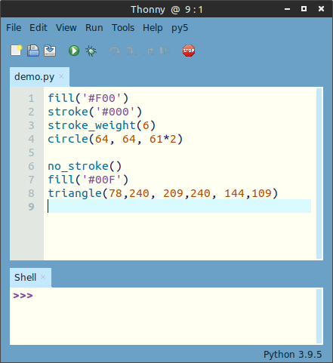
./plotters/vector_graphics/svg
<circle
cx="64"
cy="64"
r="61"
style="fill:red; stroke:black; stroke-width:6px"
/>
<polygon
points="78 240 209 240 144 109 78 240"
style="fill:blue"
/>
http://py5.ixora.io

Slide 12
./plotter_art
plotter art

Slide 13
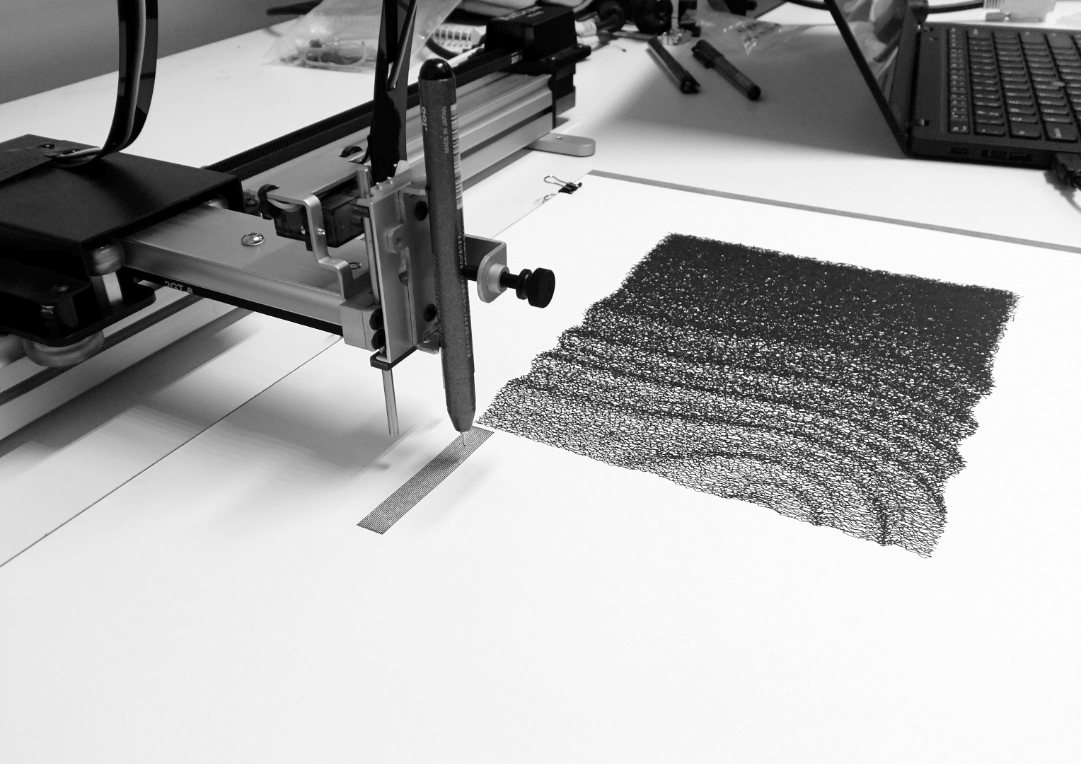
./plotter_art
https://tabreturn.com

Slide 14
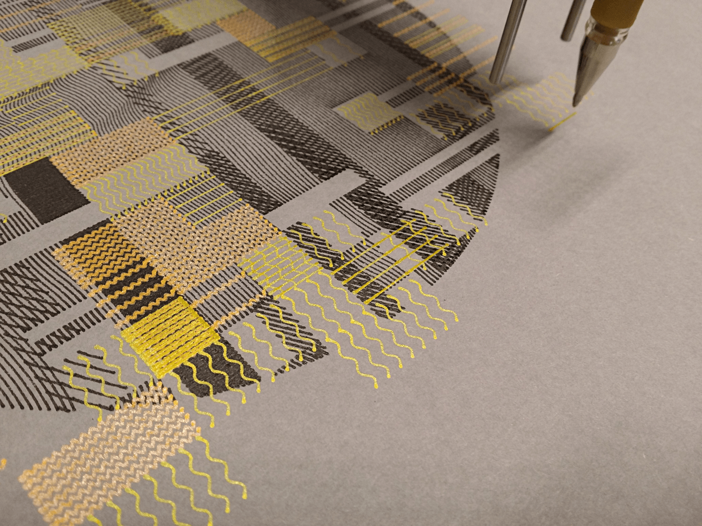
./plotter_art
https://tabreturn.com

Slide 15
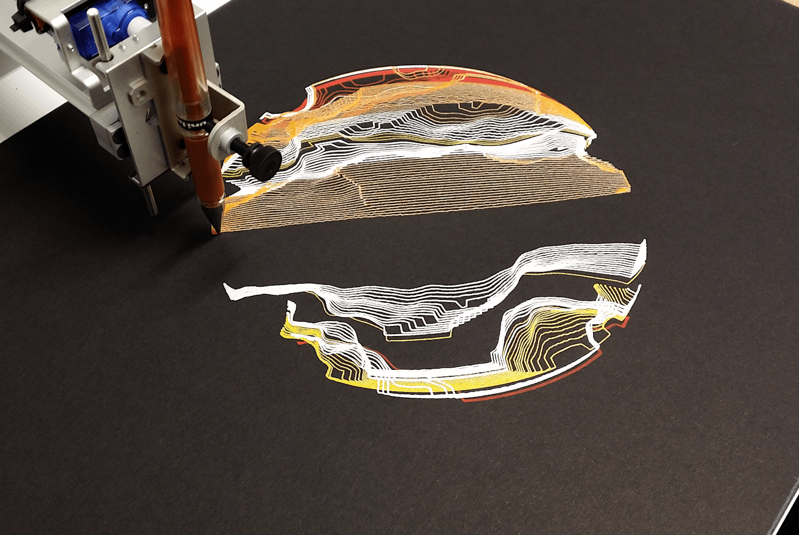
./plotter_art
https://tabreturn.com

Slide 16
./plotter_art/weaving-inspired_designs
weaving-inspired patterns

Slide 17
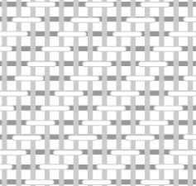
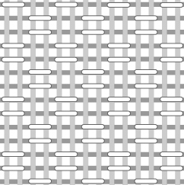
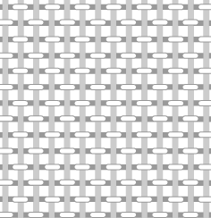
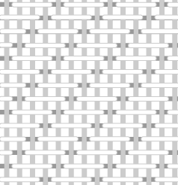
./plotter_art/weaving-inspired_designs
https://wikipedia.org

Slide 18

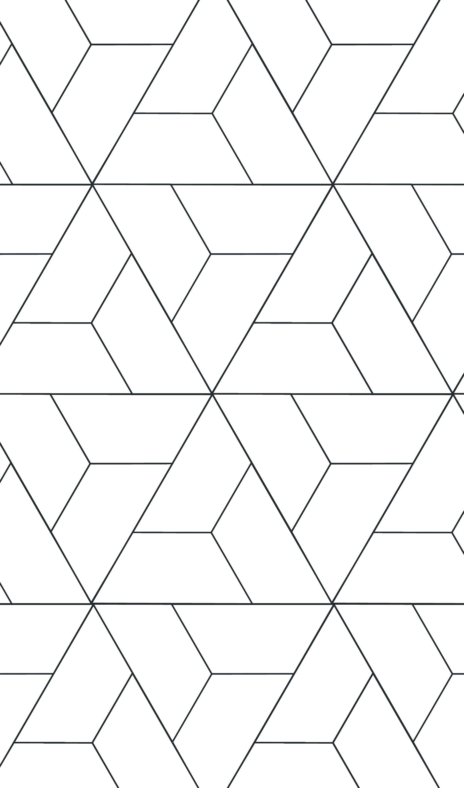

./plotter_art/weaving-inspired_designs
https://anttile.com

Slide 19
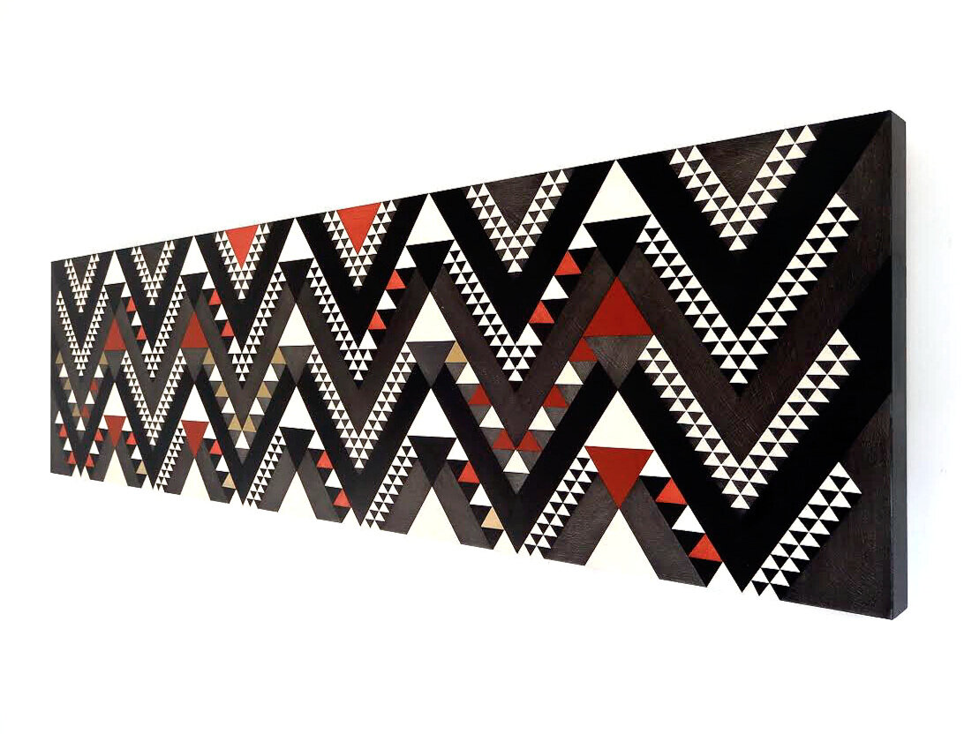
./plotter_art/weaving-inspired_designs
https://www.shereewillman.com

Slide 20
./end
end

