Slide 1

A JavaScript runtime environment running Google Chrome’s V8 engine
  a.k.a. a server-side solution for JS
  Compiles JS, making it really fast
Runs over the command line
Designed for high concurrency
  Without threads or new processes
Never blocks, not even for I/O
Uses the CommonJS framework
  Making it a little closer to a real OO language

Slide 2

Instead of threads Node uses an event loop with a stack
Alleviates overhead of context switching

Slide 3

Threads | Asynchronous Event-driven
Lock application / request with listener-workers threads | only one thread, which repeatedly fetches an event
Using incoming-request model | Using queue and then processes it
multithreaded server might block the request which might involve multiple events | manually saves state and then goes on to process the next event
Using context switching | no contention and no context switches
Using multithreading environments where listener and workers threads are used frequently to take an incoming-request lock | Using asynchronous I/O facilities (callbacks, not poll/select or O_NONBLOCK) environments

Slide 4

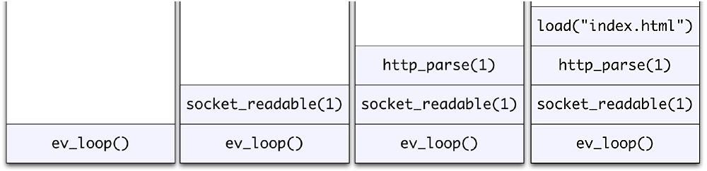
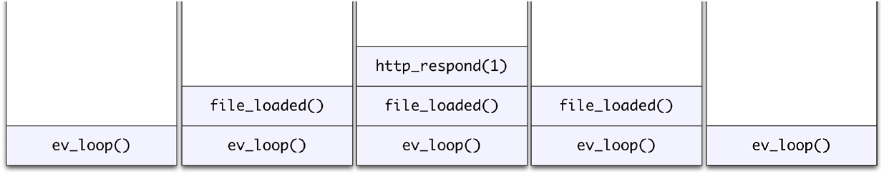
Request for “index.html” comes in
Stack unwinds and ev_loop goes to sleep
File loads from disk and is sent to the client

Slide 5

Servers do nothing but I/O
  Scripts waiting on I/O requests degrades performance
To avoid blocking, Node makes use of the event driven nature of JS by attaching callbacks to I/O requests
Scripts waiting on I/O waste no space because they get popped off the stack when their non-I/O related code finishes executing

Slide 6

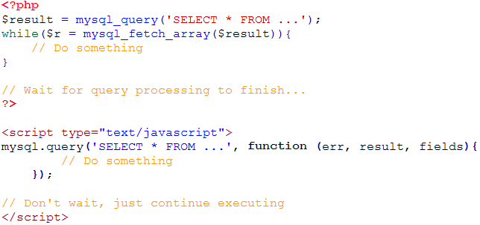

Slide 7

Use of JS on both the client and server-side should remove need to “context switch”
  Client-side JS makes heavy use of the DOM, no access to files/databases
  Server-side JS deals mostly in files/databases, no DOM
    JSDom project for Node works for simple tasks, but not much else

Slide 8

  It's fast
  It can handle tons of concurrent requests
  It's written in JavaScript (which means you can use the same code server side and client side)
Platform | Number of request per second
PHP ( via Apache) | 3187,27
Static ( via Apache ) | 2966,51
Node.js | 5569,30

Slide 9

http://nodejs.org/
http://nodejs.org/cinco_de_node.pdf
http://ajaxian.com/archives/google-chrome-chromium-and-v8
http://blog.chromium.org/2010/12/new-crankshaft-for-v8.html
http://news.softpedia.com/news/IE9-RC-vs-Chrome-10-9-vs-Opera-11-vs-Firefox-11-Performance-Comparison-183973.shtml

