Slide 1

Simple Search Engine
Group 5
104518447 Tengxiaoyao (Tab) Tu
104559835 Junwei (Vian) Wu
104462928 Yunpeng (Steven) Bai
{tu6, wu16u, bai11e}@uwindsor.ca

Slide 2
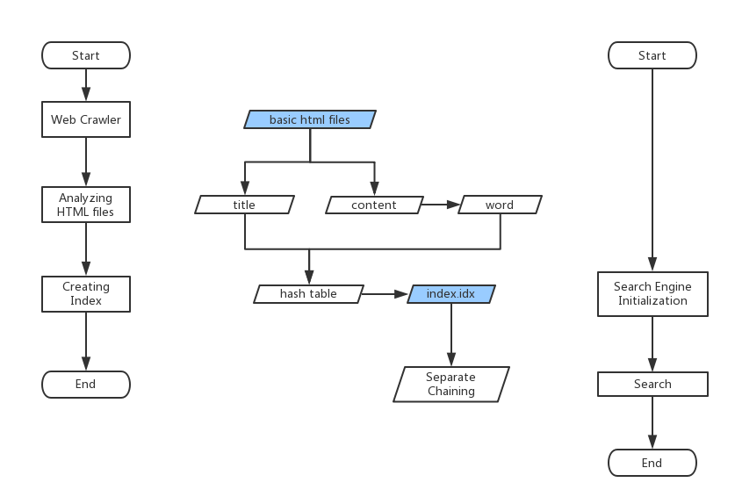
Outline
Create an Index
Search by key
Introduce some details
Notes:
There are 2 parts of our system. First parts is build a index, second part is load the index.

Slide 3
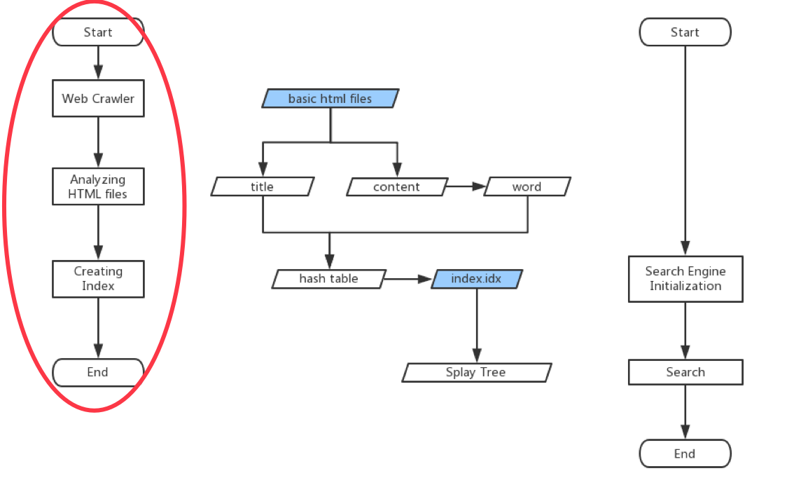
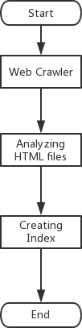
Build index
Web Crawler
· Download HTML files from the Internet
Analyze HTML files
· Decode hyper-text to normal text
· Get titles and content
· Separate words by space(lowercase)
Create index
· Put words into Hash Table
Notes:
1/Download HTML files from the Internet, but this time we use the course data files.
2/Decode hyper-text to normal text
Get titles and content
Separate words by space
3/Put words into Hash Table

Slide 4
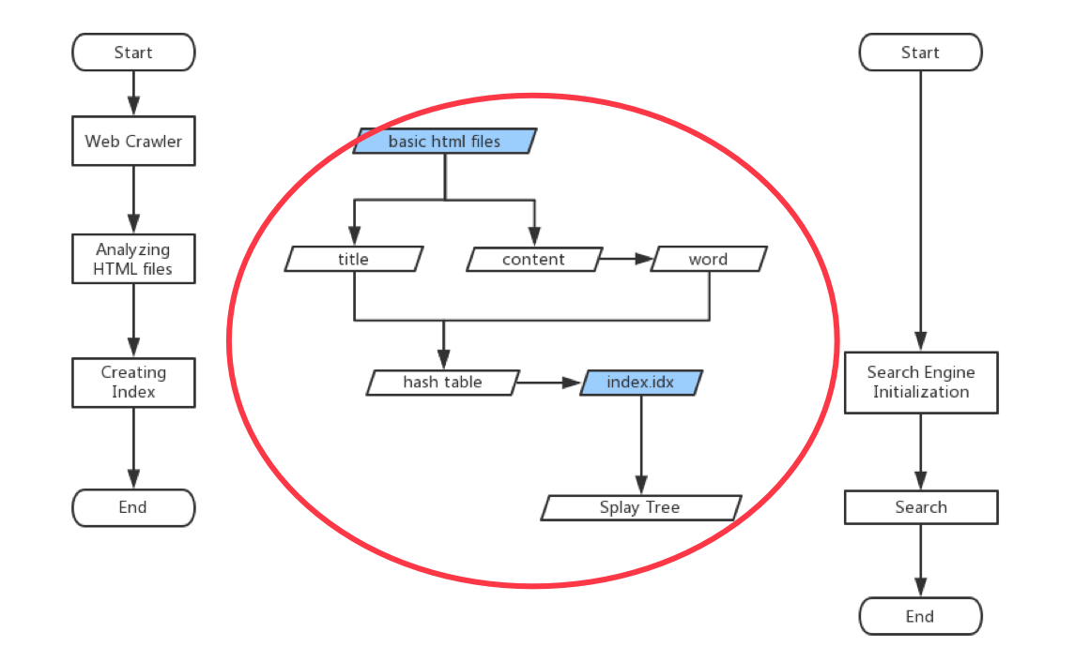
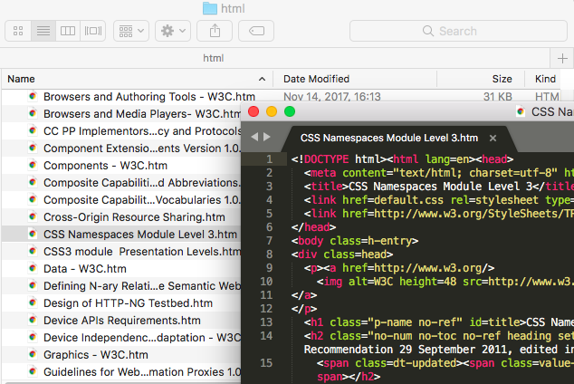
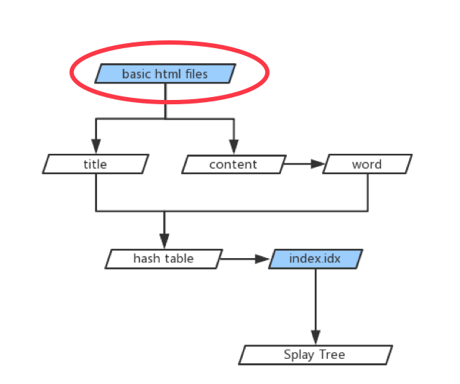

Data Stream
Notes:
This is a HTML from course data files. We choose CSS namespaces module Level 3.html to display the detail.
We can see the html file from the screen.

Slide 5
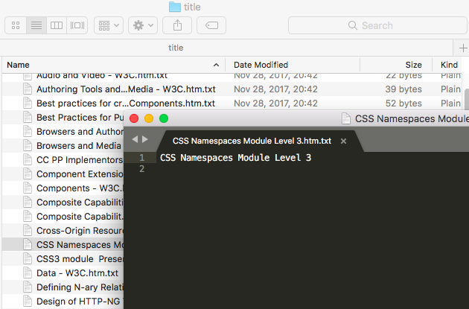
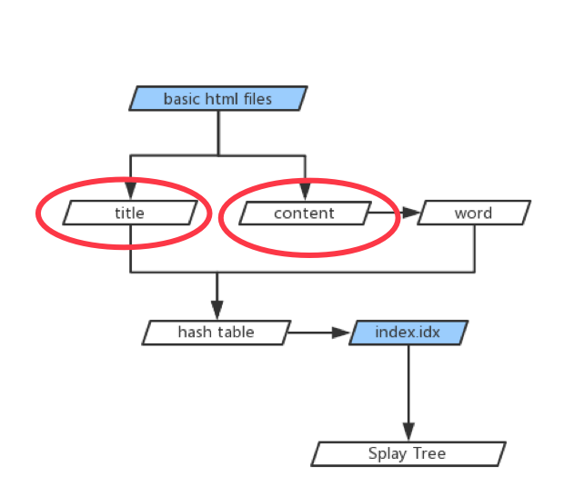
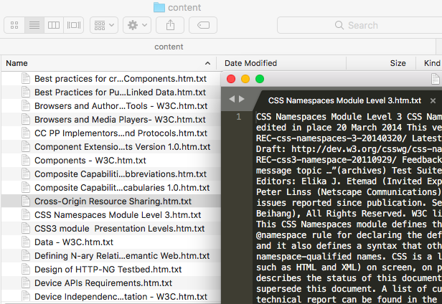
Data Stream
Notes:
After the decode Hyperlink, the system save the html file to title file and content file.
We can see the title is CSS……
And
Content file has no hyperlink.

Slide 6
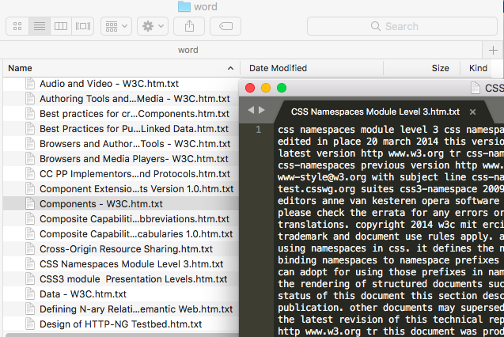
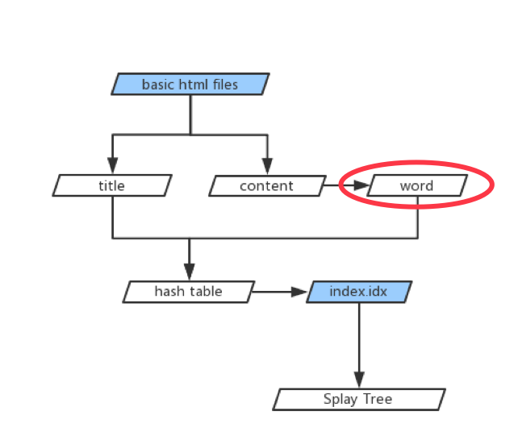
Data Stream
Notes:
Using word segmentation to separate the word by space. Every word has been separated.

Slide 7
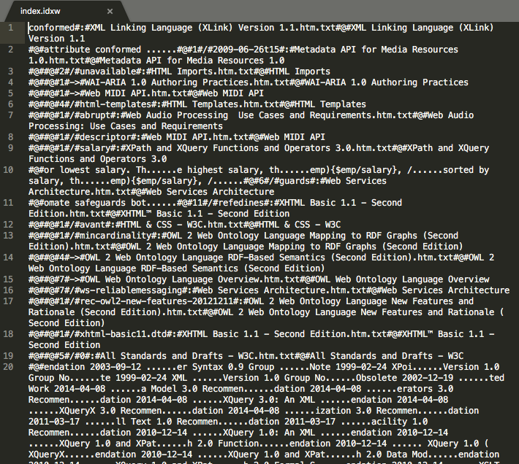
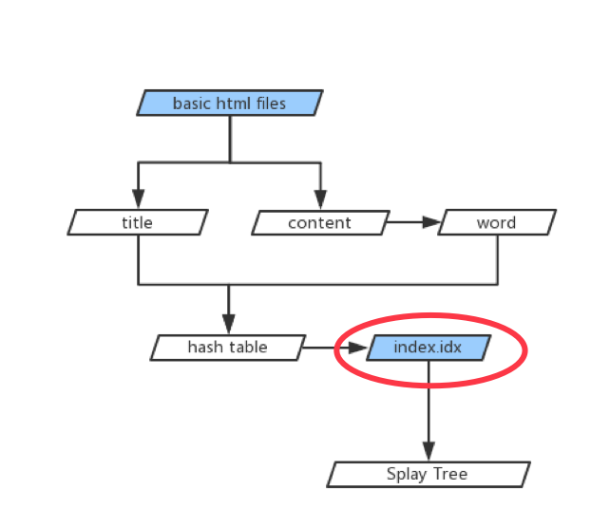
Data Stream
Notes:
This is the index file. Using the index file, we can finish the search. In our system, we use separate chaining as the main search algorithm.

Slide 8
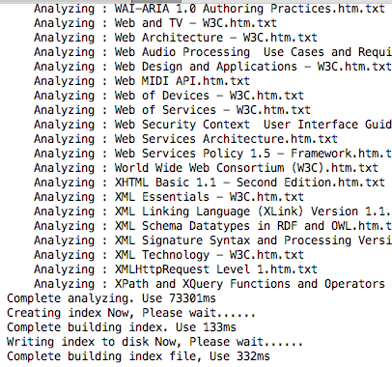
Screen Shot
100 HTML files
analyzing files: 73.301s
Building index: 0.133s
Saving index.idx: 0.332s

Slide 9
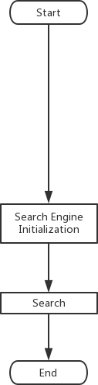
Search Engine
Notes:
Contains the title, url, content and word’s frequency.
The search engine initialization is based on the index file, separate chaining to find the result.
Our result list is ordered by page rate.

Slide 10
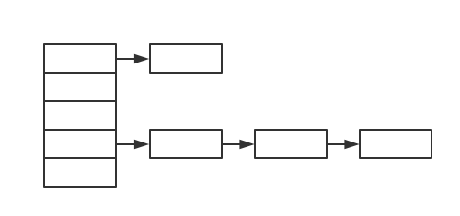
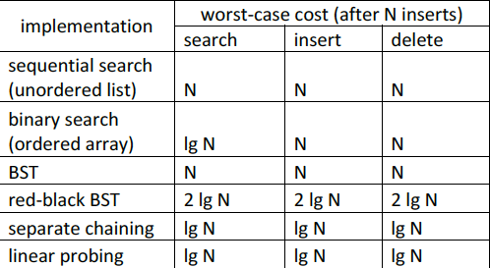
Separate chaining
DEMO
Definition:
Contrast:
Notes:
In separate chaining, each bucket is independent, and has some sort of list of entries with the same index.
We compared some searching strategies with separate chaining, and the time complexity is logN, which is the fastest. Also, our algorithm is based on harsh table, so the separate chaining is

Slide 11
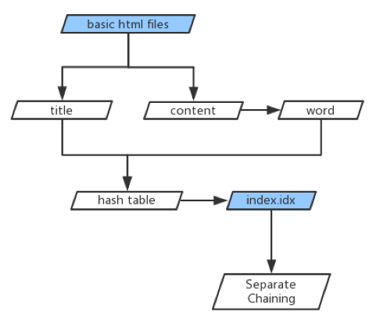
Concepts
Jsoup
IKSegmenter
KMP
Quick Sort
Notes:
These are some algorithms and methods that we finished on lab courses and we used in our final project.
Here, we are only listing the main algorithms and methods that we used in this project.
Jsoup: analyze html files, decode hypertext into title and content.
KMP: find the word location in a content
Quick Sort: sort the result that we found by searching, rate them by word frequencies.

Slide 12
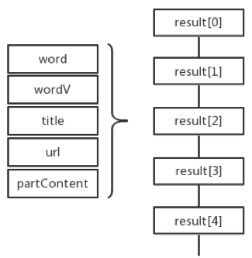
Data Structure
word: key word
wordV: word frequency
title: title in html file
url: link url
partContent:
…(50 letters before) + key + (50 letters after)…
……

Slide 13
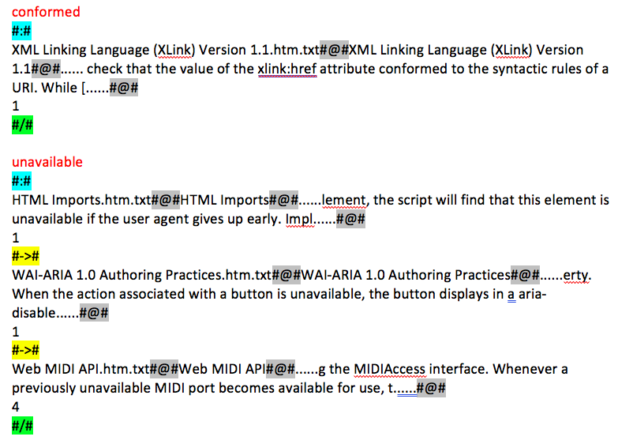
Save .idx file
#:#
identify key word
#/#
mark hash element
#@#
separate content
#->#
link content
Notes:
Specific method we use in saving .idx file
#:#
#/#
#@#
#->#

Slide 14
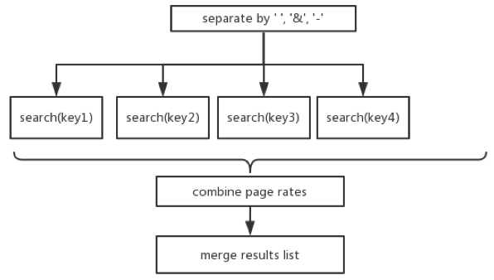
Multi-Search
……

Slide 15
Q&A
Thank you

