Slide 1
Data Analysis on Customer Retention

Slide 2
Customer Retention
Customer retention refers to the ability of a company or product to retain its customers over some specified period. High customer retention means customers of the product or business tend to return to, continue to buy or in some other way not defect to another product or business, or to non-use entirely.

Slide 3
Benefits of Customer Retention
Retention is Cheaper than Acquisition. ...
Loyal Customers are More Profitable. ...
Your Brand Will Stand Out from the Crowd. ...
You'll Earn More Word of Mouth Referrals. ...
Engaged Customers Provide More Feedback. ...
Customers Will Explore Your Brand. ...
Loyal Customers are More Forgiving.

Slide 4
Strategies of Customer Retention
Surprise Gifts and Discounts. Customers are people and people love to feel appreciated. ...
Provide Excellent Customer Service. ...
Customer Surveys. ...
Be Active in Your Community. ...
Keep Customers Informed. ...
Customer Onboarding. ...
Use Gamification. ...
Be Personal.

Slide 5
Tips for success in Customer Retention
Data, Behavioral Analytics Driven Customer Experience. ...
Omni Channel Customer Experience. ...
Customer Journey Mapping. ...
Look, Ask and Be Open for Feedback. ...
Deliver Personalized Email & Web Experiences. ...
Add Incentives for Long-Time Loyal Customers.

Slide 6
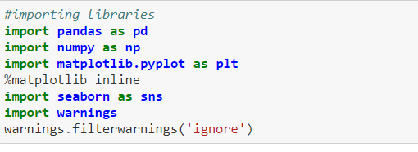
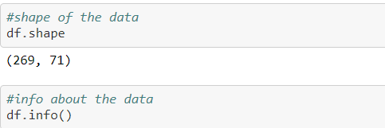
Visualization on Customer Retention data
Importing the Libraries into the data.
Importing the data into Jupyter notebook.
Checking the shape of the data.
Checking the info of the data.

Slide 7
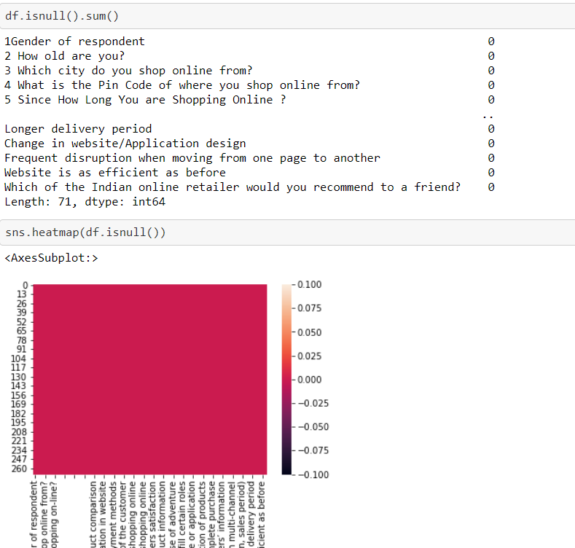
Checking the null values in the data.
In this data there are no null values to handle.

Slide 8
Exploratory Data Analysis
The given data set will be divided in to 4 parts-
1. Information about the customer 2. Information about the website. 3. what the customer feel about the website. 4. Information about the customer satisfaction and how much easy they found the website while using it.

Slide 9
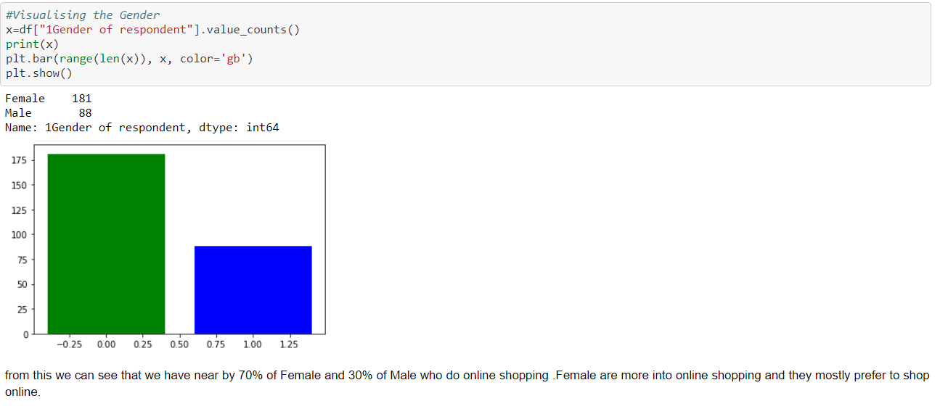
Visualizing the data

Slide 10
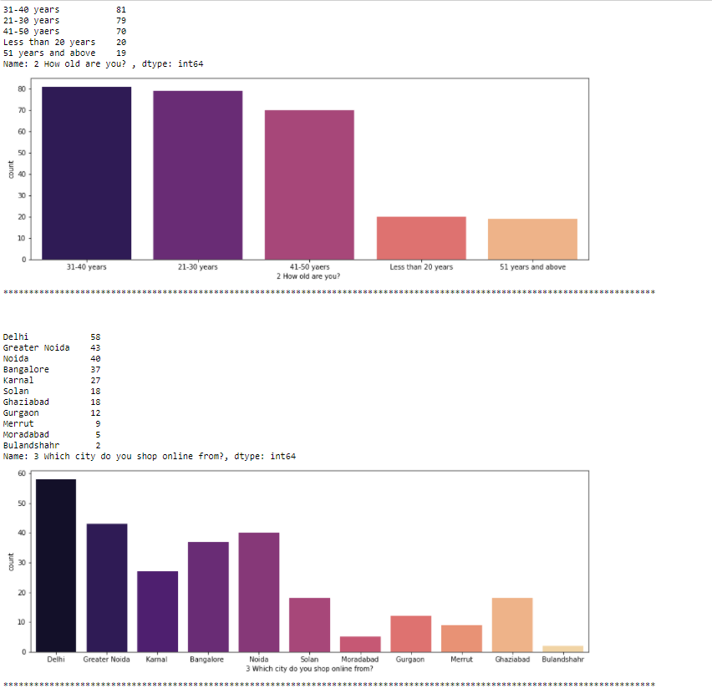
Part 1 – Customer Info

Slide 11
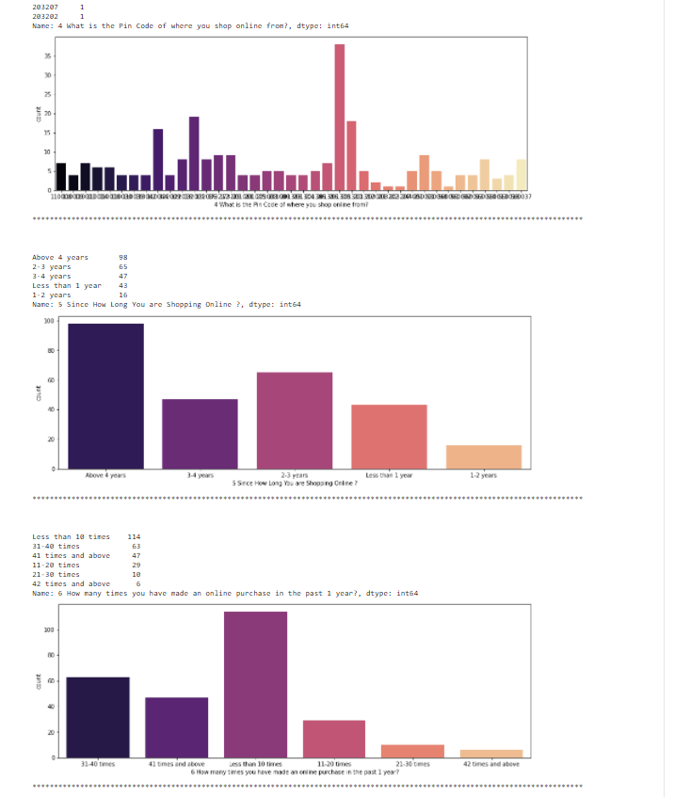

Slide 12
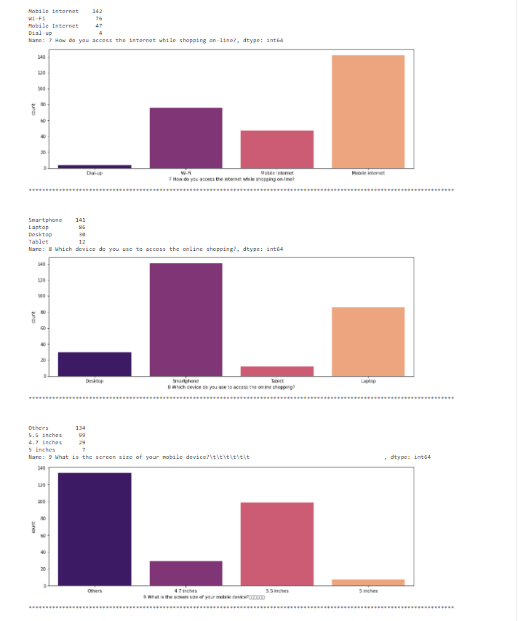

Slide 13
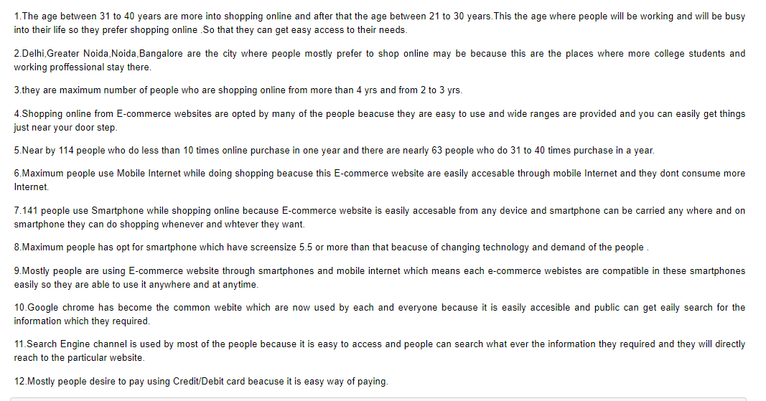
Observations

Slide 14
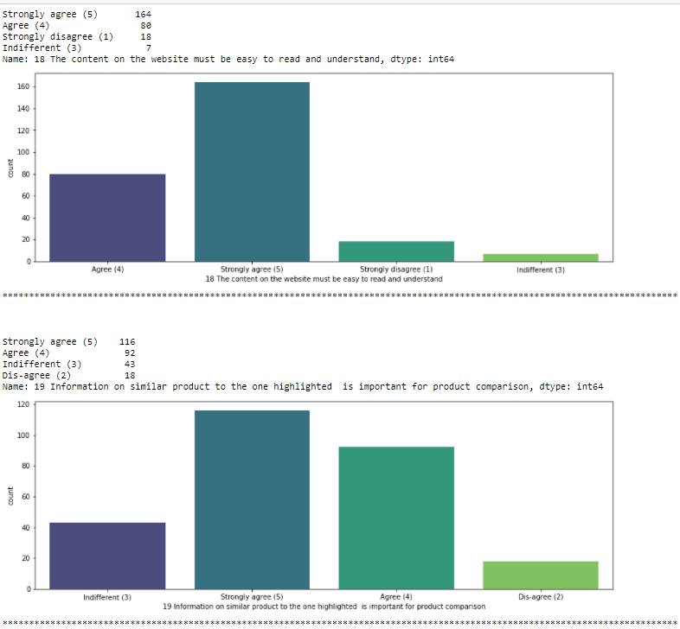
Part 2- Website Info

Slide 15
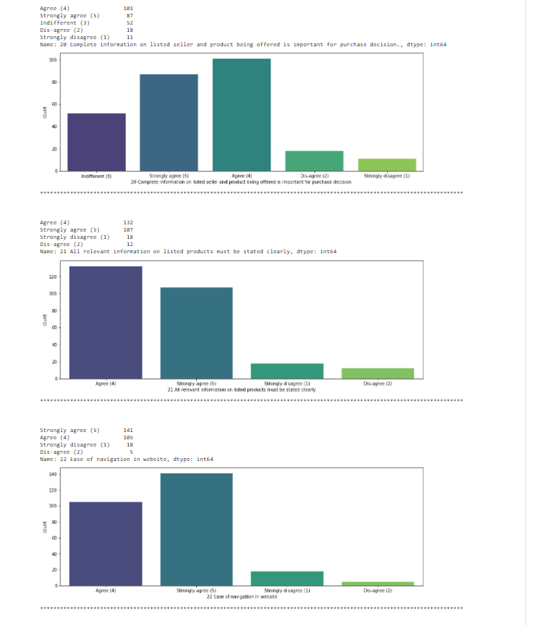

Slide 16
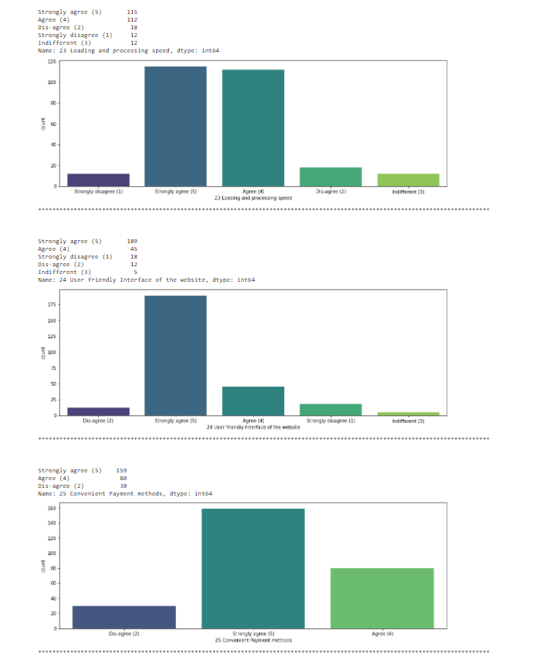

Slide 17
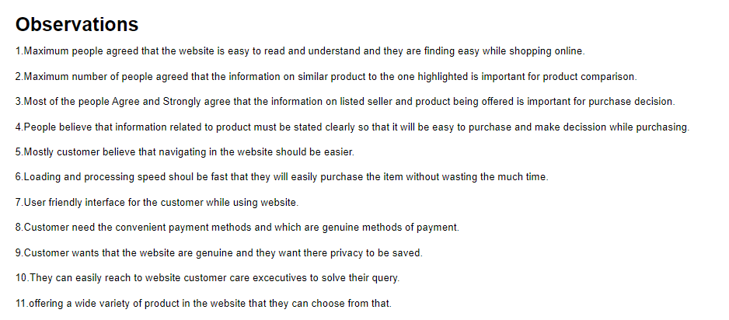
Observations-

Slide 18
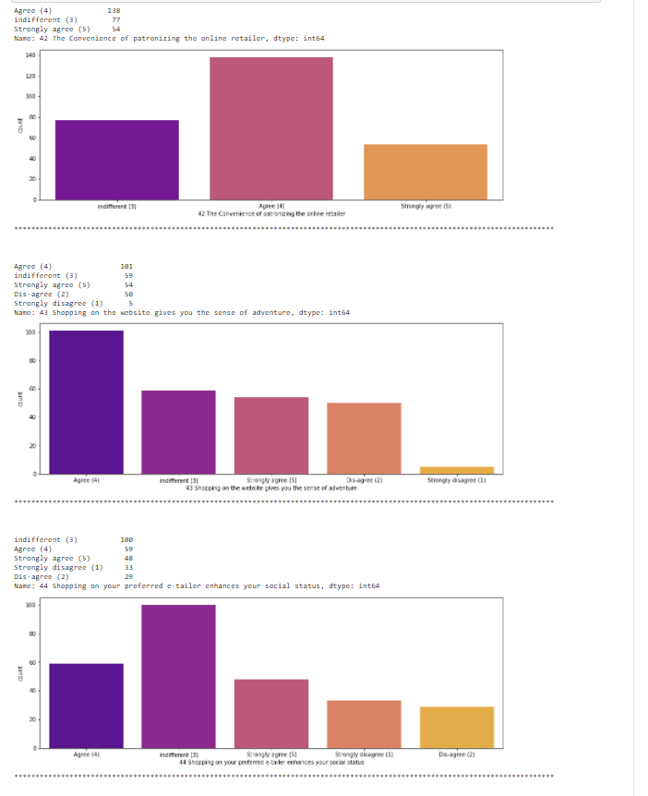
Part 3- Customer Review

Slide 19
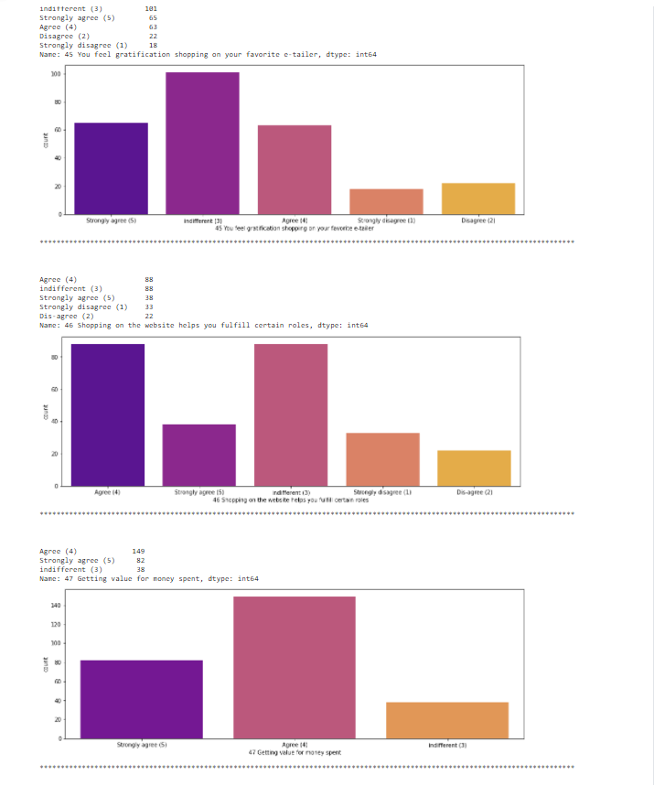

Slide 20
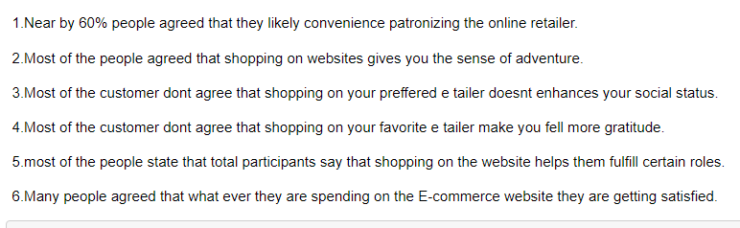
Observations-

Slide 21
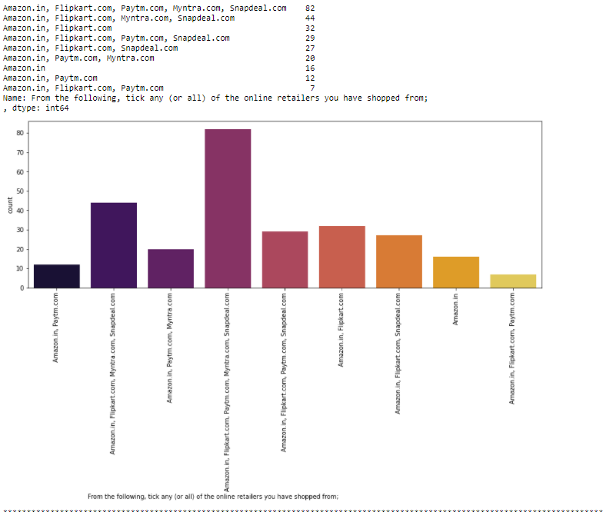
Part 4- Customer Satisfaction

Slide 22
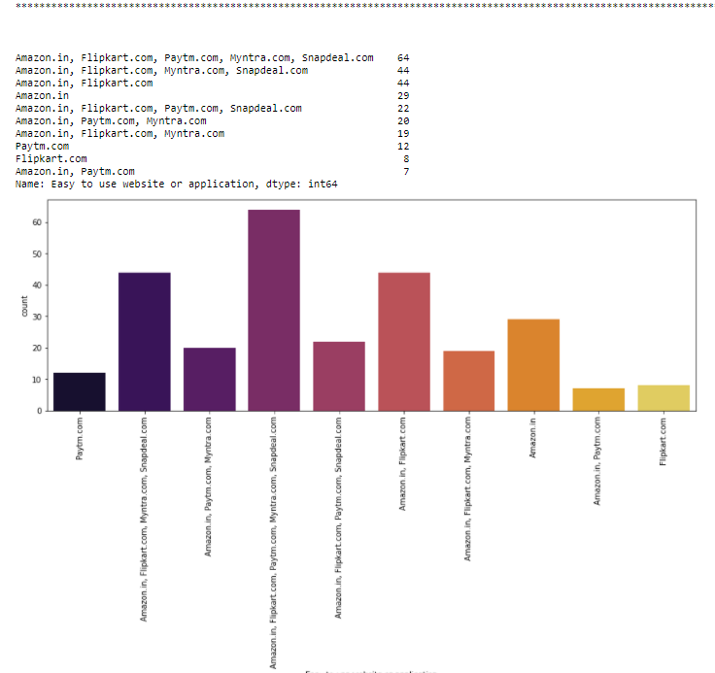

Slide 23
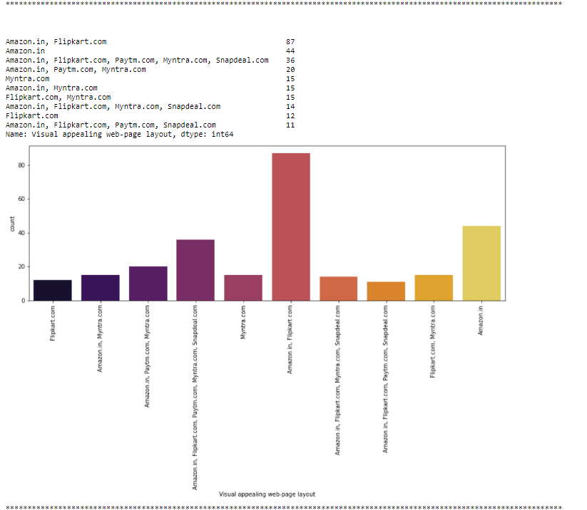

Slide 24
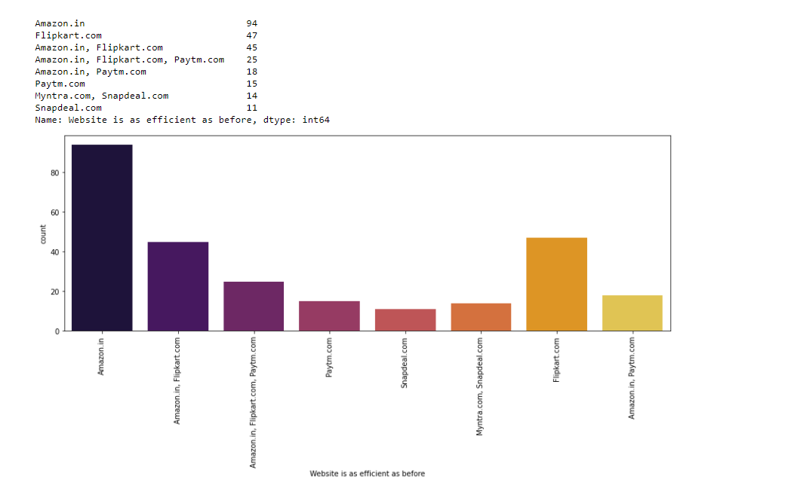

Slide 25
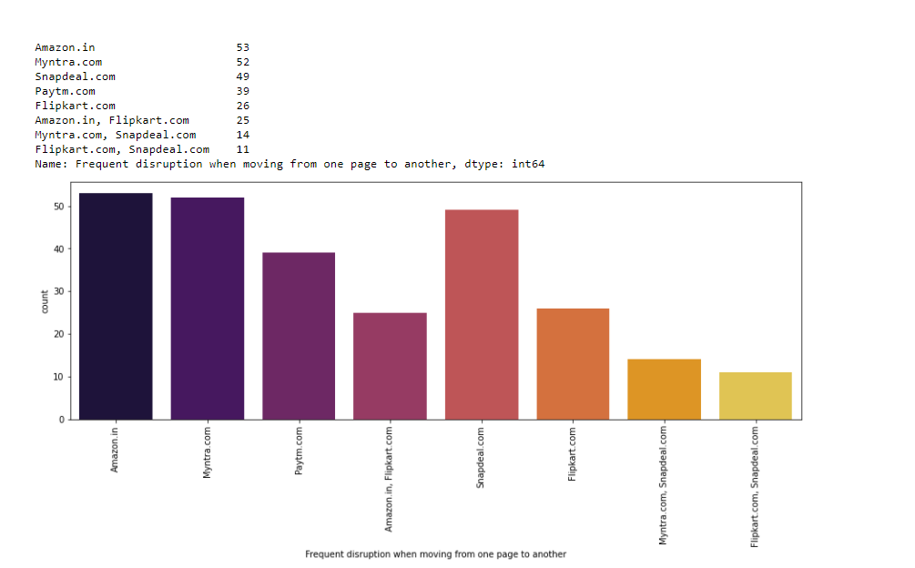

Slide 26
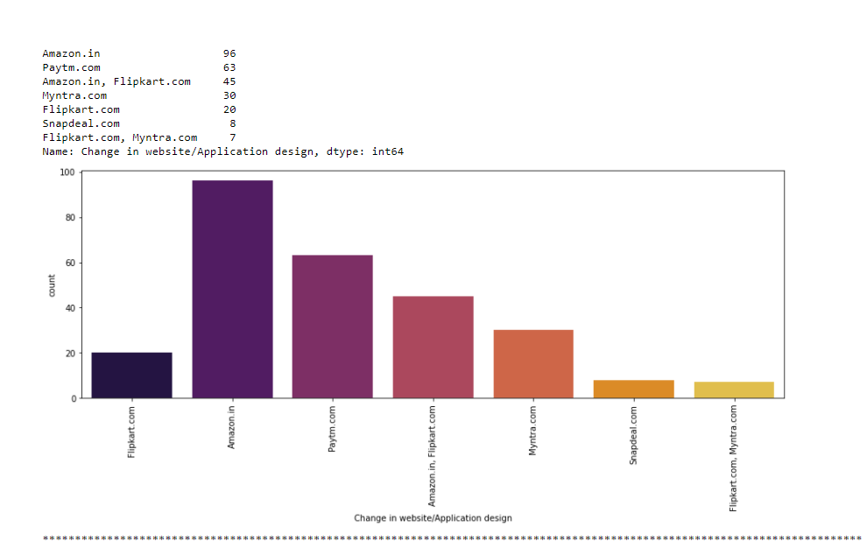

Slide 27
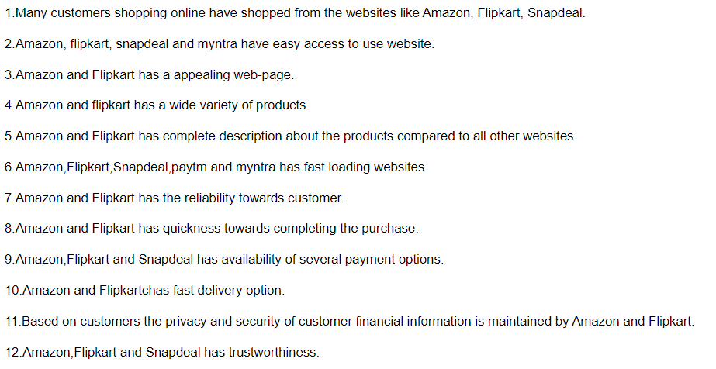
Observations-

Slide 28
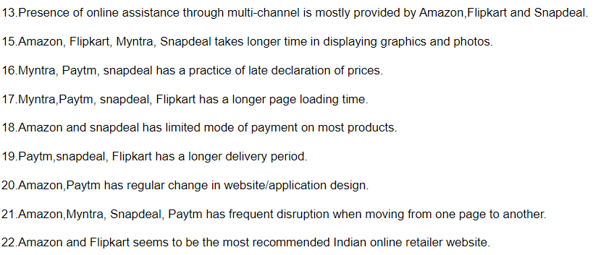

Slide 29
Conclusion
To conclude, having the right customer retention strategy will keep your company grows if you know how to take advantage of it. Your customers will find their way back and continue buying stuff from you. If your customers feel like they are valued, they will become increasingly loyal to your brand.
Customer retention increases your customers' lifetime value and boosts your revenue. It also helps you build amazing relationships with your customers. You aren't just another website or store. They trust you with their money because you give them value in exchange.

Slide 30
Thankyou

