Slide 1
A MUTUAL INFORMATION-BASED MULTIPLE LEVEL
DISCRETIZATION NETWORK INFERENCE FROM TIME-SERIES
GENE EXPRESSION PROFILES
class Information:
self.STUDENT = “CAO TUAN ANH”
self.SUPERVISOR = “PROF. YUNG-KEUN KWON”
### the last execution on 19/11/2021

Slide 2
CONTENT
Introduction
Motivation
Proposed model
Experiments and results
Conclusion and Future works
Notes:
My presentation is divided into 5 parts:
First, Introduction: Overview about network inference in biological system
Second….
My presentation will last about 25 minutes, if you have any questions, please, leave all questions at the end…

Slide 3
INTRODUCTION
https://www.frontiersin.org/journals/cell-and-developmental-biology/articles/10.3389/fcell.2014.00038/full
Gene regulatory networks (GRNs) determine the ensemble of underlying interactions among genes that carries out their expression.
The clarification of GRNs is extensively important to understand the functioning and pathology of organisms and it remains one of the major challenges of systems biology.
While these exist network inference methods have reached some maturity, their performance on real datasets remains far from optimal and calls for the permanent improvement of both inference result as well as computational speed.
Notes:
Gene regulatory networks determine the ensemble of underlying interactions among genes
The clarification of GRNs is extensively important to understand the functioning and pathology of organisms and it remains one of the major challenges of systems biology.
When high throughput technology begins being exploded many methods have been proposed and have reached some maturity, but their performance remain so far from optimal. So, it needed a permanent improvement of both inference result and running time.

Slide 4


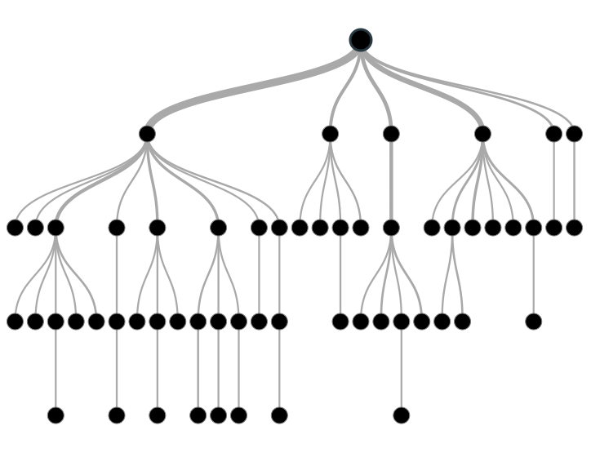



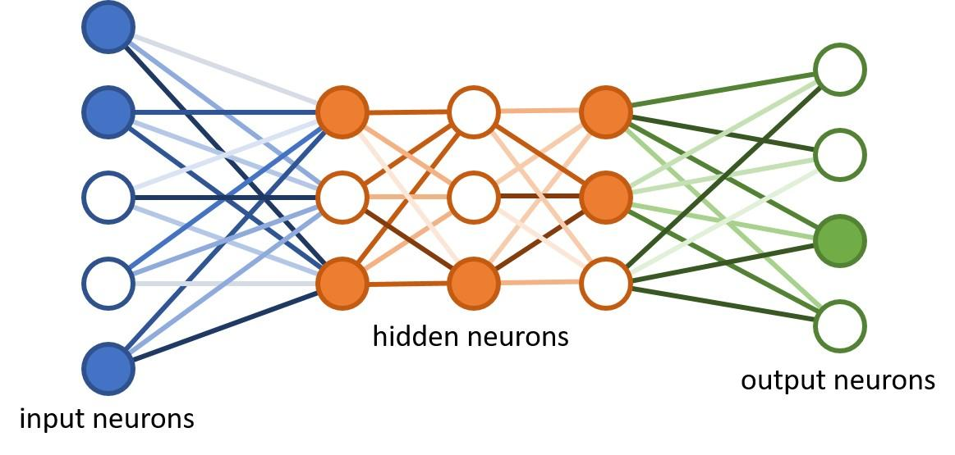
PROBLEM FORMULATION
Prediction network structure
Inference algorithms
Time-series gene expression
 |  |  | . | .
 | 0.5631 | 0.2465 | … | … | 0.6158
 | 0.5778 | 0.0124 | … | … | 0.0915
 | … | … | … | … | …
 | … | … | … | … | …
 | 0.1949 | 0.2306 | … | … | 0.1854
Dynamics: a set of rules
Notes:
Given a two-dimension micro array of real values as an input. This values are observed from real biological experiments. Look at the picture: x-axis are genes, y-axis is time-steps of observation. Example here.
The output of this system is prediction network structure. This mean we try to know which gene or group of genes are regulated by another gene or group of genes. Beside prediction of the network structure. The output also is a set of rules (functions) that explain mechanism of transformation from genes to genes.
To achieve the output many different approaches from tree base methods to AI techniques are applied.

Slide 5





EXIST APPROACHES
Time-series gene expression
Prediction network structure
 |  |  | . | .
 | 0.5631 | 0.2465 | … | … | 0.6158
 | 0.5778 | 0.0124 | … | … | 0.0915
 | … | … | … | … | …
 | … | … | … | … | …
 | 0.1949 | 0.2306 | … | … | 0.1854
* Genie3, tigress, mrnet…
Real valued used methods
Inference algorithms
discretization
 |  |  | . | .
 | 0 | 0 | 0 | 1 | 0
 | 1 | 1 | 1 | 1 | 0
 | 0 | 1 | 1 | 0 | 1
 | 1 | 0 | 0 | 0 | 1
 | 1 | 1 | 1 | 0 | 0
Boolean models
Dynamics: a set of rules
* mibni, gabni…
Notes:
According to processing data type, it can be divided into 2 groups:
Real value used methods: In this group there are some well-known methods such as GENIE3, MRNET, TIGRESS or NARROMI. This approaches uses directly continuous values, so don’t need any representative data methods, so that there is no information loss in this kind of approaches. However, this models costs inference time and are sensitive to data noise.
To speed up the inference process and handling the noise sensitivity, Boolean models are widely used when real valued data are represented by 0 and 1. 0 mean off or inhibition state, 1 denotes on or activation state. Some well-known methods can be mentioned like MIBNI, or GABNI. These models costs less inference time and less sensitive to data noise. But the main drawback is information loss due to simplicity of data representation.

Slide 6
MOTIVATION
01
02
03
Speed up the inference process and be less noise-sensitive of the real-valued use methods.
Reduce information loss of Boolean models.
Enhance not only structural but also dynamics accuracy.
Notes:
To handle all mentioned above problems, a new approach is needed, and this also leads to our method motivation.
First, The new method should speed up…
Second, the new method should overcome information loss in Boolean models
And finally, the method should enhance…

Slide 7
PROPOSED MODEL
A discretization network model
Inference algorithm
Evaluation modules
Notes:
Our proposed model can be described as consisting of 3 stages:
First, we will present the discretization network model
Second, Inference algorithm
And the last is evaluation modules

Slide 8
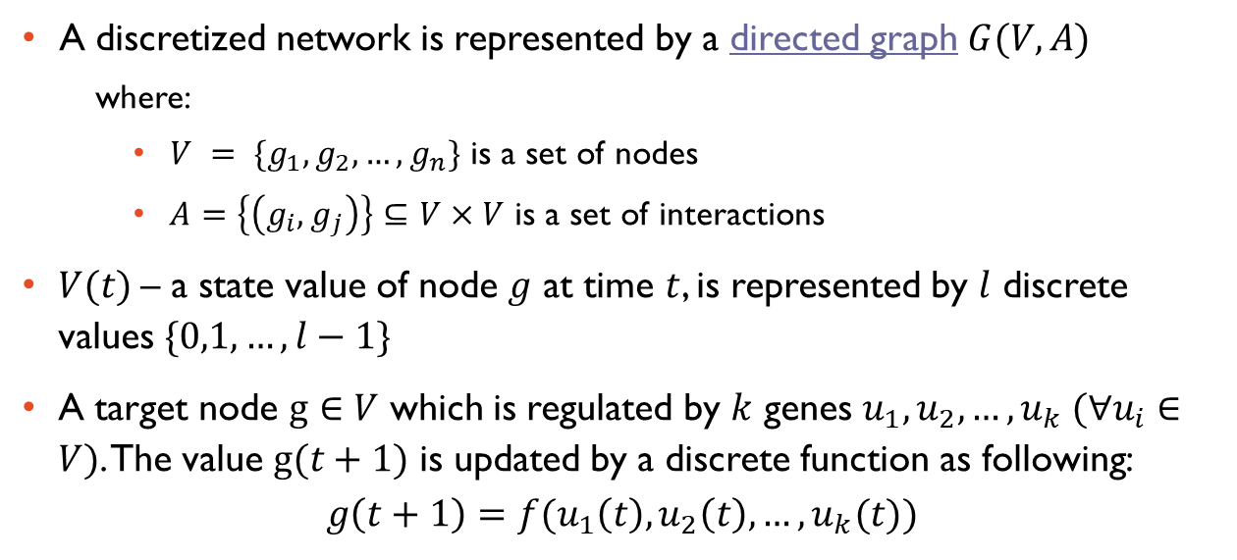










DISCRETIZATION NETWORK MODEL
Notes:
Before going to our model, we have a quick look at discretization network model, some basic concepts:
A discretized network is represented by a directed graph as you see at the picture on the right hand.
We have a set V, that contains all nodes of the network
a set A that is a set of interactions between nodes.
A state value of node g at time t is represented by l discrete values ranging from 0 to l-1
Supposed a target node g which is regulated by k other genes from u1 to uk. So the value node g at time t+1 is updated by a discrete function as showing on the screen.

Slide 9
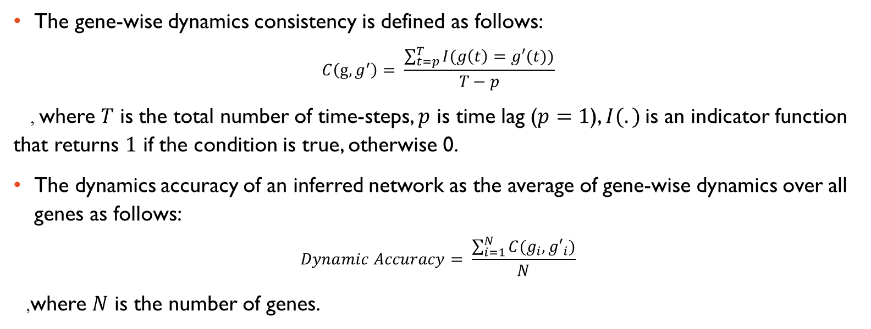
THE DISCRETIZATION NETWORK INFERENCE
Notes:
The inference performance can be evaluated by comparing the trajectory generated by the inferred network and the observed time-series gene expression. Let 𝑣′(𝑡) the predicted value of the gene 𝑣 at time 𝑡 in the inferred discretization network. We define the gene-wise dynamics consistency 𝐶(𝑣, 𝑣′) as the similarity between the discretization trajectories of the observed gene expression 𝑣(𝑡) and the estimated gene expression 𝑣′(𝑡), as follows:

Slide 10
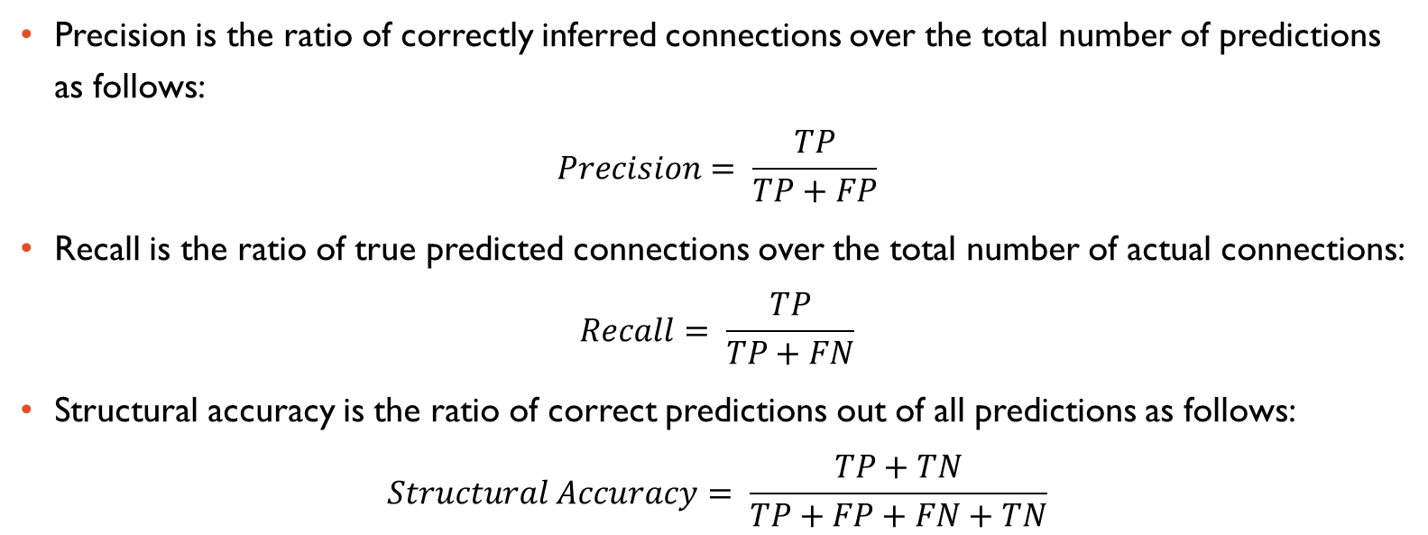
STRUCTURE PERFORMANCE METRICS

Slide 11










METHODOLOGY
Structural accuracy
The input network
The prediction network
 |  |  | . | .
 | 0.5631 | 0.2465 | … | … | 0.6158
 | 0.5778 | 0.0124 | … | … | 0.0915
 | … | … | … | … | …
 | … | … | … | … | …
 | 0.1949 | 0.2306 | … | … | 0.1854
Inference algorithm
Observation values
MIFS
Discretization algorithm
SWAP
Validity index
K-mean
Discretization stage
 |  |  | . | .
 | 1 | 0 | 0 | 1 | 2
 | 1 | 1 | 1 | 2 | 0
 | 0 | 2 | 1 | 0 | 1
 | 1 | 0 | 0 | 0 | 1
 | 1 | 1 | 1 | 2 | 0
Regulatory genes and rules
 |  |  | . | .
 | 0 | 0 | 0 | 1 | 0
 | 1 | 2 | 1 | 1 | 2
 | 0 | 1 | 1 | 0 | 1
 | 2 | 0 | 0 | 2 | 1
 | 1 | 1 | 1 | 0 | 0
Discretized values from the prediction network
Dynamics accuracy
Notes:
The two dimension-micro array of real values as an input observed from the input network(this network is unseen).
This input array is converted into a discretized expression dataset using the K-means discretization algorithm.
K value is determined based on the validity index for each gene. In this study k might equal to 2 or three depending upon distribution of every gene.
The data is then fed into MIFS and SWAP subroutines.
The output is the sets of regulatory genes for genes of the input network. Based on this result, we will reconstruct the network as a prediction network. From this prediction network we also get inferred discretized values.
At the evaluation stage, we compares two network structures to get structural accuracy and for dynamics accuracy by comparing two matrices of discretized values

Slide 12
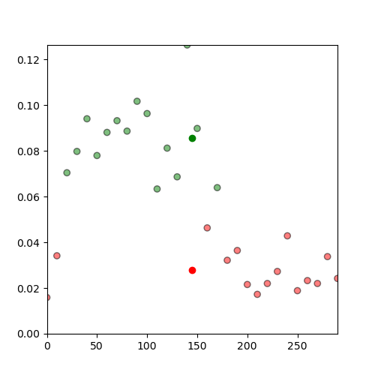
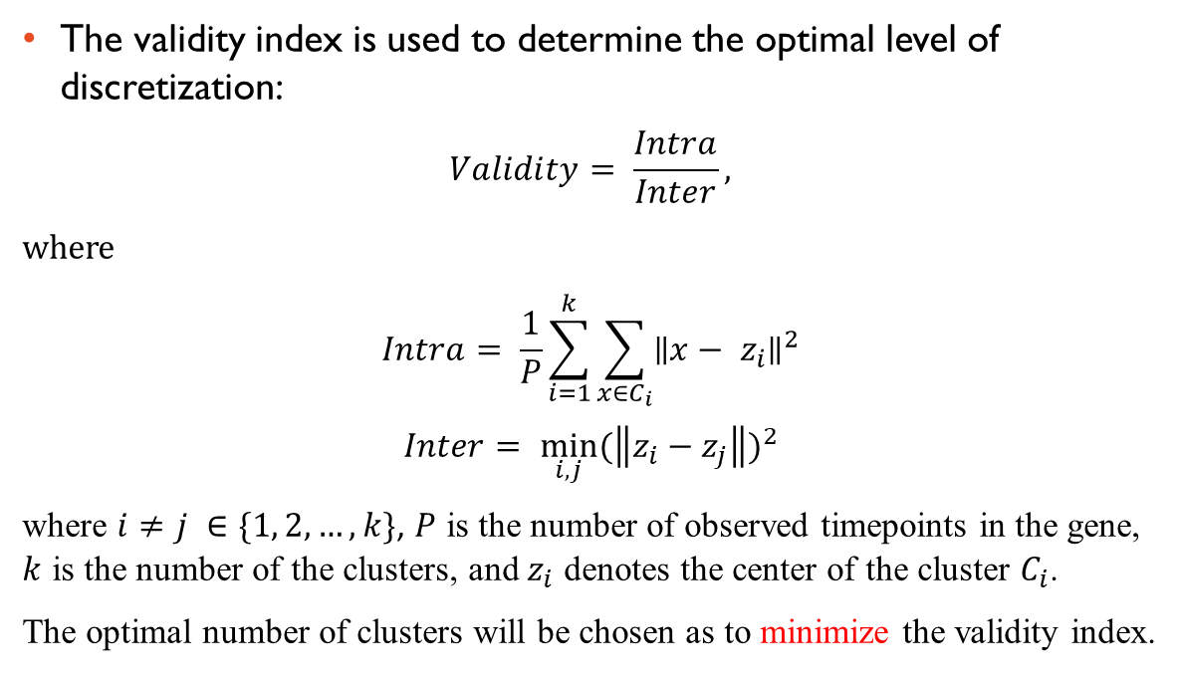
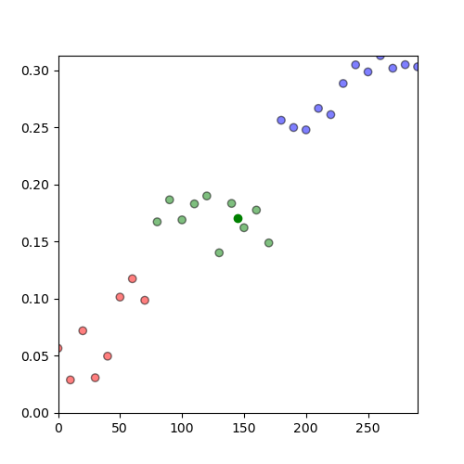
DISCRETIZATION
Boolean discretization
Three level-discretization
Notes:
As mentioned above, in our study, the level discretization of genes in the input network might be two or three. To determine the optimal this value the validity index is applied. And it is a ratio of Intra over Inter value.
The Intra value is an average of distances between points and its centroids in power 2
The Inter value is minimum of distance between two different centroids in power 2
The optimal level discretization of gene will be chosen so that to minimize the validity index

Slide 13
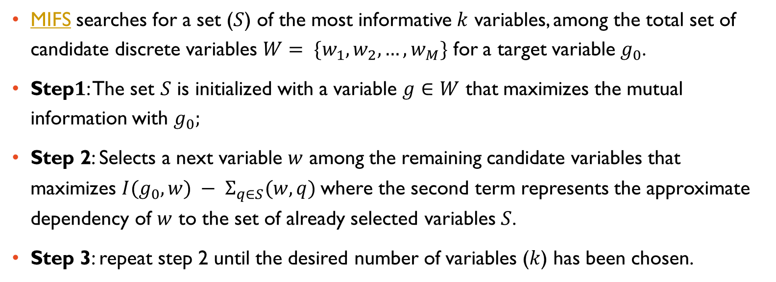
MIFS SUBROUTINE
Notes:
For each target gene g0, MIFS select a set of k potential regulator genes. The value K is a user determined-parameter. In this study, K maximum is 8.
MIFS can be described with 3 steps:
Step1: select a gene that maximizes the mutual information with g0
Next gene that have maximizes this equation, the first one is mutual information between the next candidate and the target gene, and second one is the approximate dependency of the next candidate and the set of already selected candidates
Repeat step 2 until the desired number k candidate has been chosen.

Slide 14
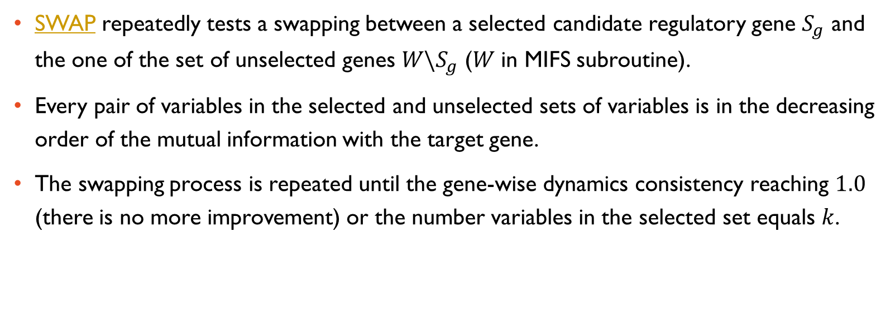
SWAP SUBROUTINE
Notes:
The main drawback of MIFS subroutine is that it does not compute the exact multivariate mutual information, and it often fails to find the optimal set of regulatory variables.
To overcome this problem, we propose a simple iterative SWAP subroutine to improve the dynamics accuracy by swapping the same number of variables between the sets of selected and unselected variables.
The swapping process is repeated until the gene-wise dynamics consistency reaching 1.0 (mean there is no more improvement) or the number of potential candidates in the selected set equals k

Slide 15
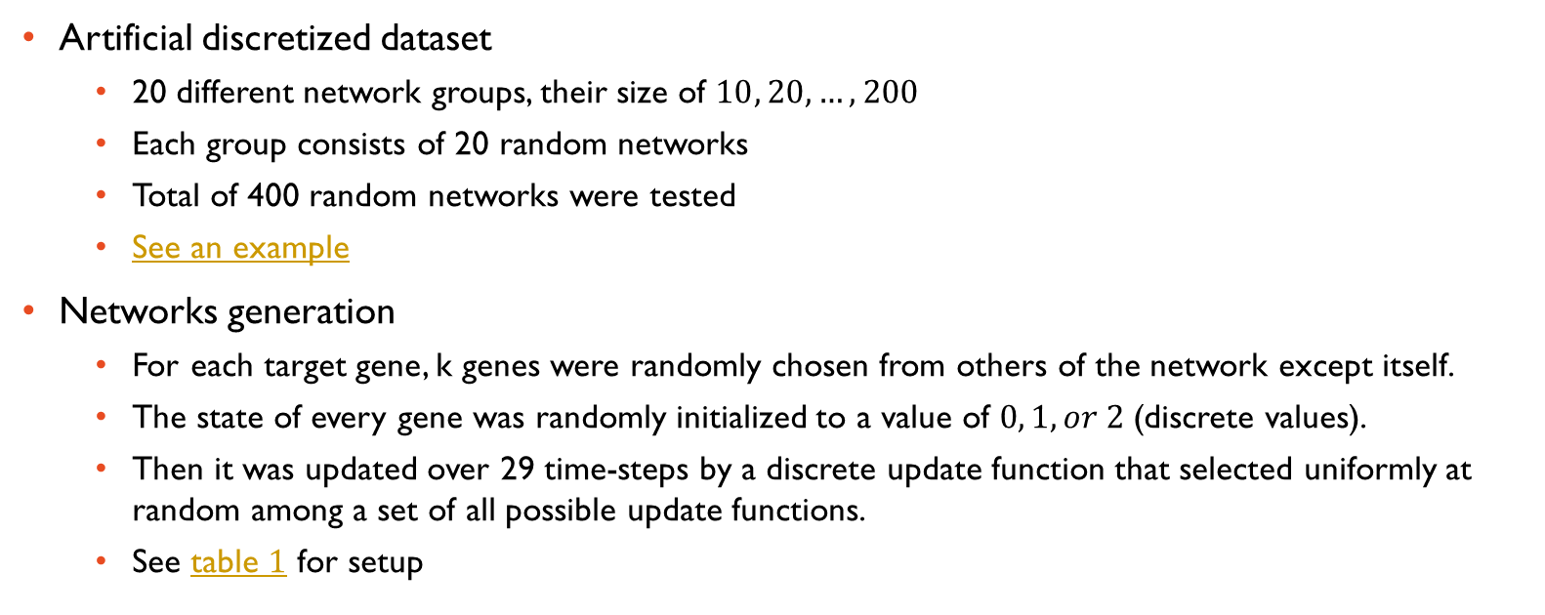
DATASETS

Slide 16
DATASETS
Artificial real-valued dataset
  Consists of 4 network groups of size 50, 100, 200, and 300
  Each group includes 20 different random networks
  Total of 80 networks were tested.
  See an example.
Networks generation
  Real-valued time-series gene expression dataset was generated by using the Hill function.
  The Hill function description.
  The Hill function parameters while generating dataset.

Slide 17
COMPARISON METHODS
DBN selects potential regulators by determining the time points of the initial changes in the expression (up- or down-regulation) of genes.
MICRAT builds an undirected graph representing the associations between genes based on the maximal information coefficient and determines the directions of the edge by using average entropy.
GENIE3 is an approach inferring regulatory networks from expression data using tree-based methods and showed the best performance in the DREAM4 In-silico multifactorial challenge.
MIBNI is our previous study that used Boolean values to infer the network.

Slide 18
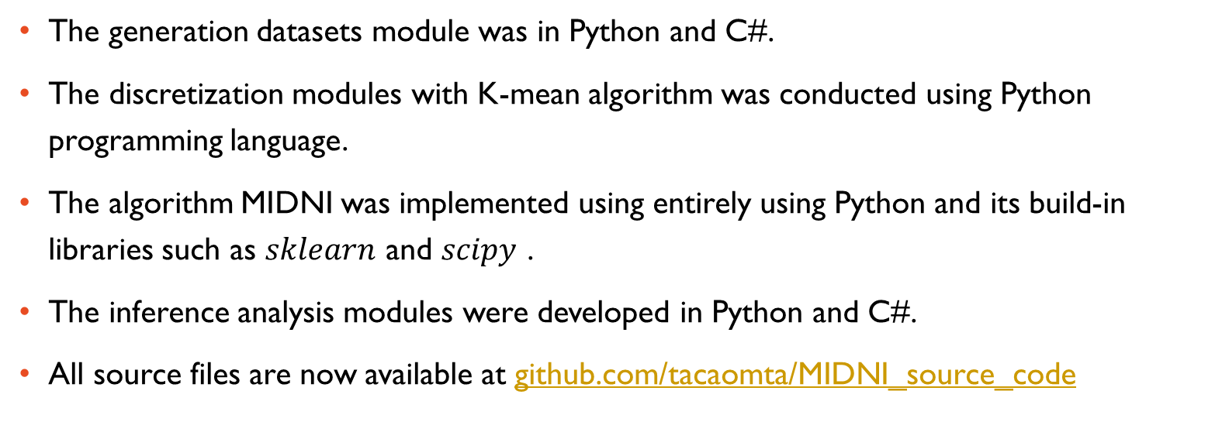
EXPERIMENTS
Notes:
All modules were implemented entirely in Python and C#
And all source code files are now available online at..

Slide 19
RESULTS
Proportion of three-level analysis
Case study : Artificial discretized dataset
Case study : Artificial real-valued dataset
Running time

Slide 20
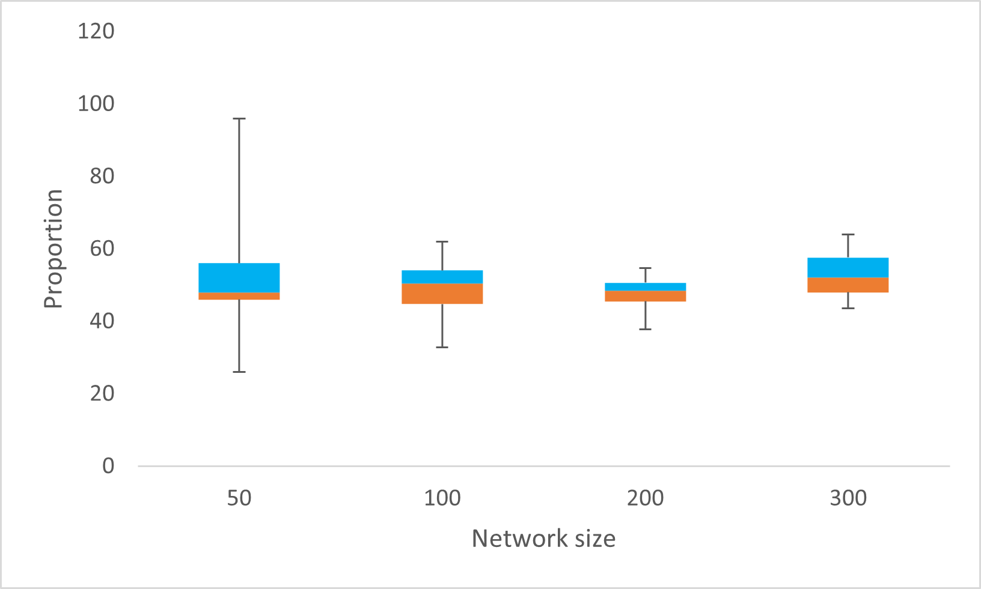
PROPORTION OF THREE-LEVEL ANALYSIS
The proportion of three-level discretized genes in the networks.
Notes:
We first examined the proportion of three-level discretized genes in the networks.
As shown in the figure, the proportions of the binarized and three-level discretized genes are considerably similar to each other.
This implies that three-level discretization is observed as frequently as two-level discretization in our method.

Slide 21
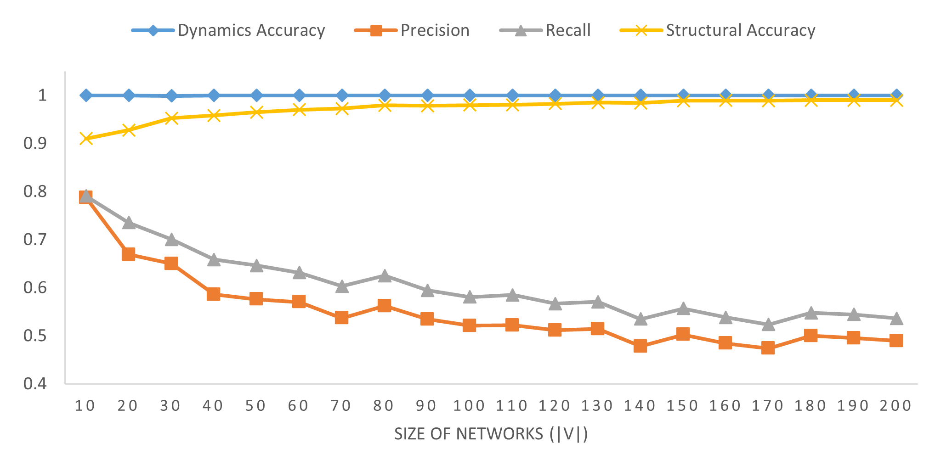
CASE STUDY : ARTIFICIAL DISCRETIZED DATASET
The performance of MIDNI on the artificial discretized dataset. The x-axis means the network size denoted by the number of genes in the network. For each size, the y-axis shows the average value of each performance metric over 20 random networks.
Notes:
This figure shows the method performance on artificial discretized dataset with four evaluation metrics:
X-axis means the network size from 10 to 200, y-axis shows the average of each performance metric.
Look at the figure we can se that:
Dynamics accuracy always reached perfectly at 1.0 within all network sizes
Structural accuracy is over 0.9
Precision and recall decreased while the network size increasing but they are over 0.5 by network size of 200.
In sort, our method show a reliable result on this dataset.

Slide 22
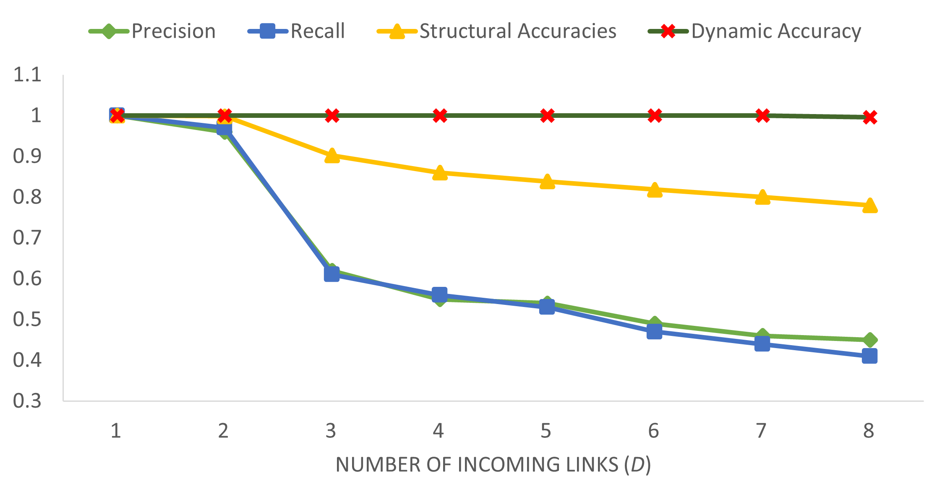
CASE STUDY : ARTIFICIAL DISCRETIZED DATASET
Inference performance according to the number of incoming links (D) in the gold-standard network.
Notes:
We also show the performance on this dataset by grouping the number of regulatory genes for each target gene in the gold-standard network as showing on this slide.
As the number of incoming links increases, the performance metrics decrease because the number of incoming links means the difficulty of inference problems.
As showing in this figure:
dynamics accuracy almost remains stable although in the most difficult case when the number of incoming links = 8.
And precision and recall metrics stop still over 0.4

Slide 23
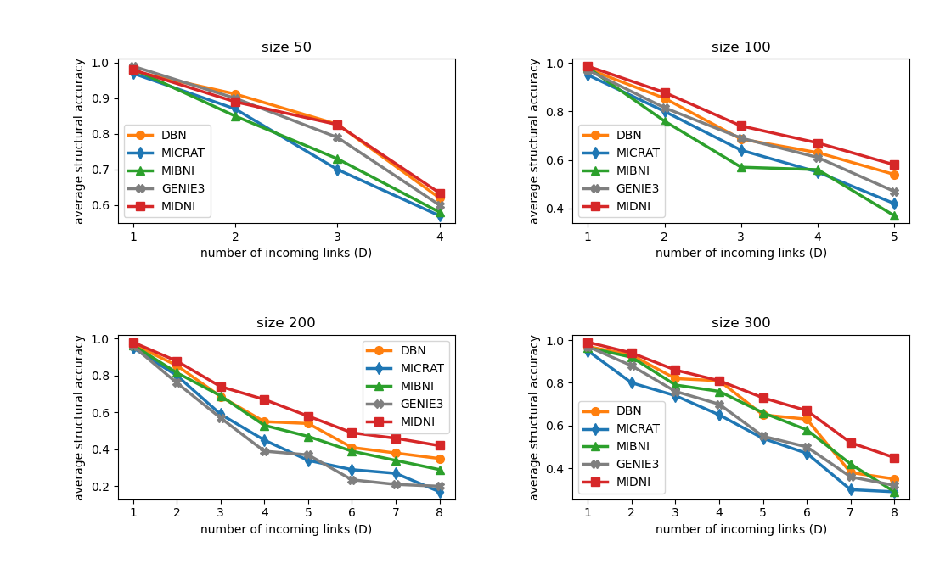
CASE STUDY : ARTIFICIAL REAL-VALUED DATASET
Structural accuracy
Notes:
This slide shows the structural accuracy of method and four comparison methods on 4 group network size: 50, 100, 200 and 300
Overall, MIDNI performance is better than others
Furthermore, on 4 group network sizes when the number of incoming links equals 1 or 2, the performance of all methods is not different to each other, however, when the number of incoming links increases, our method shows much better than others. This implies that the efficiency of our method in a large-scale and difficult-to-solve inference problem.

Slide 24
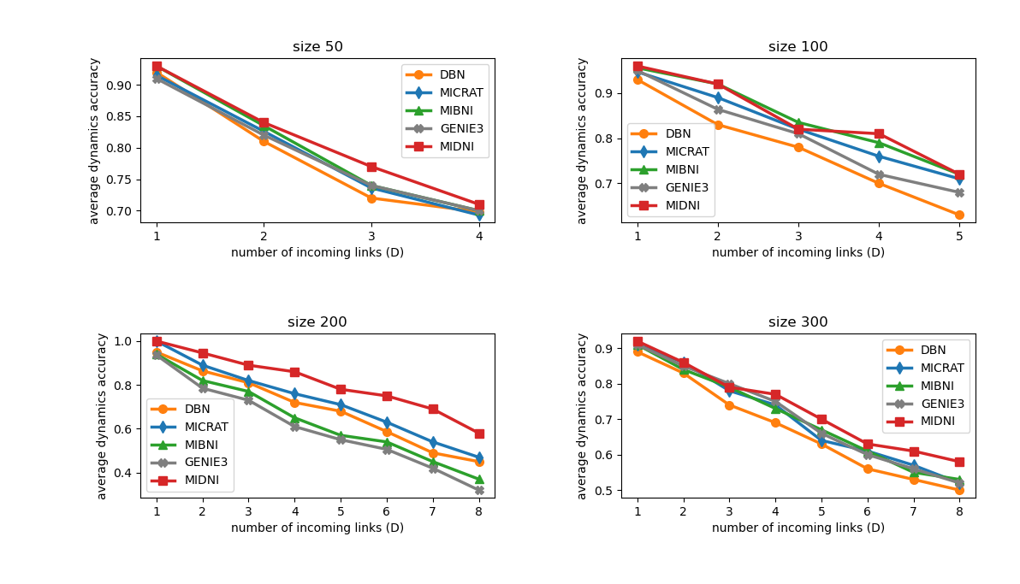
CASE STUDY : ARTIFICIAL REAL-VALUED DATASET
Dynamics accuracy
Notes:
Here shows dynamics accuracy of all methods on groups network size: 50, 100, 200 and 300.
As structural accuracy, the dynamics accuracy of proposed method is over others, especially in larger networks: size 200 and 300.
Taken together, MIDNI outperforms comparison methods in terms of both structural and dynamics accuracies.

Slide 25
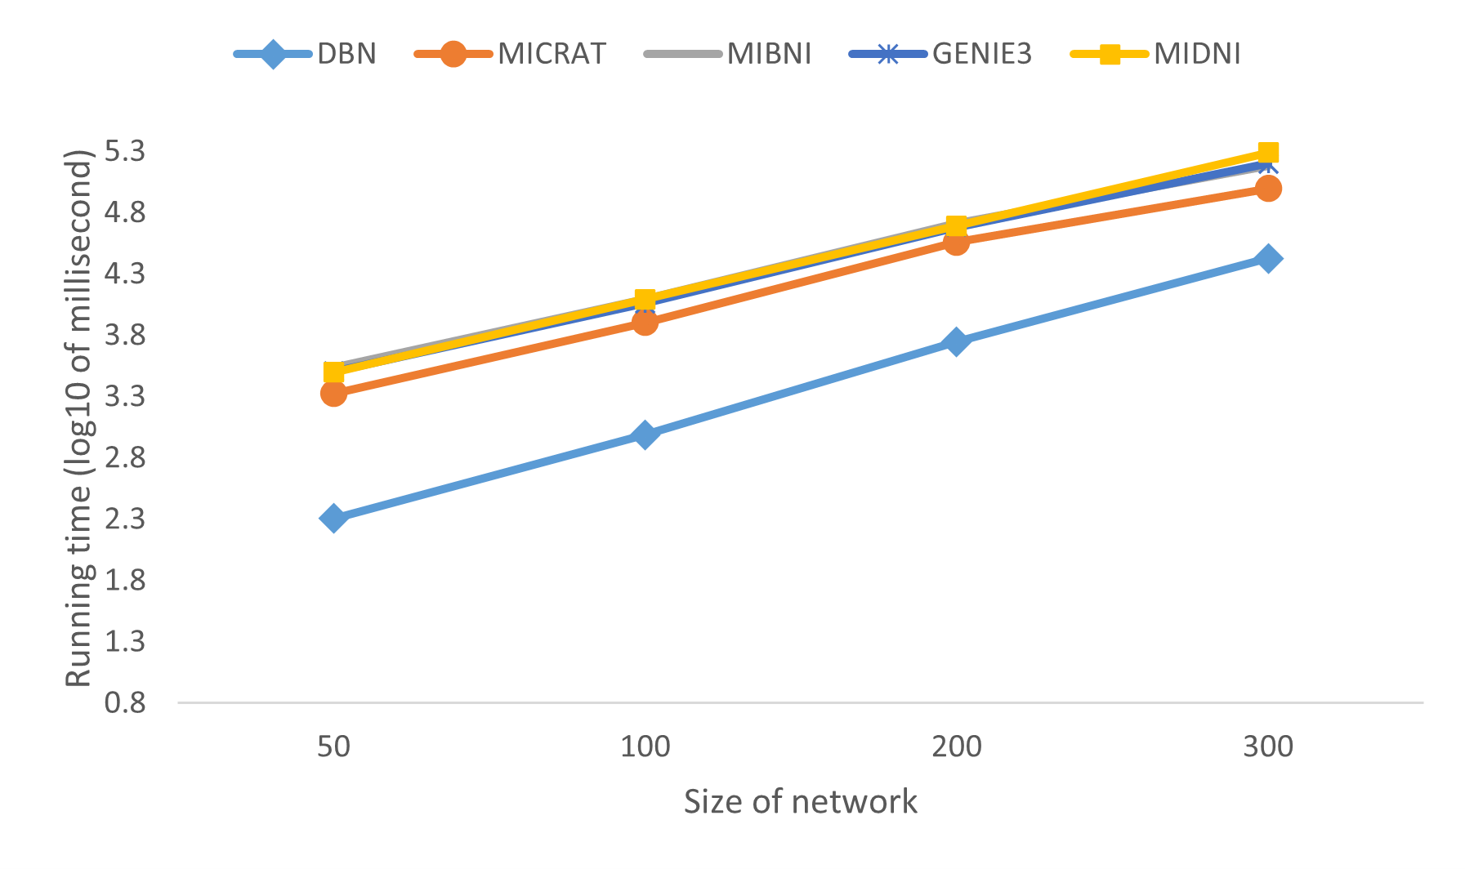
RUNNING TIME
The experiments are conducted on a PC with AMD Ryzen 5 3400G 3.70 GHz CPU and 16 GB RAM
Notes:
We also conducted a comparison with running time among the methods. The result is shown on this figure.
Look at the chart, our method is comparable to others except dbn method.
Briefly, MIDNI is a promising tool for predicting both the structure and the dynamics of a gene regulatory network, especially for large-scale and dense input networks.

Slide 26
CONCLUSION
Infer regulatory network using multiple level of discretization for the input data
Outperform the compared methods in terms of both structural and dynamical accuracies.
Cope with dense and large networks.
Be comparable to others in terms of inference time.
Limitation:
  Using the correlation coefficient to determine the type and direction of interactions.
  MIFS and SWAP subroutines are greedy algorithms.
Notes:
Conclusion:
Our method infer…
It…, especially with dense and large network
And the it is …
The finally, like other methods, proposed method also come out with its limitation:
First, it used…
MIFS and SWAP…

Slide 27
FUTURE WORKS
Develop a new subroutine that can adapt to multimodal problem where there are a lot of optimal solutions.
Apply other metric to determine the interaction direction of genes during the inference instead of correlation coefficient which is relatively simple and inadequate for enhancing the accuracy.
Speed up the inference process by applying optimized search algorithms or parallel computation techniques.
Conduct an experiment of data representation by using other algorithms to compare with K-mean.
Try to infer the network with other kind of data like the steady state (in this study using only time-series) and combine with prior knowledge data to improve the inference accuracy.
Notes:
This brings us to the end of my presentation, thanks

Slide 28

THANK YOU FOR LISTENING

Slide 29

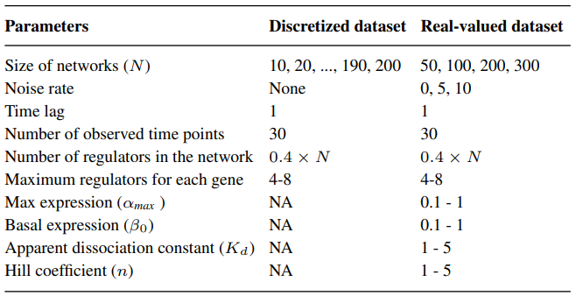
THE SETUP IN GENERATION OF DATASETS

Slide 30
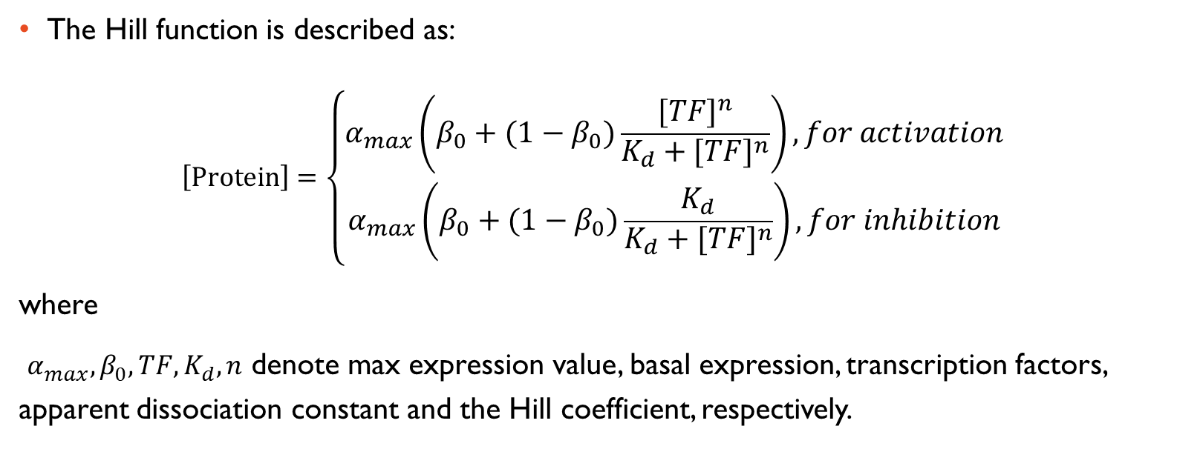
THE HILL FUNCTION

Slide 31
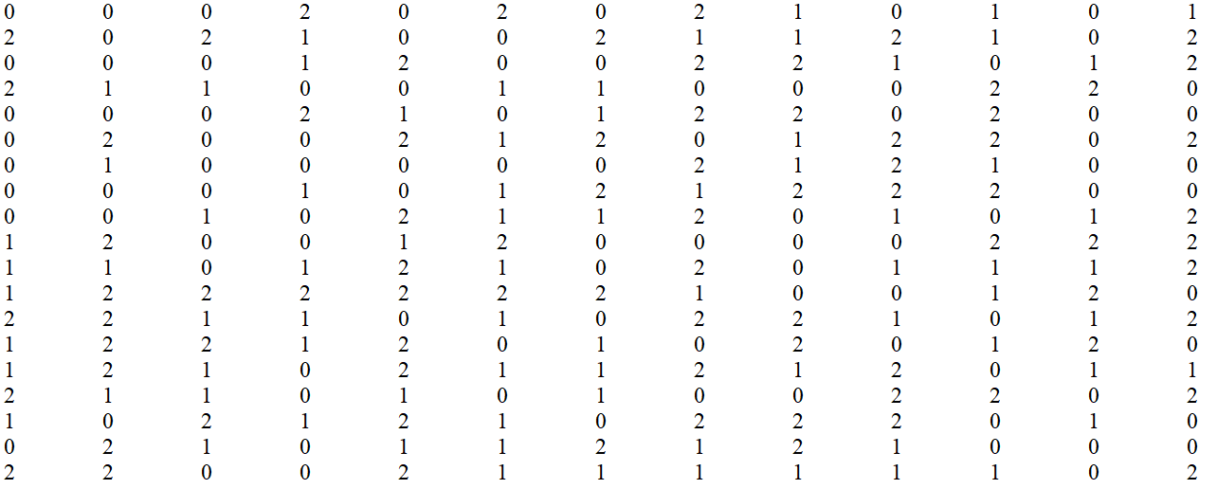
ARTIFICIAL DISCRETIZED DATASET EXAMPLE

Slide 32
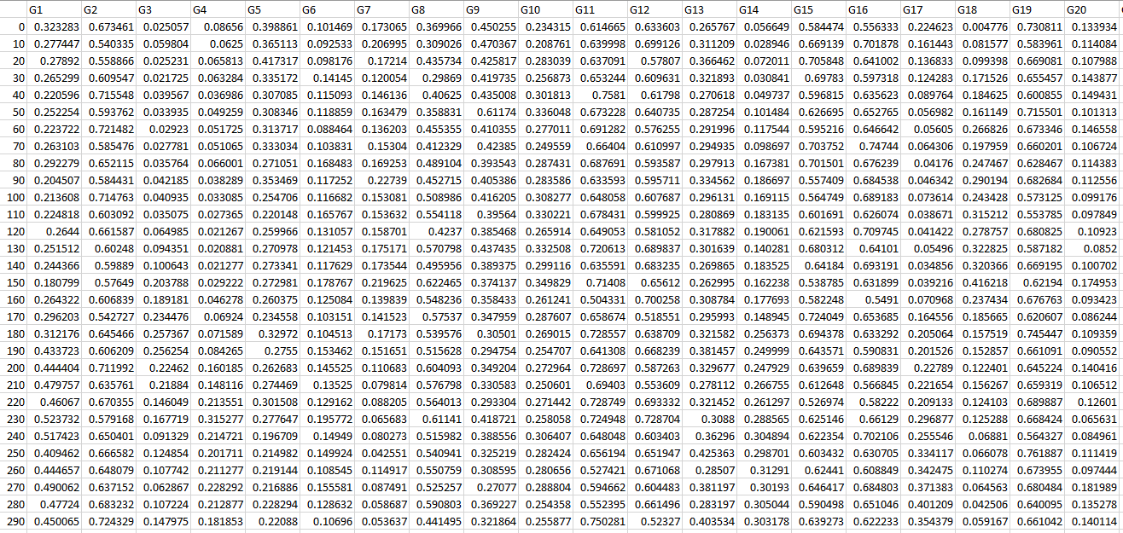
ARTIFICIAL REAL-VALUED DATASET EXAMPLE

Slide 33
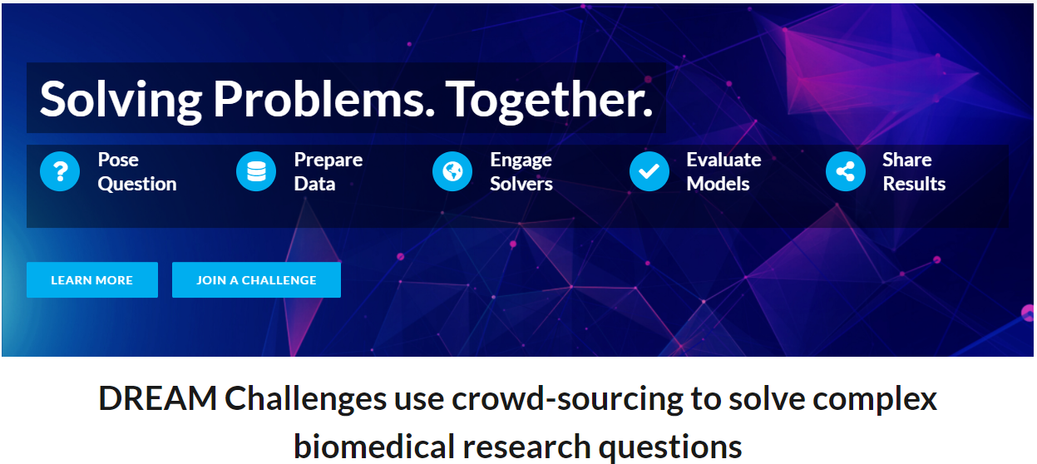
DREAM CHALLENGE WEBSITE

Slide 34
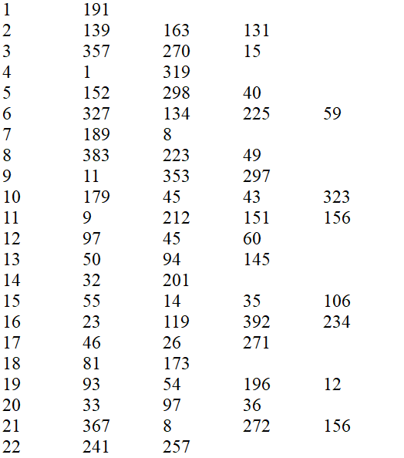
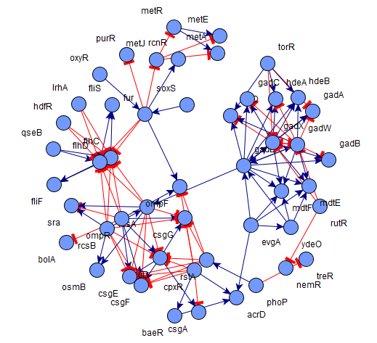
EXAMPLE OF AN OUTPUT

Slide 35
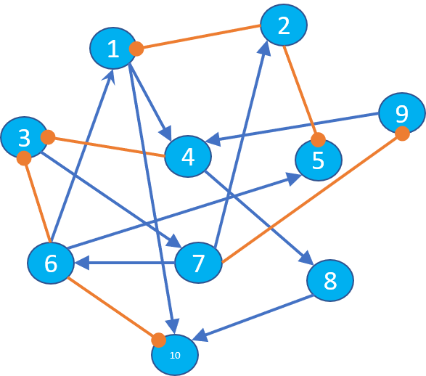
EXAMPLE OF DIRECTED GRAPH

Slide 36
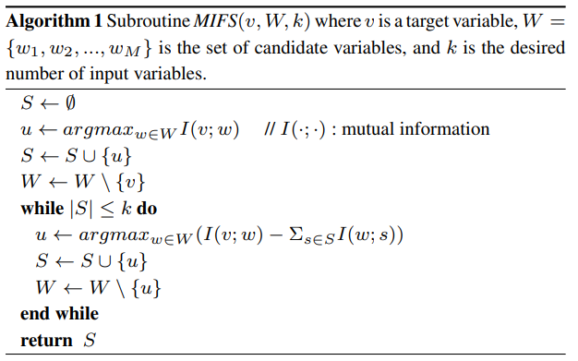
MIFS SUBROUTINE

Slide 37
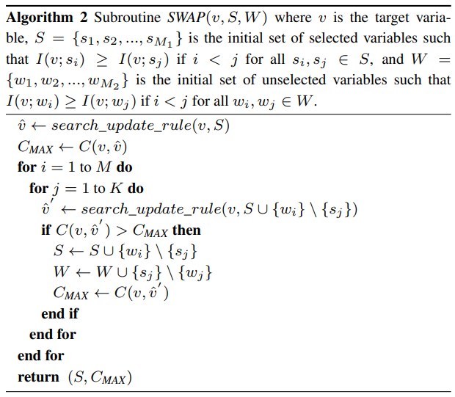
SWAP SUBROUTINE

Slide 38










METHODOLOGY
Structure accuracy
The input network
The prediction network
 |  |  | . | .
Inference algorithm
 |  |  | . | .
Observation values
 |  |  | . | .
MIFS
Discretization algorithm
SWAP
Validity index
K-mean
Discretization stage
 |  |  | . | .
 |  |  | . | .
 |  |  | . | .
 |  |  | . | .
Regulatory genes and rules
 |  |  | . | .
 | 0 | 2 | 0 | 1 | 0
 | 2 | 1 | 0 | 2 | 0
 | 0 | 2 | 1 | 0 | 1
 | 2 | 0 | 2 | 0 | 2
 | 1 | 1 | 1 | 2 | 0
 |  |  | . | .
 | 0 | 2 | 0 | 1 | 0
 | 2 | 1 | 1 | 2 | 0
 | 0 | 2 | 1 | 0 | 1
 | 1 | 0 | 2 | 0 | 2
 | 1 | 1 | 1 | 2 | 0
Discretized values from the prediction network
Dynamics accuracy
Notes:
A real-valued time-series gene expression dataset is converted into a discretized expression dataset using the K-means discretization algorithm. K value is determined based on the validity index for each gene. The data is then fed into MIFS and SWAP subroutines. The result is the sets of regulatory genes for genes of the input network. Based on this result, we will reconstruct the network as a predictive network.

