Slide 1
Graph-Fused Multitask
Gene Regulatory Network Inference
Extending the Inferelator with Task-Coupled Regularization
Based on Castro et al. 2019 · Miraldi et al. 2019

Slide 2

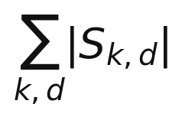
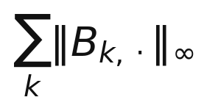
Castro et al. 2019 — Multi-Study Inference
ℓ₁/ℓ₁ on S — Dataset-Specific
ℓ₁/ℓ∞ on B — Conserved Component
— Element-wise sparsity on S
— Each dataset selects its own unique edges
— Captures condition-specific interactions
— S accommodates differences across datasets
— Row-sparse penalty on shared B
— If a TF matters in any one dataset, B retains it for all
— This IS the coupling mechanism
— But coupling is uniform — no weighting by task similarity

Slide 3
The Problem with Castro
1. Tasks are treated as equally similar
2. Rigid B + S decomposition
ℓ₁/ℓ∞ pulls all tasks toward the same edge set with uniform weight.
Tfh and Treg cells are not equally related --> ignoring this structure wastes information.
The shared baseline B is fixed additively. There is no mechanism to
learn how much structure is shared vs. condition-specific from the data.
3. Prior Φ is applied only to S, not B
4. Single dataset assumption
The prior penalty modulates only the sparse perturbation term.
The shared baseline B is unguided, potentially absorbing spurious signal.
Castro defines 'tasks' as separate studies (different expression matrices).
For pseudobulk data — one matrix, multiple cell types — this is not directly applicable.

Slide 4
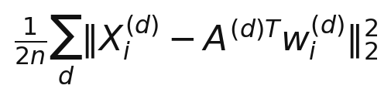
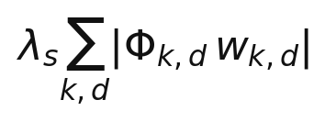
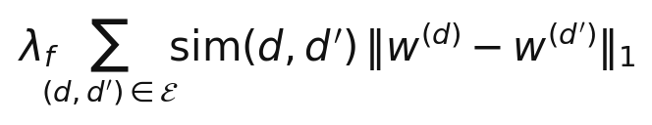
New Objective — Graph-Fused Multitask LASSO
Data Fit
Prior-Weighted LASSO λ_s
Graph Fusion λ_f [NEW]
Standard least-squares per task.
Identical to original Inferelator.
Prior Φ lowers penalty for known edges.
Unchanged from original codebase.
Applied per task.
Pulls related tasks toward shared edges.
Similarity sim(d,d') encodes cell type proximity.
Related tasks share more; distant tasks less.

Slide 5
How This Differs from Castro
Castro et al.
Graph-Fused MT (This Work)
Task definition
Separate expression matrices
(separate studies)
Cell types within one matrix
(pseudobulk columns)
Task coupling
ℓ₁/ℓ∞ on B couples tasks uniformly —
if a TF is selected in any dataset,
it tends to be retained in all.
No weighting by task similarity.
λ_f × sim(d,d') — weighted by
cell type proximity. Related tasks
share more; distant tasks share less.
Network structure
Additive B + S decomposition
(shared baseline + sparse deviation)
Single W per task, coupled
via graph fusion penalty
Prior Φ
Applied to S only
(sparse deviation term)
Applied to all W^(d)
(every task, full weight matrix)
Solver
Closed-form / GLMNet
ADMM — per-gene, tasks coupled
within each gene's subproblem
Output
One consensus + per-study S
Per-task network + consensus
averaged across tasks

Slide 6
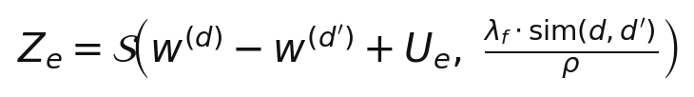

ADMM Solver — Per-Gene, Tasks Coupled
Key insight: the fusion penalty is separable per target gene — tasks are coupled within each gene's ADMM subproblem, not across genes. Per-gene parallelism (Threads.@threads) is fully preserved.
①
W-update
②
Z-update
③
U-update
Per-task weighted LASSO
Fusion proximal operator
Dual variable update
Augmented response/predictor passed to GLMNet.
Identical to original for tasks with no fusion neighbors.
Soft thresholding on pairwise task differences.
Threshold weighted by sim(d,d') — similar tasks,
stronger pull.
Standard ADMM dual ascent step.
No solver required — pure arithmetic.

Slide 7
Package Structure — What Changed vs Unchanged
UNCHANGED
NEW FILES
geneExpression.jl — Data module
multitaskData.jl — MultitaskExpressionData, MultitaskGrnData, MultitaskBuildGrn
mergeDegenerateTFs.jl — MergeDegenerate
networkIO.jl — I/O utilities
taskSimilarity.jl — buildSimilarityFrom{Metadata,Expression,Ontology}
dataUtils.jl — Data utilities
admm.jl — admm_fused_lasso, admmWarmStart
utilsGRN.jl — firstNByGroup
prepareGRN.jl — preparePredictorMat!, preparePenaltyMatrix!
prepareMultitask.jl — splitByTask!, calculateTFAPerTask!, MT prepare loops
buildGRN.jl — chooseLambda!, rankEdges!
combineGRN.jl — combineGRNs
buildMultitask.jl — chooseLambdaMT!, rankEdgesMT!, buildConsensus!
combineGRN2.jl — combineGRNS2
main.jl — runMultitaskInferelator()
Metric.jl / calcPRinfTRNs.jl — evaluation

Slide 8
Caveats & What to Watch Out For
Per-task sample size
Circular similarity
Splitting by cell type reduces samples per task. LASSO with hundreds of TF predictors on 10–20 pseudobulk samples is aggressive. The fusion penalty helps regularize but validate on simulated data first.
Using expression data to build the task graph AND to fit the model is circular. Prefer metadata or ontology sources. If expression must be used, restrict to held-out housekeeping genes.
Two lambda parameters
ADMM convergence cost
λ_s and λ_f must be tuned jointly. bStARS instability can guide λ_s but λ_f has no principled selection criterion yet. Start with λ_f = 0.1 and validate on gold standard.
ADMM runs inside the bStARS subsample loop — O(totSS × totGenes × ADMM_iters) total. With 80 subsamples and 40 lambdas this is significantly more expensive than the original GLMNet calls.

Slide 9
Summary
→
Castro couples tasks symmetrically — all pairs treated as equally similar
→
Graph-fused multitask LASSO couples tasks proportional to biological similarity
→
Fusion penalty is separable per gene — per-gene parallelism preserved
→
ADMM solver replaces GLMNet inside bStARS loop — per task GLMNet still used in W-update
→
All original modules unchanged — new functionality is purely additive
→
Validate on simulated data with known GRN before applying to real data

