Slide 1
Lambda Optimization Strategy
Graph-Fused Multitask Inferelator
Three options: Fixed Ratio | EBIC Grid | 2D bStARS
Elastic Net Extension

Slide 2
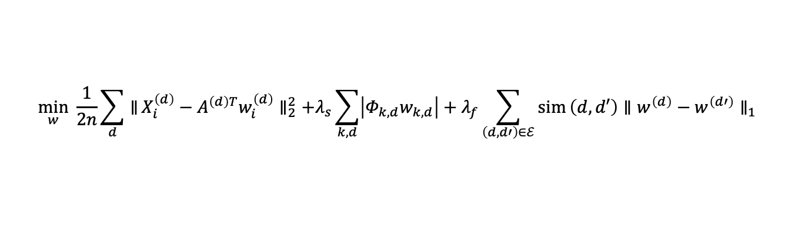



The Two-Lambda Problem
$$\min_{w} \frac{1}{2n}\sum_{d}^{​}{∥}X_{i}^{\left(d\right)}−A^{\left(d\right)T}w_{i}^{\left(d\right)}∥_{2}^{2}+λ_{s}\sum_{k,d}^{​}{\left|Φ_{k,d}w_{k,d}\right|}+λ_{f}\sum_{\left(d,d′\right)∈ℰ}^{​}{sim}\left(d,d′\right)∥w^{\left(d\right)}−w^{\left(d′\right)}∥_{1}$$
$λ_{s}$ — Sparsity
$λ_{f}$— Fusion
— Controls how sparse each task network is
— Controls strength of cross-task coupling
— Prior lowers penalty for known edges
— Higher $λ_{f}$means tasks share more structure
— bStARS selects this in single-task setting
— No bStARS analogue exists natively
— Status: SOLVED by bStARS
— Status: THE PROBLEM TO SOLVE
Key challenge: the two parameters are not independent — optimal $λ_{s}$ shifts as $λ_{s}$ changes. All three strategies account for this.

Slide 3



Option 1 — Fixed Ratio
$$λ_{f}=α×λ_{s} α∈\left[0,1\right] \text{user}\text{−}\text{defined}$$
How it works
Choosing alpha
1. bStARS warm start finds L_s search range
alpha = 0
No fusion — independent LASSO
2. Set $λ_{s}$= alpha x $λ_{f}$ at every grid point
alpha = 0.1-0.3
Light coupling, heterogeneous tasks
3. ADMM runs with both penalties coupled
alpha = 0.5-1.0
Strong coupling, similar tasks
4. bStARS selects $λ_{s}$ at instability target
Recommended
Start at 0.1, validate on gold standard
5. $λ_{f}$ is fully determined by $α$
Pros
Zero added cost over original bStARS
Code: lambdaOpt = :fixed_ratio
Cons
alpha is arbitrary; misspec affects all tasks
Verdict: Fastest. Least principled for $λ_{f}$. Best for initial exploration.

Slide 4
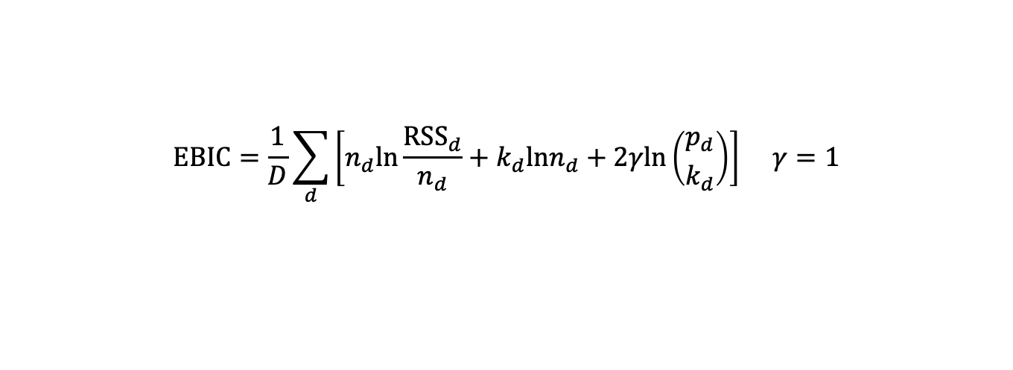

Option 2 — EBIC Grid Search
$$EBIC=\frac{1}{D}\sum_{d}^{​}{\left[n_{d}ln\frac{{RSS}_{d}}{n_{d}}+k_{d}lnn_{d}+2γln\left({p_{d} \atop k_{d}}\right)\right]} γ=1$$
1
Build 2D grid
2
Warm-start ADMM
3
Select min EBIC
Log-scale $λ_{s}$ in [0.01, 10]
= L_f/L_s in [0.05, 1.0]
Enforce (1/2) < L_s/L_f < 1
Typically 10x10 grid
Traverse grid from high to low
(L_s + L_f) decreasing order.
Init each point from previous
converged solution (~80% faster)
Evaluate EBIC at each point
Choose (L_s*, L_f*) = argmin
Use gamma=1 for dense penalty
Code: lambdaOpt = :ebic
Verdict: Balanced cost and rigor. Recommended for production runs. No gold standard required.

Slide 5
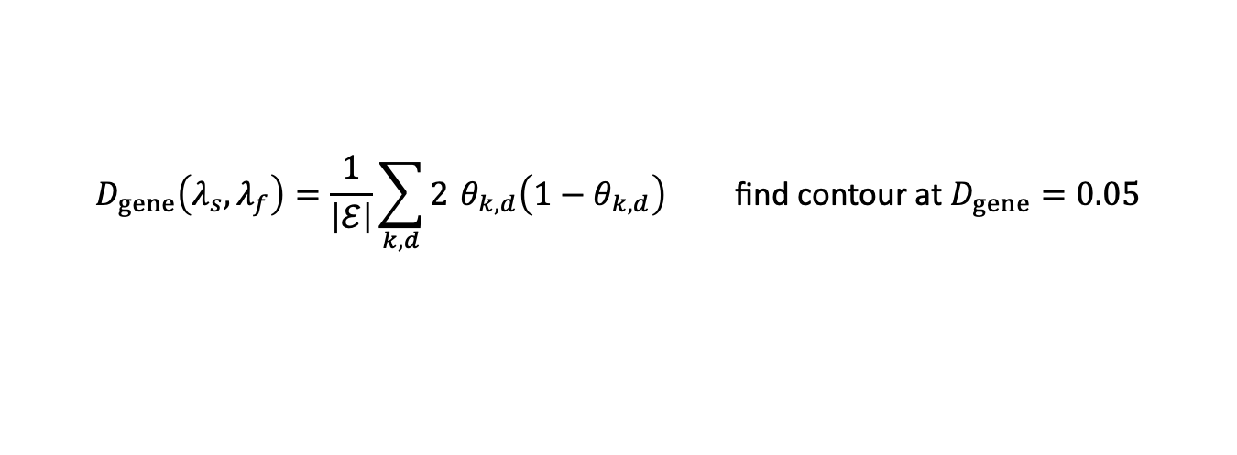
Option 3 — 2D bStARS Instability Surface
$$D_{gene}\left(λ_{s},λ_{f}\right)=\frac{1}{\left|ℰ\right|}\sum_{k,d}^{​}{2} θ_{k,d}\left(1−θ_{k,d}\right) \text{find} \text{contour} \text{at} D_{gene}=0.05$$
Approach
Why This Is Strongest
Compute instability across 2D (L_s, L_f) grid
Extends the exact bStARS criterion used for single-task — no new assumptions added
Identify contour D_gene(L_s,L_f) = 0.05
Stability guarantee applies to BOTH parameters simultaneously
Within contour, apply secondary criterion:
max L_s (most sparse network)
EBIC tiebreaker combines stability with goodness-of-fit
max L_f (most fused network)
Most expensive but most defensible for publication
min EBIC <-- recommended
Coarse-to-fine: 5x5 then 10x10 refinement
Best use: gold-standard benchmarking and final publication validation
Code: lambdaOpt = :bstars_2d
Verdict: Most principled. Highest cost. Use for benchmarking and publication.

Slide 6
Comparison & Recommended Progression
Option 1: Fixed Ratio
Option 2: EBIC Grid
Option 3: 2D bStARS
Cost (relative)
1x
~10-20x
~50-200x
L_f principled?
No — user alpha
Yes — EBIC
Yes — bStARS+EBIC
L_s principled?
Yes — bStARS
Yes — EBIC
Yes — bStARS
Stability guarantee
For L_s only
None
Both parameters
Best use
Exploration
Production
Benchmarking
Recommended:
Step 1 — :fixed_ratio (alpha=0.1) verify pipeline end-to-end
Step 3 — :bstars_2d gold-standard validation only
Step 2 — :ebic production networks

Slide 7
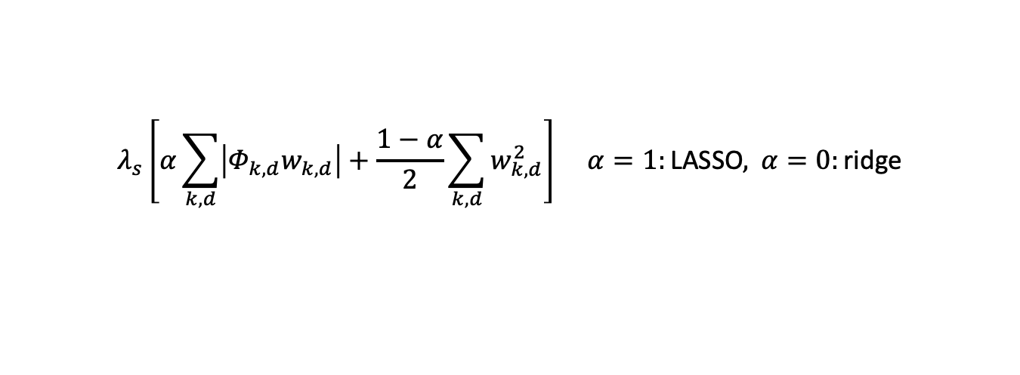
Elastic Net — Why It Belongs Here
$$λ_{s}\left[α\sum_{k,d}^{​}{\left|Φ_{k,d}w_{k,d}\right|}+\frac{1−α}{2}\sum_{k,d}^{​}{w_{k,d}^{2}}\right] α=1:\text{LASSO}, α=0:\text{ridge}$$
Correlated TF activities
Demerged TFs
Pure LASSO arbitrarily picks one TF when two have correlated activities. Elastic net distributes weight across both — more biologically interpretable.
After mergeDegenerateTFs expands meta-TFs back to individuals, those TFs share identical target sets — perfectly correlated by construction. Elastic net handles this gracefully.
Small per-task sample size
ADMM synergy
After splitting by cell type, each task may have only 10-20 pseudobulk samples. L2 regularization stabilizes coefficient estimates in this low-sample regime.
The W-update already adds a quadratic proximity term (rho/2)||w-Z+U||^2. Elastic net L2 integrates cleanly and improves numerical conditioning of the augmented problem.

Slide 8
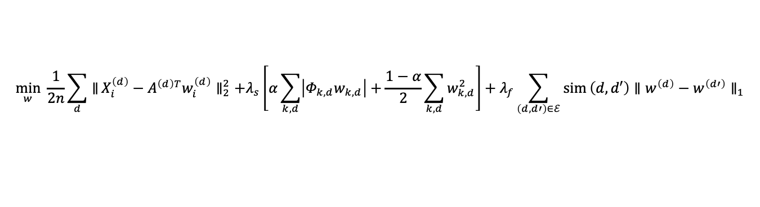
Elastic Net — Full Objective & Implementation
$$\min_{w} \frac{1}{2n}\sum_{d}^{​}{∥}X_{i}^{\left(d\right)}−A^{\left(d\right)T}w_{i}^{\left(d\right)}∥_{2}^{2}+λ_{s}\left[α\sum_{k,d}^{​}{\left|Φ_{k,d}w_{k,d}\right|}+\frac{1−α}{2}\sum_{k,d}^{​}{w_{k,d}^{2}}\right]+λ_{f}\sum_{\left(d,d′\right)∈ℰ}^{​}{sim}\left(d,d′\right)∥w^{\left(d\right)}−w^{\left(d′\right)}∥_{1}$$
Scenario
Recommended elasticNetAlpha
Many correlated TFs, small per-task n
0.5 — balanced L1/L2
Demerged TFs present
0.5 to 0.7 — group correlated predictors
Few correlated TFs, adequate n
0.9 — near-LASSO
Pure LASSO behavior desired
1.0 — original behavior
# In admm.jl W-update — single line change:
lsoln = glmnet(augA, augX, penalty_factor=augPenalty, lambda=[lambda_s], alpha=elasticNetAlpha)
Note: elasticNetAlpha (L1/L2 mix) is distinct from fusionRatio (L_f = fusionRatio x L_s in Option 1). Both are named explicitly in the codebase to avoid confusion.

Slide 9
Summary
Two lambdas, not one:
L_f adds a second parameter that requires joint selection with L_s.
->
Start simple:
Option 1 (fixed ratio, alpha=0.1) costs nothing extra and is sufficient for initial runs.
->
Go principled for production:
Option 2 (EBIC grid) jointly selects both parameters with a well-established criterion.
->
Benchmark with bStARS:
Option 3 (2D bStARS) extends the exact stability criterion to both parameters — use for publication.
->
Elastic net is a free upgrade:
Set elasticNetAlpha=0.5 whenever demerged TFs are present or per-task n is small. No new hyperparameter tuning required.
->
Starting recommendation:
lambdaOpt=:fixed_ratio, fusionRatio=0.1, elasticNetAlpha=0.5
->

