Slide 1
Improving data processing performance with Spark
Utilizing and optimizing Apache Spark to improve the data processing performance of the WifiSpeed

Slide 2


The motivation and problem definition
Motivation of this project is to enhance the data processing performance of WifiSpeed with the use of a distributed data processing tool.
For that purpose, company choses Apache Spark to execute their data processing jobs faster.
Apache Spark is an open-source distributed data processing framework used for big data works.
So, this project adresses the problem of slowness in the data processing of WifiSpeed by using Apache Spark.

Slide 3




What is Apache Spark?
According to the Spark’s document, Apache Spark is a unified analytics engine for large-scale data processing. Spark has API’s in Java, Scala, Python and R. It also has Spark SQL for SQL and structured data processing and MLlib for machine learning.
Spark is widely used in big data industry to process and stream data and perform analytics and machine learning on them.

Slide 4
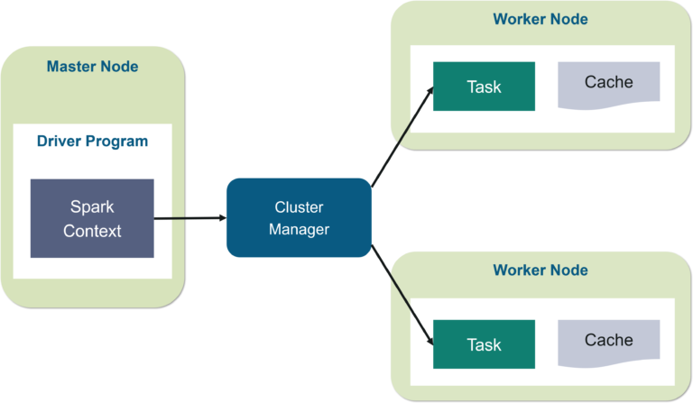
What is Apache Spark?
In memory processing: Spark offers in memory processing for data jobs. This ability of Spark allows data jobs to execute faster.
Parallelism: In addition to in memory processing, Spark also offers parallelism. Basically, Spark divides the input data into partitions and executes them in parallel. This reduces the time it takes to reduce the time.

Slide 5
The Objective of the Project
Objective of this project is to optimize the data processing jobs of WifiSpeed using Apache Spark. It is planned to use methods and techniques that are found by reviewing the related literature. And the suitable ones will be applied after testing.

Slide 6
Methods and Tools Used
Methods used are listed below:
Understanding the Spark UI
Data Filtering (Lazy Loading)
Managing the Number and the Size of Partitions
Caching
Broadcast Join

Slide 7
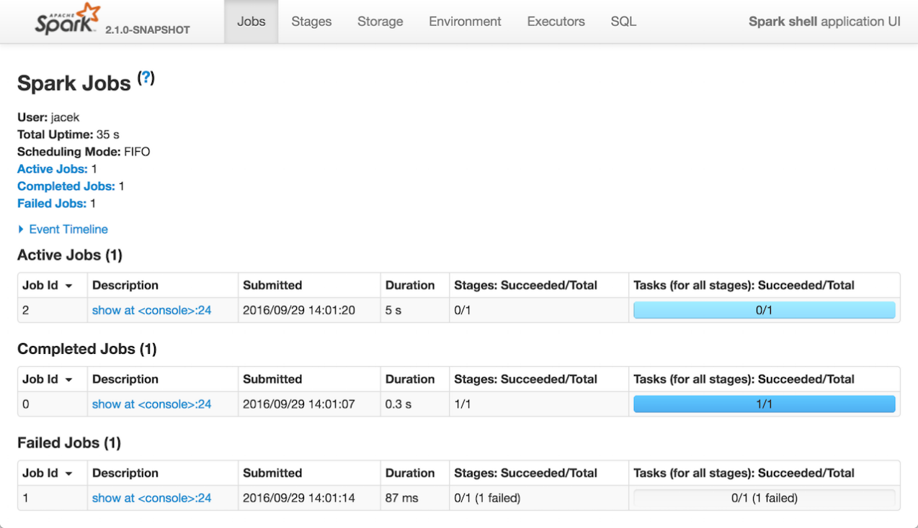
Understanding the Spark UI

Slide 8
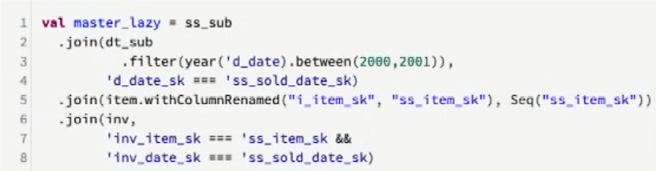
Data Filtering (Lazy Loading)
Common practice while reading a data or processing is loading the whole data. Sometimes this is necessary but there are some cases where we can and should filter the data according to some attribute as this will reduce the time of the job. Below screenshot shows an example of this.

Slide 9
Managing the Number and The Size Of Partitions
Partitions are very important in Spark as Spark operates on partitions by assigning each partition to one core. This core executes the desired operation on the partition.
To use all the cores available in your cluster, it is recommended to have at least the same number of partitions as the number of cores in the cluster.
spark.conf.set(“spark.default.parallelism”, N)
Moreover, it is optimal in most of the cases to use number of partitions as 2-3 times the number of cores in the cluster.

Slide 10
Managing the Number and the Size of Shuffle Partitions
What is shuffle?
Shuffle is a process that occurs automatically when a transformation that requires partitions to Exchange data between them called on a dataset(s).
Shuffles occures because it is not possible to execute some transformations on the partitions of a dataset without exchanging data between those partitions.
The transformations that cause shuffle are named Wide Transformations. Some of these transformations are: reducebyKey(), groupbyKey(), join(), repartition().
Other transformations are called Narrow Transformations. Some of these transformations are: map(), filter(), sample().

Slide 11
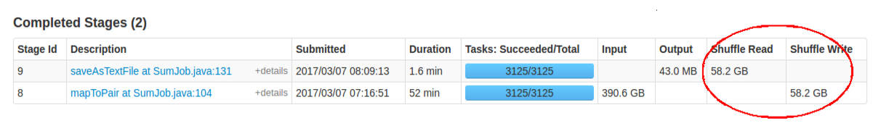
Managing the Number and the Size of Shuffle Partitions
How to optimize shuffle partitions?
Size of each shuffle partitions should be smaller than or equal to 200 MB. If the power of the cores in the cluster is higher than usual, more than 200 MB can be considered. But in this project, shuffle partitions’ size is kept < 200 MB in most of the time.
To keep this size as desired, below equation is used to determine the optimal number of partitions:
Partition Count = Stage’s Shuffle Input Data / Target Size (should be lower than or equal to 200).
Stage’s Shuffle Input Data can be seen in Spark UI in stages tab as shown below:

Slide 12
Managing the Number and the Size of Shuffle Partitions
How to optimize shuffle partitions?
After determining the partition count with the equation, if the number that it gives is more than the number of cores in the cluster, shuffle partition count is set to that number
If the number that it gives is less than the number of cores in the cluster, shuffle partition count is set to the number of cores in your system.
To set the number of shuffle partitions, set N in spark.conf.set(“spark.sql.shuffle.partitions”, N).

Slide 13
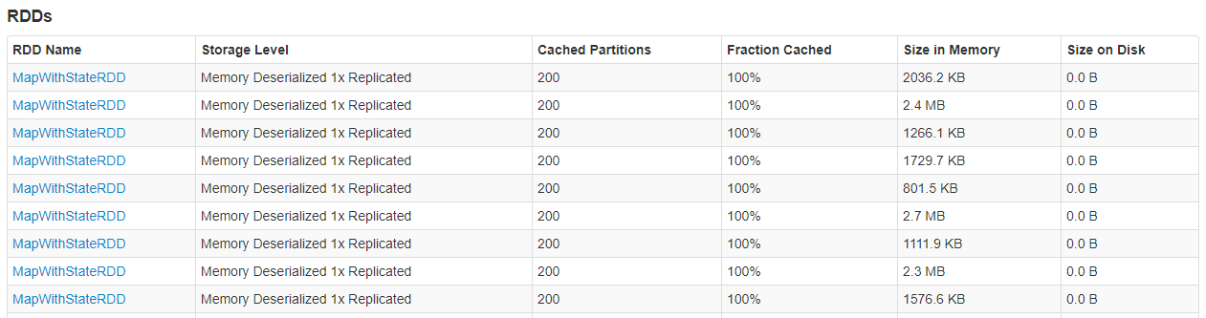
Caching
Spark’s in memory processing does not mean that all the datasets are stored in memory.
Spark has a method to store the dataset in memory. This method is called caching (cache()).
In this project cache is used on the datasets that is repeatedly used. Doing this reduces the time that it takes to retrieve the dataset as RAM is much more faster than disk.
One important point is to remove the datasets from cache when they are no longer needed. This can be done with unpersist() method.

Slide 14
Broadcast Join
Join is a wide transformation which means that it is an expensive transformation.
There are lots of methods to optimize joins but most of them are advanced and not applicable in the scope of this project. Broadcast join is applicable and beneficial.
To use Broadcast join, one of the two tables should be small. This join, joins two tables by broadcasting the small ones into all of the partitions of a dataset. One of the tables should be small because of this. This saves a lot of time because by this method, there is no shuffle and re-partition needed.

Slide 15
The Outcomes and Deliverables
Outcome of this project and applied methods were the reduced time in the data processing jobs of WifiSpeed.
Some of the methods are applied directly to the jobs and all of them was helpful to WifiSpeed.
In general, it can be said that outcome of this project was faster and efficient data processing jobs.
Methods and techniques are found and tested to see if they are applicable to WifiSpeed. After that, information about these methods and their test results are delivered to company to apply on their jobs.

Slide 16
Results
In the tests that are conducted, it is stated that caching method made jobs 1.5-2 times faster. Company used caching efficiently and cautiously after and during this internship project.
Also, other methods showed similar positive results to caching.
In addition, understanding and observing Spark UI with the knowledge gained from this project, WifiSpeed was able to improve their data processing jobs.
Even though this project showed positive results about optimizing by Spark, it is seen that there are a lot of methods and techniques to make WifiSpeeds data processing fully optimized. So, it can be said that this project was succesful but not complete. In the light of this project, company is interested to continue their works on Spark.

