Slide 1


Towards Spatial Selection Transmission for
Low-end IoT devices with SpotSound
Tingchao Fan¹, Huangwei Wu¹, Meng Jin¹, Tao Chen², Longfei Shangguan², Xinbin Wang¹, Chenghu Zhou¹
¹Shanghai Jiao Tong University, China
²University of Pittsburgh, USA
Notes:
Hello everyone, I’m Huangwei Wu, a second-year Ph.D. student from shanghai Jiao Tong University.
It’s my honor today to present our work: Towards Spatial Selection Transmission for Low-end IoT devices with SpotSound.
This is a joint work between Shanghai Jiao Tong University and University of Pittsburgh.

Slide 2
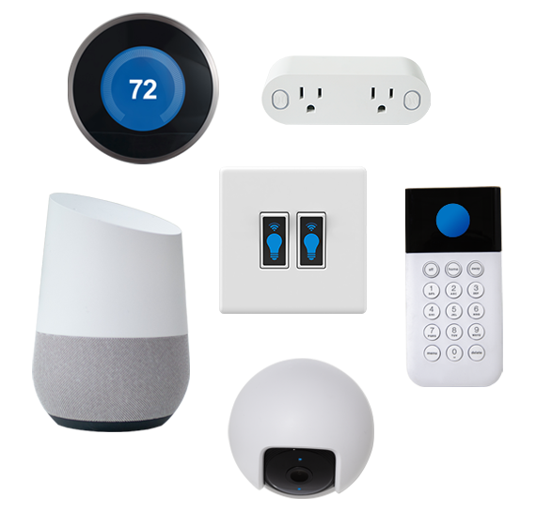
IoT devices are prevalent nowadays
The broadcast nature of the wireless channel brings a lot of privacy concerns
2
Notes:
In recent years, IoT devices are prevalent in our home and office.
(stick)
These devices continuously collect information about the users and the environment, and then share the information through wireless channel.
(stick)
However, the broadcast nature of the wireless channel brings a lot of privacy concerns, especially for IoT devices.

Slide 3
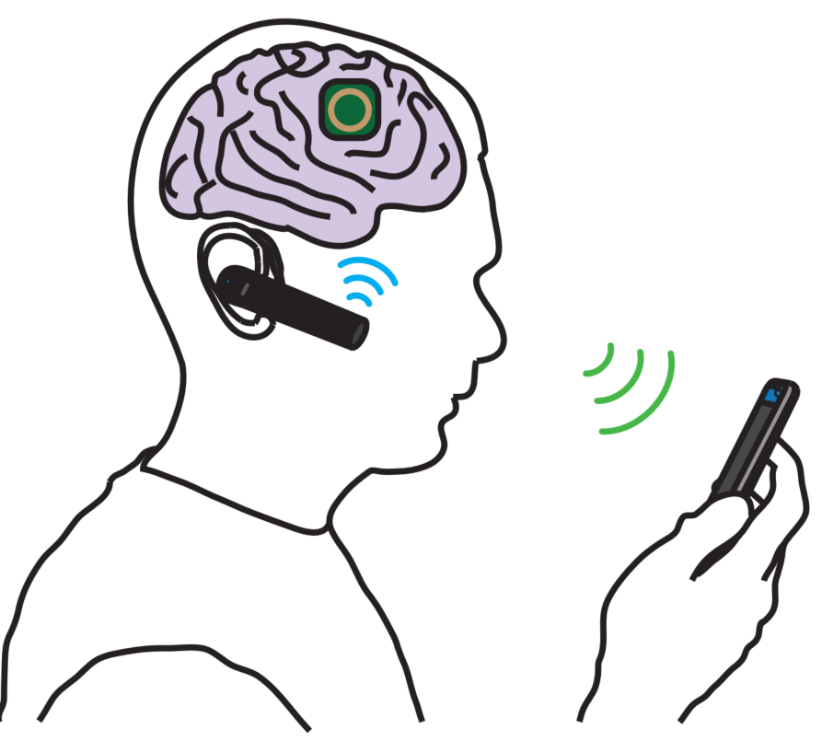
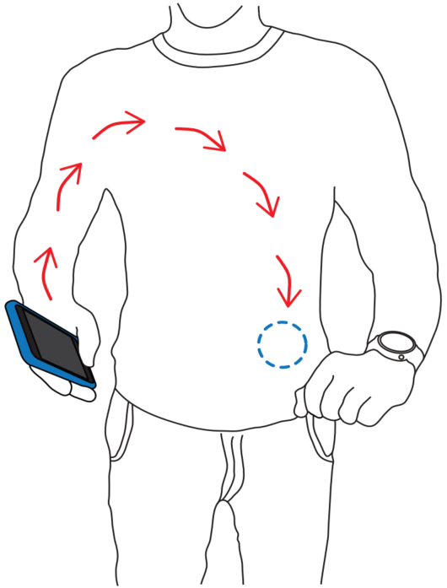

Potential Privacy Risks
Activity
Health condition
Trade information
Private information shared among IoT device
3
Notes:
On one hand, most information shared among IoT devices has major privacy implications, such as user’s health condition, activity, and so on.
Considering that IoT devices support only weak encryption, these privacy-related information is vulnerable to eavesdropping attack.

Slide 4
Potential Privacy Risks
Activity
Health condition
Motion
Trade information
Location
Private information shared among IoT device
Side channel information from the signal itself
Can we achieve spatial-selective transmission?
4
Notes:
On the other hand, even if the data is well encrypted, an eavesdropper can still obtain some privacy information by simply observing features of the wireless signal.
For example, it can infer a device’s location by simply observing the strength of the signal.
So, we can see that the fundamental security issue here is the omnidirectional and uncontrolled signal propagation on wireless channel.
To address this problem, we’d like to ask a question (stick): can we achieve spatial-selective transmission?
That is to say, can we make the signal detectable only by the legitimate receiver, while an attacker at other location cannot detect the signal.

Slide 5



Large quantity of deployed tags
Existing Solution: Beamforming
????
Eavesdropper
Sender
Directional beam
Receiver
5
Notes:
One way to achieve this is to use beamforming, which can (stick) concentrate the signal on a beam, so that (stick) an attacker that locates outside the beam cannot hear the signal.

Slide 6
Large quantity of deployed tags
Existing Solution: High Hardware Cost
……
Antenna array
Directional beam
Too costly to deploy on IoT devices
6
Notes:
However, generating a narrow beam typically require a large (stick) antenna array, which is too costly and bulky to deploy on IoT devices.
(
做成两页，然后做beamforming动画
)

Slide 7
Large quantity of deployed tags
Existing Solution: High Hardware Cost
……
Metasurface
Antenna array
Directional beam
Directional beam
Too costly to deploy on IoT devices
High infrastructure cost
7
Notes:
A potential solution is to offload the task of beamforming to a (stick) metasurface that is deployed in the environment.
However, since a single metasurface has limited coverage, we need to deploy large number of metasurfaces in the environment, which leads to a (stick) high infrastructure cost.

Slide 8

SpotSound: Single Antenna Beamforming
with Single Speaker and Single Microphone
Focus signal on a Spot
8
Notes:
We in this work propose SpotSound, a novel acoustic communication system that can use a single speaker,,,[pause] (stick) to focus the signal on a small spot.

Slide 9
The idea of SpotSound
Indoor Environment
Natural Beamformer !
9
Notes:
We achieve this by leveraging the indoor environment as a natural beamformer

Slide 10
The idea of SpotSound
Power Delay Profile
10
Notes:
Specifically, when a signal transmits from the transmitter, it will (stick) bounce off many reflectors indoors, such as walls, chairs, and tables.
And multiple reflected copies will combine at the receiver.
（multipath动画不要自动，手按）
(stick)
Such a multipath channel can be characterized by a power delay profile, which gives the power strength and delay of the signal transmitted on each path.

Slide 11


The idea of SpotSound
$$R_{B}\left(t\right)=h_{B}\left(t\right)⊗s\left(t\right)+w(t)$$
$$R_{E}\left(t\right)=h_{E}\left(t\right)⊗s\left(t\right)+w(t)$$
Different Locations
Different Multipath Channels
11
Notes:
Then the received signal can be considered as the temporal convolution between transmitted signal and the power delay profile.
Due to the signal’s diverse propagation paths indoors, signals received at (stick) different locations will experience quite different multipath channel, which will alter the transmitted signal in different ways.

Slide 12
The idea of SpotSound
$$R_{B}\left(t\right)=h_{B}\left(t\right)⊗s\left(t\right)+w(t)$$
$$R_{E}\left(t\right)=h_{E}\left(t\right)⊗s\left(t\right)+w(t)$$
Considering the wireless channel as a
location-dependent filter
12
Notes:
So, for each location, we can consider the associated physical channels as a location-dependent filter.

Slide 13

The Idea of SpotSound
Find a modulation method in a way that the embedded information can pass through only the target "filter“.
Target channel
0011……
Modulated signal
Other channel
???
Channels
13
Notes:
Then, our target is to find a modulation method, which can modulate the signal in a way that the embedded information can pass through (stick) only the target "filter“. While for the other channels, the information is filtered out.
Considering that the multipath channel decorrelates significantly across different locations, we can concentrate the signal to a small spot.
However, the challenge we meet here is, (stick) how to find the mapping between the target channel and the modulated signal?
That is to say, if we can predict how the target channel will impact the transmitted signal and find the right way to modulate the signal, we can make the signal only decodable on that channel.

Slide 14
The Idea of SpotSound
Finding the unknown mapping
Target channel
0011……
Modulated signal
Other channel
???
How to Find the right way for modulation based on how the target channel will impact the transmitted signal ?
Channels
14
Notes:
Then, our target is to find a modulation method, which can modulate the signal in a way that the embedded information can pass through (stick) only the target "filter“. While for the other channels, the information is filtered out.
Considering that the multipath channel decorrelates significantly across different locations, we can concentrate the signal to a small spot.
However, the challenge we meet here is, (stick) how to find the mapping between the target channel and the modulated signal?
(stick)
That is to say, if we can predict how the target channel will impact the transmitted signal and find the right way to modulate the signal, we can make the signal only decodable on that channel.

Slide 15
The Idea of SpotSound
Identify distinctive characteristics of a target channel
Uncover how these characteristics impact the signal waveform
Modulate the transmitted signal to make it decodable only after the target channel
Finding the unknown mapping
Target channel
0011……
Challenging Task !
Modulated signal
Other channel
???
Channels
15
Notes:
This is a challenging task because we need to identify distinctive characteristics of a target channel, and uncover how these characteristics impact the signal waveform, then correspondingly modulate the transmitted signal so that the signal is decodable only if it passes through the target channel

Slide 16
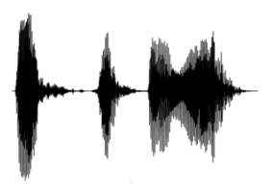
Deep Learning-based Communication
Transmitter
Receiver
Delay profile
0101
Target channel
Carrier
(noise signal)
Non-target channel
????
0101
Eavesdropper
Embed data on noise
Make data only detectable on the target channel
16
Notes:
We solve this problem with deep learning.
Specifically, we propose a learning-based modulation algorithm, which learns to generate satisfying signals for any given target channel.
In this design, both the transmitter and the receiver are neural networks.
[stick]
The transmitter is a generative network. It learns to embed the data on a series of random noise in a way that the data is detectable only on the target channel.

Slide 17
Deep Learning-based Communication
Transmitter
Receiver
Delay profile
0101
Target channel
Carrier
(noise signal)
Non-target channel
????
0101
Eavesdropper
Guide transmitter to generate satisfying signals.
Check signal’s decodability on each channel.
17
Notes:
To guide the transmitter to generate satisfying signals, we use two receivers in the training process: a target receiver and a non-target receiver.
The two receiver respectively check whether the generated signal is decodable on the target channel and the non-target channel.

Slide 18
Deep Learning-based Communication
Transmitter
Receiver
Delay profile
0101
Target channel
Carrier
(noise signal)
Non-target channel
????
0101
Eavesdropper
Generate signals in a channel-selective manner
18
Notes:
This forces the transmitter to generate signals in a channel-selective manner.
Then we explain how the transmitter learns to generate satisfying signals .

Slide 19
SpotSound’s model
G
Features
19
Notes:
Specifically, for each modulated signal, (stick) it can be characterized by a set of features, which (stick) are controlled by the inputs of the generator.

Slide 20



SpotSound’s model
Resistant to the impact of the target channel
$$⨂h_{B}\left(t\right)$$
0101
G
0101
$$⨂h_{E}\left(t\right)$$
???
Features
Vulnerable to other channel
20
Notes:
Here, part of the features are controlled by the data, and others are controlled by the random noise.
To make sure that the data can be detected by, and only by, (stick) the target receiver, the transmitter is trained to embed the data in the features that are resistant to the impact of the target channel, while is (stick) vulnerable to other channel.
Thus for a target receiver, (stick) features that represent the transmitted data are preserved, while for an eavesdropper, it can only receive a series of noise.

Slide 21
SpotSound’s model
$$⨂h_{B}\left(t\right)$$
0101
G
0101
$$⨂h_{E}\left(t\right)$$
???
Features
21
Notes:
But, how the generator knows which features can be used to embed the data for a certain target channel?
To achieve this, (stick) the generator takes another source of input …that is the delay profile of the target channel.
Specifically, it extracts distinctive characteristics of the channel’s delay profile, which are highly related to the modulation process.
Then it learns a latent mapping from the channel characteristics to the features of modulated signals
Those features can be detected only after the signal propagates through the target channel.
Once such a map is learned, the trained transmitter can generate satisfying signal for any indicated channels.

Slide 22
Model Training
Alice
①
②
①
Bob
②
$$⨂h_{B}\left(t\right)$$
③
Bob
0101
G
Carol
③
Carol
Alice
$$⨂h_{E}\left(t\right)$$
???
① Alice to Bob Channel
② Bob to Alice Channel
③ Alice to Carol Channel
Measure reciprocal channels between Alice and Bob and use them respectively as Alice’s input and Bob’s channel.
22
Notes:
In training, generator is called Alice, the legitimate receiver is called Bob and the eavesdropper is called Carol.
To make the model tolerate the errors of channel estimation between estimated target channel and the real target channel. we measured reciprocal channels between Alice and Bob, and use them respectively as Alice’s input and Bob’s channel. Eve’s channel is also measured for training.

Slide 23

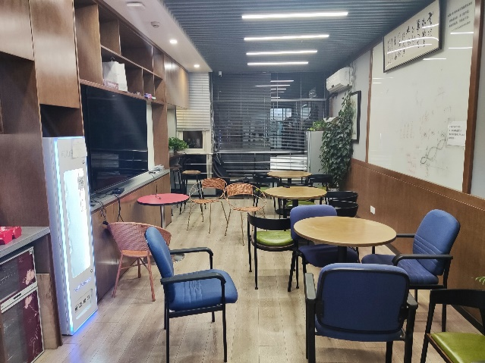
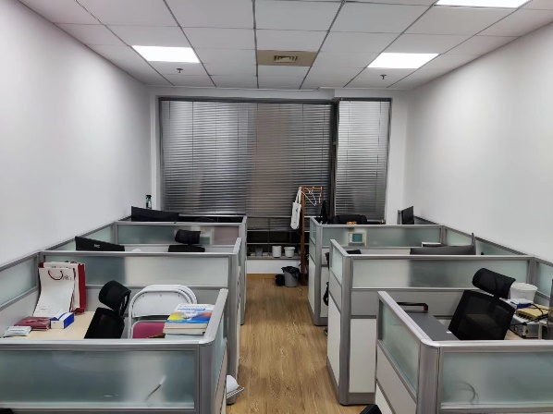
Model Training
Alternation between Alice/Bob and Carol
Bob
Bob
Alice
Alice
Carol
Carol
Data collection: 430,000 delay profiles from 12 different indoor rooms.
……
23
Notes:
we alternate the training of Alice and Bob with that of Carol, which is similar as what GAN does.
In the training of Alice and Bob, they may discover a way to communicate that Carol cannot understand.
While in the training of Carol, it may start to break the special coding between Alice and Bob.
As the adversarial training progresses, Alice and Bob may discover some ways that exploit the channel diversity better for information hiding, and Carol will eventually finds it impossible to decode the signal.
(stick)
At last, for training, we collect over 430 thousand delay profiles from 12 different indoor rooms.

Slide 24
Practical problems
Detected once overlap >40%
Alice
0
0
0
1
Alice-to-Bob
Noise signal
Bob
Bob-to-Alice
Modulation
signal
Carol
Alice-to-Carol
Move with a larger step
Packet
Detector
0 or 1
Different measured channels
Channel Estimation : obtain the delay profile of the target channel with channel reciprocity
Packet Detection: detect signal at legitimate receiver with a binary classifier
Details can be found in the paper
24
Notes:
To embed the model into a practical system, we have also addressed a set of practical challenges, including channel estimation with channel reciprocity and packet detection with a binary classifier
(stick) The details can be found in our paper.

Slide 25
Evaluation
25
Notes:
Then let’s look at the performance of Spotsound

Slide 26
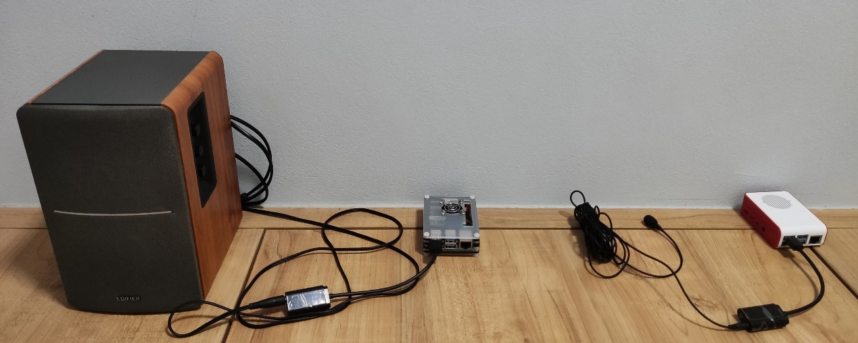
Implementation
Hardware
Speaker
Sound card
Raspberry pi
Mic
Raspberry Pi 4 Mode
EDIFIER R1200TII speaker
TakStar TCM-400 microphone
Model
Model | Description | Memory | Computation
I | DSC | 1,234,743 | 100.84 MFLOPS
II | LRA+DSC | 549,795 | 26.71 MFLOPS
III | LRA+DSC+Pruning | 188,467 | 22.16 MFLOPS
Implement 3 compression technologies
DSC: Depth-wise separable convolution
LRA: Low-rank approximation
Pruning
Alice & Bob: Model III
85%
78%
26
Notes:
We implement SpotSound on Raspberry Pi with commercial speaker and microphone.
To make Spotsound practical in IoT devices, we perform 3 kinds of model compression technologies and evaluate with the most compressed model. After compression, the parameters size and the computation overhead are reduced by 85% and 78%, respectively.

Slide 27
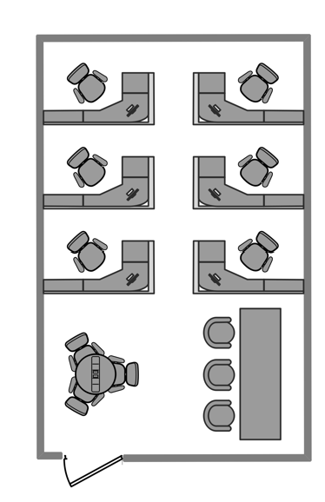
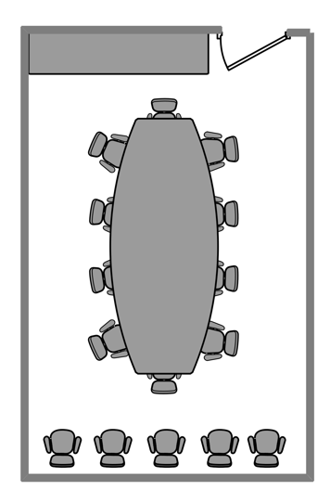
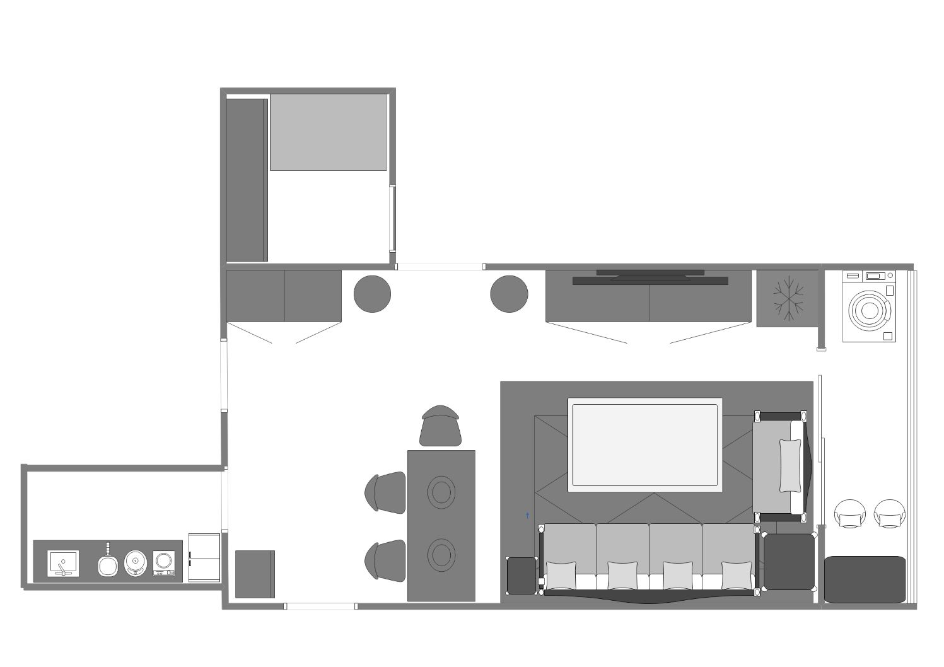

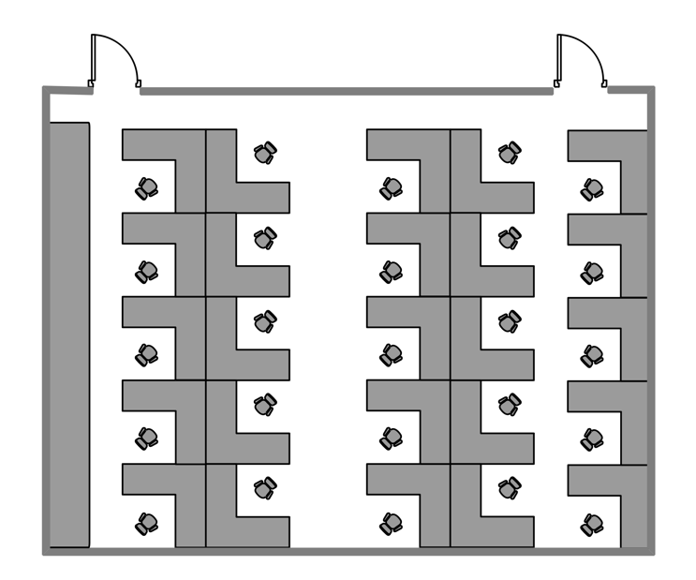
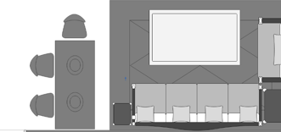
Setting
Scene 5: Meeting room
Scene 6: Small office
Evaluate in 7 unseen rooms
3.5m
3.5m
Scene 2: Study room
8.3m
8.3m
Scene 7: large office
Scene 1: Living room
EVE
Scene 3: Balcony
7.6m
Bob
Alice
2m
Scene 4: Kitchen
4m
7.8m
Apartment
Office
27
Notes:
We evaluate spotsound in 7 unseen rooms. They are all common scenarios such as apartment and office.

Slide 28
Overall performance
1m²
(a-1)
(a-2)
(a-3)
(a-4)
Sender
1m²
Target Receiver
Non-target Receiver
(b-1)
(b-2)
(b-3)
28
Notes:
Then let’s look at the performance in 2 different rooms.
[laser pen]
Here, a darker color means a lower BER measured in that location.
The speaker icon represents the sender and the green triangle represents the legal receiver.
We can see that, no matter where the receiver locates, SpotSound can always focus the signal on a nearly 0.25 square meters spot around the target location.
The evaluation in another room shows similar results, which verifies spotsound’s generalization to different environments.
(同样加文字描述，高亮0.25m2)
不加0.25的框，因为原本的图是经过高斯模糊处理的，形状容易引起困惑
小房间的concentration范围明显比大房间要小 -> 和具体的环境有关，we don’t want to use results in specific scenarios to overclaim the performance.

Slide 29
Impact of model complexity
There is no obvious performance gap between Model III and the other two models, although its size is reduced by nearly 85% compared with Model I
Bob
EVE
29
Notes:
We evaluate the performance of models with different compression ratio.
This figure shows the BER achieved by models with different compressed-level
In the results, we do not observe an obvious performance degradation even when we use the most lightweight model

Slide 30
Impact of direction and distance
SpotSound’s communication distance can achieve at least 6m.
Transmission Direction
30
Notes:
We also evaluate the impact of the signal’s propagation direction and the distance.
Here, the bar with different colors shows the performance obtained under different transmission directions.
We can see that, compared with transmission distance, the transmission direction has a more apparent impact on the performance.
We can still achieve a lower than 5% BER, even when the receiver locates behind the speaker and with a distance of 6m.

Slide 31
Conclusion
We for the first time achieve spatial-selective transmission by leveraging a single speaker.
We reveal that deep learning is good at optimizing objectives in wireless communication which is hard to achieve with hand-craft algorithms.
We implement SpotSound on low-end devices and show its ability to concentrate its signal in a less than 0.25𝑚² spot.
31
Notes:
In conclusion, SpotSound makes the following contributions:
Firstly, we for the first time achieve spatial-selective transmission by leveraging the multipath wireless channel.
Then, we reveal that deep learning is good at optimizing objectives in wireless communication that is hard to achieve with hand-craft algorithms.
At last we implement SpotSound on low-end devices and show its ability to concentrate its signal in a less than 0.25𝑚² spot.

Slide 32
Thanks You !
Q & A
Notes:
Thank you so much for attention
I’m happy to take questions.

Slide 33




What SpotSound learns is an signal embedding operation based on whether the input channel and the real channel are matched.
Since the signal received at eavesdropper has no data features,
$$h_{b}$$
Match?
Random Noise
$$S_{0}$$
Alice
(Generator)
Data
Features
$$S_{0}⨂h_{b}$$
Bob
(Discriminator)
$$BER↓$$
Controlled by data
Controlled by random signal
Our model can be generalized to unseen channels and unseen eavesdroppers
33
Notes:
What SpotSound learns is an signal embedding operation based on whether the input channel and the real channel are matched. It has nothing to do with the specific channels
And
Since the signal received at eavesdropper has no data features, the specific model structure of eavesdropper will not affect the decodability.

Slide 34
Model’s tolerance of imperfect channel estimation
Alice
Alice
①
③
②
Bob
②
①
Carol
$$⨂h_{B}\left(t\right)$$
0101
G
③
① Alice to Bob Channel
② Bob to Alice Channel
③ Alice to Carol Channel
$$⨂h_{E}\left(t\right)$$
???
34
Notes:
we find out CIRs measured on the same location while at different directions, and use them respectively as Alice’s input and Bob’s channel.
(data collection放在这个后面)

Slide 35
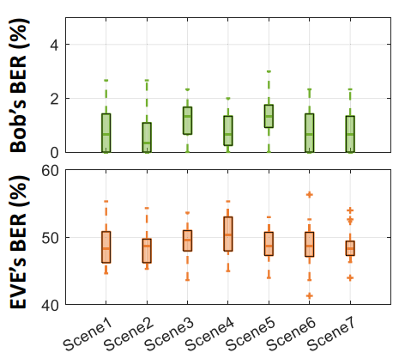
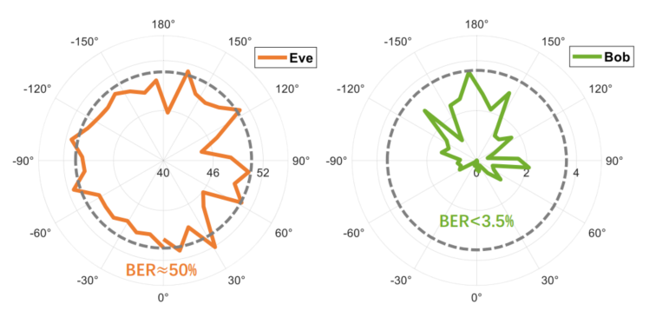
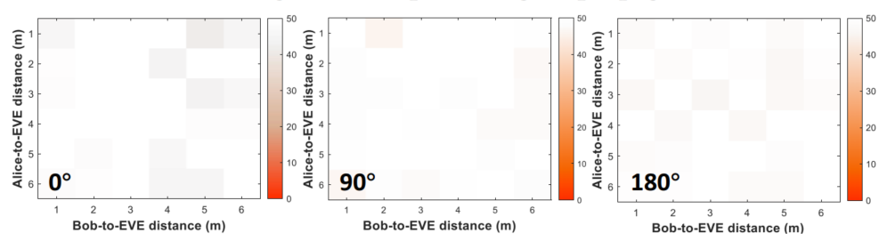
Impact of unseen environments
Impact of signal propagation direction
EVE’s BER under different Alice-to-EVE distances and Bob-to-EVE distances
35

Slide 36
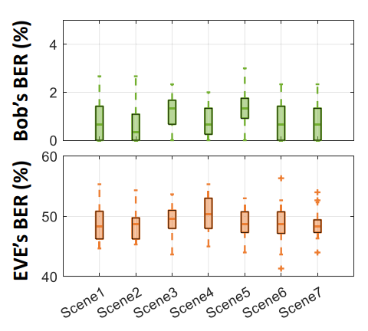
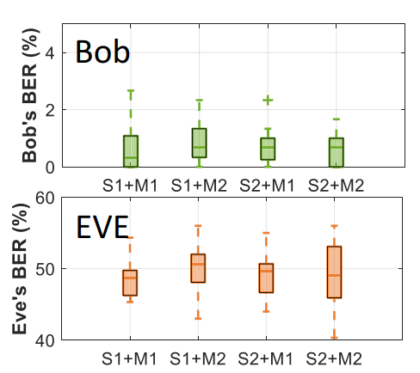
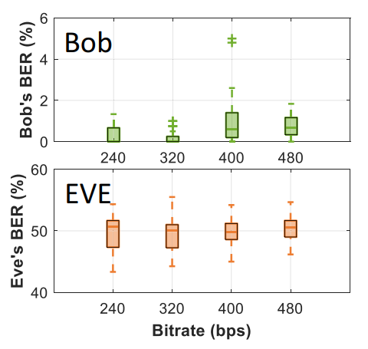
Performance in different unseen environments
Impact of environmental dynamic
S1: Speaker, EDIFIER R1200TII
S2: Speaker, M200MKIII
M1: Microphone, TakStar TCM-400
M2: Microphone, LATZZ A3
Performance with different devices.
Performance under different bitrates.
36

Slide 37
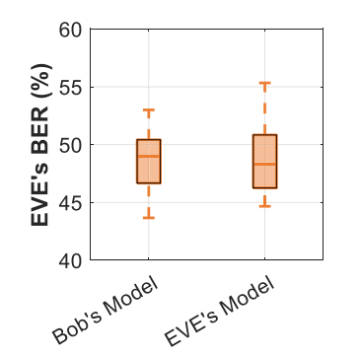
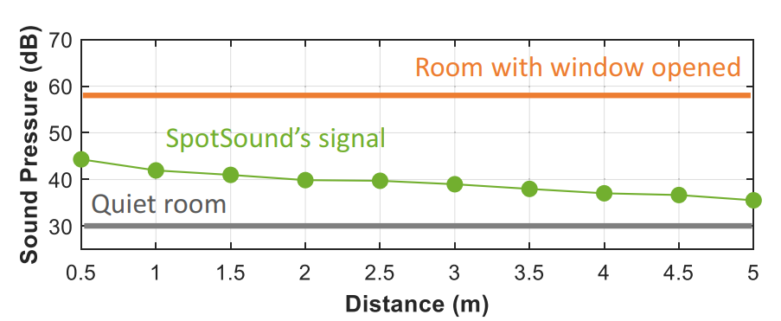
Eve’s BER when EVE uses Bob’s model
Eve’s BER when there are stronger EVEs
Sound pressure of SpotSound’s signal measured from different distances
37

Slide 38
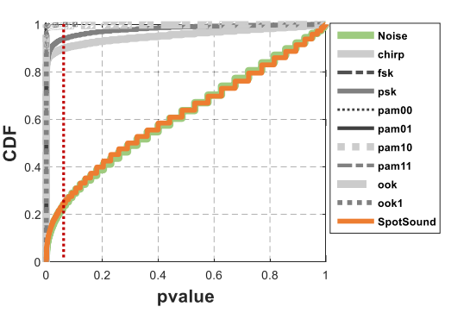
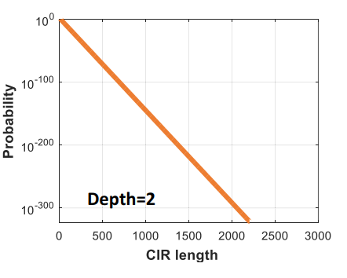
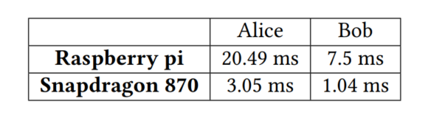
KS test for randomness evaluation
Computation cost for brute force attack.
Processing time for a 60-bit packet
38

