Slide 1
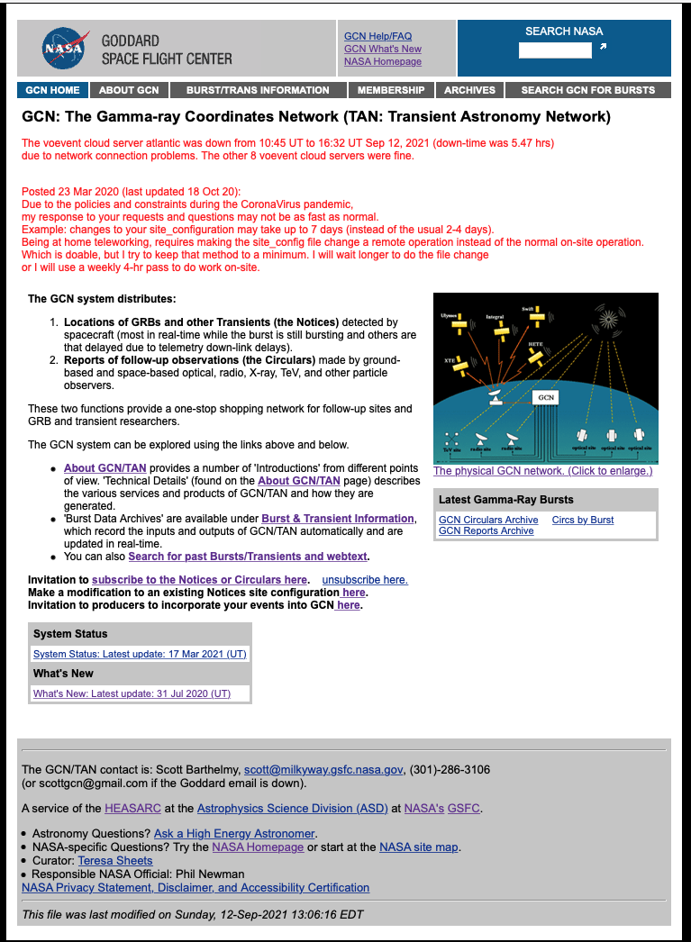
Current GCN Front Page:
General Information
About GCN
Burst/Trans Information
Membership
Subscribe
Unsubscribe
Modify Notices
Invite producers
Archives
Circular Archive
Past Bursts/Transients and webtext
GCN Reports Archive
Search
GCN for Bursts
GCN by Burst
Search NASA
News
Banner Bulletin
Website Updates
Website Status
6. Contact
GCN Help and FAQ
Curator
NASA POC
GCN/TAN POC
Ask an Astronomer
7. NASA
NASA Homepage
Search NASA
Site map
GSFC
Parent and Adjacent Organizations (HEASARC & ASD)
Legal and Regulatory Disclaimers

Slide 2
6.i
Current GCN Front Page:
General Information
About GCN
Burst/Trans Information
Membership
Subscribe
Unsubscribe
Modify Notices
Invite producers
Archives
Circular Archive
Past Bursts/Transients and webtext
GCN Reports Archive
Search
GCN for Bursts
GCN by Burst
Search NASA
News
Banner Bulletin
Website Updates
Website Status
6. Contact
GCN Help and FAQ
Curator
NASA POC
GCN/TAN POC
Ask an Astronomer
7. NASA
NASA Homepage
Search NASA
Site map
GSFC
Parent and Adjacent Organizations (HEASARC & ASD)
Legal and Regulatory Disclaimers
* Redundant Items
7.iv
5.i
4.iii/7.ii
*
7.i
*
*
4.i
1.i
1.ii
2
3
5.i
*
1.i
*
1.i
3.i
4.ii
*
1.ii
3.iii
3.ii
2.i
2.ii
2.iii
5.iii
2.iv
5.i
6.iv
6.v
7.v
7.iv
*
6.ii
7.i
7.iii
6.iii
7.vi

Slide 3
6.i
Current GCN Front Page:
General Information
About GCN
Burst/Trans Information
Membership
Subscribe
Unsubscribe
Modify Notices
Invite producers
Archives
Circular Archive
Past Bursts/Transients and webtext
GCN Reports Archive
Search
GCN for Bursts
GCN by Burst
Search NASA
News
Banner Bulletin
Website Updates
Website Status
6. Contact
GCN Help and FAQ
Curator
NASA POC
GCN/TAN POC
Ask an Astronomer
7. NASA
NASA Homepage
Search NASA
Site map
GSFC
Parent and Adjacent Organizations (HEASARC & ASD)
Legal and Regulatory Disclaimers
* Redundant Items
7.iv
5.i
4.iii/7.ii
*
7.i
*
*
4.i
1.i
1.ii
2
3
5.i
Text here about new portal…
*
1.i
*
1.i
3.i
4.ii
*
1.ii
3.iii
3.ii
2.i
2.ii
2.iii
5.iii
2.iv
5.i
6.iv
6.v
7.v
7.iv
*
6.ii
7.i
7.iii
6.iii
7.vi

Slide 4
Pages for New GCN
Front page
News/changes about site
Publications and research highlights
List of missions
Documentation
About GCN
History
Team
Support contact
Getting started
I am a…
Hobbyist
Professional observer
PI of a mission or observatory
I want to…
Receive and/or post GCN Circulars
Receive and/or Post GCN Notices
Add my mission or observatory with GCN
Mission info
Event info
List of alerts
Links to other databases
Papers about this object
System status
Submit a circular
Archive
When you arrive from a mission page
When you arrive from the front page
Search results
Log in / sign up
User preferences
Manage API keys
Email subscriptions

Slide 5
Front Page
Banner Text Identifying this as an official website of the US government
NASA Logo & Link
GSFC Logo & Link
GCN/TACH Banner Logo
(Returns to Front Page)
Search
(GCN)
Sign up / Login
Account
Horizontal Navigation Menu
About GCN | Missions | Documentation | Alerts | Archive
[Big Eye Catching Graphic]
Most Recent Alerts
Vertical Crawler
TAGLINE
Two or three sentence paragraph that fleshes out the GCN tagline without going into verbose details.
NEWS
Location to place bulletins about recent updates, upcoming changes, or any other news that is deemed worthy for outreach to the vast majority of users.
Admin and Legal Navigation
Contact GCN | Parent and partner orgs | Legal and Disclaimers | System Status | Change log | "Site last updated"

Slide 6
Front Page
Banner Text Identifying this as an official website of the US government
NASA Logo & Link
GSFC Logo & Link
GCN/TACH Banner Logo
(Returns to Front Page)
Search
.
Sign up / Login
Account
Horizontal Navigation Menu
About GCN | Missions | Documentation | Alerts | Archive
Current Mission 1
Current Mission 2
Current Mission 3
______________
Inactive Mission 1
Inactive Mission 2
[Big Eye Catching Graphic]
Most Recent Alerts
Vertical Crawler
TAGLINE
Two or three sentence paragraph that fleshes out the GCN tagline without going into verbose details.
NEWS
Location to place bulletins about recent updates, upcoming changes, or any other news that is deemed worthy for outreach to the vast majority of users.
Admin and Legal Navigation
Contact GCN | Parent and partner orgs | Legal and Disclaimers | System Status | Change log | "Site last updated"

Slide 7
Sign up/Login
Banner Text Identifying this as an official website of the US government
NASA Logo & Link
GSFC Logo & Link
GCN/TACH Banner Logo
(Returns to Front Page)
Search
.
Sign up / Login
Account
Horizontal Navigation Menu
About GCN | Missions | Documentation | Alerts | Archive
Non-NASA Authenticator Login
NASA Launchpad Login
Forgot Username | Reset Password
Standing Declaration of Terms of Service, Acceptable Use, and implicit consent to security measures.
New User Registration Block of Fields
Admin and Legal Navigation
Contact GCN | Parent and partner orgs | Legal and Disclaimers | System Status | Change log | "Site last updated"

Slide 8
Account Management
Banner Text Identifying this as an official website of the US government
NASA Logo & Link
GSFC Logo & Link
GCN/TACH Banner Logo
(Returns to Front Page)
Search
.
Sign up / Login
Account
Horizontal Navigation Menu
About GCN | Missions | Documentation | Alerts | Archive
Manage API Keys
Subscriptions Management
Other Preferences
Admin and Legal Navigation
Contact GCN | Parent and partner orgs | Legal and Disclaimers | System Status | Change log | "Site last updated"

Slide 9
About GCN
Banner Text Identifying this as an official website of the US government
NASA Logo & Link
GSFC Logo & Link
GCN/TACH Banner Logo
(Returns to Front Page)
Search
.
Sign up / Login
Account
Horizontal Navigation Menu
About GCN | Missions | Documentation | Alerts | Archive
GCN Mission Statement
Utilize Accordian feature
In Order to provide a drop down for each heading
That gives the detailed text associated with each topic
Graphics and Links can be provided if necessary.
What's New at GCN (headline level news)
History of GCN
How GCN works with observatories and missions
GCN Team with BIO and Contact [Links to Contact GCN page]
Admin and Legal Navigation
Contact GCN | Parent and partner orgs | Legal and Disclaimers | System Status | Change log | "Site last updated"

Slide 10
Missions Landing Page
Banner Text Identifying this as an official website of the US government
NASA Logo & Link
GSFC Logo & Link
GCN/TACH Banner Logo
(Returns to Front Page)
Search
.
Sign up / Login
Account
Horizontal Navigation Menu
About GCN | Missions | Documentation | Alerts | Archive
<sortable by name or mission type>
Possible Concept for Missions Landing Page
A Large graphic illustrating current/active
Missions and observatories with
Each icon acting as a button
That links to the specific
Mission's page.
List of Legacy/Inactive Missions with links to their archived pages
__________________
LINK
__________________
LINK
__________________
LINK
__________________
LINK
__________________
Admin and Legal Navigation
Contact GCN | Parent and partner orgs | Legal and Disclaimers | System Status | Change log | "Site last updated"

Slide 11
Missions Page Example
Banner Text Identifying this as an official website of the US government
NASA Logo & Link
GSFC Logo & Link
GCN/TACH Banner Logo
(Returns to Front Page)
Search
.
Sign up / Login
Account
Horizontal Navigation Menu
About GCN | Missions | Documentation | Alerts | Archive
Fermi Alerts
Fermi Archives
Mission Name (EX: Fermi)
Brief Mission and History Statement
Instrument Facts Table
GBM— some text about this instrument, links to relevant Fermi SSC pages
LAT — some text about this instrument, links to relevant Fermi SSC pages
Alert Crawler Type 1
FERMI_GBM_FLIGHT_POS – short description
Table of fields in schema
Alert Crawler Type 2
FERMI_GBM_GND_POS – short description
Table of fields in schema
Link to Mission's Homepage
Admin and Legal Navigation
Contact GCN | Parent and partner orgs | Legal and Disclaimers | System Status | Change log | "Site last updated"

Slide 12
Documentation
Banner Text Identifying this as an official website of the US government
NASA Logo & Link
GSFC Logo & Link
GCN/TACH Banner Logo
(Returns to Front Page)
Search
.
Sign up / Login
Account
Horizontal Navigation Menu
About GCN | Missions | Documentation | Alerts | Archive
Documentation Table
Of Contents (Link)
Documentation Search Box
Circular Information Page Link
I'm A ...
I want to ...
Observer
Receive GCN Circulars
Educator/Hobbyist
Post / Submit a GCN Circulars
Notice Producer
(I want add notices to GCN)
Receive GCN Notices
Post / Submit a GCN Notices
Add my Mission/Observatory to GCN
Admin and Legal Navigation
Contact GCN | Parent and partner orgs | Legal and Disclaimers | System Status | Change log | "Site last updated"

Slide 13
Documentation: Receive GCN Circular
Banner Text Identifying this as an official website of the US government
NASA Logo & Link
GSFC Logo & Link
GCN/TACH Banner Logo
(Returns to Front Page)
Search
.
Sign up / Login
Account
Horizontal Navigation Menu
About GCN | Missions | Documentation | Alerts | Archive
Documentation Table
Of Contents (Link?)
Documentation Search Box
Circular Information Page Link
Breakdown of Circular types and information
Relevant Fields for Subscribing to a Circular
Admin and Legal Navigation
Contact GCN | Parent and partner orgs | Legal and Disclaimers | System Status | Change log | "Site last updated"

Slide 14
Documentation: Submit GCN Circular
Banner Text Identifying this as an official website of the US government
NASA Logo & Link
GSFC Logo & Link
GCN/TACH Banner Logo
(Returns to Front Page)
Search
.
Sign up / Login
Account
Horizontal Navigation Menu
About GCN | Missions | Documentation | Alerts | Archive
Documentation Table
Of Contents (Link)
Documentation Search Box
Circular Information Page Link
Standing Policies, Rules, and Terms of Use
Relevant Fields for Circular Input
Admin and Legal Navigation
Contact GCN | Parent and partner orgs | Legal and Disclaimers | System Status | Change log | "Site last updated"

Slide 15
Documentation: Receive GCN Notices
Banner Text Identifying this as an official website of the US government
NASA Logo & Link
GSFC Logo & Link
GCN/TACH Banner Logo
(Returns to Front Page)
Search
.
Sign up / Login
Account
Horizontal Navigation Menu
About GCN | Missions | Documentation | Alerts | Archive
Documentation Table
Of Contents (Link)
Documentation Search Box
Notice Information Page Link
Breakdown of Notice types and information
Relevant Fields for Subscribing to Notices
Admin and Legal Navigation
Contact GCN | Parent and partner orgs | Legal and Disclaimers | System Status | Change log | "Site last updated"

Slide 16
Documentation: Submit GCN Notices
Banner Text Identifying this as an official website of the US government
NASA Logo & Link
GSFC Logo & Link
GCN/TACH Banner Logo
(Returns to Front Page)
Search
.
Sign up / Login
Account
Horizontal Navigation Menu
About GCN | Missions | Documentation | Alerts | Archive
Documentation Table
Of Contents (Link)
Documentation Search Box
Notice Information Page Link
Standing Policies, Rules, and Terms of Use
Relevant Fields for Notice Submission
Admin and Legal Navigation
Contact GCN | Parent and partner orgs | Legal and Disclaimers | System Status | Change log | "Site last updated"

Slide 17
Documentation: Add Mission/Observatory to GCN
Banner Text Identifying this as an official website of the US government
NASA Logo & Link
GSFC Logo & Link
GCN/TACH Banner Logo
(Returns to Front Page)
Search
.
Sign up / Login
Account
Horizontal Navigation Menu
About GCN | Missions | Documentation | Alerts | Archive
Documentation Table
Of Contents (Link)
Documentation Search Box
Circular Information Page Link
Standing Policies, Rules, and Terms of Use
Relevant Fields for Application to GCN Mission/Observatory Contribution
Admin and Legal Navigation
Contact GCN | Parent and partner orgs | Legal and Disclaimers | System Status | Change log | "Site last updated"

Slide 18
Alerts
Banner Text Identifying this as an official website of the US government
NASA Logo & Link
GSFC Logo & Link
GCN/TACH Banner Logo
(Returns to Front Page)
Search
.
Sign up / Login
Account
Horizontal Navigation Menu
About GCN | Missions | Documentation | Alerts | Archive
List of Event Alerts Chronologically
Direct Links to Databases
______________
Link
______________
Link
______________
Link
______________
Link
______________
Link
______________
Link
Admin and Legal Navigation
Contact GCN | Parent and partner orgs | Legal and Disclaimers | System Status | Change log | "Site last updated"

Slide 19
Archive
Banner Text Identifying this as an official website of the US government
NASA Logo & Link
GSFC Logo & Link
GCN/TACH Banner Logo
(Returns to Front Page)
Search
.
Sign up / Login
Account
Horizontal Navigation Menu
About GCN | Missions | Documentation | Alerts | Archive
[Card style component]
Notice Archive
Explanation Paragraph
.
[Card style component]
Circular Archive
Explanation Paragraph
.
[Card style component]
Publications related to GCN
Explanation Paragraph
.
[Card style component]
Legacy GCN Page
Disclaimer that this site is not updated past a certain date
.
Note:
The location and arraignment of the cards will be set based on the user's screen size
Active Missions Link
Circulars by Number
Inactive Missions Link
Circulars by Event
Publications Link
Legacy GCN Link
Admin and Legal Navigation
Contact GCN | Parent and partner orgs | Legal and Disclaimers | System Status | Change log | "Site last updated"

Slide 20
Contact GCN
Banner Text Identifying this as an official website of the US government
NASA Logo & Link
GSFC Logo & Link
GCN/TACH Banner Logo
(Returns to Front Page)
Search
.
Sign up / Login
Account
Horizontal Navigation Menu
About GCN | Missions | Documentation | Alerts | Archive
Help/FAQ
Suggestion Box
"contact us"
Designated Project Point of Contact Name | Title
Head of GCN Project Name | Title
Report Website Issues Name | Title
List of project members with photo, title, bio.
(Pending GSFC privacy regulations and desire of individuals to be included)
Admin and Legal Navigation
Contact GCN | Parent and partner orgs | Legal and Disclaimers | System Status | Change log | "Site last updated"

Slide 21
Contact GCN: FAQ Page
Banner Text Identifying this as an official website of the US government
NASA Logo & Link
GSFC Logo & Link
GCN/TACH Banner Logo
(Returns to Front Page)
Search
.
Sign up / Login
Account
Horizontal Navigation Menu
About GCN | Missions | Documentation | Alerts | Archive
First Frequently Asked Question
Utilize Accordian feature
In Order to provide a drop down for each heading
That gives the detailed text associated with each topic
Graphics and Links can be provided if necessary.
Second Frequently Asked Question
Third Frequently Asked Question
Fourth Frequently Asked Question
Fifth Frequently Asked Question
Admin and Legal Navigation
Contact GCN | Parent and partner orgs | Legal and Disclaimers | System Status | Change log | "Site last updated"

Slide 22
Parent and Partner Orgs (AKA: Links)
Banner Text Identifying this as an official website of the US government
NASA Logo & Link
GSFC Logo & Link
GCN/TACH Banner Logo
(Returns to Front Page)
Search
.
Sign up / Login
Account
Horizontal Navigation Menu
About GCN | Missions | Documentation | Alerts | Archive
NASA
Link directly to Missions' homepage
Link directly to Observatories' homepage
Goddard
Link directly to Centers' homepage
HEASARC
Link directly to Universities' homepage
Admin and Legal Navigation
Contact GCN | Parent and partner orgs | Legal and Disclaimers | System Status | Change log | "Site last updated"

Slide 23
System Status
Banner Text Identifying this as an official website of the US government
NASA Logo & Link
GSFC Logo & Link
GCN/TACH Banner Logo
(Returns to Front Page)
Search
.
Sign up / Login
Account
Horizontal Navigation Menu
About GCN | Missions | Documentation | Alerts | Archive
[Card style component]
Monitored System/Sub-system
Text and graphic current state indicator
Time graph showing recent history of failures/drops
Might Look Like
Important Widget: GOOD
[Card style component]
Monitored System/Sub-system
Text and graphic current state indicator
Time graph showing recent history of failures/drops
Might Look Like
Noteworthy Gizmo: BAD
Admin and Legal Navigation
Contact GCN | Parent and partner orgs | Legal and Disclaimers | System Status | Change log | "Site last updated"

Slide 24
GCN Statistics
Banner Text Identifying this as an official website of the US government
NASA Logo & Link
GSFC Logo & Link
GCN/TACH Banner Logo
(Returns to Front Page)
Search
.
Sign up / Login
Account
Horizontal Navigation Menu
About GCN | Missions | Documentation | Alerts | Archive
Realtime Feed of Desired/Relevant Statistics of GCN Use.
Number of total Visitors
Number of Notification Subscribers
Number of Circulation Subscribers
Number of Notification Producers
Number of Circulation Contributors
Alerts Per Day
Time since last Alert
Etc.
Admin and Legal Navigation
Contact GCN | Parent and partner orgs | Legal and Disclaimers | System Status | Change log | "Site last updated"

Slide 25
Change Log
Banner Text Identifying this as an official website of the US government
NASA Logo & Link
GSFC Logo & Link
GCN/TACH Banner Logo
(Returns to Front Page)
Search
.
Sign up / Login
Account
Horizontal Navigation Menu
About GCN | Missions | Documentation | Alerts | Archive
List from most recent to first
Change number 3 | Change Headline and date| Change description | Change author
Change number 2 | Change Headline and date| Change description | Change author
Change number 1 | Change Headline and date| Change description | Change author
Admin and Legal Navigation
Contact GCN | Parent and partner orgs | Legal and Disclaimers | System Status | Change log | "Site last updated"

