Slide 1
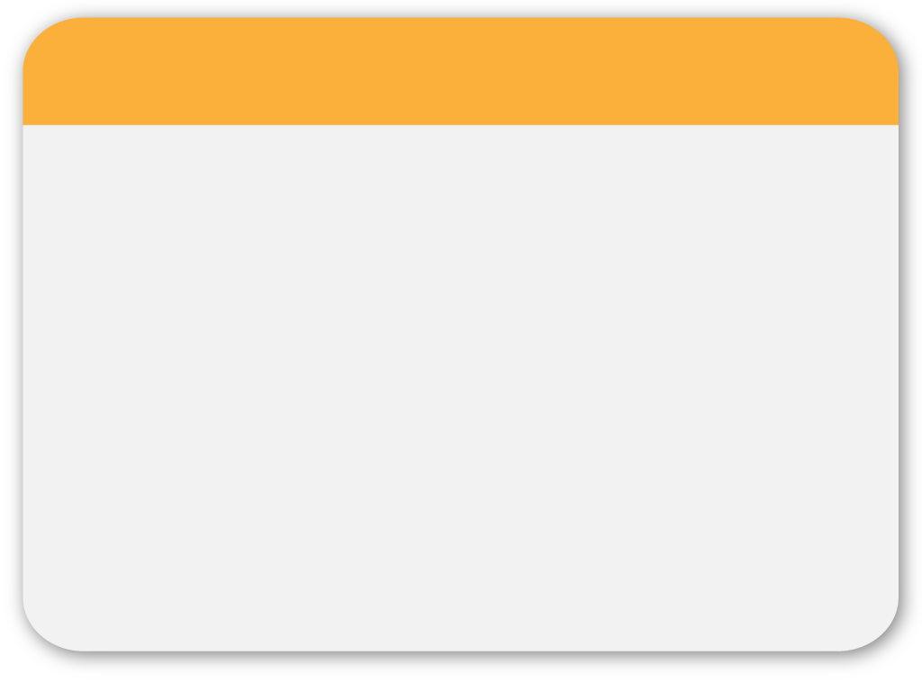
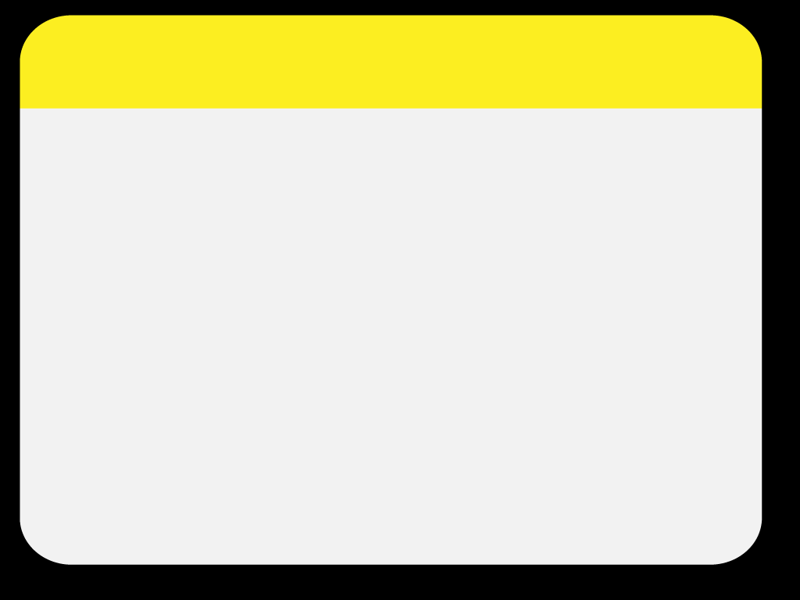
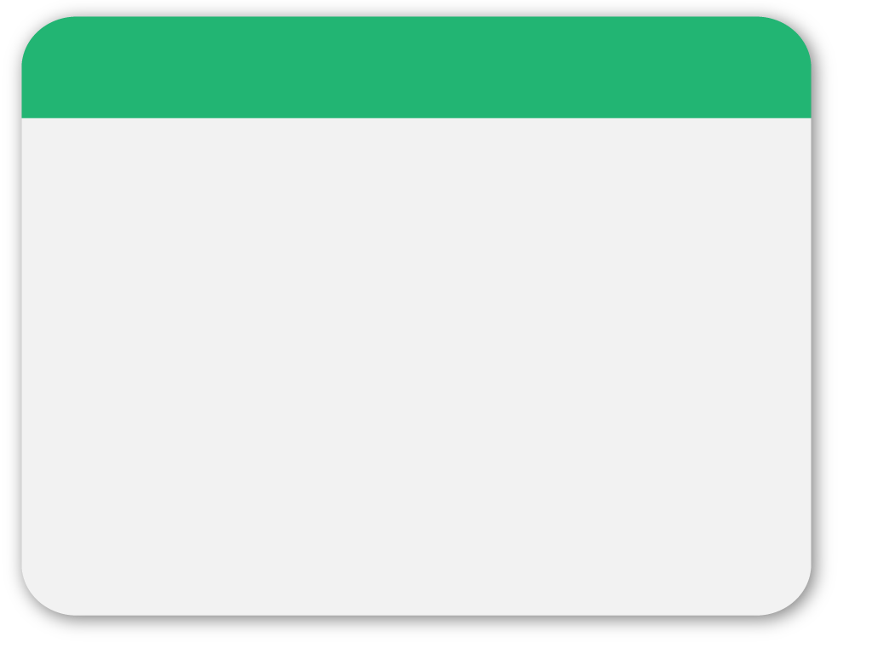
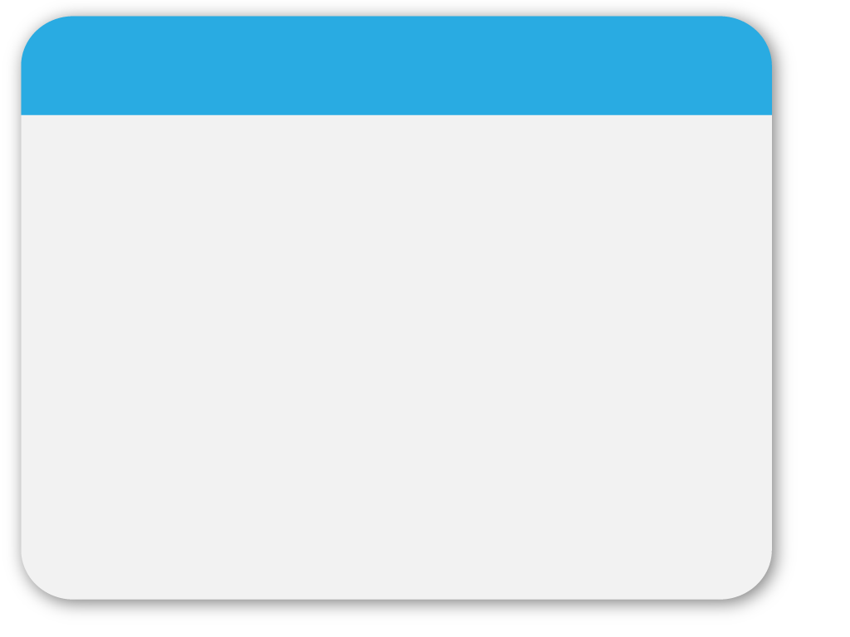
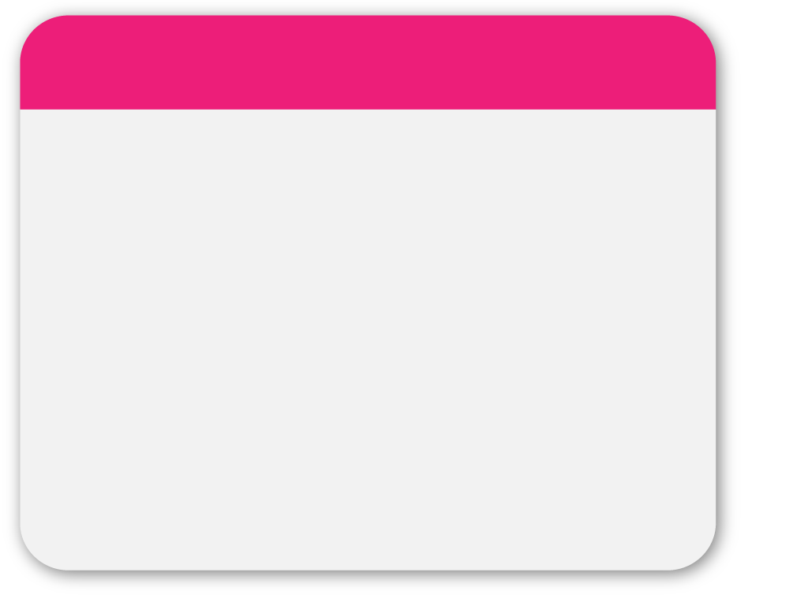
WINTER
LANG106 T26
New Invention
Sonia
Template

Slide 2
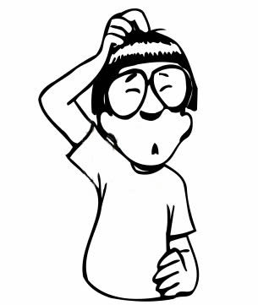
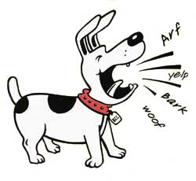
Communication Gap
WINTER
Are you thirsty?
Are you hungry?
Template
I like singing~

Slide 3
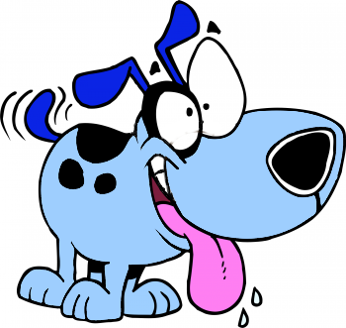

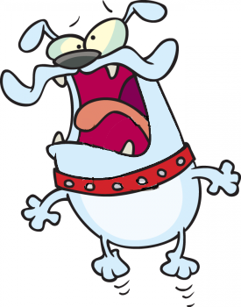
Behaviors Implies Emotion
Excited
Nervous and Scared

Slide 4


Behaviors Implies Emotion
There is a danger!!!
I am very confident~

Slide 5



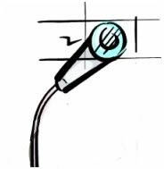
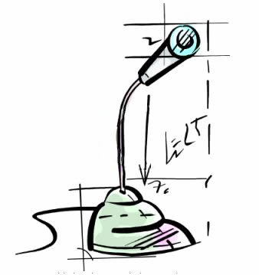
Bridge
Memory
CPU
Glasses
Recorder

Slide 6

Bridge Design
Glasses Get Images
Recorder Record Voice
Memory Store Files
CPU Search for Solution

Slide 7
Bridge Workflow
Glasses
CPU
Memory
Suggestions
Input device
dictionary
Recorder
Input device

Slide 8
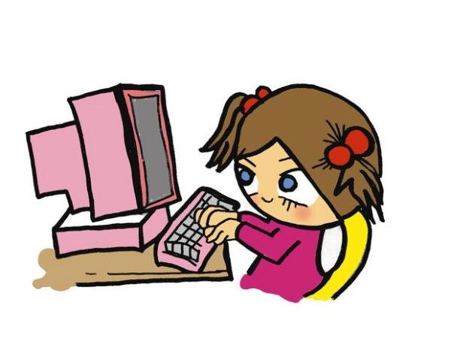
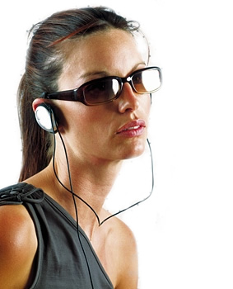
The Way to Get Suggestions
By Computer
By Earphones
or

Slide 9


Advantages
Download Countless Files from Internet

Slide 10
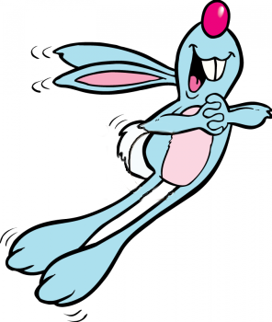

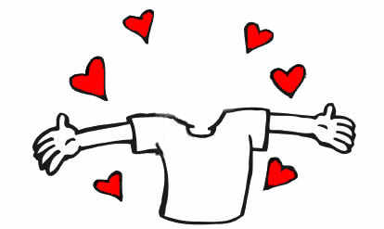


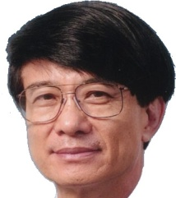


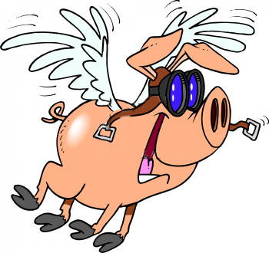

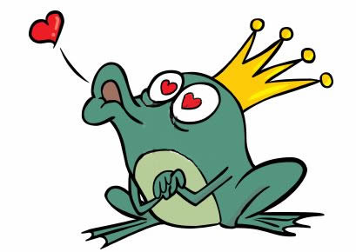




The Most Popular Person

Slide 11
©2009 Sonia, XIAO Sa
Thank You
I am Bridge. Please Take me home~

