Slide 1
FAA/EASA CERTIFICATE CLASSIFIER
End To End Project Overview using a
Convolutional Neural Network
February 2020
By: Jeff Tackes

Slide 2
Presentation Overview
Introduction to the business problem
Building the Raw Dataset
Exploratory Data Analysis & Data Augmentation
ImageDataGenerators
Loading Data
Creating more sample data
Preparing / Normalizing data
Building the Model
Defining CNN layers
Brief Overview on how CNN works
Predicting new data
Evaluating and interpreting the model results
Current Model Performance
Thoughts on improving performance
Next steps

Slide 3
INTRODUCTION
Aviation is highly regulated industry and requires strict documentation of installed components
All serialized components require 3 forms for complete airworthiness
FAA/EASA Shop Certificate (REQUIRED)
Trace
Non-Incident Statement NIS
Quality Control Shortcomings
Documents should be scanned and tagged appropriately on receipt
If missing documents, part should be quarantined until missing/revised paperwork received.
QC process does not always follow these procedures
Business Problem
Missing paperwork is not flagged until we go to ship the part
Requires us to scramble to locate/produce proper paperwork
Create risk to missing our service obligation to our customer
Business Proposal
To build and train an image classifier using a CNN to identify a CERT from a NONCERT.

Slide 4
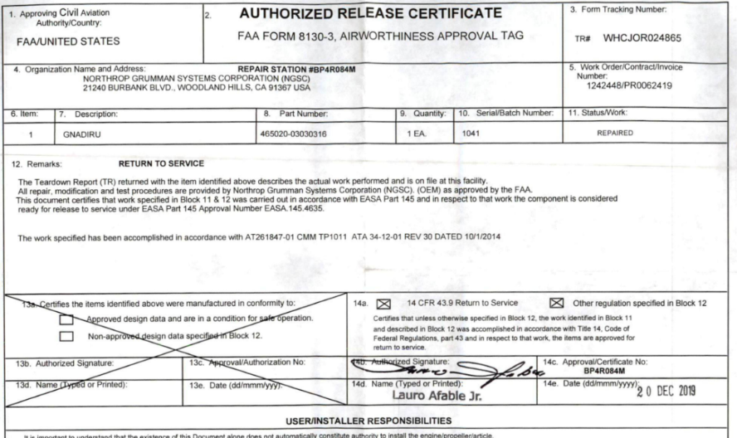
Building Dataset
ERP System Challenges
Gathering and creation of raw dataset
Manually Download system images and documents to create dataset
Files consist of a mix of JPGs, TIFs, and PDFs.
PDFs require splitting by page and conversion to JPG
Each individual image then needs review and placed in to the correct class
CERT
NONCERT
Bigger is better, but need to start somewhere.
Constructed dataset with a minimum of 100 images in each class for my training data.

Slide 5



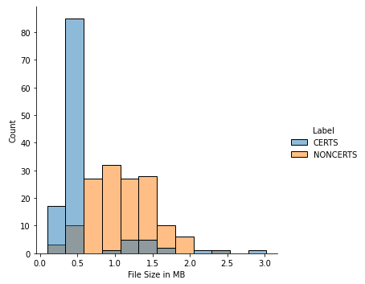
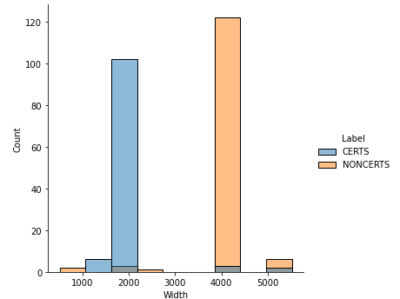
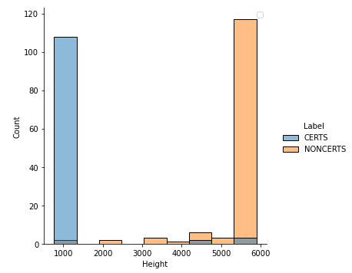
Exploratory Data Analysis
Height / Width / File Size
NonCerts are considerably larger than CERTs both in file size and dimensions
I can also now see how much training data I have
113 Training CERTS and 134 NONCERTS

Slide 6
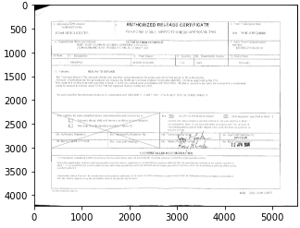
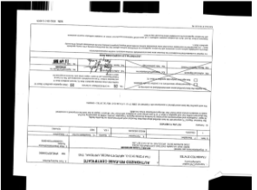
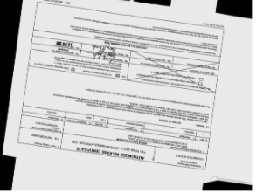
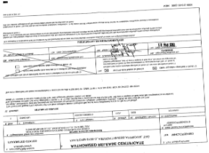
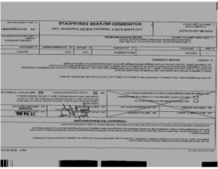
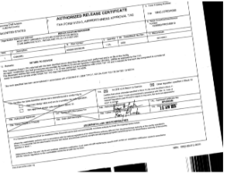
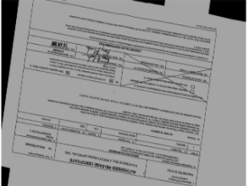
Data Augmentation
Original Raw Image
Augmented Images
Used Keras ImageGenerator() to load and augment our images
Original Dataset had 247 Images, with 113 CERTS
I performed 10 epochs, with new version of the image at each epoch. Thus our dataset was expanded to 2,470 images.

Slide 7
Data Augmentation Parameters
Benefits of Keras ImageGenerators
Iteratively loads image batches, ideal for very large datasets
Allows for resizing on loading
Data Augmentation
train_datagen = ImageDataGenerator(
rescale=1. / 255,
shear_range=0.1,
zoom_range=0.1,
horizontal_flip=True,
vertical_flip=True,
rotation_range=10,
brightness_range=[0.5,1.5],
width_shift_range=0.05,
height_shift_range=0.05)
Hyperparameters Explained
Rescale – Normalize our input data between values of 0 and 1
Sheer_range – Angle in counterclockwise rotation (distortion)
Zoom_range – Zoom in and out
Flips – Adds both horizontal and vertical flips
Rotation – Added 10 degree rotation
Brightness - + or – 50%
Shifts - + or - 5%

Slide 8
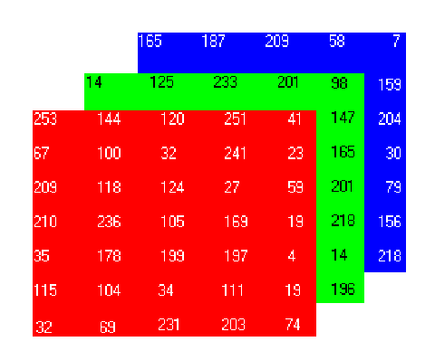
Building Data Generator
Keras Generator
Used our ImageDataGenerator previously discussed
Set our target width and height. This is where our EDA on size comes in. I used the min dimension as a baseline.
Since I need to work with square images, I used the min for both dimensions.
Batch_size – Used 32 which is pretty standard for smaller datasets.
Color_mode – Grayscale to reduce dimensions and since color is not meaningful
Class_mode – Outputs a 2D one-hot encoded labels
train_generator = train_datagen.flow_from_directory(
TRAIN_PATH,
target_size=(img_width, img_height),
batch_size=batch_size,
color_mode = 'grayscale',
class_mode='categorical')

Slide 9
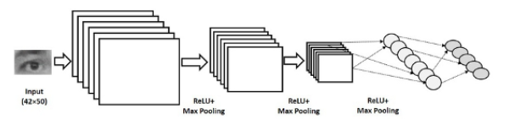
Building Model
3 Layer types
Convolutional Layer
Pooling Layer
Fully Connected Layer
Layer 1 & 2
32 filters – (3,3) Kernel
May want to increase to (5,5) to learn larger spatial features in early layers
MaxPooling (2,2) – Reduces spatial dims by half
Finds strongest features
Detects Simple Features
Layer 3
Similar to first 2 layers with 64 filters
Spatial Volume is decreasing but # of filters is increasing
Detects more complicated features
Layer 4
Our fully connected layer
Flattens our data into a 1-D array for inputting in to next layer
Layer 5
Classifier Layer
Uses Softmax (multiclass) or sigmoid (2-class)
K.clear_session() model = Sequential()
model.add(Conv2D(32, (3, 3), input_shape=input_shape)) model.add(Activation('relu')) model.add(MaxPooling2D(pool_size=(2, 2)))
model.add(Conv2D(32, (3, 3))) model.add(Activation('relu')) model.add(MaxPooling2D(pool_size=(2, 2)))
model.add(Conv2D(64, (3, 3))) model.add(Activation('relu')) model.add(MaxPooling2D(pool_size=(2, 2)))
# Fully Connected Layer model.add(Flatten()) model.add(Dense(64)) model.add(Activation('relu'))
# Classifier / Output Layer model.add(Dropout(0.5)) model.add(Dense(2)) model.add(Activation('sigmoid'))
opt = keras.optimizers.Adam(learning_rate=0.01)
model.compile(loss='binary_crossentropy',
optimizer=opt,
metrics=['accuracy'])
model.summary()

Slide 10
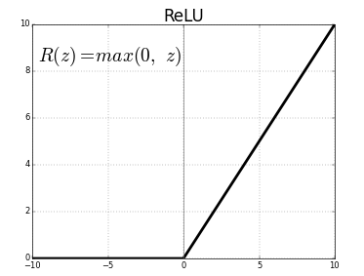
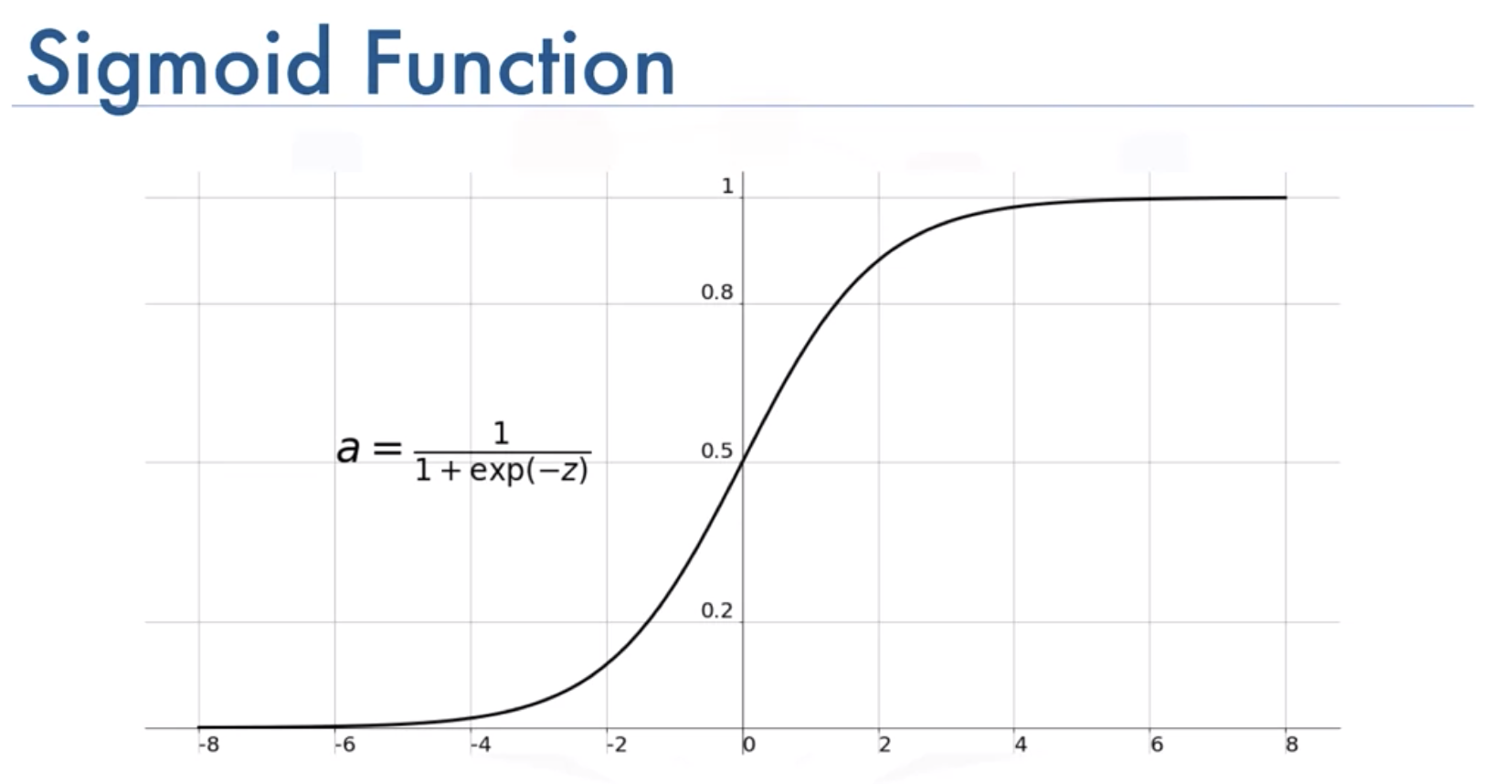
Activation Functions
Inner Layers - Relu
First it's Non-Linear( although it's acts like a linear function for x > 0)
ReLU is cheap to compute. Since it's simple math, model takes less time to run
Outer Layer – Sigmoid
Could also use Softmax (usually for multiclass)
Exists between 0 & 1
Useful when needing to predict probability

Slide 11
Convolutional Neural Networks Explained
CNN Layers – Convolutional Layer
Convolutional Layer
Purple represents our input values
Tan represents Filter/Weights
Animated Gif Complements of: https://i.stack.imgur.com/uEoXw.gif

Slide 12
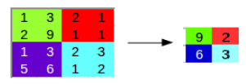
Convolutional Neural Networks Explained
CNN Layers – Pooling Layer
Pooling layer
Reduced Size of inputs
Increase speed of calculation
Commonly use MaxPooling
Convolutional Layer Output
MaxPooling Layer Output

Slide 13
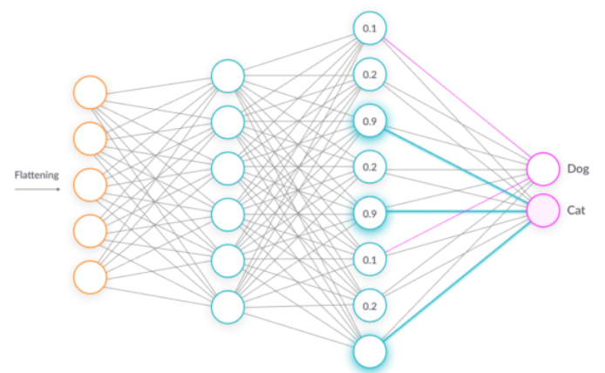
Convolutional Neural Networks Explained
CNN Layers – Fully Connected Layer
Fully Connected Layer
Objective is to take the results of the convolution/pooling process and use them to classify the image into a label.
Output of convolution/pooling is flattened into a single vector of values, each representing a probability that a certain feature belongs to a label.
CERT
NONCert

Slide 14
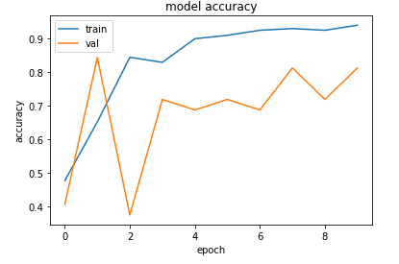
Evaluate Performance (Validation Data)
Accuracy
Model trained accuracy is in mid 90s, while validation accuracy is ~80%.
Possible Overfitting given the large variance in results
Typically accuracy is a great metric to use in a binary classifier if the 2 classes are about balanced. Ours is not,
will need to look at other metrics as well.
Validation (80 Noncerts to 40 Certs)
Overfitting Reduction Tactics
Add more data
Use data augmentation
Use architectures that generalize well
Add regularization
Dropout - randomly switches node to 0. (Most common in deep learning)
Forces model to learn other features
L1 or L2 Regularization
Reduce architecture complexity.

Slide 15


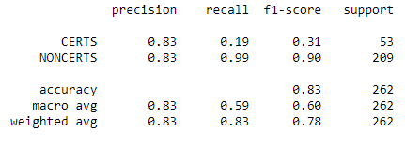
Evaluate Performance (Test Data)
Accuracy – 83% looks good but data is not balanced
Precision – % of those predicted to be part of a particular class, were actually a part of that class.
Recall - % of actual positives the model captures
F1 – Weighted Average of Precision and Recall

Slide 16
Note on Final Performance
I did not have a ton of images to train the model. I attempted to expand my training set using data augmentation. I also have about 20% more NONCERT examples than CERT examples. It is quite possible that the poor performance identifying certs is due to not having enough data. AAR has literally millions of these images loaded in to our system, the challenge is extracting the data at mass to be able to perform analysis on them. I am very confident, that if we increased the dataset size, our CERTS performance would significantly improve.

Slide 17
Next Steps
More Data
Clearly our results are not where I want them to be yet, however this model does show promise as it does perform better than random guessing. With only a couple hundred samples to train on, the data is insufficient to learn enough features to be able to generalize to new data.
GPU Processing
GPUs can process CNNs magnitudes faster than the CPU. The CPU worked fine for this relatively small dataset, but in the production environment with hundreds of thousands of images, I will need to take advantage of the GPUs processing power. It will also allow me to test out larger training datasets and more data augmentation.
Implement model in production environment.
This will require the support of my IT department, since accessing the images on the backend requires special permissions. We are currently working on transitioning our backend storage of our images to BOX, which we can then also take advantage of AZURE computing power.
Expand classifier to detect other document types
This classifier was focused around identify the FAA/EASA CERT form. The other 2 critical items I need to identify are the airline trace document and None Incident (NIS) form.

