Slide 1
Time Series Bootcamp · Day 2
Deep learning, foundation models and advanced topics
Weekly retail sales · 18,692 products · one supermarket
neuralforecast · statsforecast · mlforecast · timecopilot · polars
Notes:
Welcome back. Yesterday: baselines, evaluation, gradient boosting. Today: neural global models, tuning, covariates, foundation models, hierarchy, uncertainty, and how to pick and combine models. Same data, same split, same leaderboard.

Slide 2
Today
Time | Segment | Type | Notebook
0:00 | Recap and handoff: Day 1 leaderboard | talk | 00
0:10 | Deep learning for global modelling | talk
0:25 | ML vs NNs: transforms, features, parameters, evaluation, losses | talk
0:45 | Default training with GFMs | lab | 01
1:05 | Hyperparameter optimisation | lab | 02
1:35 | Break
1:50 | Exogenous variables and responsiveness | lab | 03
2:20 | Foundation models | talk
2:40 | Foundation models: tune or not? | lab | 04
3:10 | Hierarchy and coherence | lab | 05
3:30 | Uncertainty: scoring rules and conformal | talk + demo | 06
3:50 | Model selection and ensembling | lab | 07
4:10 | Final standings |  | 07
Time Series Bootcamp · Day 2
2 / 43
Notes:
255 minutes. Labs are designed so the core cells run in the slot on a laptop CPU with the default 2,000-series sample. Anyone with a GPU can set BOOTCAMP_N_SERIES=0 and BOOTCAMP_MAX_STEPS=1500.

Slide 3
Recap: the rules of the game
2023-07-05 ────────── train ────────── 2025-04-16 ─── test (14 weeks) ─── 2025-07-16
valid (last 14 train weeks) ┘
Target: weekly sales_units per item · horizon 14 weeks · weeks start on Wednesday (W-WED)
Score: mean RMSSE, scaled by each series' in-sample 52-week seasonal-naive error
Also: median RMSSE, MASE, sMAPE, WAPE (volume-weighted), fit time
Same stratified 2,000-series sample in every lab (bootcamp.load_panel())
Every lab ends with bc.record(...) → one row per model in results/day2/leaderboard.csv
Time Series Bootcamp · Day 2
3 / 43
Notes:
Run notebook 00 live. It rebuilds the Day 1 references (Naive, SeasonalNaive, AutoETS, LightGBM) so the leaderboard is never empty. If participants kept results/day1/leaderboard.csv, it is shown too.

Slide 4
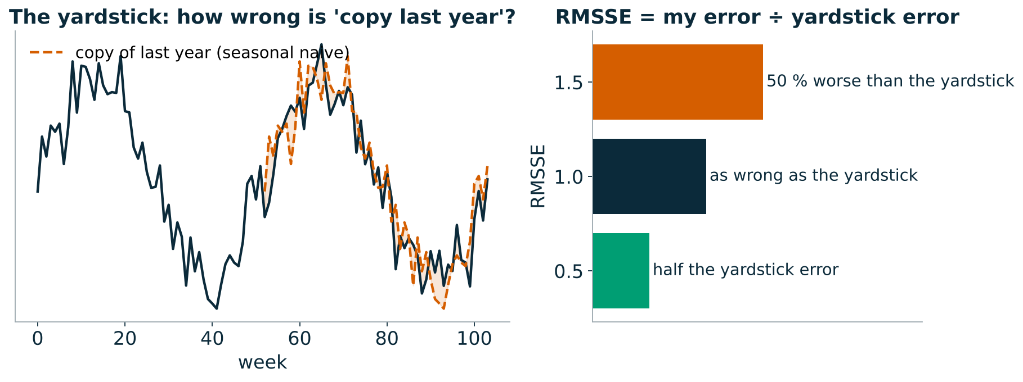
Reading RMSSE in one picture
INTUITION
The yardstick is "copy the same week last year", measured on each item's own history. RMSSE = my error ÷ the yardstick's error
0.6 means 40 % smaller errors than the yardstick. Scale-free: a 600-unit item and a 150k-unit item count the same
Above 1 is normal out of sample: the yardstick was measured on the past, our forecast is judged on a future it has not seen
Time Series Bootcamp · Day 2
4 / 43
Notes:
Intuition first, formula never. Ask the room: if RMSSE were 1.0 for every item, what would that mean? (We are exactly as good on the future as copying last year was on the past.) Make sure everyone can read a leaderboard number before the labs start.

Slide 5
Recap: Day 1 leaderboard
What we learned
Open questions for today
Seasonal naive is hard to beat on slow movers
A global GBDT with lags, calendar and price/promo features was the strongest model
Mean RMSSE treats every series equally; class J (slow movers) is ~2/3 of series
Is the GBDT strong because it is global, or because it sees covariates?
Can a neural net learn the features we hand-built?
What does it cost?
Does any of it respond to price the right way?
Time Series Bootcamp · Day 2
5 / 43
Notes:
Show the leaderboard printed at the end of notebook 00. Ask the room the two handoff questions at the end of the notebook.

Slide 6
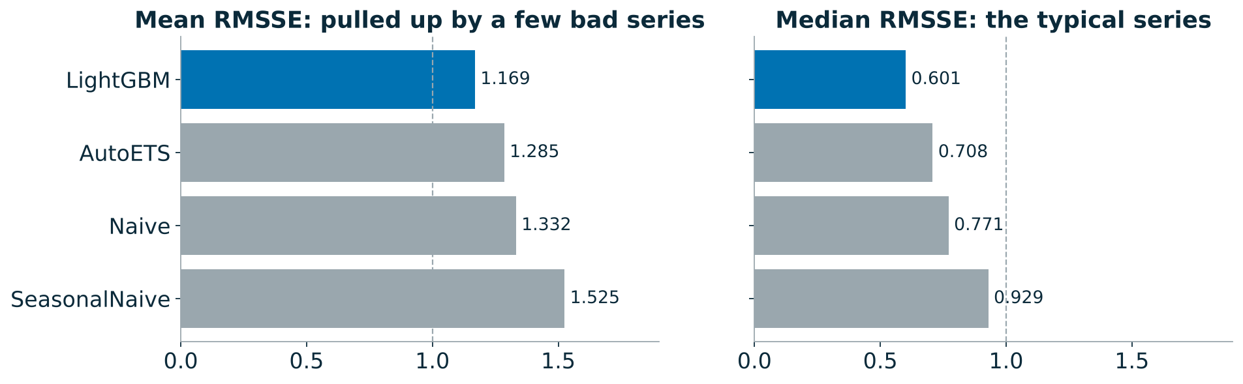
Day 1 in one picture
WHAT WE FOUND
Last week beats last year (Naive 1.33 vs SeasonalNaive 1.52): with under two years of history and promotions that move around the calendar, "the same week last year" is a weak guide
Mean 1.17, median 0.60: the typical item is forecast well; a minority of erratic, promo-driven items drags the mean up. Keep both numbers in view all day
Time Series Bootcamp · Day 2
6 / 43
Notes:
Numbers are from the reference run (2,000-series sample). Your room's numbers will be close but not identical. The mean/median gap comes back in lab 07, where 22 % of series turn out to make half of the mean.

Slide 7
Deep learning for global modelling
Global model = one set of parameters shared by all series, trained on windows sampled from every series.
Learns patterns that recur across series (promo spikes, seasonal shapes, launch curves)
Works for short and new series that a local model cannot fit
Training cost scales with windows sampled, not with number of series × models
The three architectures we use today, all in neuralforecast:
 | N-BEATS | N-HiTS | TFT
Core | stacked MLP blocks, backcast/forecast residuals | N-BEATS + multi-rate pooling + interpolation | LSTM encoder + attention + variable selection
Decomposition | optional (trend/seasonality basis) | implicit, by frequency band | none
Covariates | future + static (NBEATSx) | future + historic + static | future + historic + static, gated
Speed | fast | fastest | slow
Time Series Bootcamp · Day 2
7 / 43
Notes:
15-minute segment. Emphasise: these are all window-based global MLPs or seq2seq models, not "magic". N-BEATS: Oreshkin et al. 2020, won M4 among pure DL. N-HiTS: Challu et al. 2023, cheaper and better at long horizons. TFT: Lim et al. 2021, interpretability via variable selection weights and attention.

Slide 8
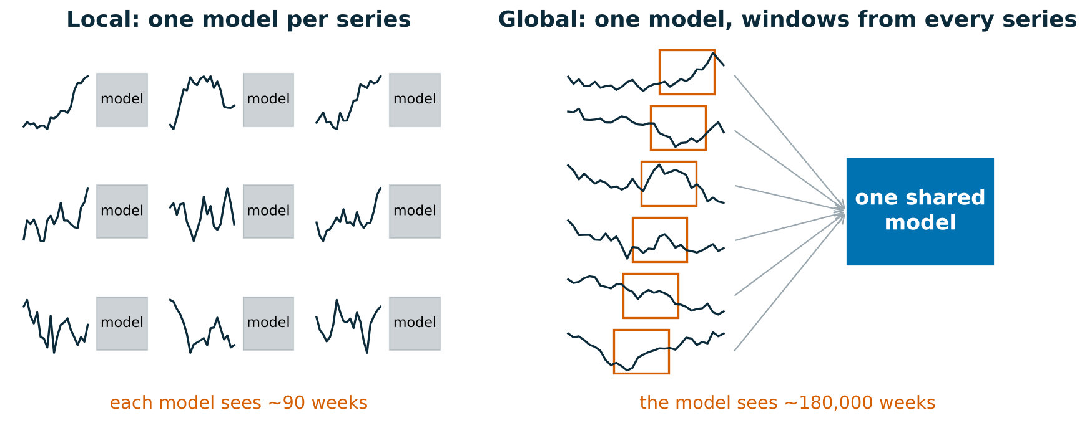
Why one model for 2,000 series works
INTUITION
A local model is a shop assistant who has only ever watched one shelf. A global model has watched the whole store, so it recognises a promo spike it has seen thousands of times, even on a brand-new item
The catch: it learns typical behaviour. Per-window scaling and covariates are how it adapts to each item
Time Series Bootcamp · Day 2
8 / 43
Notes:
This is the single most important idea of the morning. The data per local model is ~90 weeks; the global model sees about 180,000 weeks. Everything else (N-BEATS, N-HiTS, TFT, LightGBM with lags) is a different way of learning from that pooled data.

Slide 9
N-BEATS in one slide
Input: the last input_size values · output: the next h
Each block: MLP → coefficients θ → backcast (explains the input) and forecast
Next block sees the residual of the input: doubly residual stacking
Generic stack: θ maps through a learned linear basis
Interpretable stack: θ are coefficients of a polynomial trend and Fourier seasonality basis → the forecast is a sum of trend + seasonality components you can plot
N-HiTS adds max-pooling on the input (each stack looks at a different time resolution) and predicts a few points that are interpolated to the horizon: fewer parameters, faster, smoother.
Time Series Bootcamp · Day 2
9 / 43
Notes:
Lab 01 trains both generic and interpretable N-BEATS so the room can see whether the decomposition prior helps on two years of weekly data. In the reference run it made no difference to accuracy (1.216 vs 1.216): there are only ~1.8 seasonal cycles to learn from.

Slide 10
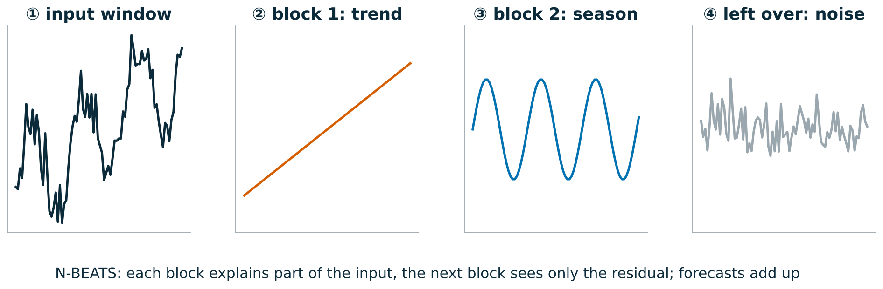
N-BEATS as a relay race
INTUITION
Each block is a runner: it explains the part of the input it can, subtracts it, and hands the rest to the next runner. The forecast is the sum of what every runner carried
Interpretable N-BEATS forces runner 1 to be a trend and runner 2 a season, so you can plot each piece
N-HiTS runs the same relay, but runners look at blurred (pooled) inputs, from coarse to fine: cheaper and smoother
Time Series Bootcamp · Day 2
10 / 43
Notes:
If people remember one picture of N-BEATS, make it this one. Residual stacking is just "explain, subtract, pass on". The interpretable variant is the same machine with a constraint on what each block may output.

Slide 11
Temporal Fusion Transformer in one slide
Variable selection networks weigh each covariate per time step
Static covariate encoders condition everything on item attributes
LSTM encoder–decoder for local patterns, multi-head attention for long-range ones
Natively outputs quantiles
Interpretable: variable importances and attention patterns
Cost: an order of magnitude slower to train than N-HiTS on the same data; benefit grows with rich, informative covariates and long histories.
Time Series Bootcamp · Day 2
11 / 43
Notes:
Mention that TFT is in lab 01 behind RUN_TFT=False because on a CPU it does not fit in the 20-minute slot.

Slide 12
Neural global models vs GBDTs
 | GBDT (LightGBM via mlforecast) | Neural GFM (neuralforecast)
Features | you build them: lags, rolling stats, calendar | learned from the raw window (+ covariates)
Multi-step | recursive or one model per step | direct: whole horizon at once
Scaling | target transforms per series | per-window scaler inside the model
Training cost | minutes on CPU | minutes to hours, GPU preferred
Inference cost | cheap, CPU | cheap per batch, GPU helps
Tuning burden | moderate, robust defaults | sensitive: lookback, lr, steps
Monotone constraints | built in | not available
Probabilistic | quantile objective or conformal | quantile / distribution losses
Evidence: M5 (Walmart) was won by LightGBM ensembles; N-BEATS / N-HiTS shine on long, regular series and many horizons.
Time Series Bootcamp · Day 2
12 / 43
Notes:
Costs to call out: GPU hours, engineering time for feature pipelines, MLOps (two very different stacks), and serving latency. For a weekly batch job of 20k series, both are cheap to serve; the real cost is training and tuning iterations.

Slide 13
ML vs NNs (1/3): transforms and features
Transformations
GBDTs: transform the target per series (LocalStandardScaler, log1p, differences) and invert after prediction
NNs: scale each input window (scaler_type="robust" | "standard" | "revin"); one global scaling fails when series differ by 5 orders of magnitude (class A ≈ 150k units/week, class J ≈ 600)
Zero-heavy series: log transforms need an offset; robust scaling needs non-zero IQR
Feature engineering
GBDTs need lags, rolling means, calendar, price features spelled out
NNs learn lags from the window but still need covariates (price, promo) and benefit from calendar features at weekly resolution
Hierarchy ids: categorical features for GBDTs; for NNs use embeddings or numeric static covariates (log mean sales, share of zero weeks, share of promo weeks). A raw id fed as a number is meaningless
Time Series Bootcamp · Day 2
13 / 43
Notes:
20-minute segment total for the three ML vs NN slides. Live: show `bootcamp._add_price_features` – these relative price features are shared by LightGBM and NHITSx in lab 03.

Slide 14
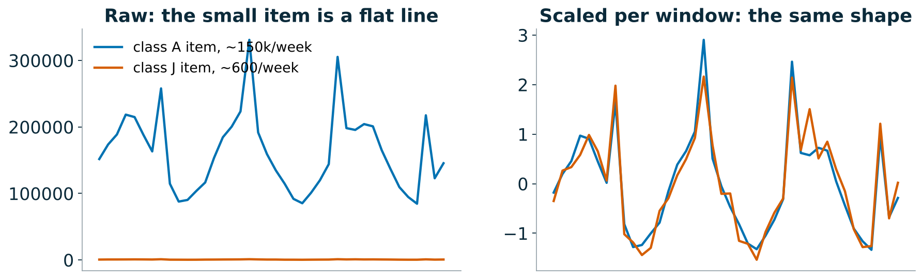
Scaling: compare shapes, not sizes
INTUITION
Unscaled, a class J item (~600/week) is a flat line next to a class A item (~150k/week), and the network learns only the big ones
Scaled per window, both show the same shape: what the global model actually needs to learn. The forecast is scaled back afterwards
Same reason covariates must be relative (price index, discount depth): a raw price of 0.99 vs 39.99 says nothing about a discount
Time Series Bootcamp · Day 2
14 / 43
Notes:
This is why NHITSx broke during preparation when we fed raw sale prices: the network saw "expensive item" instead of "cheaper than usual". Lab 03 uses scale-free covariates and scaler_type="standard".

Slide 15
ML vs NNs (2/3): parameters and evaluation
What you tune
GBDT | NN
num_leaves, learning_rate, n_estimators | input_size (lookback), learning_rate, max_steps
min_data_in_leaf, regularisation | scaler_type, loss, batch_size
which lags / windows | architecture size (rarely matters)
How you evaluate
Both: temporal holdout + rolling-origin cross-validation, never random K-fold
NNs: validation window inside training for early stopping (val_size=h)
NNs are stochastic: re-run with 3 seeds before believing a 1 % difference
Report fit time next to accuracy
Time Series Bootcamp · Day 2
15 / 43
Notes:
Seed variance is the thing most people skip. In lab 01 the two CV folds give the noise floor.

Slide 16
ML vs NNs (3/3): loss functions
Loss | Estimates | Use when
MSE | mean | metric is RMSE/RMSSE, few outliers
MAE | median | metric is MAE/MASE, robust to spikes; median of intermittent series can be 0
Huber | between the two | promo spikes + RMSE-type metric
Poisson / Tweedie | mean of counts | intermittent, non-negative demand (GBDT objective; DistributionLoss in NNs)
Quantile / MQLoss | quantiles | intervals, asymmetric costs (stock-outs vs waste)
Match the loss to the metric and to the decision. Training on MAE and scoring on RMSSE is a common silent mismatch.
Time Series Bootcamp · Day 2
16 / 43
Notes:
Lab 02 includes loss in the sensitivity sweep so participants can see how much it matters on this data.

Slide 17
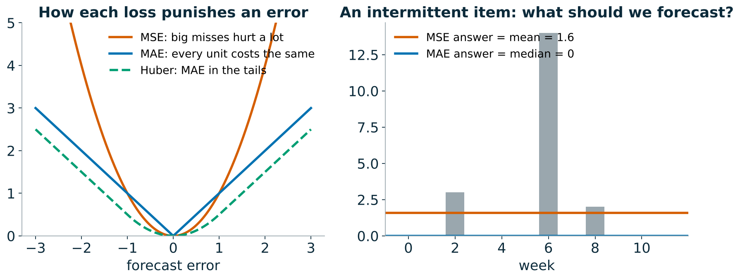
The loss decides which number you get
INTUITION
Train on MSE and the model aims for the mean; train on MAE and it aims for the median
For an item that sells nothing most weeks, the median is 0: an MAE model may happily forecast zero, and stock nothing
Pick the loss for the decision: the mean for volume planning, a high quantile for avoiding stock-outs
Time Series Bootcamp · Day 2
17 / 43
Notes:
Ask: which number do you want for a slow mover that sells 0, 0, 3, 0, 0, 0, 14? The answer depends on what you do with it, which is the point. Lab 02 shows the loss is the most influential knob on this data.

Slide 18
Default training with GFMs
LAB · 01 · 20 min
Wrangle: polars panel → pandas long format; check gaps, duplicates, weekday, scale spread
Split: train / valid (early stopping) / test; 2-fold rolling-origin CV on train for the noise floor
Train with defaults: NHITS · N-BEATS generic · N-BEATS interpretable (trend + seasonality) · DLinear (moving-average decomposition) · TFT optional
bc.record(...) → leaderboard
Discuss: did decomposition help? How does fit time compare with LightGBM?
Time Series Bootcamp · Day 2
18 / 43
Notes:
Expected result on CPU with defaults (500 steps): neural models land between LightGBM (1.17) and AutoETS (1.29); NHITS at about 1.19. The results slide that follows has the reference numbers and how to read them.

Slide 19
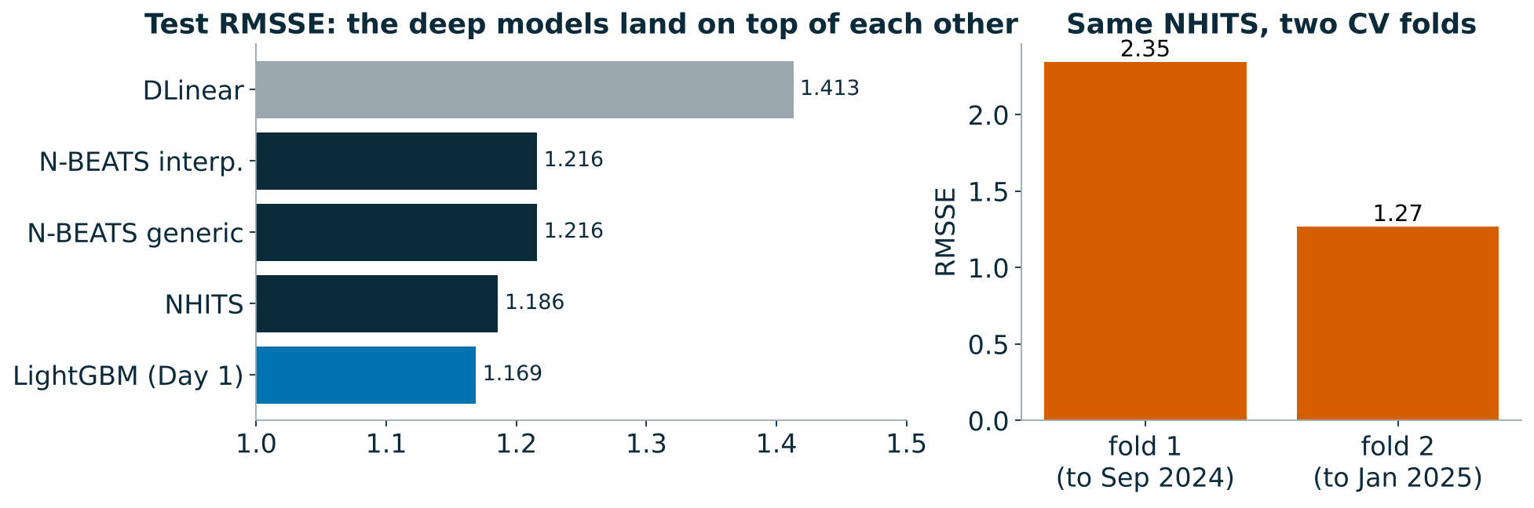
Lab 01: what we found
WHAT WE FOUND
The deep models land on top of each other (1.19–1.22) and next to LightGBM (1.17). DLinear, a linear model, is clearly worse: weekly retail is not linear
Interpretable = generic (1.216 vs 1.216): the trend/season prior costs nothing and buys plots, but 1.8 yearly cycles are too few to learn a season from
The noise floor: the same NHITS scores 2.35 or 1.27 depending on which 14 weeks it is tested on. A 0.03 gap between models on one window may well flip on the next
Cost: 20–30 s per neural fit vs 1.6 s for LightGBM
Time Series Bootcamp · Day 2
19 / 43
Notes:
Reference run, CPU, 500 steps. Turn the room's attention to the fold bars: the period you test on moves the score far more than the model choice does. This sets up lab 02: if a tuning gain is smaller than this, it is not a gain.

Slide 20
Hyperparameter optimisation
LAB · 02 · 30 min
Part 1: one-at-a-time sensitivity (scored on the validation window, not the test)
vary input_size, learning_rate, scaler_type, loss, max_steps, mlp_units, n_blocks
plot the RMSSE spread per parameter → that ranking is your tuning budget
Part 2: Optuna TPE search with AutoNHITS over the parameters that mattered, fANOVA importances, refit, score
Usually worth tuning | Usually not
lookback, learning rate, steps, scaler, loss | layer width, number of blocks, activation
Time Series Bootcamp · Day 2
20 / 43
Notes:
Ask: compare each spread to the CV fold-to-fold spread from lab 01. Anything smaller is noise. If the room is short on time, cut the GRID to input_size, learning_rate and mlp_units.

Slide 21
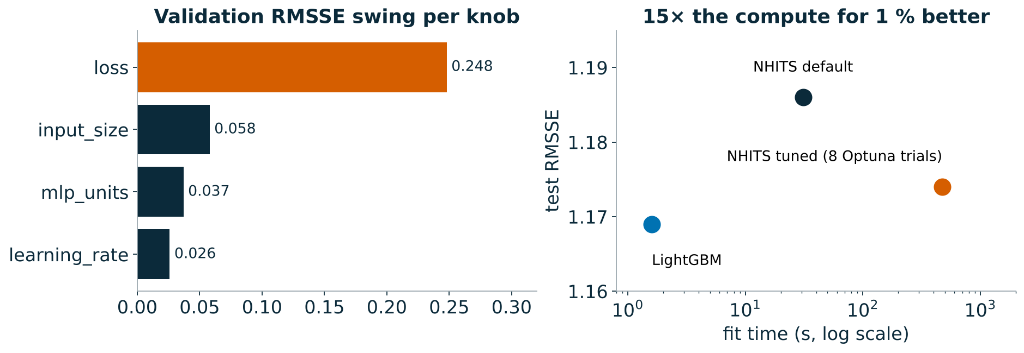
Lab 02: what we found
WHAT WE FOUND
The loss was the big knob: MSE 1.51 vs MAE 1.26 on validation. MSE chases the promo spikes and overshoots every normal week
Lookback, width and learning rate each moved the score by less than 0.06: small next to how much the score moves between test periods
Optuna: 8 trials, 474 s, test RMSSE 1.186 → 1.174. That is 15× the compute for 1 %, and LightGBM is still ahead
Rule of thumb: get the loss and the scaling right, then stop tuning
Time Series Bootcamp · Day 2
21 / 43
Notes:
fANOVA on the Optuna study put 97 % of the importance on the learning rate, but only within the narrow range we searched; the one-at-a-time sweep is the more honest picture of "what is worth tuning" here.

Slide 22
Break · 15 min

Slide 23
Exogenous variables and responsiveness
LAB · 03 · 30 min
Covariate type | Example | Known in the future?
future (futr_exog_list) | planned price, promo flag, discount depth | yes, by plan
historic (hist_exog_list) | competitor price, footfall | no
static (stat_exog_list) | log mean sales, share of zero / promo weeks | constant
Response-curve checks: shift price −25 % … +25 %, switch promos on/off, re-forecast.
Price curve should slope down; promo lift should be positive and close to the empirical lift
Arc elasticity per series; share of perverse (> 0) and flat responses
LightGBM with monotone_constraints forces the sign; a NN cannot
For a global NN, covariates must be scale-free (price_index, discount_depth), not raw prices
Time Series Bootcamp · Day 2
23 / 43
Notes:
Key message: an accurate forecast that does not respond to price is useless for promo planning. Confounding: retailers cut prices when they expect high demand, so naive models can learn price↑ → sales↑.

Slide 24
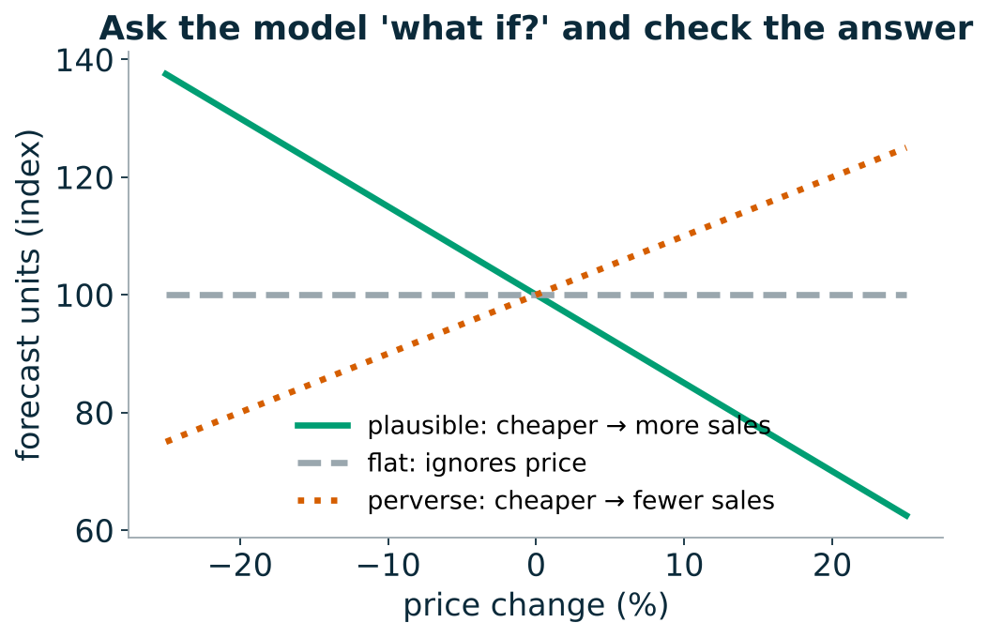
Accuracy vs responsiveness
INTUITION
Accuracy asks: did you predict what happened?
Responsiveness asks: if we changed the price, would you predict the right thing?
A model can score well and still answer "what if?" wrongly: it may have learned when promos happen, not what they do
Confounding: retailers discount when they expect demand to be high, so the data alone can suggest "cheaper → fewer sales"
Time Series Bootcamp · Day 2
24 / 43
Notes:
Analogy: ice-cream sales and sunburn rise together; banning ice cream does not prevent sunburn. The model sees promotions and high sales together but cannot tell which way the arrow points without a check like the response curves in this lab.

Slide 25
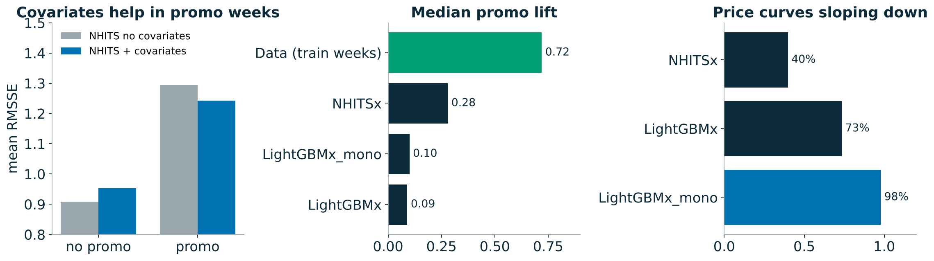
Lab 03: what we found
WHAT WE FOUND
Covariates help where they carry information: in promo weeks NHITS improves 1.29 → 1.24; in ordinary weeks it gets slightly worse (0.91 → 0.95)
Direction mostly right: fewer than 2 % of price curves point the wrong way, and the monotone constraint makes 98 % of LightGBM curves slope down
Size wrong: the data shows a +72 % median promo lift; models predict +9 % to +28 %. Global models pull every item toward the average week, so they are timid
Check lifts against the data before anyone plans a promotion with them
Time Series Bootcamp · Day 2
25 / 43
Notes:
The headline for the room: the best-scoring model on the leaderboard under-predicts what a promotion does by a factor of 2.5. Accuracy and responsiveness are different questions.

Slide 26
Foundation models for time series
Pretrained on large, diverse corpora; forecast new series zero-shot from the context window.
Model | From | Idea | Covariates
Chronos / Chronos-Bolt | Amazon | T5 on scaled, quantised values / patches | no
Chronos-2 | Amazon | encoder with group attention across series and covariates | past + future, in-context
TimesFM | Google | decoder-only, patched input | limited (via regression)
Moirai | Salesforce | any-variate masked encoder | yes
TabPFN-TS | Prior Labs | tabular prior-fitted network on time features | yes, as columns
timecopilot wraps these (and statsforecast / neuralforecast models) behind one forecast(df, h, freq) API.
Time Series Bootcamp · Day 2
26 / 43
Notes:
20-minute segment. Stress the pattern: patching/tokenising + transformer + huge pretraining corpus + mean/quantile heads. Chronos-2 and TabPFN-TS are the ones that use covariates, which matters for this retail data.

Slide 27
Foundation models: the well-travelled forecaster
INTUITION
Zero-shot: a consultant who has seen millions of series from every industry, but never your shop. You show them the last 93 weeks and ask for the next 14
Covariates in context: Chronos-2 reads your promo calendar like notes in the margin, without retraining
What to look for in lab 04: is zero-shot within a few percent of our best model? If so, it is a strong baseline for almost no effort. Fine-tune only if validation says it clearly helps
Fine-tuned: the same consultant after a week of induction on your data. Better on your quirks, but you now pay for training and can overfit
Time Series Bootcamp · Day 2
27 / 43
Notes:
Lab 04 was not executed in the reference run (no access to Hugging Face from the build machine), so there are no reference numbers. Fill in the decision table live with the room's results.

Slide 28
Zero-shot vs fine-tuned
Zero-shot
Fine-tuned (full or LoRA)
No training: minutes to first forecast
Strong on regular, seasonal series
Knows nothing about your promo calendar unless the model takes covariates
Benchmark caveat: public test sets may be in the pretraining data
Adapts to your domain: intermittency, promo spikes
Needs enough series, a validation window and GPU time
Risk: overfitting / forgetting with little data
You now own a training pipeline again
Context length: Chronos-2 and TimesFM 2.5 accept thousands of points; our weekly series have ≤ 93 training weeks, so context is not the bottleneck here; covariates are.
Time Series Bootcamp · Day 2
28 / 43
Notes:
Ask the room: with 93 weeks of history, what does a model with 8k context buy you? (Nothing; the value is the prior learned across millions of series.)

Slide 29
Inference cost
 | Params | Hardware | Relative cost per 1k series
SeasonalNaive / ETS | — | CPU | ≈ free
LightGBM | ~MB | CPU | low
NHITS | ~1–5 M | CPU / GPU | low (after training)
Chronos-Bolt (small/base) | 48–205 M | CPU ok, GPU better | medium
Chronos-2 | ~120 M | GPU preferred | medium–high
TabPFN-TS | ~10s of M, per-series fitting | GPU preferred | high
Rule: measure seconds per 1,000 series in lab 04 and put it next to RMSSE.
Time Series Bootcamp · Day 2
29 / 43
Notes:
Numbers are orders of magnitude; the lab measures the real ones on your hardware. TabPFN-TS runs a forward pass per series with its own feature table, so it scales worst with the number of series.

Slide 30
Foundation models: tune or not?
LAB · 04 · 30 min
Zero-shot via timecopilot: Chronos-2 (with and without covariates), TabPFN-TS on a subset
Fine-tune Chronos-2 on the training windows; compare on the validation window first
Measure seconds per 1,000 series
Fill in the decision table:
 | Accuracy gain vs tuned NHITS / LightGBM | Cost | Decision
zero-shot | ? | ?
fine-tuned | ? | ?
Time Series Bootcamp · Day 2
30 / 43
Notes:
Downloads: Chronos-2 weights come from Hugging Face; make sure the room downloaded them before the break (the notebook's first cell does it). On CPU, use the 500-series subset flag in the notebook.

Slide 31
Hierarchy and coherence
LAB · 05 · 20 min
Total → departments → classes → subclasses → items (from hierarchy.csv). Independent forecasts do not add up.
ỹ = S·G·ŷ — S sums bottom to all levels, G maps base forecasts to the bottom level.
Method | G uses | Good at
BottomUp | items only | items
TopDown / MiddleOut | the top / a middle level + proportions | top / middle
MinTrace ols · wls_struct · mint_shrink | all levels, weighted by (estimated) error covariance | usually all levels
Discuss: which level does the business consume, and which method wins there?
Time Series Bootcamp · Day 2
31 / 43
Notes:
Lab builds the hierarchy from hierarchy.csv with hierarchicalforecast.aggregate, AutoETS base forecasts, six reconcilers, coherence check and accuracy by level.

Slide 32
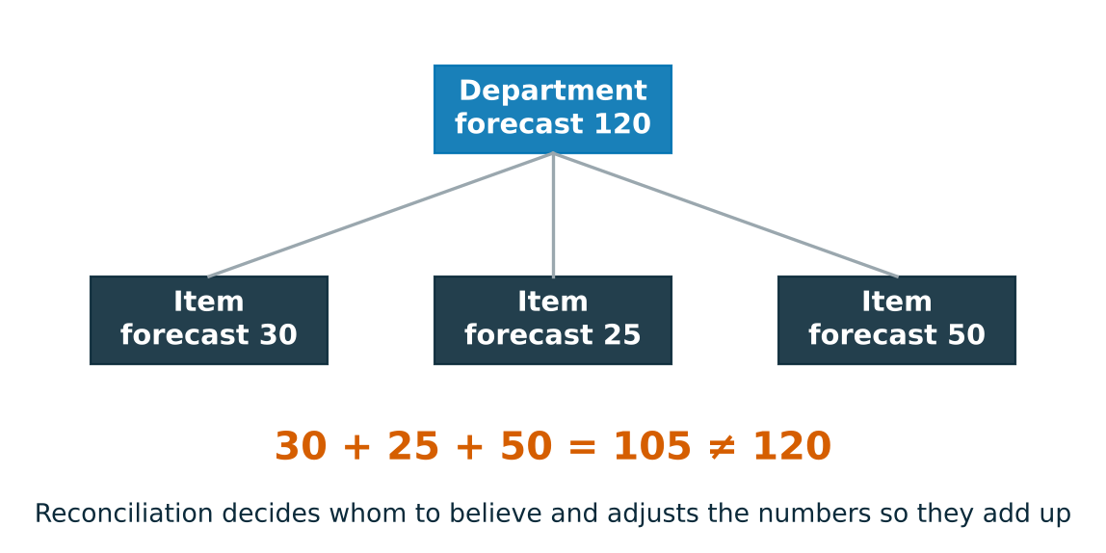
Coherence: the numbers must add up
INTUITION
Forecast every level separately and the items will not add up to the department, like a budget whose line items disagree with its total
BottomUp trusts the items, TopDown trusts the total and splits it by history
MinTrace trusts each level in proportion to how reliable it has been, and moves each number as little as possible
Time Series Bootcamp · Day 2
32 / 43
Notes:
Ask: who in the business reads which level? Buyers read items, finance reads departments and the total. Coherence matters because those people talk to each other.

Slide 33
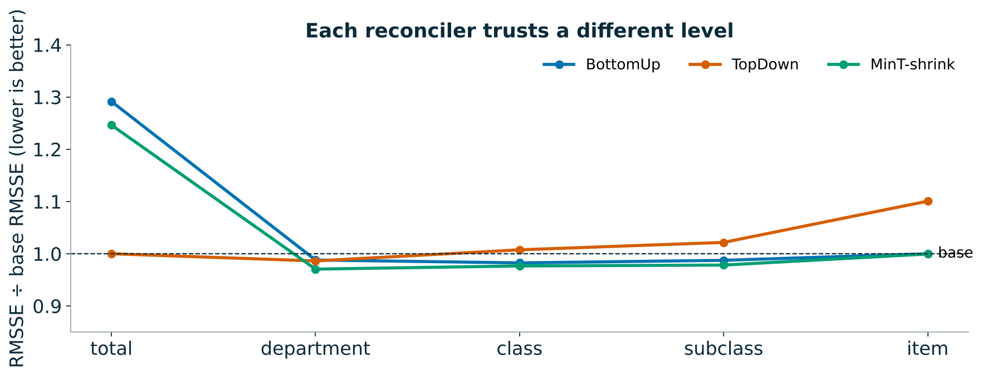
Lab 05: what we found
WHAT WE FOUND
BottomUp: items unchanged, but the total is 29 % worse: small item biases add up across 2,000 items
TopDown: the total is perfect, items are 10 % worse: fixed proportions miss item-level promotions
MinT-shrink: within a few percent of the best at every level, and coherent. Not shown: MinT-ols is 3–11× worse below the total, because it weighs a 600-unit item like a 150k one
On the item leaderboard, reconciliation even helped a little: AutoETS 1.285 → 1.251
Time Series Bootcamp · Day 2
33 / 43
Notes:
Ratios are relative to the incoherent base forecasts (lower is better). The take-away: reconciliation is cheap and rarely hurts, but the weights matter.

Slide 34
Uncertainty: what are we scoring?
A forecast for ordering stock is a distribution, not a number: quantiles, intervals, samples
Calibration: 80 % intervals contain the truth 80 % of the time
Sharpness: among calibrated forecasts, narrower is better
Proper scoring rule: the expected score is optimised only by reporting your true belief
Score | For | Formula (per observation)
Pinball / quantile loss | a quantile q_τ | max(τ(y−q), (τ−1)(y−q))
CRPS | full distribution | ∫ pinball over τ ≈ 2 · mean pinball over quantiles
Interval (Winkler) score | [l, u] at 1−α | (u−l) + (2/α)(l−y)₊ + (2/α)(y−u)₊
Scale them per series (like RMSSE) before averaging across series.
Time Series Bootcamp · Day 2
34 / 43
Notes:
20-minute segment with notebook 06 as the live demo. Coverage alone is not a score: [0, ∞) has 100 % coverage.

Slide 35
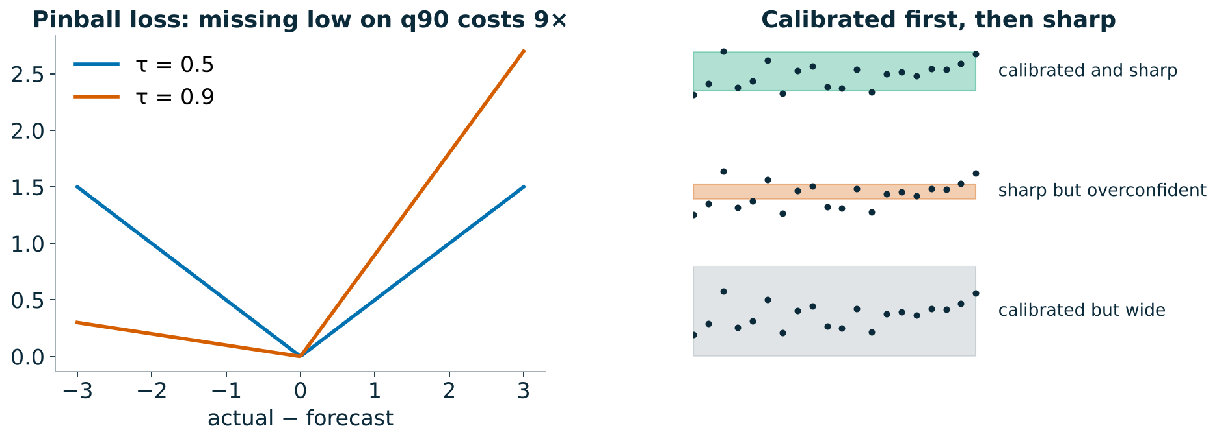
Calibration, sharpness and honest scores
INTUITION
A weather forecaster who says "30 % chance of rain" should see rain on about 30 % of those days: that is calibration
"Between 0 and 100 mm" is always right and useless: among calibrated forecasts, prefer the sharpest
A proper score rewards honesty: you cannot improve your expected score by reporting anything other than what you believe
Time Series Bootcamp · Day 2
35 / 43
Notes:
The pinball loss on the left is the whole idea of quantile forecasting: for the 90 % quantile, being 1 unit too low costs 9 times as much as being 1 unit too high, so the best answer sits high.

Slide 36
Conformal prediction
Split conformal around any point model:
Hold out calibration windows (rolling origins in the training data)
Conformity scores = |y − ŷ| on those windows, per horizon step
Interval = ŷ ± the (1−α) quantile of the scores
Guarantee: marginal coverage ≥ 1−α under exchangeability, in finite samples
Not guaranteed: coverage per series, per promo week, or under drift
Extensions: CQR (conformalise quantile-model intervals), adaptive CP for drift, per-segment calibration
In the stack: PredictionIntervals (mlforecast), ConformalIntervals (statsforecast); quantile losses (MQLoss) in neuralforecast.
Time Series Bootcamp · Day 2
36 / 43
Notes:
In the demo, plot coverage by velocity class: conformal intervals pooled across all series tend to over-cover fast movers and under-cover slow ones, or vice versa.

Slide 37
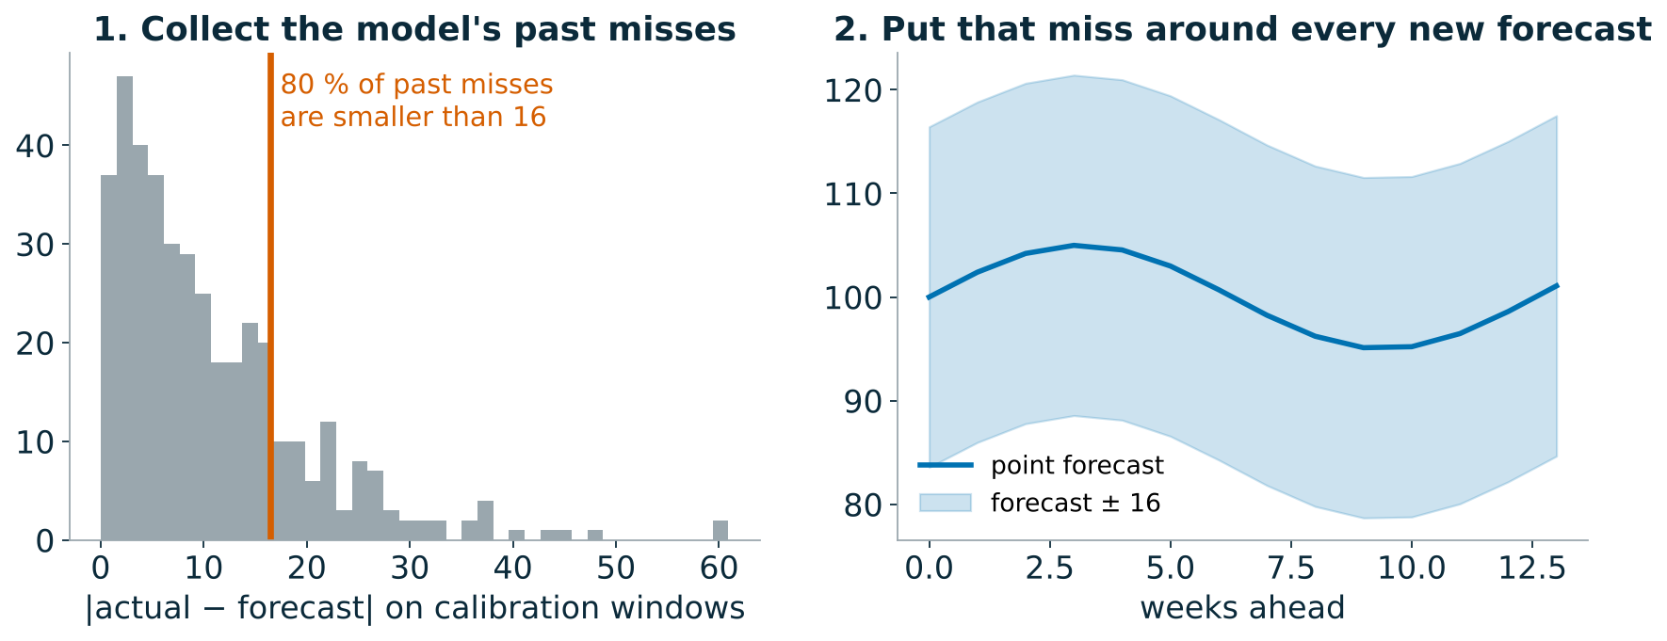
Conformal: be as wrong as you were before
INTUITION
Look at how wrong the model has been on recent, held-out weeks, and promise that much around every new forecast
It works for any model and needs no distribution assumptions
The promise holds only if the future looks like the past you calibrated on
Time Series Bootcamp · Day 2
37 / 43
Notes:
That last line is the setup for the result on the next slide: in our test quarter, the future did not look like the calibration windows.

Slide 38
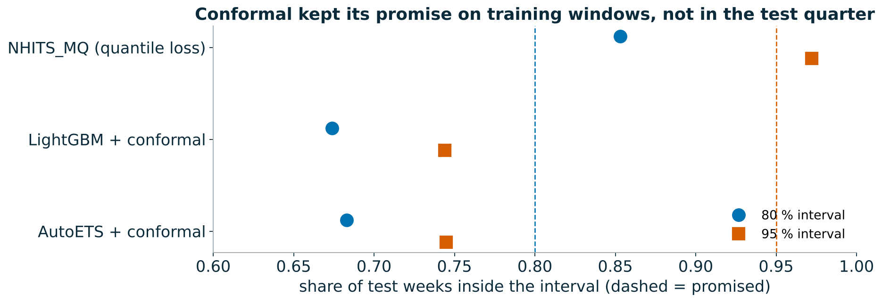
Demo 06: what we found
WHAT WE FOUND
NHITS with quantile loss slightly over-covers (85 % for a promised 80 %) and has the best CRPS (1.47 vs about 2.6): it learned per-item widths
Conformal under-covers in the test quarter: 67–68 % instead of 80 %. April–July brought promotions and shifts the calibration windows had not seen, and one width is shared by fast and slow items
Fixes: calibrate per class and on recent windows, or conformalise the quantile model (CQR)
Time Series Bootcamp · Day 2
38 / 43
Notes:
Good moment to repeat: the conformal guarantee is marginal and assumes exchangeability. It did exactly what it promised on the data it was calibrated on.

Slide 39
Model selection and ensembling
LAB · 07 · 20 min
Win rate: share of series where A beats B (ties count ½)
Bradley–Terry: P(A beats B) = s_A / (s_A + s_B), fitted on all series-level duels
Elo: replay series as matches, update r ← r + K(s − E), average over shuffles
By volume (velocity class A–J) and shape (smooth / erratic / intermittent / lumpy, feature clusters)
Ensembles: mean, median, top-3, best-per-class, chosen on half the series, scored on the other half
Time Series Bootcamp · Day 2
39 / 43
Notes:
Point to watch: rating order vs mean-RMSSE order. A model can win most duels by a little and still lose on the mean because of a few large misses (often promo spikes on fast movers).

Slide 40
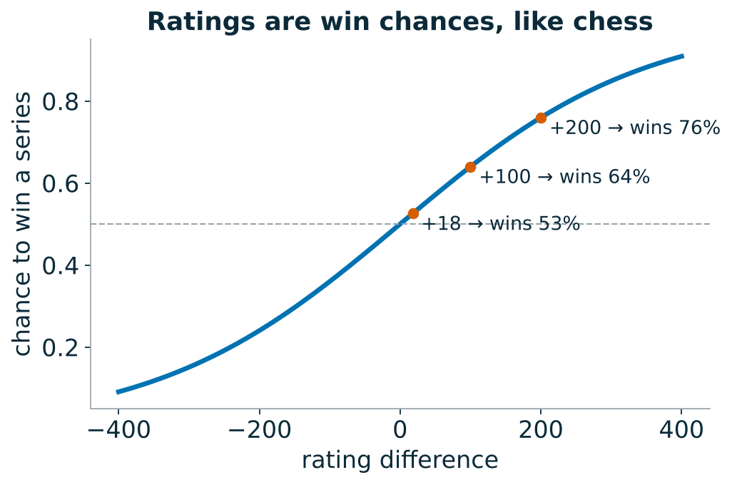
Ratings: a league table for models
INTUITION
Treat every series as a match between two models: whoever has the lower RMSSE wins
Win rate: how often A beats B. It ignores by how much, so one disaster cannot dominate
Elo / Bradley–Terry turn all the matches into one rating, like chess: +100 points ≈ 64 % chance to win a series
Ensembles: a panel of forecasters whose mistakes partly cancel
Time Series Bootcamp · Day 2
40 / 43
Notes:
Mean RMSSE answers "who is best on average, including disasters"; ratings answer "who usually wins". Both are legitimate; they disagree when a model is consistently a little better but occasionally very wrong.

Slide 41
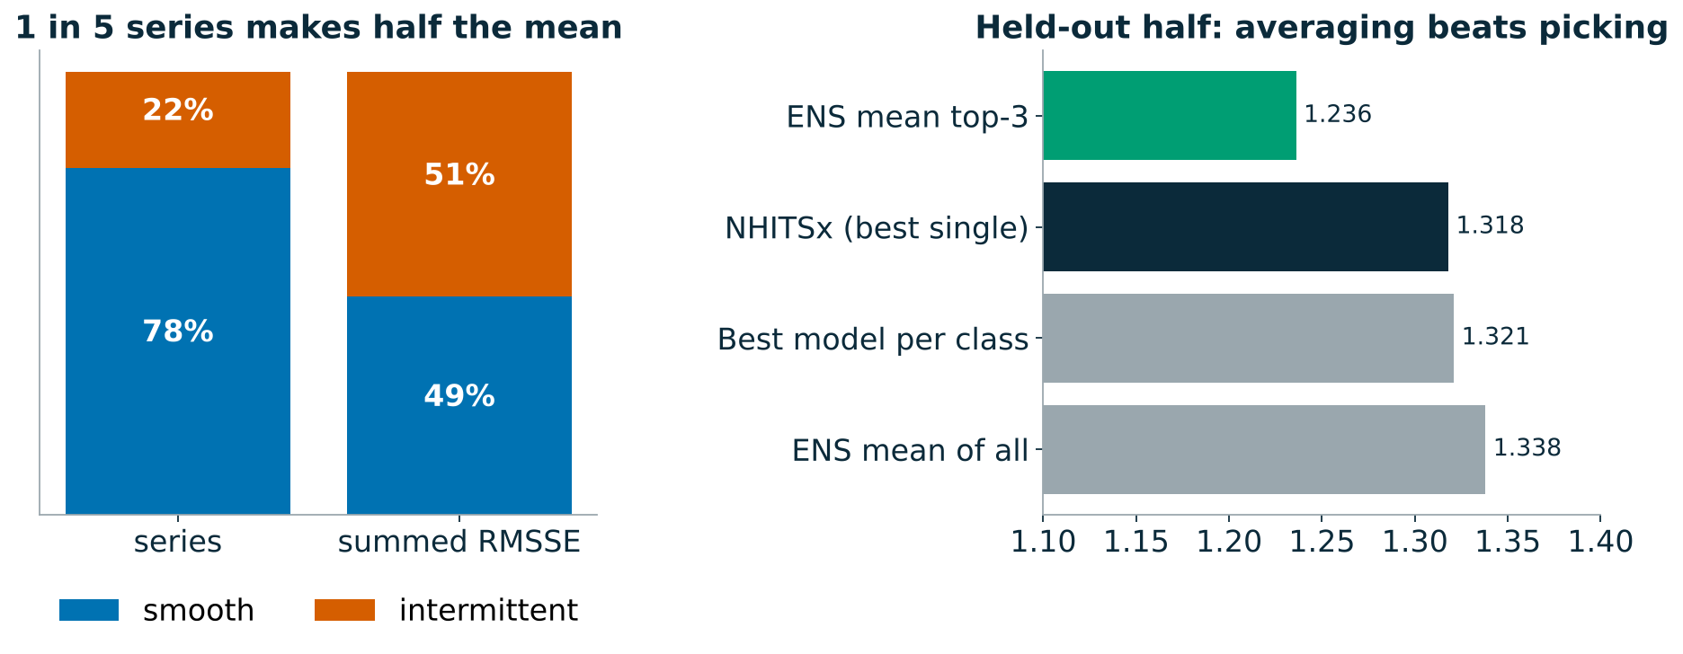
Lab 07: what we found
WHAT WE FOUND
Ratings and the mean disagree: LightGBM is 4th on mean RMSSE but 2nd by Bradley–Terry. It wins more series by a little and loses some intermittent ones by a lot
430 intermittent series (22 %) make 51 % of the summed RMSSE: the mean is mostly a contest about the hardest items
On the held-out half, the plain average of the top 3 beats every single model (1.24 vs 1.32): their errors partly cancel
Picking the best model per class looked great on the selection half and did not carry over: selection overfits, averaging does not
Time Series Bootcamp · Day 2
41 / 43
Notes:
The final leaderboard: ENS_mean_top3 (NHITSx + LightGBM + NHITS_noexog) at 1.032 is the overall winner of the day, about 12 % better than the best Day 1 model.

Slide 42
Final standings
Run the last cells of 07; the chart is saved to results/day2/final_standings.png
Decision framework to take home
Baselines first
Global before deep: the tuned GBDT is the bar
Tune the few things that matter, then stop
Check responsiveness before accuracy when the forecast drives prices or promos
Foundation models: strong zero-shot baseline; fine-tune when validation says so and the budget allows
Reconcile when several levels are consumed
Report win rates and segments, ensemble when nobody dominates
Time Series Bootcamp · Day 2
42 / 43
Notes:
5 minutes. Announce the top three, then go back to the open questions from the recap slide and answer them with today's numbers.

Slide 43
This morning's questions, answered
WHAT WE FOUND
Question from the recap | What today's numbers say
Is the GBDT strong because it is global or because of covariates? | Mostly global: NHITS without covariates (1.148) already matches LightGBM (1.169); covariates add a few percent, mostly in promo weeks
Can a neural net learn the hand-built features? | Yes, about as well, from the raw window
What does it cost? | 20–30 s per neural fit vs 1.6 s; tuning 474 s for 1 %
Does it respond to price the right way? | Direction yes, size no: promo lift +9 % to +28 % vs +72 % in the data
Best of the day? | The average of the top 3 (1.032), about 12 % better than the best Day 1 model
Time Series Bootcamp · Day 2
43 / 43
Notes:
Close the loop explicitly: go back to slide 4's open questions and read this table out. Then the decision framework on the previous slide is the take-home.

