Slide 1

Covid Scepticism on Telegram A distinctive style of writing?
Rebekka Borges
TaCoS 2023 Düsseldorf
Notes:
Welcome to my talk on the writing style of covid sceptics on telegram, it‘s such a pleasure you all came.

Slide 2
Content
Covid Sceptics on Telegram and their writing style
Covid Sceptics‘ Telegram Chats as a classification problem
Classification by keywords or abstract features?
Experiments & methods
Results & interpretation
Notes:
In this talk I will be presenting the framework of my Master‘s thesis that I just started working on.
I will be giving you a quick introduction into my topic of covid sceptics‘ telegram chats and then introduce their classification problem. I will shortly present the differences between certain neural network architectures and the representation of style and then explain my methods and results to you.
Minutes: 5-3-5-2-5=20

Slide 3
1. Covid Sceptics on Telegram and their writing style

Slide 4
Recap: Covid Sceptics
Sceptic regarding the existance / danger of covid
Broad spectrum from heterogenious groups of the society
Telegram Network with enormous groups, informative channels, channels by VIPs, echo chamber, bubbles
Notes:
First a short recap: What are covid sceptics?
Covid Sceptics are the people who criticise the covid measurements because they don't think the corona virus exists or is as dangerous as politics and the media show. You already see that this is a broad spectrum and the people who criticise the measurements out of fascistic (meaning they think we should just let the old and chronically ill people die) reasons are not even on this scale.
The covid sceptics are therefore by definition believing in conspiracy theories because it is scientifically proven that covid exists and is not a hoax performed by the government who wants to chip us, kill us or keep us inside to change the batteries of the pigeons.
They cover every population stratum age wise, educational wise or politics wise and they assemble on protests and most and foremost on Telegram in groups with at the pandemic’s peak up to 100.000 members. Telegram offers this kind of large public group and additionally channels next to of course private chats like any messenger.
4

Slide 5
Why Telegram?
Messenger = no censorship
Large, public groups / channels & easy linking
→ Large amount of publically available language data
Notes:
But why did they chose Telegram as their platform to connect on?
After creators posted conspiracy theory content they were often banned from platforms
Telegram allows reaching huge amounts of people and is prone to building up networks
I personally used the data of covid sceptics for my style analysis because their public groups allow for downloading hundred thousands of messages in minutes without signing up anywhere
5

Slide 6
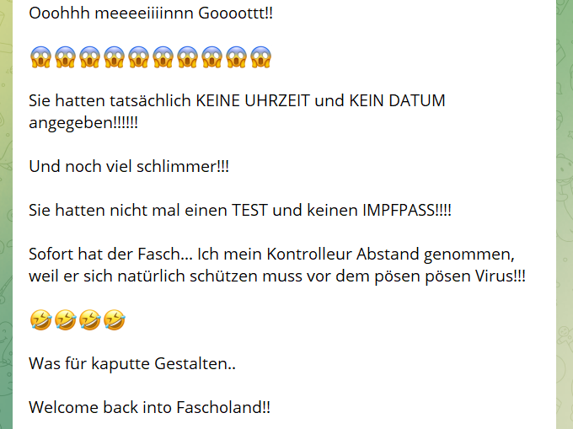
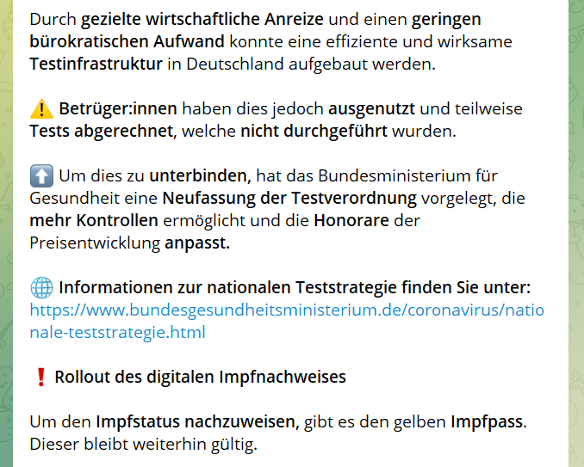
Example
Notes:
If you read this text message, would you say the author was rather corona skeptic or not?
Context: The text refers to a video that shows how a guard reacts while checking visitors with an incorrect form an missing covid test or vaccination pass
Note: They need a minute to read
6

Slide 7
Example
Part of a text from December 2nd, 2021 in „Q-ANONS 🇩🇪🇦🇹🇨🇭“
Part of a text from June 10th, 2021 in „Infokanal des Bundes-
ministeriums für Gesundheit“
Notes:
Solution: QAnon (conspiration theories concerning covid) versus german ministry of health information concerning covid
Humans can distinguish between corona sceptic and informative texts
Note: If you ask questions they need a minute to answer
7

Slide 8
Example
Notes:
But why? Style!
Both texts contain the same keywords (test, impfpass)
+ Emojis, keywords that only occur in a certain context (Fascholand), keywords that occur more frequent in a context (tatsächlich), punctuation, irony, register
Excluding covid sceptics inherent vocabulary, all these style markers are not exclusively used by covid sceptics. But they share similar stylistics, maybe to strengthen their group identity, and the combination of these make their messages distinctive from other authors to humans.
But does it make them distinctive for machines? That’s what we’re about to find out!
8

Slide 9
2. Covid Sceptics‘ Telegram Chats as a classification problem
Notes:
If the differences in lexic and style ar that obivious, covid sceptics‘ chats should be able to be identified as such in a classification problem. The other class in a binary classification could possibly be newspaper texts or a telegram chat from a different group of authors etc.
9

Slide 10
2 hypotheses
Texts written by covid sceptics can be labelled as such in a classification problem.
Texts written by covid sceptics can be labelled as such in a classification problem based on stylistic markers.
+ 1 assumption: Covid sceptics make use of a characteristic writing style
Notes:
Vectorisable
What exactly is the difference between these two hypotheses?
It is very likely that an algorithm could learn to distinguish between the samples shown before. The bare simple approach would be using a hand full of keywords like “Impfzwang” versus “Impfschutz” which constitute two classes of texts because only one class contains them. I would assume covid sceptics texts having the same complexity to their category as spam emails which have been successfully classified with even naive bayes algorithms for decades.
But that does not fulfil my linguistic aspirations yet. I showed to you how we as humans classify covid sceptics’ texts by linguistic markers such as certain terms, creative language use, speech acts like irony, certain visual aspects and much more and not necessarily based on their semantic content. In other words: We can distinguish by style, which is per definition a certain choice of words or syntactic structures or other linguistic components. My underlying assumption is that terms like “Impfzwang” only occur in one class because those authors choose the term over alternative wording like “Impfpflicht” which is less aggressive.
10

Slide 11
Example
Notes:
These stylistic markers could be playing into their labelling, if they’re vectorizable. Of course, when turning the words into vectors, creative spelling or neologisms will just not be taken into account because fasttext which I used just doesn’t provide vectors for those words, it can’t.
Beyond simple words, style can be the decision to use irony which is visible to us as a long sequence of exaggerations. Or certain argumentative structures like wenn-dann / sentence length / even emoji alternations
11

Slide 12
3. Classification by keywords or abstract features?

Slide 13
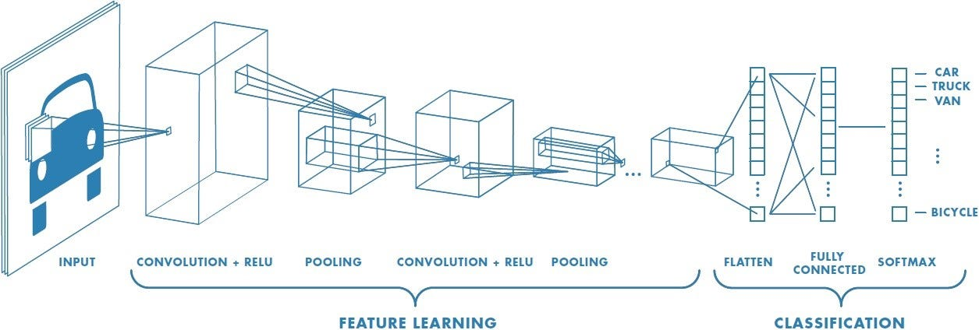
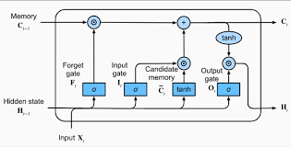
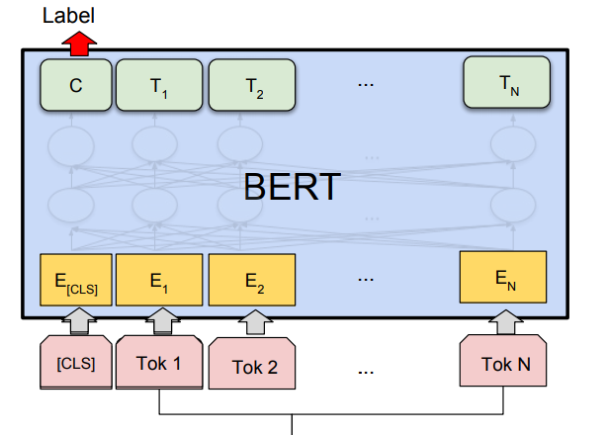
Architectural differences
CNN
LSTM
BERT
Notes:
History of neural Networks: artificial neuron 1943, Perceptron 1958, CNN 1985, LSTM 1997, BERT 2018
Convolutional Neural Network
Fastforward
Convolutional layers: information in the filter gets compressed and more relevant features can be extracted
keywords
Long Short Term Memory in Recurrent Neural Network
Bidirectional Encoder Representations from Transformers
13

Slide 14
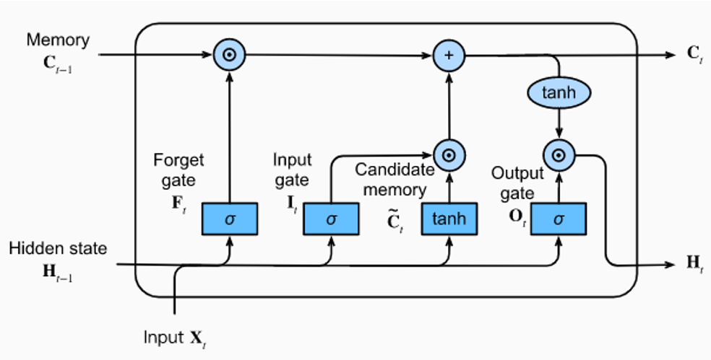
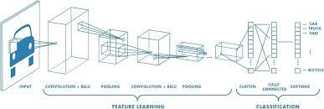
Architectural differences
CNN
LSTM
BERT
Notes:
Convolutional Neural Network
Long Short Term Memory in Recurrent Neural Network
Recurrent Neural Networks
LSTM NNs are capable of learning long-term dependencies, especially in sequence data… like language data!
Different from cnns, rnns are not fastforward, they have the recurrent feedback cycle connections, it’s capable of processing the entire sequence of data, apart from single data points
This is such a memory cell: the Cell state keeps information like a long term memory, it‘s the line above that can be changed and information can be added through gates
No parallelization
Bidirectional Encoder Representations from Transformers
14

Slide 15
Architectural differences
CNN
LSTM
BERT
Notes:
Convolutional Neural Network
Fastforward
Convolutional layer
keywords
Long Short Term Memory in Recurrent Neural Network
Bidirectional Encoder Representations from Transformers
Transformers are prone to long-distance dependencies
Encoders and decoders transform data between layers
→ Every architecture is prone to find specific features which increase in complexity

Slide 16
4. Experiments & methods

Slide 17
Data preprocessing
Hashtags and Emojis translated into words
Fasttext embeddings 300 dimension
300.000 texts of sceptics + balanced amount of newspaper texts
Parted for 10 cross validations, 10 % test set
Maximum length 50 words
Notes:
Und Ausrufezichen? Sind die in fasttext drin?
Therefore spelling unfortunately couldn‘t be taken into account even though it
17

Slide 18
Method
10 cross validations
Each experiment with 3 neural network architectures
Variables: medium – communication setting – topic – sceptics
Notes:
As you can see, here the NN is just a method, I‘m looking at variation
18

Slide 19
Various experiments
Baseline: covid scpetics‘ channels versus newspaper texts from telegram
Rule out effect of medium / setting: Train on channel – test on group/YouTube/…
Masking keywords like covid, vaccination etc.
Notes:
Of course we have various variables that can influence writing style that we want to not interfere with the variable covid sceptic – or not.
To rule out the effect of the communication setting
The hypothesis is always that if masking a keyword makes the NN worse, it heavily relied on keywords + if it performs better
I don‘t want to find out if cnns rely on keywords more that bert, I want to see that bert is always better because there‘s always more than vocabulary distinctive to their writing style
19

Slide 20
5. Results & interpretation

Slide 21
Results
Experiment | CNN | LSTM | BERT
Channel vs. Newspaper | 88.68 | 93.58 | 99.12
Group vs. Group | 76.45 | 89.41 | 97.89
Train vs. Test | 67.66 | 72.37 | 91.18
Notes:
Here we have the average results of the cross validations for every architecture for every experiment I was able to do so far into my thesis
Overfitting after 2 to 3 epochs → not enough features / noisy data?

Slide 22
BUT…
>>> model.get_nearest_neighbors('corona', k=20)
[(0.695988118648529, 'ungaria'), (0.6672549247741699, 'coronas'), (0.6461941003799438, 'mascota'), (0.6431934833526611, 'leonis'), (0.6420835256576538, 'gloria'), (0.6380131840705872, 'florido'), (0.6333363652229309, 'coronae'), (0.6286222338676453, 'creata'), (0.6277955770492554, 'patria'), (0.6270483732223511, 'grecia'), (0.6253677010536194, 'crucis'), (0.6240208148956299, 'gran'), (0.6238141059875488, 'aurora'), (0.6238107681274414, 'hungaria'), (0.6226333379745483, 'monarca'), (0.6222739219665527, 'mexicani'), (0.6195427775382996, 'saturno'), (0.6186578273773193, 'scv'), (0.6180465817451477, 'perfecta'), (0.6177297234535217, 'campeador')]
Notes:
As you can see here, if you look at the most similar words of the term corona, the fasttext model shows lots of words from Romanian languages implying that the meaning in this model is not yet pandemic associated
The pretrained fasttext vectors I used were created for German before the covid pandemic started. That means, a lot of highly frequent terms like for example covid-19, corona, impfausweis, lockdown and many more are either neologisms created during the pandemic or changed their meaning a lot which makes the fasttext vectors pretty obsolete in this semantic field.
Additionally, the fasttext vectors are only available for lowercase words and exclamation marks as any other punctuation are not included, which makes most of the initial markers we found irrelevant.
A further step would be training my own vectors on data including neologisms from the pandemic

Slide 23
Further improvements
Data pre-processing:
Translating exclamation marks into vectors
Use a sign for words in all caps
Embeddings:
Pretraining my own covid-embeddings
Variations:
Masking
Specific topic
Larger datasets
More specific samples
Notes:
Pretraining my own covid-embeddings including uppercase wording

Slide 24


Thank you for attending!
Pfertility
Adventsqalender
BQQM
Covidiot
deshalb ist Wiederstand jetzt auch Flicht
borges@uni-bonn.de
linkedin.com/in/rebekka-borges-736329277

