Slide 1

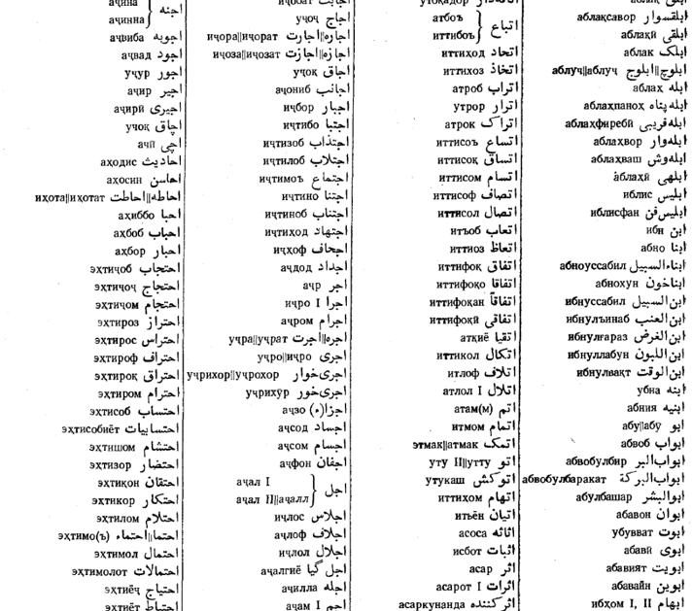


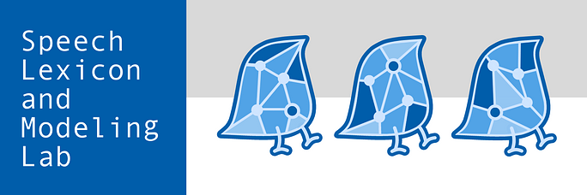
Machine Transliteration between Two Persian Dialects – The Case of Farsi and Tajiki
Rayyan Merchant
Kevin Tang
Akhilesh Kakolu Ramarao
University of Florida
Heinrich-Heine University
rayyan.merchant@ufl.edu
kevin.tang@hhu.de
kakolura@hhu.de

Slide 2
Outline
Background
Challenges
Previous Research
Our Model
Our Corpus
Our Results

Slide 3
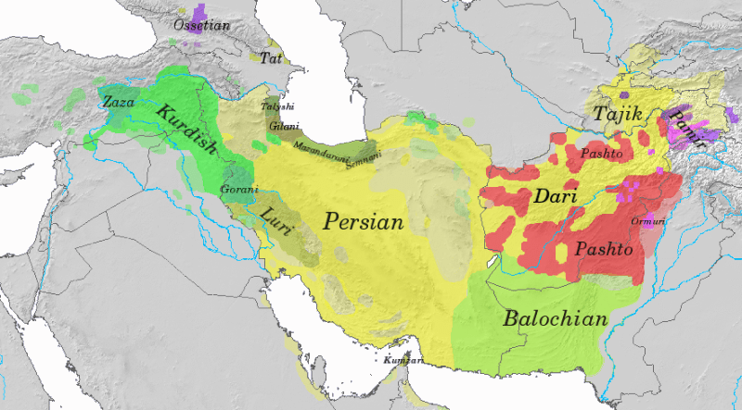
Map of modern Iranian languages.
Image created by Wikipedia user Dbachmann, provided under CC BY-SA 3.0

Slide 4

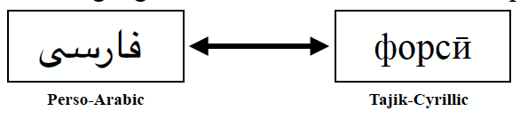



Persian is a Digraphic Language

Slide 5
The Problem With Digraphia
Mutual intelligibility between standard varieties is extremely high in spoken form, but falls to zero in written form
Tajikistan has ~10 million Persian speakers who cannot access any written media from the rest of the Persian-speaking world (~100 million)

Slide 6
The Problem With Digraphia
These two scripts CANNOT be transliterated on a one-to-one basis
Can a model be trained to transliterate between the two scripts?

Slide 7
Script Comparison
Perso-Arabic script is an (impure) abjad
Vowels are often unwritten and ambiguous
Tajik-Cyrillic script is an Alphabet
Phonetic

Slide 8
Uppercase and Lowercase
Perso-Arabic script does not implement case, Cyrillic does
م
М м

Slide 9
One to Many, Many to One
Several syllables and letters have one rendering in Cyrillic, but several in Arabic
ز
ذ
ض
ظ
З /z/

Slide 10
Example: “I read the book”
من کتاب را خواندم
ман китобро хондам
mn ktâbrâ xwândm
man kitobro xondam

Slide 11
Previous Research
Finite-state Transducer + Lookup table (Megerdoomian & Parvaz 2008)
”Grammar” -> FST -> Options -> Lookup Table
Only Proof of Concept
Statistical Model for Machine Transliteration (Davis 2012)
3503 Word Pairs
GIZA++ Alignment Training
Decoded with Phramer

Slide 12
Problems with Previous Research
Too bulky
The Finite-State Transducer outputs (on average) 6.27 alternatives per word
All alternatives are subject to morphological analysis and then looked up in a dictionary
Evaluation Methods:
Only looked at Tajik to Farsi, not the other way around
Also did not report words that were close, but not exactly the right spelling
Spelling mistakes do not prevent comprehension!

Slide 13
Problems with Previous Research
Evaluation Methods
Lacked a true parallel corpus, would would have allowed for word error evaluation (X out of Y words transliterated correctly)
Instead used two separate corpora with completely different sentences
Evaluated model by:
training PoS tagger on transliterated text and evaluating it
transliterating then translating to English with BLEU score calculated
BLEU score is a corpus-based metric for machine translation models
Looks at N-gram overlap between reference and output
(Papineni et al 2012)

Slide 14
What is a Transformer Model?
Transformer models are neural networks that learn context through tracking relationships across a sequence
They do this by applying ”attention”
Attention is a set of everchanging mathematical techniques
Tags data and follows it to see how it relates to other data
This allows it to see patterns like us!
Recent research has shown that transformer approaches outperform recurrent models of G2P (Yolchuyeva et al 2020)

Slide 15
Our Proposed Approach
Neural network-based Grapheme to Phoneme (G2P) Model
(Yolchuyeva et al 2020)
G2P models are typically used in Text-to-Speech (TTS) systems
This situation mirrors two scripts: one non-phonetic representation and a phonetic one
We can set
Arabic as our Grapheme sequence
Cyrillic as Phoneme sequence
Current model only works in one direction:
Arabic -> Cyrillic

Slide 16
Our Corpus
Problem: Lack of Tajik-Farsi parallel corpora to work with
1
Complication: Any parallel corpora we needs to have the exact same phrasing (or as close as we can get)
2
Solution: Blog posts and articles written in both scripts
3

Slide 17
Our Corpus
Data was manually collected from these websites
Aligned using
Gale-Church
(Tan and Bond 2014)
Result: The very first digraphic Persian corpus
~4,700 sentences, ~100,000 words

Slide 18
Our Preliminary Results
49.2% of words transliterated correctly
When combined with words that are
1 edit-distance away: 72.6%
1 & 2 edit-distances away: 85.4%,

Slide 19
An Edit-Distance of 1 looks like
нозир
нозар
nozir
nozar

Slide 20

Evaluation
Both methods of evaluation tell us that our model outputs understandable transliterations, but still far away from being perfect

Slide 21
Example Model Output (Mistakes Highlighted)
Script | Example Sentence (errors highlighted)
Arabic | امروز ناظران بین‌المللی کنفرانس مطبوعاتی در شھر دوشنبه برگزار می‌نمایند
Cyrillic (Expected) | Имрӯз нозирони байналмиллалӣ кунфронси матбуотӣ дар шаҳри Душанбе баргузор менамоянд
Cyrillic (Output) | имрӯз нозирон байналмилалӣ кунфаронс матбуотӣ дар шар душанбе баргузор минамоянд

Slide 22
Takeaways
Our model has made good progress, but not fully surpassed the challenge of vowel detection and selection
Capitalization and other issues should be “outsourced” to another tool
Our output can be likened to a 7-year-old’s writing
Full of spelling mistakes
Still largely understandable

Slide 23
Next Steps
Continue Refining Hyperparameters!
Proper Noun Detection
Ezafe Detection
Spell Checker

Slide 24

End Goal
Web Browser extension that can transliterate a web page with a click

Slide 25
Bibliography
Alireza Nourian, Mohammad Sadegh Rasooli, Mohsen Imany, and Heshaam Faili. 2015. On the Importance of Ezafe Construction in Persian Parsing. In Proceedings of the 53rd Annual Meeting of the Association for Computational Linguistics and the 7th International Joint Conference on Natural Language Processing (Volume 2: Short Papers), pages 877–882, Beijing, China. Association for Computational Linguistics.
Chris Irwin Davis. 2012. Tajik-Farsi Persian Transliteration Using Statistical Machine Translation. In Proceedings of the Eighth International Conference on Language Resources and Evaluation (LREC'12), pages 3988–3995, Istanbul, Turkey. European Language Resources Association (ELRA).
Karine Megerdoomian and Dan Parvaz. 2008. Low-Density Language Bootstrapping: The Case of Tajiki Persian. In Proceedings of the Sixth International Conference on Language Resources and Evaluation (LREC’08), pages 3293–3298, Marrakech, Morocco. European Language Resources Association (ELRA).
Papineni, K., Roukos, S., Ward, T., & Zhu, W. J. 2002. BLEU: A Method For Automatic Evaluation Of Machine Translation. In Proceedings of the 40th annual meeting on Association for Computational Linguistics.
Yolchuyeva, S., Németh, G., & Gyires-Tóth, B. 2020. Transformer based grapheme-to-phoneme conversion.
William A. Gale and Kenneth W. Church. 1993. A Program for Aligning Sentences in Bilingual Corpora. Computational Linguistics, 19(1):75–102.
Liling Tan and Francis Bond. 2014. NTU-MC Toolkit: Annotating a Linguistically Diverse Corpus. In Proceedings of 25th International Conference on Computational Linguistics (COLING 2014). Dublin, Ireland.

