Slide 1
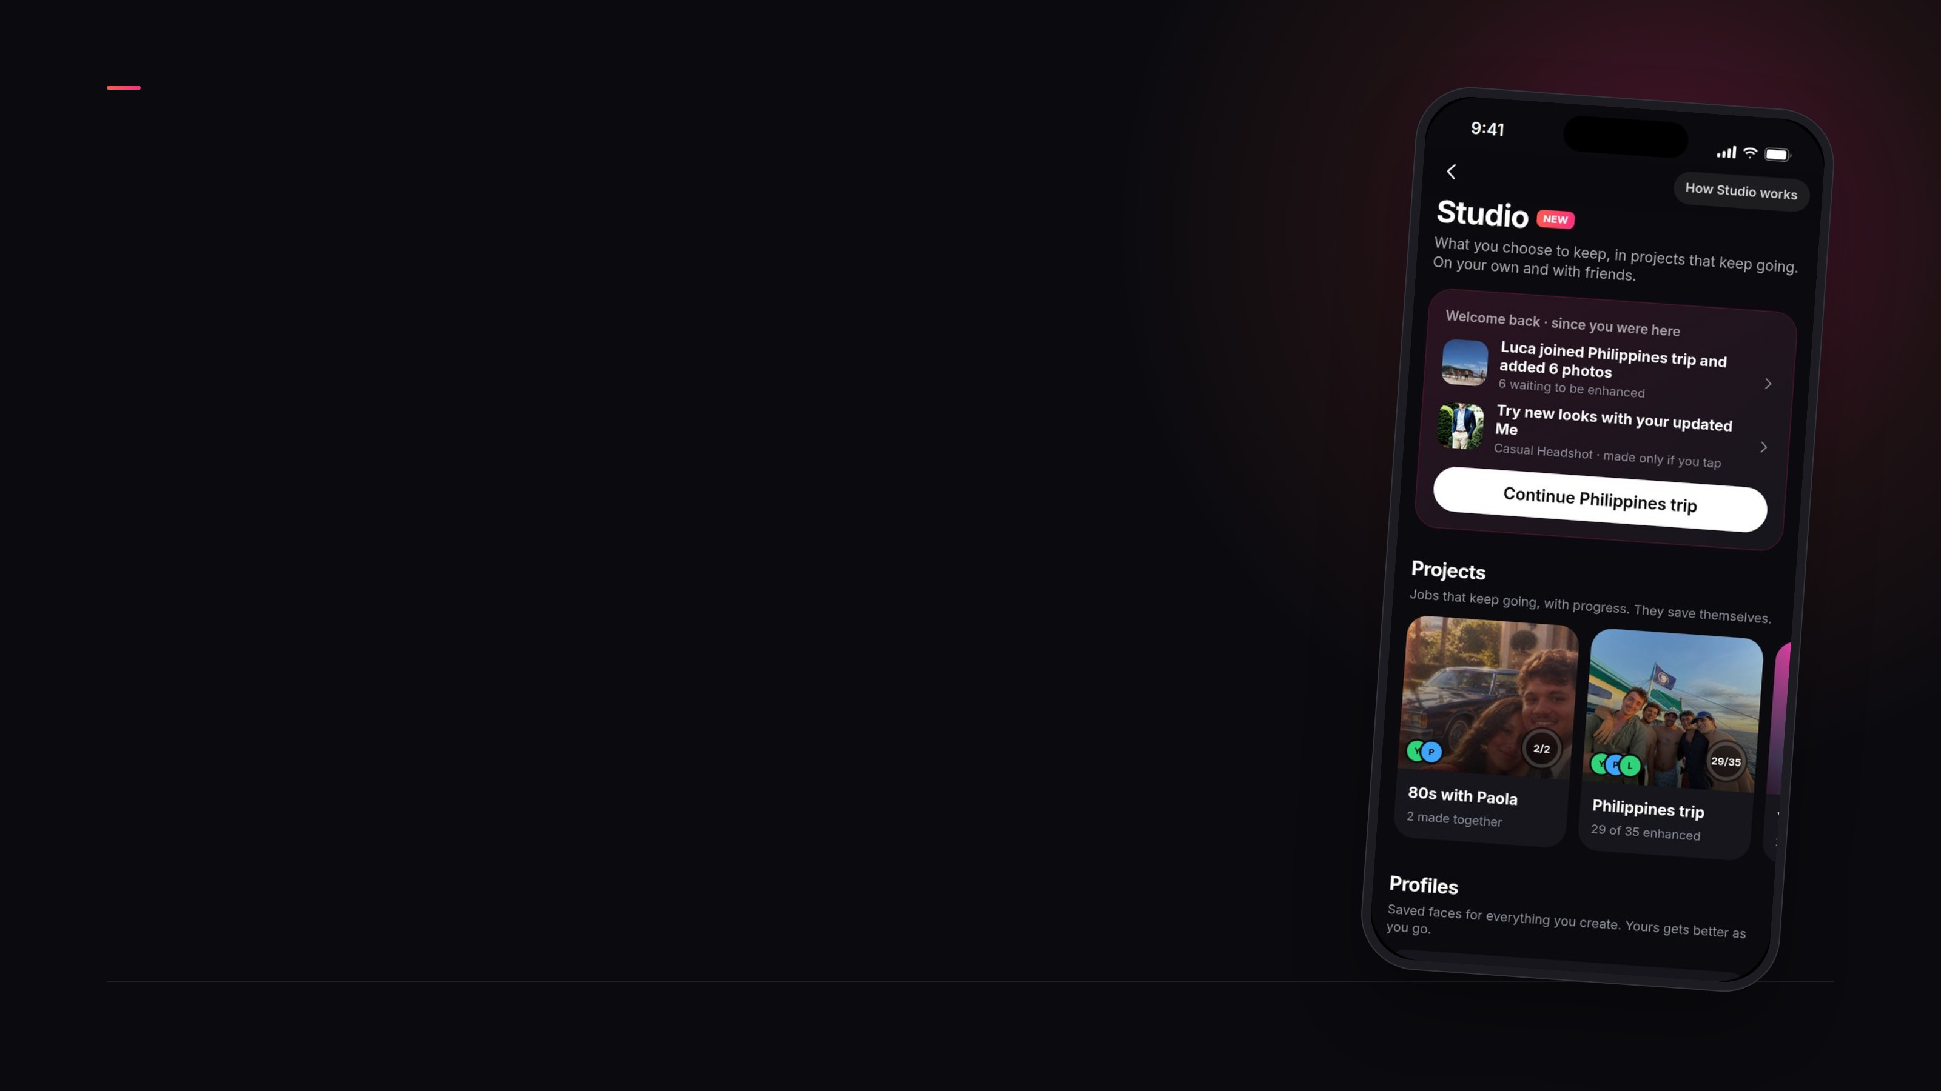
A PROPOSAL FOR BENDING SPOONS
Remini
Studio
From a single result to projects that keep going,
alone or with friends
A new Remini feature for at least $5M of NPV over 2 years
Concept, analysis and prototype by Riccardo Cara · fictitious case data
Remini Studio

Slide 2

EXECUTIVE SUMMARY
Agenda
01
The idea
02
Why now: the market, Remini today and its users
03
Why it works
04
The impact
05
Feasibility, test and launch
Remini Studio · 2

Slide 3
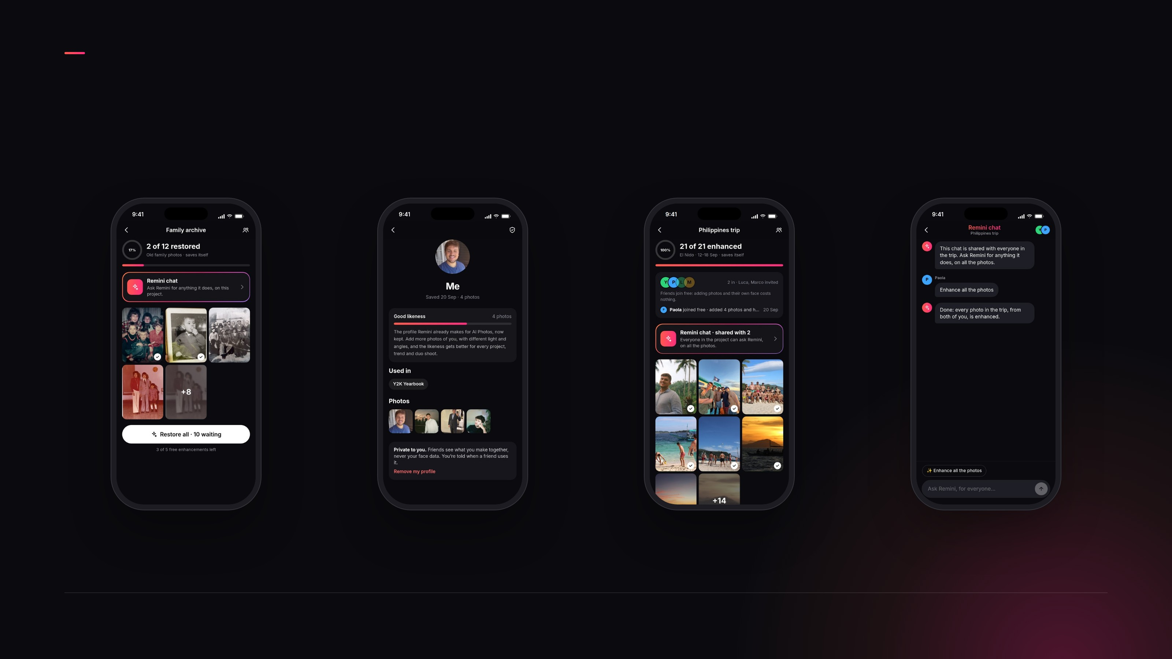
THE IDEA
Remini Studio: a personal space to create, keep and grow
work, alone or with friends
01 · PROJECTS
02 · PROFILES
03 · TOGETHER
04 · AI ACROSS IT
Jobs that keep going
Your face, saved and
improving
Friends join and create with
you
Remini chat in every project
Free limits stay the same · you choose what to keep · private, not a feed
Remini Studio · 3

Slide 4
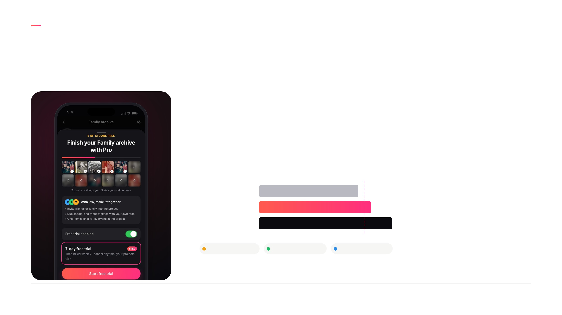
THE IMPACT
The free limit lands inside a job people care about, and the
Balanced scenario reaches the $5M target
NPV OVER 2 YEARS · BALANCED SCENARIO
$5.3M
1.06x target
$5M target
Trial rush
$4.7M
Balanced
$5.3M
Engaged
$6.3M
Trial start +10%
Conversion held
Paid weeks +6%
Remini Studio · 4

Slide 5
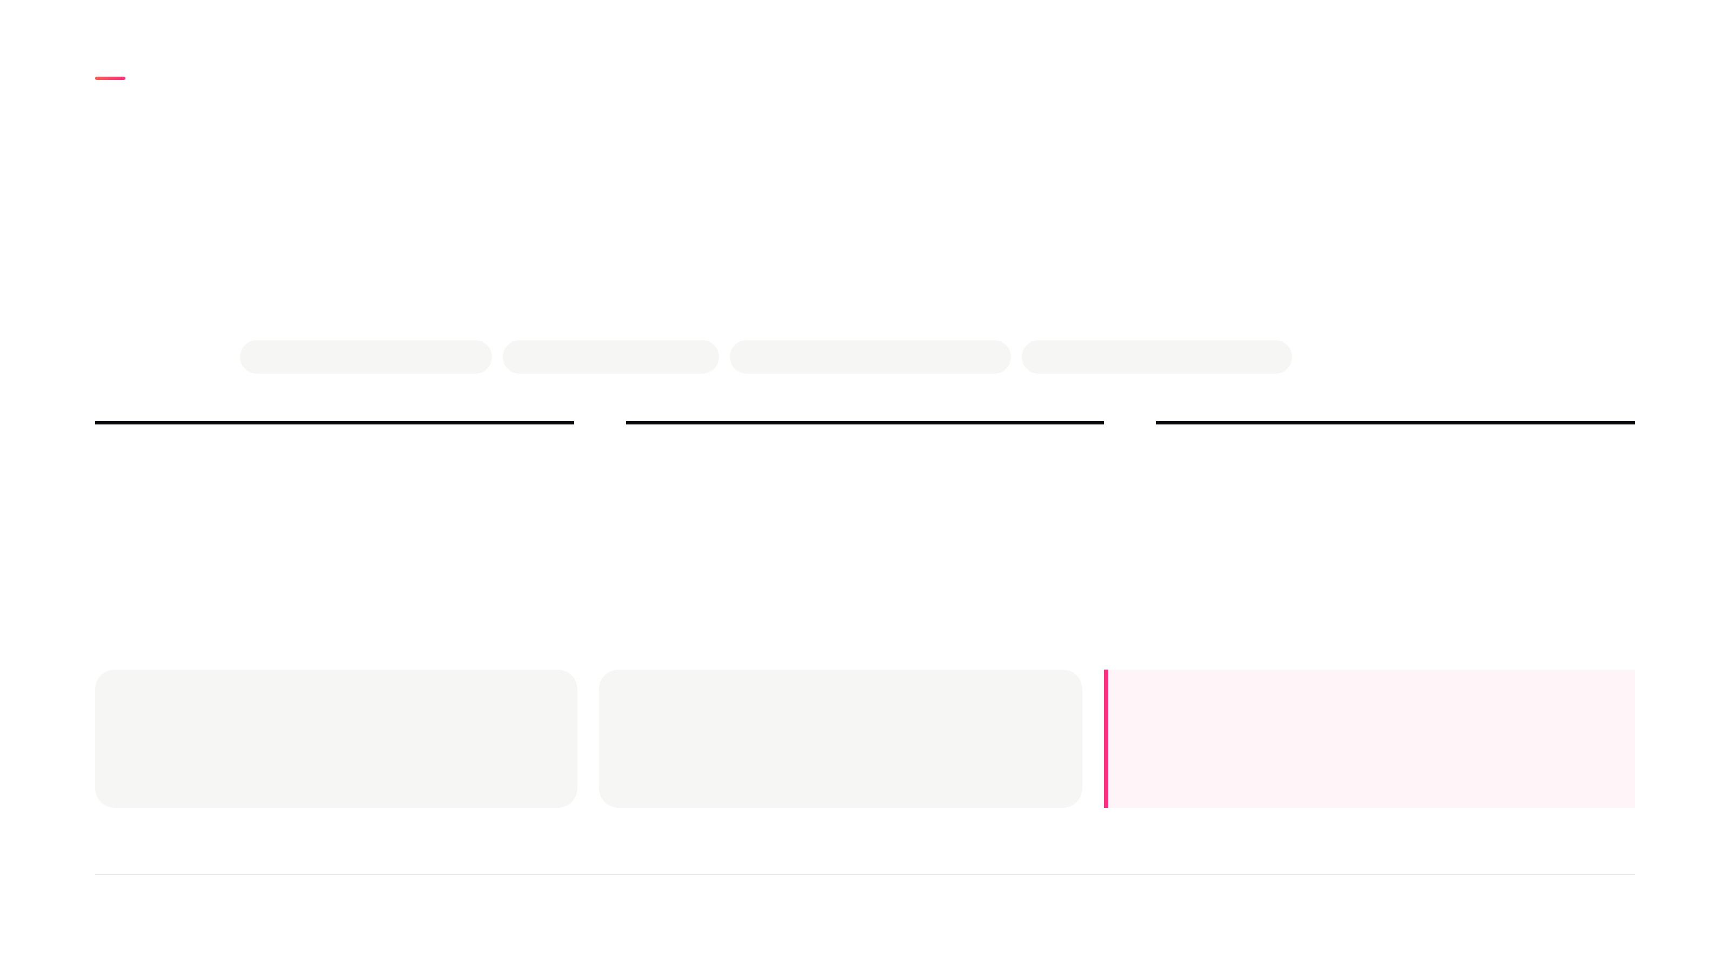
WHY NOW
Single edits are easy to find, so Remini's next step is value
that carries on after the first result
THE MARKET
AI edits are a commodity
Viral waves are short
New users are harder to win
Keeping revenue over time
5%
98%
4 wks
of installs start a trial: large room to grow
of daily users installed earlier: a large,
engaged base
is how long subscribers stay
FIXERS
CREATORS
Both need something that carries on after
the first result
Come to improve their photos: big jobs
that stop at the free limit
Come to create: small jobs that end with
the trial
Remini Studio · 5

Slide 6
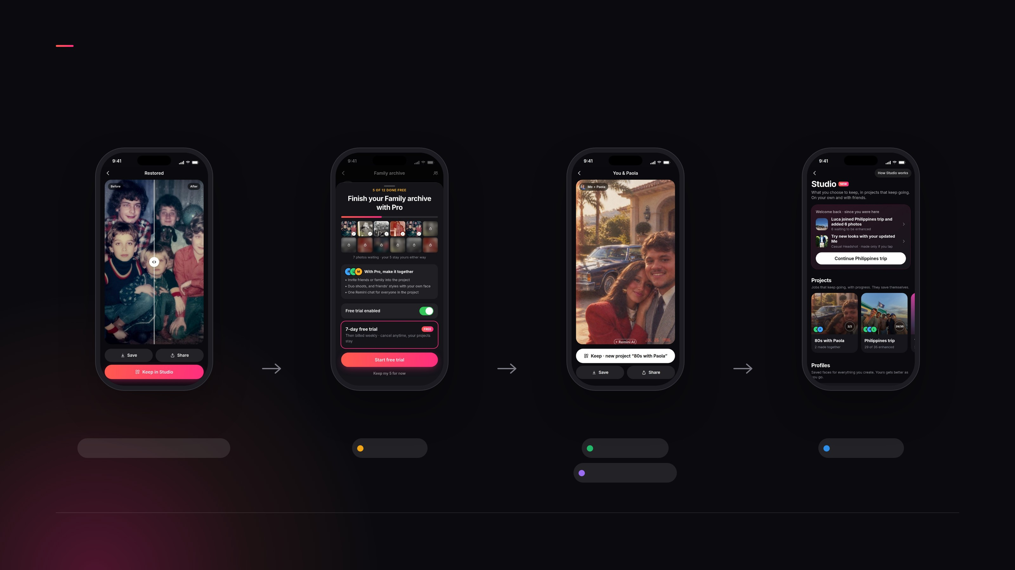
WHY IT WORKS
Each step of the journey moves one lever
FIRST RESULT
FREE LIMIT
TRIAL WEEK
WEEKS LATER
Keep starts a project
It lands inside the project
Together unlocks
Work waiting to continue
A job bigger than one edit
Trial start
Conversion
Paid weeks
Invited installs
Also: returning users find a project worth a trial, and a history of your work is hard to leave
Remini Studio · 6

Slide 7
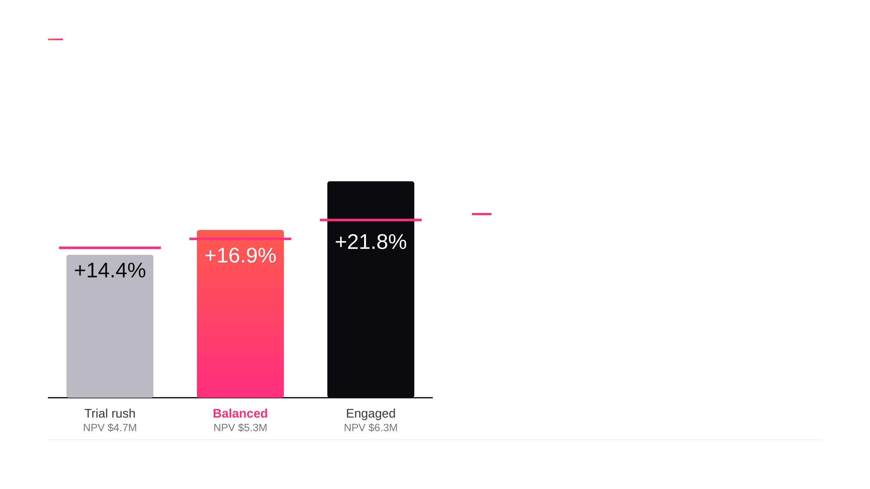
THE IMPACT
Studio needs about 16% more revenue per install, and the
Balanced scenario delivers 16.9%
Change in revenue per install by scenario, against the bar each needs for the $5M target
The bar for the $5M target
CONVERSION IS THE PIVOT
More trials alone earn less: +14% vs +17%
THE REAL COST IS MARGIN
89% to 86% after AI cost
RETURNING USERS ADD $0.8M
The least evidenced input
ANCHORED IN EVIDENCE
AI Photos lifted trials 20%; the Balanced scenario assumes half
Remini Studio · 7

Slide 8
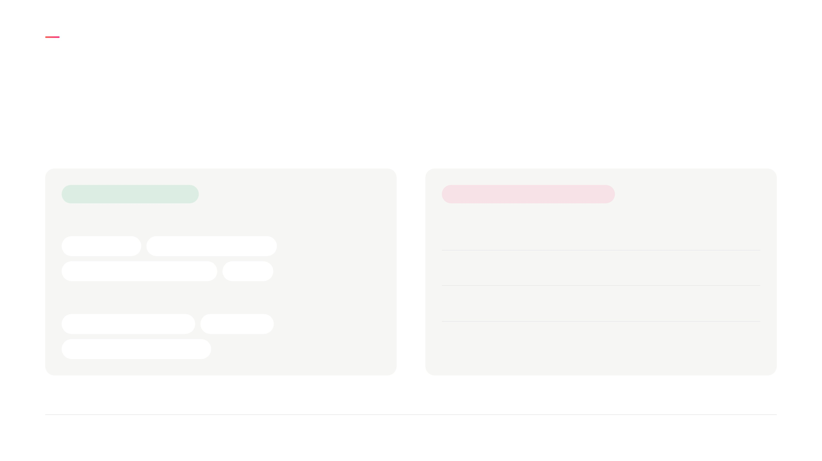
FEASIBILITY
Technically low risk, and operationally manageable with
clear rules
TECHNICAL · LOW RISK
OPERATIONAL · CLEAR RULES
ALREADY IN REMINI
Faces
Only you add yours, and can remove it
Face profiles
Enhance and AI photos
Trend packs and duo shoots
AI chat
Privacy
Same consent and deletion as AI Photos
NEW TO BUILD
Content
Projects private to their members
Studio area and storage
Enhance all
Compute
Free limits and a 7-day trial
Invites and shared projects
Remini Studio · 8

Slide 9
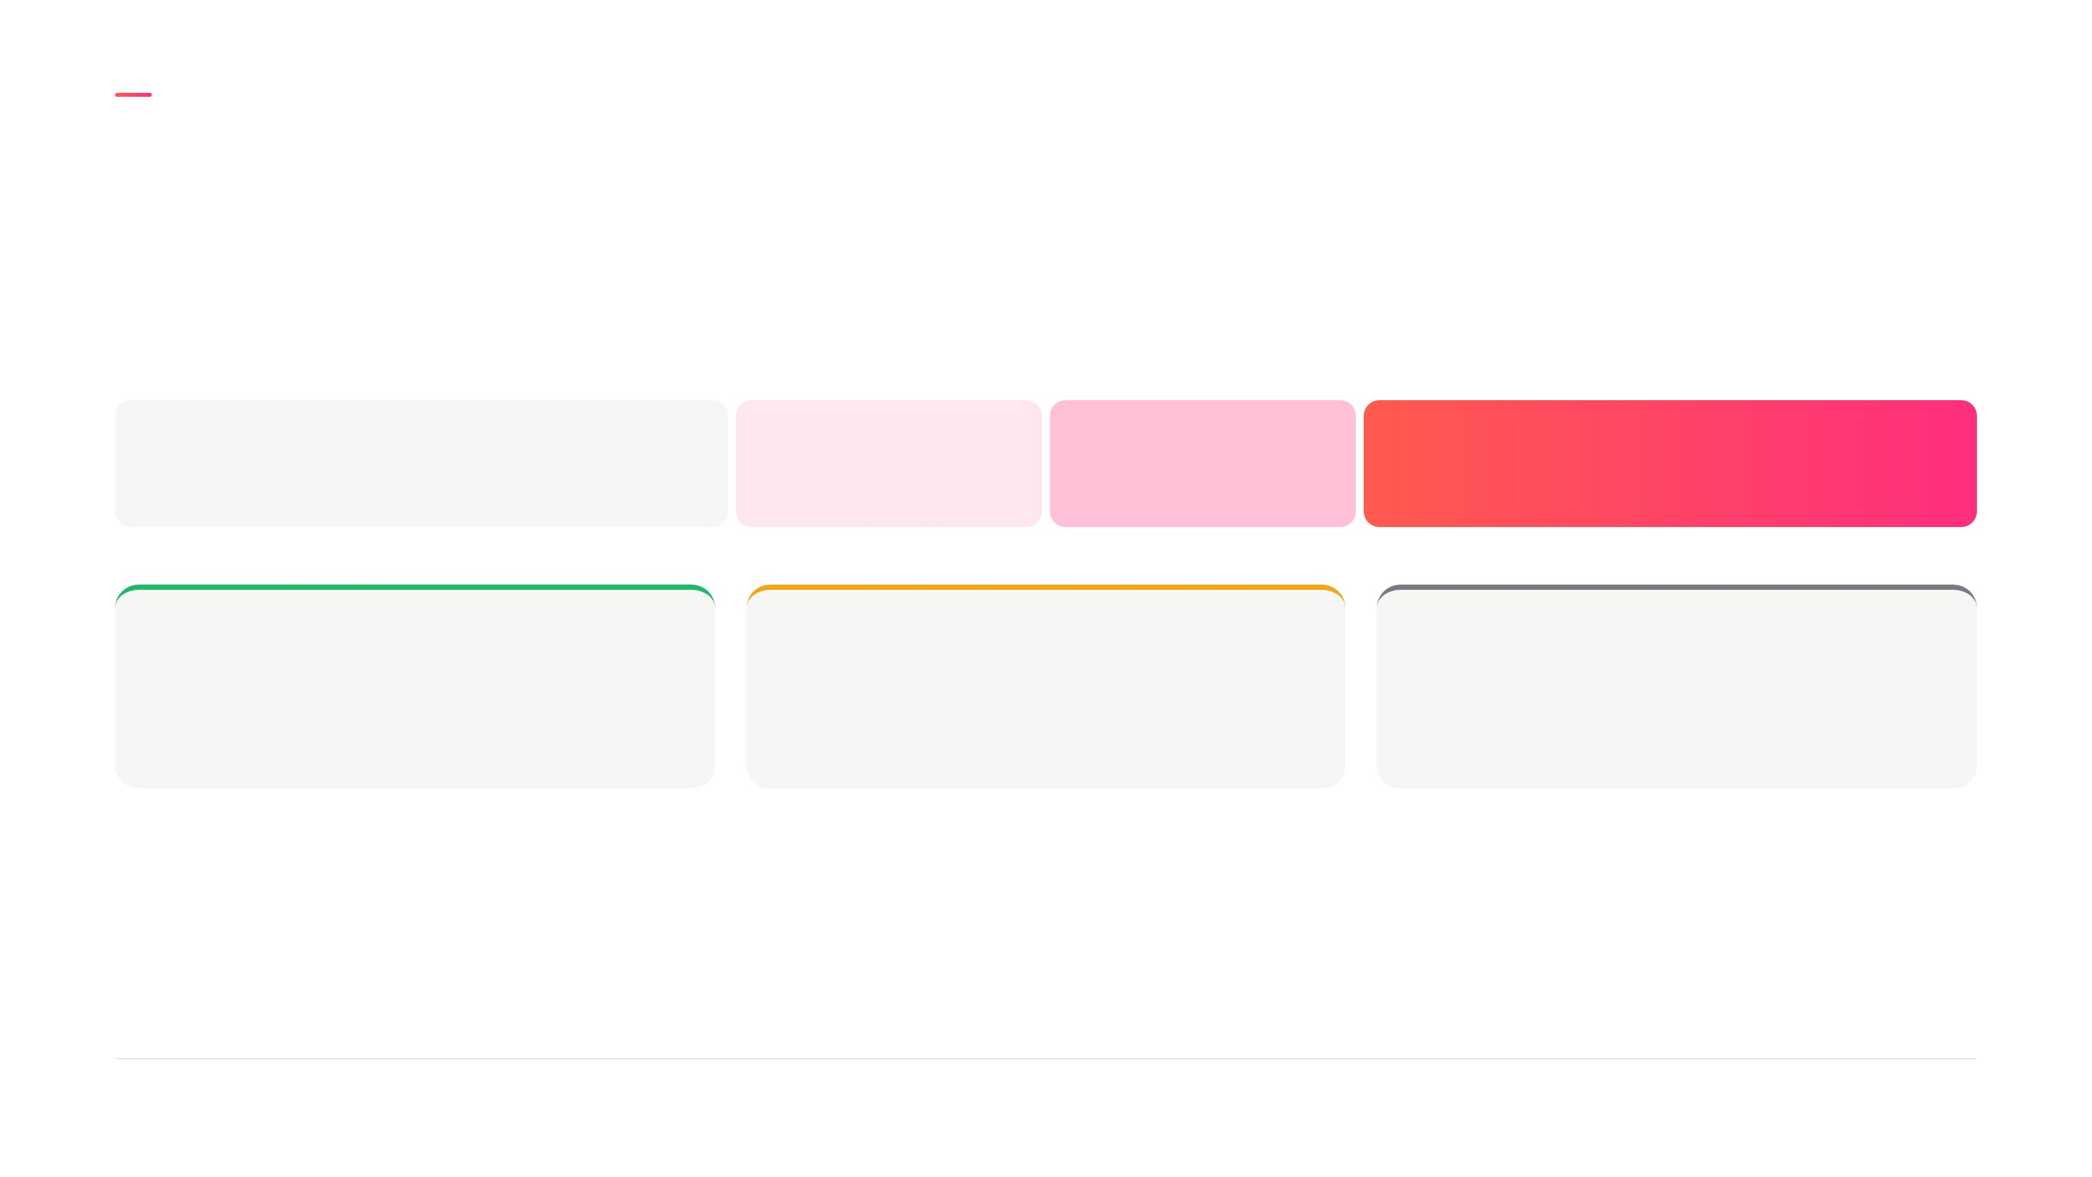
TEST AND LAUNCH
A random test on new installs settles it within weeks
Months 1 and 2
Month 3
Month 4
Month 5 onwards
Build
Test on 10%
50%
Everyone
Roll out
Improve
Stop
Revenue per install after costs clears the
bar
People use Studio, but money does not
move
Neither trials nor repeat use move
Next: the live demo
Remini Studio · 9

Slide 10
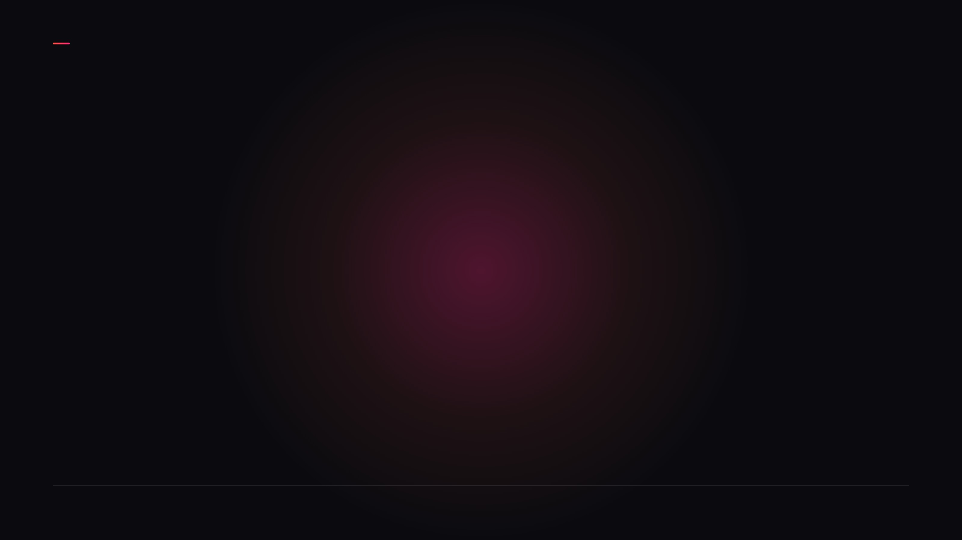
REMINI STUDIO
Thank you
Riccardo Cara
Remini Studio · 10

